Slide 1
Re-Order Instructions
Submit a Vector ticket for a Standard Printing Request
Input job title, indicating if you need the 2-9424 or 2-0101 tags.
Choose Small Print, Brochure/Flyer/Card
Complete the information, indicating if you need the 2-9424 or 2-0101 tags.
In the paper section, choose “Printer recommendation” and type in Synaps 12mil in the additional detail section.
Attach this file to the request

Slide 3
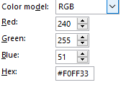
6”
Yellow: as close to below as possible
Fonts and Sizes:
Verdana, 20pt
1.5”
4”
Backside of tag remains solid yellow (no text)
Verdana, 16pt
Verdana, 18pt, bold

