Slide 1
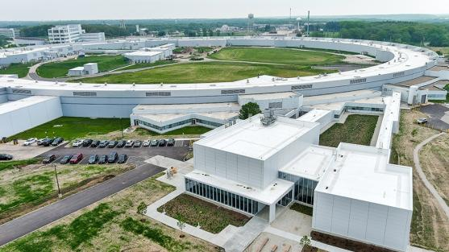
Beamline Sources and its Characteristics
Mohan Ramanathan
Associate Project Manager for Experimental Systems and Insertion Devices
Argonne National Laboratory
January 16, 2025
Notes:
Univ of Chicago Review, Aug. 30, 2010
1

Slide 2
Outline
Why APS-U
BM source selection
Insertion Device selection
Insertion Device status
Insertion Device choice
Insertion Device performance

Slide 3
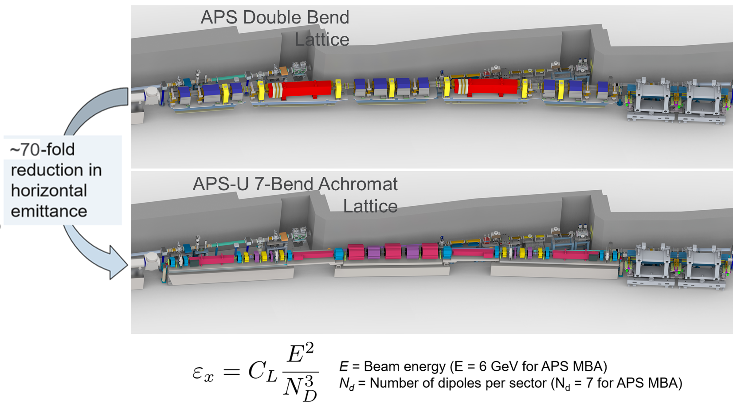
APS Upgrade
The APS Upgrade is a next-generation facility:
Optimized for hard x-rays
Incorporating advanced beamlines, optics and detectors
Large reduction of horizontal emittance provides a ‘Round’ source ideal for imaging

Slide 4
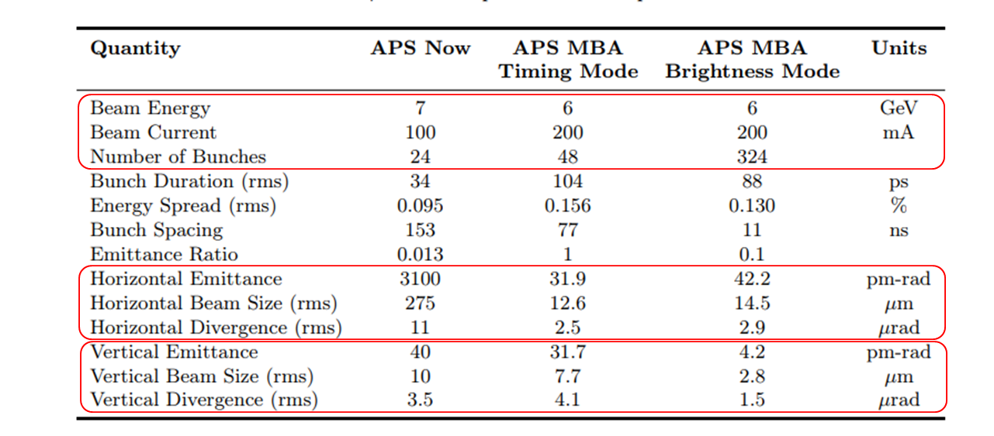
APS to APS-U Parameters
APS-U Preliminary Design Report, September 2017

Slide 5
Bending Magnet Beamline Source
The storage ring tunnel was built to provide a BM source and an ID source per sector based on APS lattice.
Changing from 2 dipoles to 7 dipoles per sector, the ID and BM ports will not line up correctly. The APS-U ring has been setup to line up the ID sources which will require the BM source to be shifted.
APS BM source was 6 mrad fan of radiation from the B dipole magnet
Angle between center of BM fan and the ID centerline has been kept the same from APS to APS-U
APSU BM source was chosen to be the M3 dipole.
B:M
BM source point
B:M3

Slide 6
Bending Magnet Beamline Source
The APS-U MBA lattice with the reverse bend makes the BM source complex
APS-U BM beamline centerline has been displaced laterally inboard by 42.3 mm while keeping the angle the same (M3 magnet source point) and the source is further upstream by 1.826m
The reverse bend lattice overlays the two dipole sources (M4 and M3) and the Q8 (weak dipole) on top of each other
Beamlines will see a combination of three sources (M4+Q8+M3) on the outboard half and a clean M3 source on the inboard
For a clean source, a mask in the front end limits the fan to 2.7mrad inboard from M3 source
M3
-0.653T
25.06 mrad
M4
Q8
-0.609T
21.26 mrad
0.186T
-5.36 mrad
Schematic of radiation sources
M4
Q8
5.4 mrad
Radiation Fan
M3
M4 Dipole
Q8 Quadrupole
BM Beamline Source Point
Inboard
Outboard
2.7 mrad
2.7 mrad
M4
Q8
M3
M3
View from beamline
M3 Dipole
FODO Section
Aperture of FE mask

Slide 7
Bending Magnet Beamline Source
Source Magnet | Max Field (T) | Critical Energy (keV) | Horizontal Fan (mrad) | Ave Power/mrad (W) | Max Power Density (W/mm²)
APS BM @ 100mA | 0.599 | 19.519 | 78.54 | 87 | 1.24
APSU M3 @ 200 mA | 0.653 | 15.633 | 25.06 | 119 | 1.27
The radiation fan for the new BM source will be different between the inboard and outboard fans (outboard has multiple magnet sources)
All BM beamlines will use clean M3 radiation (inboard 2.7 mrad fan)
Due to reduction of storage ring energy the critical Energy of the BM source is lower in APSU even though the field is stronger.
Flux on BM beamlines is higher than APS BM source for all energies up to 37 keV with very little increase in power and power density
APS-U M3
APS BM
37 keV

Slide 8
Insertion Device Selection
APS had the following IDs in operation:
  Common periods with more than 1 device of each: 3.3 cm, 3.0cm, 2.7cm 2.3cm and 1.72 cm
  Special devices 3.5cm, 3.6cm and 1.8 cm
Due to reduction in e-beam energy the undulator energy range shifts to lower values and the tunability gets reduced
  This is compensated with smaller gaps achievable: 8.5 mm for APSU vs previous 11.0 mm for APS
APS-U designed and installed 5 new period IDs:
  2.8 cm period which has full tunability at 8.5mm gap
  2.5 cm period and 2.1 cm period to complement in a Revolver undulator
  1.35 cm period for providing highest flux at 23.6 keV for special purpose
  1.4 cm period for providing highest flux at around 20 keV for special purpose
APS-U has reused the 3.3cm, 3.0cm , 2.7cm and 2.3cm period devices after rebuilding them
Periods smaller than 2.7 cm will have gaps between 1st and 3rd order

Slide 9
Insertion Device Status
Most of the existing gap separation mechanism has been reused, additional once were manufactured
New gap separations for revolvers has been built.
New strong backs for all magnets built and installed.
All new control system with servo motors with resolvers
Requirements for all devices in APS-U are the same
All devices have been retuned to meet <3º phase error and be able to operate at closed gaps of 8.5 mm
The 3.0 cm and 3.3 cm period devices will have a higher minimum gap due to large power
  1st harmonic starts at 2.13 keV and 1.54 keV at a minimum gap of 8.5mm
  Minimum gap is set to 9.0 mm for 3.0 cm and 10.0mm for 3.3 cm device
  For 3.0 cm device at 9.0 mm gap the minimum energy is 2.5 keV and has full tunability
  For 3.3 cm device at 10.0 mm gap the minimum energy is 2.0 keV and has full tunability

Slide 10
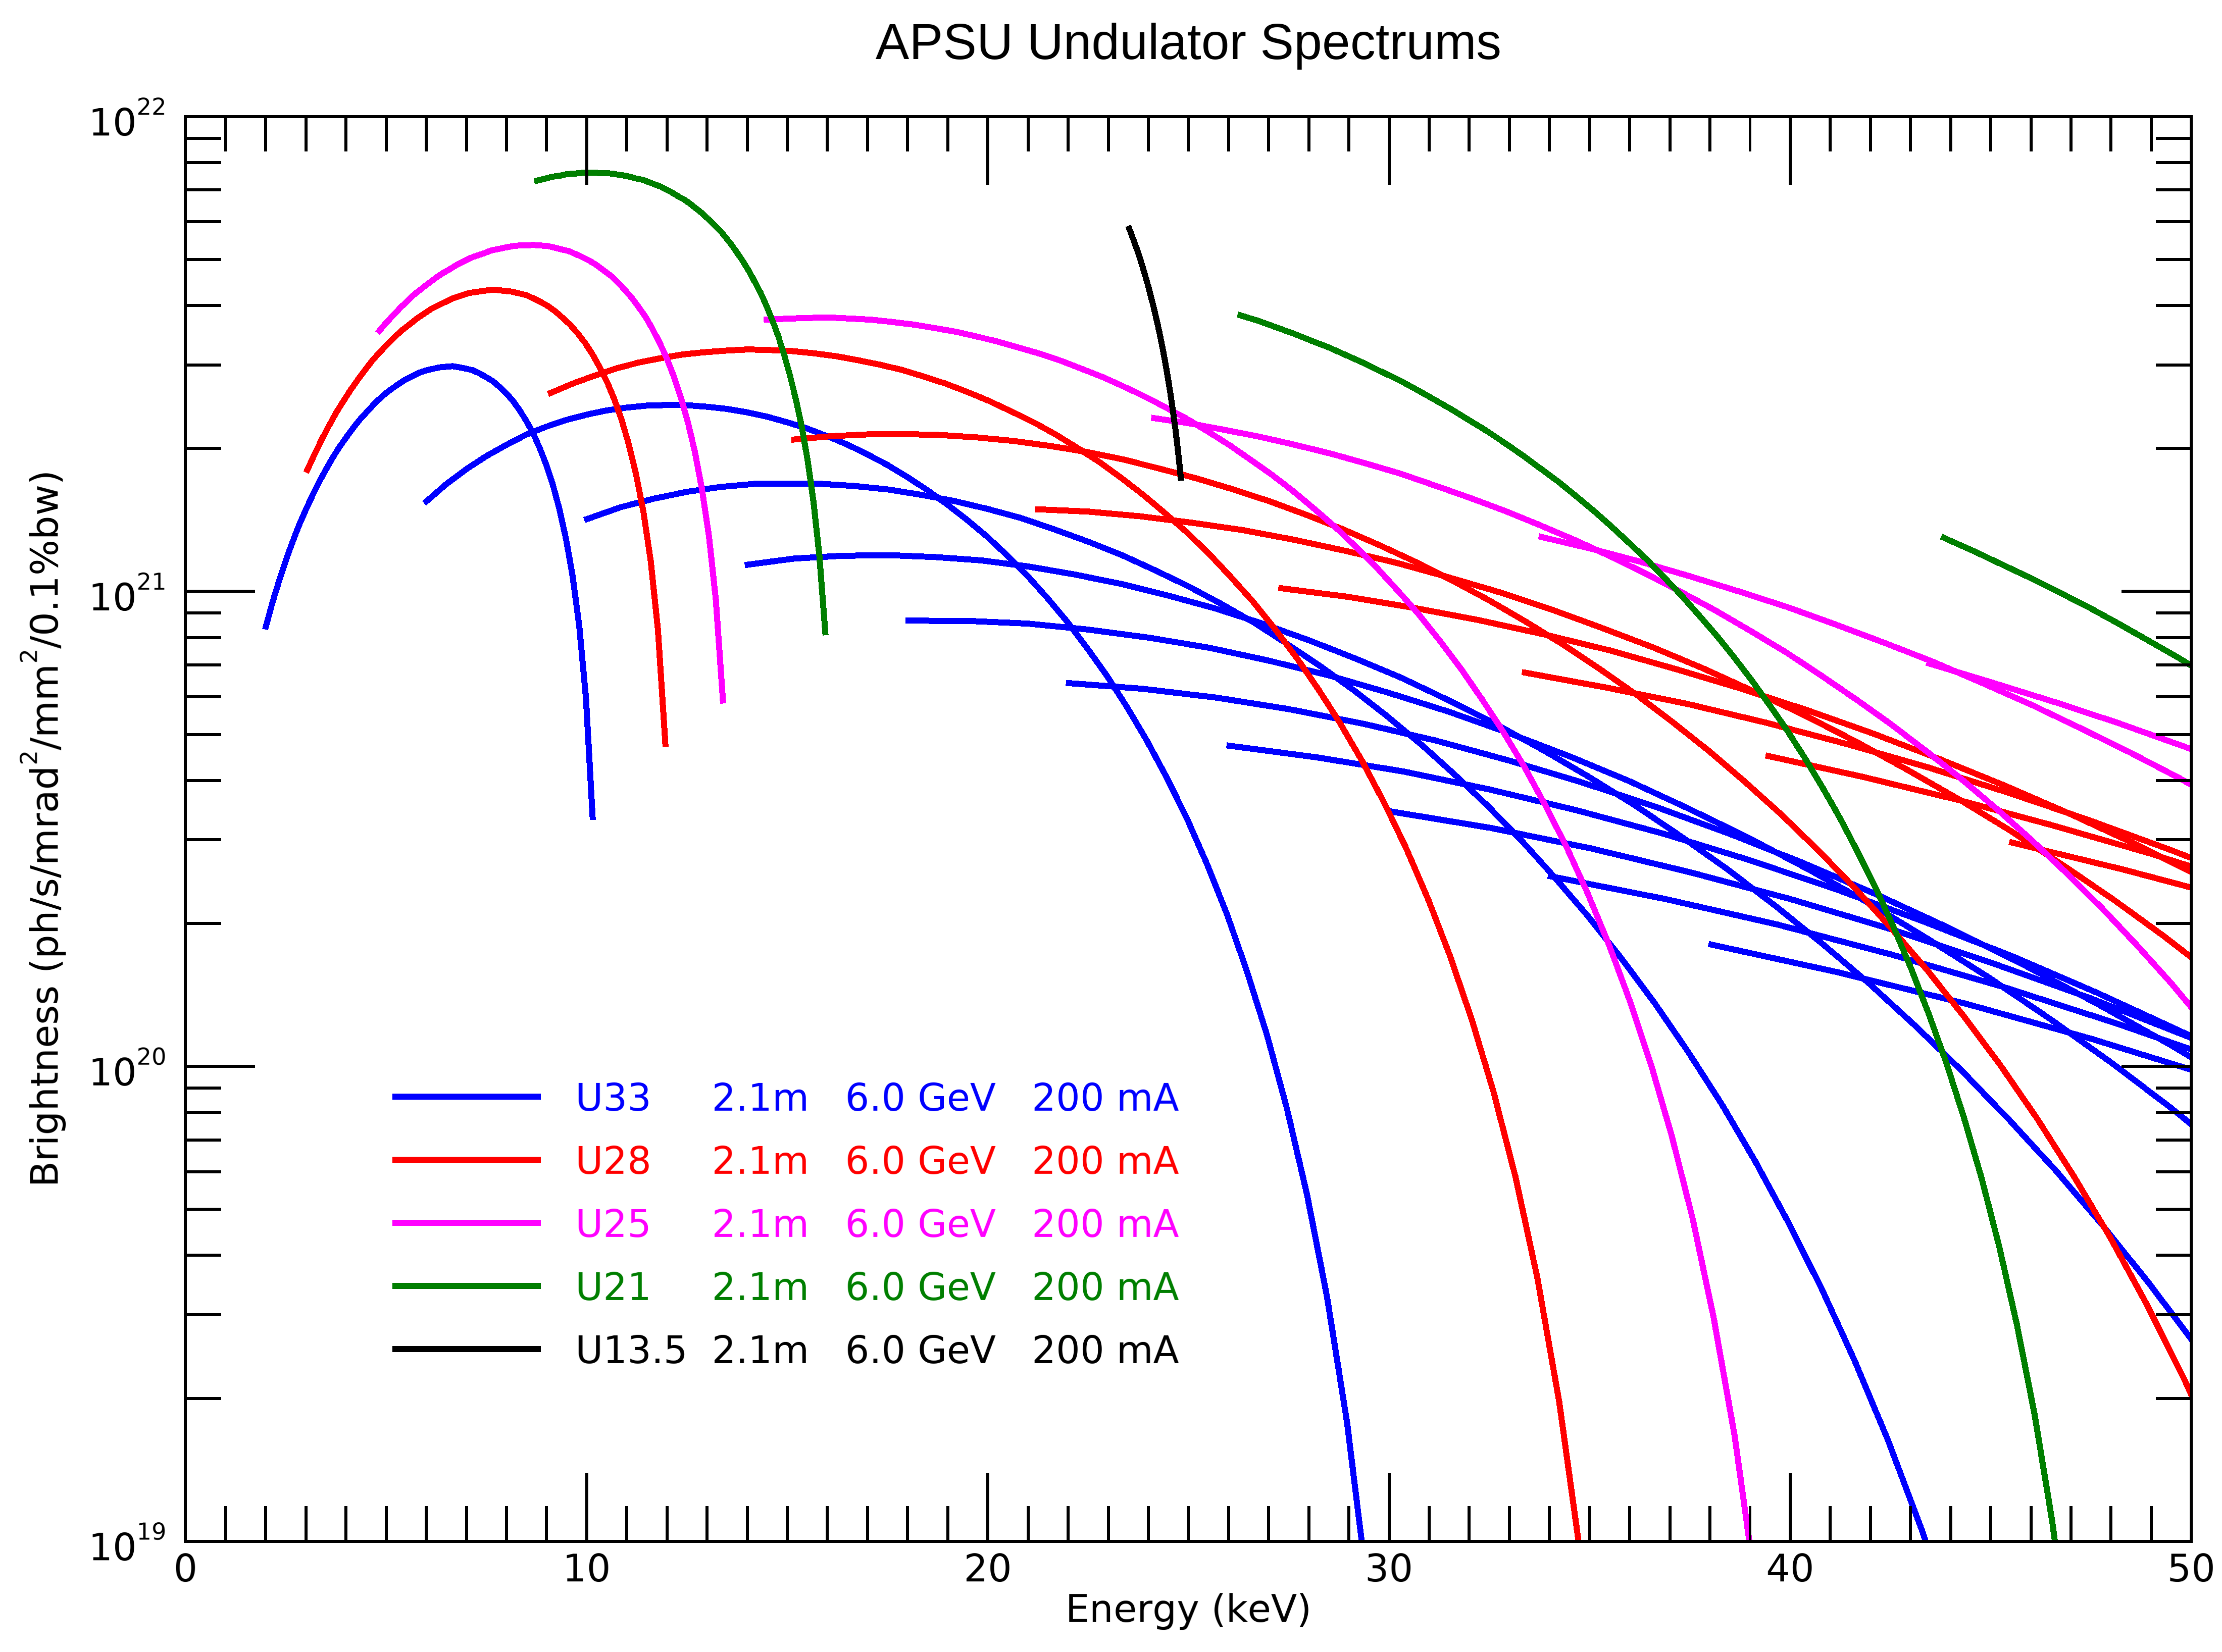
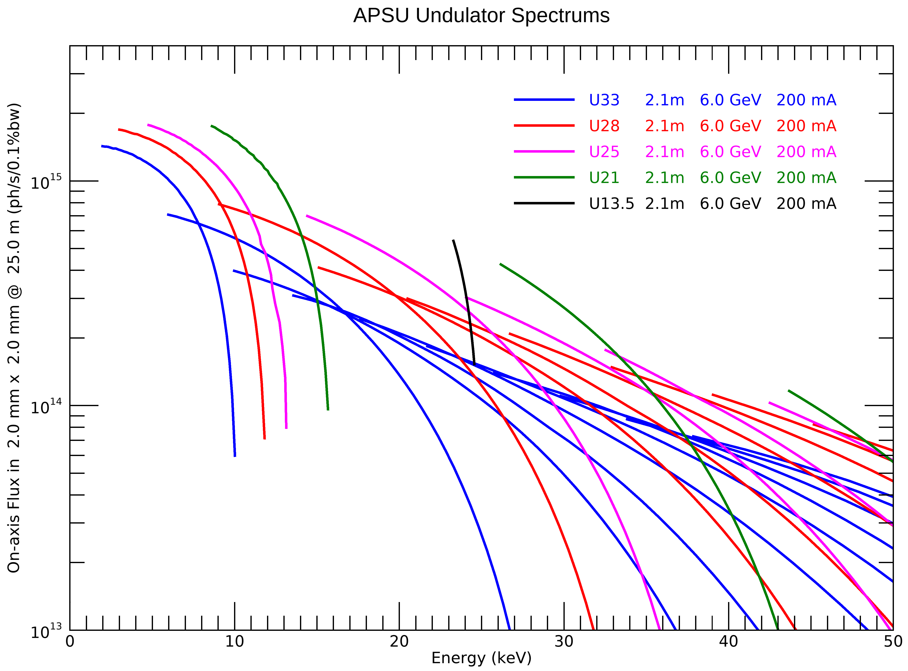
Insertion Device Comparisons
Brightness
Flux in a 2mm x 2mm aperture @ 25m
A few period devices are shown. Only Odd harmonics are shown in plots
Devices with period less than 2.7cm will have a gap between 1st and 3rd harmonics

Slide 11
Beamline ID Source Choice
Interface control documents between ID, FE and beamline for each ID beamline was used to define the configuration
ID source is defined with spectrum
FE configuration is defined
Ray tracing are also provided
Formal agreement for the beamlines

Slide 12
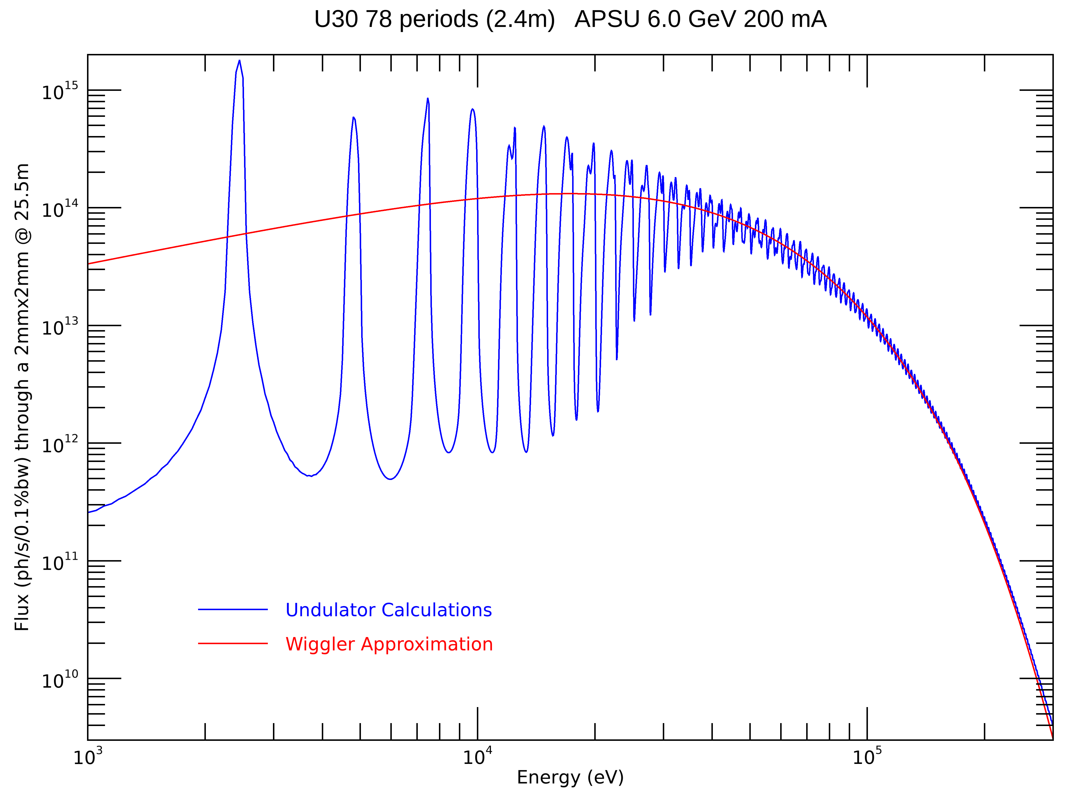
Why an Undulator ?
An insertion device can be envisioned as multiple dipoles stacked up is row (in a periodic fashion)
We use a deflection parameter called “K” which is a function of the field and the period of the device.
When the period of the device is large it’s a wiggler ( K>>3)
When the period gets smaller its called an undulator (K<3)
Due to constructive and destructive interference between photons from subsequent magnets, we have peaks and valleys which are harmonics.

Slide 13
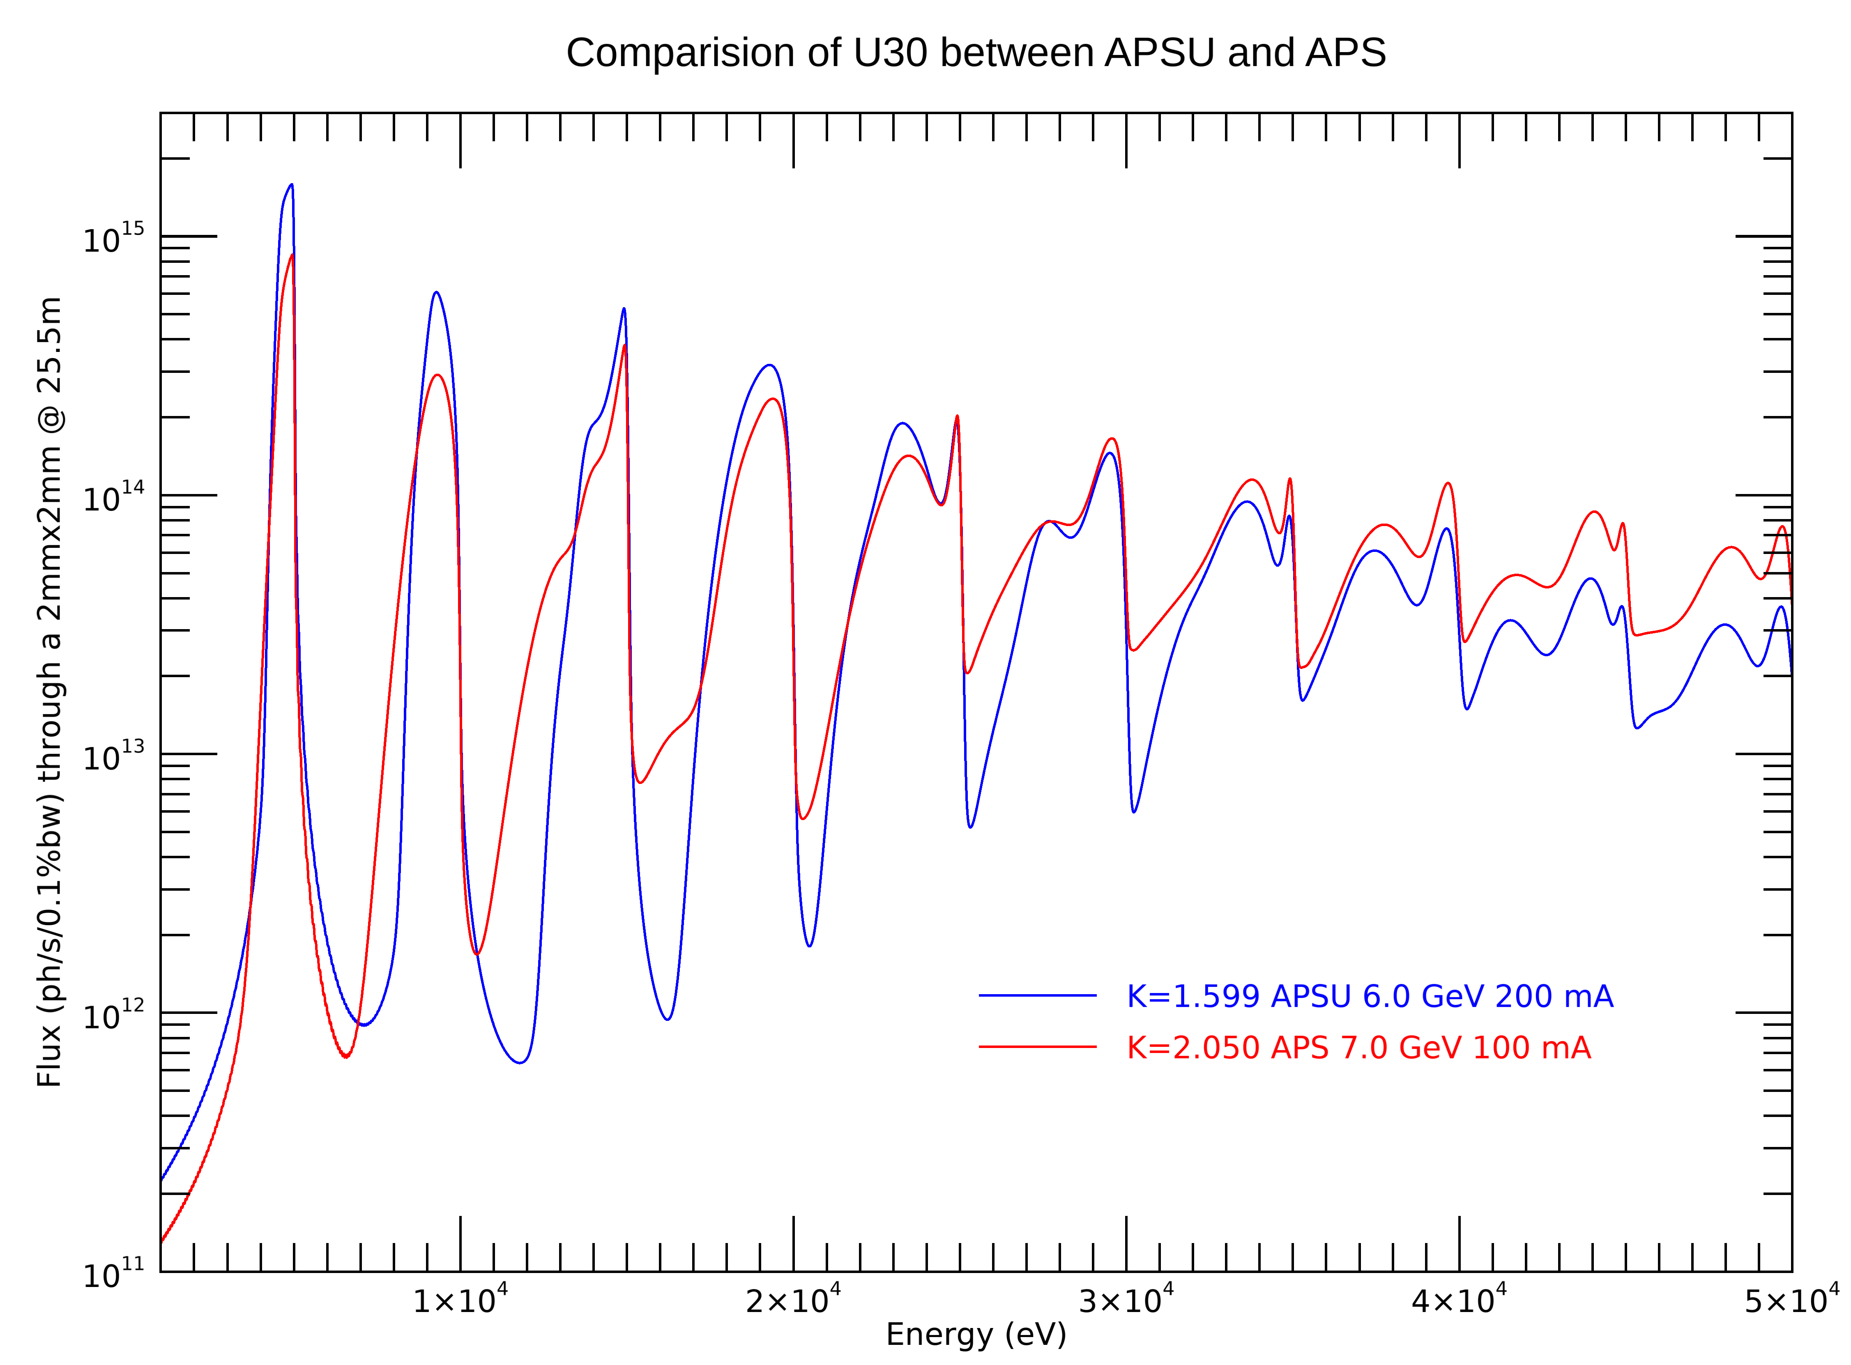
Undulator Spectra
For the same period device to achieve 5 keV on the fundamental the K value is smaller for APSU compared to APS
While the spectra has peaks and valleys the valleys are NOT ZERO!!
The plot shows the total flux on an aperture of 2mm x 2mm at 25.5mm.
To better understand the beam structure one has to look at the flux density in this aperture.
We will scan through the energy over 9 harmonics with optics to see the beam structure

Slide 14
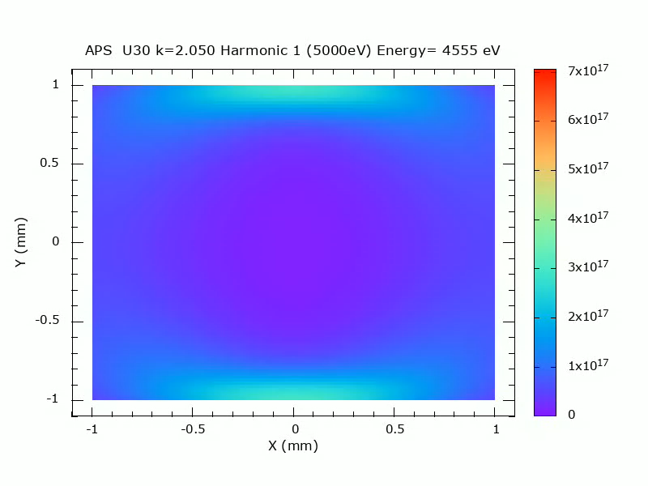
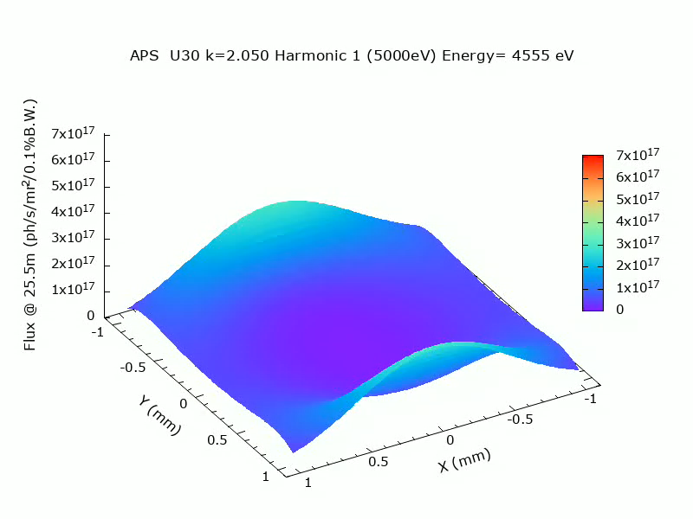
Flux Density - APS
U30 5 keV on the fundamental (K=2.050). If you scan the monochromator energy over 9 harmonics….
Flux Density is scaled for each harmonic to see clearly the changes
Even Harmonics are weaker in the middle but still usable

Slide 15
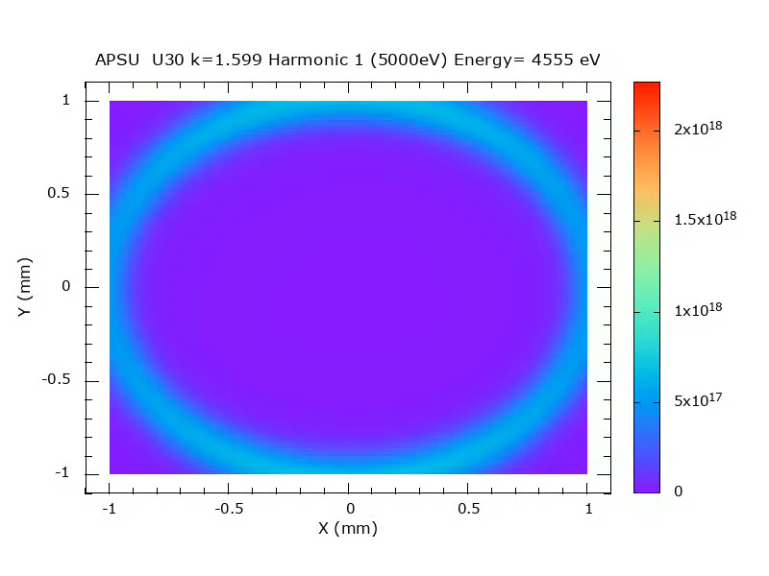
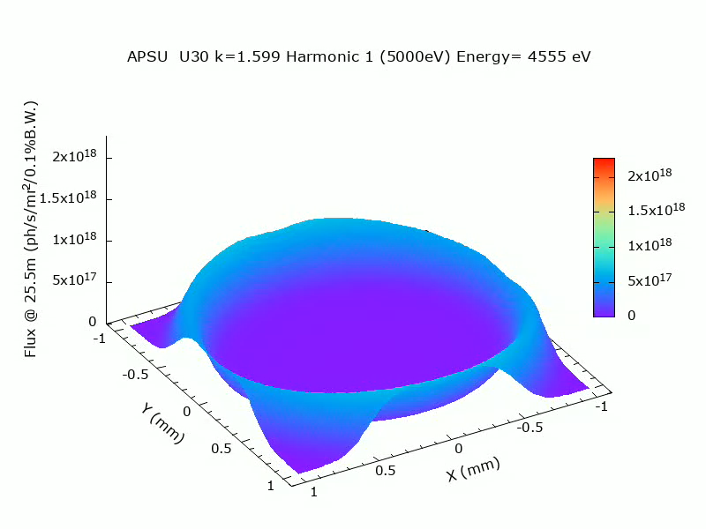
Flux Density - APSU
U30 at 5 keV on the fundamental (K=1.599). If you scan the monochromator energy over 9 harmonics….
Flux Density is scaled for each harmonic to see clearly the changes
Even Harmonics are NOT usable for APSU as most of the flux will not be in the middle!!

Slide 16
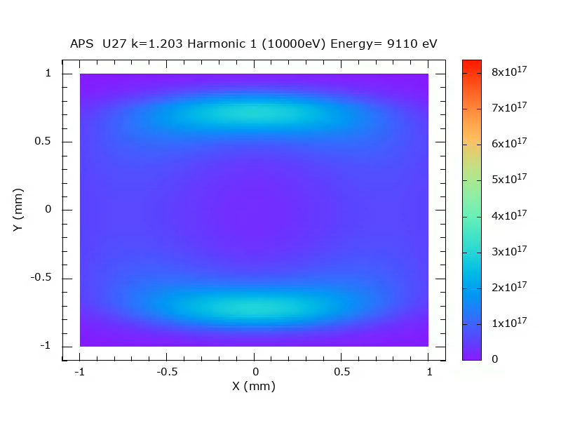
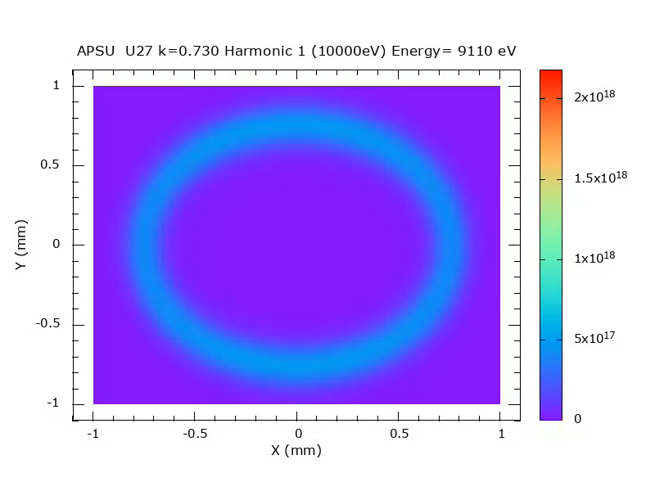
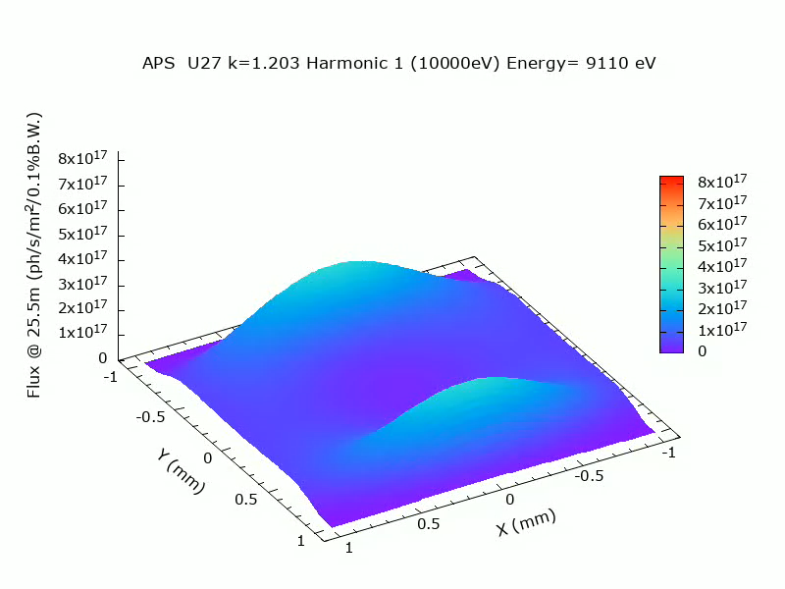
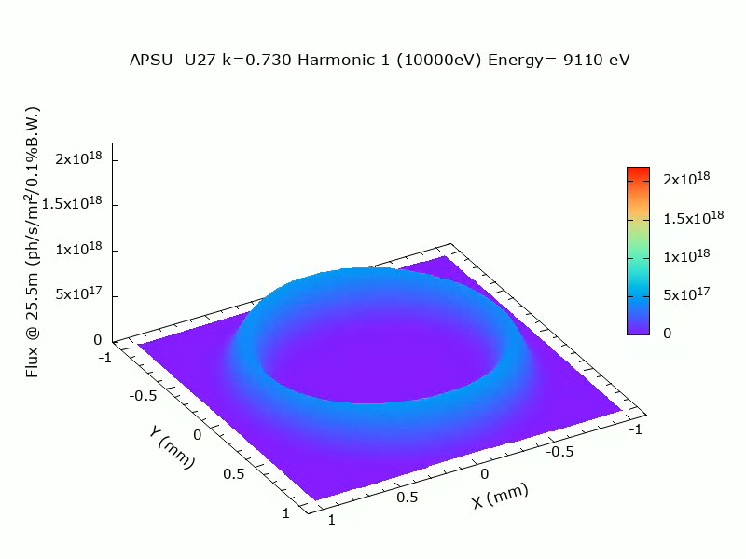
Flux Density Comparison - APS and APSU
APS U27 @10 keV
APSU U27 @10 keV

Slide 17
Slit or Not ?
The front end exit mask has either a 2mm H x 2mm V for canted and a 2mmH x1mm V for HHL
This was done to reduce the power on downstream components.
One has to evaluate based on the undulator period and the gap they run to pick an optimum slit before their optics to get the lowest power on the optics for the maximum flux desired
The exit mask in most cases is larger than is needed.
  An aperture of 1mm x1mm in front of optics is more than sufficient in most cases and even a smaller aperture is better..

Slide 18
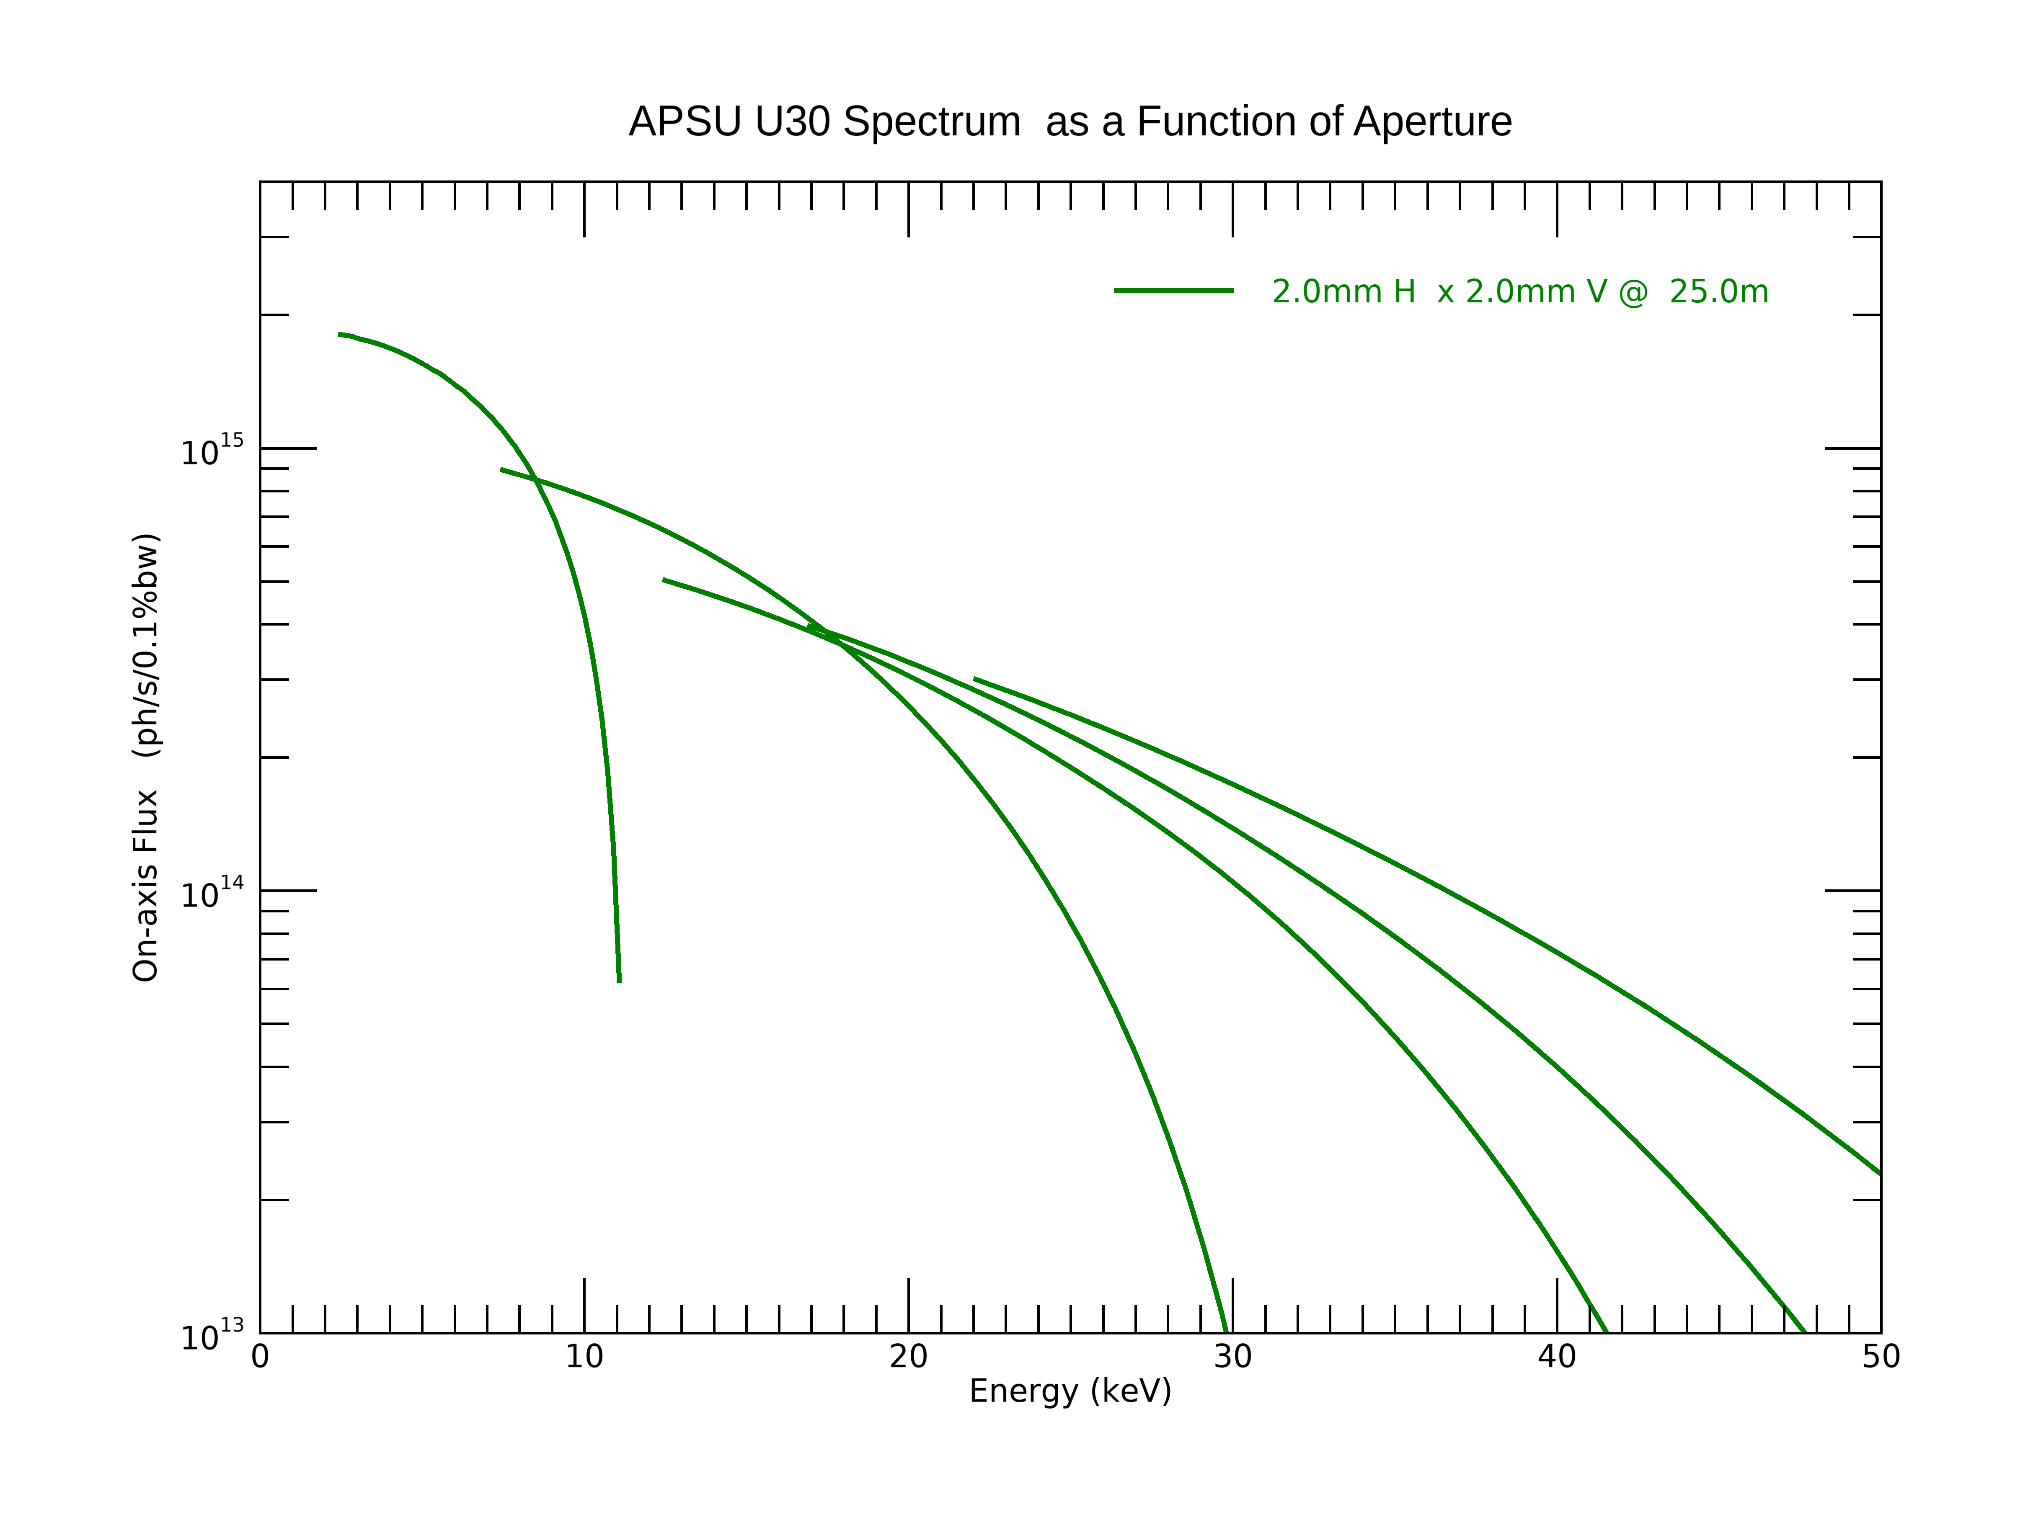
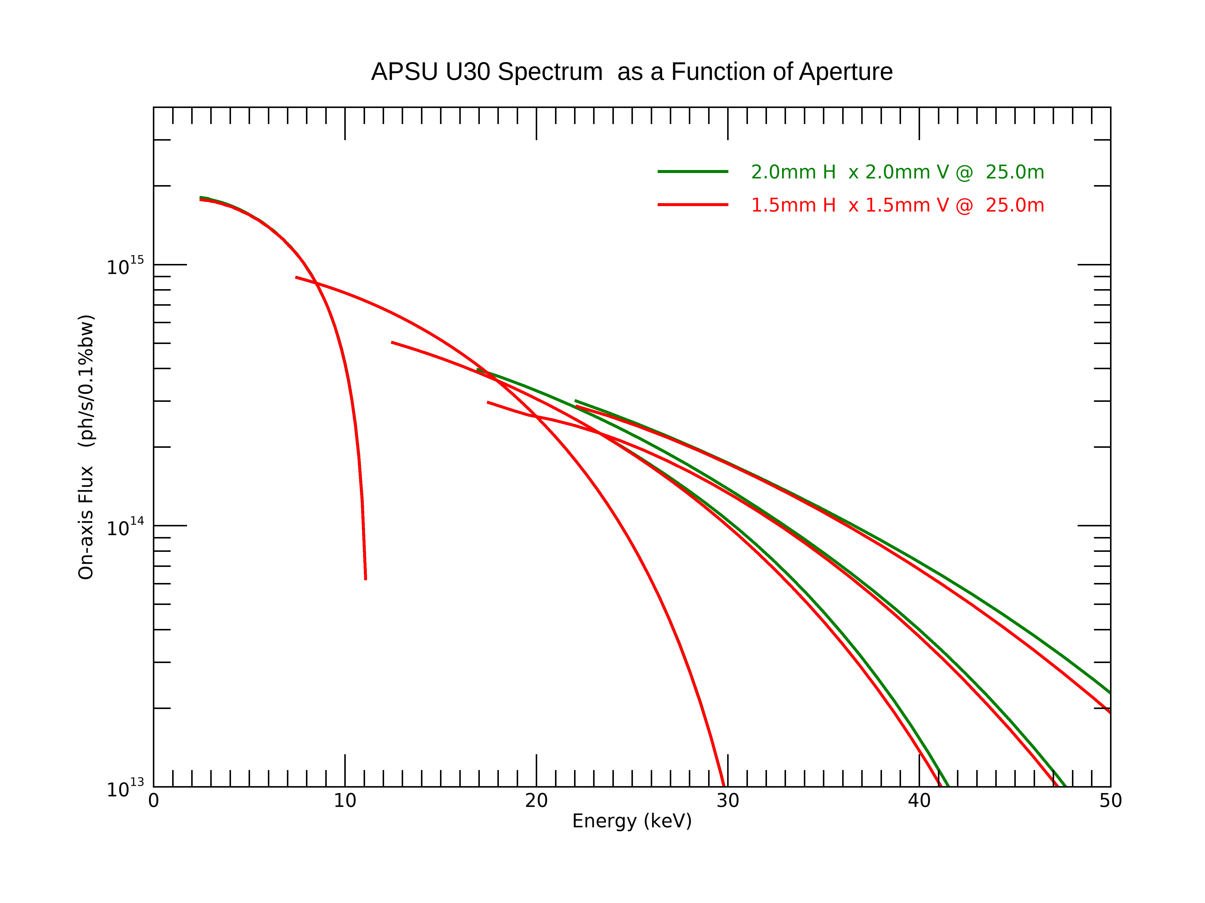
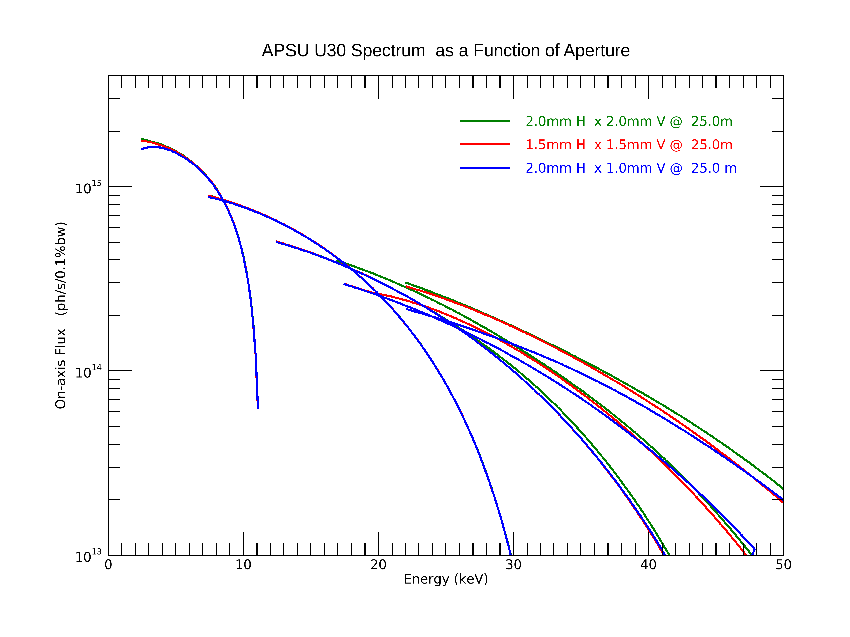
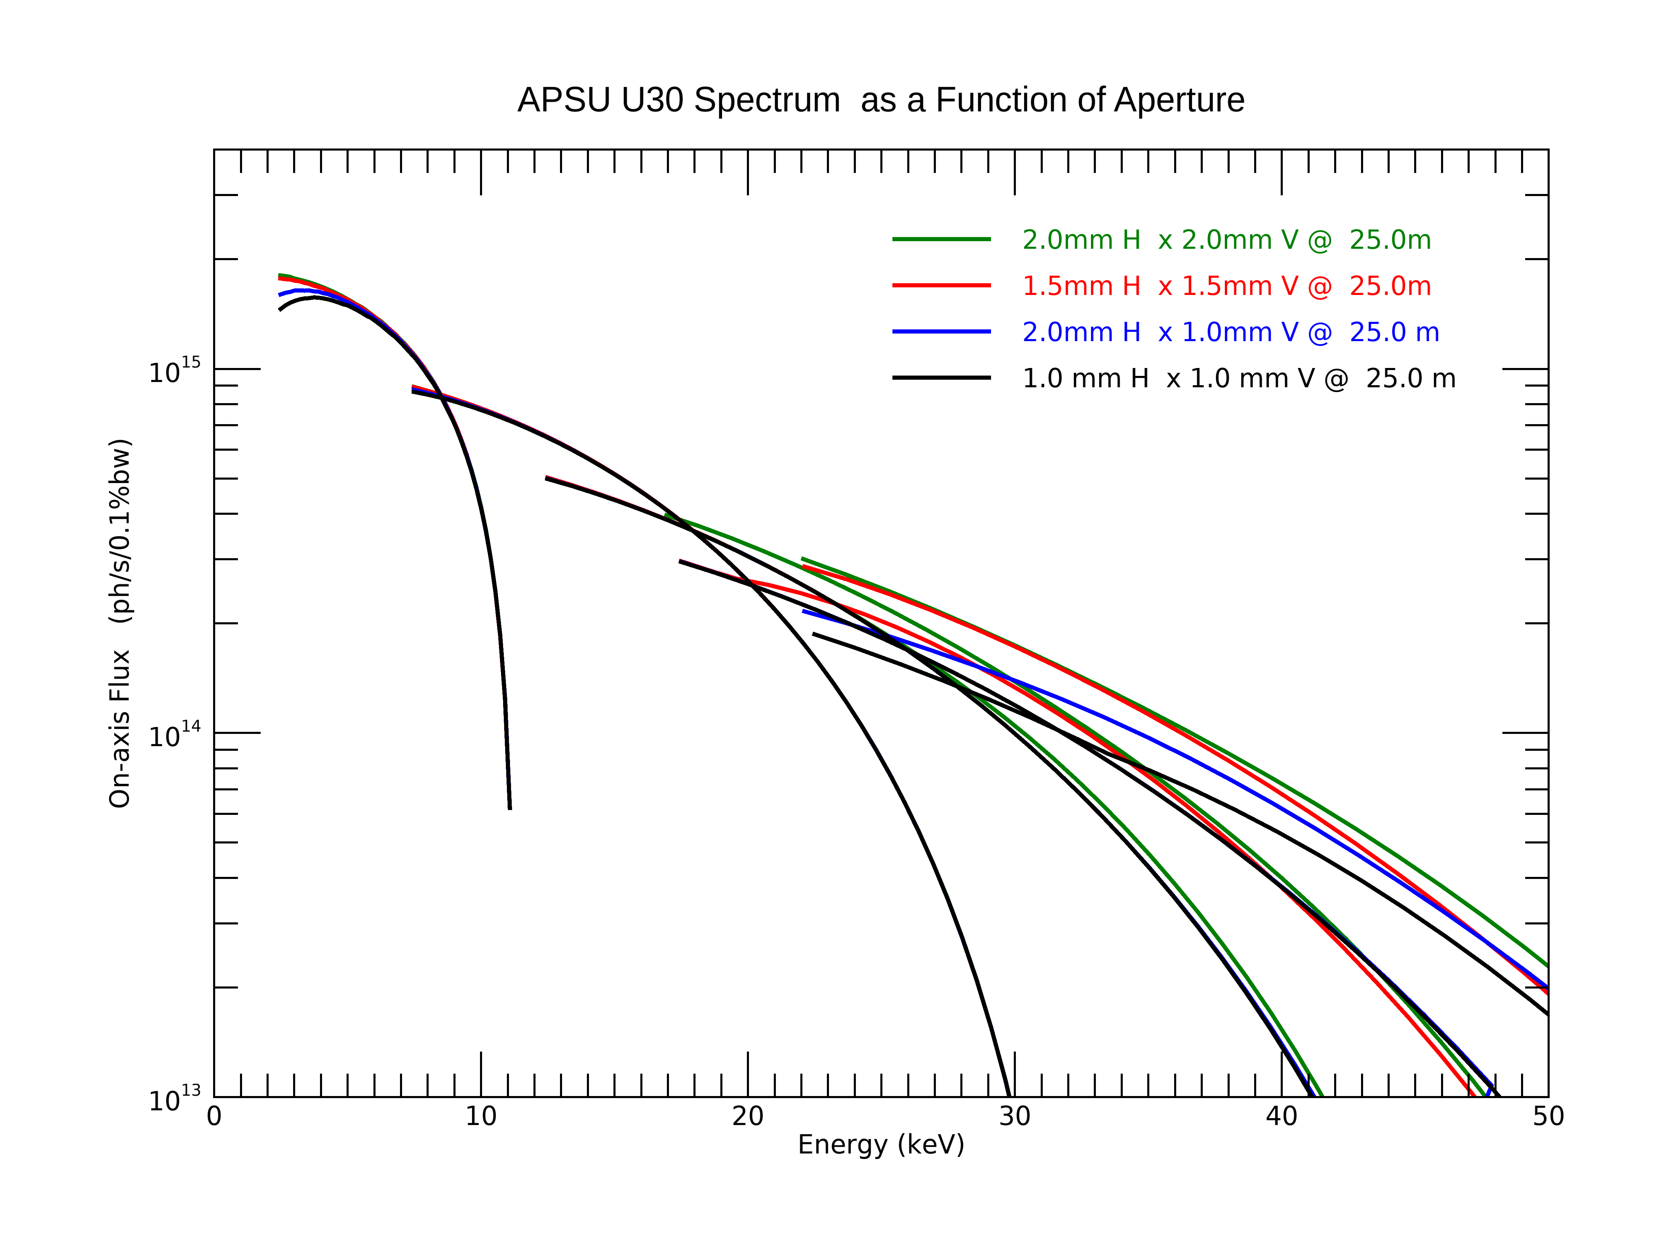
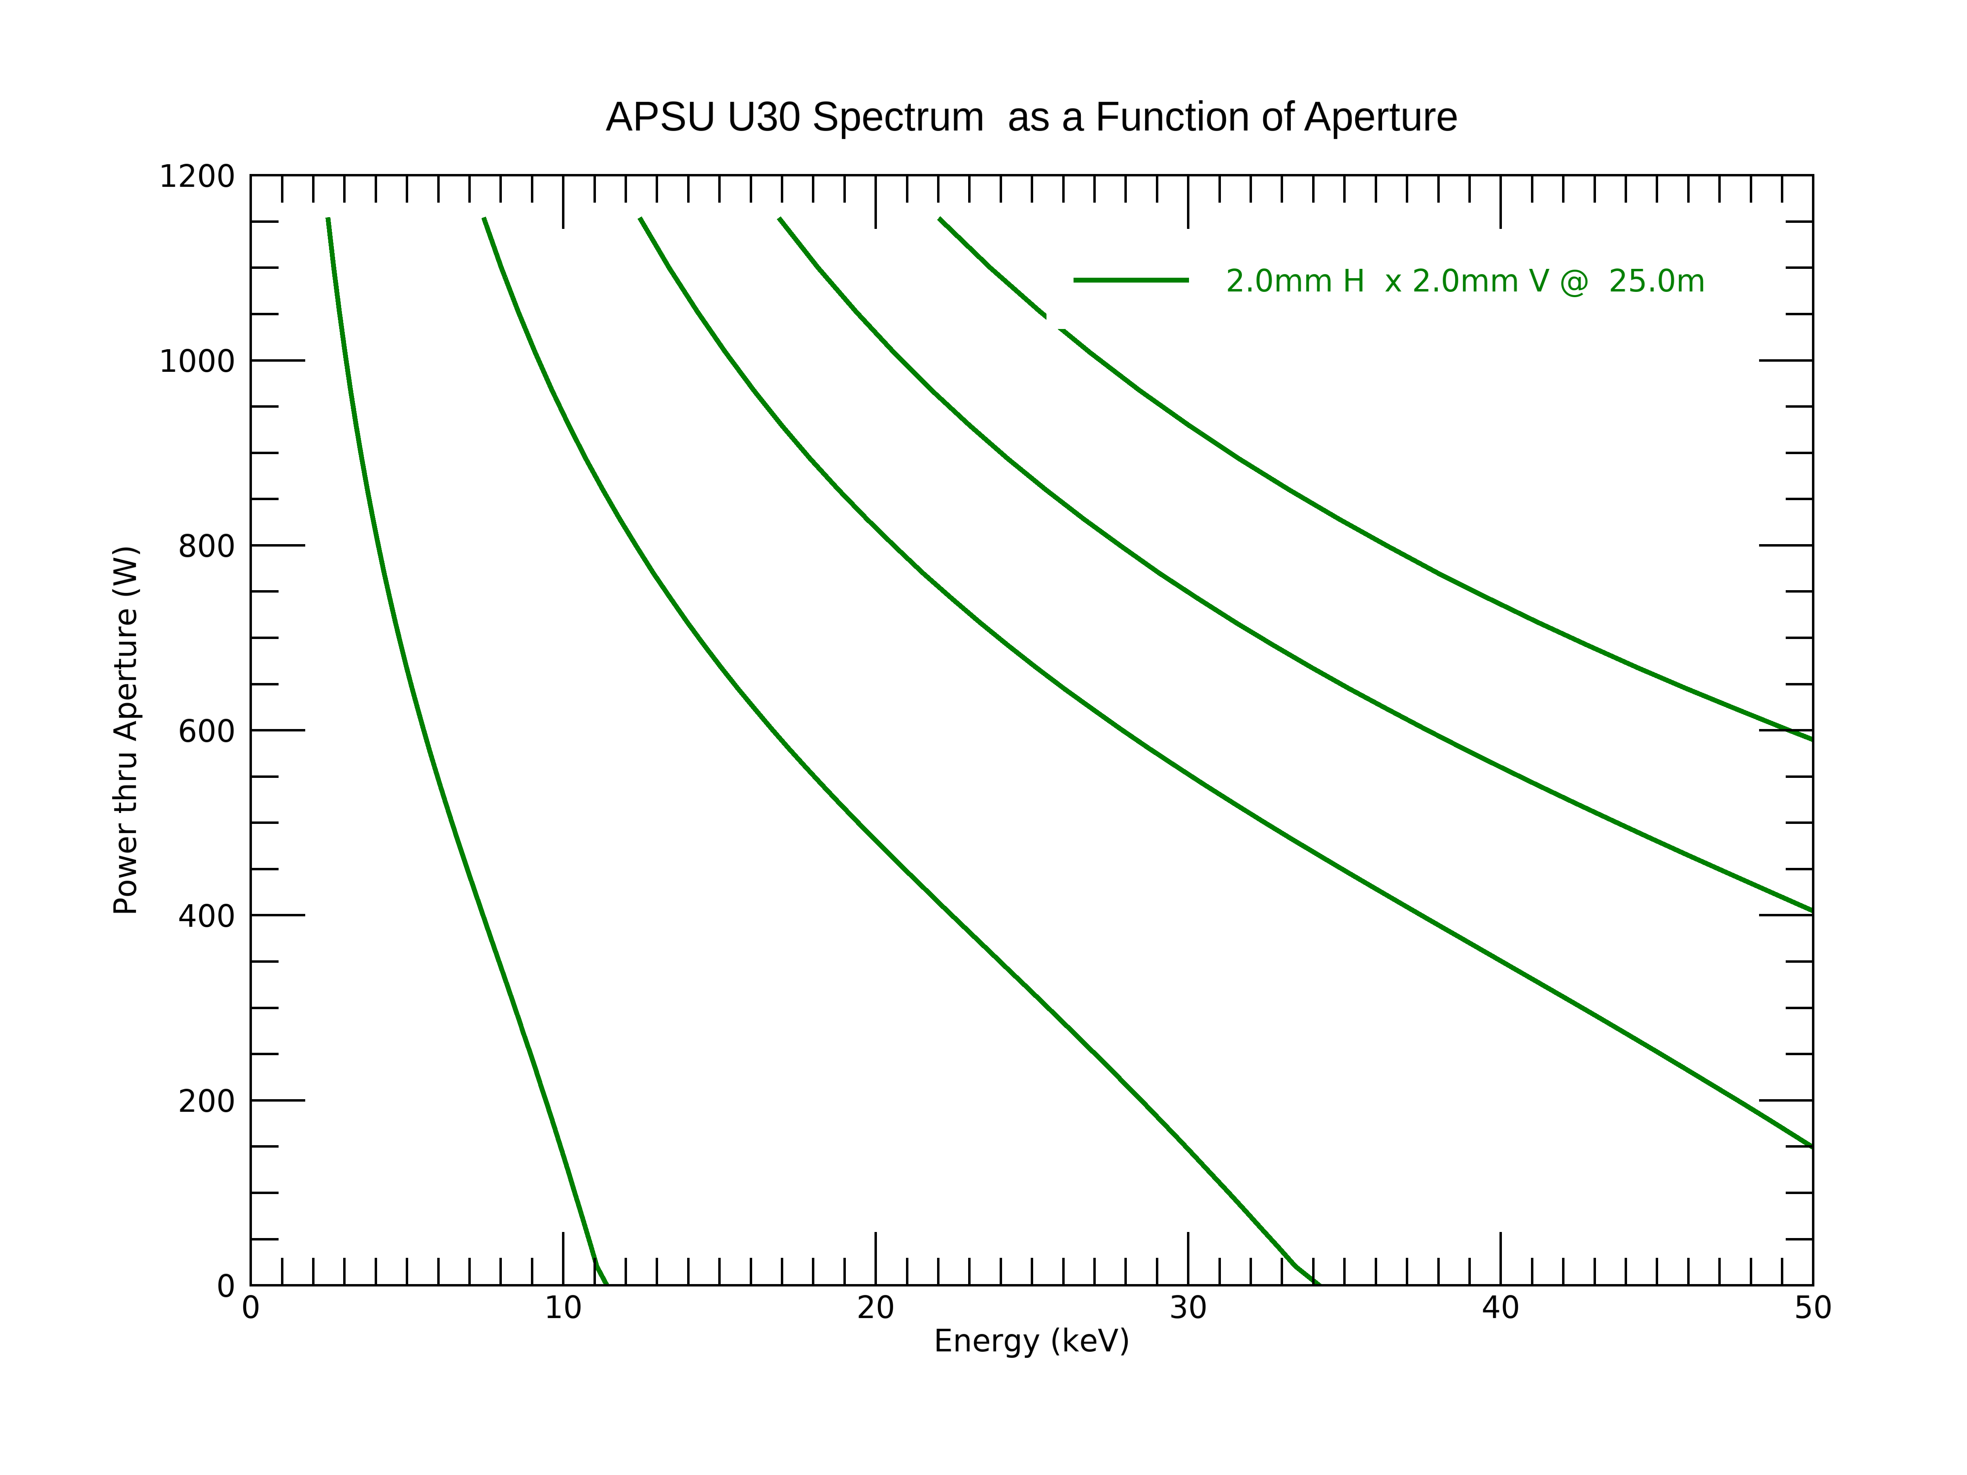
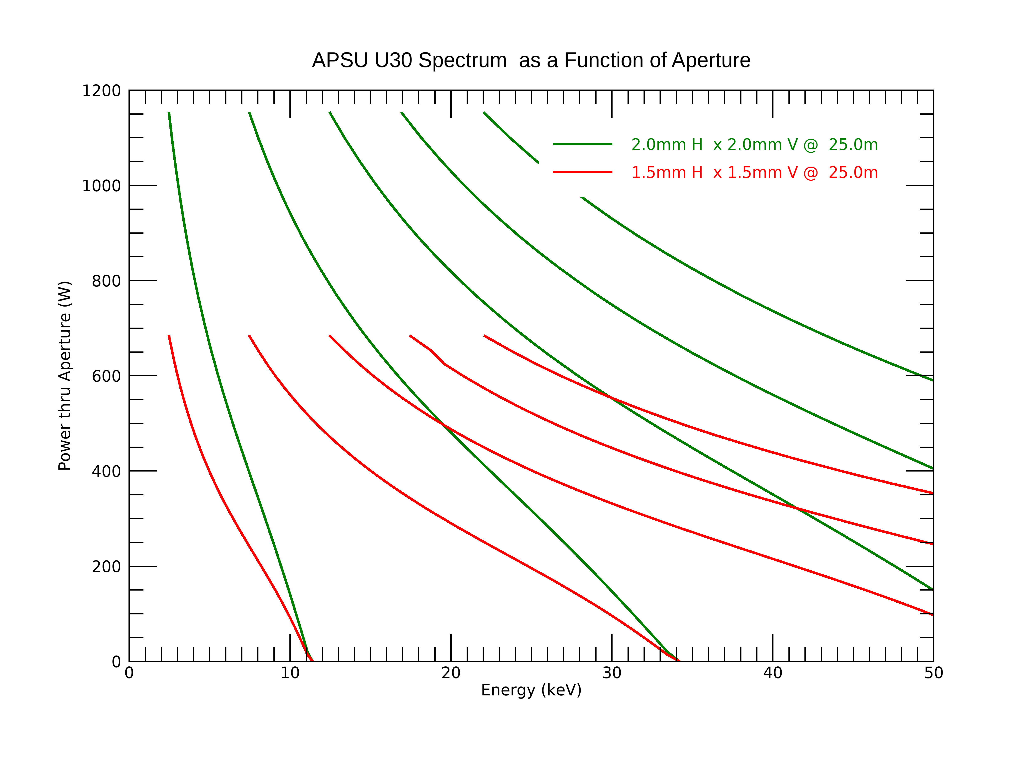
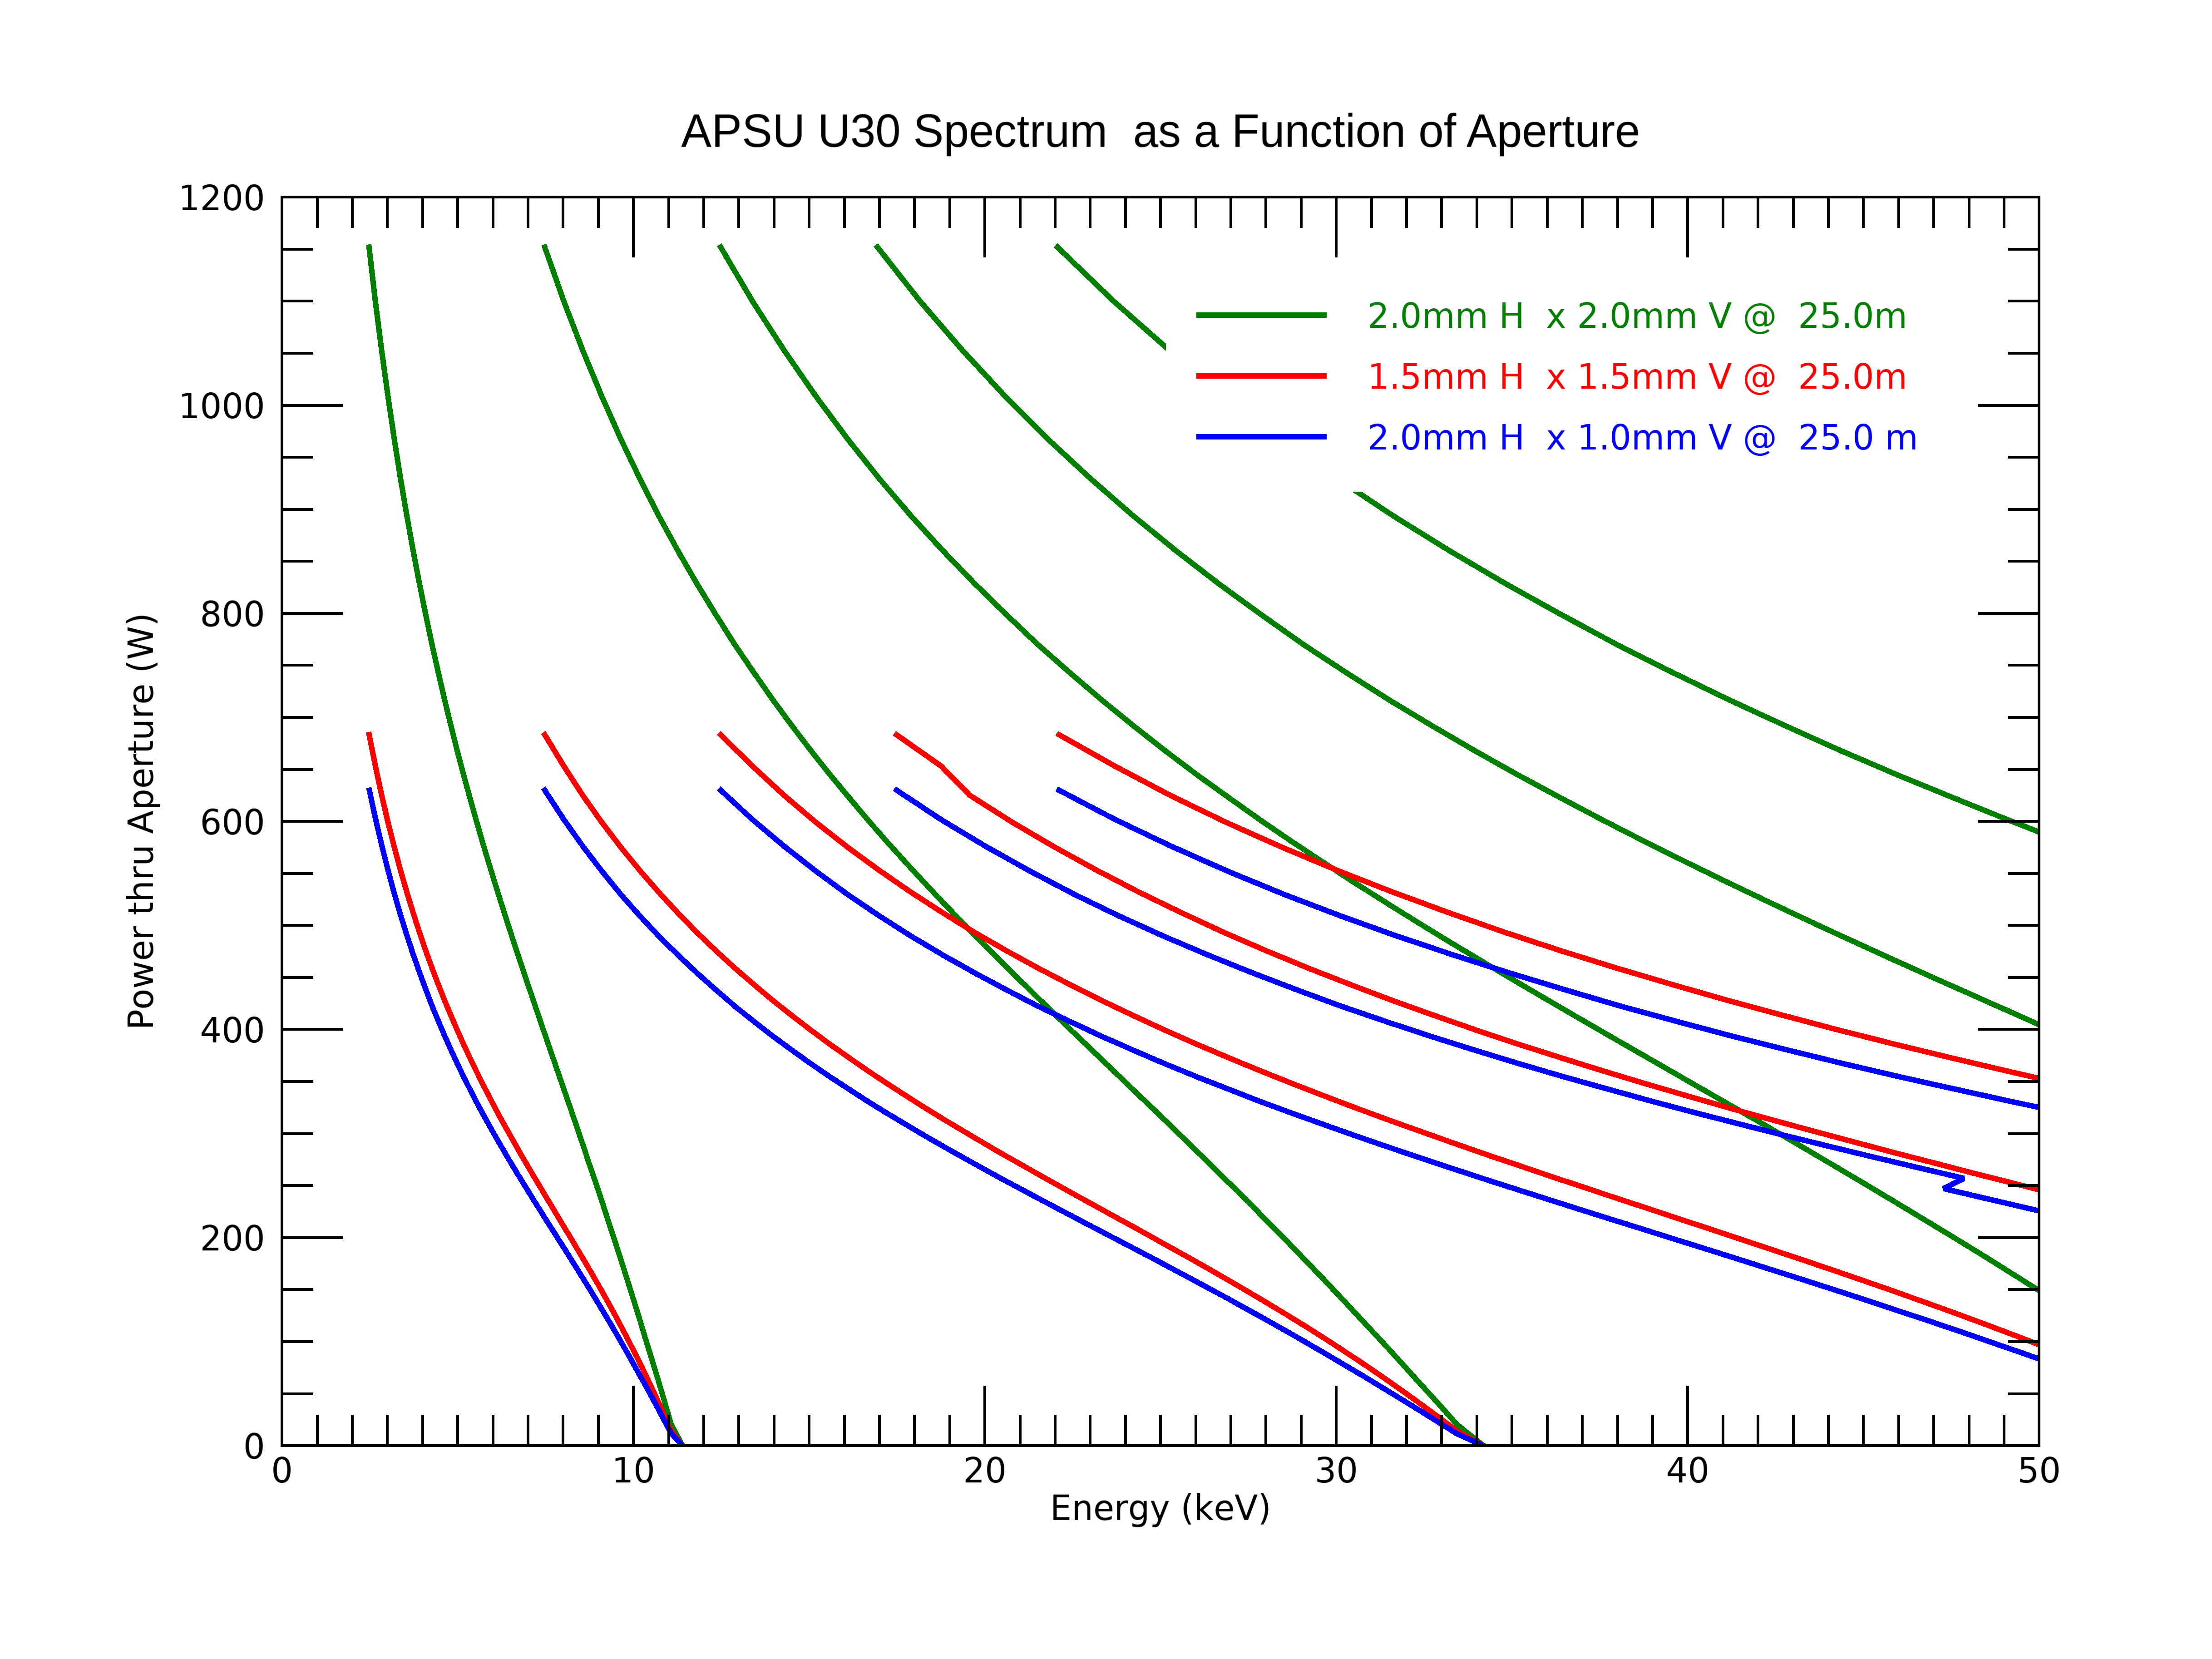
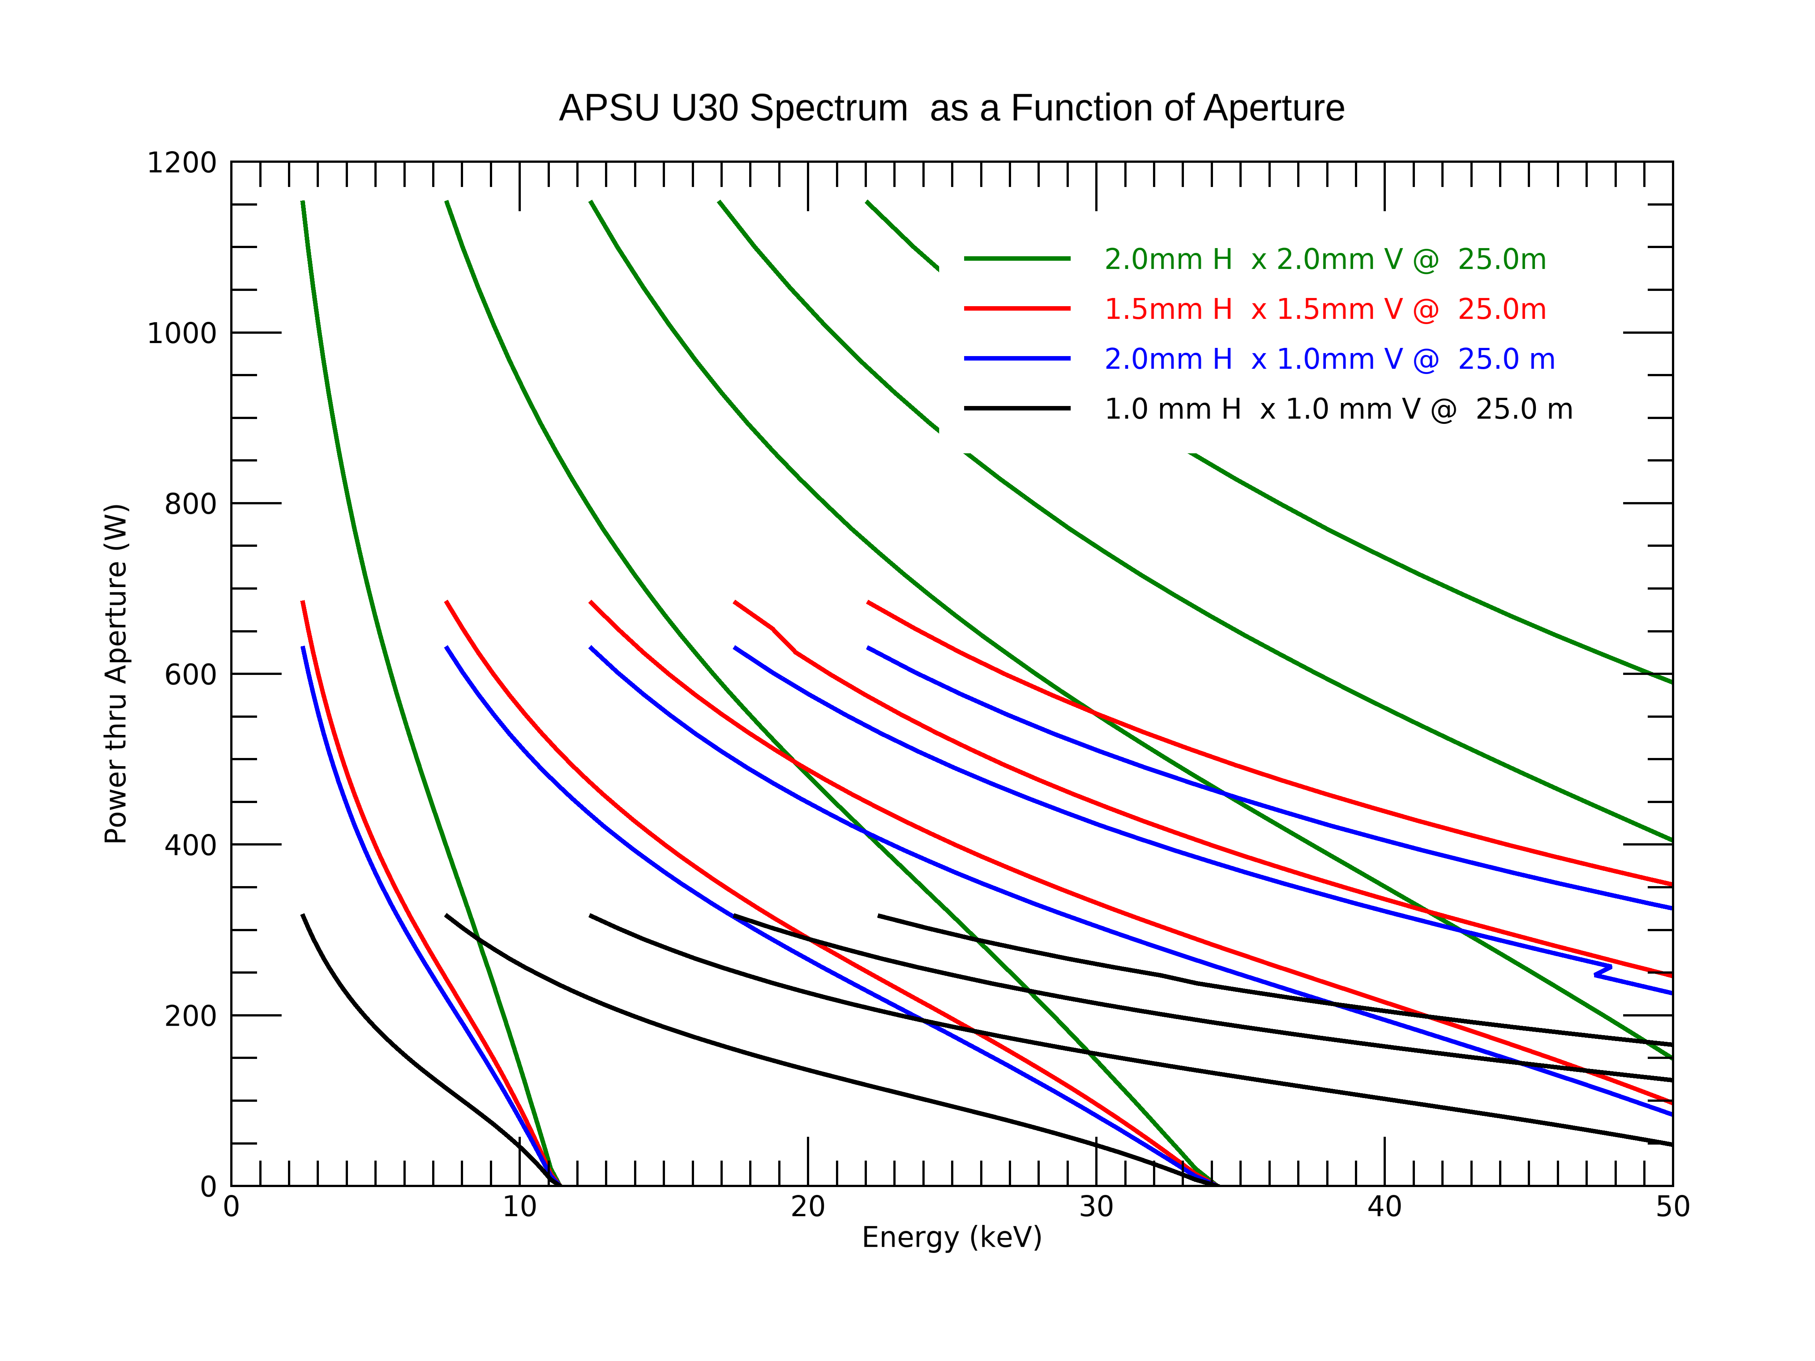
Flux and Power Comparison
Aperture Flux @ 25m
Power thru an Aperture
All canted FE have 2mm H x 2mm V while HHL FE have 2mm H x 1mm V aperture at 25.5m
As can be seen for a significant reduction of power on your optics you don’t lose flux until the 7th harmonic with a 1mm x 1mm aperture.

Slide 19
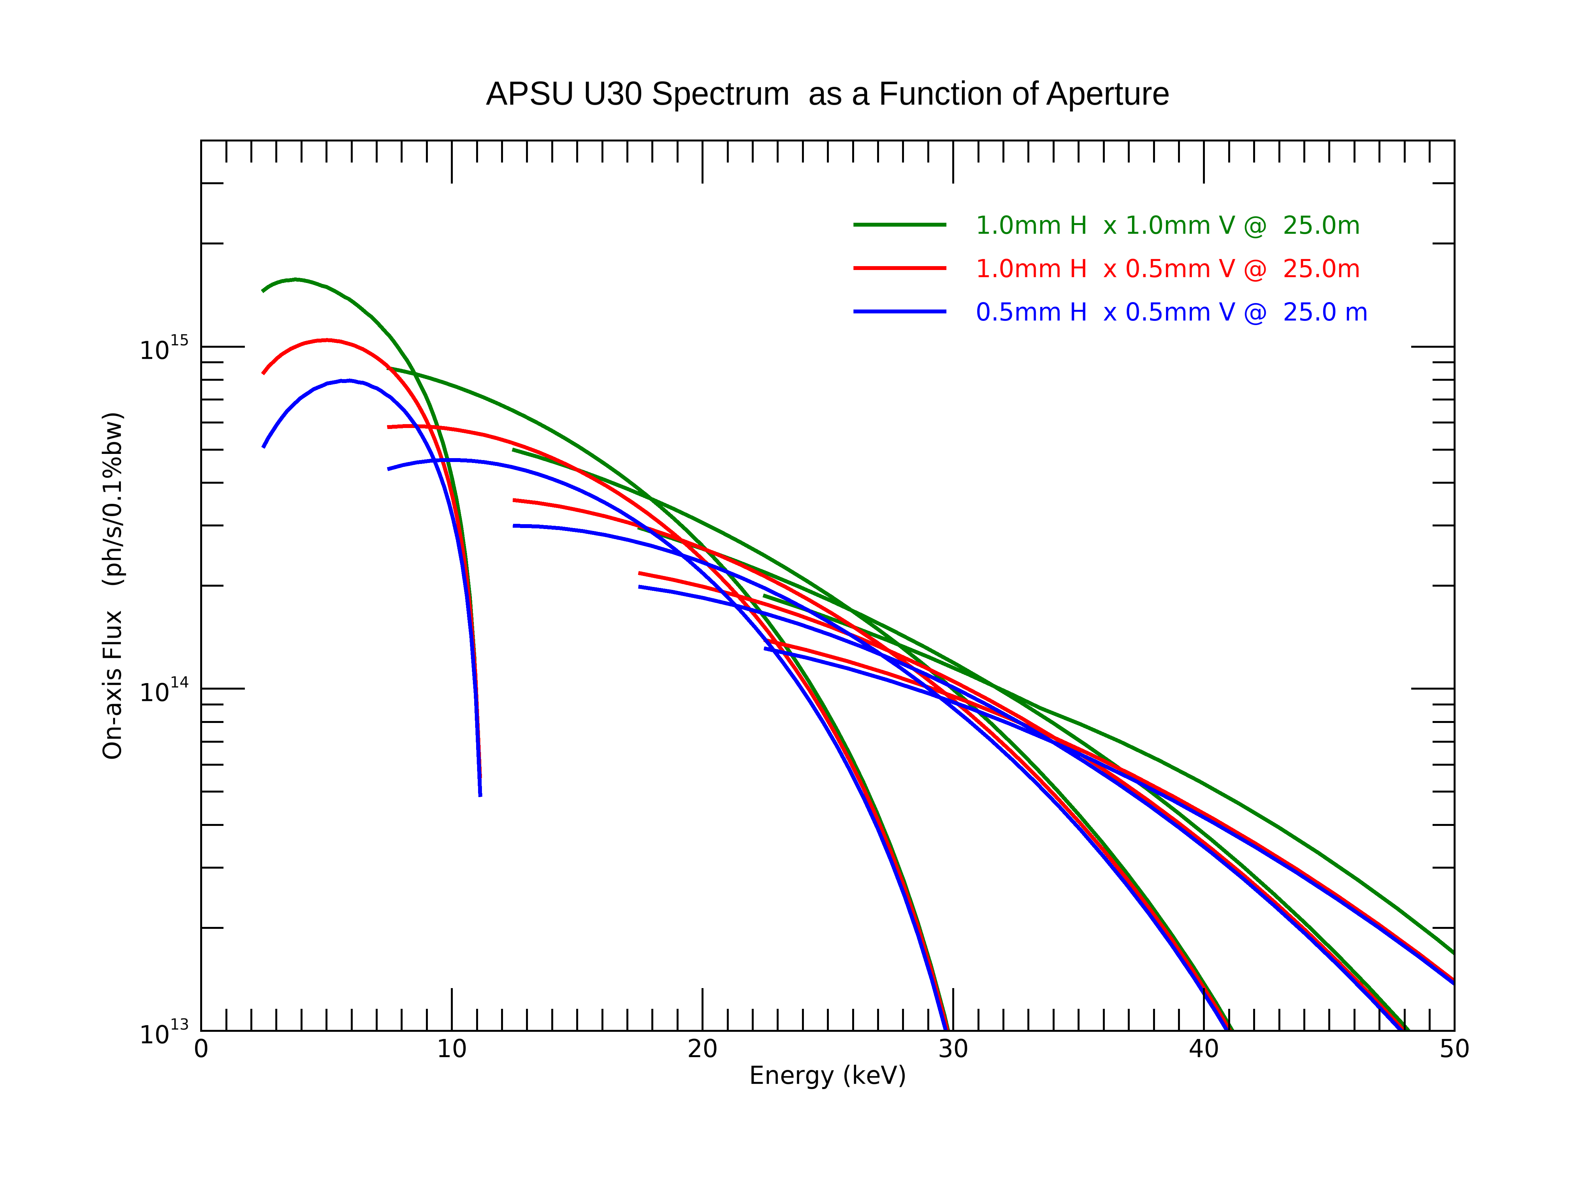
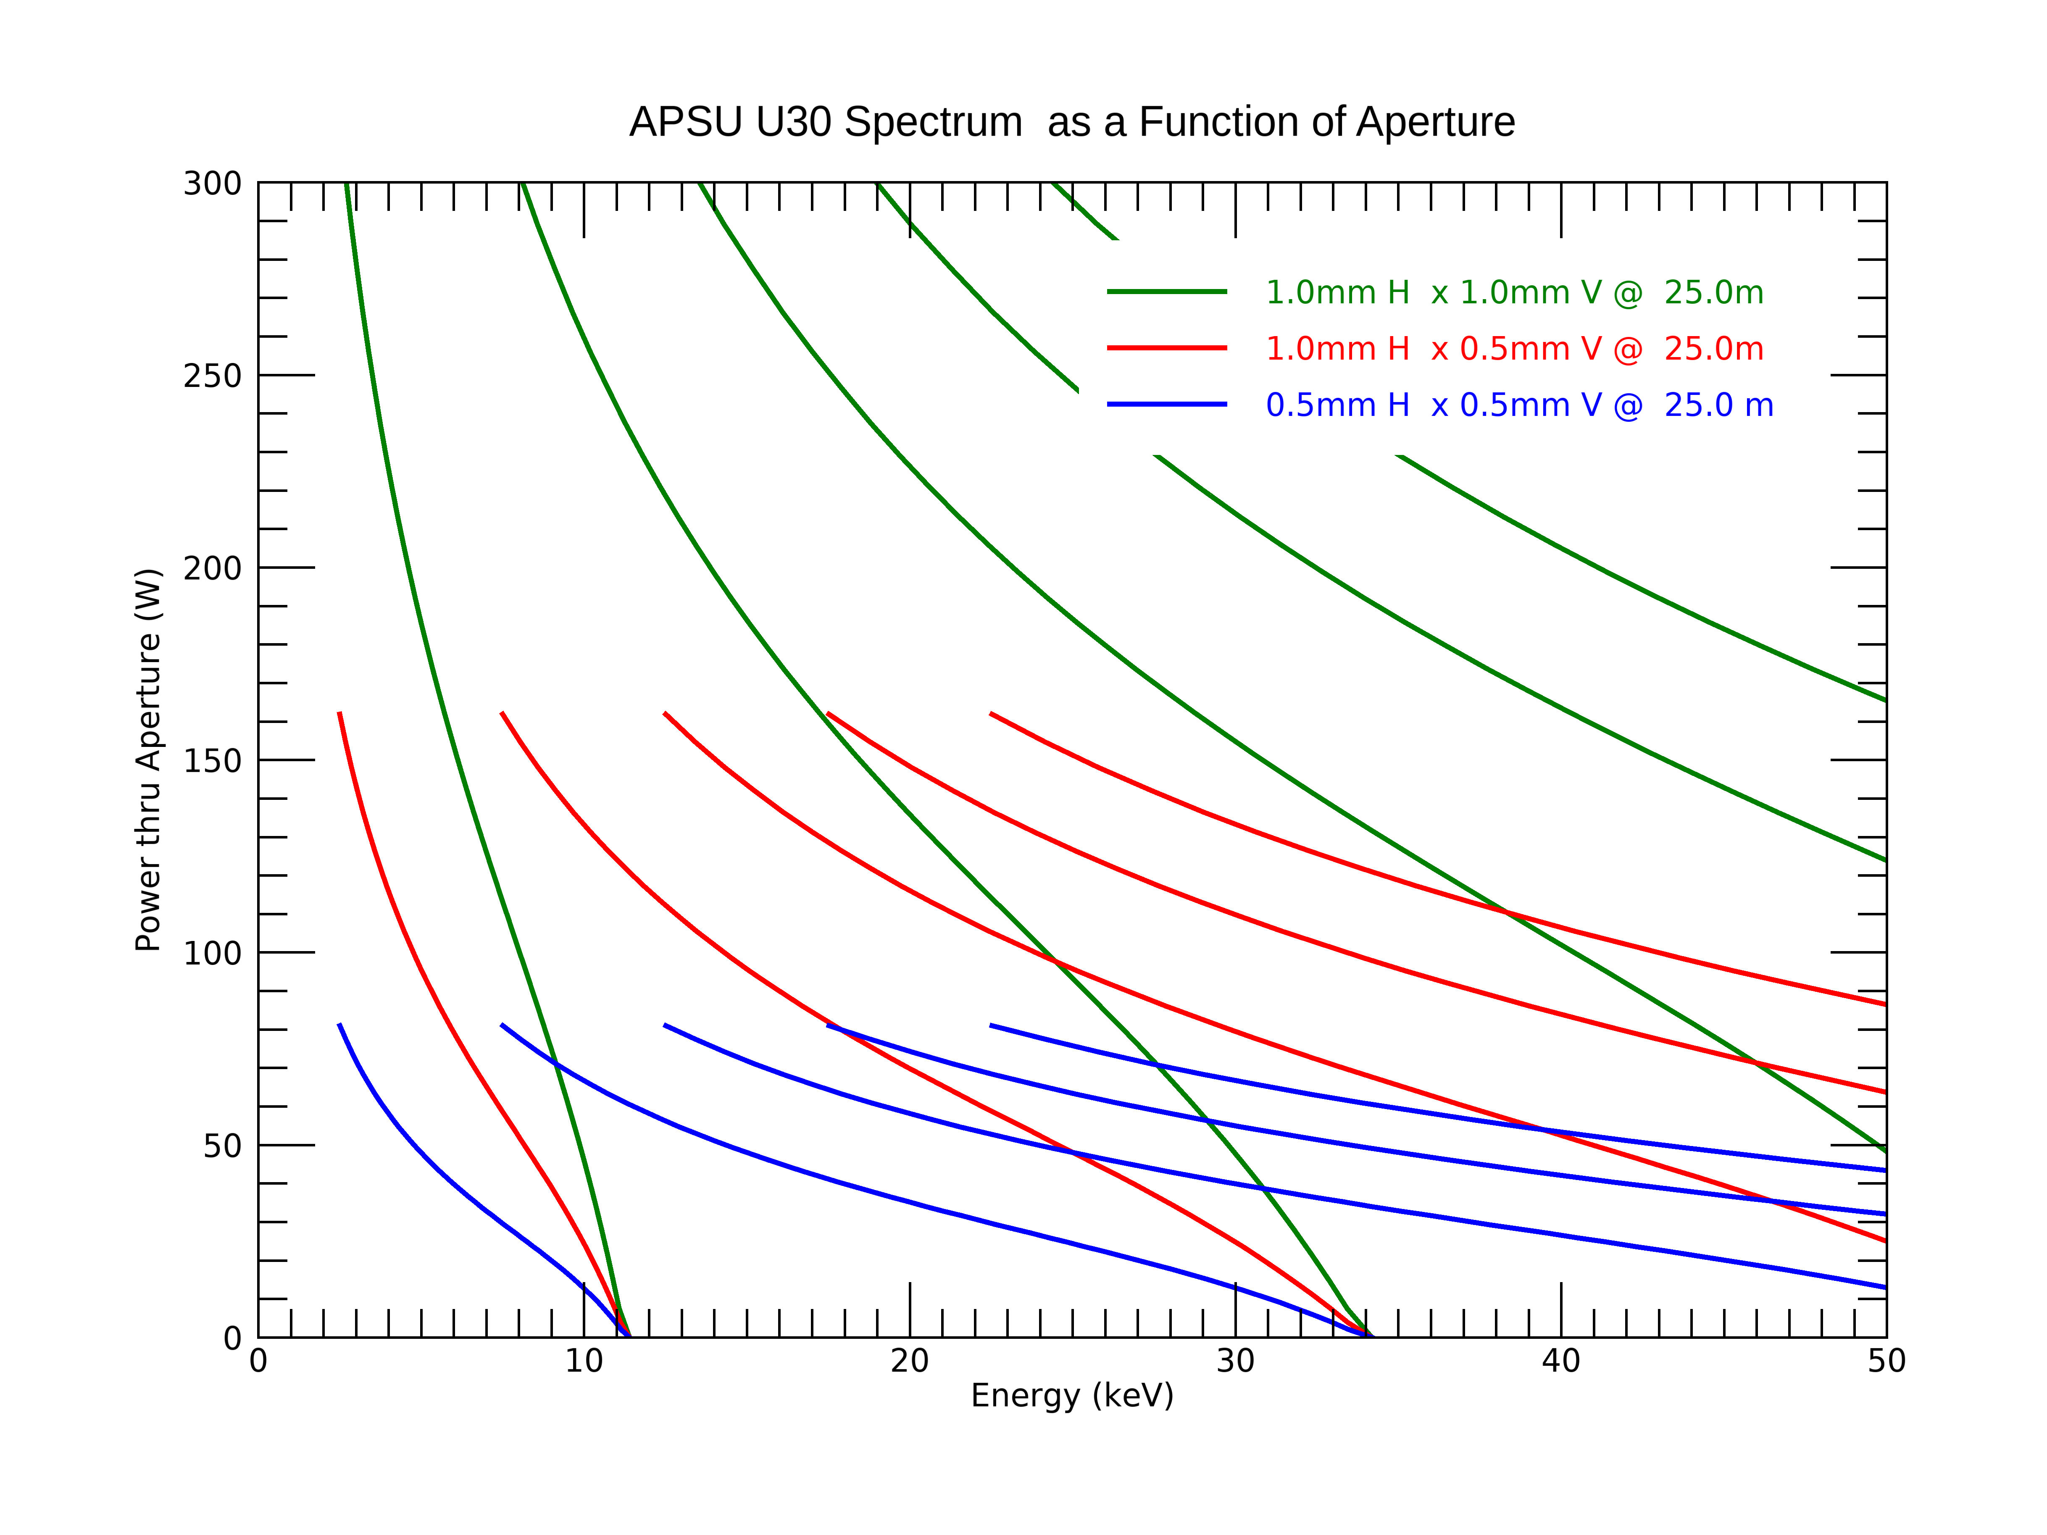
Flux and Power Comparison
Aperture Flux @ 25m
Power thru an Aperture
Taking it even further from 1mm H x 1.0V down to 0.5mm H x 0.5mm V :
Flux does get reduced but the power is significantly reduced.
One should use a Power vs Flux ratio to get the best operating condition for the beamline.

Slide 20
Summary
The APSU source has a great potential for new science
Understanding your beamline optics along with the source is very important..
There are numerous simulation tools available today and easy to use.
APS Optics group has experts on some of these tools
For Source simulations and others:
  XOP. - IDL based GUI with underlying code ( Distributed by APS –Contact Roger Dejus)
  SPECTRA - Excellent code of ID source with more capabilities being added. Has a python interface version also
          Distribution: https://spectrax.org/spectra/index.html
  OASIS - Pythons based complete package to simulate from source thru optics. Has the XOPpackage built in, SRW and Shadow are some of the example package built in.
          Distribution :https://www.aps.anl.gov/Science/Scientific-Software

