Slide 1
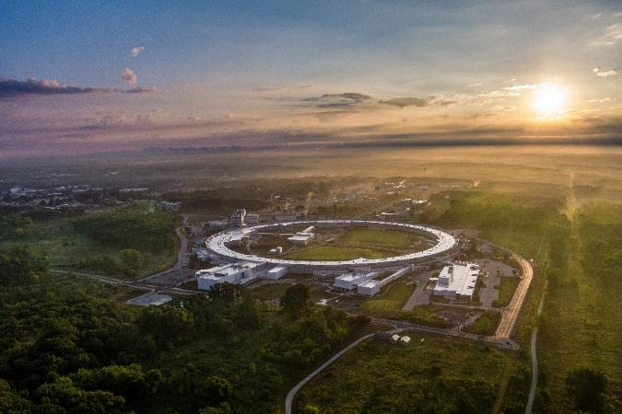
APS Design & Drafting
Extended Services Offered
- additive manufacturing
- reverse engineering
July 17, 2025
Brian rusthoven
Group Leader

Slide 2
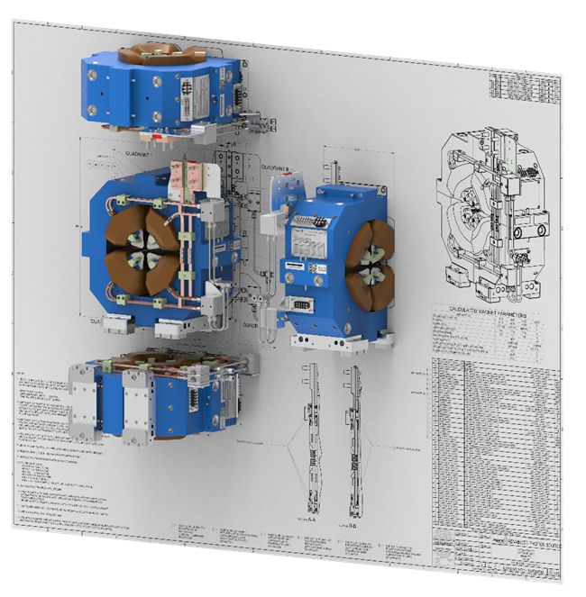
Agenda
Design and Drafting Group
Additive Manufacturing Facility
  Facility Overview
  Machine Descriptions
  Desktop Metal (BMD)
  Satellite Shop Expansion
Reverse Engineering
  Wide Area Scanning
  Digital Twin Creation
  Small Area Scanning
CAD Help Desk

Slide 3
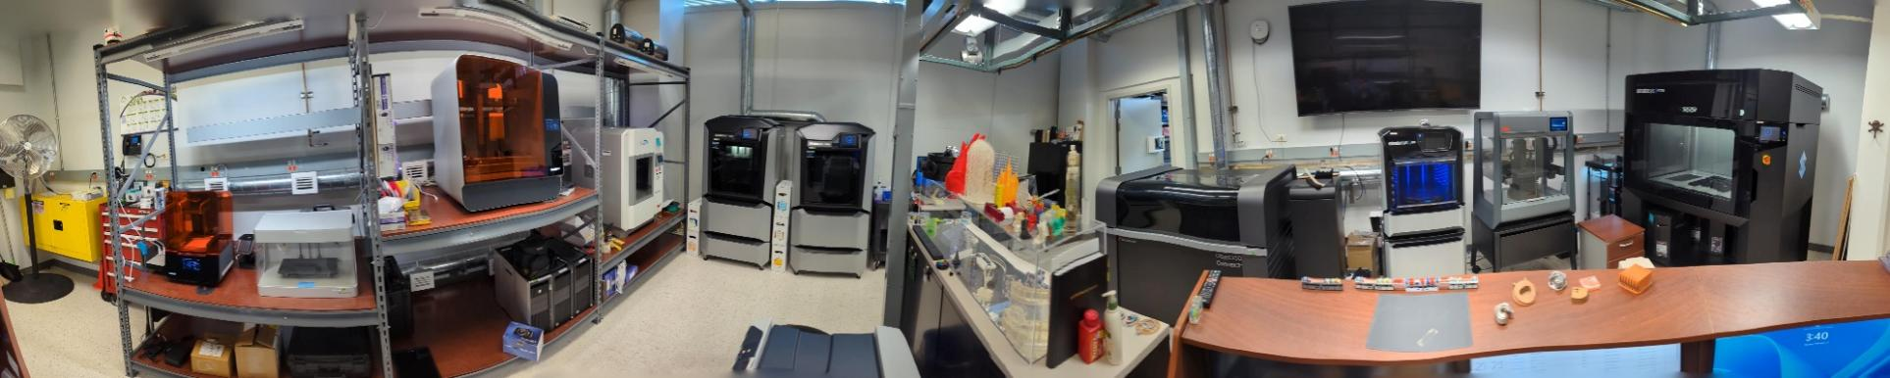
Design and Drafting Group
additive manufacturing facility
Introduced in 2009, it has matured into a full production environment averaging over 2,000 parts per year.
The current equipment list consists of:
Stratasys
  J850 Prime
  J55
  F770
  F370 – (2)
FormLabs
  Form 3L
  Form 3
10 - Year Trend
Desktop Metal System
  Studio System Printer
  Debinder
  Furnace
Wazer Waterjet Cutter
MarkForged Mark II
CreatBot PEEK-300

Slide 4
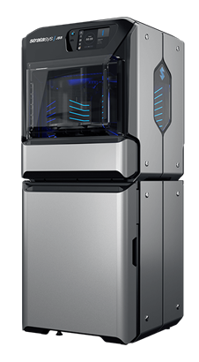
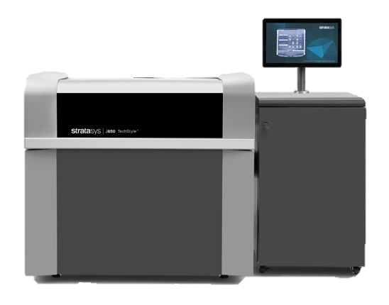
Design and Drafting Group
additive manufacturing facility - PolyJet
Highest resolution printer and well suited for small precise models and test cells.
STRATASYS J850 PRIME POLYJET
Highest resolution PolyJet 3D technology – polymer resin jets onto build platform and is cured by UV light.
Built with a layer thickness of 14 microns (.0006”).
Accuracy based on size: under 100mm ±100μ; above 100mm ±200μ or ±0.06% of part length whichever is greater.
Includes full color visual models including tactile prototyping.
Build envelope of 19.3” x 15.35” x 7.9”.
STRATASYS J55 PRIME POLYJET
The J55 Prime includes full color visual modeling including tactile prototyping.
The five-material channel features a rotating build platform with fixed print head for outstanding surface finish and print quality.
Accuracy based on size: under 100 mm ±180μ; above 100 mm ±0.2% of part length.
Horizontal build layers down to 18 microns (0.0007 in.)
Round Print Tray with Largest Model Size of 140 mm x 200 mm x 190 mm
Print Height: 187mm (7.36 in.)

Slide 5
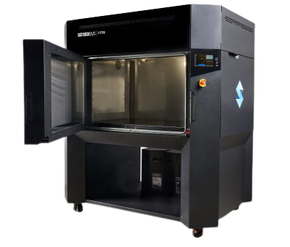
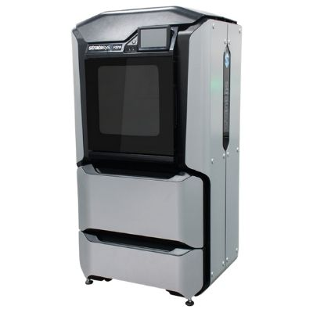
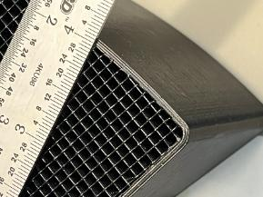
Design and Drafting Group
additive manufacturing facility - FDM
Excellent resolution and well suited for support fixtures, mounting plates, adapter plates and brackets.
Adjustable infill as needed for strength and durability.
Example of
20% Infill
STRATASYS F770 FDM
FDM 3D technology – Fused Deposition Modeling uses production-grade thermoplastics to build strong, durable and dimensionally stable parts.
Accuracy of .010” with a layer thickness of .010”.
Available colors are Black ABS.
Build envelope of 39” x 24” x 24”.
STRATASYS F370 FDM
FDM 3D technology – production-grade thermoplastics create strong stable parts.
Accuracy of .010” with a layer thickness of .010”.
Available colors: (ASA material) Black, White, Red, Blue, Orange, Green, Yellow & Gray.
Specialty materials include: TPU, ABS-CF, ABS-PC
Build envelope of 14” x 10” x 14”

Slide 6
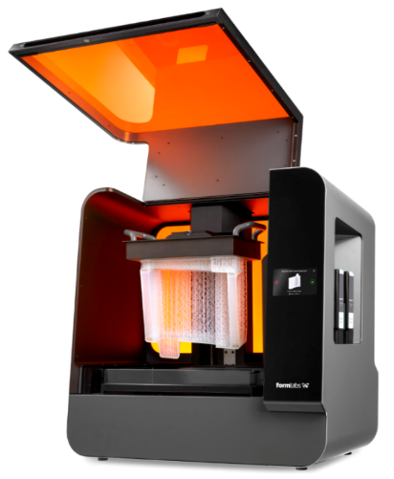
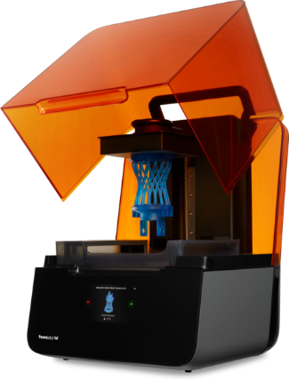
Design and Drafting Group
additive manufacturing facility – FormLabs
High resolution printer and well suited for small precise models and test cells where sacrificial external surfaces are available.
FORMLABS FORM 3L
LFS technology – Low Force Stereolithography, part is pulled from bath, developed with 2 lasers.
Accuracy of .001” with a layer thickness of .001”.
Available colors are Clear, Black and White.
Build envelope of 13.2” x 7.9” x 11.8”
FORMLABS FORM 3
LFS technology – Low Force Stereolithography, part is pulled from bath, developed with 1 laser.
Accuracy of .001” with a layer thickness of .001”.
Available colors are Clear, Black and White.
Build envelope of 5.7” x 5.7” x 7.3”

Slide 7
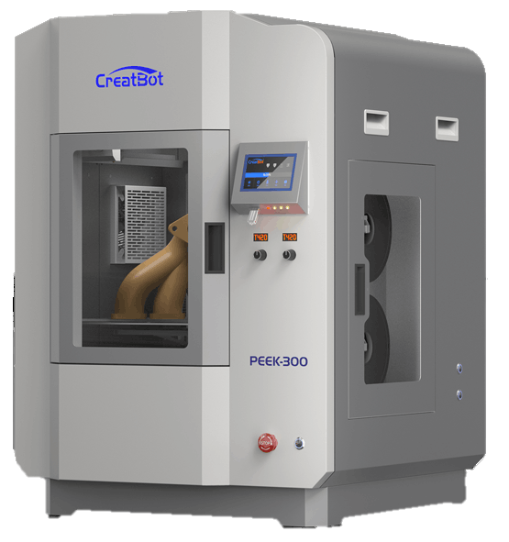
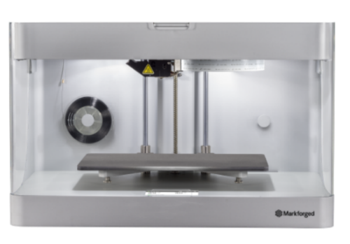
Design and Drafting Group
additive manufacturing facility – specialty materials
CREATBOT PEEK-300
Direct Annealing System (DAS) FDM style process.
Filaments: PEEK, PEI (Ultem), UltraPA-CF, PEEK-CF, PEEK-GF*
Printing these high-performance materials requires a longer lead time.
Build envelope of 11.8" x 11.8" x 15.7”
MARKFORGE MARK II
CFR 3D technology – Continuous Fiber Reinforcement
Similar to FDM technology reinforced pieces are good for small parts that need to be durable.
Layer resolution - .004” to .008”.
Available colors are Onyx Black or Nylon White.
Reinforcement materials: Carbon Fiber, Fiberglass, HSHT Fiberglass and Kevlar.
Build envelope of 12.6” x 5.1” x 6.0”

Slide 8
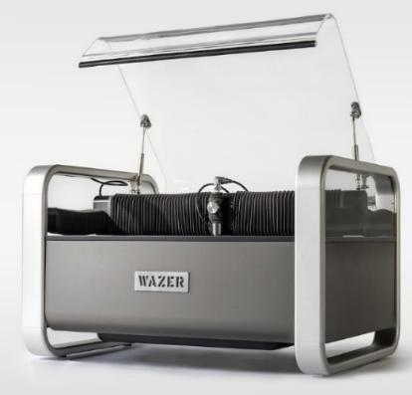
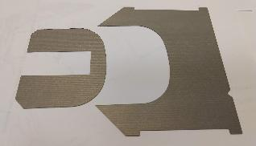
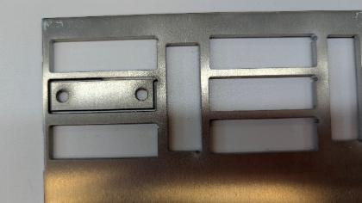
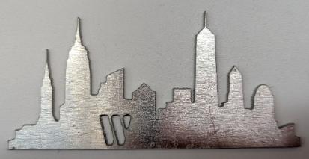
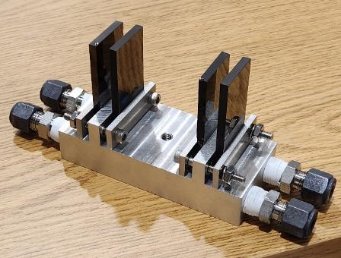
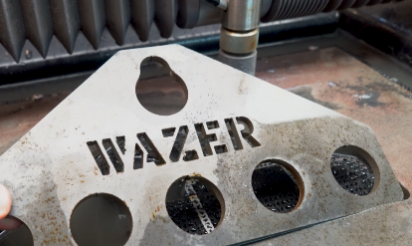
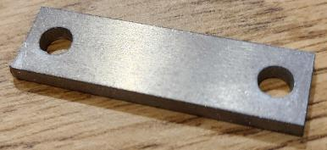
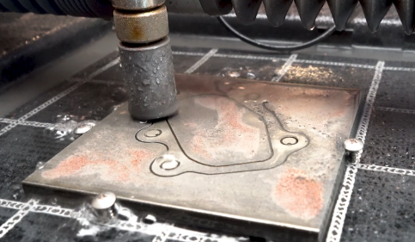
Design and Drafting Group
additive manufacturing facility – specialty machine
WAZER WATERJET CUTTER
Water and abrasive media are forced through a cutting nozzle.
Kerf (width of cut) is .044” – Position Options
Gantry Positional Precision .003”
A variety of materials can be cut for a full list go to Desktop Materials.
Cutting envelope of 12” x 18”.

Slide 9
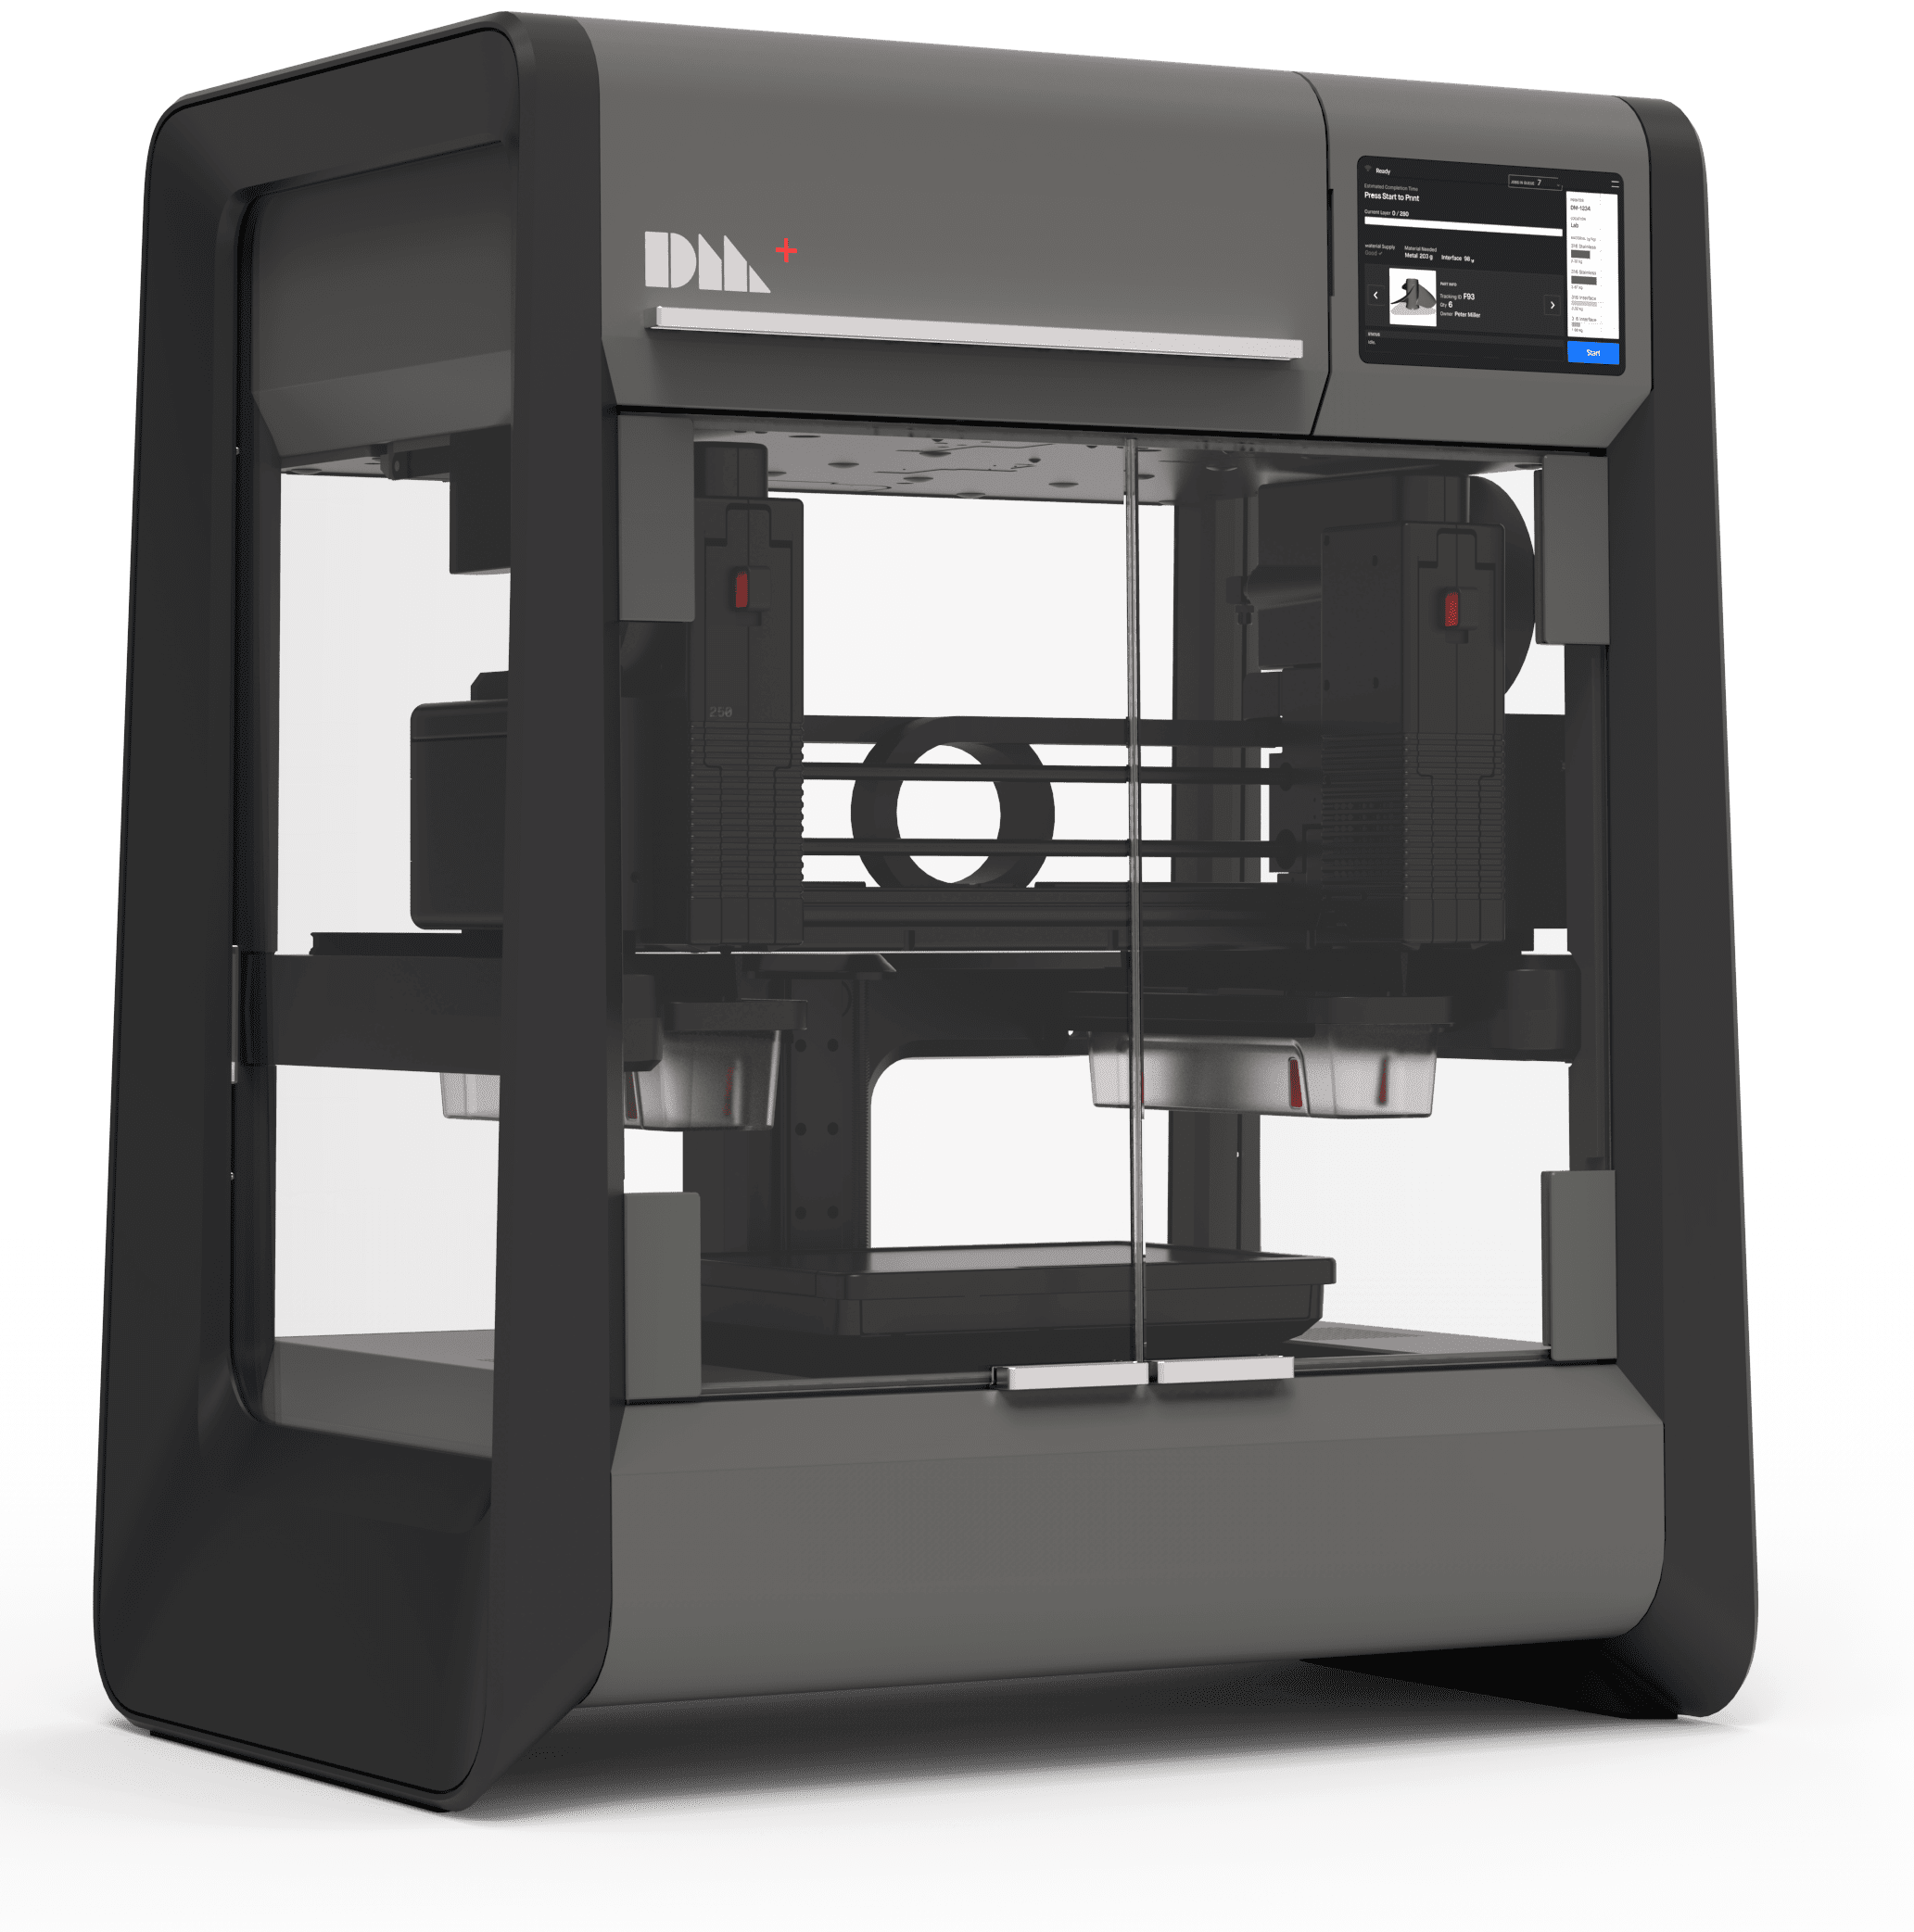
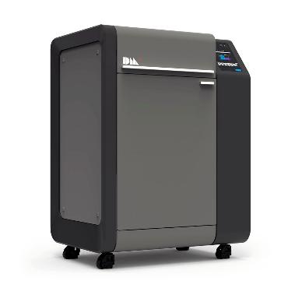
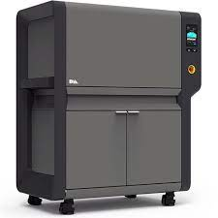
Design and Drafting Group
additive manufacturing facility – Desktop metal
*Note this process requires longer lead times than our plastic offerings. Targeting ~2 weeks.
STUDIO SYSTEM
The Studio System™ printer uses a process called Bound Metal Deposition™, or BMD™.
BMD™ is similar to Fused Filament Fabrication, FFF.
Instead of filament, the Studio System™ uses bound metal rods—metal powder held together by a wax and polymer binder.
The build volume is 300 x 200 x 200 mm (12 x 8 x 8 in).
Due to part shrinkage during sintering the parts are limited to a final size of 240 x 150 x 155 mm (9.4 x 6.0 x 6.0 in).
Desktop Metal Resources Link (BOX)
FURNACE (SINTER)
The green part (v.2 materials) or brown part (v.1 materials) is placed into the furnace where it is heated to temperatures near melting—removing any remaining binder and causing the metal particles to fuse together as the part is sintered.
This step necessitates design considerations unique to BMD™ because sintering has implications for part features, build orientation, and support structures.
DEBINDER (V.1 MATERIALS ONLY)
The green part is then placed into the debinder where it is immersed in proprietary debind fluid, dissolving primary binder and creating an open-pore channel structure to prepare the part for sintering.
Once the debind cycle is complete the part is referred to as a “brown” part.
BMD Design Guide (BOX)

Slide 10
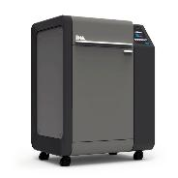
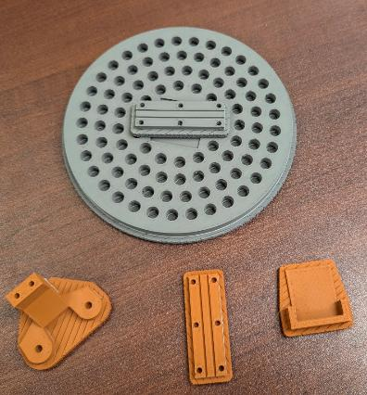
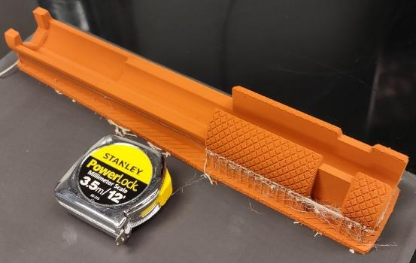
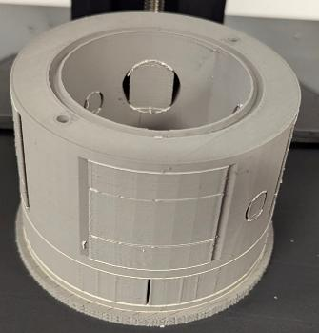
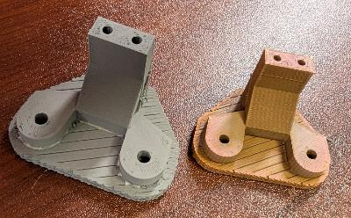
Design and Drafting Group
Desktop metal printing
Copper, 316L SST, 17-4PH SST
  Coming Soon Ti64, Nickel Alloy IN625 - Furnace Upgrade required.
It’s a three-step process to create the final parts.
  Studio System Printer creates the green part.
  Batch Debinding process to remove internal binder. (V1 Material)
  Batch Furnace process to sinter the final part.
    Live Studio calculates an average shrinkage near 20%
Average processing time is 10-14 days.
Desktop Metal Resources Link (BOX)
BMD Design Guide (BOX)
Copper
316L SST
Shrinkage Example
Part Examples

Slide 11
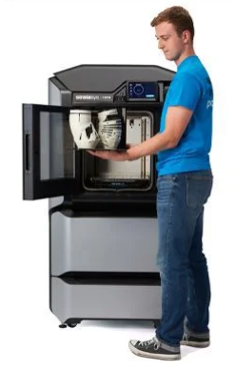
Why are we planning this??
Design and Drafting Group
Satellite AM facility – Timeframe tbd – budget hold
Other facilities offer user accessible Additive Manufacturing (3D Printing). We would like to offer a similar opportunity to our scientific community. Through this initiative, we will enhance the visibility and capabilities of Additive Manufacturing at APS, while maintaining ongoing support for users.
Where are we doing this??
When the time is closer an analysis will be completed to determine the least disruptive choice with the fewest users affected. Our goal is to not leave any user without a location to continue their work.
How are we implementing this??
AES will remove the existing equipment and implement any infrastructure changes.
AES will purchase the equipment, provide installation, training, maintenance and supplies.
Satellite shops will be accessed using Streamline software to upload and submit jobs.
Our initial offering to the community will be the Stratasys F170 FDM printer. This is a robust industrial grade printer to provide reliable constant printing to the community
  Build area of 254 x 254 x 254 mm (10 x 10 x 10 in.)
  Single material with separate support.

Slide 12
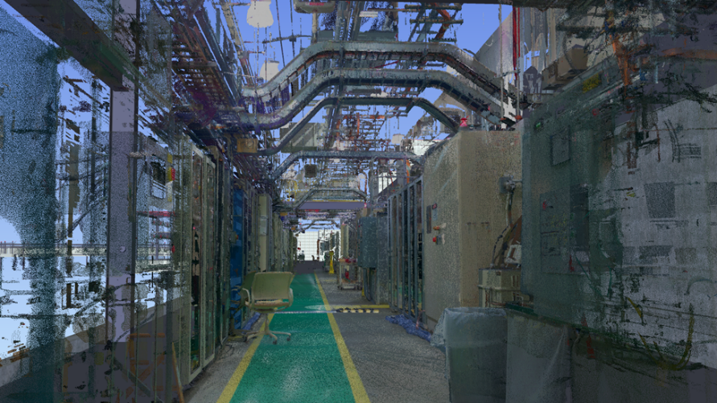
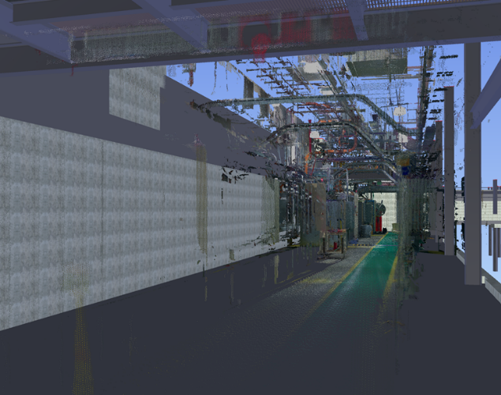
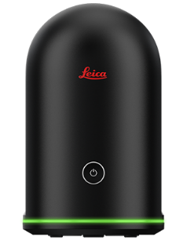
Design and Drafting Group
Reverse engineering – blk360
Over the past few years, the lack of as-built layouts for the infrastructure of the APS has become apparent. The solution has been the addition of BLK360 Laser Scanners which provide architectural grade scans. The point clouds are then processed using Leica CloudWorx, allowing us to create CAD layouts. This has provided a method to process large areas of critical as-built equipment and building locations efficiently.
Leica BLK360
Facility Scans Utilized for As-Built Conditions

Slide 13
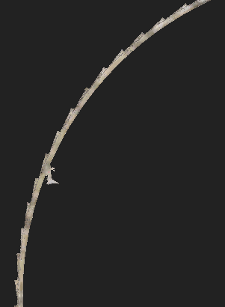
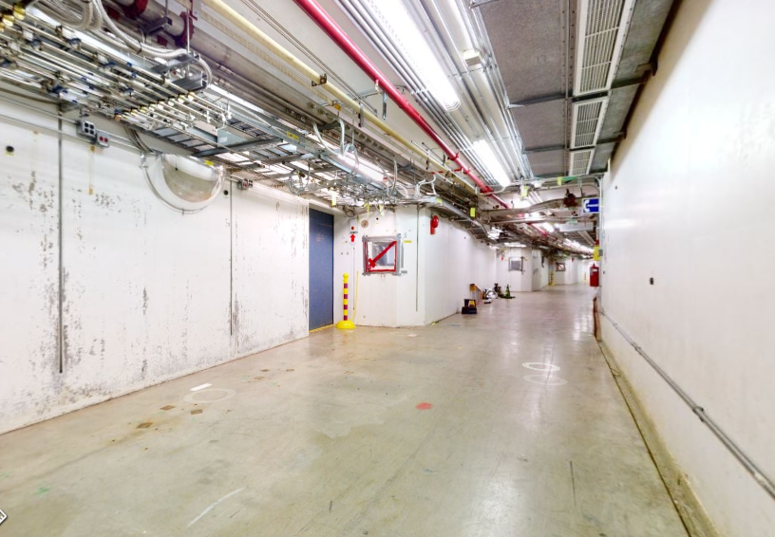
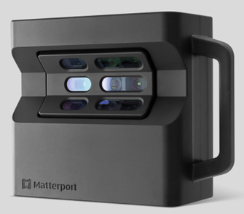
Design and Drafting Group
Digital twin - matterport
The largest time-consuming part of scanning large area is registering the data sets. This has been streamlined for our Digital Twin Process in the use of Matterport. This is a cloud-based service that takes the scans provided and stitches them together into a full Digital Twin environment automatically.
MatterPort Pro2
Empty Tunnel Scan During Upgrade

Slide 14
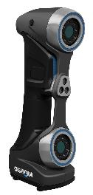
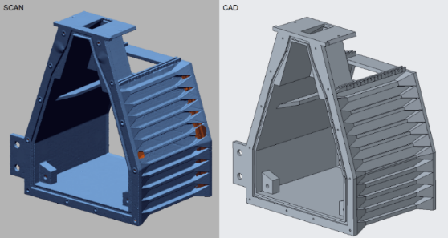
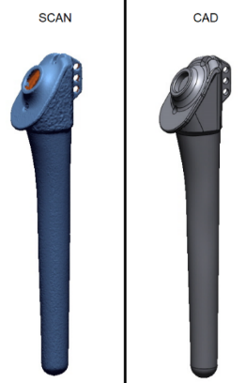
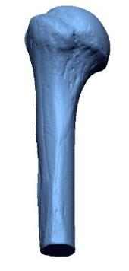
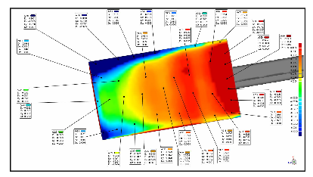
Design and Drafting Group
Reverse engineering – Handyscan 700
Handyscan 700 is a metrology grade small area scanner which enables the reverse engineering of components created by outside vendors, other facilities, or simply have been lost over time. It expedites the capturing of physical geometry and the conversion to a CAD model.
Geomagic Design X – Reverse engineering
  A software that aids in the reverse engineering process by which scan data is used to recreate 3D models.
Geomagic Control – Quality Control / Part Inspection
  A software that provides the ability to compare scan data of physical objects to their native manufacturing CAD file.
Analysis
  Scan data can be used in analysis software to test and study as-built part performance.
Reference
  For checking fits when working around existing geometries and structures.
  An efficient way to build a library of as-builts.

Slide 15
Design and Drafting Group
Cad helpdesk
Provide one-on-one support for users having issues with CAD Applications.
  Creo
  AutoCAD
  Windchill
  Vault
  Drawing Release Workflows
Available resources for knowledge acquisition.
  Knowledge base articles to capture common issues.
  Searchable for users to solve common issues.
  Monthly CAD sessions sharing lessons learned.
    Third Wednesday Each Month from 8:30 to 9:30
Ticketing system used to track quantity of support provided to CAD Users.
  This system also provides another resource to document odd issues.
Knowledge Base Home Page

Slide 16
Design and Drafting Group
Vector ticket support links
Item | Description
APS - Design and Drafting 3D Scanning & Quality Assurance Request | 3D Scanning for Reverse Engineering of Existing Installations / Manufactured Components for Quality Control / 3D Imaging of Installations for Virtual Tours
APS - Design and Drafting CAD Software Installation Request | Request for installation of Computer Aided Design (CAD) Software and related applications.
APS - Design and Drafting CAD Troubleshooting | Help requests directly related to Computer Aided Design (CAD) Software and related applications.
APS - Design and Drafting Effort Request | Request for Operational Support in developing engineering designs for fabrication.
APS - Design and Drafting Poster Request | Request for large format prints to use in presentations and conferences.
APS - Design and Drafting Prototyping Request | Request for Additive Manufacturing of Prototypes and Experimental Components.

