Slide 1
Direct-detection Imaging via BrillianSe: DFXM for Weak Scattering and Fast Imaging
Elliot Kisiel^{1,2} , Ishwor Poudyal^{2,3}, Fanny Rodolakis², Pavel Salev¹, Alex Frano¹, Zahir Islam²
¹University of California, San Diego – Department of Physics,
²XSD – Argonne National Lab,
³MSD – Argonne National Lab

Slide 2
Motivation
Motivating question: What effects do structural heterogeneities have on thin film transition metal oxide phase formation?
Imaging LSMO and VO₂ neuromorphic devices to understand structural precursors to device switching for more efficient devices.
Understanding phase separation and nucleation in transition metal oxide systems.
Elucidating structural transitions and damage sinks in He+ irradiated samples.

Slide 3
Objectives and Overview
Goal: Extend DFXM technique to low dimensional systems to further extend capabilities to low scattering systems.
Imaging various types of thin films under different conditions to provide ground work for low-intensity scattering systems.
Sub micron polycrystalline grains, single crystal thin films, CDW/CO, magnetic domains.
Improving the overall capabilities to include low-intensity systems and decrease exposure and collection times in these systems.

Slide 4
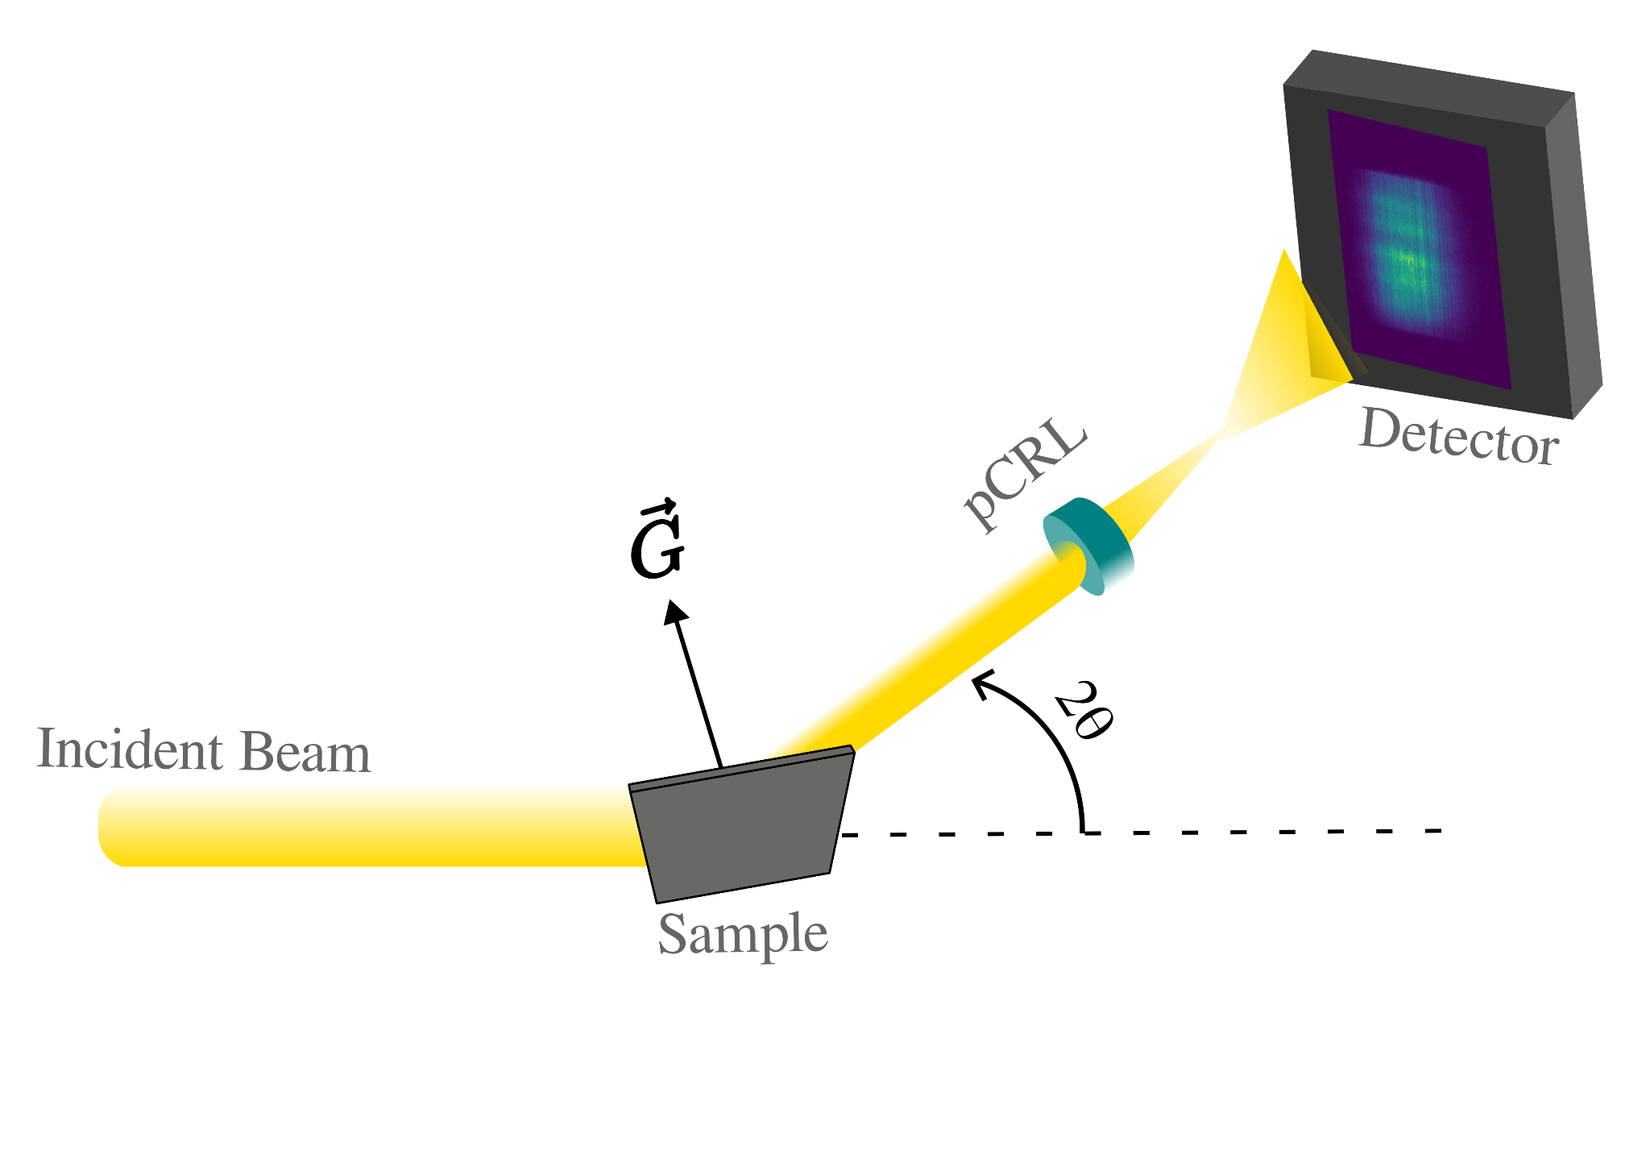
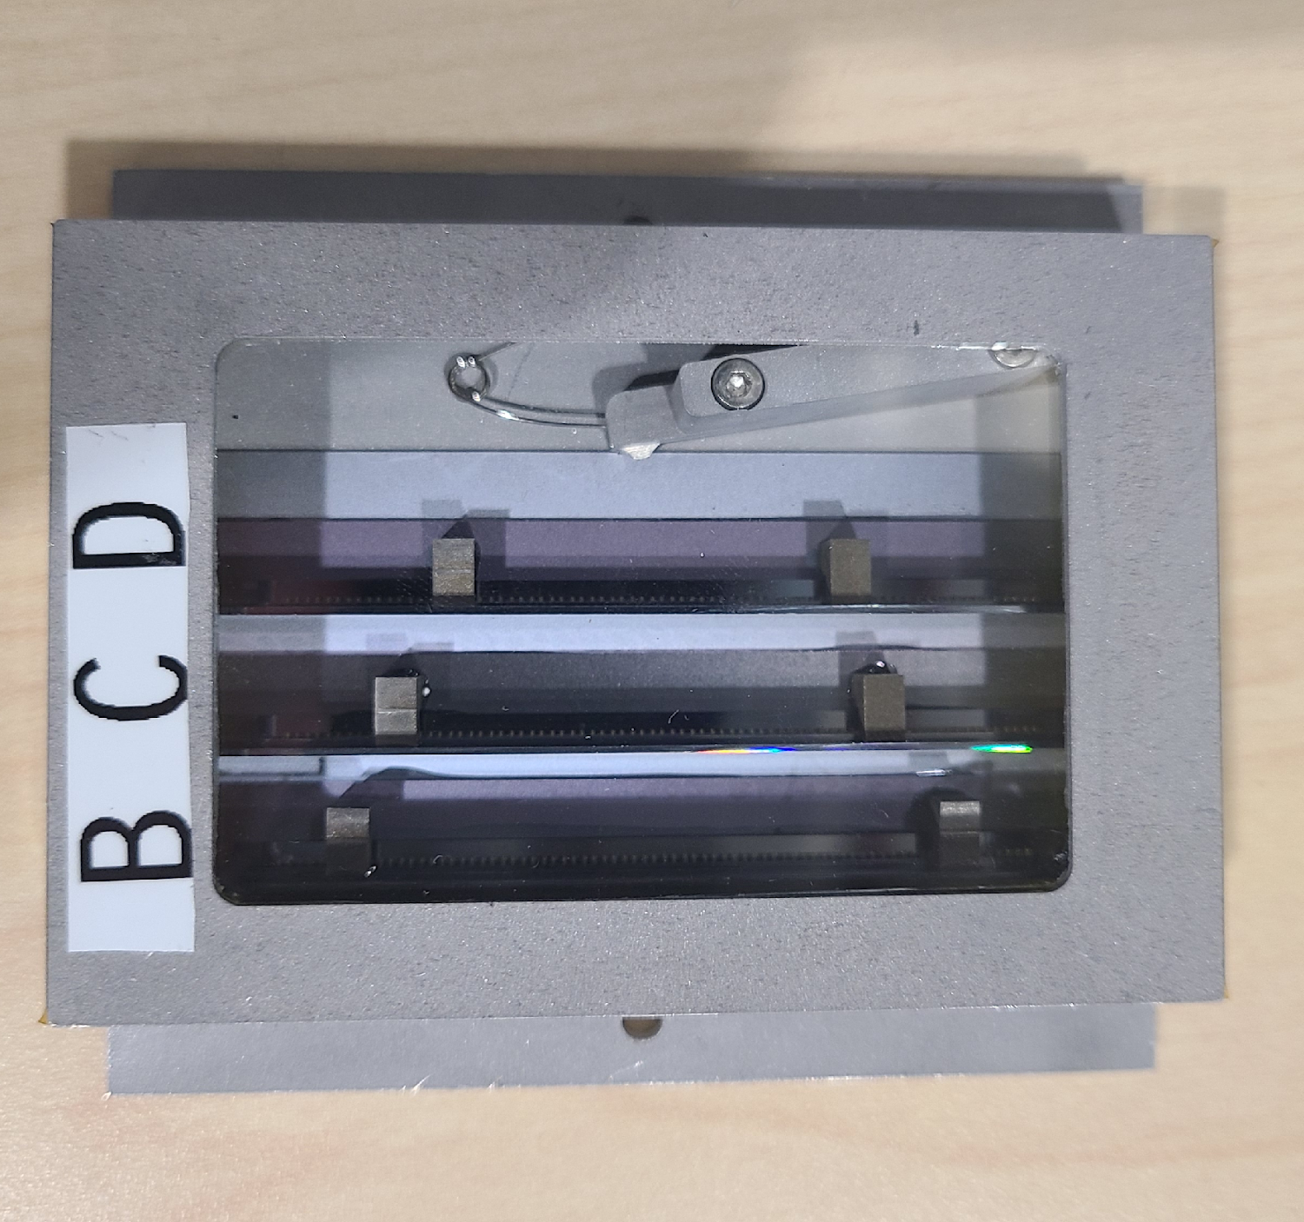
Introduction
High resolution, full field structural microscopy technique for studying samples at the mesoscopic scale.
Utilization of a high efficiency focusing optic in the diffracted beam path provides a spatial mapping of diffracted grains.
Improvements of x-ray optics in the form of polymeric CRLs allow for large numerical aperture, high efficiency, and large magnification.
Ability to manufacture 1D lenses for condenser line focusing to maintain large FOV.
Work done on characterizing lenses performed by Zahir Islam and Zhi Qiao
Poulsen, Henning "Multi scale hard x-ray microscopy." Current Opinion in Solid State and Materials Science 24.2 (2020): 100820.
Notes:
The coarse scale mapping of the grains could be done using 3DXRD or DCT. This helps in identifying small-scale elements of interest such as grains or domains and DFXM can zoom in on these elements and record the magnified image.
X-ray diffraction tomography (DCT) are now capable of mapping of up to 20,000 grains in a sample but are limited by the detector to a spatial resolution of ~1um.

Slide 5
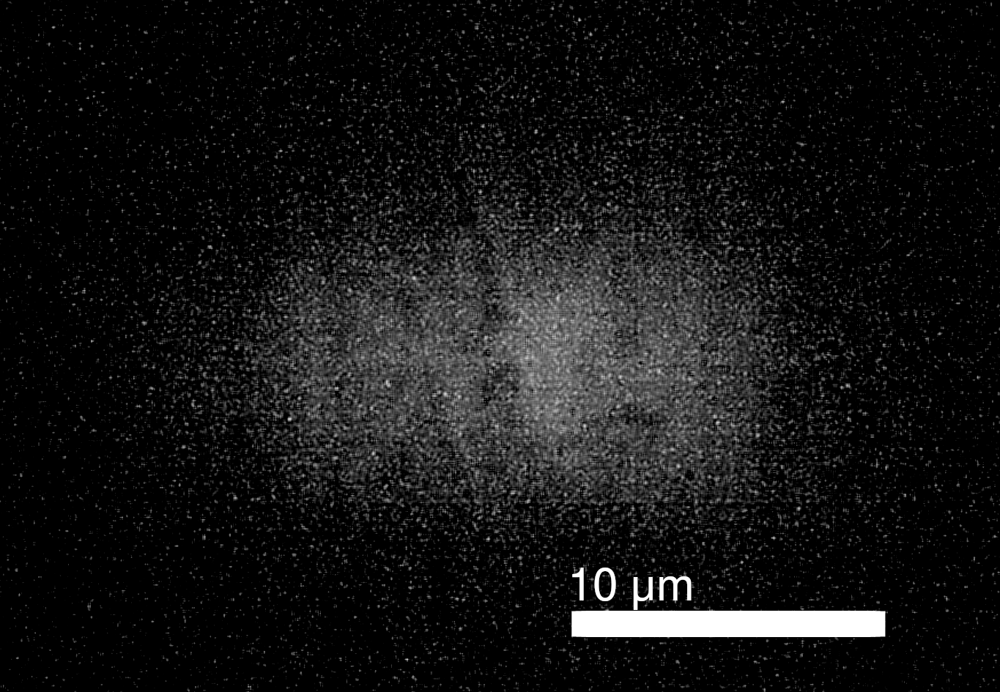
Complications
100 nm thin film VO₂ room temperature measurements.
30 second exposures have a barely discernible signal. (Faster times will decrease signal.
Low contrast making it impossible to make out features (signal ~2% greater than background.
Low scattering volume →low signal
Where can we improve our system to increase our signal?
Notes:
The coarse scale mapping of the grains could be done using 3DXRD or DCT. This helps in identifying small-scale elements of interest such as grains or domains and DFXM can zoom in on these elements and record the magnified image.
X-ray diffraction tomography (DCT) are now capable of mapping of up to 20,000 grains in a sample but are limited by the detector to a spatial resolution of ~1um.

Slide 6
Approach
Higher efficiency detector
Direct detection
Beam improvements
Condenser
APS+U
Sample improvements
Higher Z
Thicker films

Slide 7
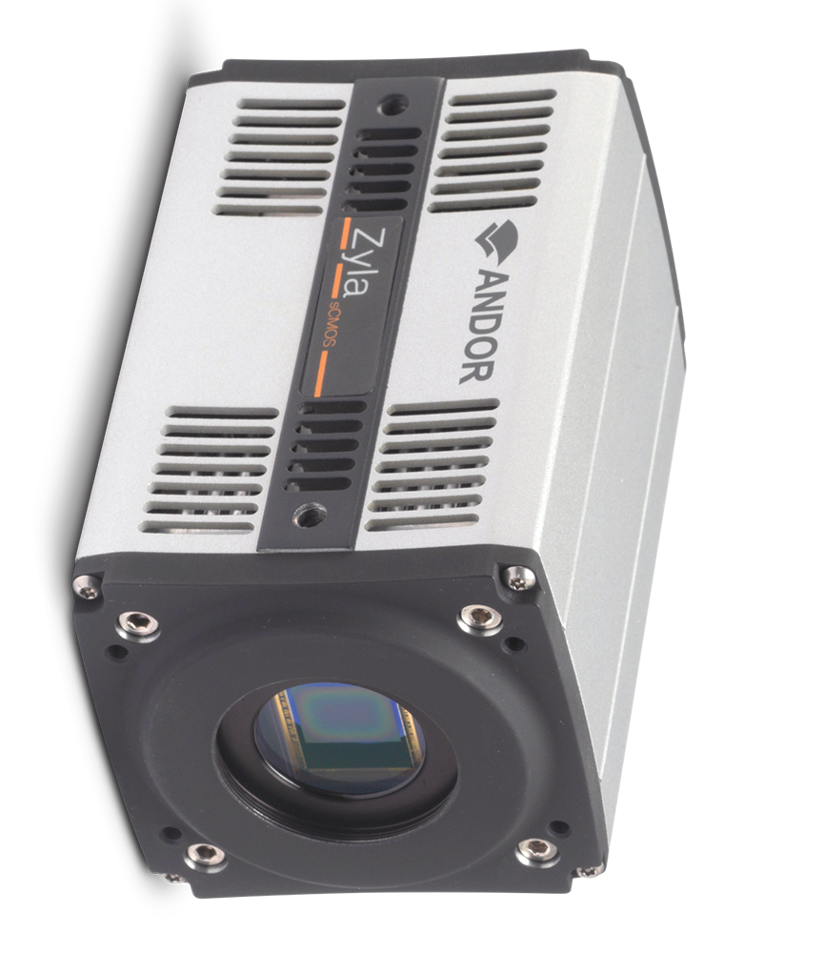
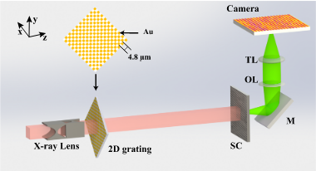
Current Systems
6.5 μm pixel pitch optical camera with a 5x optical magnification after optical conversion.
Necessitates the use of a scintillator for x-ray to optical light conversion (1-2 OOM loss).
Fast (100 fps) collection times, with the ability to expose for up to 30 s and down to sub millisecond exposures.
Z. Qiao et al. Rev. Sci. Inst. (2020)
Notes:
The coarse scale mapping of the grains could be done using 3DXRD or DCT. This helps in identifying small-scale elements of interest such as grains or domains and DFXM can zoom in on these elements and record the magnified image.
X-ray diffraction tomography (DCT) are now capable of mapping of up to 20,000 grains in a sample but are limited by the detector to a spatial resolution of ~1um.

Slide 8
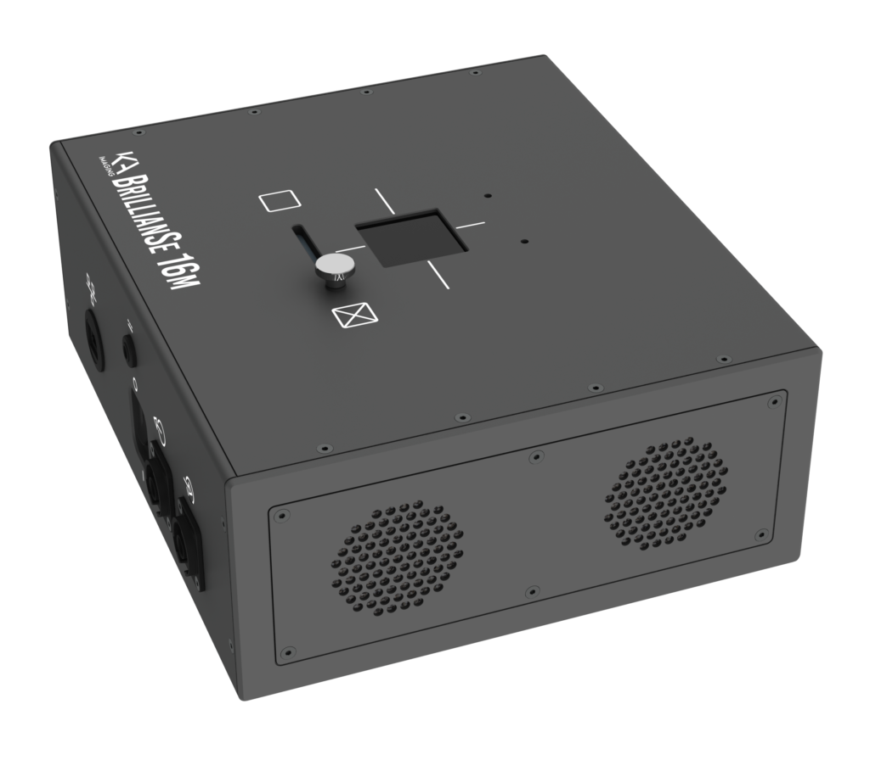
Improvements
8 μm pixel pitch direct detection camera making use of amorphous Se as the photoconductor.
Fastest frame rate of 2 Hz.
Operating energy range 13 keV to 130 keV
90% efficient at 20 keV to 3% at 100 keV.
Large detector area (4K) 32.8x32.8 mm².
71.8 dB dynamic range.
Notes:
The coarse scale mapping of the grains could be done using 3DXRD or DCT. This helps in identifying small-scale elements of interest such as grains or domains and DFXM can zoom in on these elements and record the magnified image.
X-ray diffraction tomography (DCT) are now capable of mapping of up to 20,000 grains in a sample but are limited by the detector to a spatial resolution of ~1um.

Slide 9
Improvements
Temperature range of 10 - 30 ℃.
Cannot be used in vacuum.
10 min stabilization of high voltage before data collection.
Gain, offset, bad-pixel corrections, and flat field correction implemented within vendor software.
EPICs support implemented and operational.
Notes:
The coarse scale mapping of the grains could be done using 3DXRD or DCT. This helps in identifying small-scale elements of interest such as grains or domains and DFXM can zoom in on these elements and record the magnified image.
X-ray diffraction tomography (DCT) are now capable of mapping of up to 20,000 grains in a sample but are limited by the detector to a spatial resolution of ~1um.

Slide 10
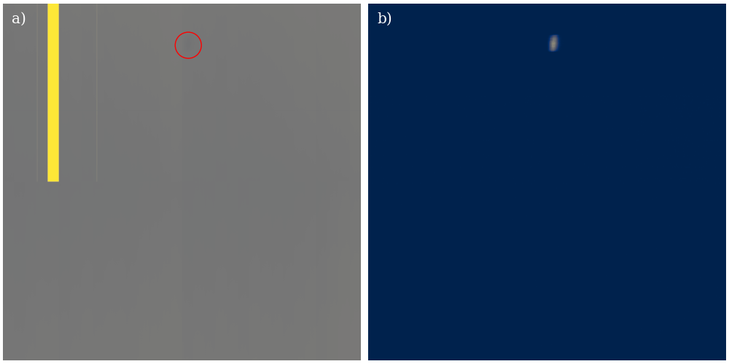

Slide 11
Comparison Metrics
Exposure time
Matching background to peak signal ratio in both optical and direct detection
Resolution
Transition broadening between dark and bright fringes.
Feature comparison
He+ ion damaged YBCO/CeO₂ sample provides large enough features.
Notes:
The coarse scale mapping of the grains could be done using 3DXRD or DCT. This helps in identifying small-scale elements of interest such as grains or domains and DFXM can zoom in on these elements and record the magnified image.
X-ray diffraction tomography (DCT) are now capable of mapping of up to 20,000 grains in a sample but are limited by the detector to a spatial resolution of ~1um.

Slide 12
Comparison Sample
10 μm
10 μm
10 μm
He+ ion damaged CeO₂/YBCO thin films
40 nm thick double film layers.
Optical images shown above of different ion fluences (low → high fluence)

Slide 13
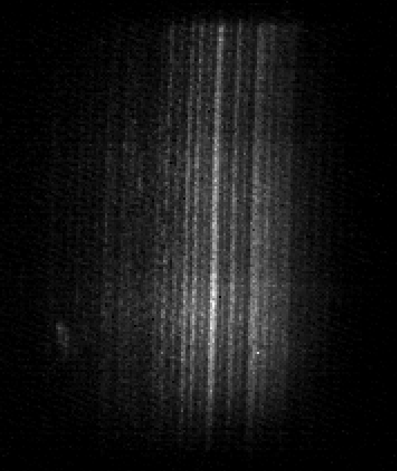
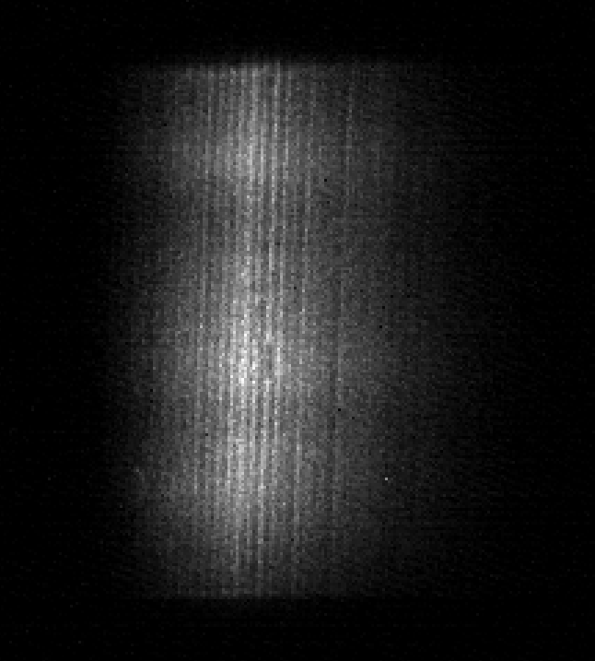
Direct Detection Images
10 μm
10 μm
Bottom YBCO, right CeO2
He+ ion damaged CeO₂/YBCO thin films
2x10¹⁵ ion/cm^2 sample used for comparison.
10 μm
10 μm
Notes:
The coarse scale mapping of the grains could be done using 3DXRD or DCT. This helps in identifying small-scale elements of interest such as grains or domains and DFXM can zoom in on these elements and record the magnified image.
X-ray diffraction tomography (DCT) are now capable of mapping of up to 20,000 grains in a sample but are limited by the detector to a spatial resolution of ~1um.

Slide 14
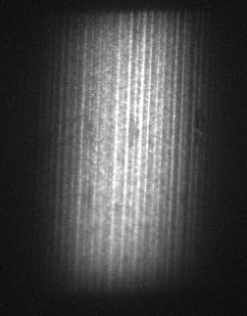
Exposure Times
Left BrillianSe, right Zyla (006) YBCO peak.
Same peak to background ratio with condenser in.
100 ms exposure vs 10 s exposure
Blurring in Zyla leads to comparable resolution in BrillianSe.
BrillianSe
Zyla + scintillator
Notes:
The coarse scale mapping of the grains could be done using 3DXRD or DCT. This helps in identifying small-scale elements of interest such as grains or domains and DFXM can zoom in on these elements and record the magnified image.
X-ray diffraction tomography (DCT) are now capable of mapping of up to 20,000 grains in a sample but are limited by the detector to a spatial resolution of ~1um.

Slide 15
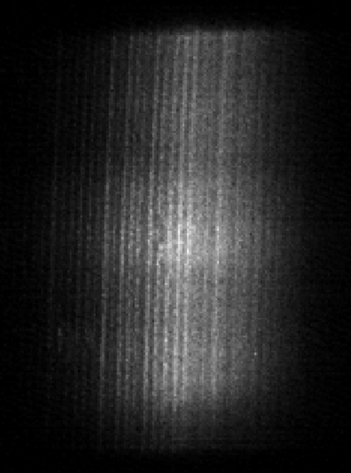
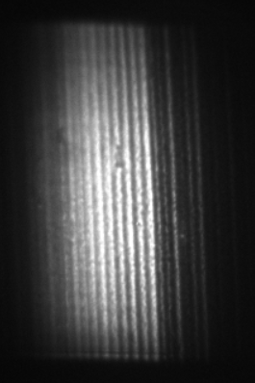
Exposure Times
Left BrillianSe, right Zyla (002) CeO₂.
Same peak to background ratio with condenser in.
10 ms exposure vs 1 s exposure
BrillianSe
Zyla + scintillator
Notes:
The coarse scale mapping of the grains could be done using 3DXRD or DCT. This helps in identifying small-scale elements of interest such as grains or domains and DFXM can zoom in on these elements and record the magnified image.
X-ray diffraction tomography (DCT) are now capable of mapping of up to 20,000 grains in a sample but are limited by the detector to a spatial resolution of ~1um.

Slide 16
Exposure Times
BrillianSe achieve ~100-fold improvement in exposure time for comparable signals.
Verified across two different intensity peaks and across rocking curve.
Lower collection times enables vibrational correction algorithms (optical flow, image registration etc.).
Enabling of observation of faster dynamics in low intensity scattering.
Notes:
The coarse scale mapping of the grains could be done using 3DXRD or DCT. This helps in identifying small-scale elements of interest such as grains or domains and DFXM can zoom in on these elements and record the magnified image.
X-ray diffraction tomography (DCT) are now capable of mapping of up to 20,000 grains in a sample but are limited by the detector to a spatial resolution of ~1um.

Slide 17
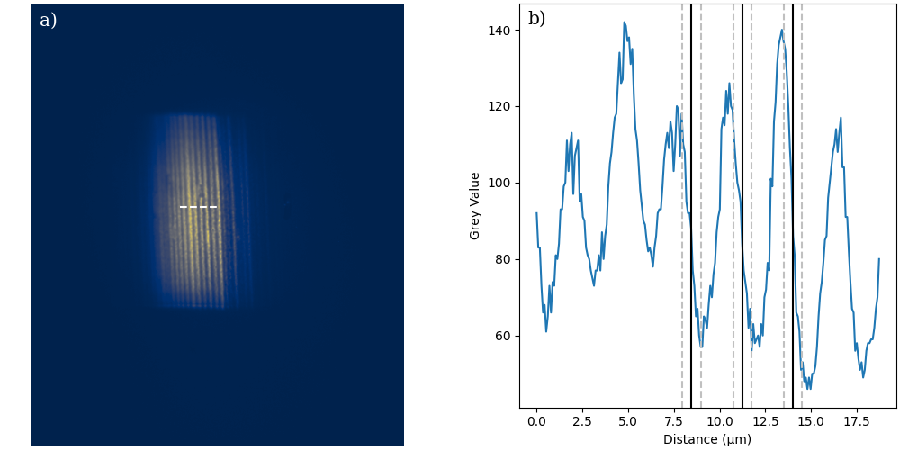
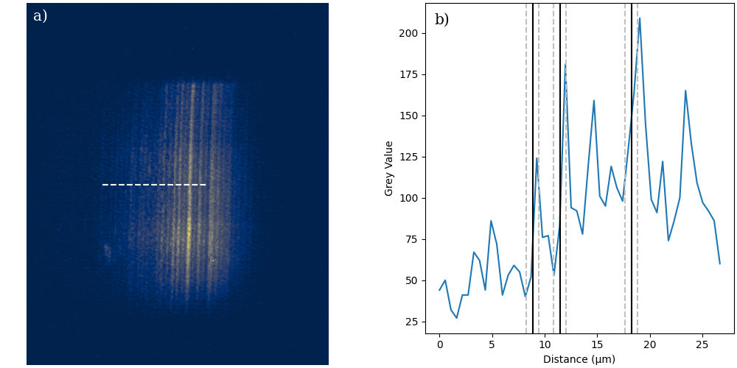
Resolution
Traditional spatial resolution of a CCD is determined as the smallest distance that can be resolved from a step function
To determine effective spatial resolution, we require an edge that transition from high intensity to low intensity.
The lines from this sample are roughly 2 - 2.5 microns wide and give us a high and low intensity next to one another.

Slide 18
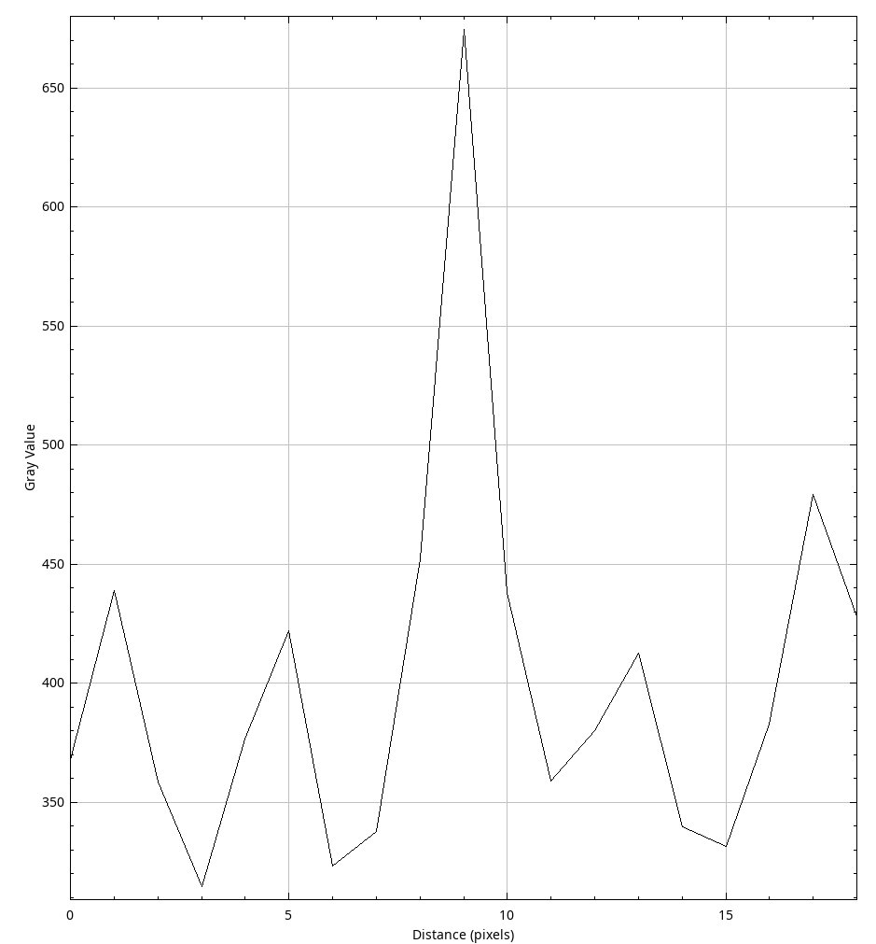
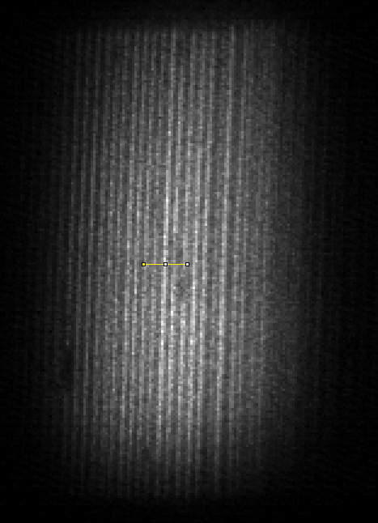
Resolution
Resolution measured along rising/falling edge.
BrillianSe resolution of 2 pixels (1 μm).
Zyla resolution of 10 pixels (700-800 nm).
10 μm
Notes:
The coarse scale mapping of the grains could be done using 3DXRD or DCT. This helps in identifying small-scale elements of interest such as grains or domains and DFXM can zoom in on these elements and record the magnified image.
X-ray diffraction tomography (DCT) are now capable of mapping of up to 20,000 grains in a sample but are limited by the detector to a spatial resolution of ~1um.

Slide 19
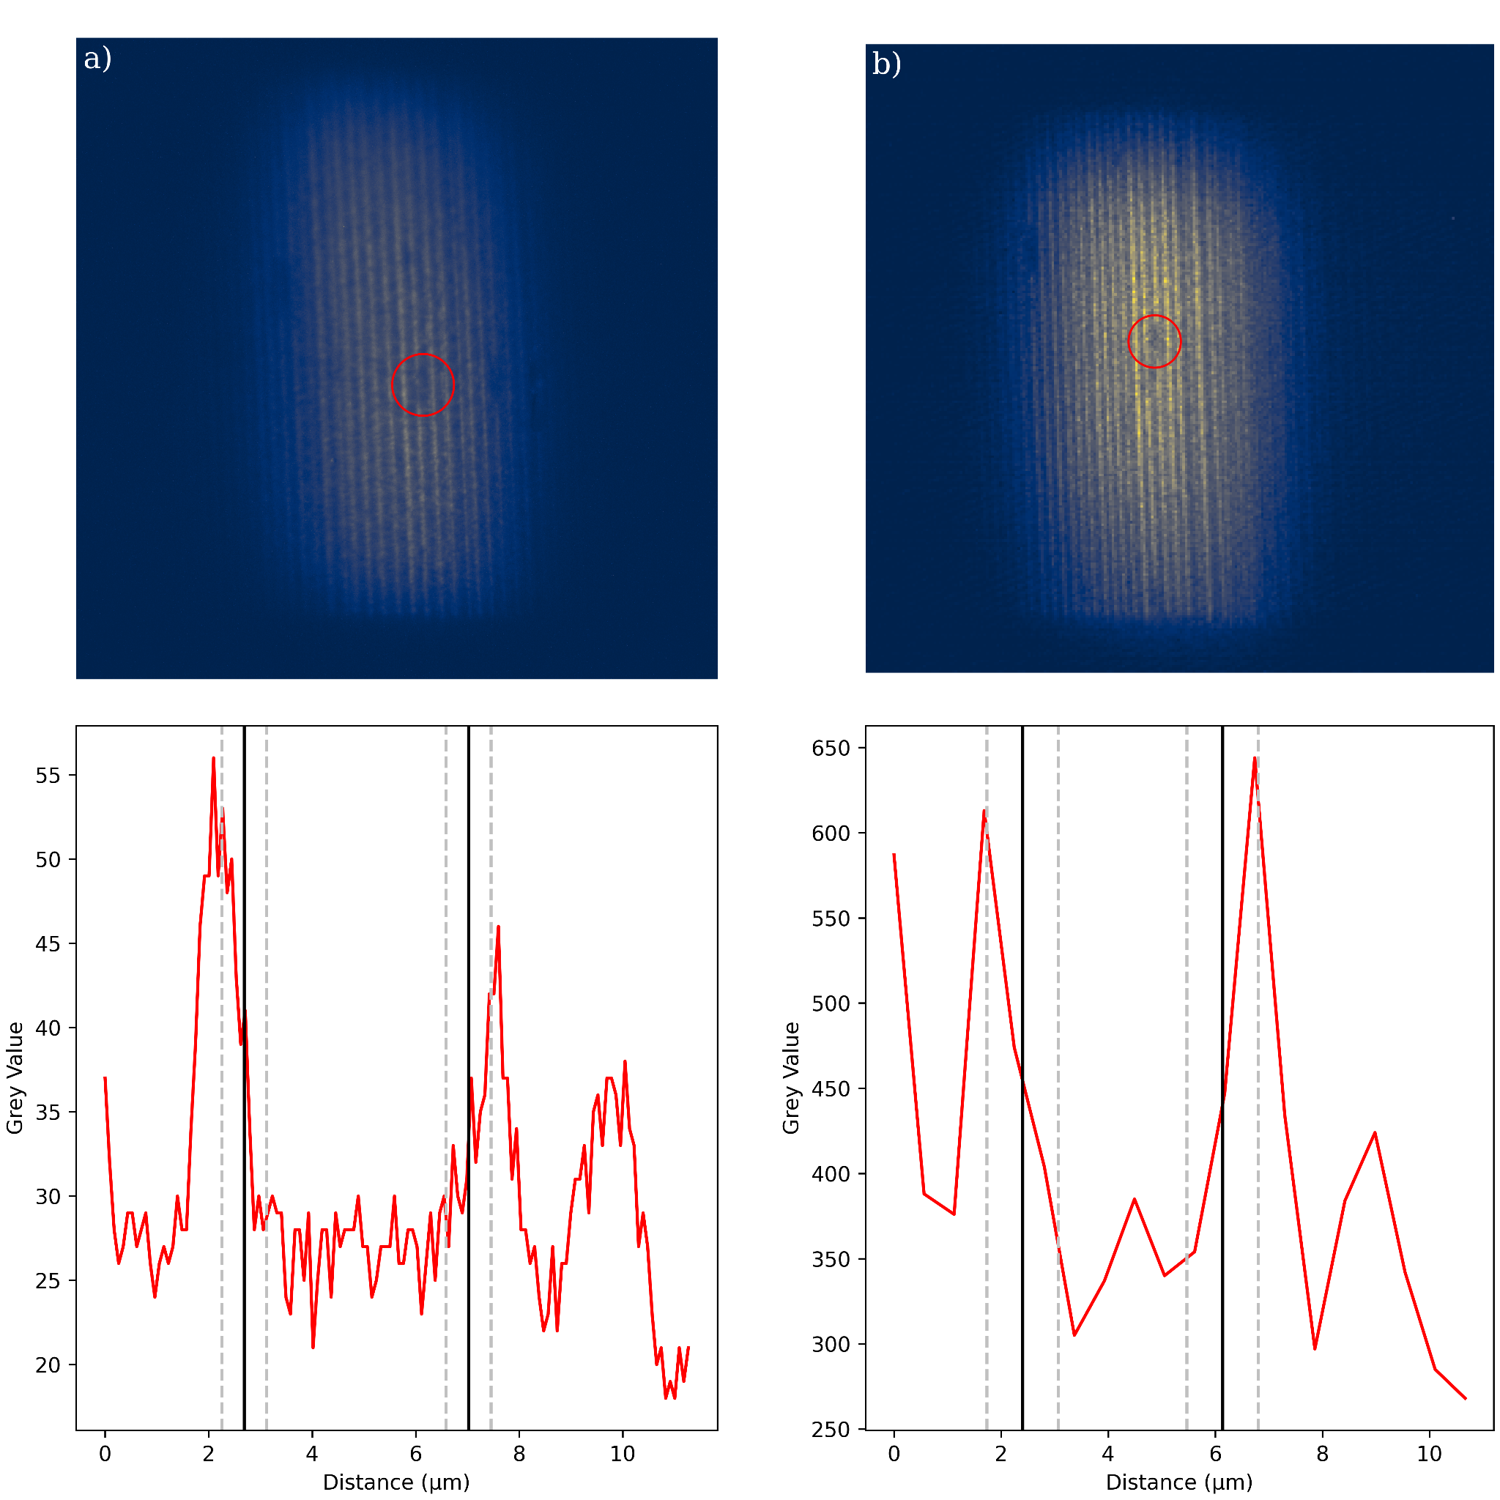
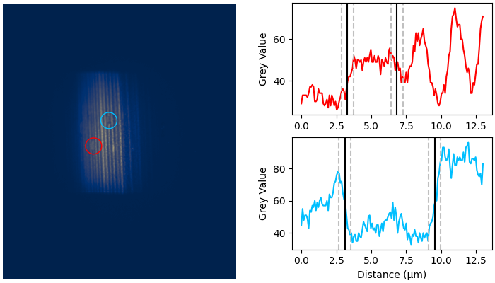
Defects and Features
We can also look at defect to also gain an insight into resolution.
Using a He+ damaged sample, we can identify these features for use in resolution and further investigation.
4 μm x 11 μm sized features detectable

Slide 20
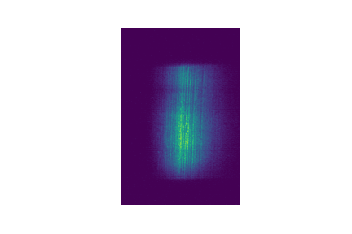
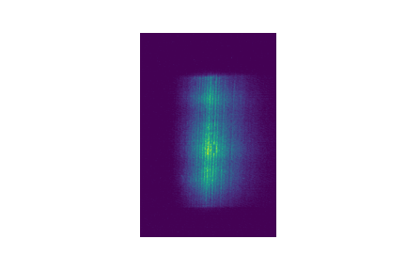
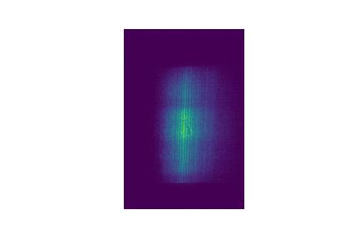
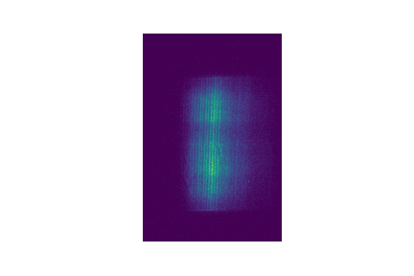
Considerations
Beam fluctuations on the 10 ms time scale cause varying illumination at the sample.
Notes:
The coarse scale mapping of the grains could be done using 3DXRD or DCT. This helps in identifying small-scale elements of interest such as grains or domains and DFXM can zoom in on these elements and record the magnified image.
X-ray diffraction tomography (DCT) are now capable of mapping of up to 20,000 grains in a sample but are limited by the detector to a spatial resolution of ~1um.

Slide 21
Conclusions
Small pixel, high efficiency direct detection opens up capabilities to low signals and faster collection times.
Large operating energy ranges allow for applications to various beamlines.
Shines in low intensity scattering, fast collection times and situations requiring higher resolution.
Preliminary test show significant improvements in comparison to current scintillation based detection methods.
Further developments and implementations will lead to better understanding of the uses and improvements.

Slide 22
Thank you.
Questions?
Notes:
The coarse scale mapping of the grains could be done using 3DXRD or DCT. This helps in identifying small-scale elements of interest such as grains or domains and DFXM can zoom in on these elements and record the magnified image.
X-ray diffraction tomography (DCT) are now capable of mapping of up to 20,000 grains in a sample but are limited by the detector to a spatial resolution of ~1um.

