Slide 1
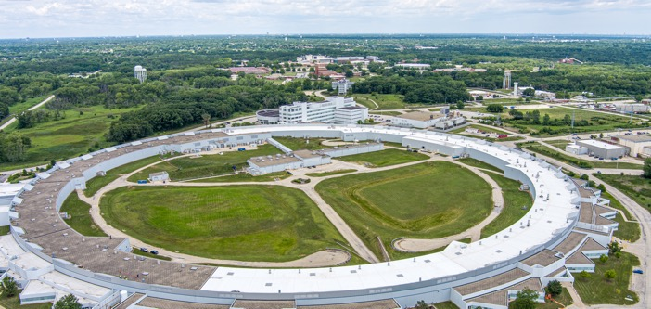
RI Cryopump
TWG-Meeting 2022
David Cyl
^{th} September 2022

Slide 2
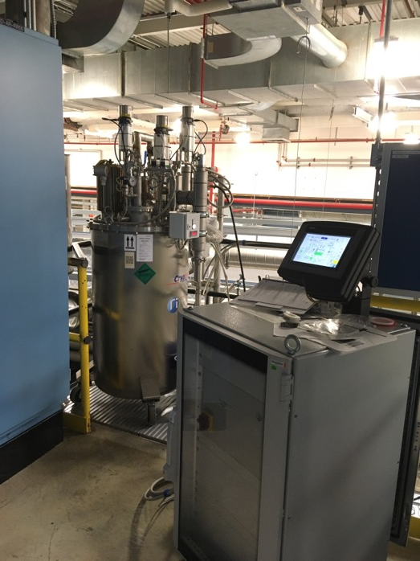
Some History
I have been supporting this type of cryopump since Jan 2018. Support includes hardware and software (ioc).
I am not an expert, but I have learned a few things and gathered a bit of knowledge and would like to add this with the pool of knowledge we already have in the community.
System has been reliable and stable from the start with no loss of experiment time related to cryopump problems.

Slide 3
Shameless Plug for WIKI
I have stood up a wiki for all of us to use to have a one place to go for our shared knowledge.
The site is divided into RI documentation and knowledge and beamline specific knowledge.
There is a spread in hardware/software versions across the site so some information may not apply to all beamlines.
Tried to make it as platform independent as possible by providing links to files on Box reducing the “stale link” condition.

Slide 4
Areas to pay attention to with the RI cryopump
Closed Loop environment
Power considerations.
Valve problems
EPS integration
The Touch Panel Issues
Network variations

Slide 5
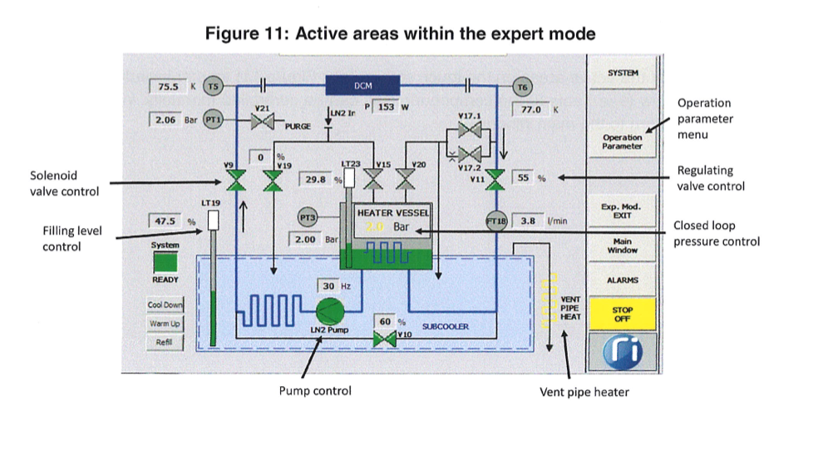
Pump diagram

Slide 6
Closed Loop
In order to maintain a closed loop the system monitors the following parameters, if any of these are not met it will assume the system is not ready.
V9 open(LN2 supply),V11(LN2 Return) >=30%,LN2 Pump on, Heater Ctl on, T6 (Temp after mono) HL not reached, PT3 (Closed loop pressure) Marker reached, No LT23 (Heater Vessel LN2 level) fault, No LT23(Upper and lower LN2 levels) Alarm.
The following will cause the system to vent via the stop-off mode
CC Enable (from EPS) not true >= 2 seconds
Air pressure fault for >= 2 seconds
LT23 (Heater vessel LN2 level) fault >= 2 seconds

Slide 7
Power
Power-the system operates on 208Volt line typically fed by the emergency power panels (ERP-XYZ).
During the switch tests the 10 second switch over time from regular to emergency is well within the 2 min power-off spec. However.
We have lost 2 touch panel units during the switch-over (33id and 3id).
I would recommend disconnecting the touchpanel during the switch-over to prevent the damage we have seen in the past.

Slide 8
Valve Leaks
Seems to only happen on the older gen pumps with the older solenoid valves.
Seen after a warmup/cooldown cycle during the pressure test step.
The valve V17.1 leaked.
Evidence of crud on the seat of the valve.
The only fix was to replace the valves. Not even possible to replace plunger seat of valve.
Need to keep spares.

Slide 9
EPS
EPS signals and jump-out option.
There are 4 outputs and 2 inputs available, at 33idd we only use CC Ready output and CC enable input which seems typical.
Outputs – CC Ready, No CC Alarm,LT19 No HL,LT19 No LL.
Inputs – CC Enable, UPS Power ok
Want to warm up the mono but keep the cryopump in local-loop mode so heater vessel and sub-cooler are still full. An EPS signal fault will cause it to go into stop-off and vent the system so we added a jumper option to bypass the EPS signal.

Slide 10
Touch Panel
This is an industrial Windows CE machine used to provide status and interact with the cryopump.
The system will operate without it but you will not be able to change the state of the pump.
You can vnc into this device but the session cannot be left to time-out, you must actively disconnect otherwise the vnc service will need to be restarted.
There are tools available to communicate with this device via the network to save/restore boot images.
The images are hardware specific and sometimes pump specific so recommend backing up your TouchPanel image wherever possible.
We have lost two, sector 33id and 3id and each seems to be related to the power-switch over from emergency to regular power.

Slide 11
Network changes
Older version had two dedicated IP’s one for the touch panel the other for the PLC. This required the PLC and TouchPanel be configured for these IP addresses.
Newer version now included a router and uses only one IP address and the TouchPanel and PLC use a fixed local IP address.
Router redirects port 5900 to TouchPanel and port 2001 to PLC.
Suggest you take an image of the router for recovery.

Slide 12
Lessons learned
We need spares of high impact parts and maybe others.
We need an epics service that can control the system as well as read the parameters. This will reduce the urgency of touchpanel failures.
It would be nice to have a maintenance team to perform regular maintenance to prepare for system aging and maintenance cycles.
A repository of beamline images, touch panel, router plc.
One complete spare system including the control cabinet would help a lot.

Slide 13
RI Cryopump WIKI
A place to pool our experiences and ideas.
A place to list which and who has spare parts.
A single one-stop place to look first.
https://wiki.anl.gov/cryopump/Main_Page
This should be open to all of us to edit as needed.

Slide 14
Thanks to …
Jiyong Zhao
Zhan Zhang
Erika Benda
Mary Westbrook
Kurt Goetze
Emily Aran
Haiko Wilhelm (RI)
Barbara Lavina

