Slide 1
Experience of using the RI cryocooler and collaborative efforts of the APS beamlines towards the APSU
erhtjhtyhy
Jiyong Zhao (Inelastic X-ray & Nuclear Resonant Scattering group)
David Cyl (Surface Scattering and Microdiffraction group)
TWG monthly meeting Sept 15th, 2022

Slide 2
Experience and effort forward
- from a user point of view
Experience of using the cryo cooled HHLM
Incidents associated with the cryo-cooler and lesson learned
3. HHLM around the APS
4. Collaborative efforts moving forward (shared with David Cyl)

Slide 3
Experience and effort forward
- from a user point of view
professional user
Experience of using the cryo cooled HHLM
Incidents associated with the cryo-cooler and lesson learned
3. HHLM around the APS
4. Collaborative efforts moving forward (shared with David Cyl)

Slide 4
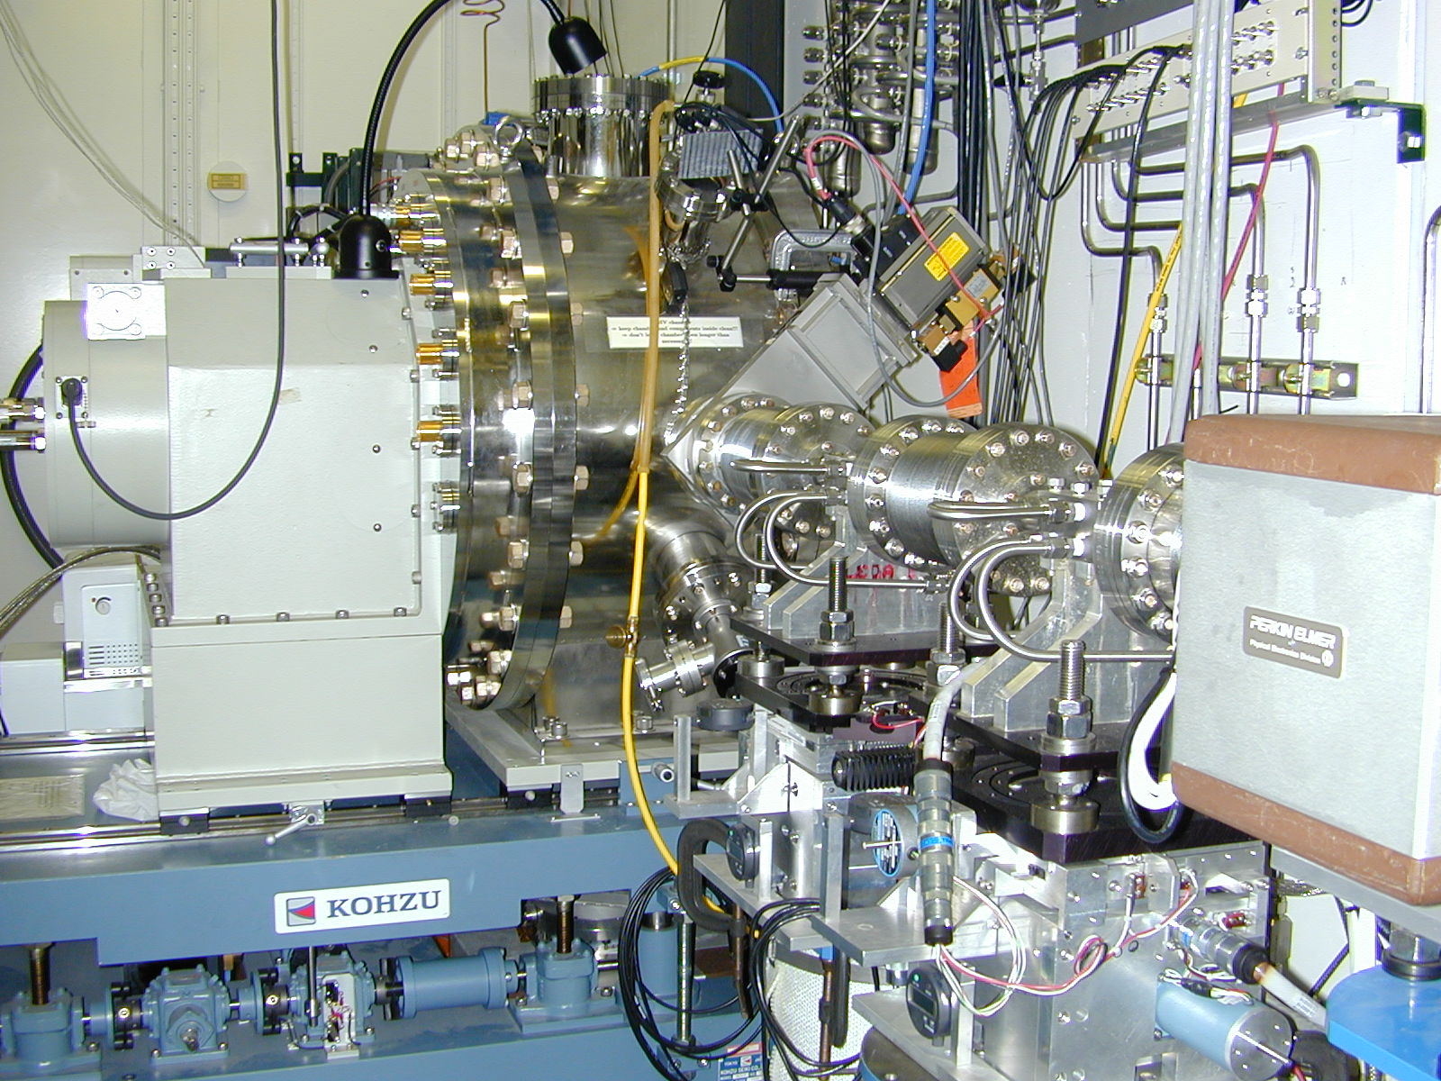
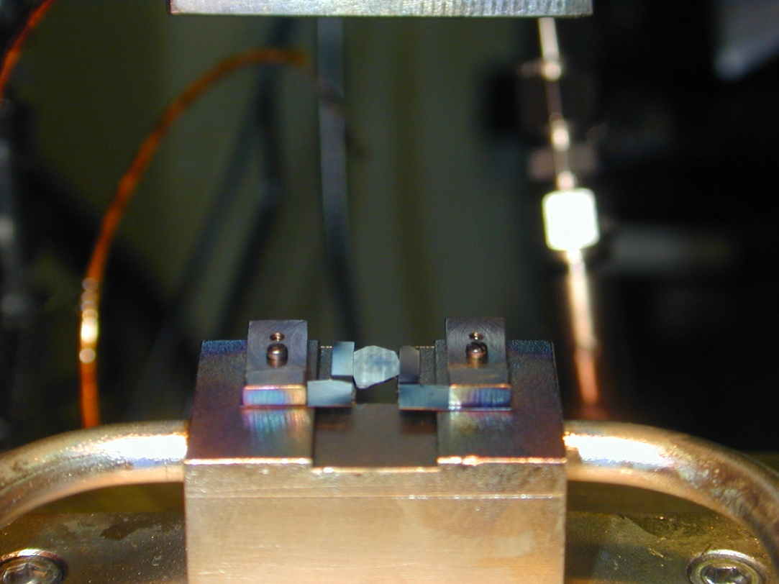
3ID beamline: High heat-load monochromator before 2017
C(111)
C(111)
Kohzu high-heat-load monochromator consists of two water-cooled diamonds

Slide 5
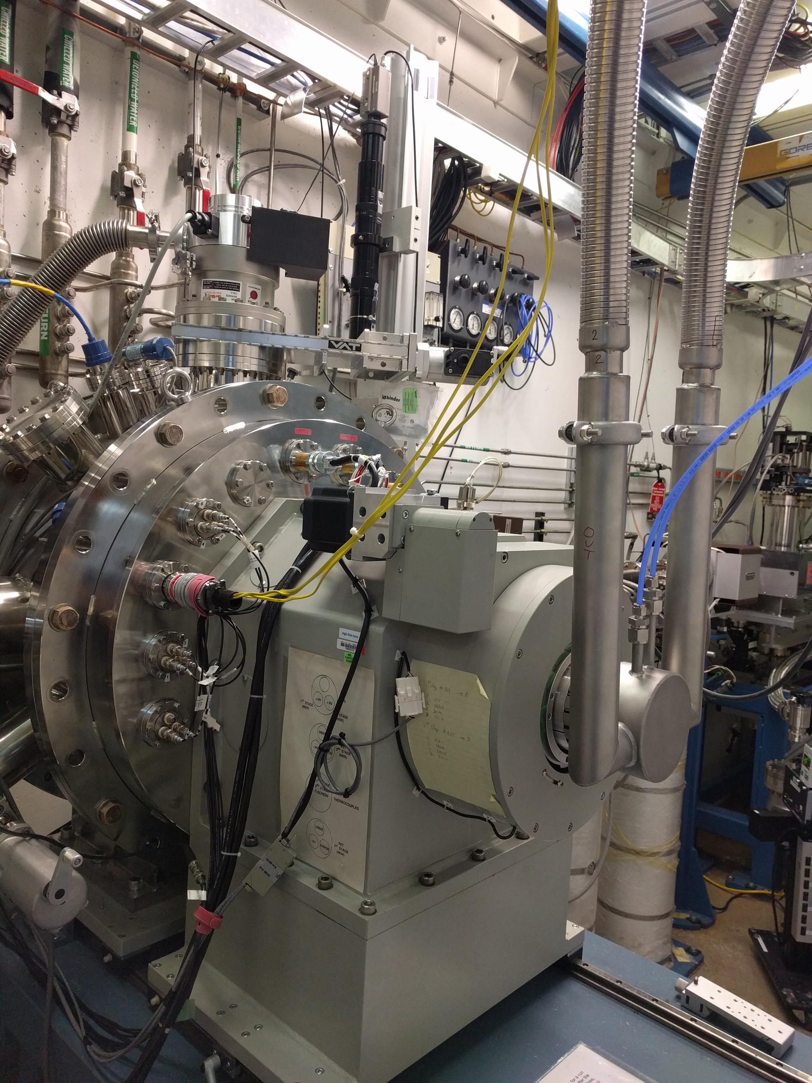
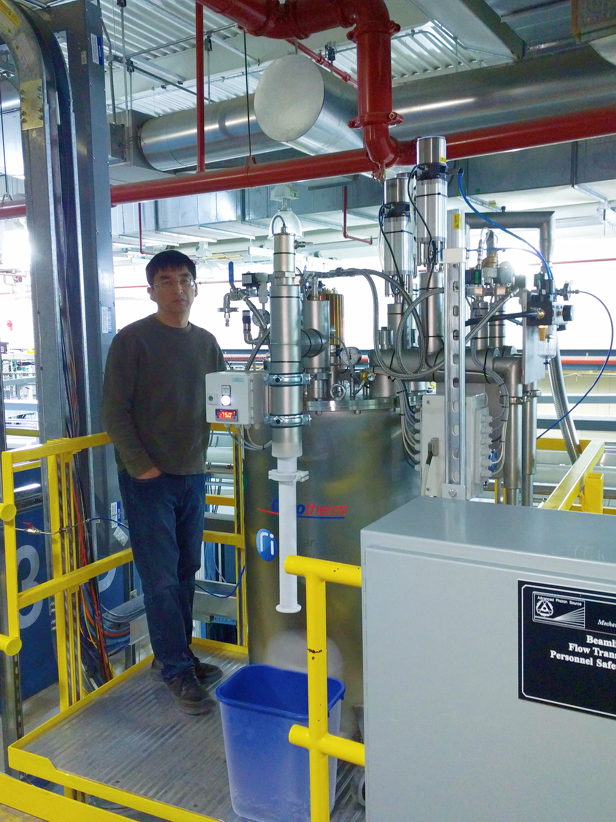
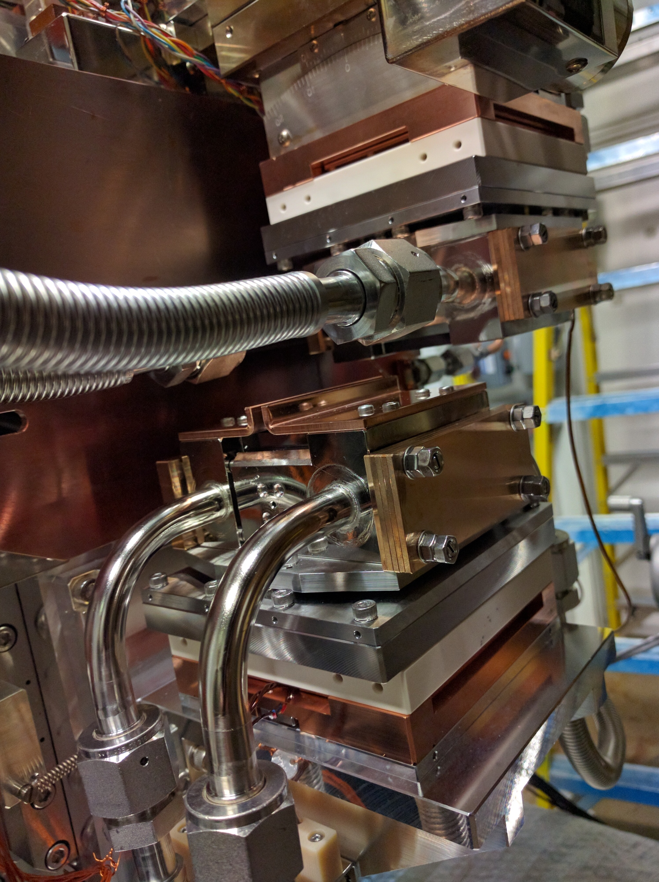
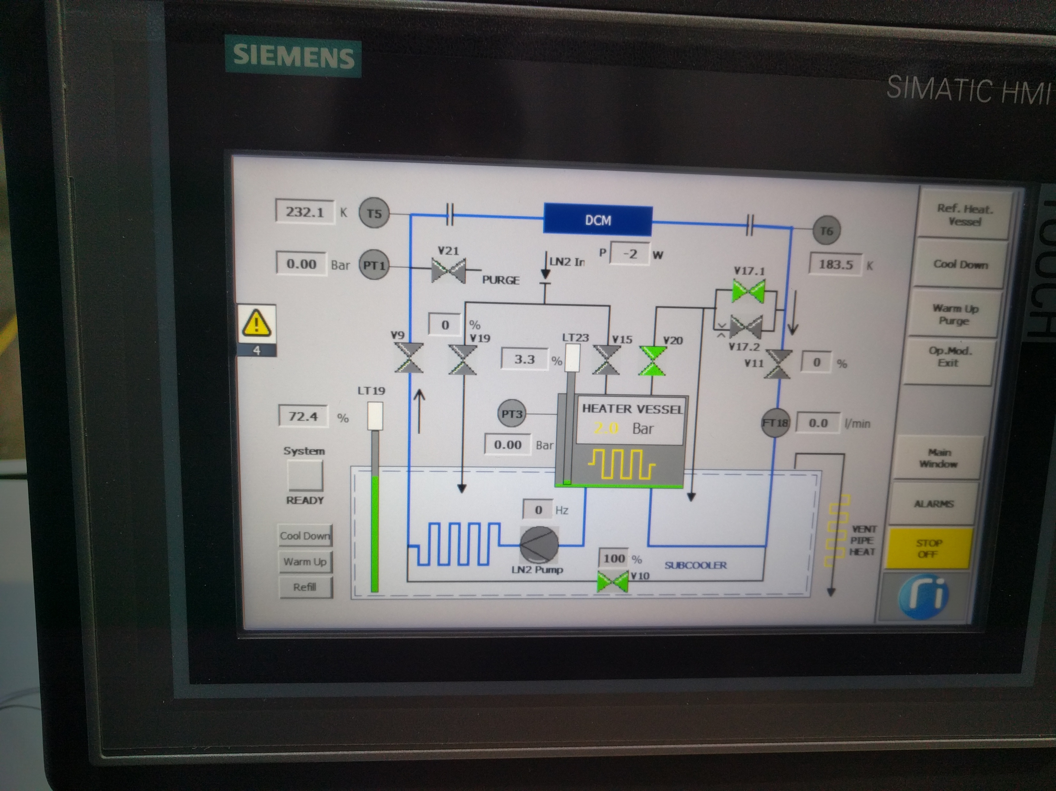
Improvement of the flux and stability
- A cryogenic cooled silicon HHLM since Jan 2017
Si(111)
Si(111)
Converting a water-cooled Kohzu HHLM using diamond crystals to a cryogen cooled silicon HHLM. It increased the flux (~1.5 spectra flux), improved the stability and greatly reduced alignment and maintenance time.

Slide 6
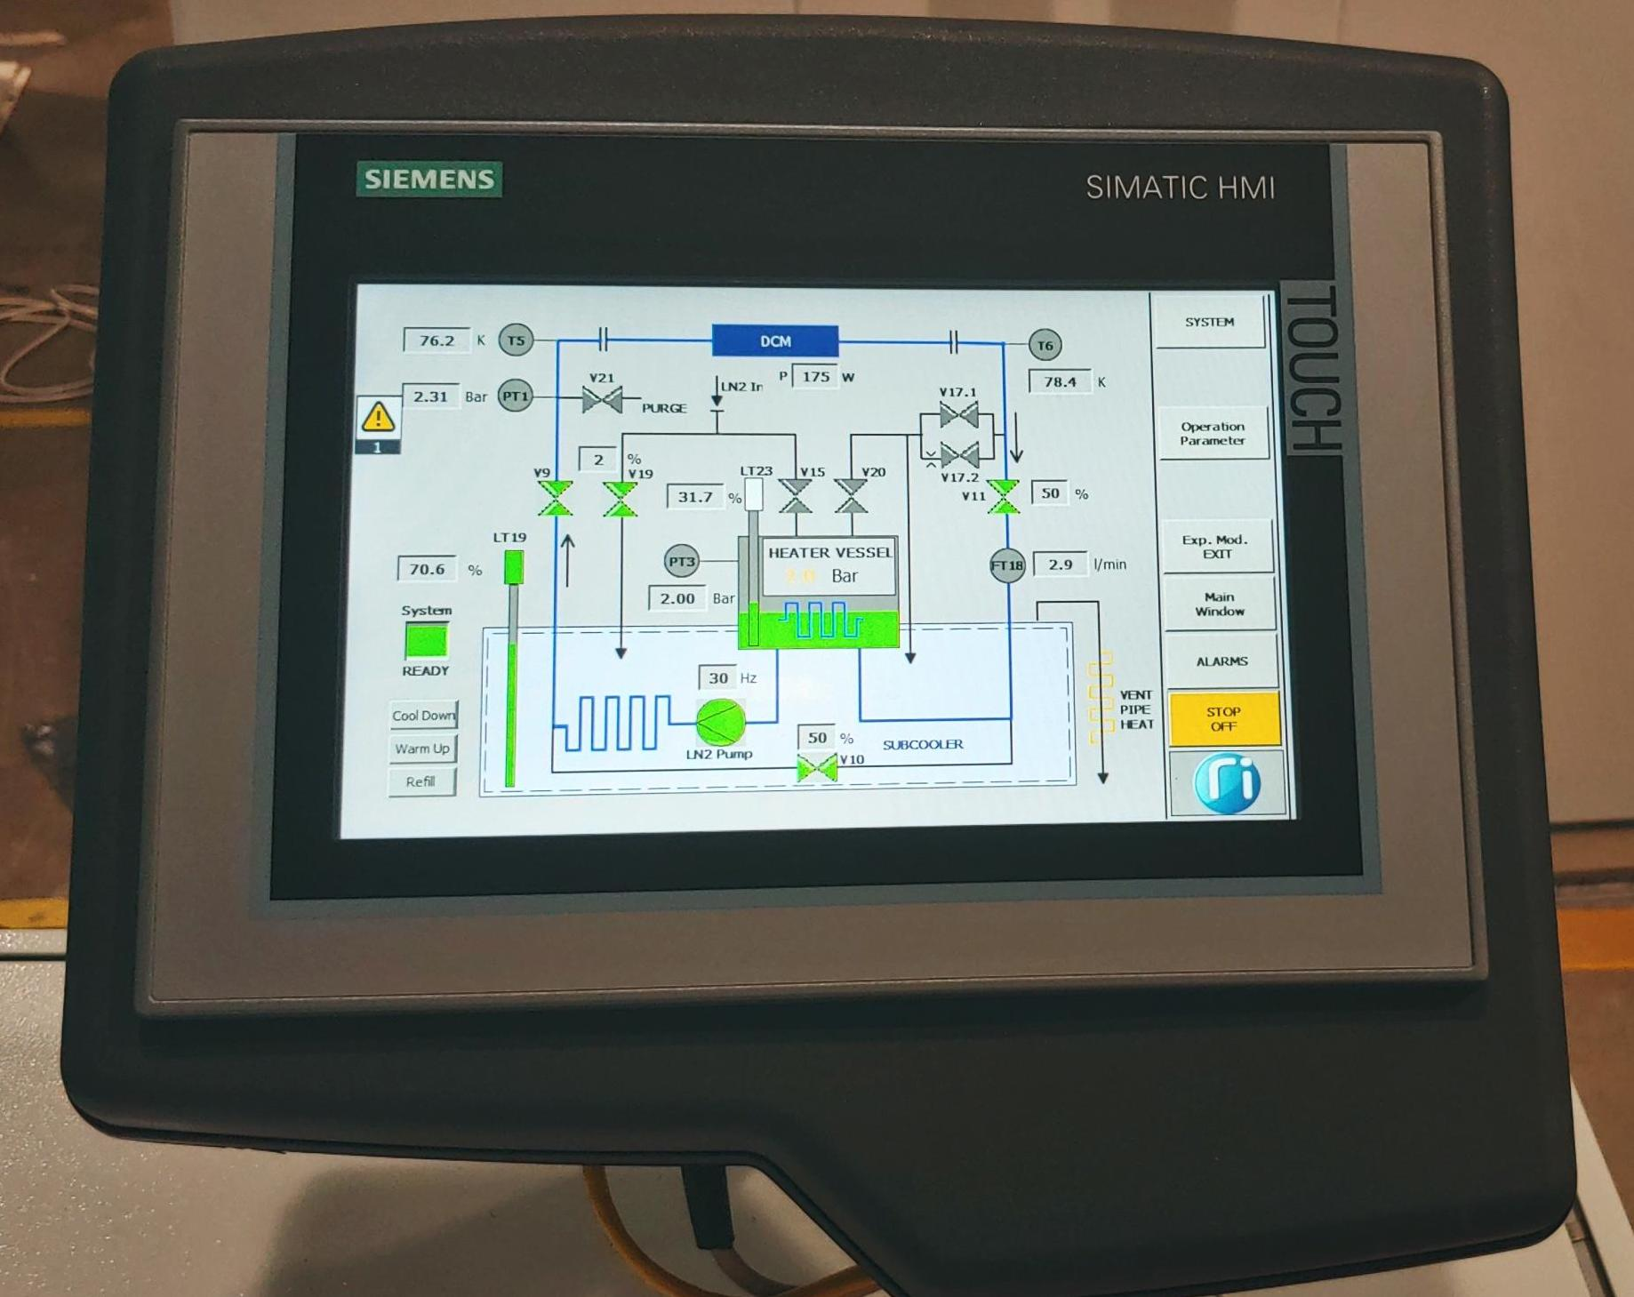
A pressurized (2 bar) liquid nitrogen circulating system (heater vessel) submerged in a liquid nitrogen bath (subcooler) for heat exchange.

Slide 7
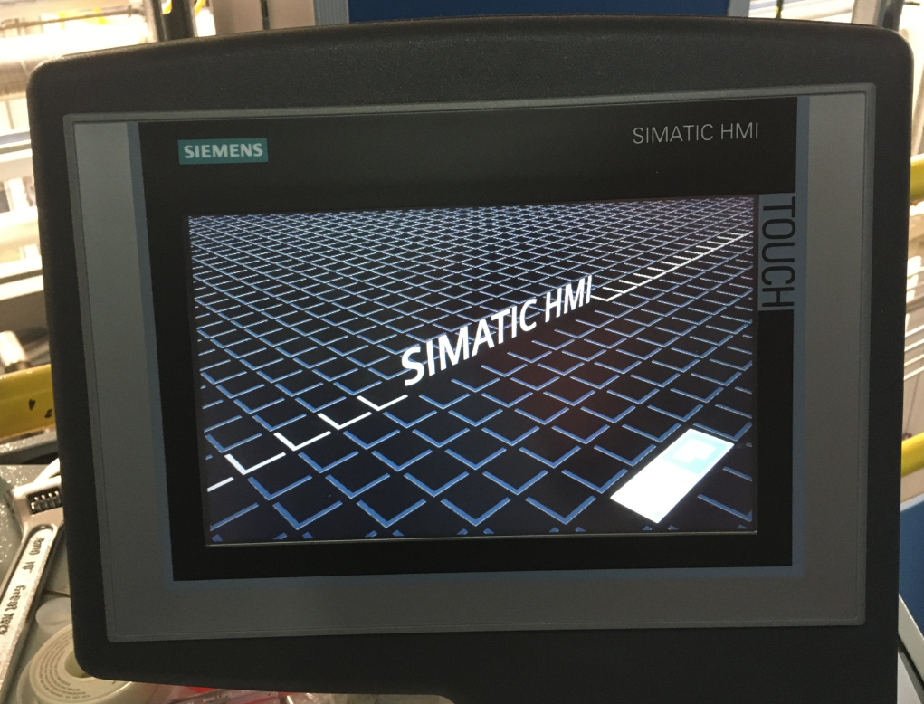
Cryogenic cooled high-heat load monochromator - a critical component for beamlines
My own experience of the RI cryo-system for the last 5 years at 3ID
Stable, reliable, little maintenance, easy to operate
Professional tech support, little information on the company websites
Hardware failures, vent heater at ID3 and ID30, TP at 3ID during a power outage
TP (touch panel) of the RI system doesn’t boot up after a planned power outage on May 2, 2022
Efforts to bring back the system without affecting user beam time (starting May 30, 2022).
RI supporters diagnosed remotely and concluded that both TP and PLC units problematic.
Help from neighbor beamline staff at the APS including APSU team: Sector 33 (David Cyl), Sector 2 (Fabricio Marin), Sector 7 (Don Walko), APSU (Mohan, Thomas Gog and Erika Benda), BCDA (Kurt Goetze), IT (Mary Westbrook), IXN group (Emily Aran, Barbara Lavina, Tom Toellner, Michael Hu)
A spare unit was used from the APSU team, and the system recovered within two weeks (5/18), before the beam restarted on May 30. There was no user beam time loss.
Broken parts were sent back to RI for repair. They came back in mid September and were put back to work at the beamline again.
Thoughts afterwards
Spikes in the power grid may be fatal for the RI units. (UPS option?)
Similar TP loss happened at Sector 33

Slide 8
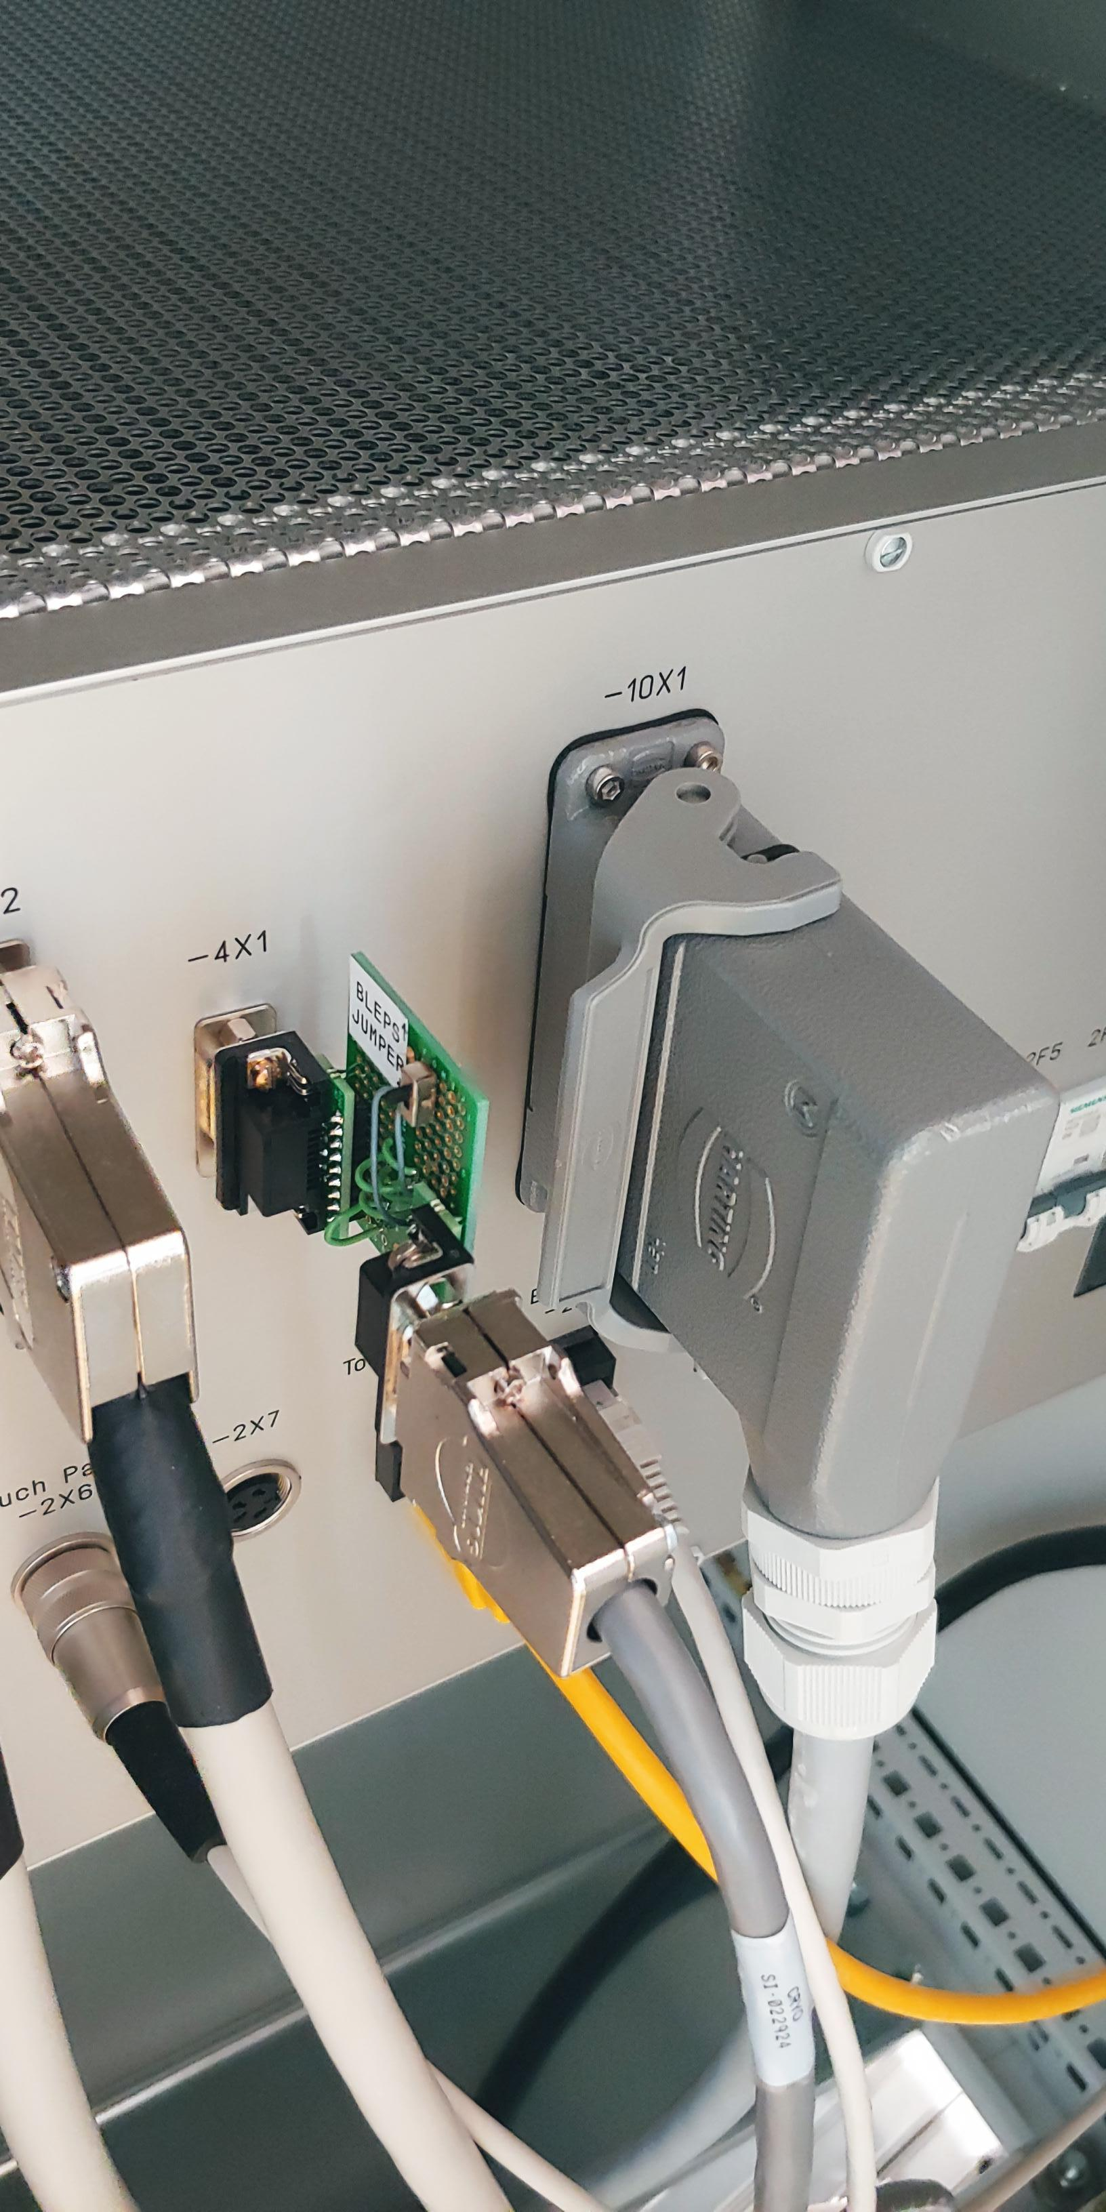
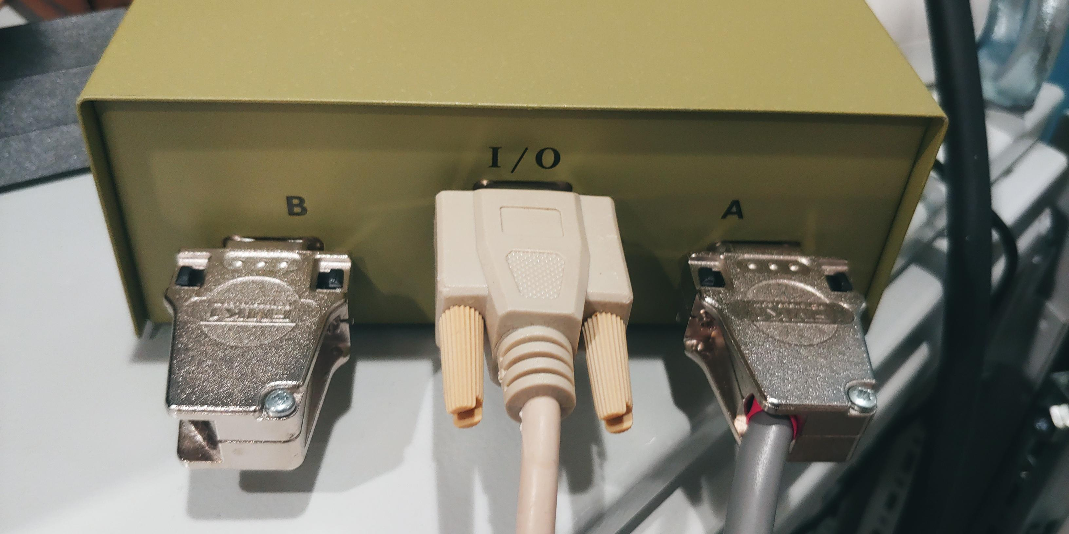
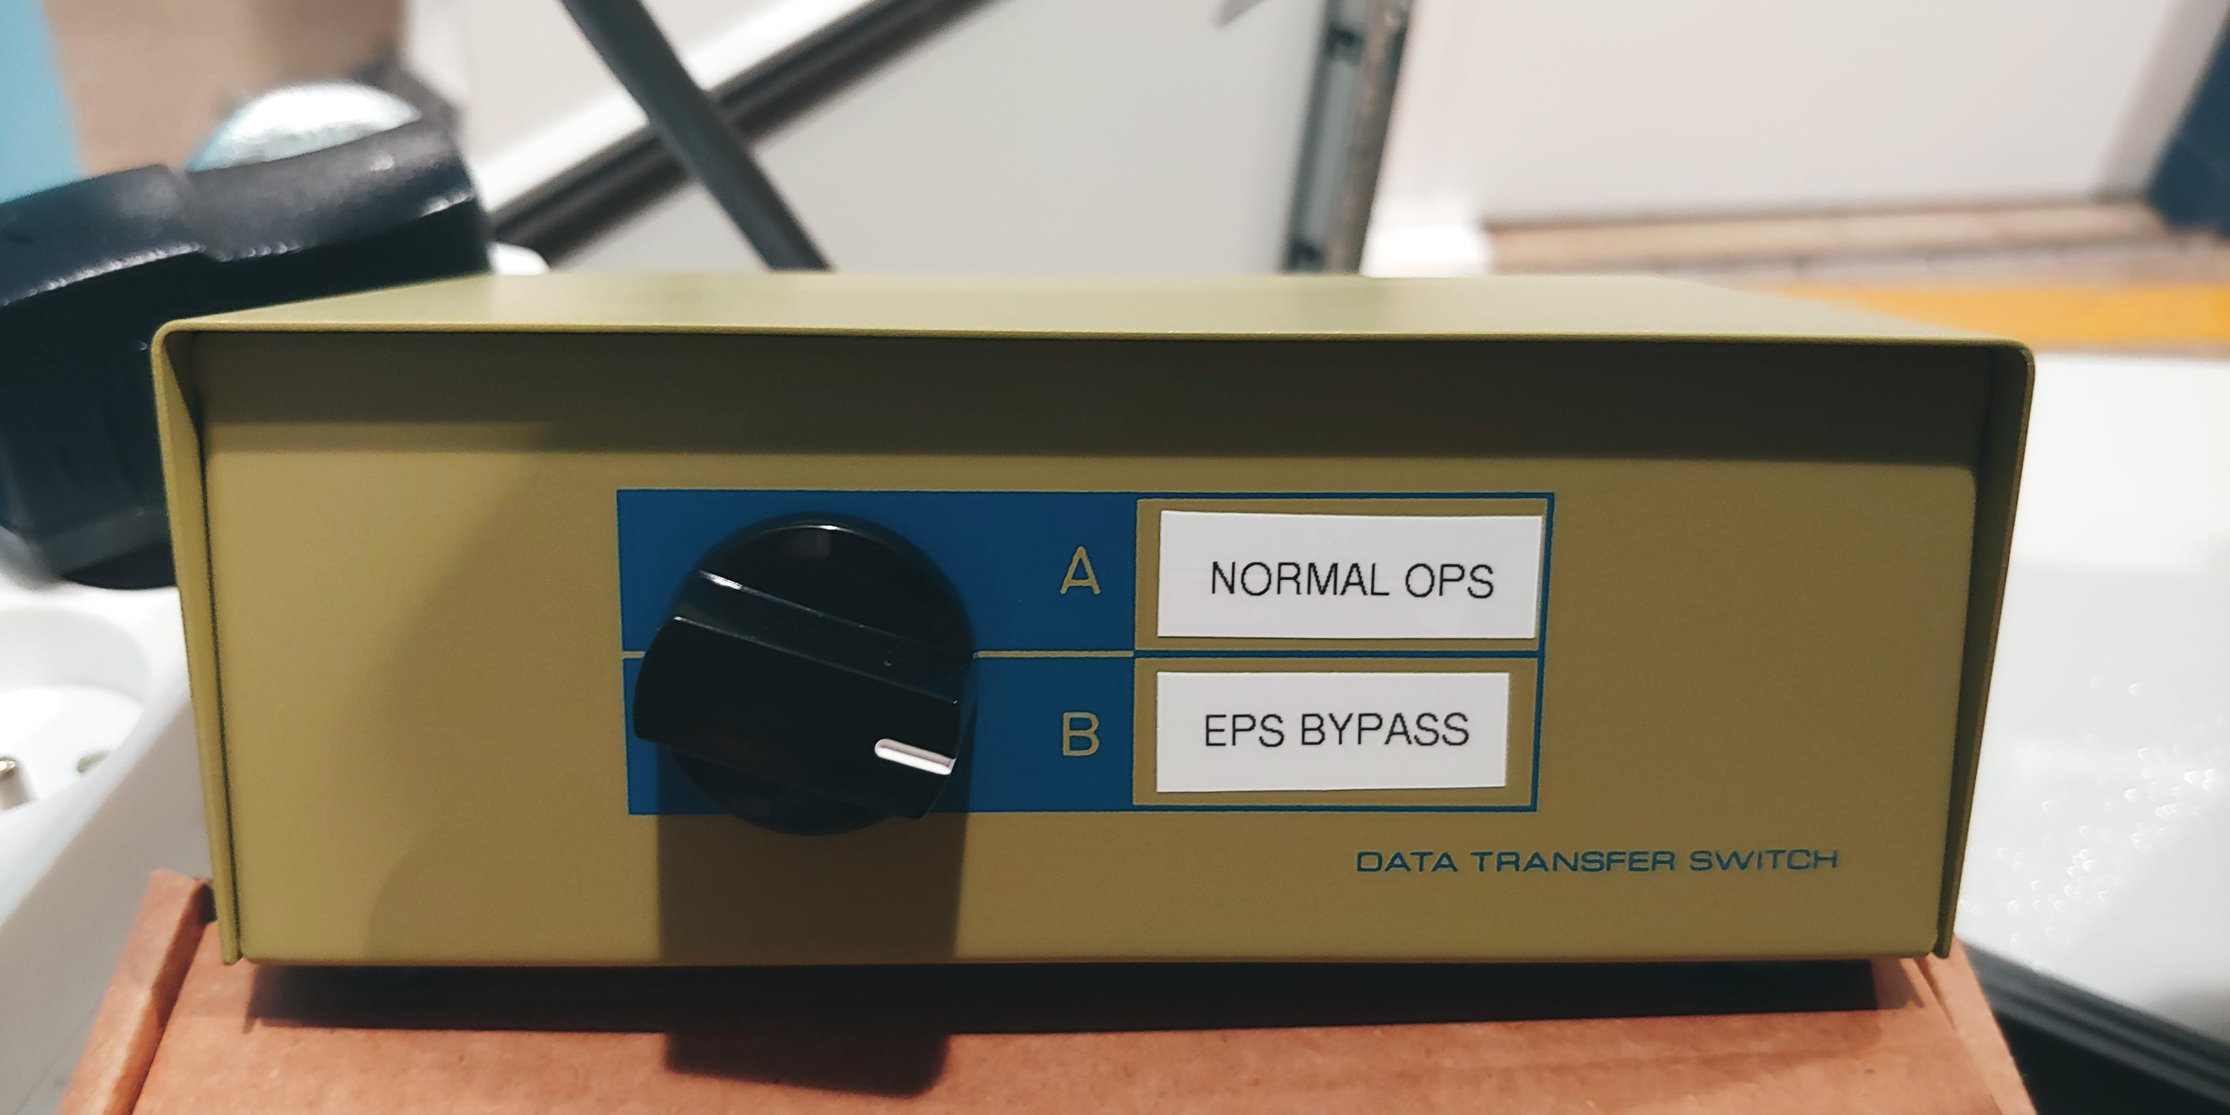
Userful tips and experience of using RI at different beamline
1. Bypass EPS for cryocooler to reduce downtime due to power outages and unexpected EPS error messages.
7ID (Don Walko), 3ID, 30ID
2ID (Fabricio Marin)
2. Reduce the pump frequency during the shutdown period to reduce liquid nitrogen consumption and extend lifetime of the pump (16-ID, Eric Rod)
3. Unplug TP when power down the system (33ID, David Cyl)
4. VNC to the unit (33ID, David Cyl)

Slide 9
HHLM at APS (not the most updated one)
23 RI/CT cryocooler systems shipped to APS，and 2 new system ordered

Slide 10
EPICS control
By Kurt Goetze, BCDA

Slide 11
Collaborative efforts at the APS (tips, tricks, experiences, and spare units)
Hardware: bypass, heater
Software: IP, image backup, EPICS support
Spare parts (HMI, valves, bearings …)
*Spare unit (important for individual beamline to recover quickly to avoid beam loss
Problem solving tips
Wiki-Cryocoller (David Cyl): share knowledge, specific problems and solutions. https://wiki.anl.gov/cryopump/Main_Page
*Regular maintenance, (MOM group?)
Onsite RI tech support? Or training an APS personnel for maintenances
A workshop is planned for the next month

Slide 12
Collaborative efforts at the APS (tips, tricks, experiences, spare parts and spare units)
Hardware: bypass, heater
Software: IP, image backup, EPICS support
Spare parts (HMI, valves, bearings …)
*Spare unit (important for individual beamline to recover quickly to avoid beam loss)
Problem solving tips
Wiki-Cryocoller (David Cyl): share knowledge, specific problems and solutions. https://wiki.anl.gov/cryopump/Main_Page
*Regular maintenance, (MOM group?)
Onsite RI tech support? Or training an APS personnel for maintenances
A workshop is planned for the next month

