Slide 1
Hosting 101: What Hosts Should Know
Susan White-DePace,
APS User Program Manager
October 24, 2016

Slide 2
What Should Hosts Know
What is DOE Order 142.3A?
Difference between Visits and Assignments
Three Categories of Foreign Nationals
Foreign Visits & Assignments at Argonne
Badging Foreign Nationals
Hosting Responsibility: Shared by Many
How are Hosts Identified for Users Conducting Experiments?
What Hosts Should Know about T3s
Hosting 101 Web Page
The I-HOST Tool
Reporting Suspicious Activity

Slide 3
What is DOE Order 142.3A
DOE Order 142.3A defines a program for unclassified foreign national access to DOE sites, information, technologies, and equipment. The Order outlines:
An approval process that is consistent with US and DOE national security and program-specific policies, requirements, and objectives;
A review process to ensure that unauthorized access to information, equipment, or technologies is denied; and
A process for documenting and tracking foreign nationals accessing DOE sites or information, technologies, or equipment. This tracking system is called FACTS.

Slide 4
Visit Requests versus Assignment Requests
The Order allows for two types of applications: visit requests and assignment requests.
The visit category is used for access requests for less than 30 days for individuals such as attendees or speakers at a meeting/conference, family members, traveling companions, or tour group members.
The assignment category is typically used for individuals conducting hands-on research at the APS or individuals who will have a long-term affiliation with the APS and will require intermittent or continuous access over a time span of up to two years.
All visitors of APS/Argonne employees must register using the Argonne Visitor Form.
All other visitors (e.g., collaborative access team visitors and guests) must register using the APS Visitor Form.
All users conducting hands-on research must complete a User Registration Form.

Slide 5
Three Categories for Foreign Nationals
The DOE Order organizes foreign nationals into three categories and specifies what actions are required before a foreign national can obtain access approval. The categories are:
non-sensitive (e.g., Japan, England, Germany, etc.),
sensitive (e.g., China, Russia, and Israel, etc.), and
State Sponsors of Terrorism --T3s (citizens of, or born in, Iran, Sudan, and Syria).
Unless physically residing in the US, non-sensitive country foreign nationals typically enter the US under the business waiver program, and sensitive country foreign nationals must apply for a visa to enter the country, such as a B1 visa. Individuals from T3s typically reside in the US, are affiliated with a US institution, and are in the US under a long-term visa like a F1, H1, or LPR.

Slide 6
Foreign Visits & Assignments at Argonne
The APS User Program Office administer the registration and approval processes for all APS users. The APS administrative personnel handle the foreign national visitors for the division.
Any foreign national requesting access to Argonne’s site or facilities must request prior approval.
Users conducting hands-on experiment work at the APS initiate this process when they submit a user registration form. Hosts are identified through the experiment safety assessment process (more details below).
Visitors initiate this process by completing an Argonne/APS Visitor Registration form. Hosts are identified when the request is made.
All foreign nationals must provide proof of legal immigration status before being granted access approval.
Identification Statement: https://www1.aps.anl.gov/Users-Information/Getting-Started/Argonne-Site-Access/Identification-Documents

Slide 7
Foreign Visits & Assignments at Argonne
All user data is maintained in the APS User Database. All visitor data is stored in an Argonne database.
A system called FAVOR is Argonne’s database for collecting, approving, and tracking foreign nationals. This system feeds a DOE database called FACTS.
The vast majority of the work done at the APS is not considered sensitive because the data will be published in the open literature.
Research teams conducting proprietary research are responsible for protecting their experiments.
If a host, or anyone else, observes a foreign national in an area that is outside of the scope of their visit or their work (e.g., in an area where proprietary research is being conducted) the person observing the incident should report it to Counterintelligence at 2-5300 immediately.

Slide 8
Badging Foreign Nationals
All foreign national users (except individuals from T3 countries) are issued user photo badges commensurate with their legal immigration status.
Example 1: User entering the country through the business waiver program would be valid for three months. The badge end date would match the last day on the visa stamp.
Example 2: User on a J1 visa, which is valid for 18 months. Badge end date would match the end date on the DS 2019.*
Example 3: User from a T3 country will only be granted a gate pass for each experiment provided they are in legal immigration status.
*A DS2019 is a ”Certificate of Eligibility for Exchange Visitor (J-1) Status” and is a Department of State controlled document that can only be produced through the Student and Exchange Visitor Information System (SEVIS).

Slide 9
Hosting Responsibility: Shared by Many
Hosting is a shared responsibility. Management, administration, and scientific staff all contribute to ensuring that the requirements of the DOE Order are met and that an APS experiment/visit is successful.
At the APS, the host is considered the point-of-contact while the foreign national is visiting or running an experiment and is the person who is aware of the day-to-day activities of the foreign national.
Regardless of a user’s citizenship or country of birth, the host:
Should have sufficient knowledge of the work being performed so that they can provide guidance regarding the limitations of the visit (i.e., potentially sensitive subjects or areas),
Should exercise due diligence in overseeing the activity of the foreign national while they are visiting or conducting experiments to ensure that the users perform within the scope of their visit/experiment.
Should immediately report any suspicious activity.

Slide 10
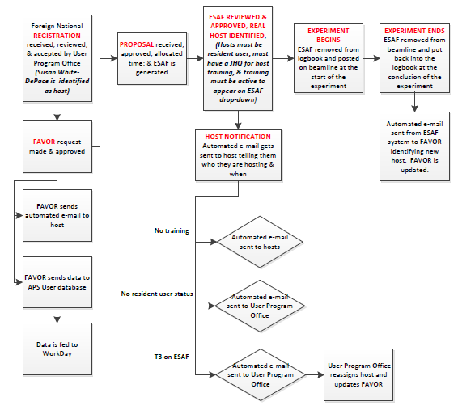
How are Hosts Identified for Experiment Users?

Slide 11
What Hosts Should Know about T3s
The T3 designation pertains to individuals born in, or citizens of, Sudan, Syria, or Iran, regardless of where they currently live.
The approval process for individuals with T3 status is initiated when a user registration/ANL or APS visitor registration form is submitted.
In order to request approval for an individual from a T3, the User Program Office collects, compiles and submits what is called a T3 package to the to the Foreign Visits & Assignments Office for processing.
T3 packages contain extensive personal and professional information as well as justifications and letters of recommendation that are not required of other foreign nationals.
All PII (personal identifiable information) is collected through a secure Box account, which is encrypted both in transit and storage to protect personal information.
T3 packages cannot be processed without an identified experiment/purpose and a host
Approval of requests can take up to three months
Requests are approved by the Secretary of Energy

Slide 12
What Hosts Should Know about T3s
Individuals from T3 countries do not need to be escorted, unlike individuals representing institutions on the US Department of Commerce Entity list.
The Entity List identifies foreign parties that are prohibited from receiving some or all items subject to the Export Administration Regulations (EAR) unless the exporter secures a license. Those persons present a greater risk of diversion to weapons of mass destruction (WMD) programs, terrorism, or other activities contrary to U.S. national security or foreign policy interests.
Individuals affiliated with the Entity List are typically denied access to the APS because escorting requirements cannot be met.

Slide 13
What Hosts Should Know about T3s
Hosts will be asked to sign a Host Acknowledgement Form, which states:
the host’s citizenship,
that the host understands his/her responsibilities,
Confirms that the user will/will not have access to sensitive or classified information, and
acknowledges that there are physical and cyber security plans in place.
If the host changes, the User Program Office ensures that all the necessary paperwork is completed and documented in FAVOR.

Slide 14
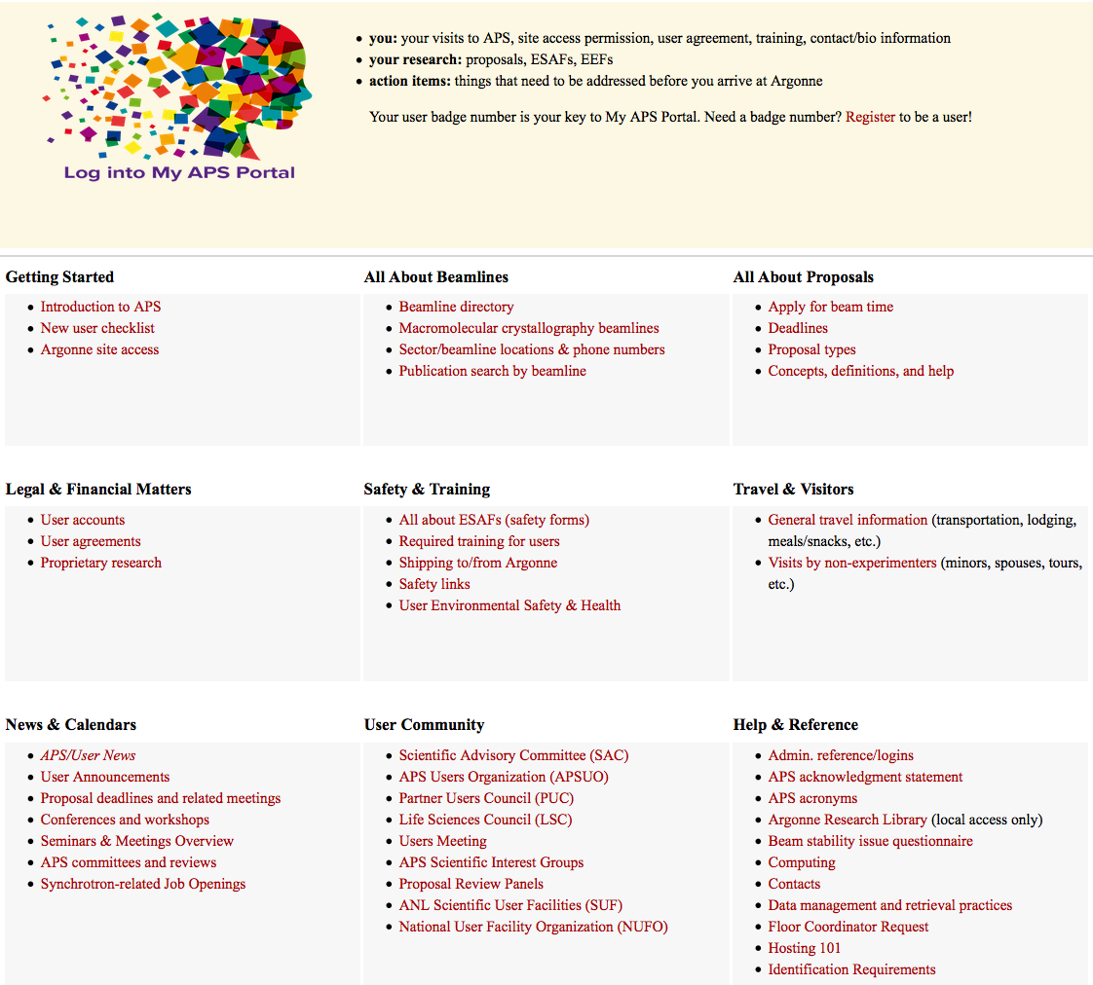
User Info Web Page https://www1.aps.anl.gov/Users-Information

Slide 15
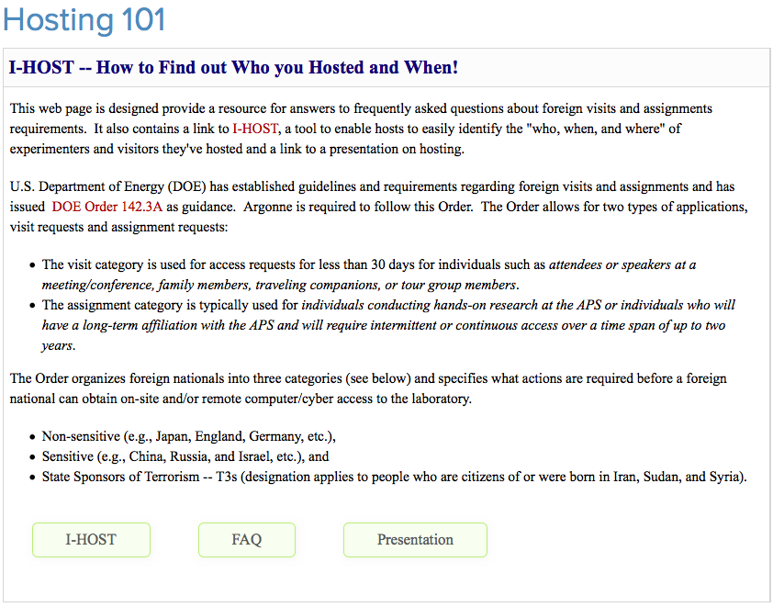
Hosting 101 Web Page

Slide 16
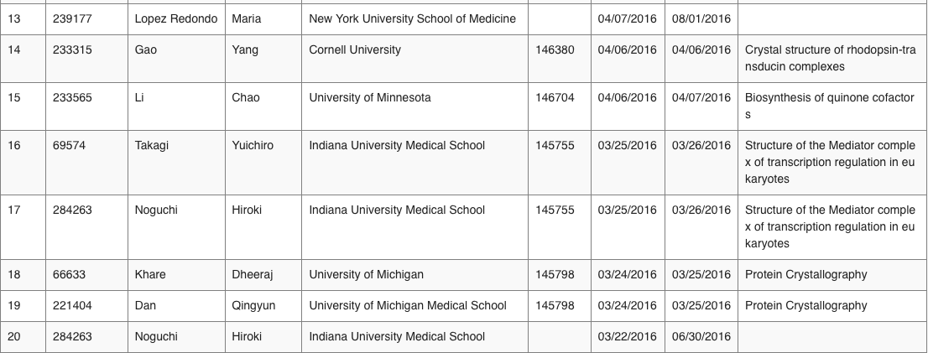
The I-HOST Tool
The I-HOST tool to enable hosts to easily identify the "who, when, and where" of experimenters they've hosted by providing their badge # and dates

Slide 17
Reporting Suspicious Activity
This is an easy requirement:
If you SEE something, SAY something!
Any suspicious behavior or attempts to solicit information outside the stated scope or intent of the visit/assignment should be immediately reported to the Argonne Counterintelligence Office at 630-252-5300. If you suspect a visitor has a hidden agenda, or if you observe any suspicious behavior, contact your counterintelligence officer. Also report any attempts to probe for information, efforts to put you in a compromising situation, and any other anomalous behaviors.

