Slide 1
Mössbauer Spectrometry Brent Fultz, California Institute of Technology Department of Applied Physics and Materials Science <AP | h | MS>
^
History
Recoil-Free Fraction
Technique, Samples
Hyperfine Interactions: IS, EFG, HMF
WIEN2k
Mössbauer Community

Slide 2
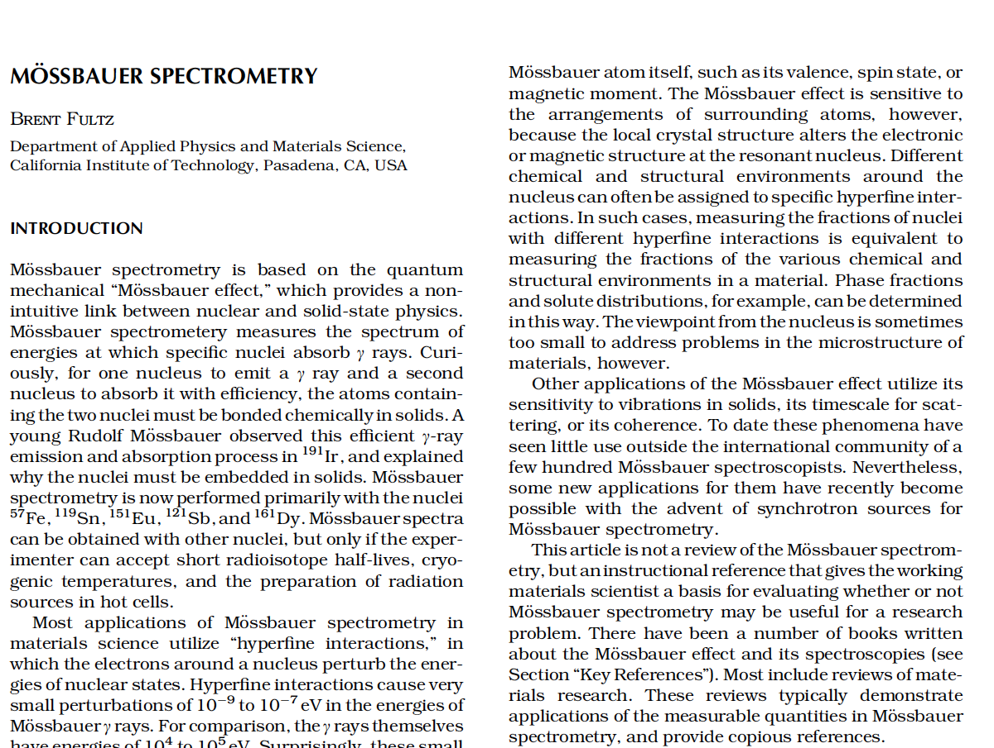
Please ask for a copy, if you would like it but don’t have it.

Slide 3
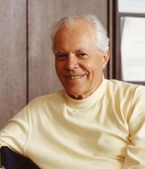
Mössbauer’s Early Work
Ph.D. thesis under Heinz Maier-Leibnitz.
Looked for nuclear resonance scattering at high temperatures.
Found best effect at low temperatures in ¹⁹¹Ir.
Had read neutron resonance scattering paper by Lamb.
Got the theory right, essentially by adapting Lamb’s approach.
Was unable to refer to effect by his own name.
Came to Caltech, worked with Felix Böhm (co-advised John Poindexter as Ph.D. student).
Explosion of interest in Mössbauer effect after discovery in ⁵⁷Fe (Argonne, Harvard).
Nobel prize in 1961.
Rudolf Mössbauer 1929-2011

Slide 4
Days of Excitement
Nobel prize in 1961.
Heinz Maier-Leibnitz did not share Nobel Prize.
Emergency meeting of Caltech faculty.
Promoted to Full Professor of Physics in 24 h
(fastest promotion process in history of Caltech).
Moved back to TUM (“air pollution in Pasadena”, I doubt it).
Coherent nuclear resonant scattering.
Neutrino oscillations 1977 with Böhm.
Proud that he did not publish false results on neutrino oscillations, but not much came of it.
Did not like the “noise” of Mössbauer spectrometry community.
Rudolf Mössbauer 1929-2011

Slide 5
Days of Excitement
Mössbauer spectrometry looks outwards from the nucleus.
Energy levels of a nucleus are altered by hyperfine interactions with the atomic electrons.
Hyperfine interactions depend on
- valence (IS)
- chemical environment (EFG)
- magnetic environment (HMF)
Mössbauer spectrometry can study local atomic arrangements, but there may be better ways to do this in 2014.

Slide 6
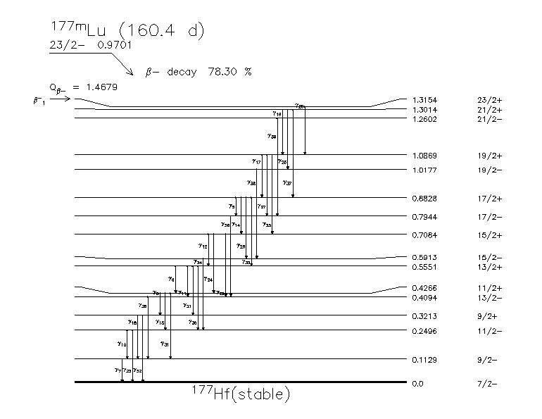
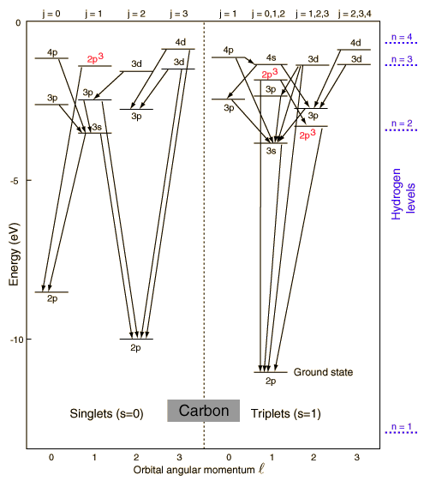
Atomic Energy Levels
Nuclear Energy Levels
1 eV
10⁶ eV
Low nuclear transitions ~10⁴ eV
Nuclear energy ~ 10⁶ chemical energy

Slide 7
Suppose a Low-Energy Nuclear Transition of 14.4 keV
Photon momentum is: p = E/c
Nuclear recoil p²/2m = 1.9x10^{–3} eV
Nuclear lifetime τ = 1x10^{–7} s
Nuclear energy width ε = h/τ = 10^{–9} eV
With recoil of free nucleus, by a factor of a million to hit the energy precision of a nuclear excitation.

Slide 8
Suppose the Entire Crystal Recoils, Not One Nucleus
Crystal contains 10⁷ atoms.
Nuclear recoil p²/(2m 10⁷) = 1.9x10^{–10} eV
Nuclear lifetime τ = 1x10^{–7} s
Nuclear energy width ε = h/τ = 10^{–9} eV
Now can hit the energy precision of a nuclear excitation and observe nuclear fluorescence.
But how do we get the entire crystal to take up the recoil momentum?

Slide 9
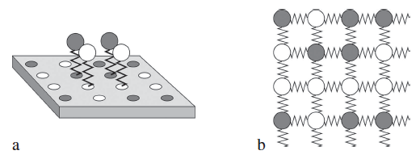
Phonons – Quanta of lattice vibrations
Einstein Model (1907) puts individual atoms on springs.
Actually, phonons are quantized normal modes of the lattice.
Einstein model:
hν = 10^{–2} eV

Slide 10
Phonons – Quanta of lattice vibrations
Einstein model:
hν = 10^{–2} eV
Recoil energy of individual nucleus = 10^{–3} eV
Not enough to excite a phonon most of the time.
If no phonon excitation, γ-ray energy loss is only 1.9x10^{–10} eV.
Nuclear resonance can occur with probility
p ~ exp(–E_{rec}/hν) = exp(–0.1) ~ 0.9 (beware, no T here)

Slide 11
Phonons – Quanta of lattice vibrations
Recoil-free fraction (RFF) or Lamb-Mössbauer factor
Fraction of nuclear gamma emissions (or absorptions) that occur without phonon excitation, and can be nuclear resonant scattering.
Recognizing the quantum origin of this is what led to the Nobel Prize.

Slide 12
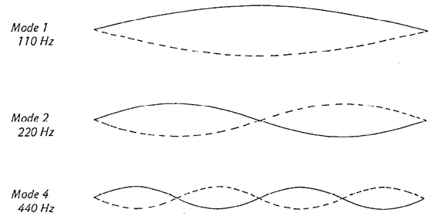
Vibrations in Crystals — Normal Modes
Normal modes are independent and live forever
Highest frequencies have adjacent atoms out of phase
Quantize normal modes to get phonons ε = ħω

Slide 13
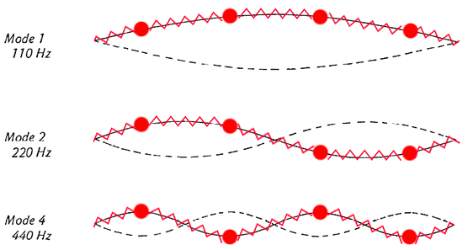
Vibrations in Crystals — Normal Modes
Normal modes are independent and live forever
Highest frequencies have adjacent atoms out of phase
Quantize normal modes to get phonons ε = ħω

Slide 14
More Rigor for Recoil-Free Fraction
This is a translation in momentum space

Slide 15
More Rigor for Recoil-Free Fraction, f
Recoil-free fraction is projection of initial state on final state
RFF, f, is:

Slide 16
Suppose a Low-Energy Nuclear Transition of 14.4 keV
E = p/c = h/λc 2π/λ = k
λ = 0.86 Å
Compare to X-ray Debye-Waller Factor
D = exp[- (Δk)² (Δx)²]
Low T, Δx = 0.01 Å
High T, Δx = 0.1 Å
D = 0.99
D = 0.56

Slide 17
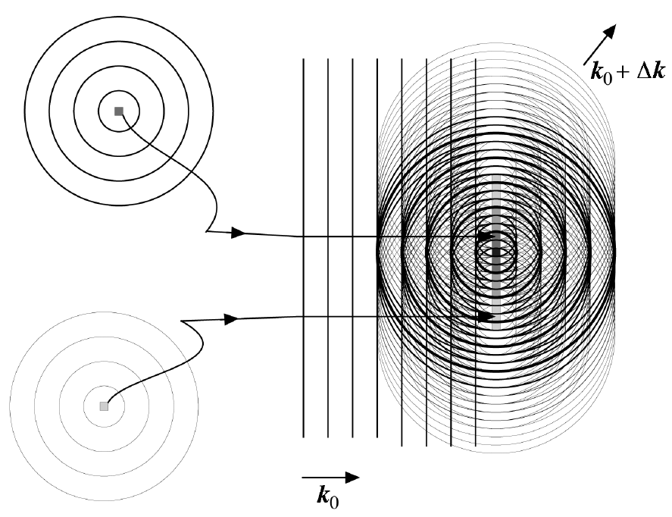
Suppose a Low-Energy Nuclear Transition of 14.4 keV

Slide 18
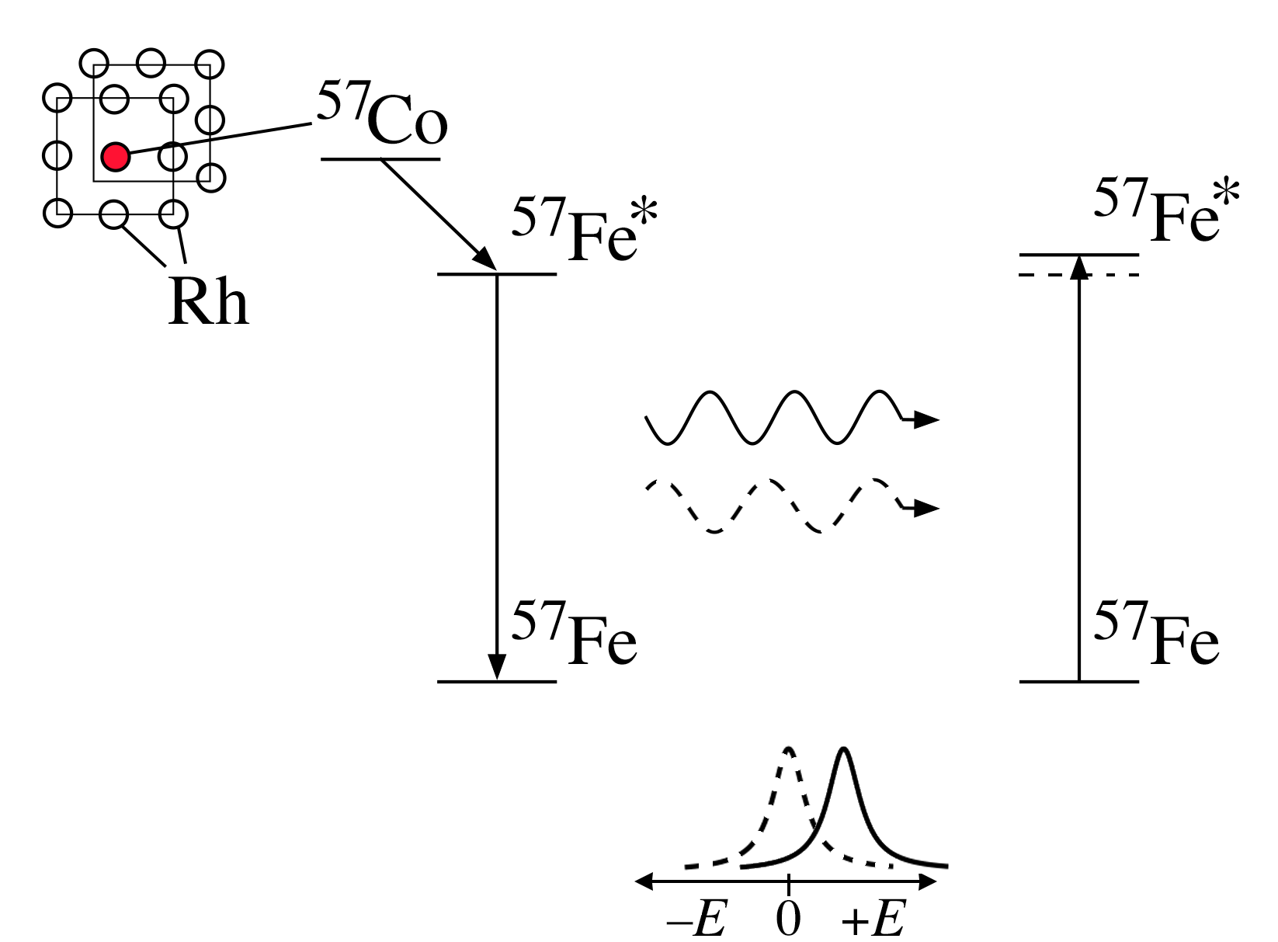
Mössbauer Spectrometry
Doppler shift to
tune γ-ray energy
ΔE ~ 10⁻¹² 10⁴ = 10⁻⁸ eV

Slide 19
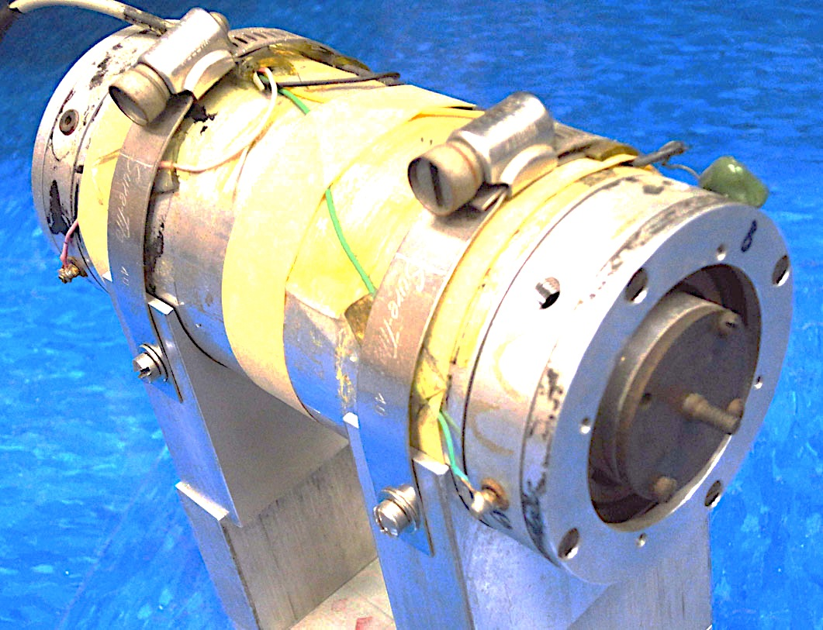

Slide 20
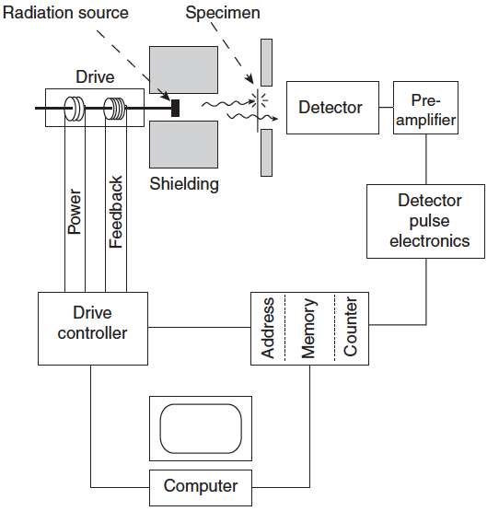
Mössbauer Spectrometer
Doppler shift to
tune γ-ray energy
ΔE ~ 10⁻¹² 10⁴ = 10⁻⁸ eV

Slide 21
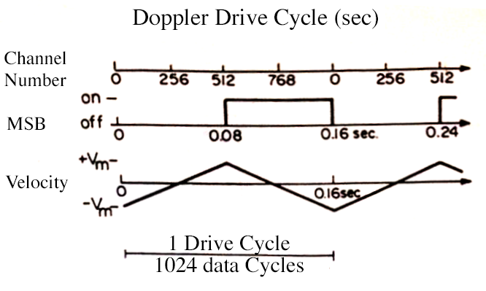
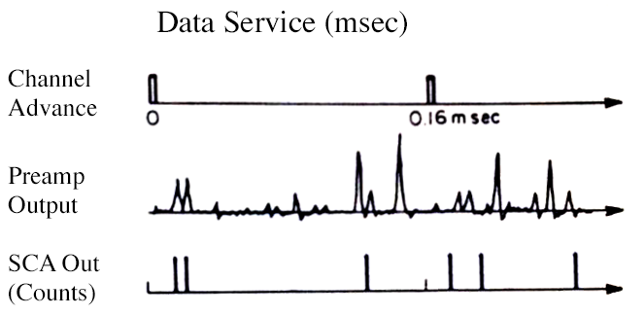
Mössbauer Spectrometer – Timing and Sync

Slide 22
For ⁵⁷Fe:
σ_{a} = 2.6 x 10^{–18} cm²

Slide 23
For single-line absorber, t = 2.75 μm

Slide 24
For Fe in a light element matrix, just make the sample thicker.
For Fe in Pb, which is highly absorbing, it is not trivial to optimize the sample thickness for best singnal/noise ratio.
Usually, calculate the absorption length of 14.4 keV photons in Pb, and assume this is the best thickness.

Slide 25
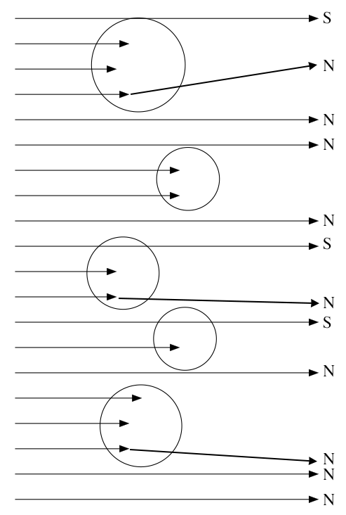
Famous Mistake:
Lumpy Sample
High Absorption
High Noise
Low Signal

Slide 26
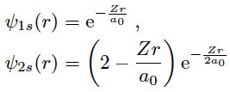
Hyperfine Interactions
The s-electron wavefunctions go inside the nucleus.
(Really! The electron kinetic energy would be too big if the electron were to swerve to avoid the nucleus.)
We see that ordinary s-electrons are at r=0 (without normalization):

Slide 27
Isomer Shift
Overlapping charge densities, larger nucleus in ground state “Isomer Shift”
R_{g}
R_{ex}

Slide 28
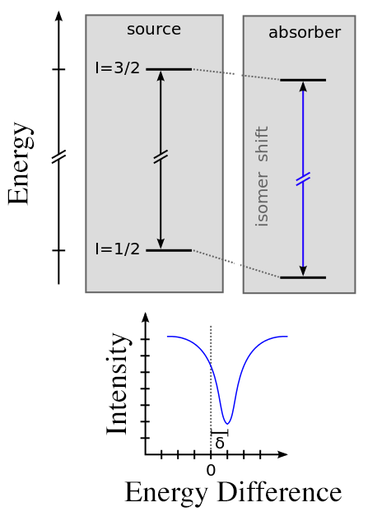
Isomer Shift

Slide 29
Electric Quadrupole Splitting
Nuclear quadrupole moment in an electric field gradient
“Quadrupole Splitting”
Excited state has angular momentum I=3/2, so it has a nonspherical shape.
Ground state is spherical.
I_{z} = +3/2
I_{z} = –3/2
ΔE_{q}
I_{z} = +1/2
I_{z} = –1/2

Slide 30
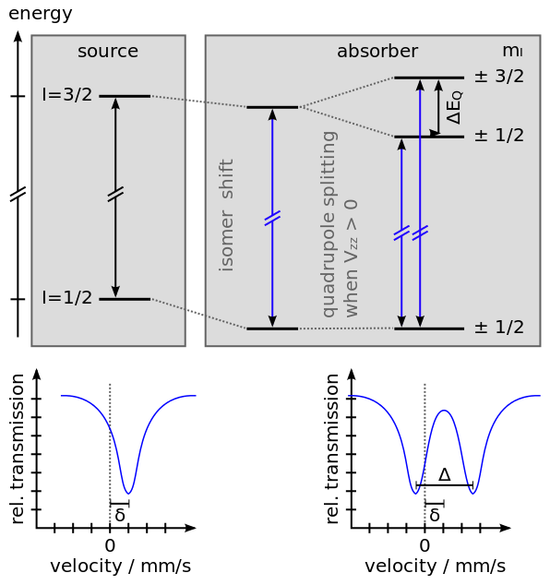
Electric Quadrupole Splitting Plus Isomer Shift

Slide 31
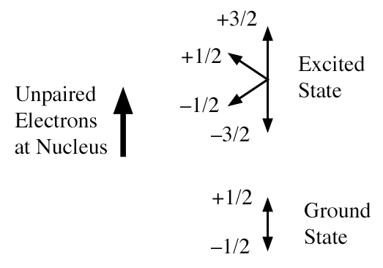
Hyperfine Magnetic Field
Nuclear spin and electron spin “Hyperfine Magnetic Field”

Slide 32
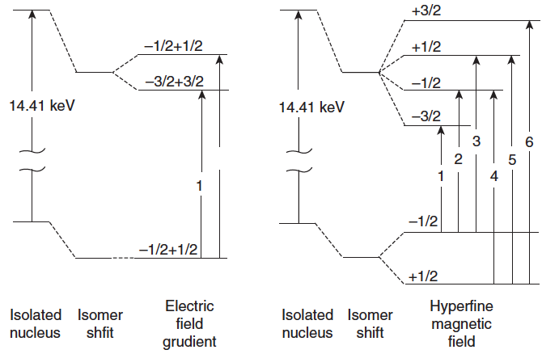
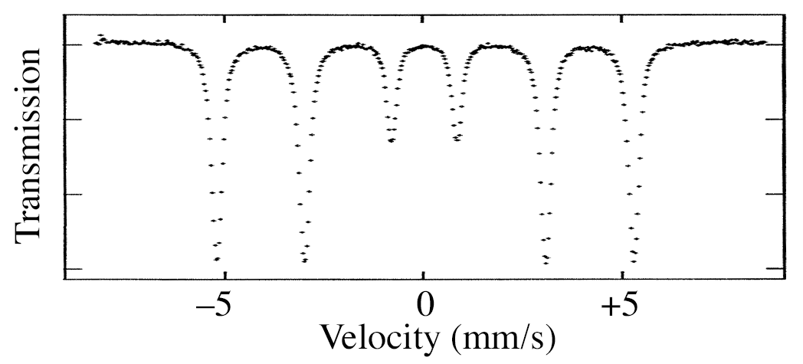
Hyperfine Energy Levels

Slide 33
Hyperfine Interactions
1) Overlapping charge densities “Isomer Shift”
2) Nuclear quadrupole moment in an electric field gradient
“Quadrupole Splitting”
3) Nuclear spin and electron spin “Hyperfine Magnetic Field”
4) Note: all have the form (nuclear factor)x(electronic factor)

Slide 34
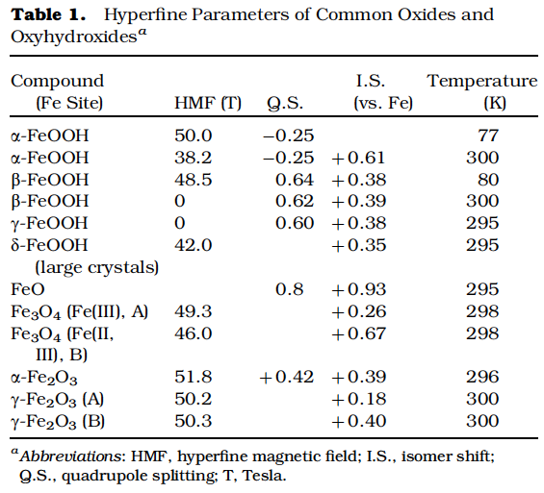
Fingerprinting Method for Identifying Compounds

Slide 35
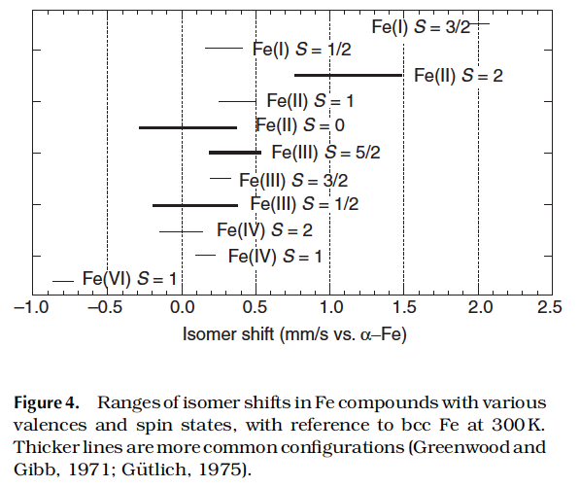
Isomer Shifts for Fe ions

Slide 36
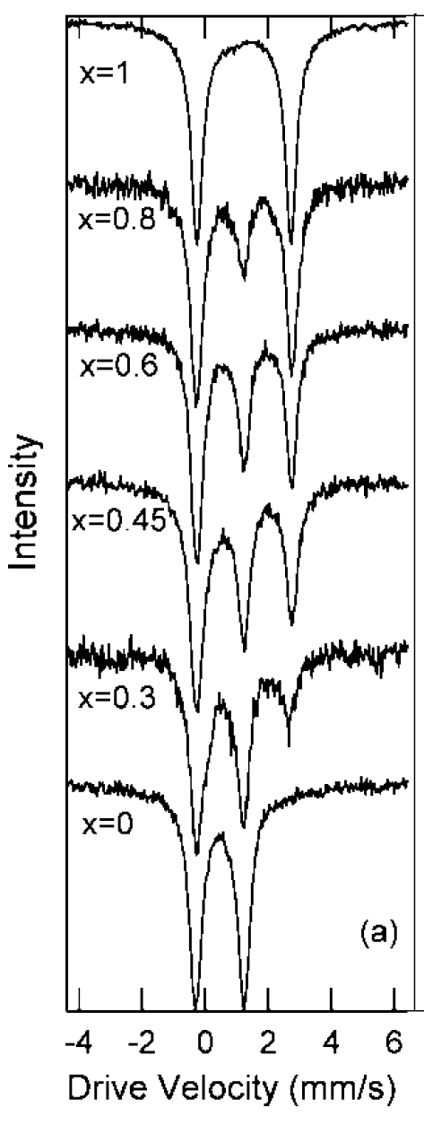
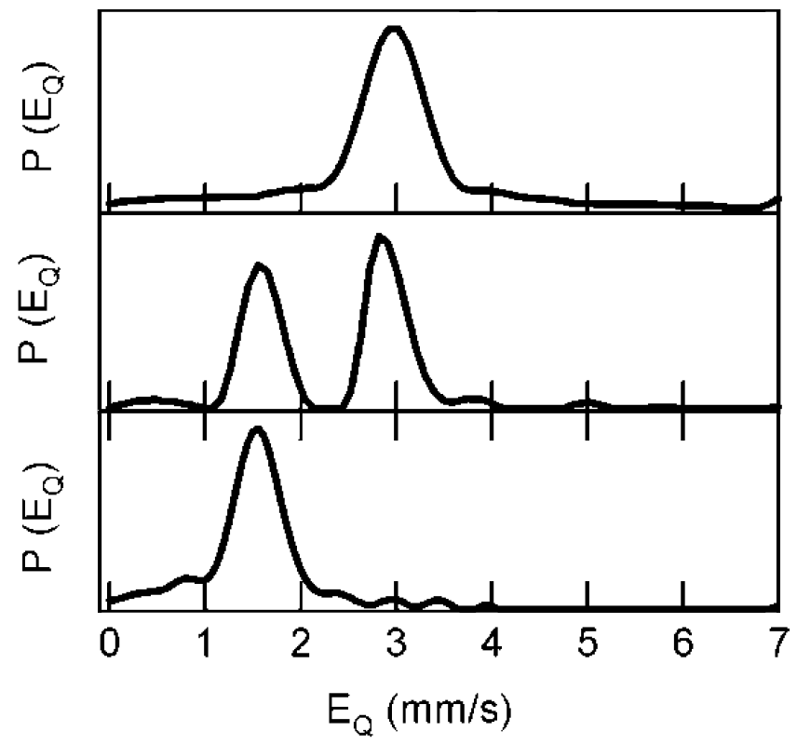
Isomer-Shifted Quadrupole Doublets of Li_{x}FePO₄
How Does Fe Valence change with x?

Slide 37
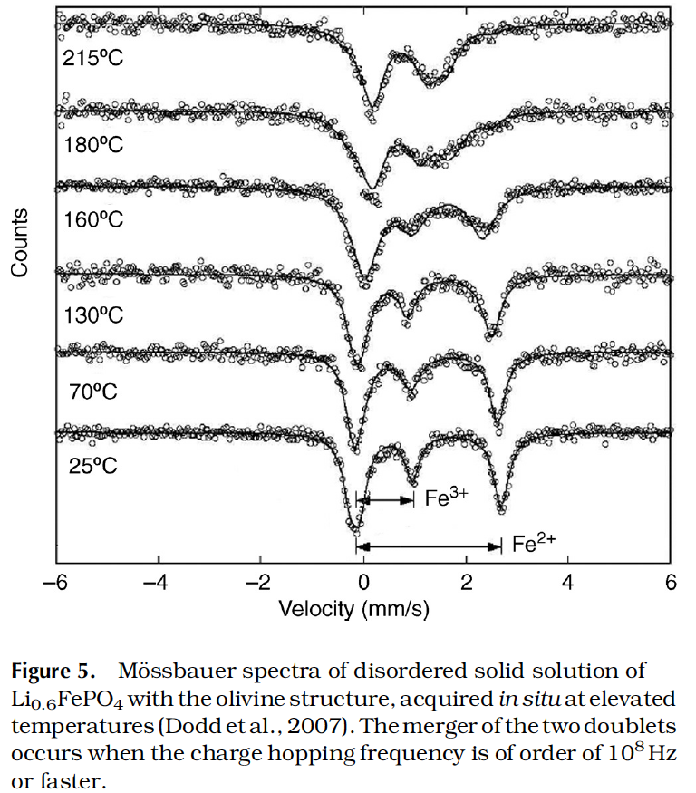
Usually the Fe Valence is Stable, But Exceptions…

Slide 38
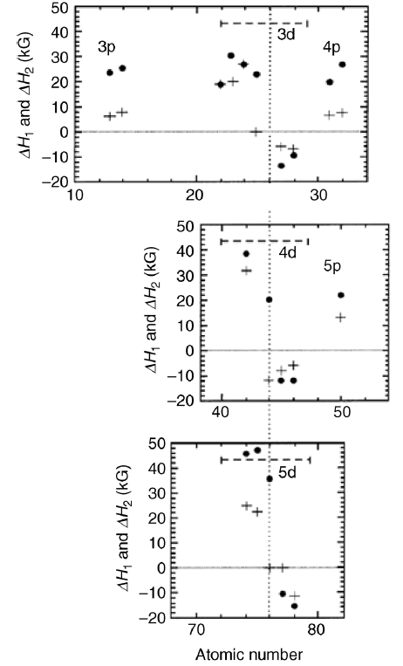
First Nearest Neighbors of ⁵⁷Fe
Alter Its HMF
Phenomenological relation for dilute bcc Fe-X alloys
ΔH = n₁ ΔH₁ + n₂ ΔH₂

Slide 39
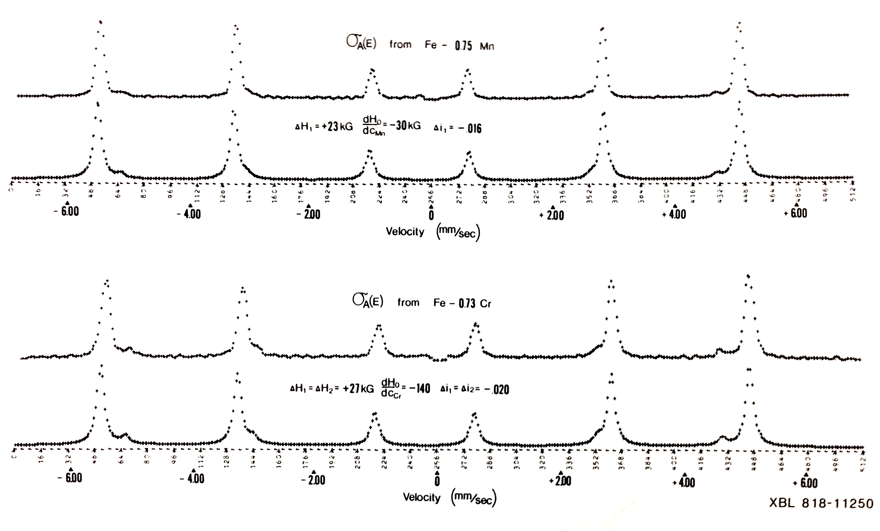
First Nearest Neighbors of ⁵⁷Fe Alter Its HMF

Slide 40
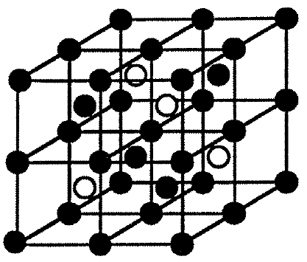
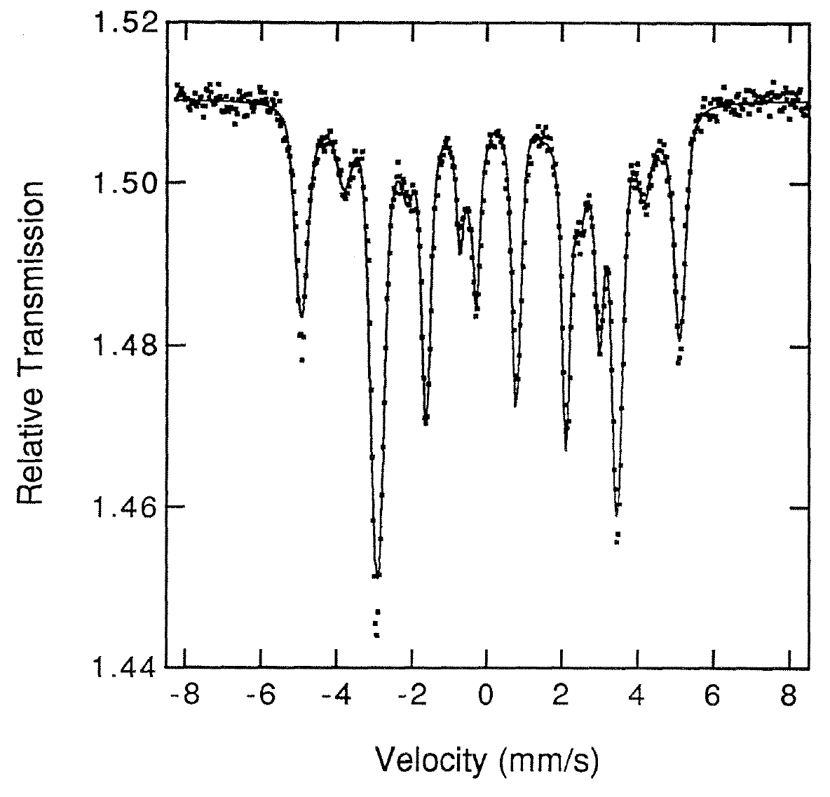
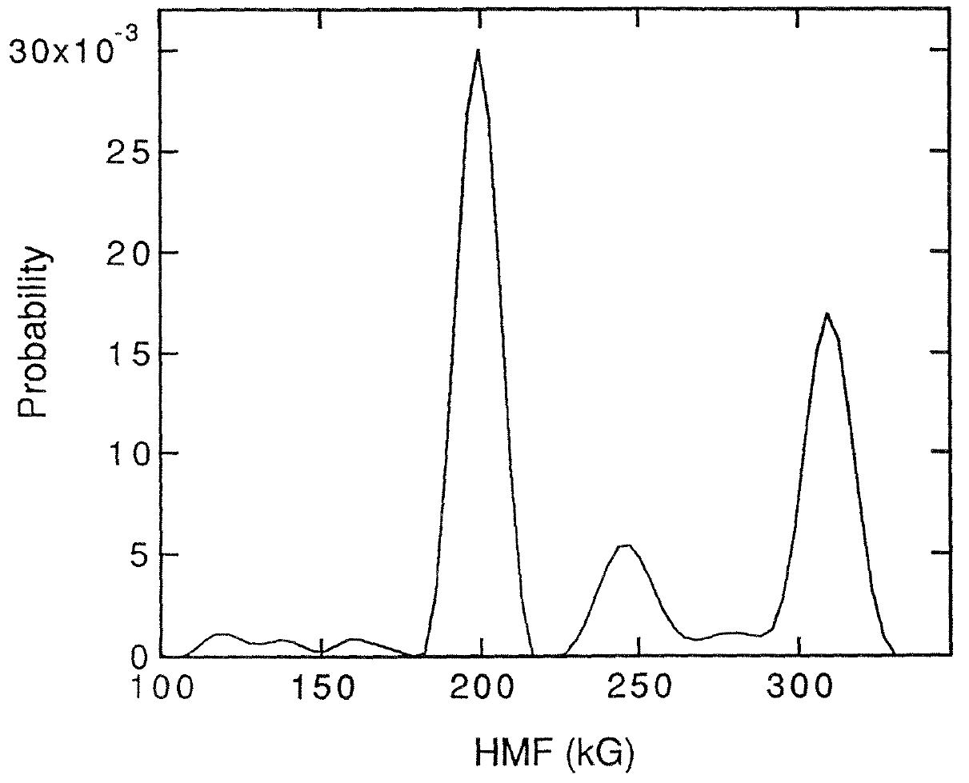
Fe₃Si Ordered Structure

Slide 41
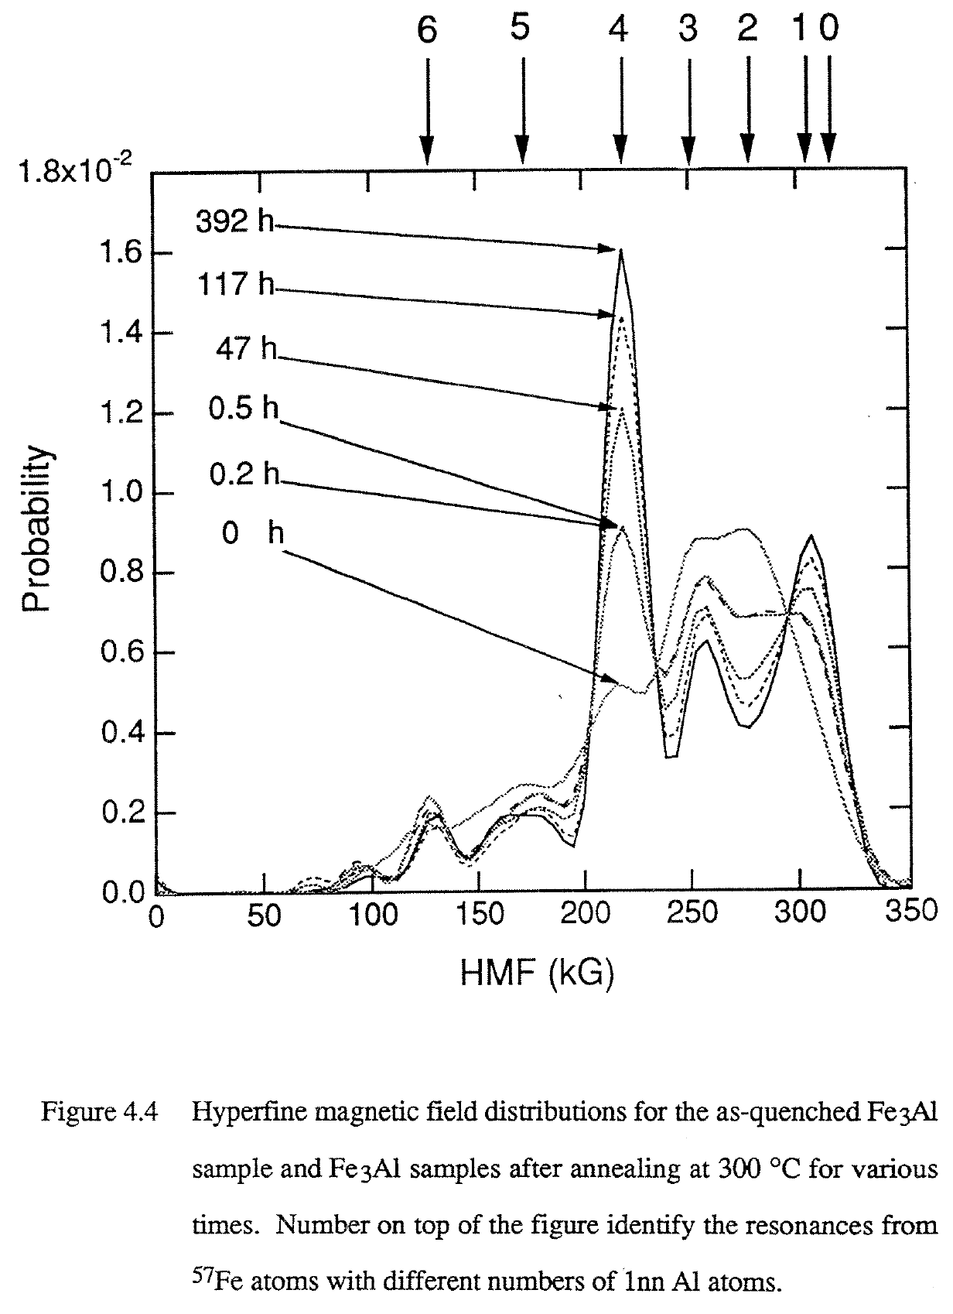
Chemical Ordering in bcc Fe₃Al Solid Solution
Sample prepared as disordered solid solution of Fe-25%Al.
Random numbers of 1nn Al neighbors.
Heated to develop the equilibrium structure that has 1/3 Fe atoms with 0 Al neighbors and 2/3 Fe atoms with 4 Al neighbors.

Slide 42
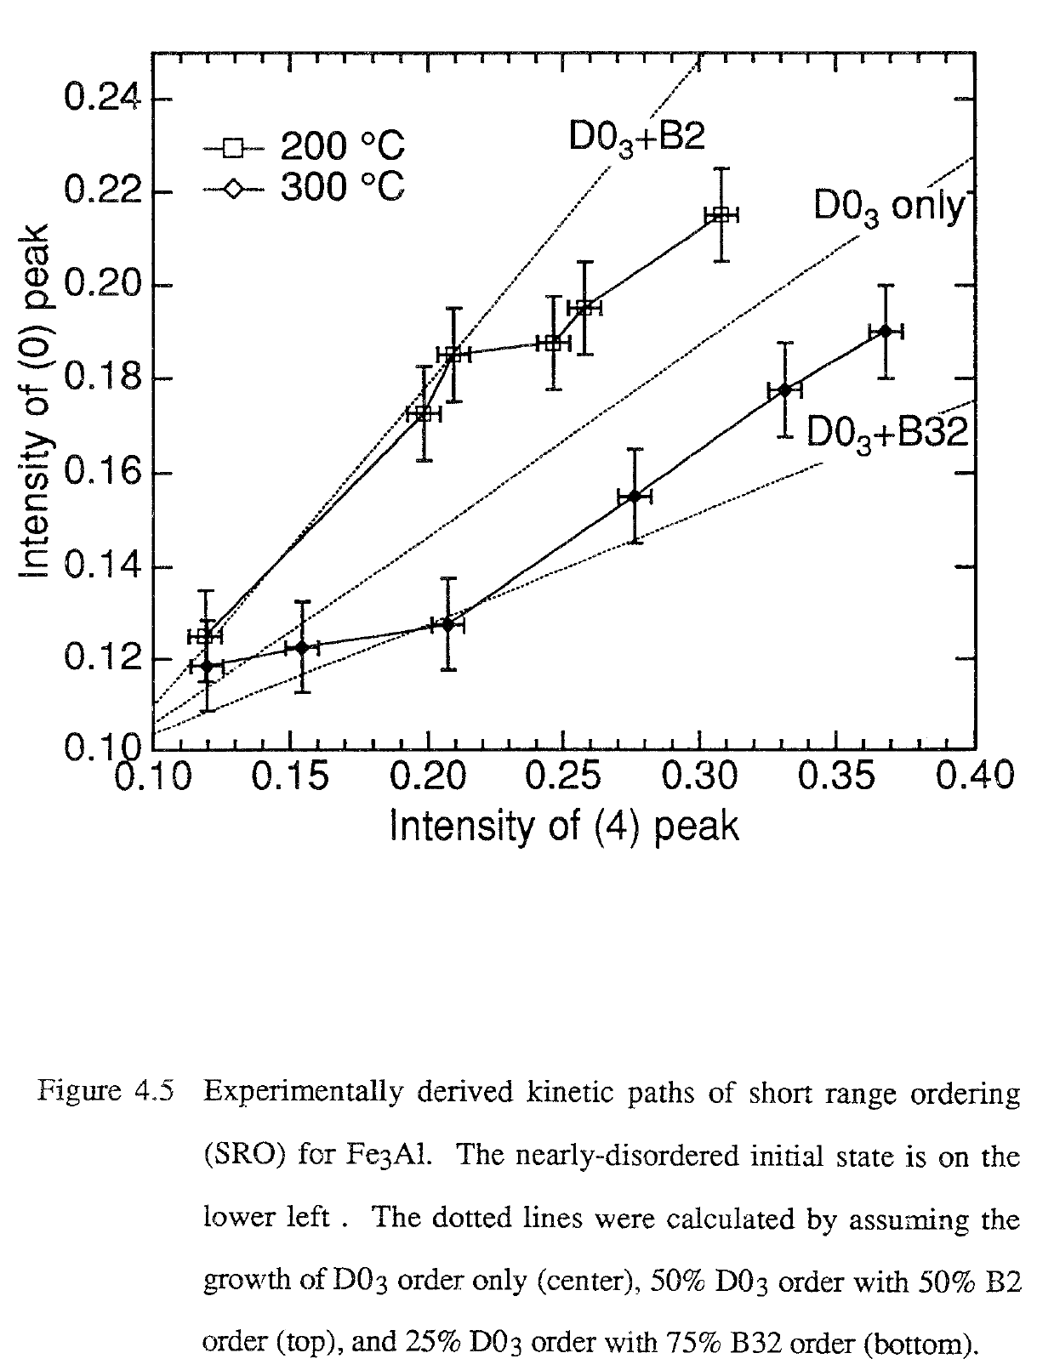
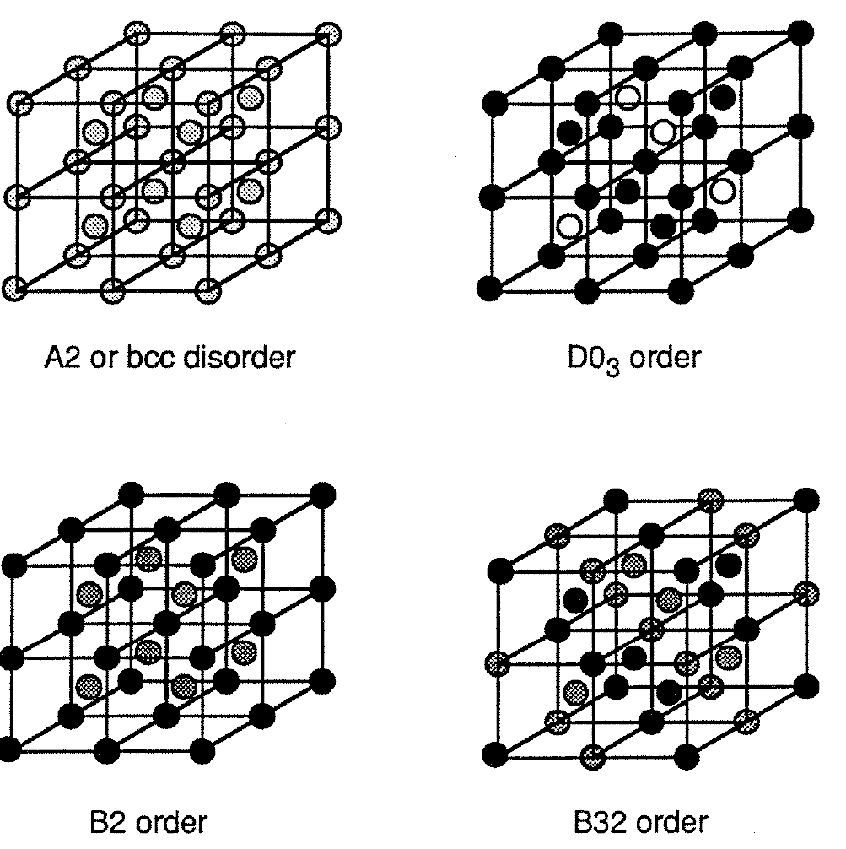
Kinetic Paths Through Independent Order Parameters

Slide 43
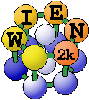
WIEN2k
P. Blaha, K. Schwarz, G. Madsen, D. Kvasnicka and J. Luitz
Inst. f. Materials Chemistry, TU Vienna
• Performs electronic structure calculations of solids using density functional theory (DFT).
• Uses the full-potential (linearized) augmented plane-wave ((L)APW) + local orbitals (lo) method.
• WIEN2k is an all-electron scheme including relativistic effects.

Slide 44
WIEN2k
• Electric field gradients, isomer shifts, hyperfine fields
• Spin-polarization (ferro- or antiferromagnetic structures), spin-orbit coupling
• X-ray emission and absorption spectra, electron energy loss spectra
• Phonons, with an interface to K.Parlinski's PHONON program

Slide 45
Is ε-Fe Magnetic?
Old Facts:
ε-Fe forms at 12 GPa pressure.
Requires diamond anvil cells, so small volumes.
Mössbauer spectrometry has shown it non-magnetic,
even at 4 K.
New DFT Calculations:
Showed ε-Fe is antiferromagnetic, which would not be detected in bulk properties.
Calculations also show a cancellation of core and conduction electron contributions, so HMF~0.
Maybe Mössbauer spectrometry is insensitive to antiferromagnetism in pure ε-Fe?

Slide 46
How to Calculate HMF?
Need polarized electron density very close to nucleus,
available from WIEN2k.

Slide 47
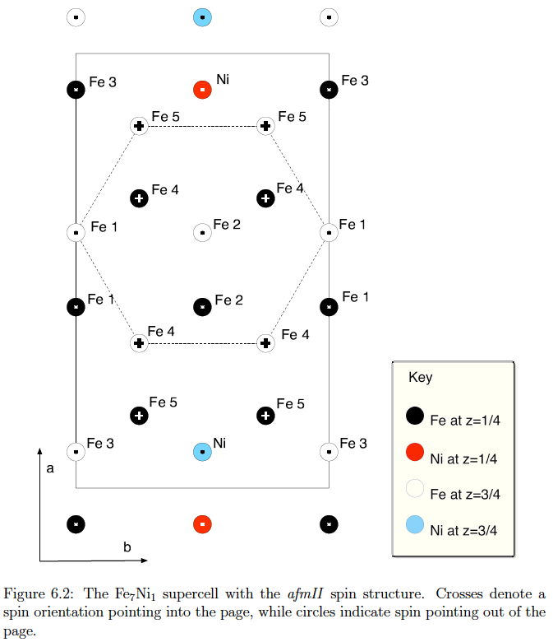
Antiferromagnetic
ε-Fe with some Ni in it

Slide 48
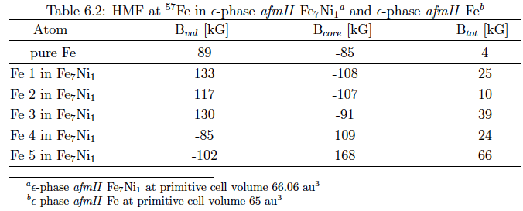

Slide 49
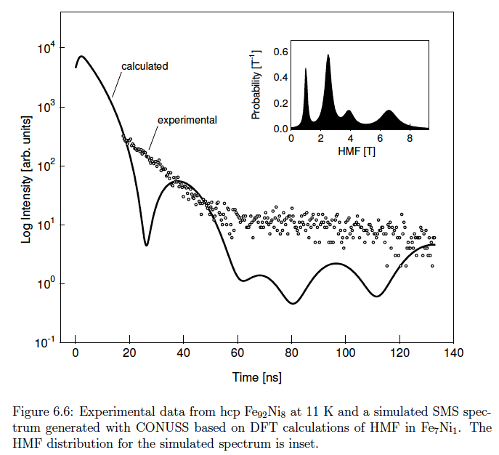
Experiment showed non-magnetic ε-FeNi

Slide 50
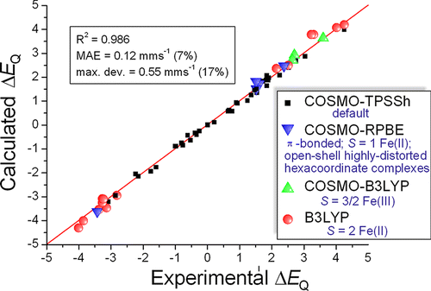
EFGs and ISs
On Predicting Mössbauer Parameters of Iron-Containing Molecules with Density-Functional Theory
Mátyás Pápai and György Vankó from Budapest, Hungary
J. Chem. Theory Comput., 2013, 9 (11), pp 5004–5020
Predicted IS and EFG for a diverse set of Fe complexes.
Sign of EFG is practical to calculate to augment experiment.

Slide 51
Mössbauer Community
Connection between nuclear physics and solids.
Elegance of the method has broad appeal.
~500 attendees at ICAME, but no parallel sessions.
Effect named after a real person and his Ph.D. thesis work.
Nice words like hyperfine, resonance, excited, harmonic.
International family flavor of Mössbauer community.

Slide 52
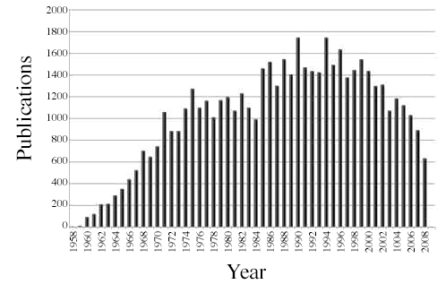
Mössbauer Community

Slide 53
So What Happened?
Big drops of activity in USA, UK, Germany, France, Japan, India, China
Growing activity in Latin America, Africa, Oman
Rich get synchrotrons, but fewer of them.
Poor get Doppler drives.

Slide 54
So What Happened? (Opinion)
Anybody can do Mössbauer spectrometry.
Not everybody can interpret the spectra properly.
Even fewer can find cases where Mössbauer spectra give critical insight.
Rudolf Mössbauer described the community as “noisy.”

Slide 55
What Next? (Opinion)
Mössbauer spectrometry still offers a unique viewpoint of materials from the inside out.
Good work in relating the hyperfine structure to the local electronic or atomic structure can still be done with calibrations.
Today, though, we can do some calibrations with density functional theory and all-electron codes.
New opportunities are possible with a Doppler drive and DFT.

Slide 56
End of Presentation

