Slide 1
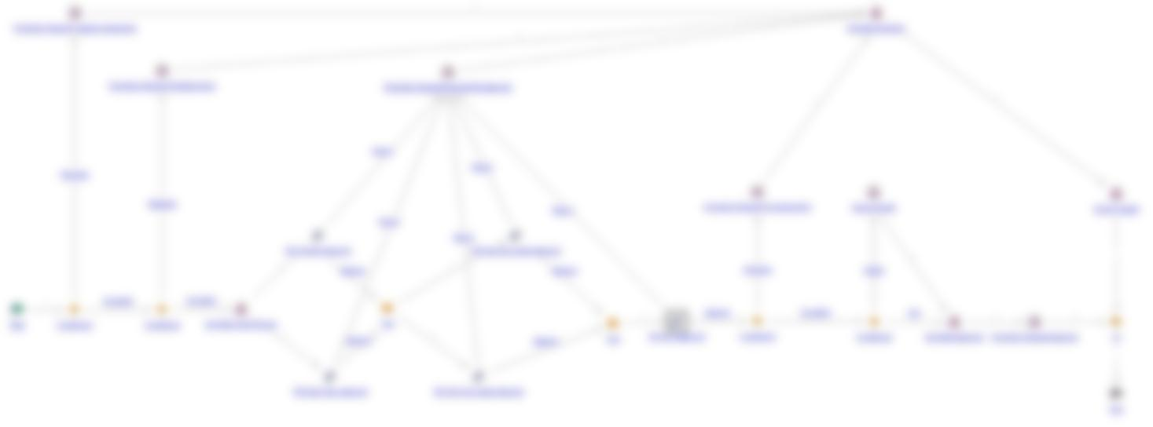
Windchill Release Process
M. Givens
Design-n-Drafting Group
2/5/2013

Slide 2
Agenda…
Initiator’s POV
  “Swim-Lane” view of the electronic workflow
  General steps taken by Initiator
  ‘New Promotion Request’
    The 3 (or 4) Pages
  The ‘Rework’ idea
Approver’s POV
  Notifications
  Task Page
  Promotion Request Page
  How to get to the Drawings
  Choices available
Summary

Slide 3
Initiators
Called Initiators because they begin the Promotion Process.

Slide 4



Things No Longer Necessary
No more publishing to pdf’s or combining them
No more pulling back down into a Workspace after final check-in
No more exported text files and Excel cover sheets
No more regen’ing to make sure the drawing shows a state it really isn’t in yet
No more ICMS data entry
No more PRINT_REL !!
Notes:
Thought to start out on a happy note… These are all the things we no longer have to do in a Release Process.

Slide 5
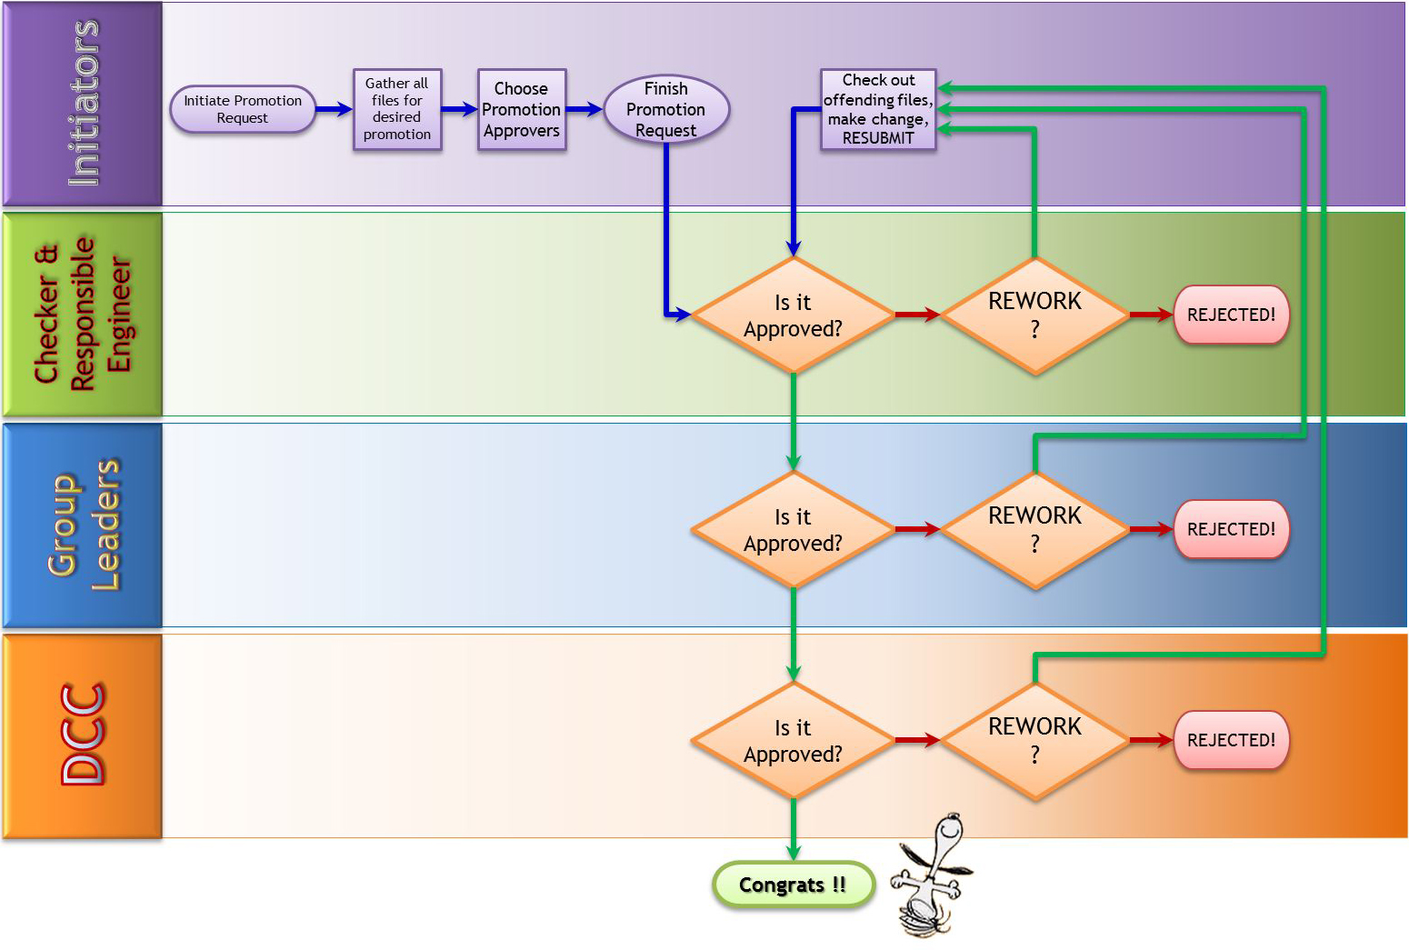
Workflow, at a glance…
Yes
No
No
Yes
Yes
No
No
Yes
Yes
No
No
Yes
Notes:
This is kinda colorful but shows the flow of the process from a role-perspective. The big boxes are called swim-lanes. Initiators inhabit the purple lane.

Slide 6
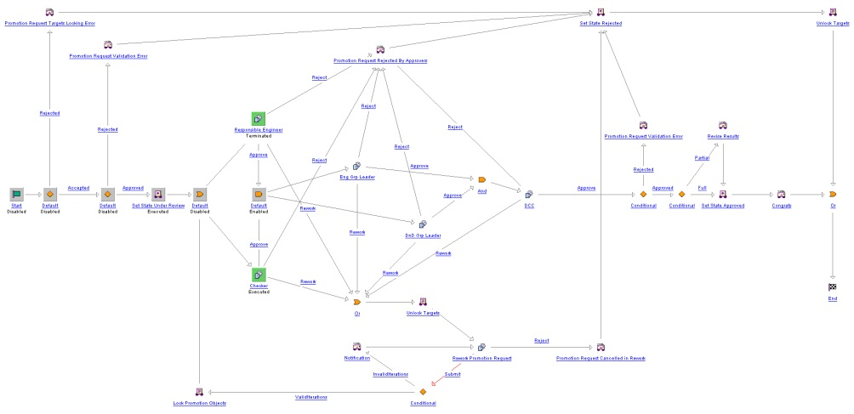
The Actual Workflow: Approvers
Notes:
Just for giggles, this is the actual workflow. This shows you the Approvers that see your work. At least, by Role. Notice this has a partial series, partial parallel flow to it.

Slide 7
So what DO “initiators” do?
Make sure your files are ready
Make sure the Promotion Request contains all pertinent files for that Approval
Make sure those files are chosen for Promotion
Make sure you choose a Responsible Engineer
Make sure you choose his/her Group Leader/Project Leader/CAM
Handle the Rework if necessary
Notes:
Now, we all know that’s terribly simplistic. There’s a lot of sub-steps here. The first one alone is the meat of the matter, but the second and third may prove a really lengthy engagement as well.

Slide 8
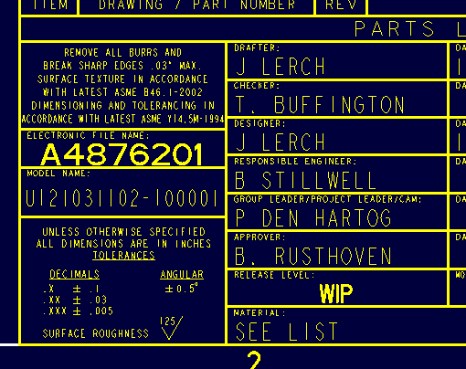
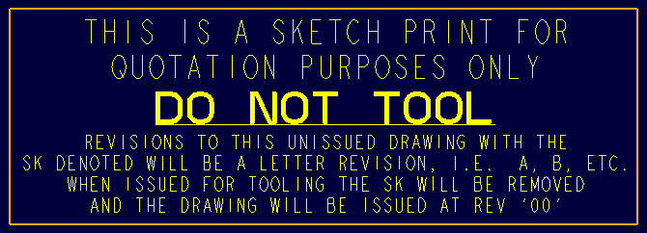
Files Ready? (Pre-Promotion)
First of all, is the work done?
  The Standards is a checklist for actual presentation
Using the new titleblocks?
Drawing Program: does it exist in every drw?
Do-Not-Tool Symbol: visible in every drw?
Are all drw’s Published?
  If you can’t see it, neither can an Approver
Metadata
  Does the drawing’s match the model’s?
  Is everything filled out?
  Are they the same Revision?
Check-In
  All files must be checked in
  Windchill will watch iterations!
Notes:
This is kind of business as usual. Dot all your I’s, cross all your T’s. The new workflow requires a new titleblock. One that does not include that whole Print_Rel thing. The Drawing Program is necessary for the control of the next guy. The Do-Not-Tool symbol. That’s a policy thing. Make sure it’s somewhere visible. Metadata: They’re your ducks. Keep ‘em in a row. Make sure both drw attributes match their respective asm’s or prt’s. Lastly, Check-In your work. Do not try to promote something without that step. And please, please, please… do NOT squilch up your message lines. They’re your friends. At least leave three! When you attempt a Check-In, make sure it says, “Check-In succeeded”

Slide 9
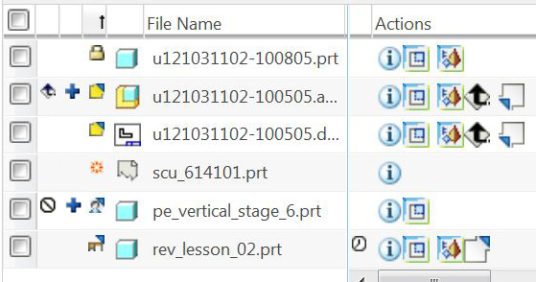
Workspace icons …
Modified Status
Local WS Status
General Status
Out-of-Date
Assembly
  Part
    Drawing
      Format
There’s also:
File is Ineligible for Upload
File needs to be Uploaded
File is locked (read-only) in the workspace
File is checked-out to YOU
File is checked-out to YOU but in a different workspace
File is checked-out by someone else
File is brand new
File is Out-of-Date, a new iteration exists in Commonspace
(using the “Atrribute_Vu” Table View)
Notes:
There’s a bunch of icons all over Windchill. This might help to figure out what you’re staring at in your workspaces. The important one for initiators is perhaps the Checked-Out icon. If you think you checked your work in, and you still see this in your workspace, something failed.

Slide 10
Criteria for Promotion
Decide what would best make a release package
  Think of it as you would the ICMS’ DRP package
    Are you just trying to get piece parts Released?
    Are you encompassing the whole of your project in one promotion?
You cannot think of it as “Pushing to Pending” anymore
Notes:
Although the steps are initially the same for your promotion requests now, you kinda have to think of the Promotion Request as a DRP. You have to gather all the files you need for whatever you wish to Release and include them in ONE Promotion Request. I know some of you presently push your files to Pending one at a time. You can’t do that with the new system unless you want full Approvals to happen one at a time.

Slide 11
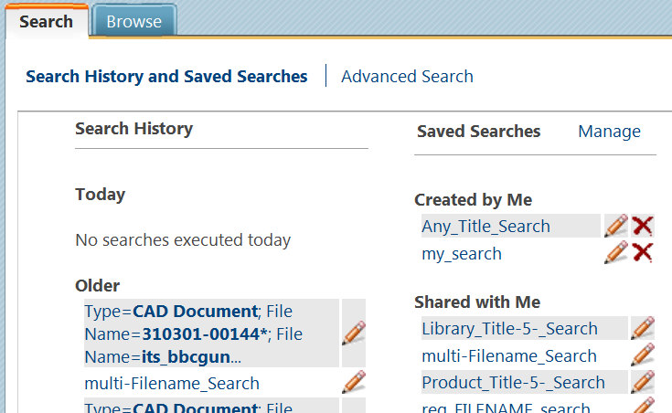

1st Step: New Promotion Request
Several ways to do this:
Promotion Requests can be a group function
  Use the Multi-Filename Search
  Include all pertinent files in your search criteria
  Then select all, click on
  Select New and then New Promotion Request
Or handle all your files in the Promotion Request window itself
Notes:
This is a Commonspace function. Go to Commonspace to do it.
The Multi-Filename Search will come back with a table populated with only the files in which you’re interested.

Slide 12
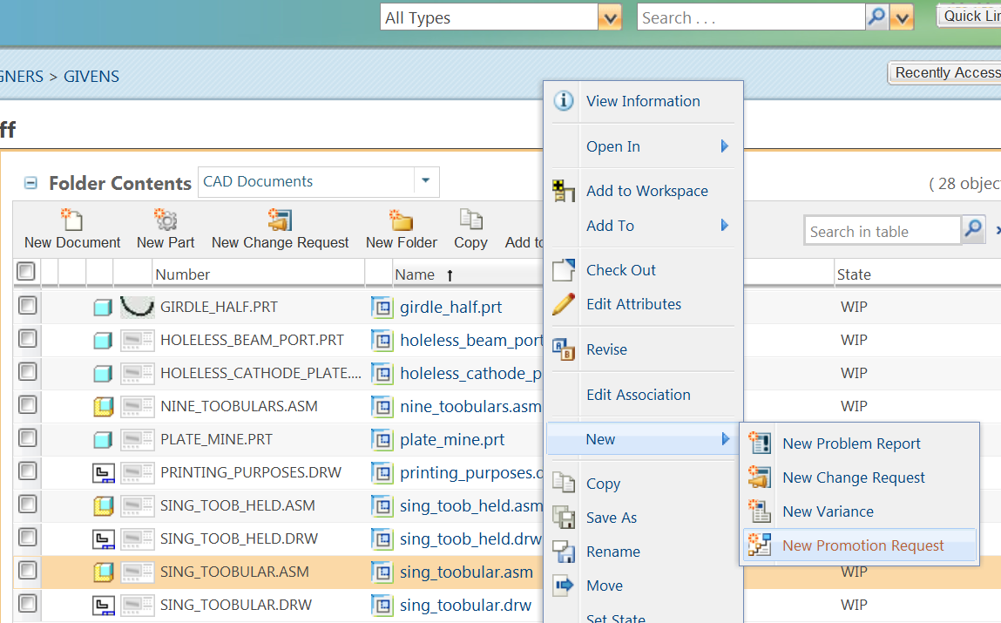
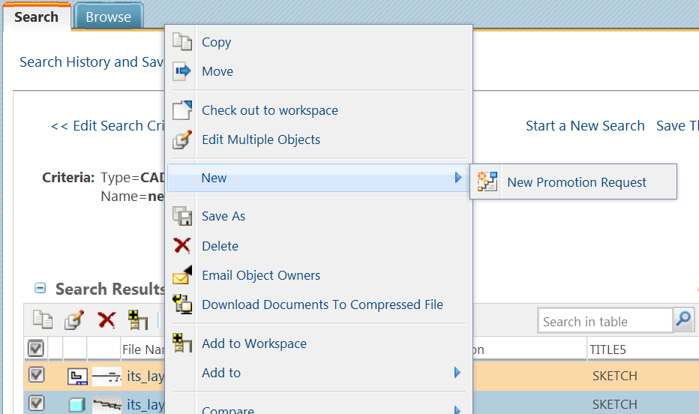
1st Step: (continued…)
Finding a File in a Folder…
Using in a
Multi-Filename Search…
Notes:
You can even get to New Promotion Request from an object’s information page by using that Actions dropdown. The right-click menus may not look exactly like this, but New will be on one of them somewhere.

Slide 13
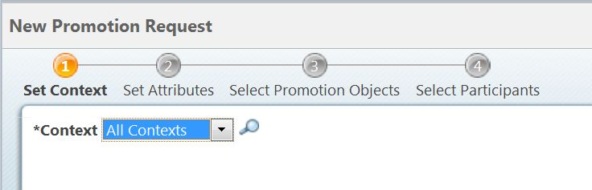
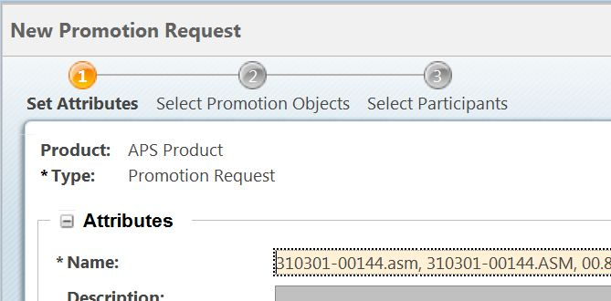
2nd Step: ‘New Promotion Request’ Window Type
4-Step window…
Pick “APS Product”
Only necessary if you don’t see “APS Product” in the dropdown
More common 3-Step window…
Notes:
I’ve seen two different Promo-Req windows, depending upon how you got there. Most of the time, you’ll get a 3-step process. If you used the Actions dropdown in a Search window, you may get a 4-Step process. Don’t sweat the extra 1st step in the rare form. It wants you to choose “APS Product” from the dropdown. It won’t let you proceed until you do. If it’s your very first time seeing this, you may find “APS Product” is not on that list, but there’s a little magnifying glass to go look for it. It’ll pop up a search window and you don’t even have to fill out anything. Just hit the Search button in there and it populates with any and all products. We don’t have many, and the only one we use is APS Product. Pick that and hit OK, and you’ll be able to move on.

Slide 14
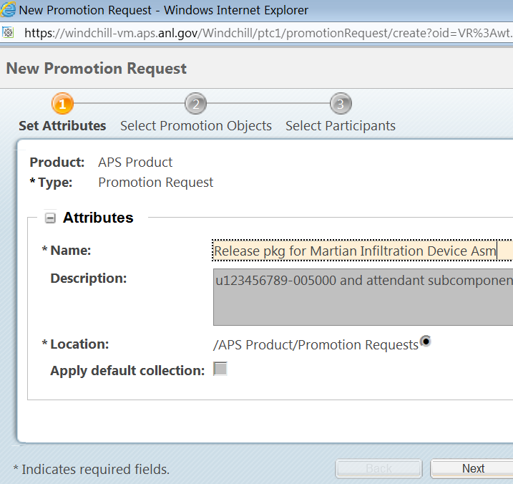
3rd Step: Setting Attributes
The first of 3 (or the 2nd of 4) pages of the Promotion Window
Important Stuff
Name:
  this gives an Approver an idea of what your package is all about
Description:
  Optional, but again it’s more info for an Approver
Apply default collection:
  This is the old Dependency property
  Our default is “All”
    Includes all parts, sub-assemblies, and drawings
Notes:
This page has to do the Promotion Request itself, as on object of its own. Notice the asterisks. Those are the required fields. Location is required, but we set that system-wide. You won’t have to choose anything there.

Slide 15
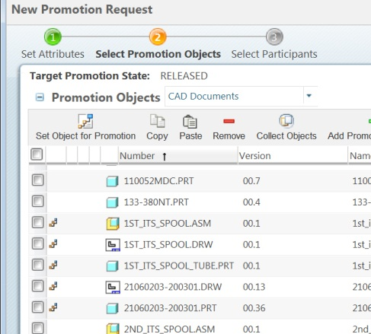


4th Step: Selecting Promotion Objects
The second of 3 (or the 3rd of 4) pages of the Promotion Window
The All-Important page!
Select only those objects for promotion
Notes:
This is where you select what you wish to Promote. You’re looking for the all-important promo-icon. The stair-step or pen-nib thing. That’s what you want to see in front of any and all things that you wish to include in your promotion request. It’s a toggle. Just like everywhere else in Windchill, the icons in the Icon Bar only work if you have something selected. This is a pretty intelligent window. You won’t be able to promote things that are checked out. It’ll even give you messages –warnings and the like- in a column for why certain files are ineligible.
This little bit is on the bottom of this page of the Promotion Request. If you’re doing the piece-part routine where you don’t have an all-encompassing assembly to gather your files for you, you can always use this function of adding files on the fly. It’s self-populating, like filling in an e-mail address in your mail program? You start to type in something, and it begins to offer suggestions, fill in with parts that begin with that bunch of text.

Slide 16
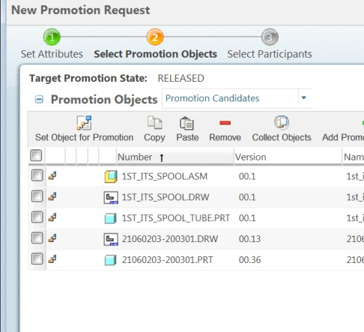
4th Step: Selecting Promotion Objects
The All-Important page!
Select only those objects for promotion
Nice feature is the Table View called “Promotion Candidates”
  This will show you only what you are going to promote
Notes:
It’s a good table view ‘cause you can see just the stuff that ends up in your request. If you have a checklist, you can go down the list. Sort it by name, and you can see if you’re missing a drawing or a skeleton part or something.

Slide 17
The Actual Workflow: Approvers
Notes:
Remember those five Approvers? These three are hard-wired. You don’t have to choose someone to fill those roles.

Slide 18
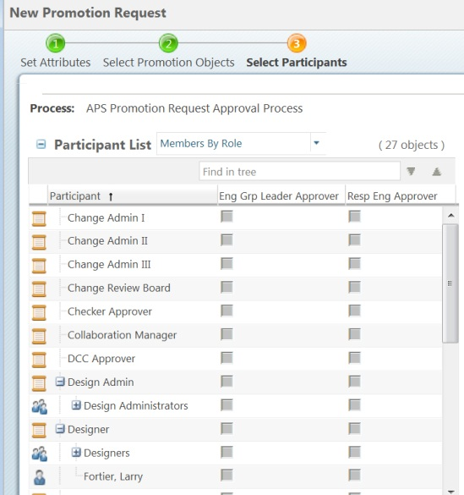
5th Step: Choosing Approvers
The last of the pages of the Promotion Window
“Participants” = Approvers
You only have to pick 2
  Responsible Engineer
  Group Leader\Project Leader\CAM
    Not Brian, the engineer’s Group Leader
Note column headings !
Put a check mark next to the name of the person to fill that role
  Easiest way: use the Find in Table box
Notes:
It’s all downhill from here. All that came before was the hard part. This is easy. There are 5 approvers. Three of them are already chosen. Our Group Leader, DCC, and the Checker position are all pre-chosen. You only have to pick the last two: the Responsible Engineer and his/her Group Leader/Project Leader/CAM. Please pay attention to the column headers! If you don’t like the Grp Leader being listed first, just click on it and drag it to the right. That’s customizable and it’s a sticky setting. It’ll stay there until you change it.

Slide 19
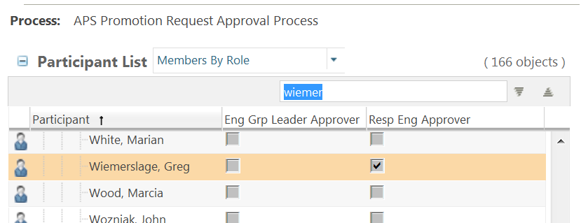
5th Step: Choosing Approvers
Using the Find in Table box…
  Responsible Engineer
Notes:
Type in a portion of the person’s name and it highlights in the list. Stick a checkmark in the box for the role you want them to play. Just so you know, if you are going to use only a portion of the name you’re looking for, it stops on every find. That’s what those arrows are for. For instance, I have several log-ons. If you typed in Givens, you’d use those arrows to cycle through my various multiple personalities.

Slide 20
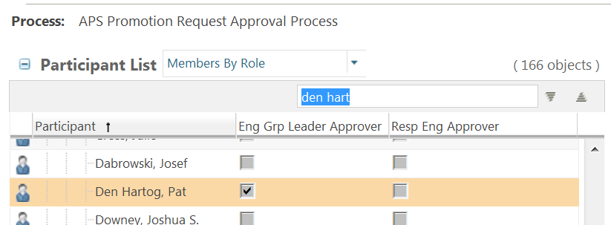
5th Step: Choosing Approvers
Using the Find in Table box…
  Responsible Engineer
  Eng Group Leader Approver (Project Leader/CAM)
Notes:
Type in a portion of the person’s name and it highlights in the list. Stick a checkmark in the box for the role you want them to play. If you need to put in more than one Approver for one Role, that’s possible. And it IS an all-required kinda thing. If you pick two people for the Responsible Engineer, both of them have to approve it before the package moves on to the Group Leaders.

Slide 21
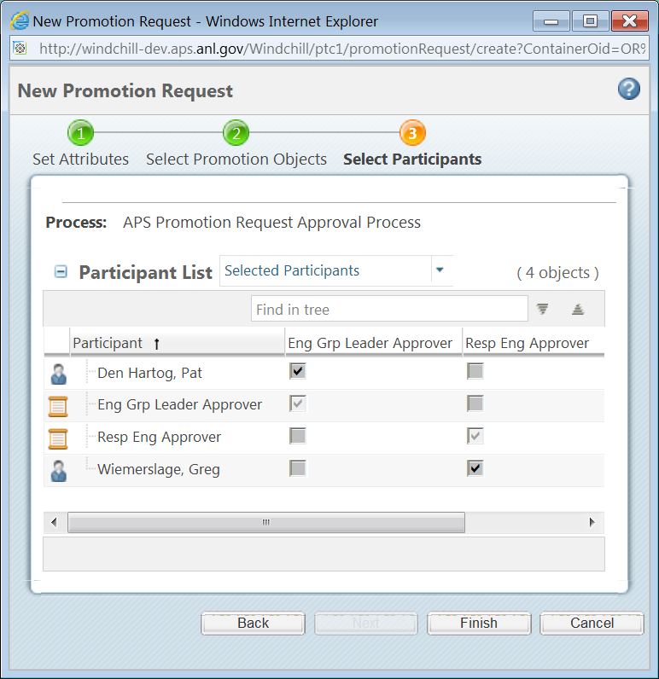
5th Step: Choosing Approvers
As a check, use the Table View called “Selected Participants”
The roles themselves may show up but will be greyed out.
The two or more people you chose
Notes:
That table view will only show you your checkmarks, the people you chose, and the roles you filled.

Slide 22
6th Step: Set it in Motion
Just click the Finish button on the bottom
Notes:
Unless there’s a reason for a Rework, this is an Initiator’s involvement in the new workflow process. It’s not as serial as the DRP process. Both checker and Responsible Engineer get it at the same time. As do the Group Leaders. Then Angela gets it last. It does not automatically reject after a number of days. The Approvers get 3 days to approve it, but if they don’t, you don’t get stuck having to resubmit it.

Slide 23
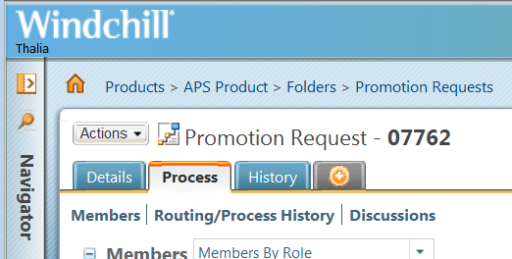
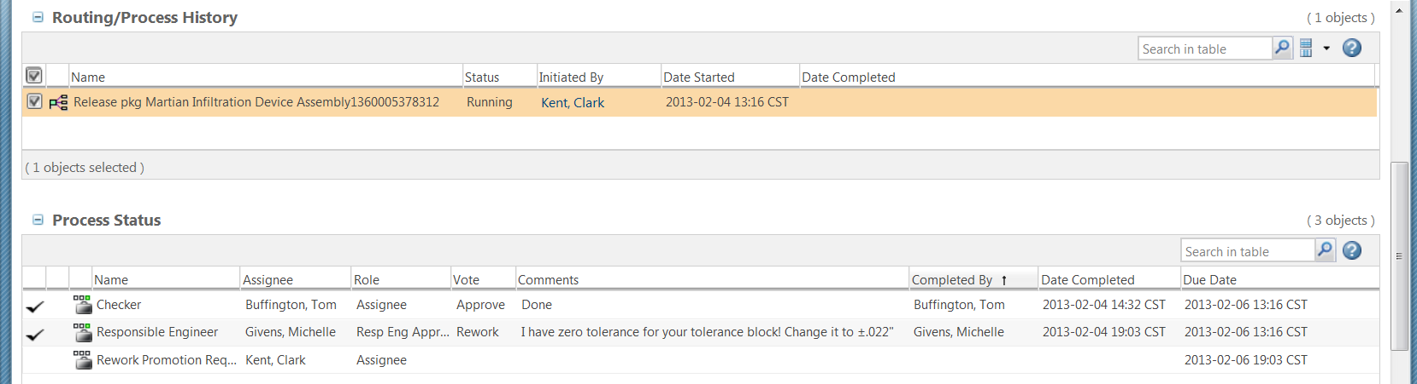

Monitoring the Plight of a Promotion Request
How do you find out the status of an entered Promotion Request?
Anyone can do this (Initiator, Approver, Admin…)
  Go to the Promotion Request’s Info Page
  Go to the Process Tab
  Cursory glance, use Process Status
  In-Depth (and graphical), use Routing/Process History
    Right-Click on the orange line and choose Open Process Monitor
Approver’s Decision
Approver’s Comments
Notes:
Somebody asked me yesterday to show how one could look up what was what with their Promotion Request. After an Initiator hits the Finish button, everything is kinda behind the scenes, but he can still find out at what step it is. You can see which Approvers have done their tasks and what comments they might have made. And ALL Approvers will be listed here as they receive tasks. It’s not just the ones that the Initiator picked.

Slide 24
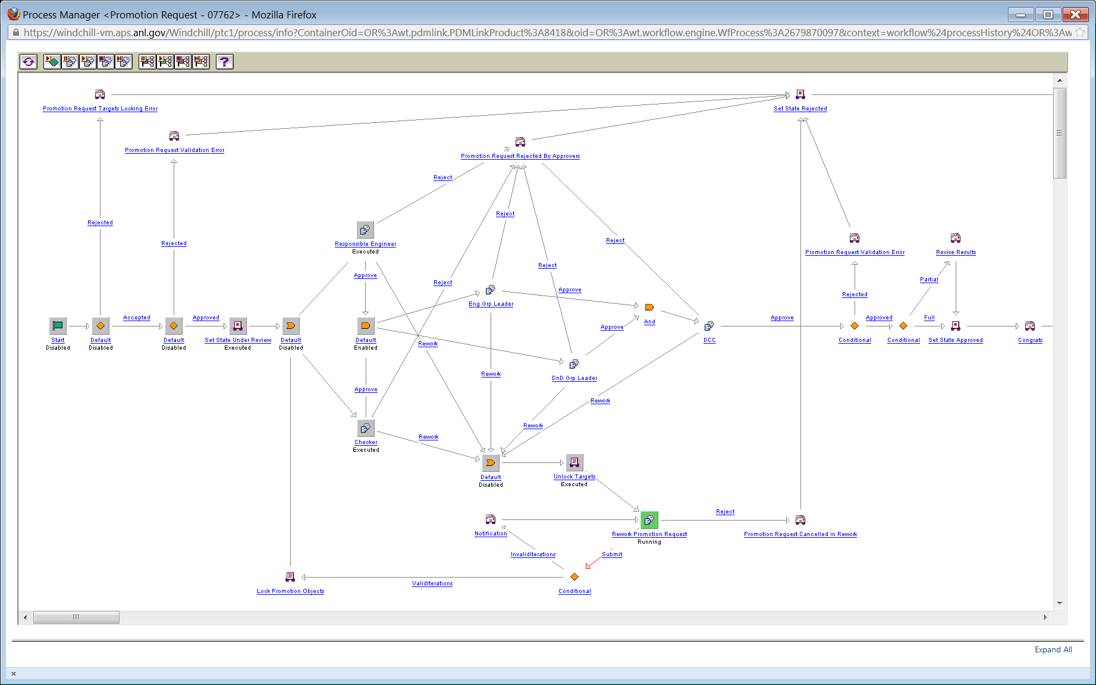
Monitoring the Plight of a Promotion Request
The Process Manager looks like this:
Notes:
Yeah. It’s the workflow itself. The green glowing one is where the workflow is stopped awaiting user input. It hardly ever stops long enough in any other type of box. Just the human-interaction ones. For instance, this one is waiting for that Rework we saw on the slide before.

Slide 25
The Actual Workflow: Rework Section
Notes:
I took this shot from a different Promotion Process, but this whole bottom section is the Rework Section.

Slide 26
What about Rework?
Notes:
Yeah what about Rework? You’ll notice every Approver has the ability to send your promotion request to a Rework. And this means every Approver. If you choose three people for the Responsible Engineer role, each one has the ability to send to Rework.

Slide 27
Rework
Purpose: It’s for simple changes
  You forgot a note
  You missspelled something
  A dimension is missing
  A drawing (and model) need a title change
What it is NOT for:
  Anything that involves an addition or deletion to the collection of initially chosen items
    No renaming anything
    No adding a component or drawing or even a weldment piece
As an Initiator, you have the ability to reject your own request
  If you find the changes require a reorganization of your assembly or a brand new part, you have a Reject on your task page
Notes:
Simple is a relative term. For the most part, if you can manage a rework without violating the bottom half of the slide then you’re probably okay.

Slide 28
Rework: What Happens…
In the middle of approvals, a Rework is deemed necessary
1st event to happen: tasks yanked (not e-mails unfortunately…)
2nd event: all objects are demoted back to WIP
3rd event: Tasks and E-mails
4th event: the workflow waits for user input
  It suspends until you handle your Rework Task
5th event: you’ve done the editing AND YOU’VE CHECKED-IN THE WORK! In the Rework Task, hit Submit
6th event: all objects returned to PENDING state
7th event: begins the Approval part of the workflow over again
Notes:
1st step: as the workflow is in some respects, concurrent in places, the first thing that might happen, is that the task for other Approver might be yanked out of his list. 2nd step: all your stuff pops back down to WIP. The 3rd step: Tasks and e-mails: Only the initiator gets one of each. It’s a Rework notification. 4th step: workflow suspends pending your input. 5th: you do the editing 6th: Windchill gathers the latest iterations of every object in your original promotion request and locks them in the Pending state. They re-enter the workflow in the 7th step.

Slide 29
Approvers
Bare minimum, 5 people to review the drawings included in a Promotion Request.

Slide 30
The Actual Workflow: Approvers
Notes:
These are the bare minimum number of Approvers.

Slide 31
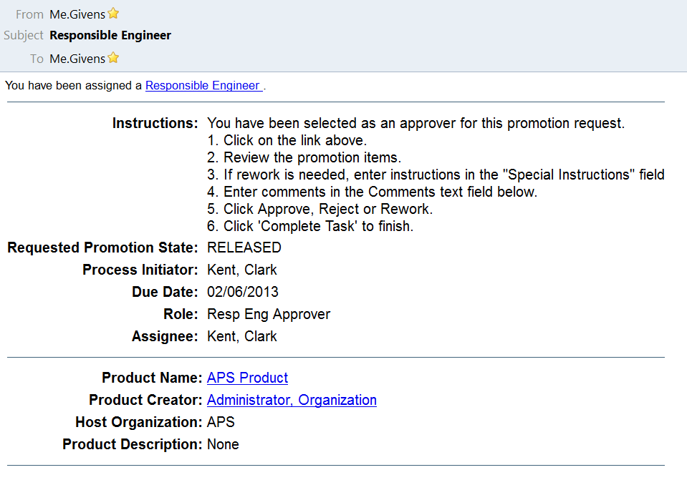
Approver Notifications
Typical E-mail
Role you are called upon to play
Link to the Windchill Task
The Initiator
Your Due Date
(your name will appear here…)
Notes:
The instructions are kind of a work-in-progress. They’ll probably change pretty soon.

Slide 32
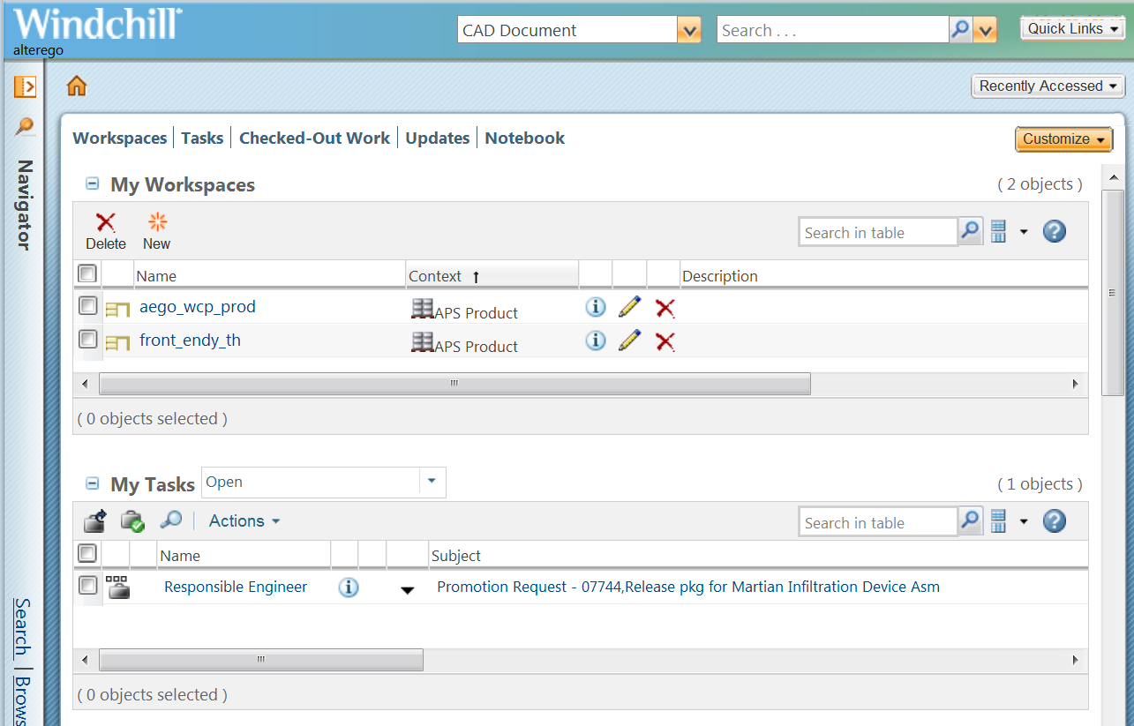
Approver Notifications
Windchill Task
Shortcuts to the tables
Link to the actual Task
The Request’s subject line
Promotion Request’s Number
Notes:
Within Windchill, you can see the other notification you’re given, a Task on your Home Page. How do you get to your Home Page? Hit the little house button. If you Home Page comes up with absolutely nothing on it, you need to customize it. Use the button off to the right. Turn on your view of your Workspaces, Checked-Out Work, and other things.

Slide 33
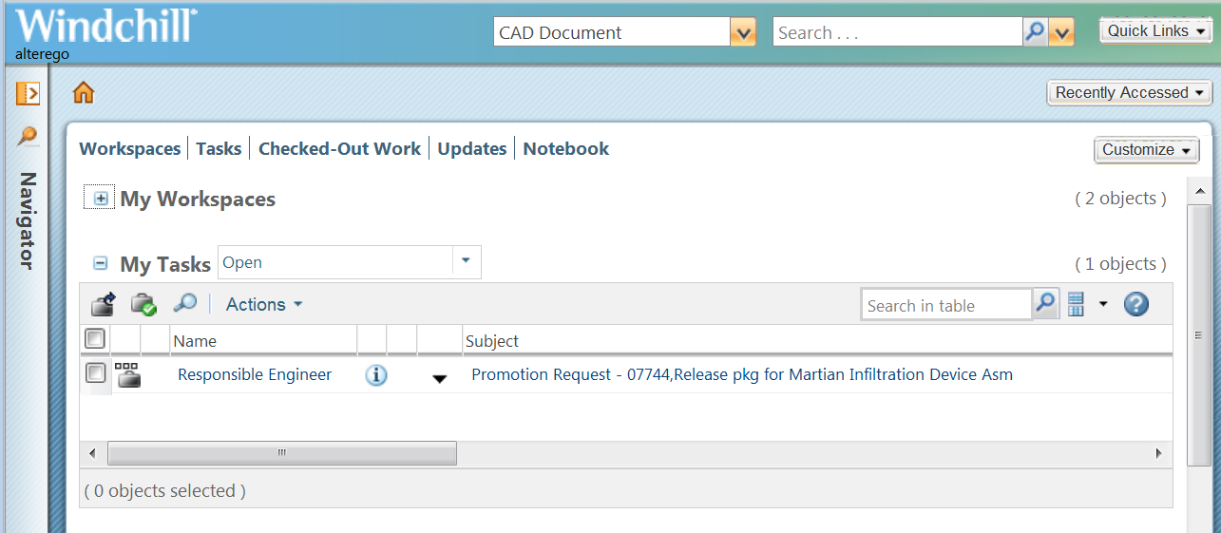
Approver Notifications
Either one gets you to the Task Page
Notes:
Like it says, either link will get you to your assigned task. The one advantage that Windchill’s Task has over e-mail is that it can disappear all on its own. And that’s actually a good thing. Say you’re an Approver other than the DCC. In the workflow, you receive your task at the same time as at least one other person. If they get to it before you do and Reject it or send it for Rework, this task disappears off your list of Things to Do. E-mail is forever. The one good thing is that such notifications don’t fire off until right before they’re needed. So in other words, the Group Cam Project Leaders don’t get tasks and e-mails until the Promotion Request gets successfully past the Checker and Responsible Engineers. And Angela doesn’t get hers until it makes it past the Group Leader Cam people.

Slide 34
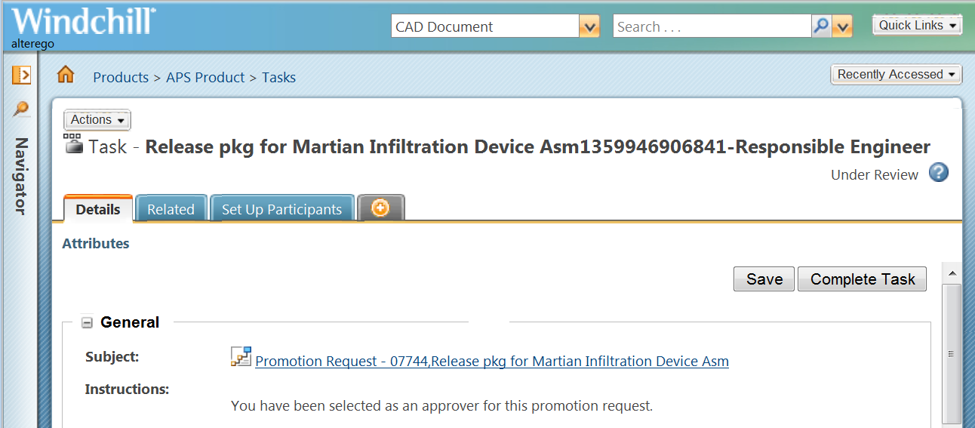
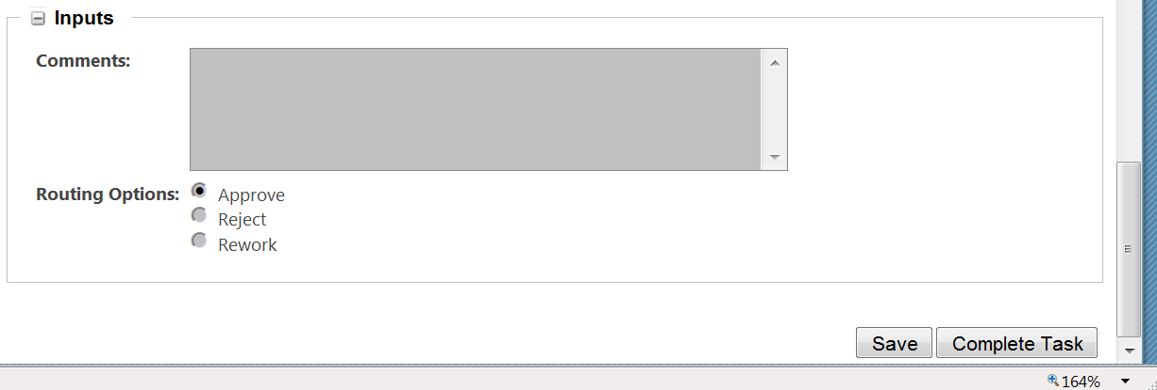
Approver’s Task Page
Where an Approver actually makes the decision
The way to get to the actual Promotion Objects!
Notes:
Okay, so you’ve been notified… You’ve clicked the link. It sends you to a page like this. If you ever follow a link and get a page like this that is lacking the Save / Complete Task buttons, it means either you’ve already done this job or the other Approver at your level already Rejected or Reworked it. Along with the missing buttons, you will see the Status of the Promotion Request telling you what happened. But this is the actual page where the decision is made to pass this one through or not. Okay, yeah this is nice but where are the drawings you’re supposed to review? They’re not here. They’re not under any of these tabs. The Task Page is strictly for the Task. You need to click that Subject Line to get to the actual Promotion Object. So, a suggestion?

Slide 35
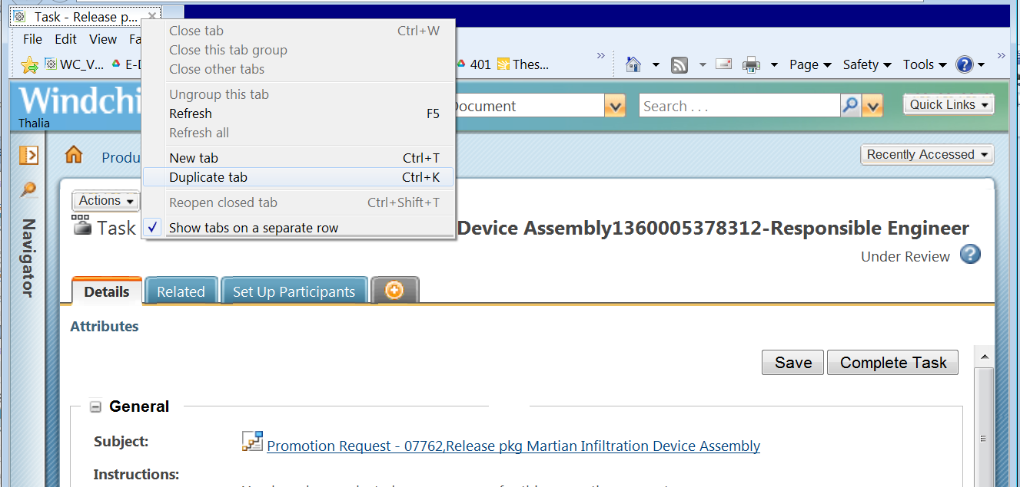
Actual Review Practice
You have to come back to the Task Page, Duplicate the browser tab so that you can
  You can always go back to your e-mails or Home Page Task link to get back here
Notes:
The Task Page is where you Approve or not, so you’ll have to come back here. Just RMB click on the browser tab and make a copy of it. Then click on your Subject link.

Slide 36
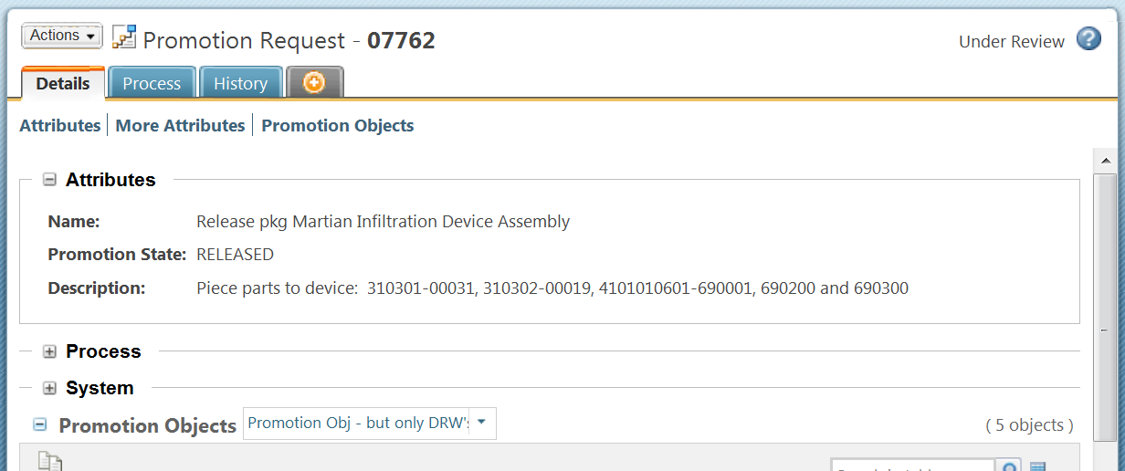
The Promotion Request Page
Details Tab
  In the Attributes Section, you find the Pkg Description
  Where to find the actual Promotion Objects
Process Tab
  Members –place to find who was chosen for what role
  Routing/Process History -tons of info with a graphical representation that steps you through your live workflow
  Discussions
History Tab
  Ignore this
Notes:
You’re sent to the Promotion Request itself. It’s got some good tabs. This is where you find the package description, the people chosen to perform in whichever role, and the all important Promotion Objects.

Slide 37
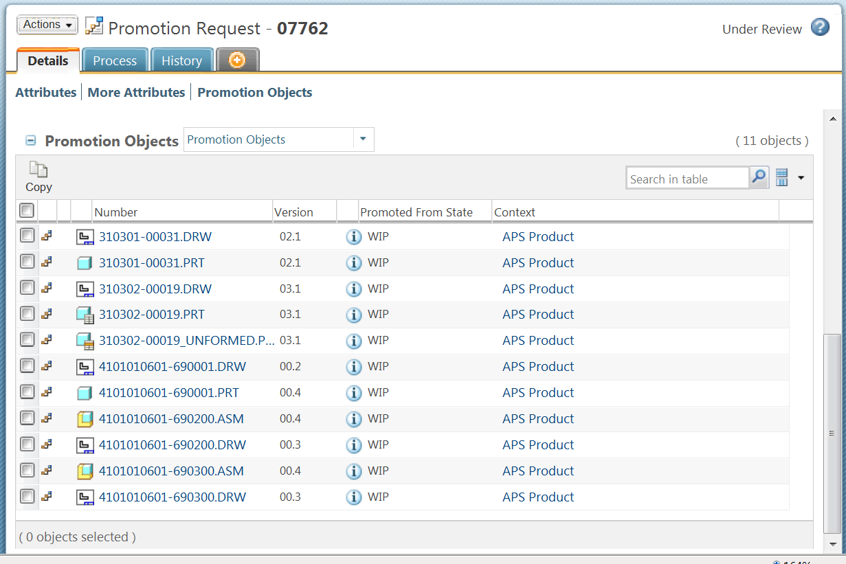
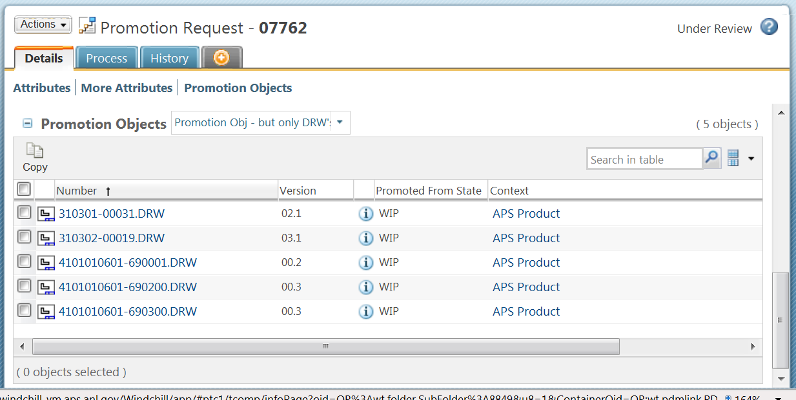
The Promotion Objects
On the Details Tab and all the way on the bottom
Table View
“Promotion Objects” (default)
Shows all objects
Table View
“Promotion Objects – but only DRW’s” (filter)
Notes:
This table shows everything that was included in the Promotion Request. Approvers are usually only interested in the drawings, so in light of that, I made a Table View to show you only those files. Everything is still there and traveling along with them, but the asm’s, prt’s, skeletons, weldment parts… are out of sight. A Table View is a nice way to filter what you see.

Slide 38
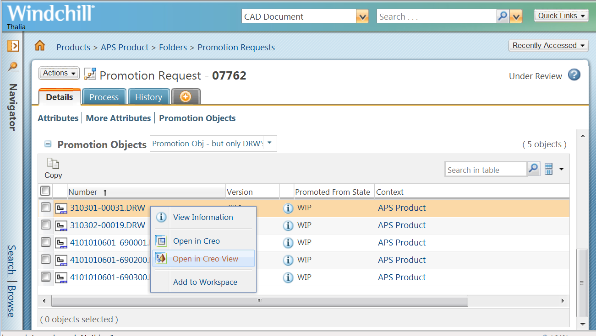
Viewing the Drawings
Right-Click on each one, choose Open in Creo View
Notes:
Just go down the list. Right-Mouse-Button Click in. Choose “Open in Creo View”.

Slide 39
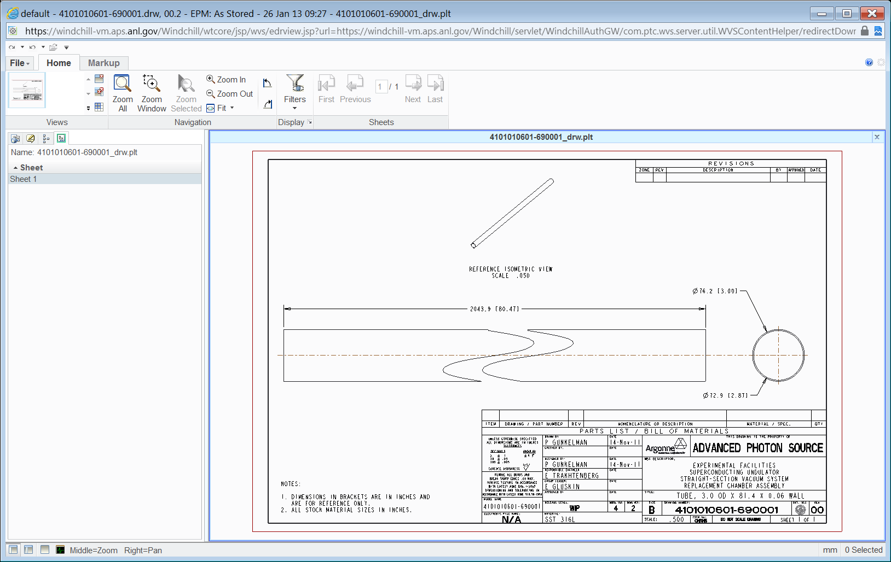
CreoView
Notes:
Kinda like Adobe Acrobat Reader, but of course, with a bunch of bells and whistles. If you notice in the bottom left, there are some helpful hints on how to navigate. If you take issue with something and think you want to send the package to a Rework, this is where that Duplicated tab comes in handy.

Slide 40
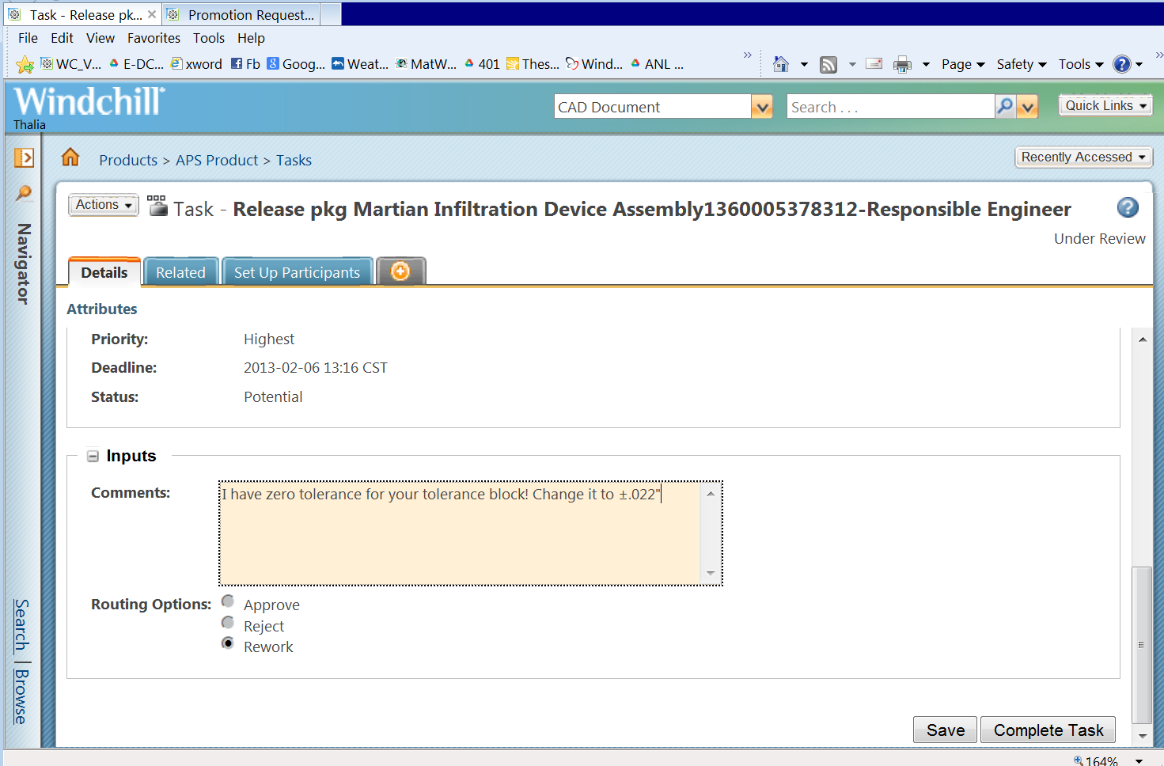
Comments Section
Use it for Rework directions and Reject complaints
Notes:
CreoView is a separate window, so just click back into your browser and add whatever comments you need down in the comments section. If it’s Rework instructions, be so good as to go through all the drawings, listing out what offends. That way, it’s just ONE Rework, and not twenty. These comments get saved for all posterity, tied to the promotion request. I believe they even show up in the Object’s History tab. Since we’re here, notice the Save button. This is a temporary save. For instance, if there are thirty drawings and you get halfway through them, you can save all your comments. You’re not done with the Task, you’ll get back to it, but for right now you’d like to save the comments you’ve made so far.

Slide 41
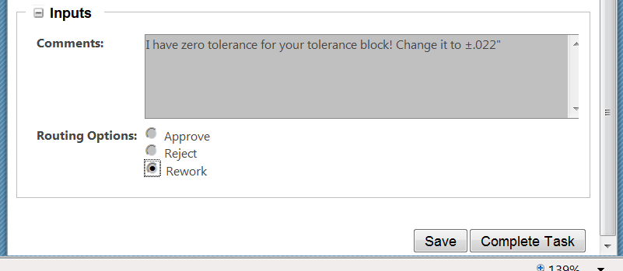
Completing the Task
This happens at the bottom of the Task Page
Choose One
Click to Finish
Notes:
The meat of the matter. You don’t have to enter comments, but you do have to choose one of the three there and click on the Complete Task button.

Slide 42
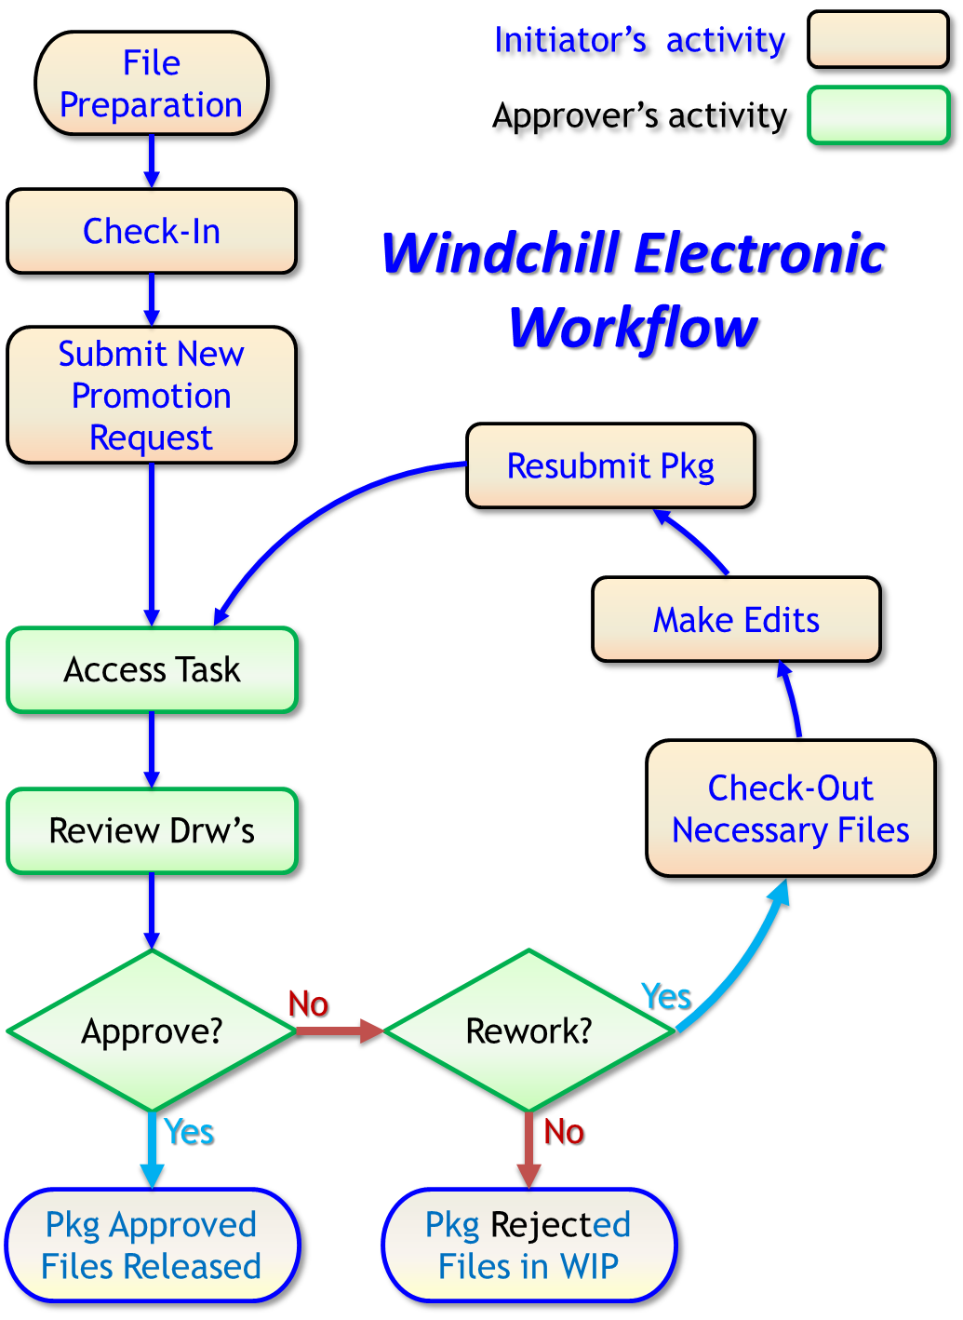
In Summary…
Initiators
  It’s all about the Promotion Request
  All drw’s and files necessary
Approvers
  Links, links, links…
    Link to the Task
    Link to the Promotion Request
    Links to the Drawings
  3-Choices
    Approve, Reject, Rework
Notes:
And in conclusion…
The picture is of one of those clicky acrobat files. Right now, most every step of it links to a page or two (taken straight from this presentation) about how to go about fulfilling that step. I hope to add more to it, flesh it out.

Slide 43
Thank you for your attention . . .

