Slide 1
The Very Basics of Windchill

Slide 2

Agenda
Very basic Windchill stuff
Why do we need it? What’s it for?
Common Starting Point
  Syntax
Connection?
Initial Windchill Actions
  Customizing your Home Page
  Creating a Workspace
Everyday Windchill Actions
  Add to Workspace
  Checking-Out
  Checking-In

Slide 3


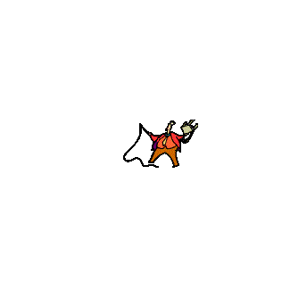
Why Windchill?
It’s all about…
Creo is the program that creates the prt’s, asm’s, and drw’s . . .
… but Windchill is the one that manages the database of all those files
prt’s
skt’s
frm’s
drw’s
asm’s

Slide 4
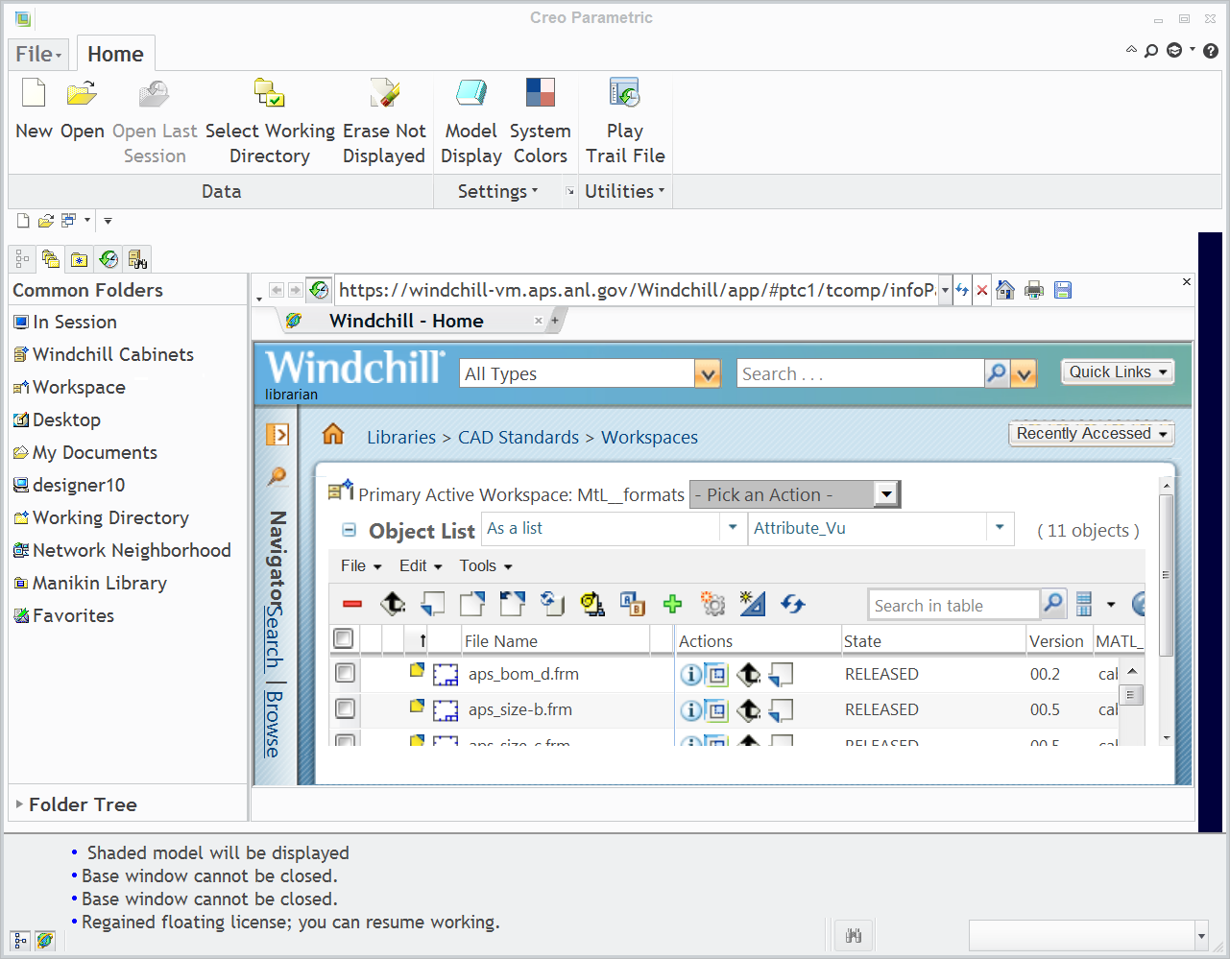
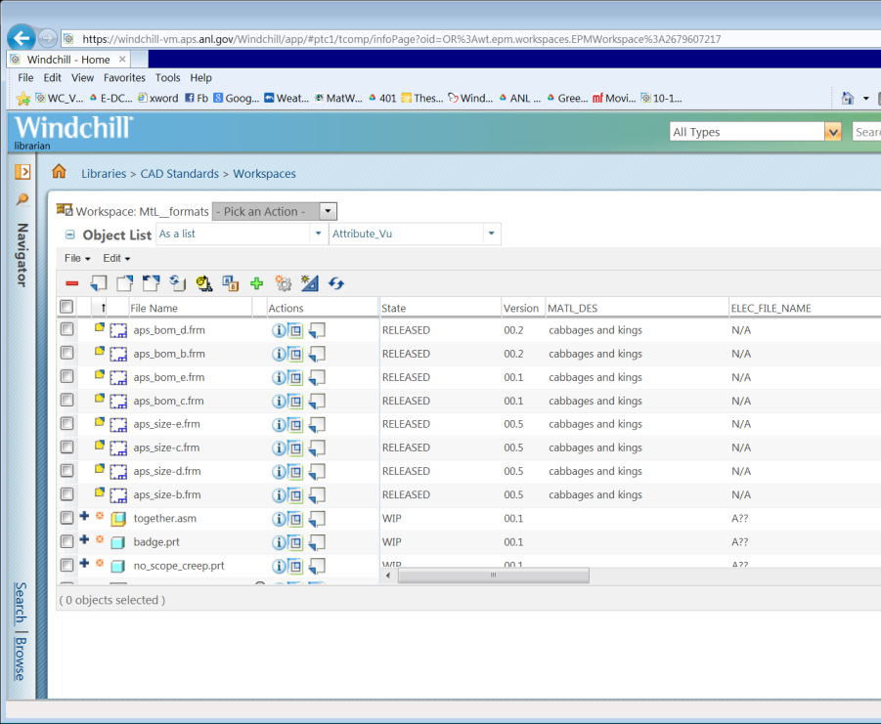
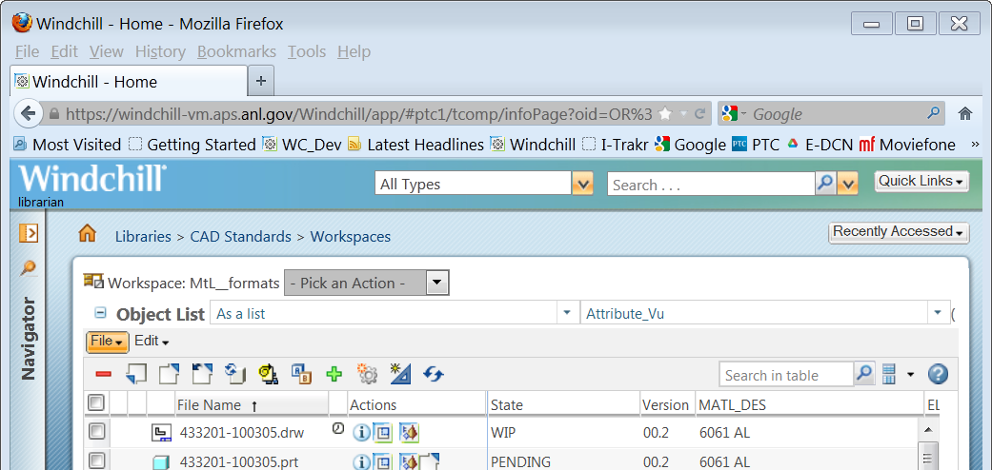
So… how does it control?
‘embedded’ browser
(IE)
Windchill is a server
it’s secure
its database is backed-up
it oversees your Workspaces
it keeps track of its files (objects)
  iterations (00.2, 05.4, 02.20)
  lifecycle states (WIP, PENDING, RELEASED)
  promotions (Approvals, Reworks, Rejects)
it’s browser-based
‘outside’ browser
(IE)
‘outside’ browser
(FireFox)

Slide 5
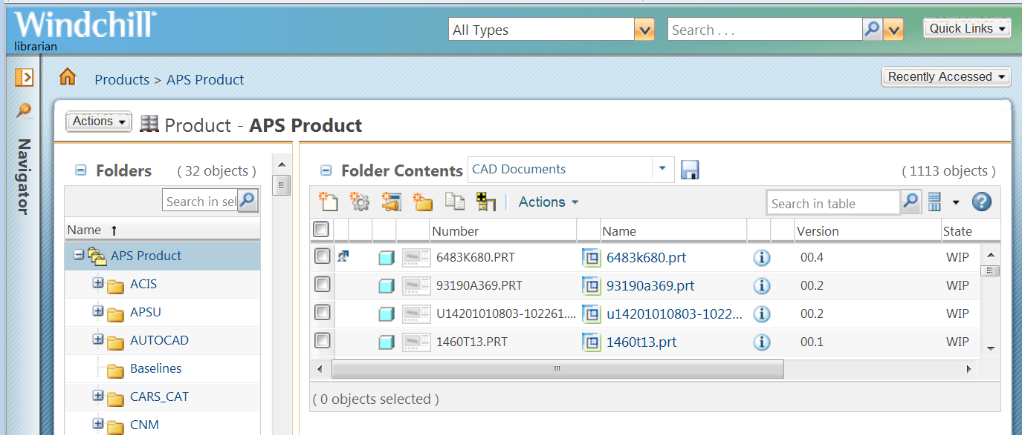
Windchill is all about data and TABLES…
Simple Search (Keyword Search)
Table View (sticky!!!)
Breadcrumb Trail
Search WITHIN Table
the Navigator Bar, for Searching and/or Browsing (shown closed)
Shows how many object in the table (has a limit of 2000)
the means to select ALL objects
Shows how many objects you’ve selected
the means to select individual objects

Slide 6
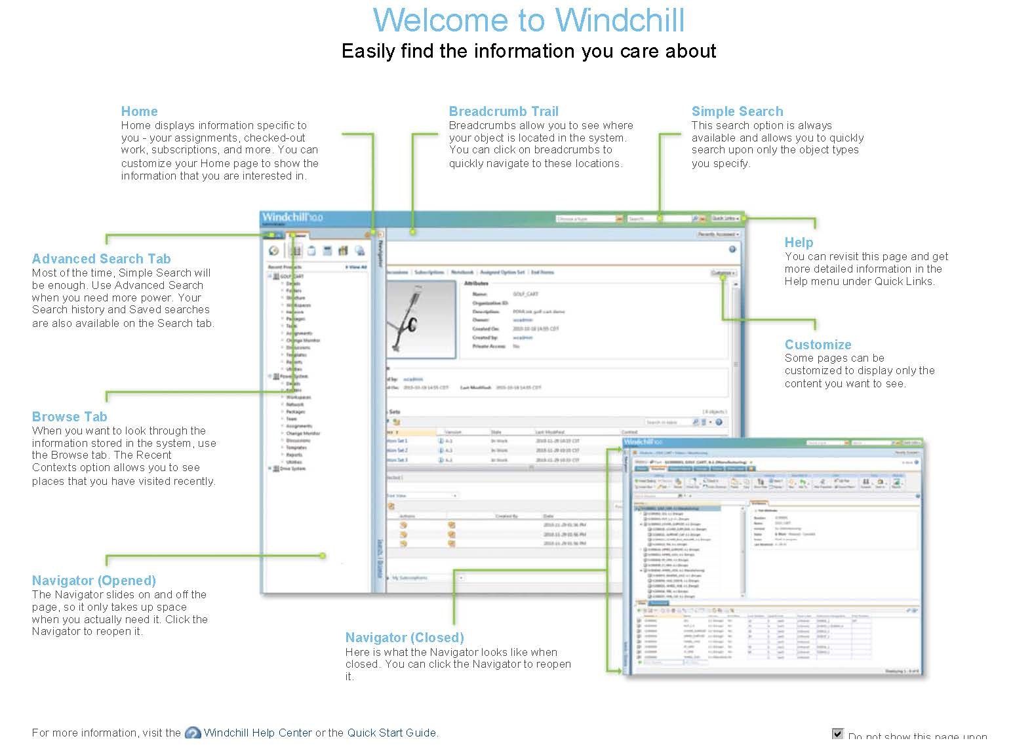
The Windchill Welcome Page…

Slide 7

Syntax: Typical Creo/Workspace View
Ribbon (hack-ptooey!)
Folder Browser
“Embedded” Browser
DropDown Line
Icon Line
Browser Toggle
Model Tree Toggle
Message Lines
Event Manager Shortcut

Slide 8
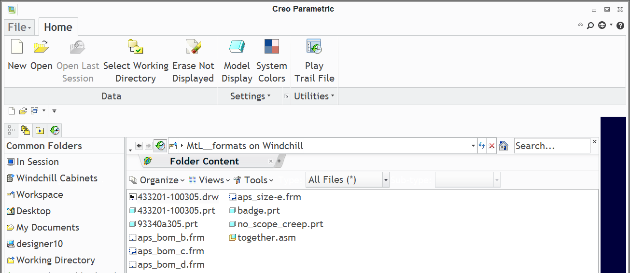
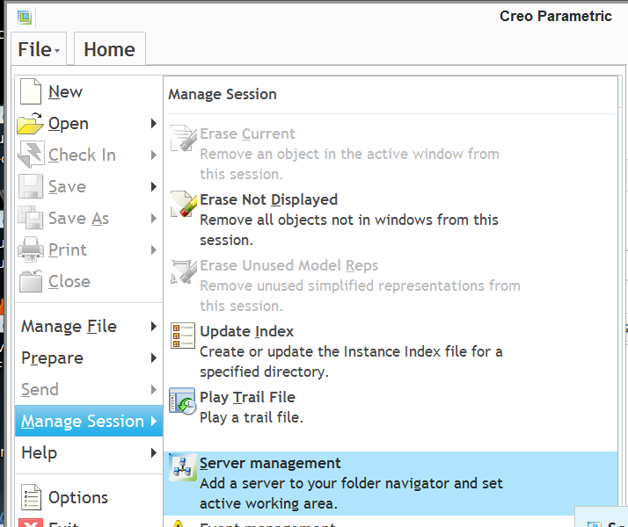
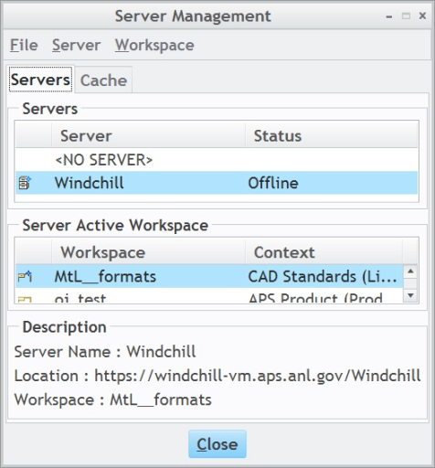
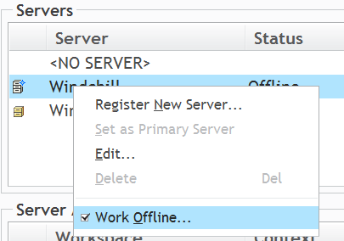
So, how do you know you’re even connected?
You’re in Creo, but are you hooked up to Windchill?
Several ways to tell:
Live
tells you you’re working Offline
Right-Mouse-Button Menu on “Windchill”
Toggle

Slide 9
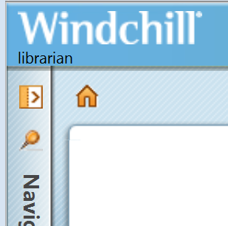
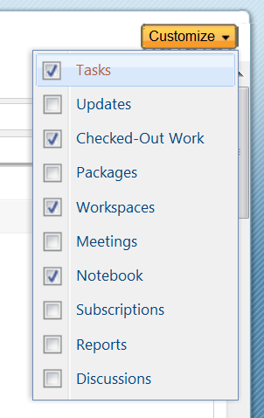
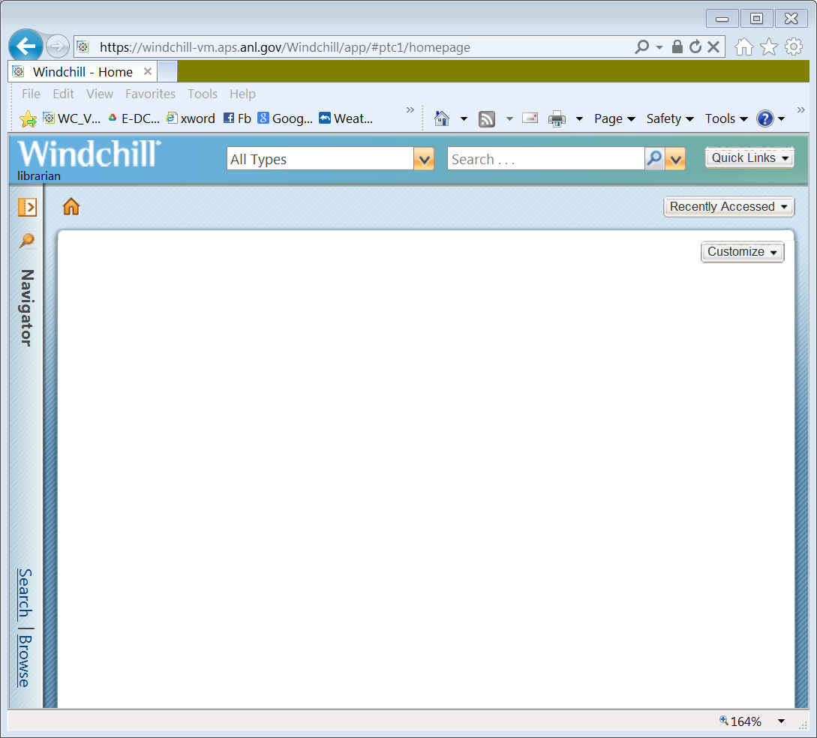
Initial Windchill Actions: Home Page Customizing
Logging-In: APS LDAP username and password (ICMS, Green Sheets, etc.)
Your Username
Shortcut to your Home Page
When you 1st log-on, it may be blank. Click here…

Slide 10
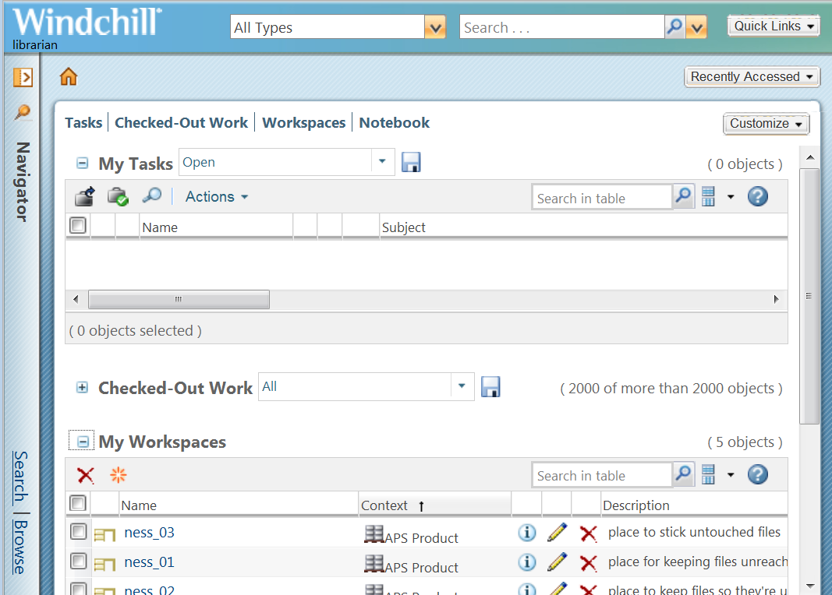
Initial Windchill Actions: Home Page Customizing
Once customizations are set, they’re ‘sticky’ (they stay put until changed)
All sections have little pluses and minuses for collapsibility
the dark blue links at the top are shortcuts and are draggable to change the order in which things are listed
opened
these are draggable if you need more page real estate for that table
closed

Slide 11
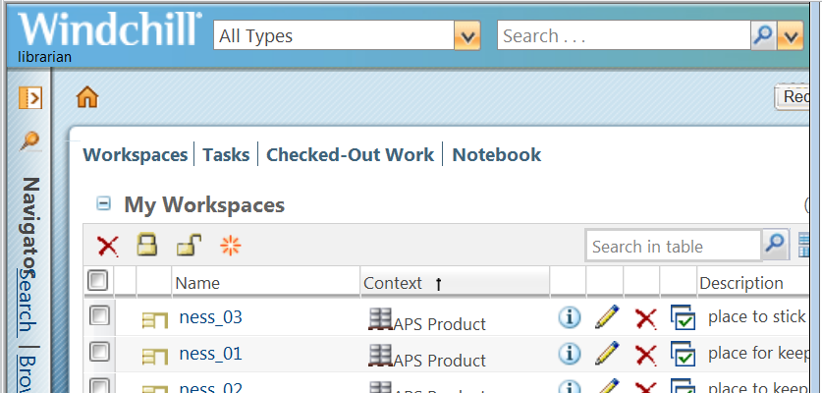

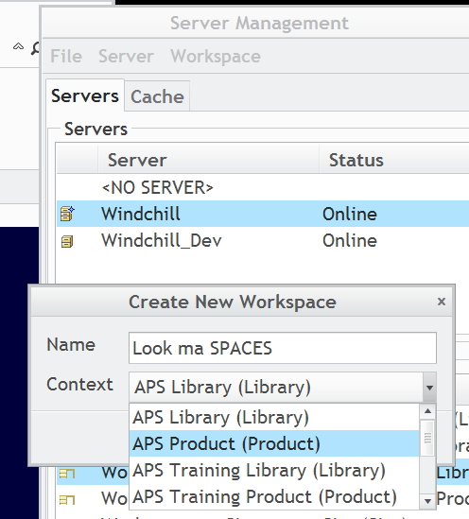
Initial Windchill Actions: Creating a Workspace
go to the My Workspaces section of your Home Page and Click on the New Workspace icon
OR within Creo, you can:
  FILE (menu choice)
  Manage Session (list choice)
  Server Management (flyout choice)
  Workspace (top menu choice)
  New (list choice)

Slide 12
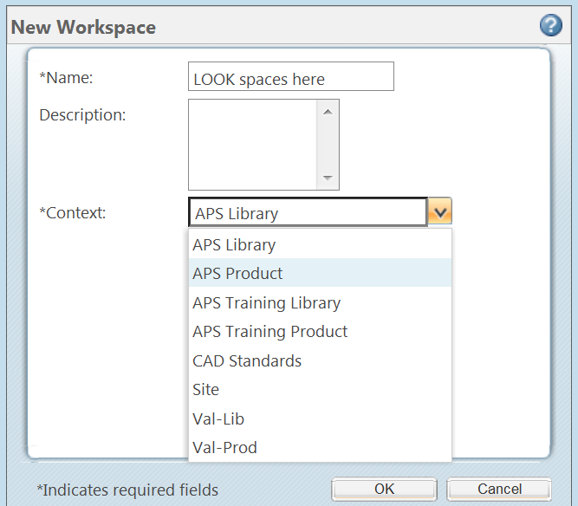
… a word about New Workspaces
method…
Please tie them to the proper context
  we only have two
    one’s the Library
      we have several for purchased parts and setup files
    the other is the Product
      you’ll see several, but we keep all work in APS Product
  unless you’re going to be making nothing but bought parts, make the Workspace’s context be APS Product
use the Description box
  it’s optional, but it’s more informative
Creo method…

Slide 13
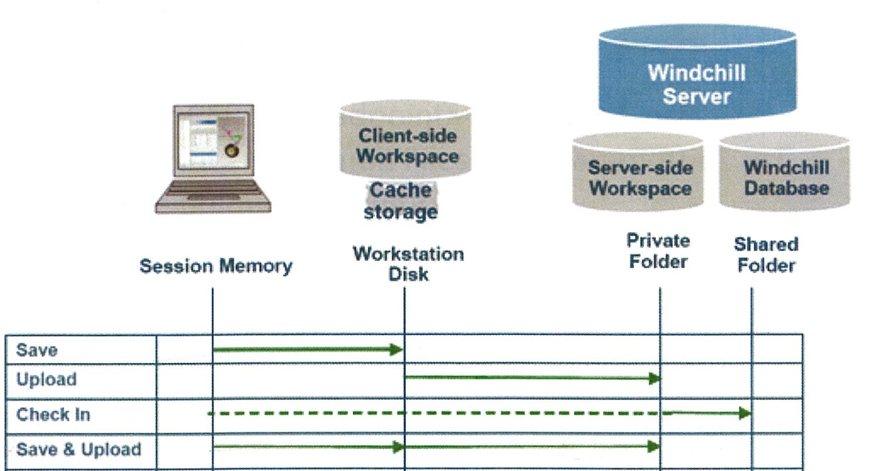
Everyday Windchill Actions: Differences…
Good…
Better…
Best!

Slide 14

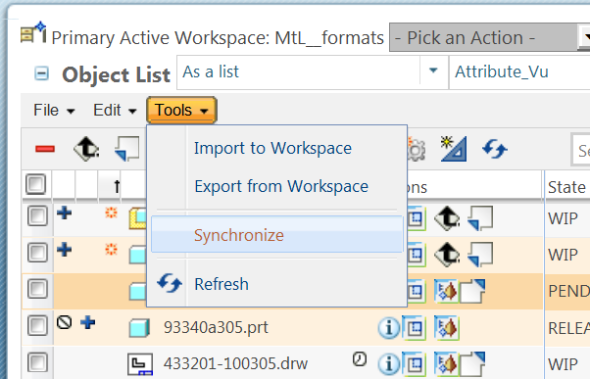
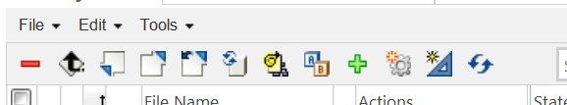
Everyday Windchill Actions: Update vs. Synchronize
both are Workspace functions
Synchronize (found under the Tools dropdown) is strictly a coordination of filenames and metadata betwixt Commonspace and your Workspace
  it does NOT touch geometry
  if you select objects in your workspace table, then Synchronize will only act on those objects selected
  if you select nothing in the table, it Synchronizes the entire workspace
Update works on Out-of-Date objects and CAN affect geometry
  if nothing is selected in the workspace, Update will gather ALL items that are out of date and attempt to update them via a download (overwriting what’s in your workspace!)
  NOT to be confused with Creo’s Update
Update
Synchronize

Slide 15


Everyday Windchill Actions: Add to Workspace
Also known as Download
Can be done from Commonspace
        Workspace
        or directly in Creo
Easiest method (if you know the exact name): in Creo
  File – Open and simply type it in (right down to the extension!)
  this retrieves the file (and any non-drawing dependents) out of Commonspace and puts it in your Workspace
    as a note, whether or not you Save or modify the file, it’s been Added
Mostly, you’ll be in Commonspace, use a Search window or find it in the folder structure, and then use the
Adding to Workspace from the Workspace is actually a cheat, but it’s a good way to collect drawings associated with objects already in the Workspace

Slide 16
Everyday Windchill Actions: Check-OUT
Places you can do that:
  Commonspace (an Actions dropdown)
  Workspace
  Creo
    easiest place to check something out
Reasons why it might Fail
  object is not WIP
  object is brand new
  object is out-of-date in your workspace
  Checked-Out by someone else (might even be YOU!)
  Already in your workspace, but locked
    easily remedied, just unlock it (File dropdown – Unlock)

Slide 17
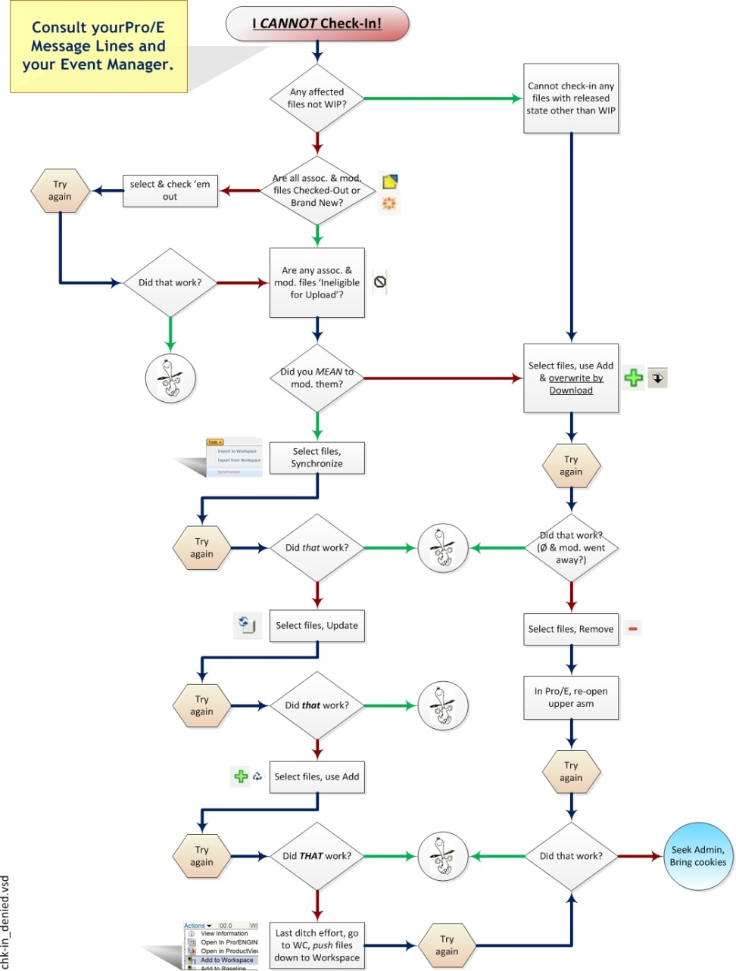
Everyday Windchill Actions: Check-IN
it IS inordinately difficult
  it’s meant to be
check your Event Manager for pertinent messages
possible reasons:
  look to the flowchart, each step has a possible reason
  usual cause is a dependent fastener or other RELEASED item that got inadvertently modified
  another common reason is Windchill’s three-pronged naming convention -if you don’t make Name and Number be exactly the same as Creo’s filename, a check-in of the drawing may fail
    in other words, all the way out, include the extension!

Slide 18
Any subjects you want me to cover in future classes, please let me know . . .
m. givens (Design-n-Drafting Group)
thalia@aps.anl.gov
2-9235

