Slide 1
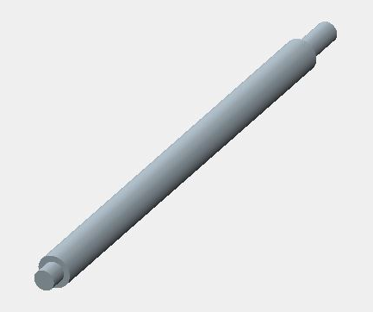
Procedure for Solidifying a STEP (.stp) file

Slide 2
Section 1 Dealing with a Part file

Slide 3
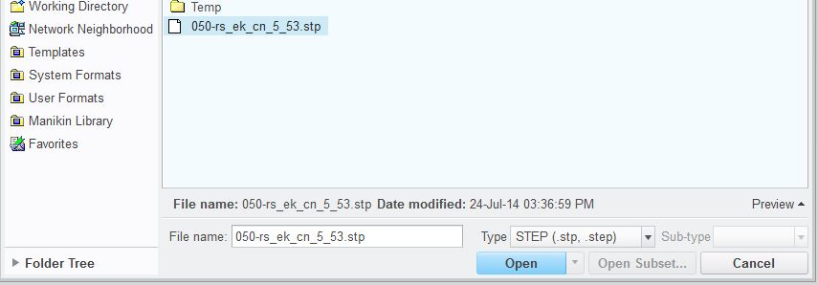
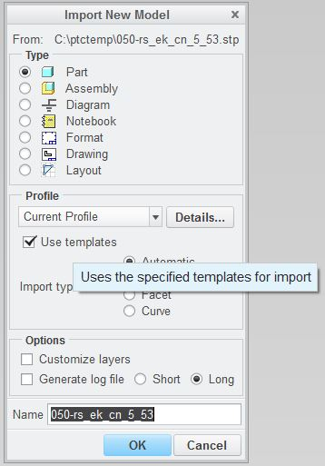
Getting Started
File, Open - Select STEP or All Files

Slide 4
1 Sided vs. 2 Sided
Magenta is a 2 sided surface, which means it is a closed surface. (this is good)
Yellow is a 1 sided surface, which means it has an open end or gap. (this is bad)

Slide 5
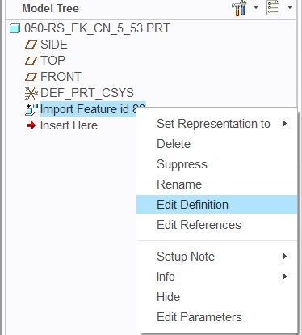
Enter into Data Doctor

Slide 6
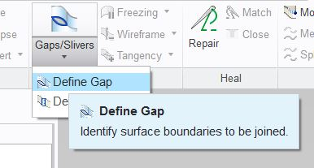
Define Gap

Slide 7
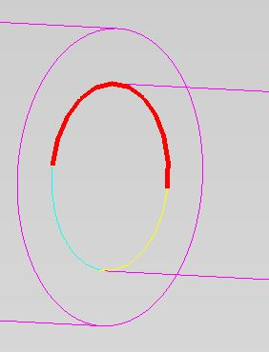
Click edge, then Ctrl + click edge until all are selected
Then click in Side 2 to define other edge

Slide 8
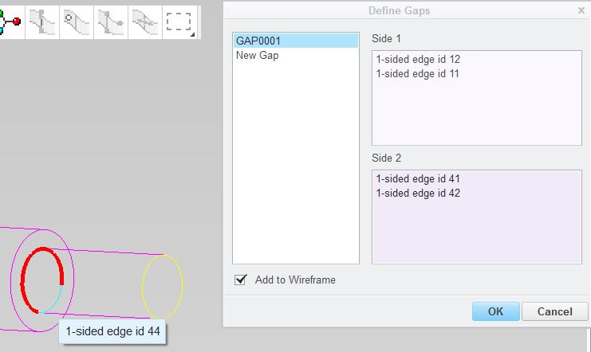
Click edge, then Ctrl + click edge until all are selected
Click OK to finish defining gap

Slide 9
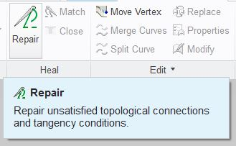
Repair Gap
Click check mark to finish
Gap has been repaired & is now a 2 Sided surface

Slide 10
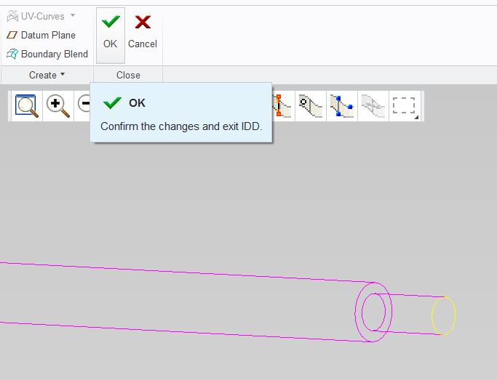
Exit Data Doctor

Slide 11
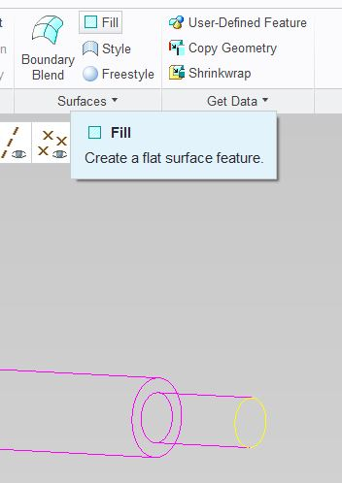
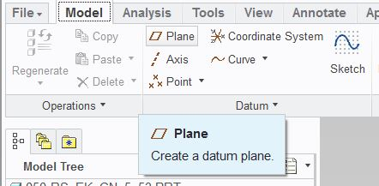
Create Fill (flat surface)
Select Model tab

Slide 12
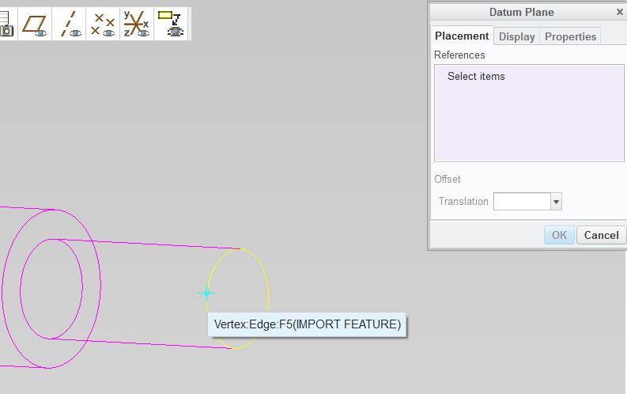
Sketching Plane on the fly

Slide 13
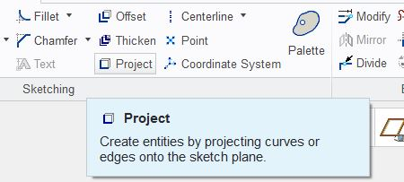
Defining Fill surface
Select Fill tab

Slide 14
Fill surface defined

Slide 15
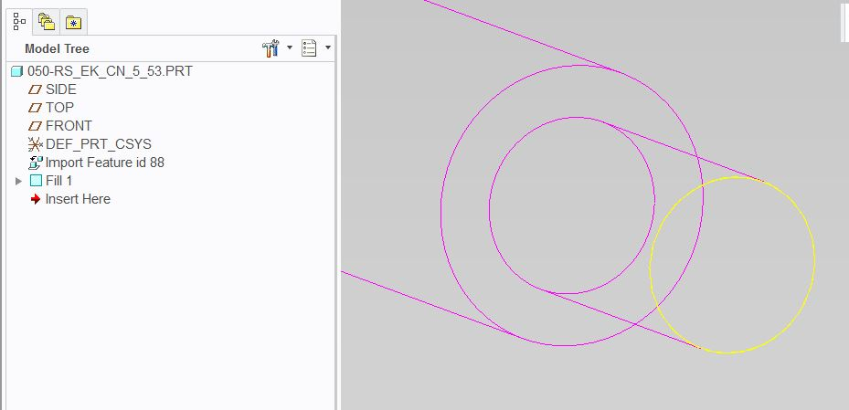
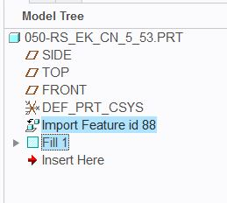
Merging surfaces
Click import feature & Ctrl + click the created fill surface, then click Merge

Slide 16
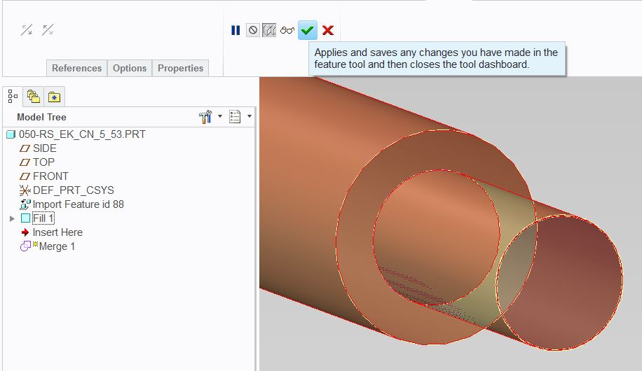
Surface Merge successful

Slide 17
Create a 2nd Fill
Repeat Slides #11 - 14

Slide 18
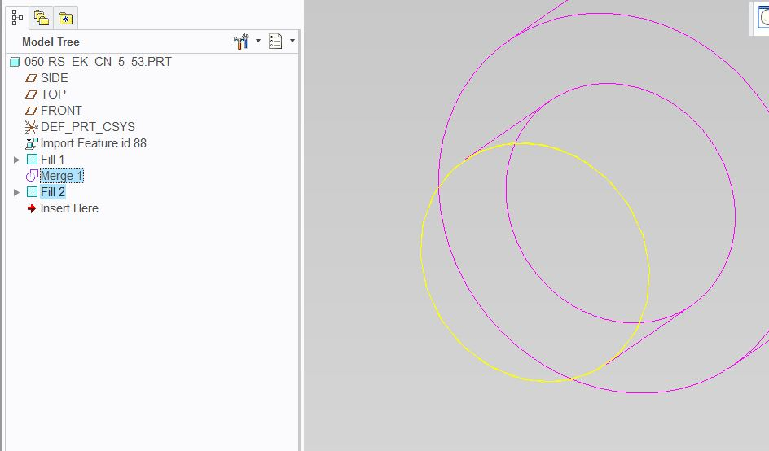
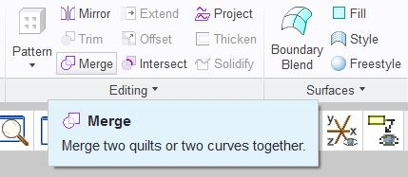
Merging Merged features
Click last Merge feature & Ctrl + click the created fill surface, then click Merge

Slide 19
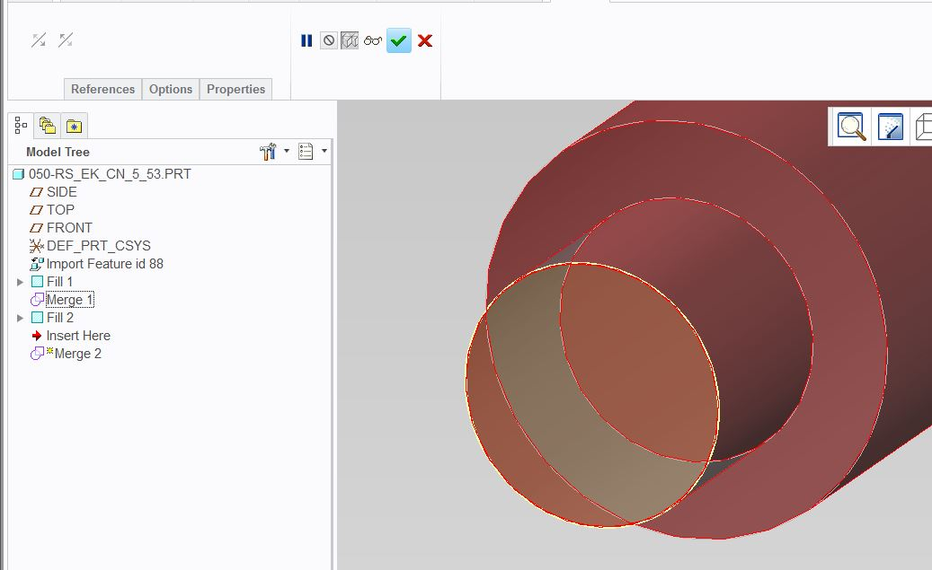
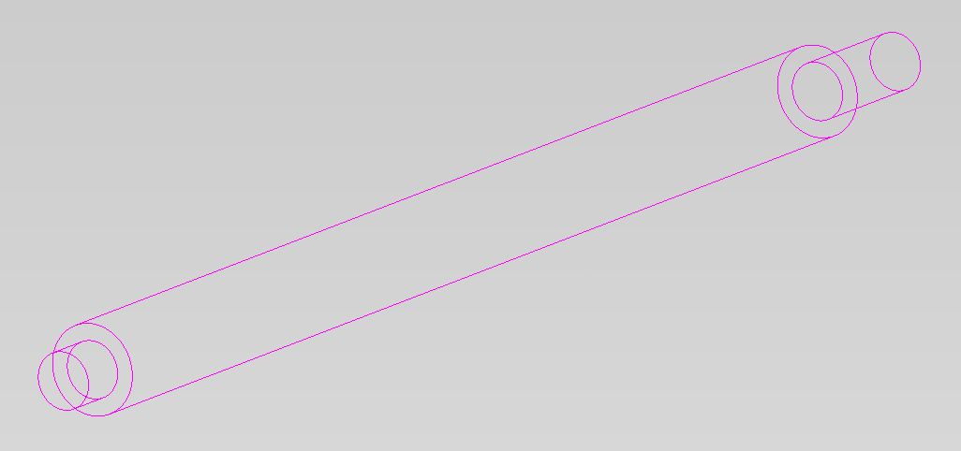
Surface Merge successful

Slide 20
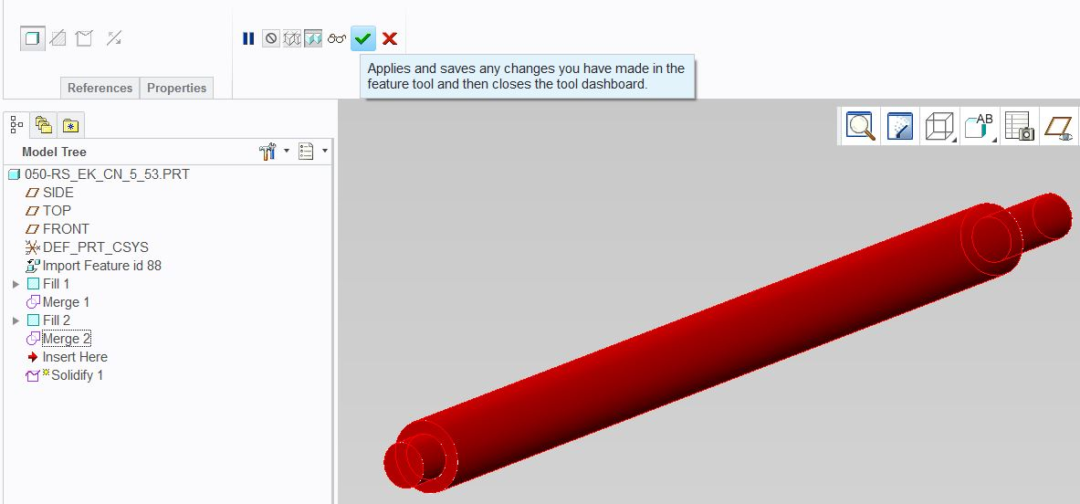
Solidify fully closed surfaces
Click last Merge feature, then click Solidify

Slide 21
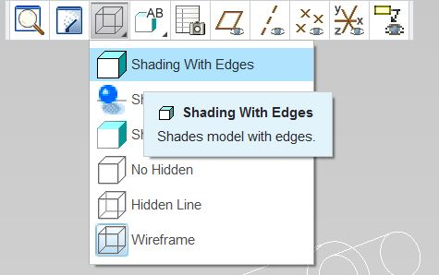
Checking Solid Model

Slide 22
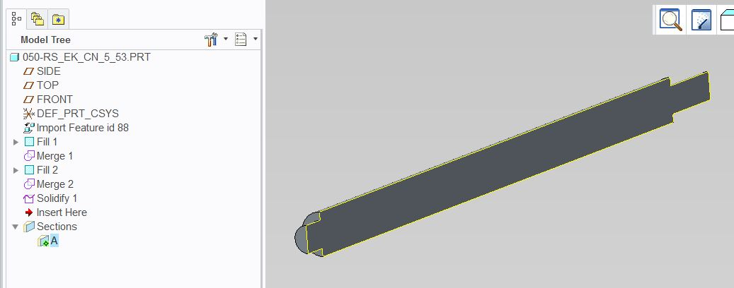
Removing extra features

Slide 23
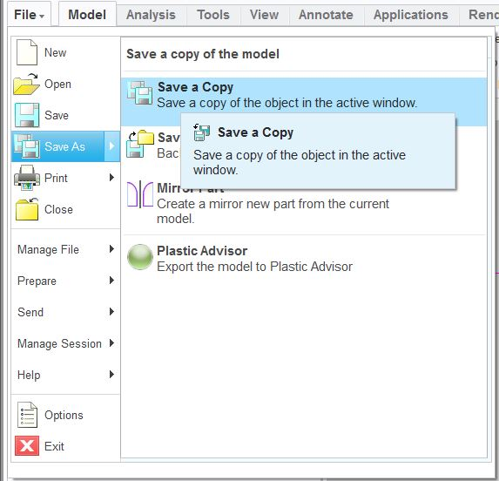
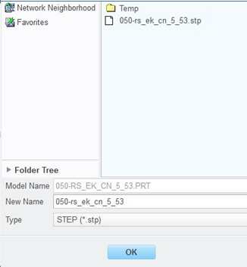
Create a new STEP file

Slide 24
Close & Clear Session

Slide 25
Open newly saved file
File, Open - Select STEP or All Files

Slide 26
One solid feature created

Slide 27
Section 2 Dealing with a Assembly file

Slide 28
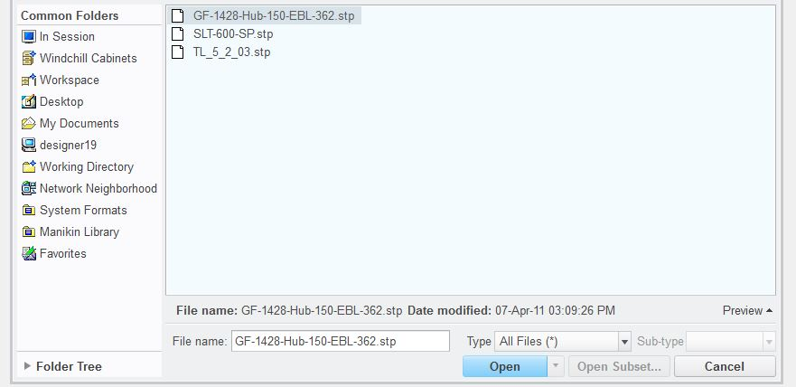
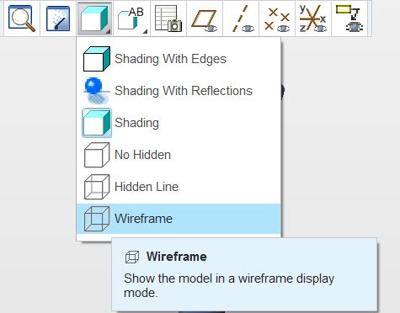
Getting Started (.asm)
File, Open - Select STEP or All Files
Select “Part” & “Use templates”

Slide 29
Verify if Part imported correctly
Obviously this assembly didn’t import as a good part. If it imported correctly you would have almost been done, unfortunately there is more to do.

Slide 30
Starting over (.asm)
File, Open - Select STEP or All Files
Select “Use templates”, but leave “Assembly”

Slide 31
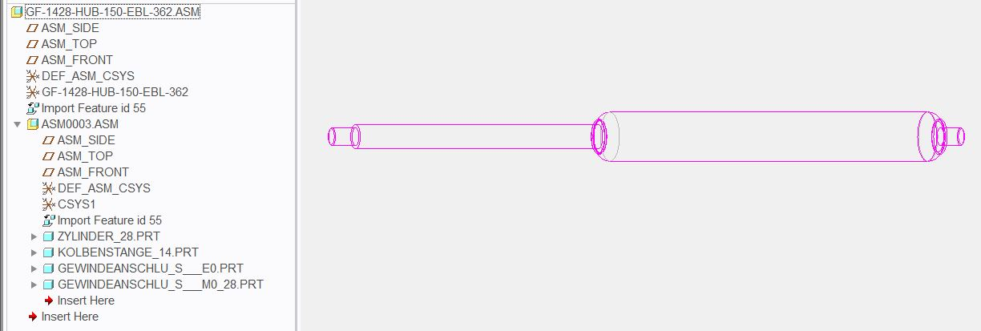
Fix any open gaps
Luckily no open gaps (if open gaps refer to previous section)
Open first component

Slide 32
Solidify fully closed surfaces of component
Click feature, then click Solidify

Slide 33
Repeat previous steps for remaining components

Slide 34
Fully solidified assembly
That’s great, but we don’t want an assembly file we want it to be a part file

Slide 35
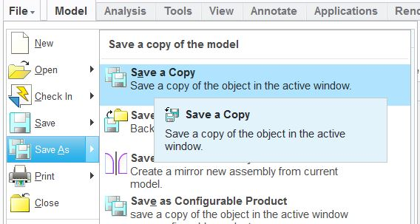
Creating Part from Assembly
Change Type to “Shrinkwrap”
Remove added extension “_sw0001”

Slide 36
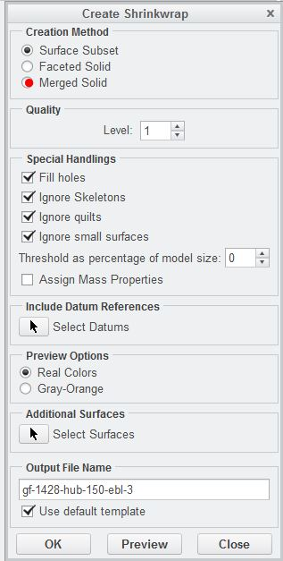

Slide 37
Open newly created file

Slide 38
Questions

