Slide 1
Datums
GD&T
Drawing Checking

Slide 2
I’ll break at specific times for Questions
So write them down
Take notes
This document is located at:
CAD User (H:)\DD- Group\Procedurals\ Datums_GD&T.pptx

Slide 3
Datum Facts
Datums are theoretically perfect points, lines, and planes.
Datums exist within a structure of three mutually perpendicular intersecting planes known as a datum reference frame.
A part is oriented and immobilized relative to the three mutually perpendicular planes of the datum reference frame in a selected order of precedence.
Since measurements cannot be made from theoretical surfaces, datums are assumed to exist in and be simulated by the processing equipment.
Datums are specified in order of precedence as they appear in the feature control frame.
Datum features are selected to meet design requirements. Functional surfaces, mating surfaces, readily accessible surfaces, and surfaces of sufficient size to allow repeatable measurements make good datum features.
A datum (Tag) feature symbol is used to identify physical features of a part as datum features. Datum (Tags) feature symbols should NOT be applied to center-lines, center planes, or axes.
Plane, flat-surface features not subject to size variations make the best datums.
When a cylinder is specified as a datum, the entire surface of the feature is considered to be the datum feature.

Slide 4
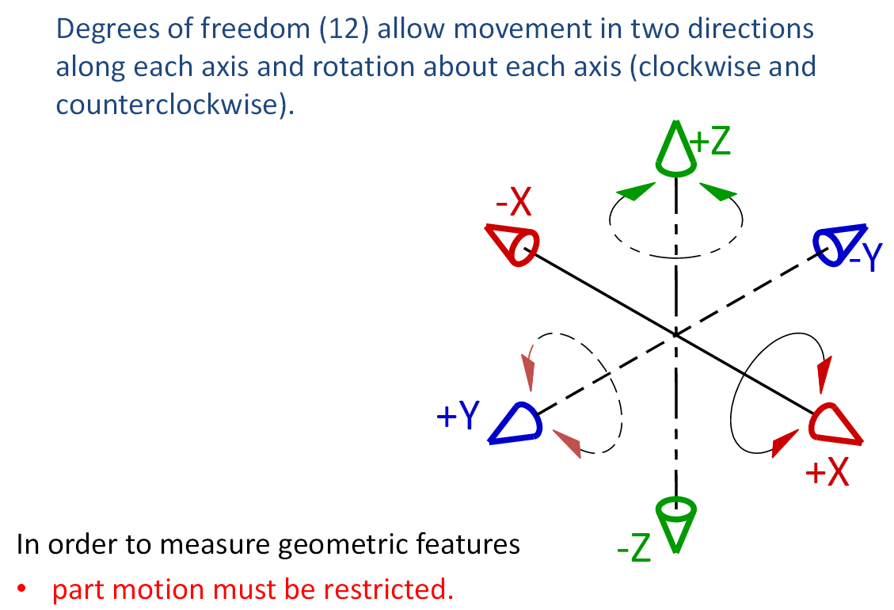
Why have Datums?

Slide 5
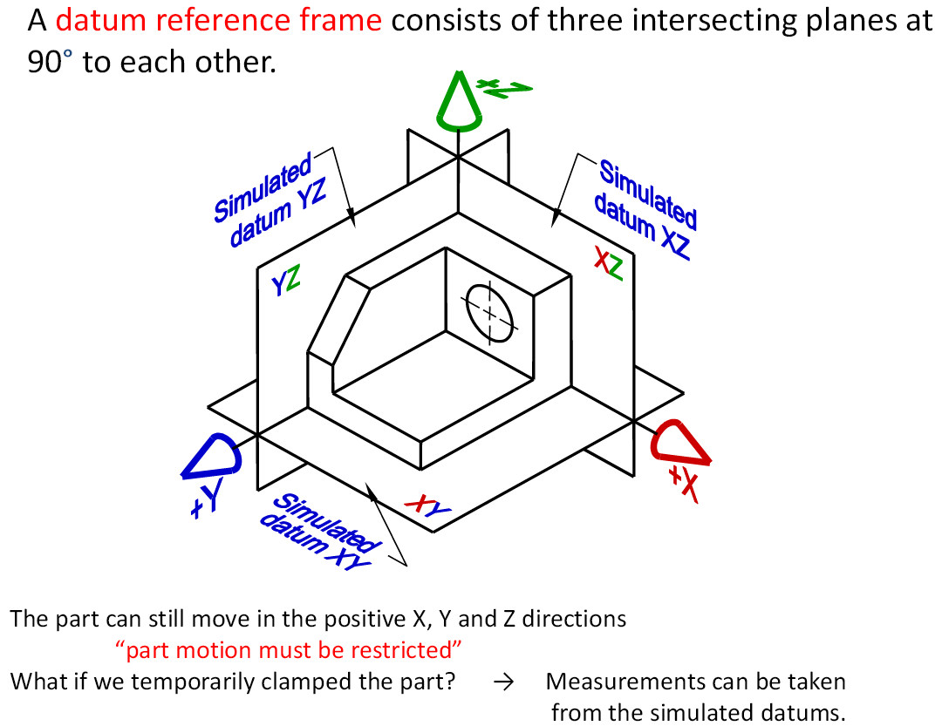

Slide 6
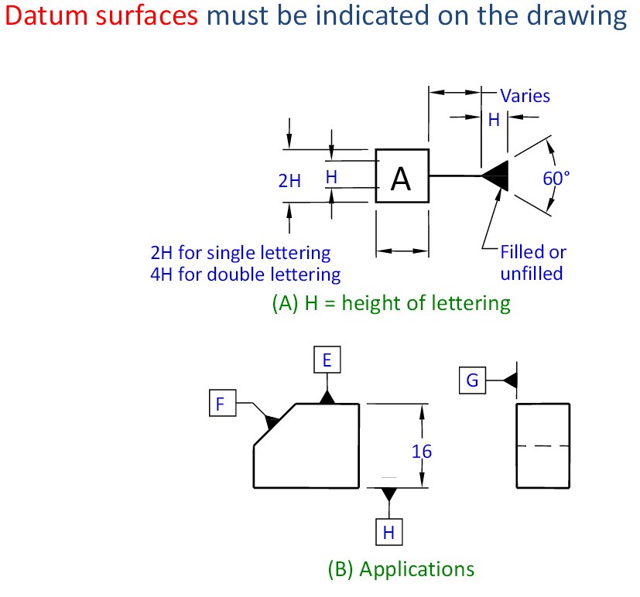
Not datum planes.
On a part surface, geometry.
These symbols are
Called Datum Tags in Creo

Slide 7
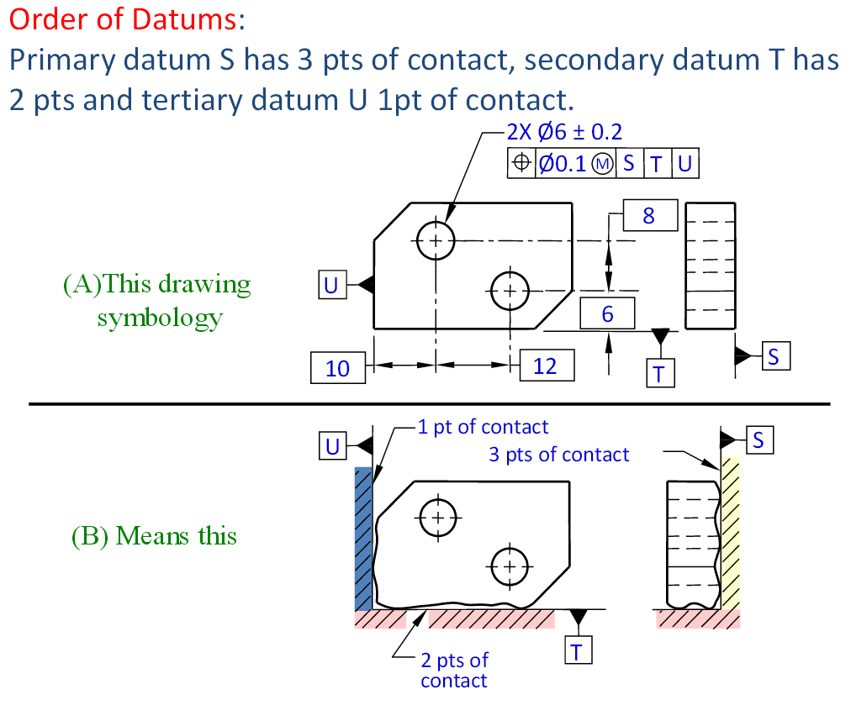

Slide 8
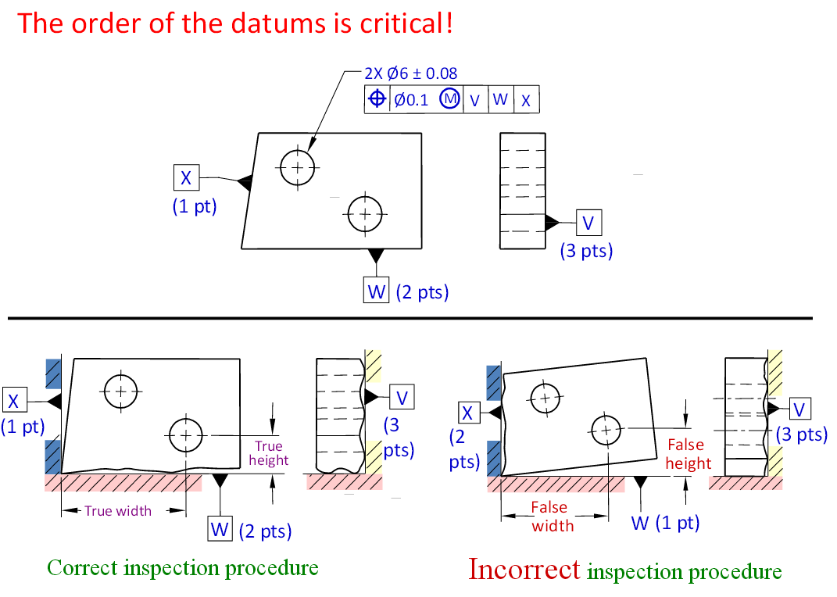

Slide 9
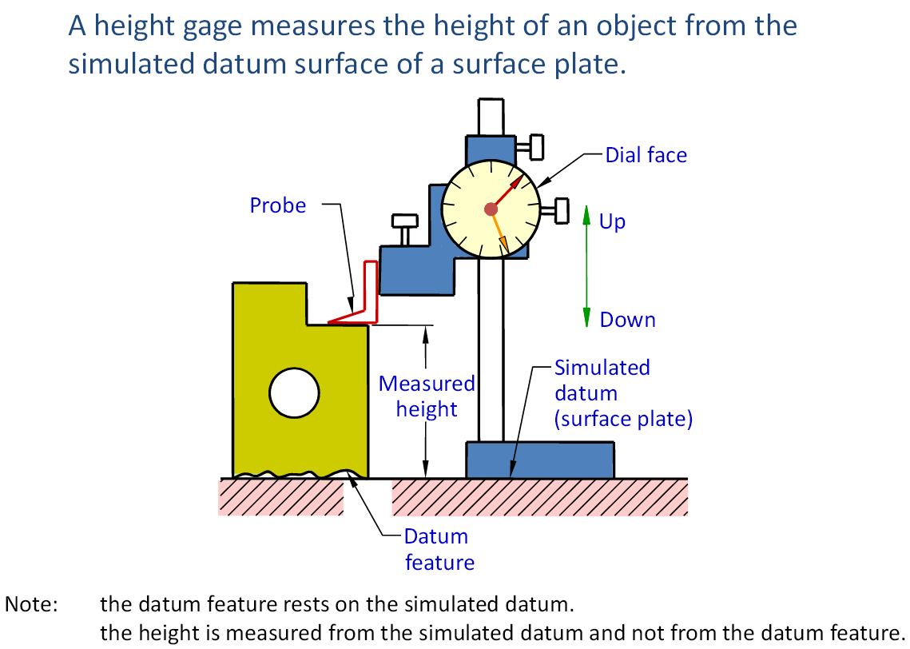

Slide 10
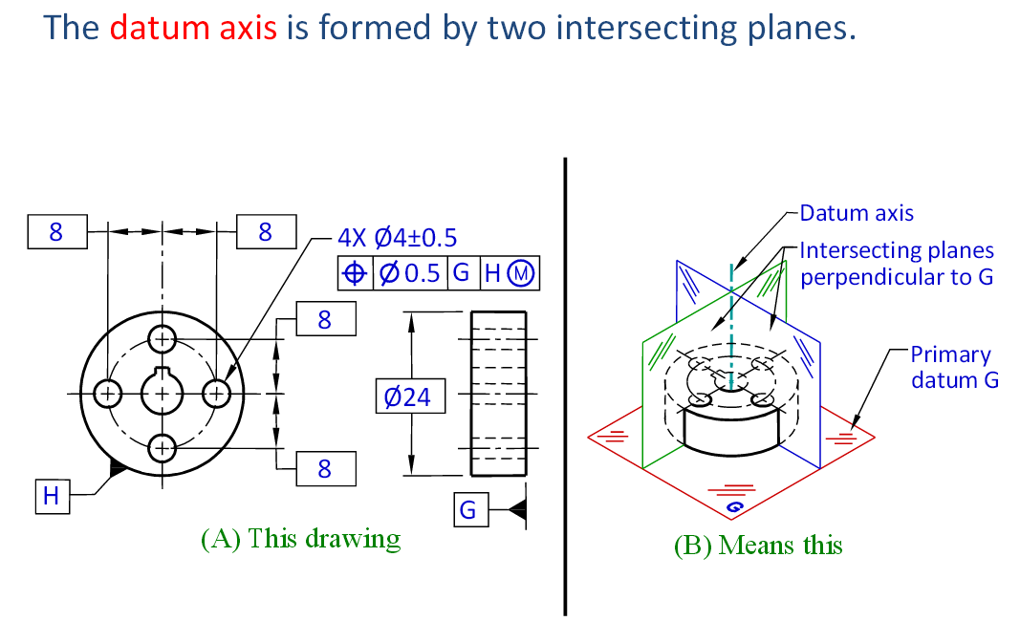

Slide 11
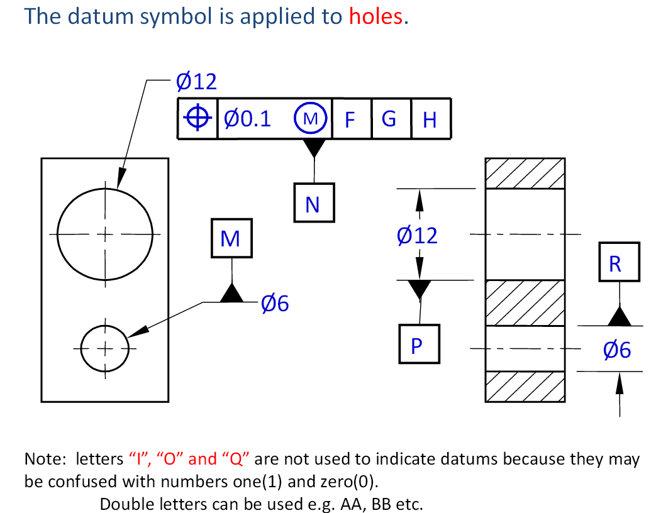
MMC, maximum material condition
At its smallest limit, or maximum amount
Material.
Never on a center-line

Slide 12
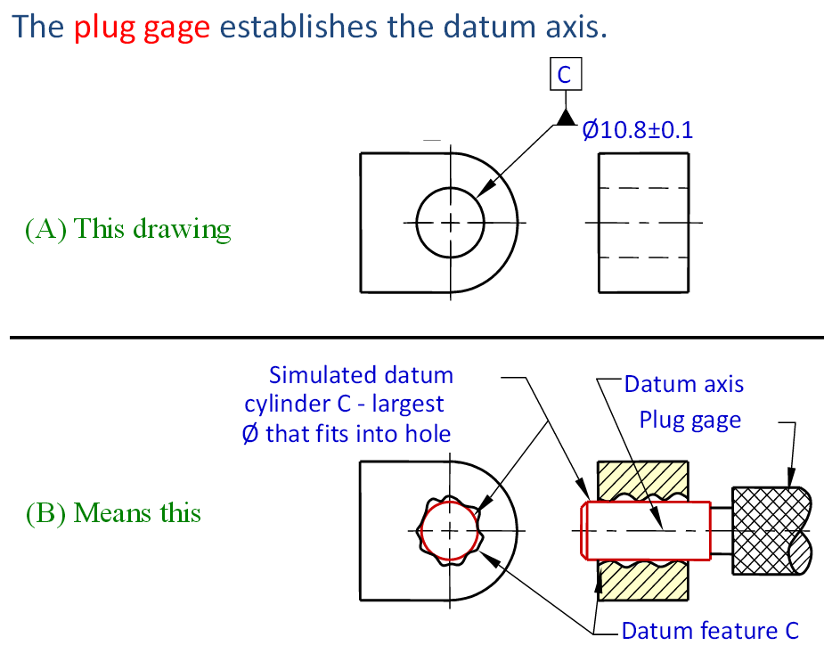

Slide 13
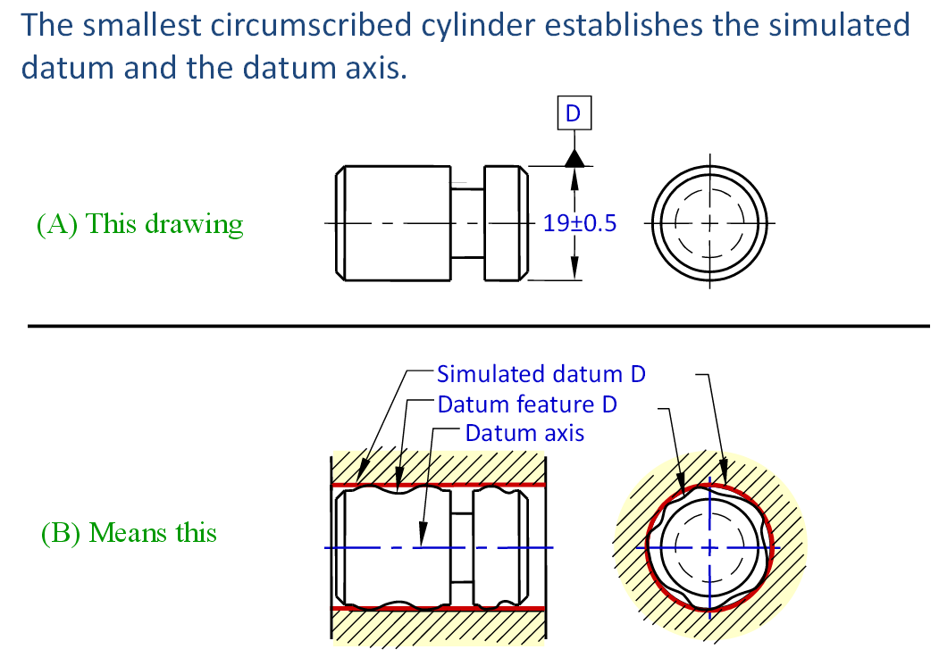

Slide 14
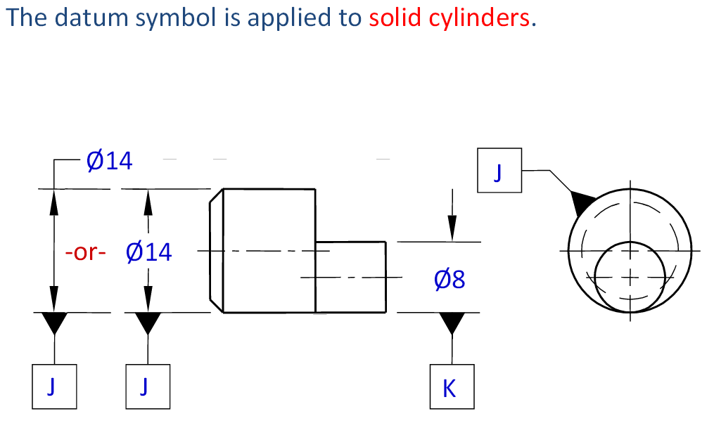
Never to a Center-line.

Slide 15
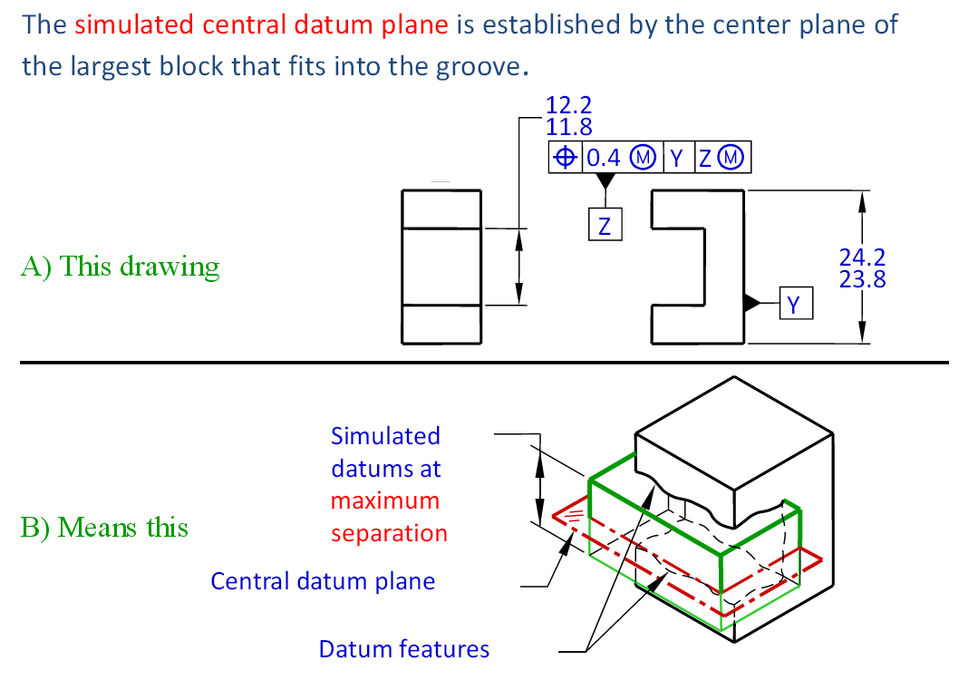

Slide 16
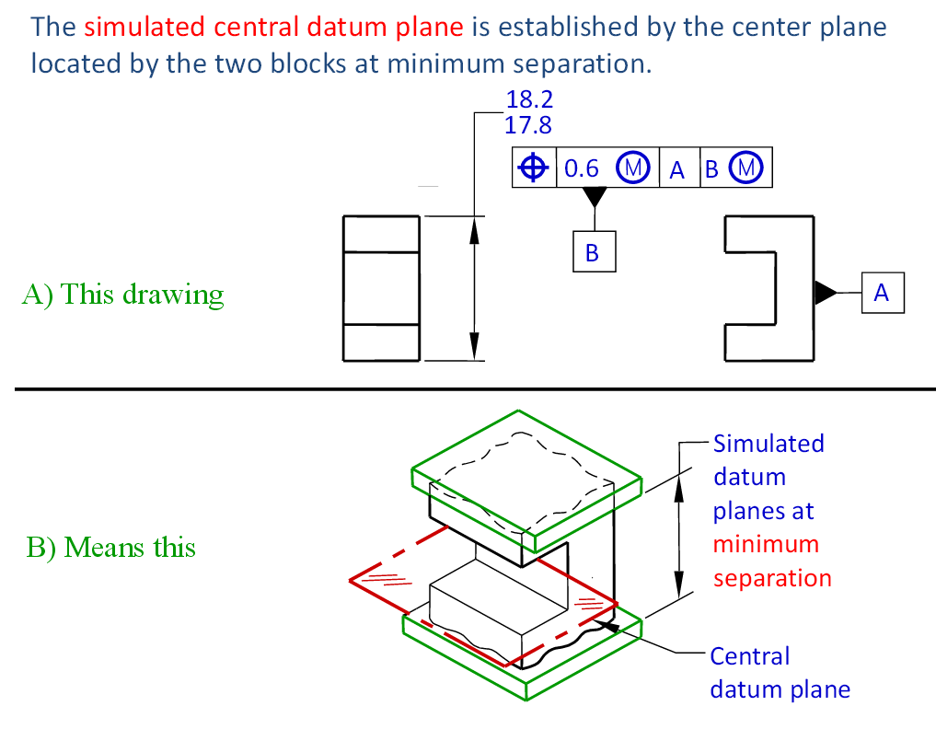

Slide 17
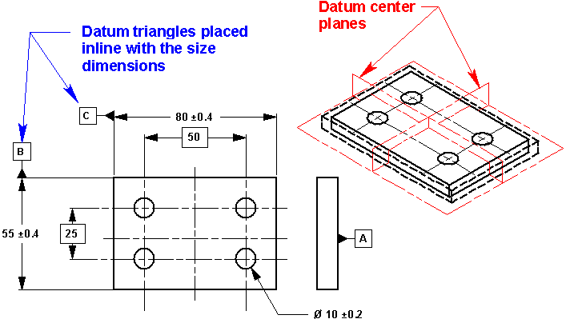
Watch Where You Put That Triangle!
A subtle difference in the placement of the datum triangle can drastically affect the drawing’s meaning.
This drawing illustrates establishing datum center planes for datums B and C.
To do this, the triangles are placed in line with the size dimensions.
This approach would be used if the pattern of holes should remain centered on the plate regardless of the actual length and width.

Slide 18
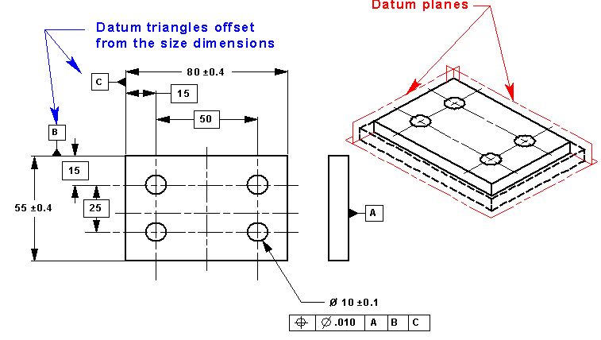
If the centering of the pattern of holes is not important, the Datum Tags may be offset, away from the dimension arrow head, as shown below.
Datum planes are established by the sides of the part. Although, this approach is usually preferred by manufacturing, the symmetry of the part is lost and may cause confusion at inspection.
Depending on the actual size of the part, the pattern will be controlled better to one side than the other.

Slide 19
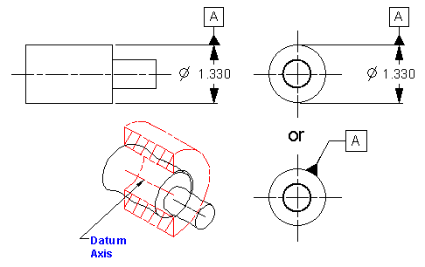
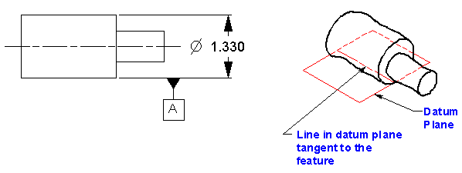
Placement of the new Datum Tag can be critical on rounds.
In the first three views below the datum feature symbol is associated with the size dimension of a feature of size.
They indicate that a datum axis should be established using the feature indicated
In the view below, the datum may be interpreted as a line lying in a plane tangent to the feature indicated. If line contact is desired a datum target line should be indicated.

Slide 20
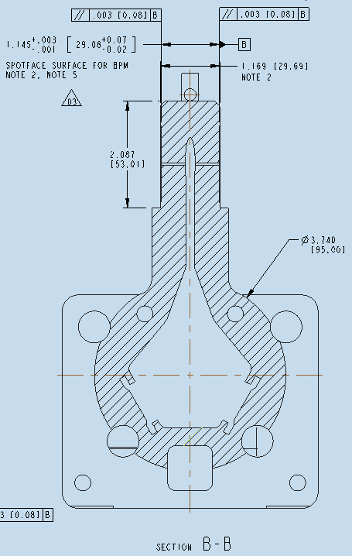
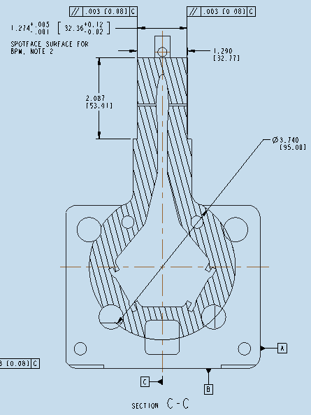
CORRECT
REJECT
Datum Tag on center-line

Slide 21
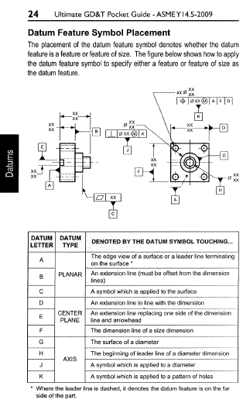

See page 24
The Ultimate GD&T Pocket Guide

Slide 22


Paused for any

Slide 23
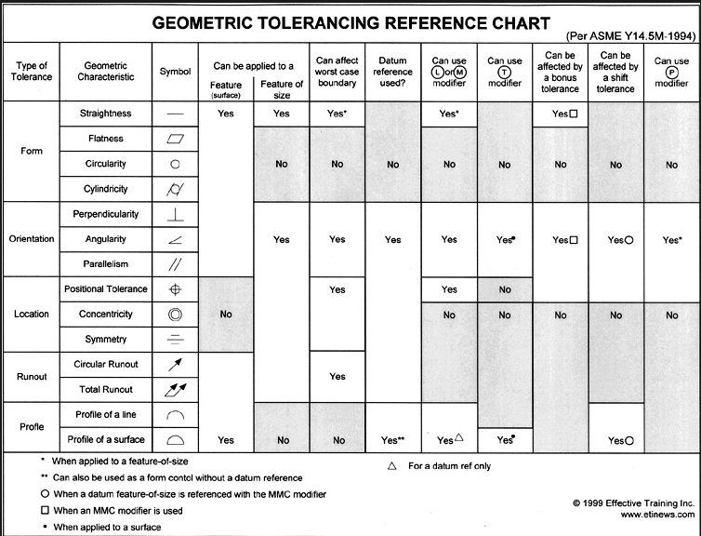
GD&T REFERENCE CHART

Slide 24
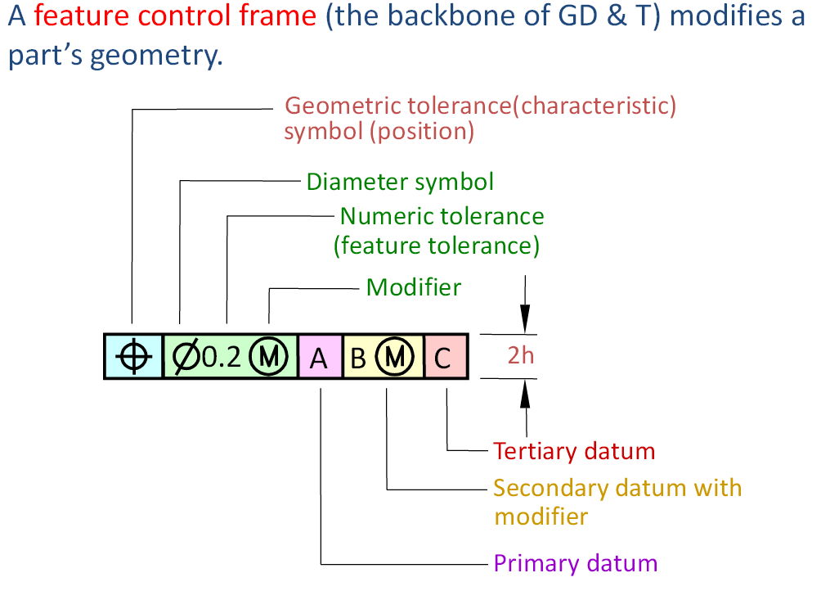
Feature Control Frame

Slide 25
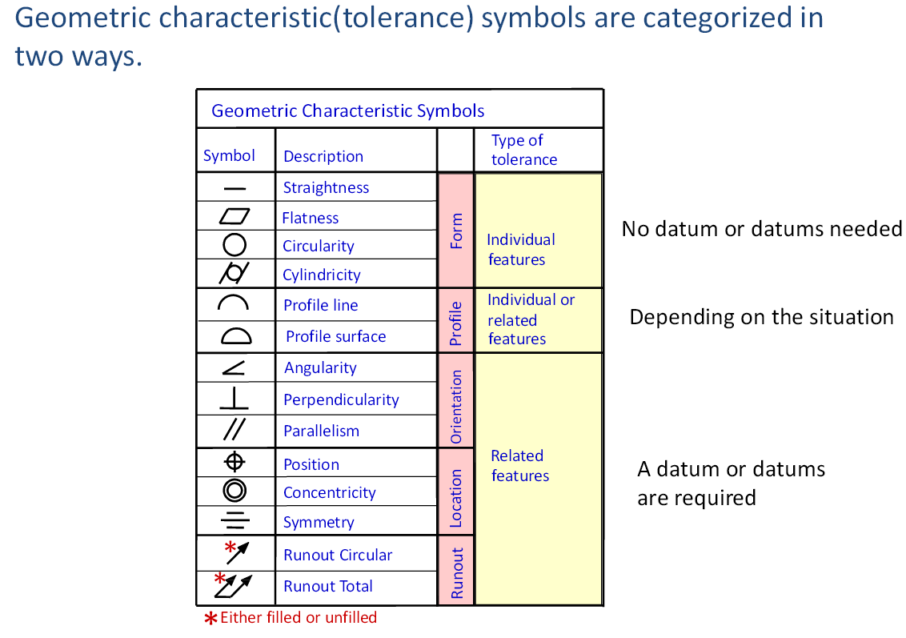
Geometric symbols

Slide 26
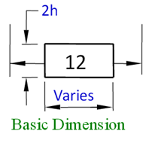
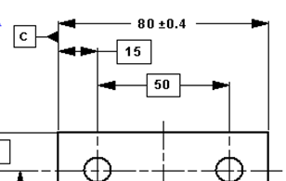
Basic Dimensions
A basic dimension is considered a theoretically exact dimension. All a basic dimension does is telling you where the geometric tolerance zone or datum target is located. Look for a geometric tolerance in a feature control frame related to the features being dimensioned.
The basic dimension originates from the datum.
The basic dimension is enclosed by a rectangle.
Basic dimensions are used to establish the "true profile" which a profile tolerance will then control. So if a profile tolerance is applied to a hole, the diameter MUST be a basic dimension.

Slide 27




Watch the Placement of Datum Identification Symbols and the Feature Control Frames for Straightness, Perpendicularity, Parallelism and Angularity!
When applying the above to features of size, the placement of the symbol or callout can greatly change the meaning. If the symbol or control is associated with the size dimension, the feature's axis or center plane is being identified or controlled. If the symbol or control is associated with the surface of the feature of size, it is identifying or controlling the surface - not the axis or center plane. In the following example both the datum feature symbol and the perpendicularity apply to the feature's center plane. Notice that there are two center planes, on the next slide.

Slide 28
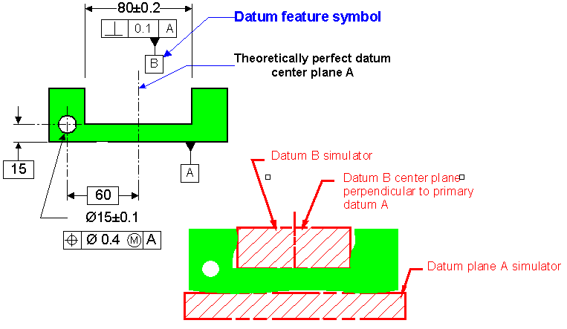
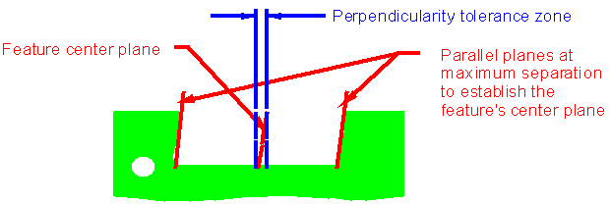
B
0.1

Slide 29
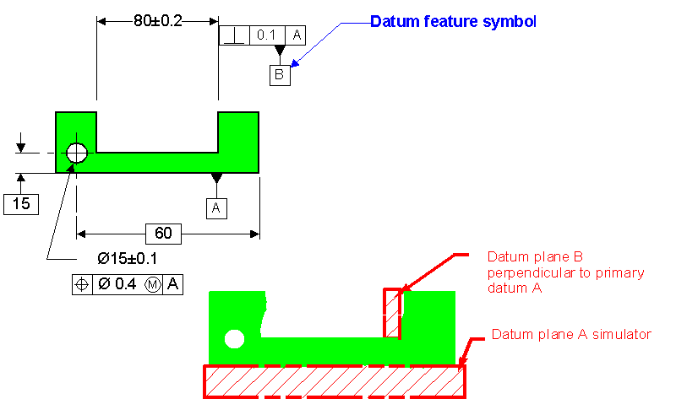
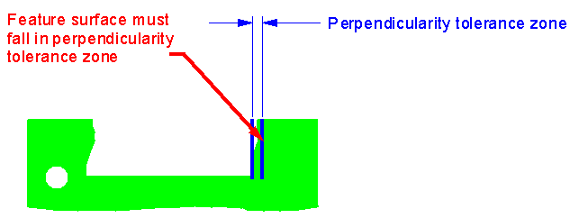
0.1

Slide 30

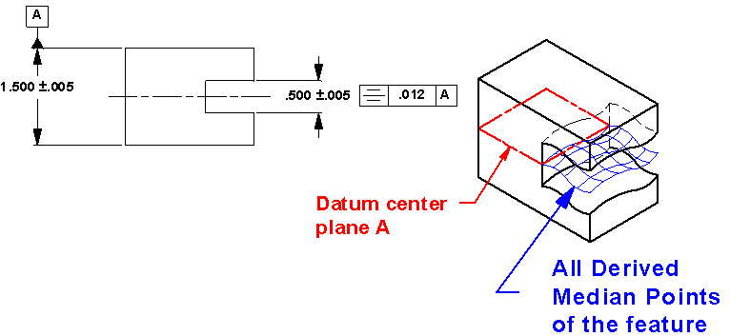
Symmetrical parts
Often designers need to create symmetrically shaped parts. Symmetrical parts are usually easier to assemble, look better and help maintain balance in a design. Features shown symmetrical must be controlled to avoid incomplete drawing requirements (2.7.3 of ASME Y14.5M-1994). Symmetry is an option in these situations, but it is difficult to measure since it requires deriving the features’ median points to determine if they are contained within the specified tolerance zone which is centered on the datum axis or datum center plane. Use Position or Profile instead.

Slide 31

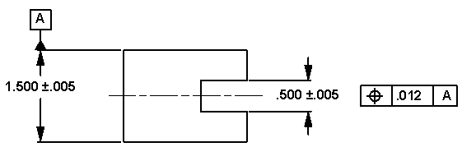
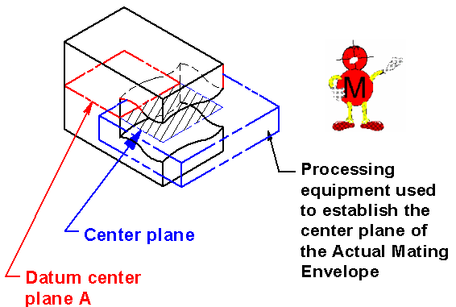
Position
Position may also be used to assure a symmetrical relationship. The advantages of using Position include the ability to modify the tolerance and datum reference at RFS (implied in 1994 Standard), MMC or LMC. In addition, verification is usually easier for Position than that required for Symmetry since it is the center plane of the Actual Mating Envelope (simulated by the inspection equipment) that must be within the tolerance zone.

Slide 32
No Need For Those “Half” Dimensions!
(In accordance with the ASME Y14.5-2009 standard)
https://www.tec-ease.com/
The last Tip (Oct 2010) brought comments of concern because the drawing does not include "half" dimensions for 20 and 60 dimensions. Since the 60 is basic, adding a 30 would not change the meaning. The pattern of holes is implied centered on the datum center plane and there is a "zero" basic implied dimension. The 20 wide slot on these drawings is directly toleranced rather than controlled indirectly with a profile of a surface tolerance. A "half" dimension could not be used to locate the slot. If a 10±0.05 dimension is added to the drawing, it is not clear where the origin of the dimension is. It could be established by the two holes in the slot or the center plane of the width of the part. The slot is not related to the datum reference frame. Also, the right side of the slot has a tighter tolerance than the left side. The drawing on the right uses a position tolerance to control the location of the center plane of the slot relative to the datum reference frame established by datum features A and B which includes the datum B center plane.

Slide 33
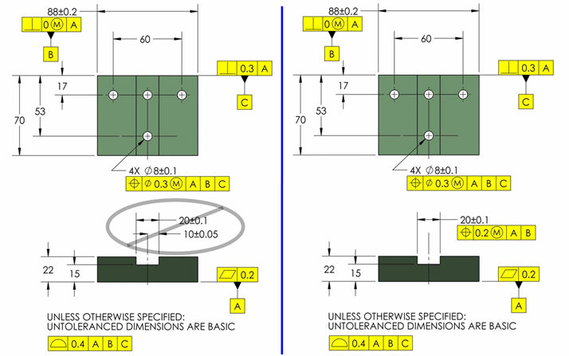
Implied Basic Zero Dimension - Where a centerline or center plane of a feature of size is shown in line with a datum axis or center plane, the distance between the centerlines or center planes is an implied basic zero.
When it is important to be certain that the tolerance is totally dependent on the actual size of the feature.
Since Datum B is a feature of size, the material boundary modifier must be used.
Use Position to control Symmetry.

Slide 34
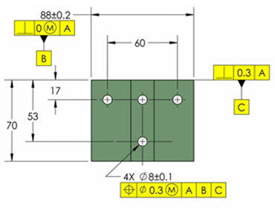
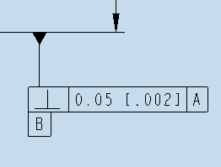
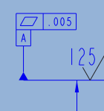
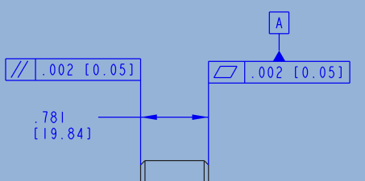
Key Take Aways
Never place a Datum Tag on a center-line.
Watch Where You Put That Triangle!
Feature Control Frames, FCF, never attach to Datum Tags, but Datum Tags can attach to a FCF.
Correct
WRONG

Slide 35
Datum plane and Centerline, the debate is over.
Datum can indeed be a centerline, but it is never to be labeled as such on a drawing.
A centerline you can talk about it, but not call it out as a datum on the drawing.
A centerline is imaginary and that they should specify the centerline of a feature and then associate other features.
What the datum letter is attached to is called the "datum feature" and this is what you grab onto for inspection. You can't grab onto a centerline, so in inspection you never really touch a true datum.
Simply, a datum must be associated with some real world feature, and that feature should have something to do with the design intent. A centerline is imaginary and therefore cannot be used as a basis for a datum. The way to look at datums is that they are constraints on your part. How do you constrain your part with an empty point in space or from inside the material? You cannot.
So a centerline cannot be a datum. To sum up, a datum can indeed be a centerline, but it is never to be labeled as such on a drawing. This is actually not 100% true. A datum is always associated with some real world feature. The fact that you can use the center of a feature as your datum, but that center is the result of clamping the feature (rectangular) or pinning it (hole). Either way, it's the engage of the real world surfaces that creates the center. The center does not magically exist by its own right.
A datum feature label may not be applied to an axis, center plane, or center point on a drawing because none of those things are datum features. This doesn't mean that an axis, center plane or center point cannot be a datum... With the datum feature label applied to a cylindrical or spherical feature that datum will be the axis or center point of that feature's datum datum feature simulator. For a slot or its inverse, often oddly called a "width", if the datum feature label is attached to the end of, or side of, dimension line applied to the feature then the datum is the feature's center plane... When there is a desire to label a centerline on a drawing that coincides with where a datum will be then Y14.5-2009 includes section 4.21 (page 79) and figures 4-43 through 4-45... That centerline can likely be labeled as either the X, Y or Z axis of the datum reference frame.
ASME Y14.5 shows a set of planes that represent theoretical datums, but in reality, you apply your datums to features. There is no point in describing it any other way.
ASME Y14.5 M-1994, 4.3.2 page 52. Datum features are identified on the drawing by means of a datum feature symbol. The datum feature symbol identifies physical features and shall NOT BE APPLIED TO CENTER LINES, CENTER PLANES, OR AXES except as defined in paras. 4.6.6 and 4.6.7.

Slide 36
Paused for any

Slide 37
Drawing Check List.
Mechanical Components and Assemblies, Weldments, Ray tracing, Electrical, Building floor plans.
Title block
Use the most current title blocks. Layers and drawing views are set to default.
Avoid copying and renaming older drawings. Make new.
Model units can be inch or mm, but drawing units are always inch. Check the title block units. For inch dual dimensions please include, in the notes, DIMENSIONS IN [ ] ARE MM AND FOR REFERENCE ONLY.
Drawing scale, use fractions. 1:½ not 1:.50. Drawing scale to be a ration 1:1
The tolerance block can be inch or metric and altered to the designers requirements. Check for Alternate tolerance block usage.
Material should be assigned to the model.
Material for assemblies, in the title block, should read: SEE PARTS LIST.
Model parameters and drawing parameters are the same, but are filled in separately. This populates the title block. Fill in names, titles and dates.
Get the W.B.S and L.D.N. from the DCC. This is the Drawing Number and Model Name.
Get the Electronic file number, (the ‘A’ number), from the DCC. The last two digits must match the REVISION NUMBER of the drawing.

Slide 38
Revisions of a drawing are described in the A-number document and a DCC number assigned to it. The revision number appears in the revision block on the upper right corner of the drawing. And use the appropriate DCS number.
Standard Notes. Paint notes. Installation procedure.
Vendor information. Identified along the outside edge of the BOM.
Bill of Material and balloons and pointing at correct items. No skipped numbers or out of sequence. Purchased components should be at the top of the BOM and have corresponding vendor number. Check the REV number of each component in the BOM and all the BOM information and it fits within the cell width.
Check the Number of sheets the drawing is composed of.
Weldment assembly drawings must have the word ‘Weldment’ as part of the Title. Weldment component’s part numbers are to have a sequential letter at the end of the drawing number in the BOM. Place an * next to the ITEM in the BOM and a note ‘* NO DRAWING AVAILABLE’. Check the welding symbols.
ICMS is used to view the PDF of the drawing.
Check the Release Level: PENDING, must match in CREO VIEW.
Do not use the # symbol. Type No. for tap hole callouts. No. 10-32 UNC.
Check the Creo drawing MODEL VER: number and the DRWG VER: number to the CREO-VIEW drawing MODEL VER: number and the DRWG VER: number. They must match.

Slide 39
Bill of Material
Items are in ascending numerical order from bottom to top, no missing numbers.
No missing Balloons.
Use simple Balloons, quantity are not required.
Multiple balloons having the same number require REF to be added to the non-original balloons.
Try to arrange Balloons in a counter clock wise sequential order, starting at the lower left.
Purchased item are to be in the upper portion of the BOM list. Reorder Index to achieve this.
Vendor ID triangle symbol to be neatly arranged to the left of the BOM table. See help post tutorial. Vendor triangle numbers, no leading zero or letter. Use single digit. Sometimes confused with drawing revision.
Vendor information and ID triangle to be on the lower left of the title block.
BOM information must fit within the cell width.
‘SEE PARTS LIST’ to be in the title block material cell for assembly drawings.
Assign material properties to the modeled parts.
Any new purchased parts need to be checked into the Upload parts folder.

Slide 40
NOTES:
Use appropriate units note: ‘DIMENSIONS IN [ ] ARE MM AND FOR REFERENCE ONLY.’
Drawing layout
Third angle projection.
Section views, check for cutting plane arrows and viewing direction. Do not cut a section from an existing section view.
Assembly drawings: Over all dimensions, height, width, length to be reference.
Dimensioning
Metric dimensions have a leading zero 0.50, Inch dimensions do not .50. Applies to dimensions tolerance and GD&T callouts.
Inch only is the standard dimension units.
Dual dimensioning requires using a different DTL drawing file. See slide 47.

Slide 41
Promotion Request inside Windchill
Check Promotion Objects with File Names. The 3 file names must match.
Correct Format and Template have been used so the “Do Not Tool” Note is on the drawings and functioning correctly.
Layers set correctly,
  Datum, Curves and Axis Layers off on Drawings
“A” items correct with proper Rev numbers and Information
Meta Data correct
Files not in Designer folder, moved to correct Common Space folder
Verify BEFORE check-in that any modified purchase parts are “Updated” not Checked in.
Any parts that are modified will require ALL sub and upper assemblies to be at least checked out and regenerated before final check-in. This keeps all As-Stored Iterations in sequence.
Synchronize all Pro/e representations of AutoCAD files; this includes Revision and all Metadata information.
Upload and check in all parts.
Verify all WIP files are included in the workflow
  This includes all non-released purchased parts.
Dimension Units correct, Tolerance block correct to units
Appropriate Notes
  Standard notes, cleaning notes, etc.
  Vacuum service, high vacuum note, spec 00095 on drawing, etc.

Slide 42
Quick Checker List
Viewable is correct revision and version in Windchill.
  Title block is correct version.
  Pending is on viewable
    Has enough time transpired to publish correctly
    Republish if required to correct above, but only if necessary
Confirm all parts in BOM are included in release package
  Verify all purchased parts on assembly are included or released already.
  On WIP Purchased parts, verify all information is accurate including Metadata and modeling dimensions.
Dimension for each feature is present.
Form, fit and function between components.
Balloons are present and pointing at correct items.
Dimension placement
  No dimension arrows on the dimension number.
  Proper view placement to aid in fabrication
Metadata is correct
  Verify BOM data is appropriate

Slide 43
Reference
APS/AES Design and Drafting standards R10/8/13, located at:
CAD User (H:)\D-D Group\Standards\aps_1429632.pdf
ASME Y14.5M-1994 and 2009, Dimensioning and Tolerancing.
The Ultimate GD&T pocket guide, 2nd edition, companion to ASME Y14.5-2009
ASME Y14.3-1994 (R1999), Multiview and sectional view drawings.
ASME Y14.6-2001, Screw thread representation.
ASME Y14.2M-1992, Line conventions and lettering.
ANSI/AWS A2.4-93, Standard symbols for welding, brazing and nondestructive examination.
ASME Y14.38-2007, Abbreviations and Acronyms for Use on Drawings…
Vacuum requirements, Doc. No. 410201-00095
Brazing for beamline vacuum devices, Doc. No. 410201-00122-01
Genium, Modern Drafting practices and Standards
Machinery’s Handbook, Various web GD&T web sites.

Slide 44
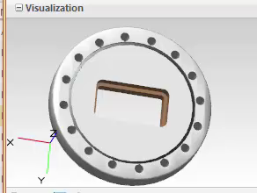
An alternative is an annotated 3D model. Instead of creating 2D drawings with multiple views laid out on a virtual sheet of paper, engineers and designers can apply dimensions, GD&T, notes and materials to the 3D model, which already exists.
Click
Play

Slide 45
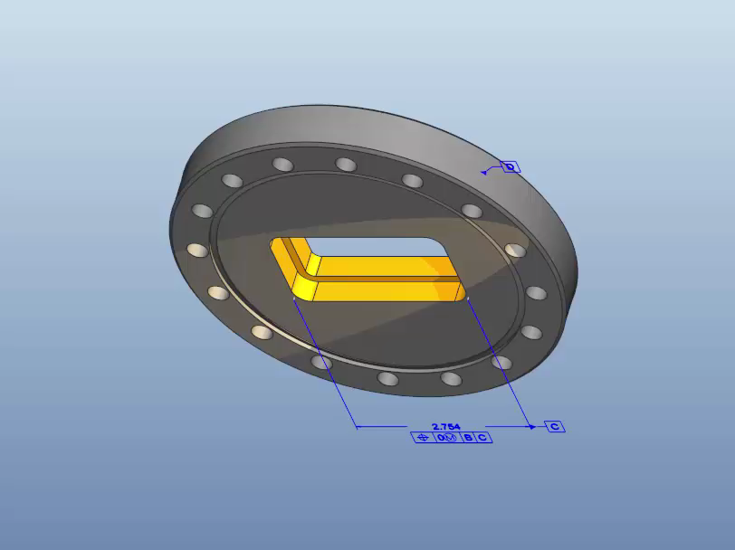

Slide 46
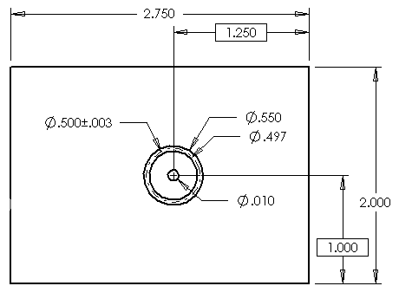
Bonus Tolerance Example
This means that the tolerance is .010 if the hole size is the MMC size, or .497. If the hole is bigger, we get a bonus tolerance equal to the difference between the MMC size and the actual size.
This system makes sense… the larger the hole is, the more it can deviate from true position and still fit in the mating condition!
.503
Actual Hole Size | Bonus Tol. | Φ of Tol. Zone
Ø .497 (MMC) | 0 | .010
Ø .499 (.499 - .497 = .002) | .002 (.010 + .002 = .012) | .012
Ø .500 (.500 - .497 = .003) | .003 (.010 + .003 = .013) | .013
Ø .502 | .005 | .015
Ø .503 (LMC) | .006 | .016
Ø .504 | ? | ?

