Slide 1
"Shutterless Vector-Scanned Data Collection Methods for the Pilatus 6MF"
Malcolm Capel
NECAT
Cornell University

Slide 2
Agenda
Motivation
Enabling Hardware
Implimentation
Methods
Examples

Slide 3
Rationale for Shutterless Ops:
Macromolecular Rotation crystallography:
100-1000’s of images (each collected over a small ∆Ω) per set.
Unavoidable control sequencing latencies involved with shuttered data collection degrade framing rate:
separate control systems for microdiffractometer and detector.
shutter lags & per frame goniometer sequencing overhead.
Pilatus readout deadtime ~ 2 msec, enabling “continuous” spindle rotation and data collection.
e.g. Max Shuttered Frame Rate (1 sec exp): 40 FPM
Unshuttered Frame Rate (1 sec exp): 60 FPM

Slide 4
Rationale for Scanned Data Collection
Scanned Data Collection: Rotation data collected in conjunction with programmed motion of the goniometer’s X,Y,Z centering axes.
Crystals frequently much larger than beam size…scanning increases efficiency of use of large crystals.
Scanning increases utilized diffraction volume…thereby partially mitigating radiation damage (reduces dose per unit volume).
Scanning to locate highest quality diffraction region of inhomogeneous samples.
Scanning to locate crystals in opaque cryomedia (due to precipitation, frost build up or use of lipidic phases).

Slide 5
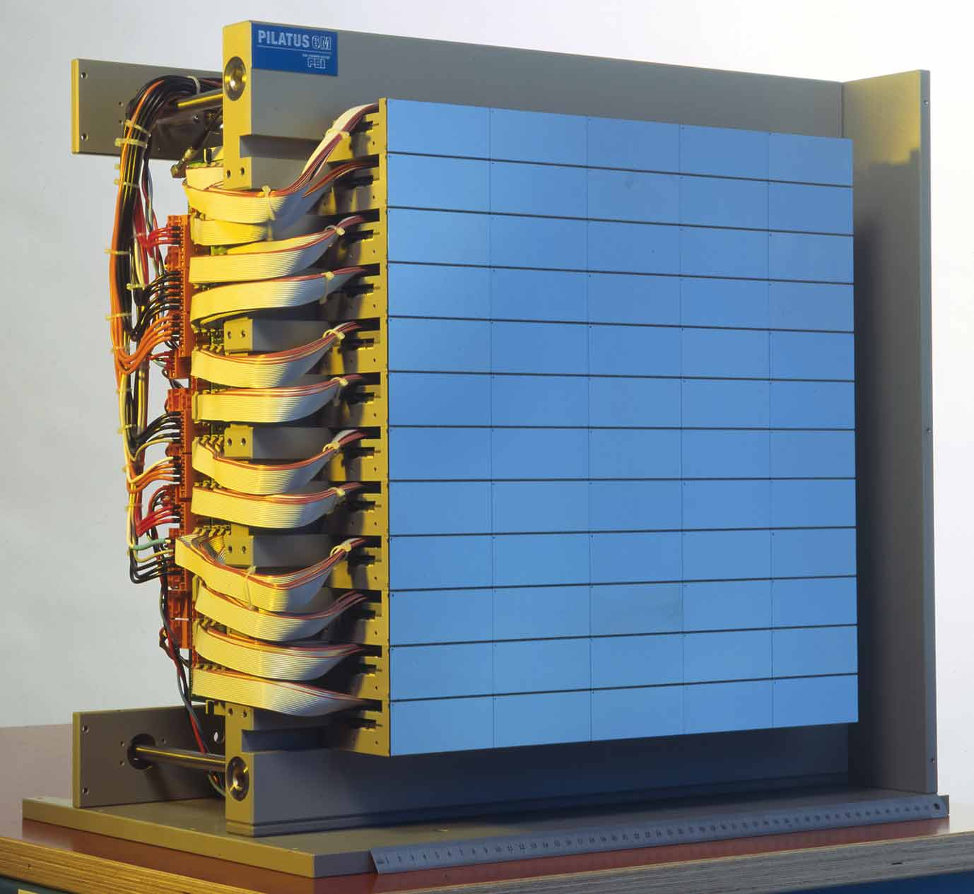
Pixel Array Detector
Pilatus 6MF
Frame rate: 24 Hz.
2msec readout dead time.
Dynamic range: 20 bit / pixel
2 Mcps / pixel (gain dependent).
Negligible read noise.
431x448 mm active area.
2527x2463 pixels.
Little geometry distortion.
8.4% Dead zone.
172 micron square pixels.

Slide 6
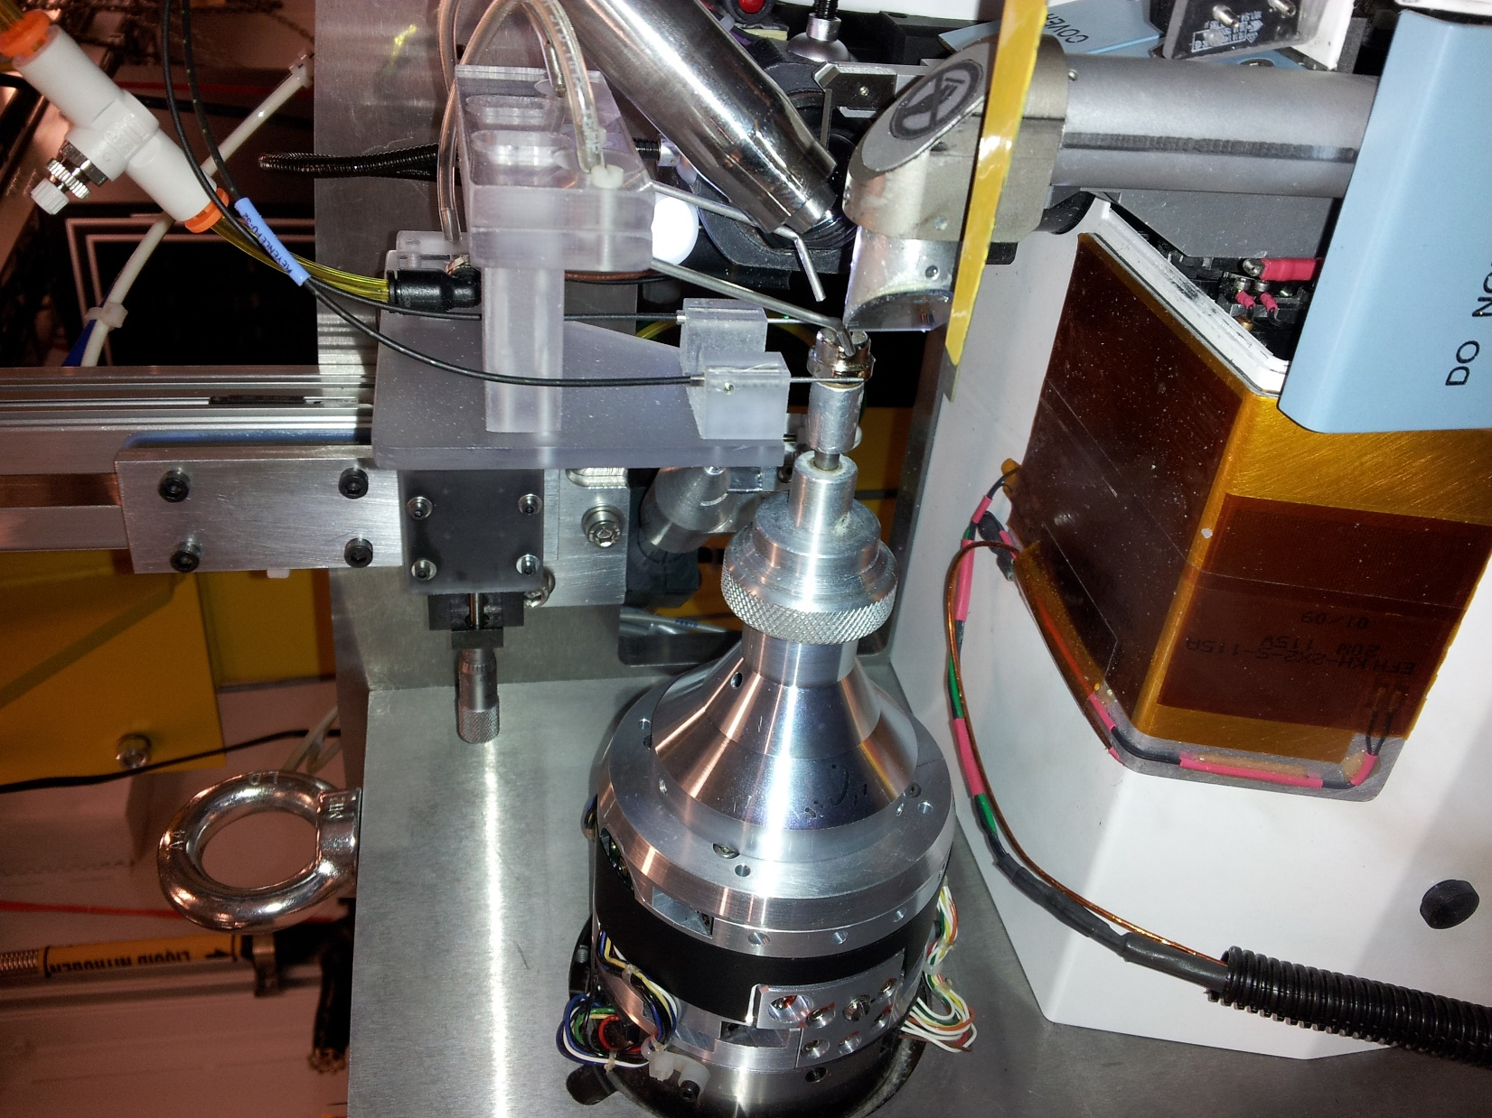
X,Y Centering
Stage
Reproducibility:
0.5 micron
Air Bearing
Omega Axis
Mounted on
Z,Y Stage
Reproducibility:
0.2 micron

Slide 7
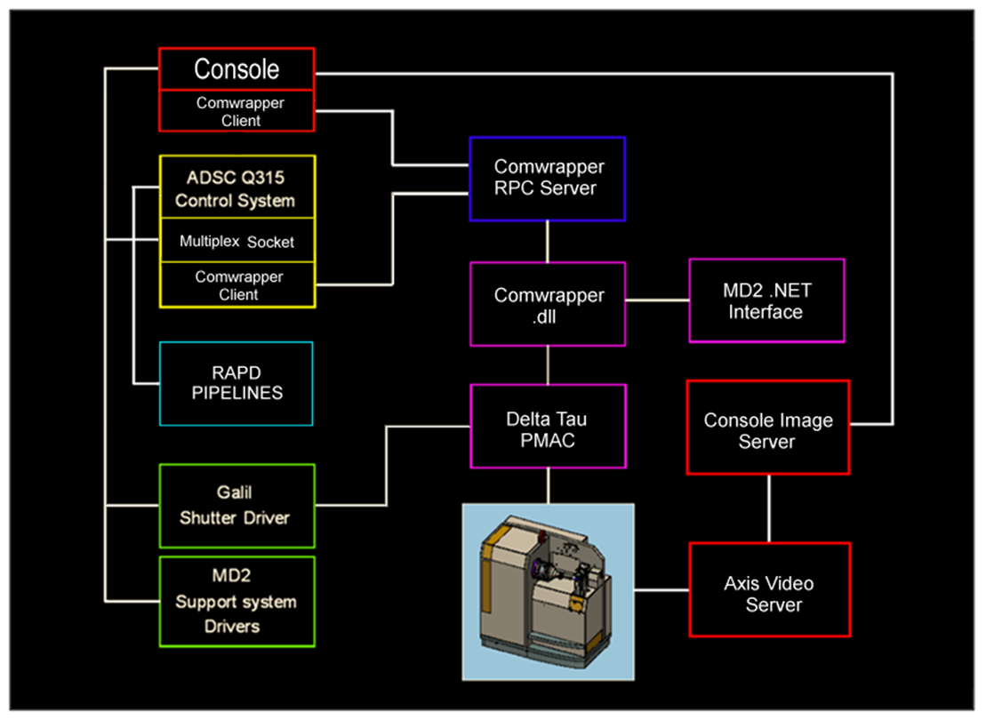
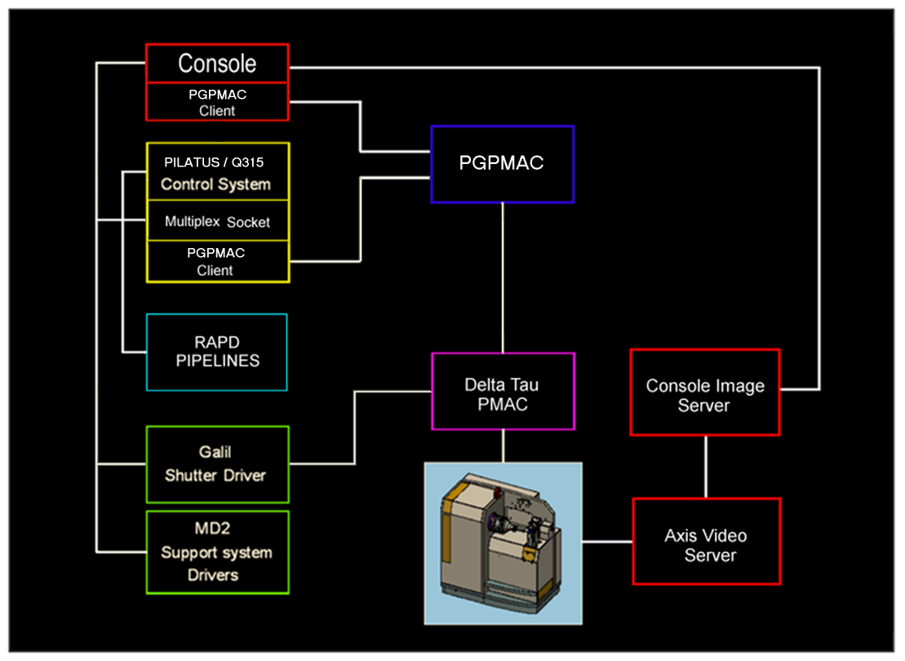
Hacked Maatel MD2 Control
Visual Basic
RPC interface from Console
Reverse engineering of VB to
Develop functional hooks to Console
LSCAT MD2 Controls
C language
Direct interface to PMAC
RPC interface from Console
Using same syntax as Maatel
Driver
Much faster, greater reliability, much easier to develop

Slide 8
New MD2 Control System
Maatel Software slow and fragile
PGPMAC
Principal Author: Keith Brister, LSCAT
Benefits over old system:
Fast startup (seconds vs minutes)
Less complex (One C module vs. Visual Basic spaghetti ball)
Much Faster … less overhead in PMAC communications
Q315 12 FPM -> 28 FPM (1sec exp)
Easily extendable … shutterless scan modes

Slide 10
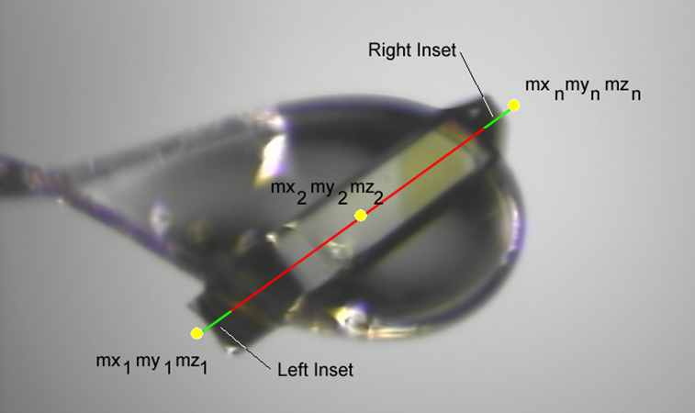
Definition of the Spanning Vector
mx = a1.mz + b1 my = a2.mz + b2

Slide 11
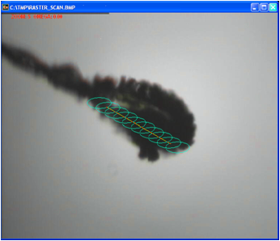
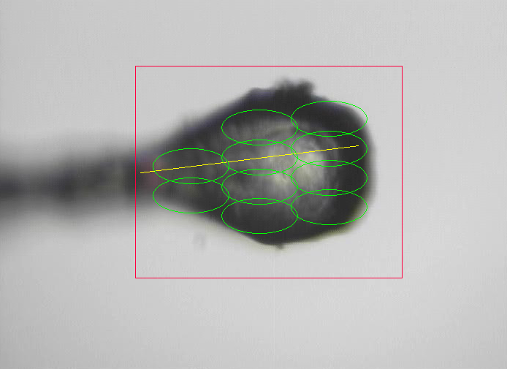
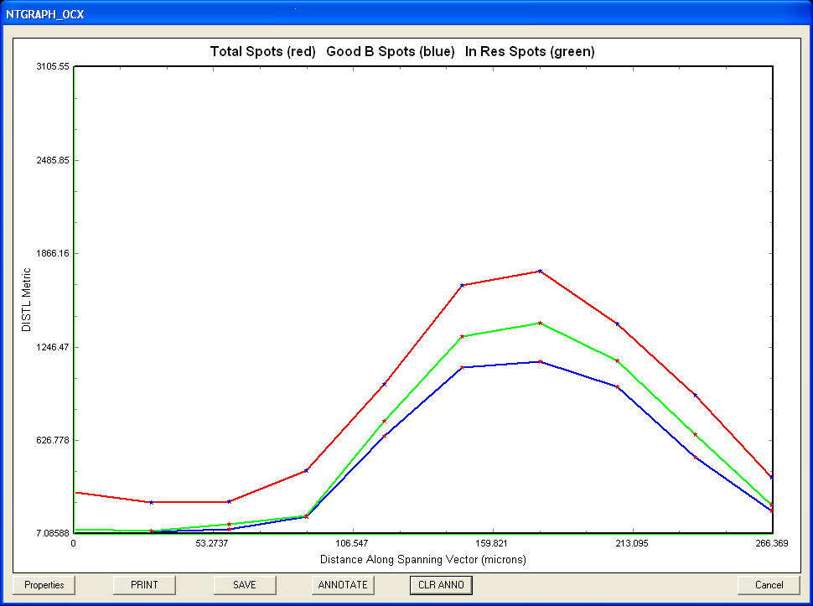
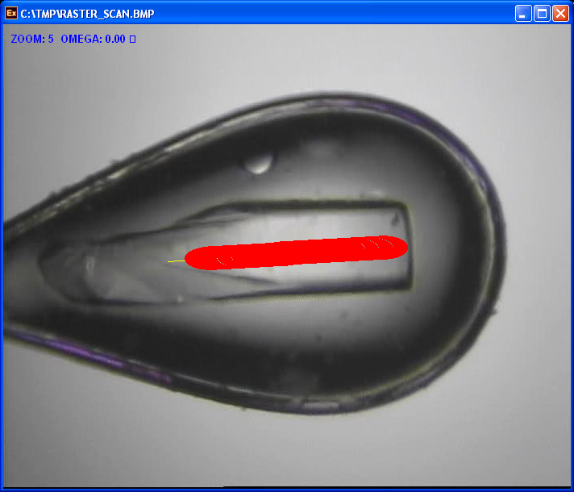
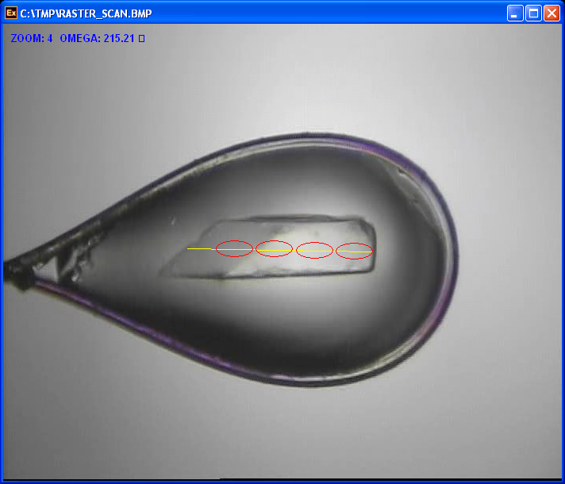
Scanned Data Collection Modes
RasterSnap Linear
Location / Quality
Assay
2D Scan for Location / Quality Assay
Continuous Vector Scan
Discrete vector Scan
Sample or vector endpoint location on occluded view
Notes:
Significantly increase time efficiency of scanned data collection techniques: A) 5-axis delta tau macros for real-time continuous scanning B) speed up MD2 control system (switch from 80-240 MHz processors) c) Get rid of dependence on current MD2 control system -> light-weight device driver.
2) Simplify scan setup
3) Improve scan result presentations
4) New scan modes automation of multicrystal user-defined paths or scan regions

Slide 12
Kinematic Scan PMAC Motion Program

Slide 13
Shutterless High Res DFA Scan
Ice-Encrusted Thaumatin Crystal

Slide 14
DFA Work Flow
User defines spanning vector and selects Ω orientation.
Image of aligned sample acquired from MD2 inline visualizer.
User defines ROI to constrain the search.
IA Server calculates bounding contour for loop from image frame.
Console tessellates union of the ROI and the interior of bounding contour with ellipses scaled to the size of the apertured beam.
Console calculates a serpentine path over the tessellated ellipses…each segment representing 1 kinematic scan.
User supplies the exposure time and ∆Ω for kinematic scans.
All scans executed, Pilatus frames sent to special directory.
Rapd Distl/Labelit pipeline monitors special directory and generates data summaries for each Pilatus frame (diffraction peak counts and resolution).
After pipeline returns all Distl/Labelit results a graphical data synopsis is generated and user selects region with best Distl/Labellit statistics…MD2 automatically moves to the corresponding centering XYZ configuration.

Slide 15
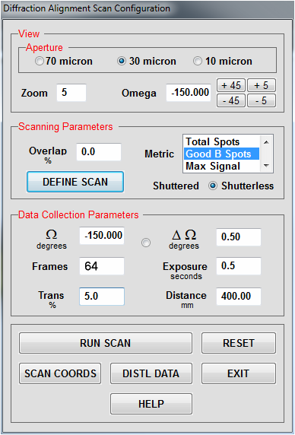
Setup

Slide 17


Slide 18
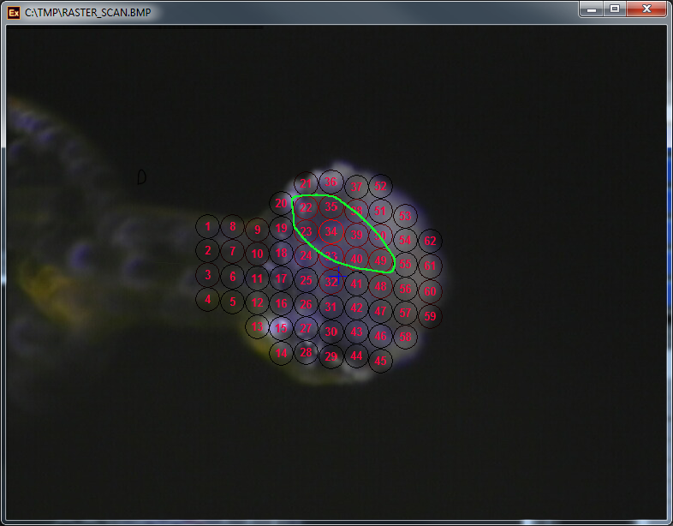
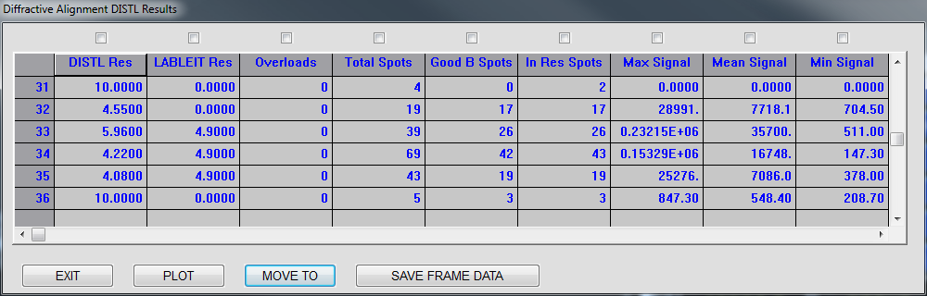
Distl Results

Slide 19
Shutterless Continuous Vector Scan
70S Ribosome Crystal

Slide 20
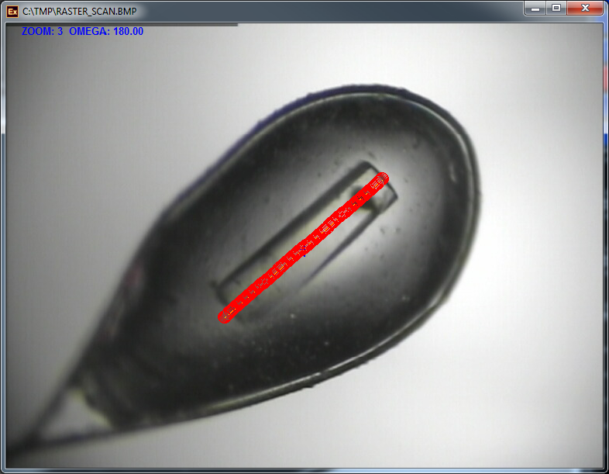
SETUP

Slide 22
