Slide 1
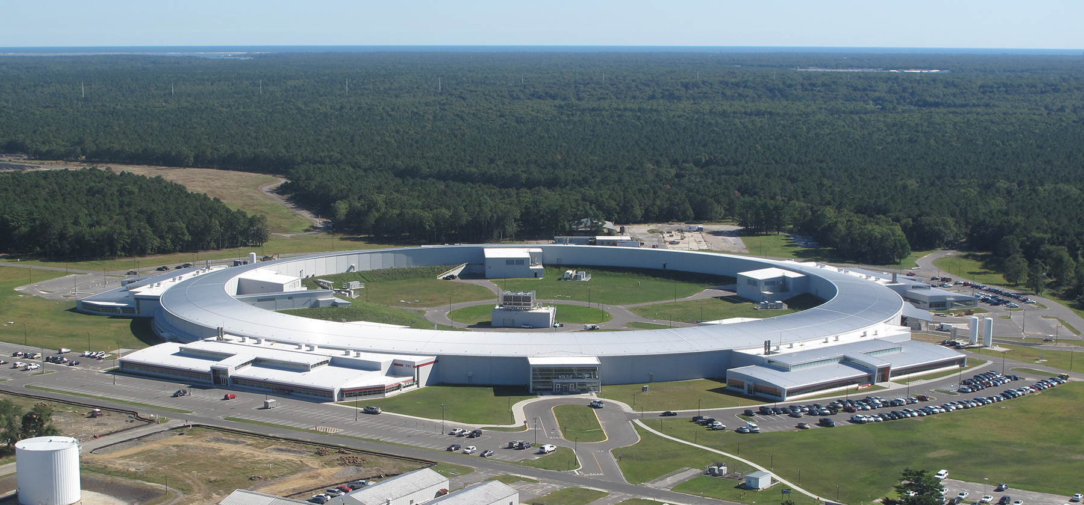
Data Acquisition at the NSLS II
Leo Dalesio, (NSLS II control group)
Oct 22, 2014 (not 2010)

Slide 2
Introduction
When we scaled some data collection to the frame size and data sets that are expected at NSLS II we found that most of the delays in processing the data were:
  Time to find the data sets that were needed for the analysis.
  Movement of the data into memory.
No Xray facility has demonstrated an architecture that supports the range of requirements posed by an entire facility.

Slide 3
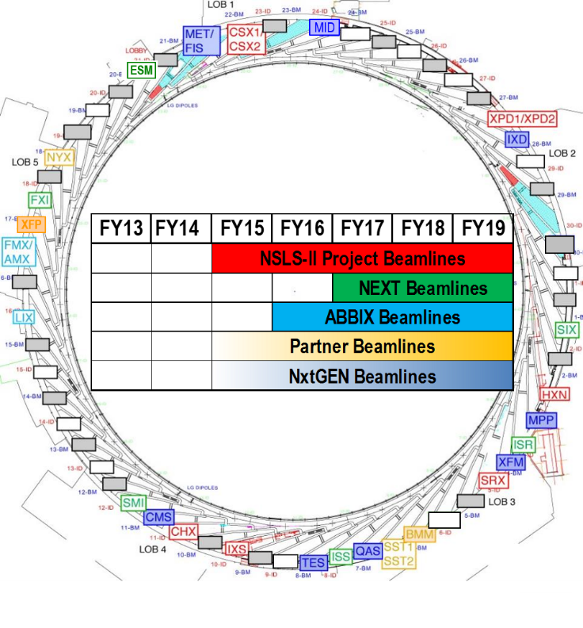
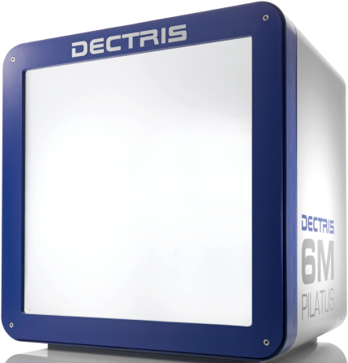
Data Rates
Each beam line can produce 8 MB frames up to 1 kfps, with data sets up to 1 TB per minute.
There will be over 60 experimental end stations when the facility is completed.
Detectors buffer all of this data on SDD storage
and does not pose a challenge.

Slide 4
Data Management
1 data set per minute, with 60 beam lines operating 20 hours per day
72,000 data sets per day, over 2 M data sets in one year.
20,000 signals are controlled and monitored on each beam line and recorded as time series.
A MetaDataStore service is being provided to support the tracking of data
A ChannelArchiver is provided to store time series data from the beam lines.
A Science Data Store is being provided to store large frame rate data sets.

Slide 5
Data Is Stored in Appropriate Repositories
metadata Store
The metadata store contains all configuration and environment parameters that are used to characterize a data set. Searches for specific data sets must be optimized.
The Experiment Log Book contains information about the data collection
It may be used to log steps in the data analysis such as export file formats used. Log entries can be made by manually or programmatically
Experiment
Log Book
The Scientific Data is the repository for large data sets. These data sets include matrices and image sets with the metadata required to plot or view the data. These are stored by sample and time stamp. Data can be written from experiment control or submitted from analysis. Other data sets can also be sent here such as reference or model data.
Scientific Data
Machine Data
Machine data is all time series data that is taken from the accelerator that is available for use in analysis.
Beamline Data
Beamline data is all time series data that is taken from the end station, beam line or accelerator that is available for use in analysis.

Slide 6
Data Processing
Scientists may be at the beam line and interact with the experiment control. In this case, we want to minimize the latency required to process the data and provide information.
Scientists may have submitted samples and interact with a scheduler and analysis report. In this case, we want to batch process the data and provide remote analysis results and reanalysis requests.
There are many architectural elements being modified or developed to address fast sample feedback to the scientist.
  Zero copy transportation of large arrays in front end computers
  Modified EPICS locking to use multicore front ends for array processing
  Requests to vendors to provide parallel SFP ports to pipe data into our FPGAs
  Multicast network protocol to send data to multiple clients
  We are developing a sample management application.

Slide 7

Data Processing Pipeline for fast results
Image
Viewer
PVAccess
Client
Image
Archive
PVAccess
Client
Image
Process
PVAccess
Client
Image
Viewer
PVAccess
Client
Image
Archive
PVAccess
Client
Image
Process
PVAccess
Client
Normative Types
Implement a narrow interface.
PVAccess protocol has C++, Java and Python Bindings
PVAccess protocol supports multi-cast and optimizes structured and large data set transfers
PVAccess
Server
Queue – 1 to n deep
Develop optimized processing blocks on multi-core processors - zero copy, interlligent locking
areaDetector Driver
Queue – 1 to n deep
Processing Block
Queue – 1 to n deep
Processing Block
Processing Block
Queue – 1 to n deep
FPGA Processing Blocks

Slide 8
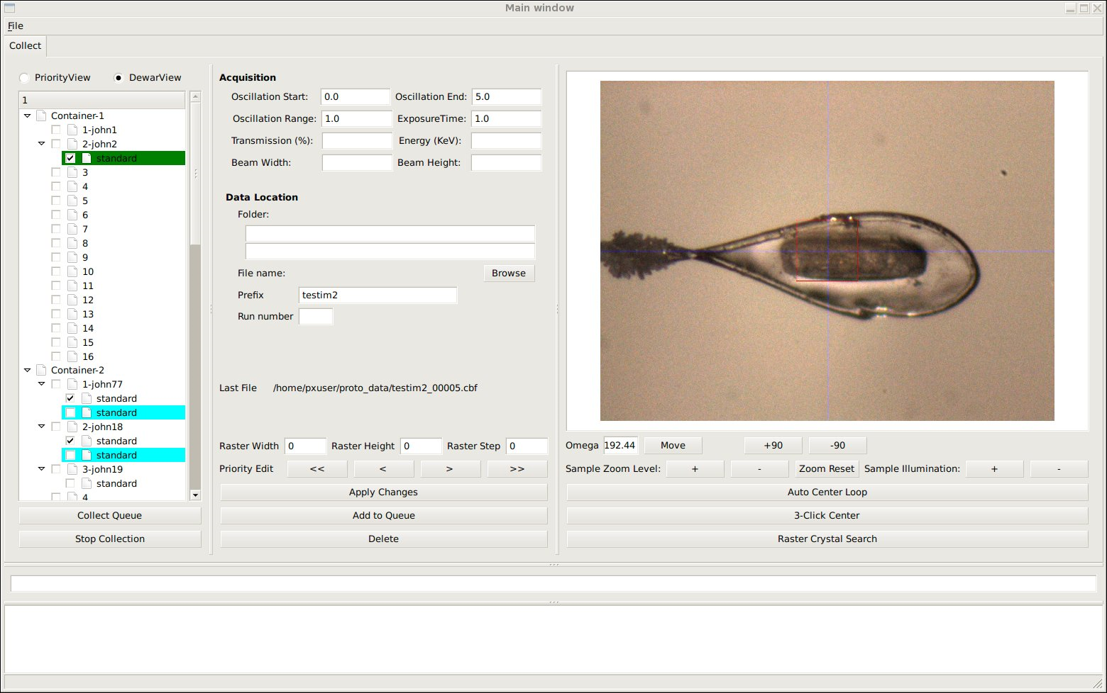
Sample Management
Samples are either viewed by their order in the sample changer dewar (DewarView), or by the order the user would like to collect (PriorityView). Priority The color coding for now is cyan=done, green=running, checked means requested to run when the "Collect Queue" button is pressed below the tree.

Slide 9
Data Analysis
There are many techniques used to study various samples at NSLS II.
Closer to the raw data, many of the algorithms used are common across beam lines.
There are some very specialized analysis routines required as well
Provenance of data must be preserved to validate the scientific process.
“Scientists would rather use someone else’s toothbrush than their analysis routines”
Users will want to use different, competing, evolved, higher performance, or just better codes.
To allow access to raw and processed data, a Data Broker API is provided
A standard library of python processing routines is produced and supported.
Processing routines use standard data types
Results from processing can be stored back into the data management system
A visualization library is supported for 1D and 2D data and data sets.
A data flow system is being developed to support the development of data analysis. VisTrails is being evaluated as a tool to provide this.

Slide 10
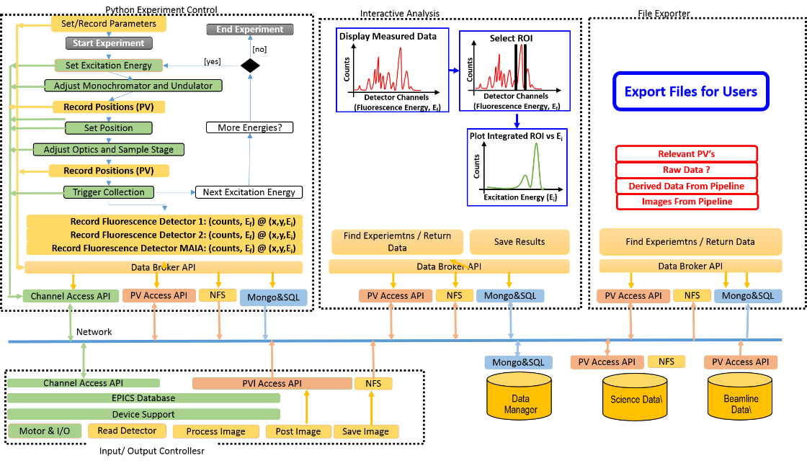
Design Status – Experiment Control (1 OF 4)

Slide 11
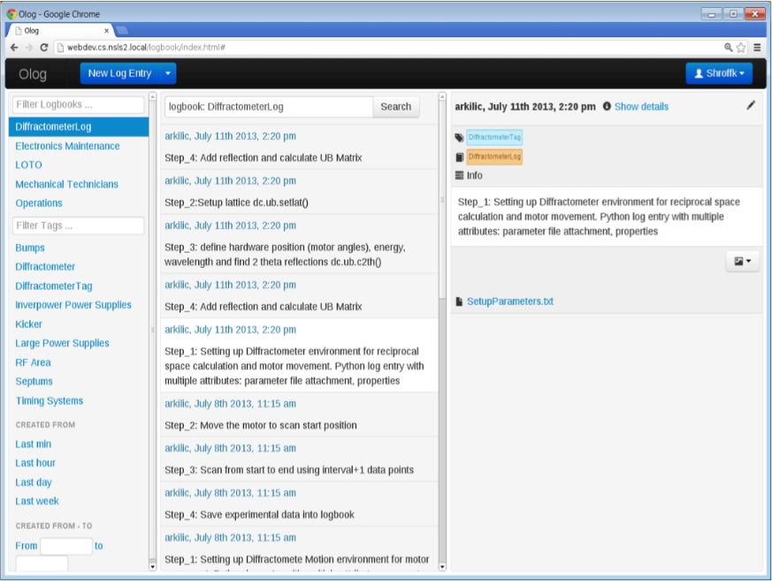
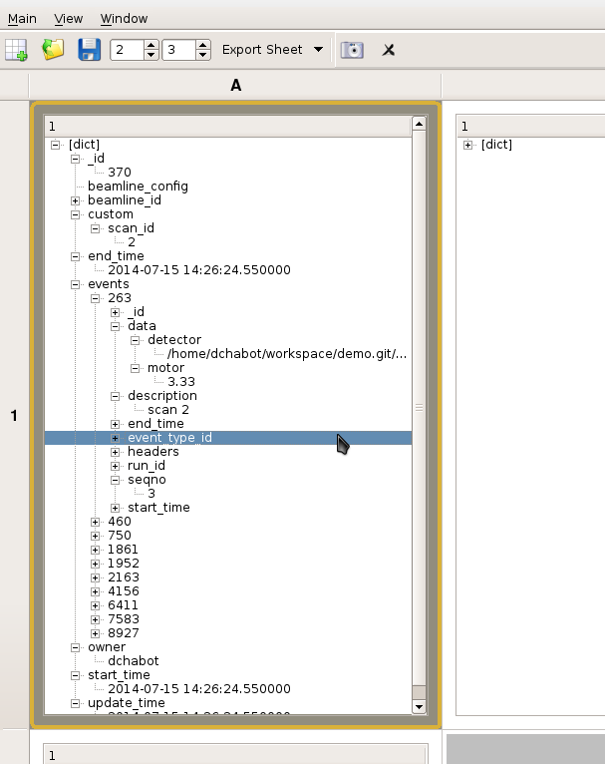
Design Status – Experiment Control (2 OF 4)

Slide 12
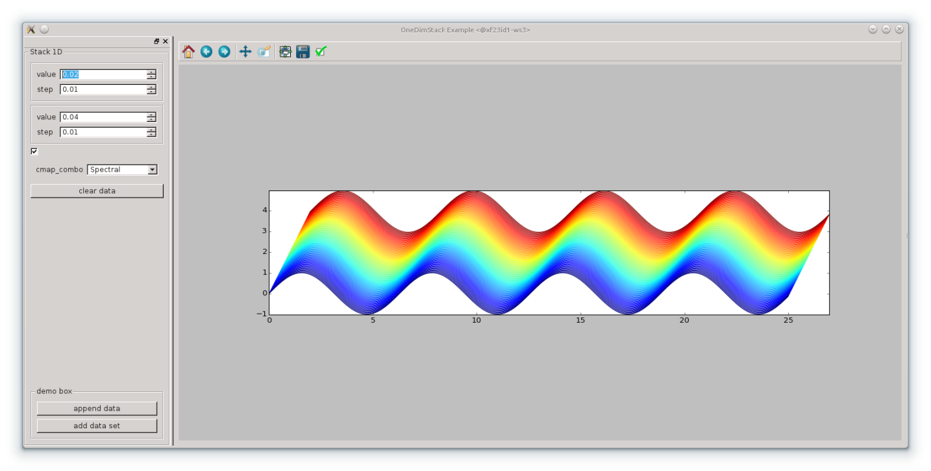
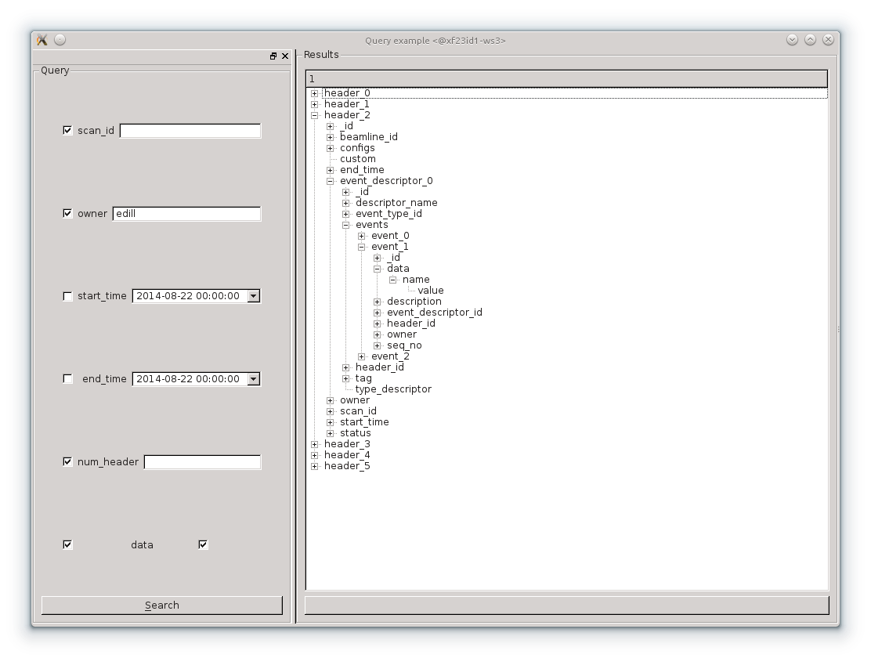
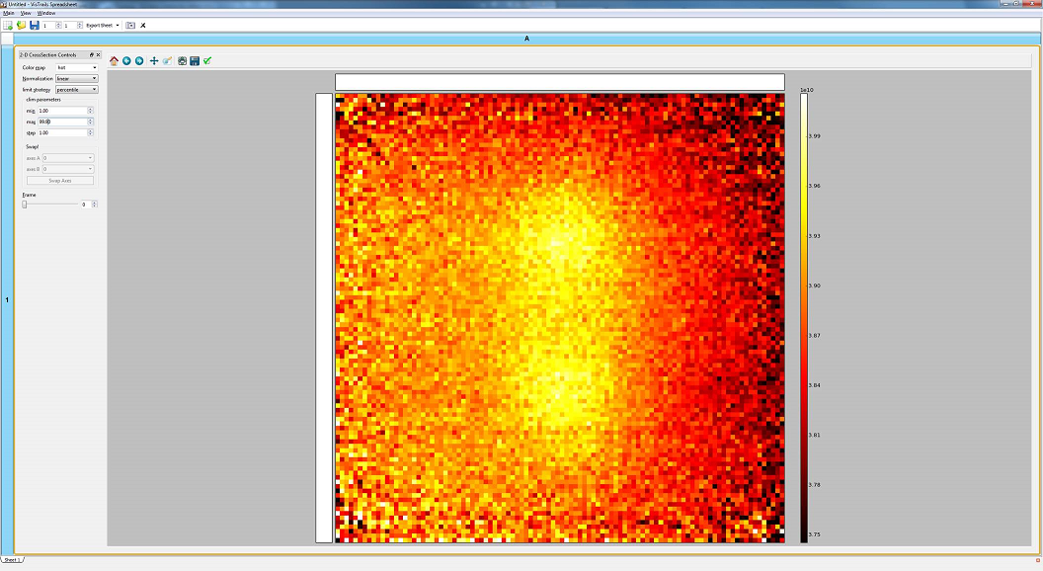
Design Status – Experiment Control (3 OF 4)

Slide 13
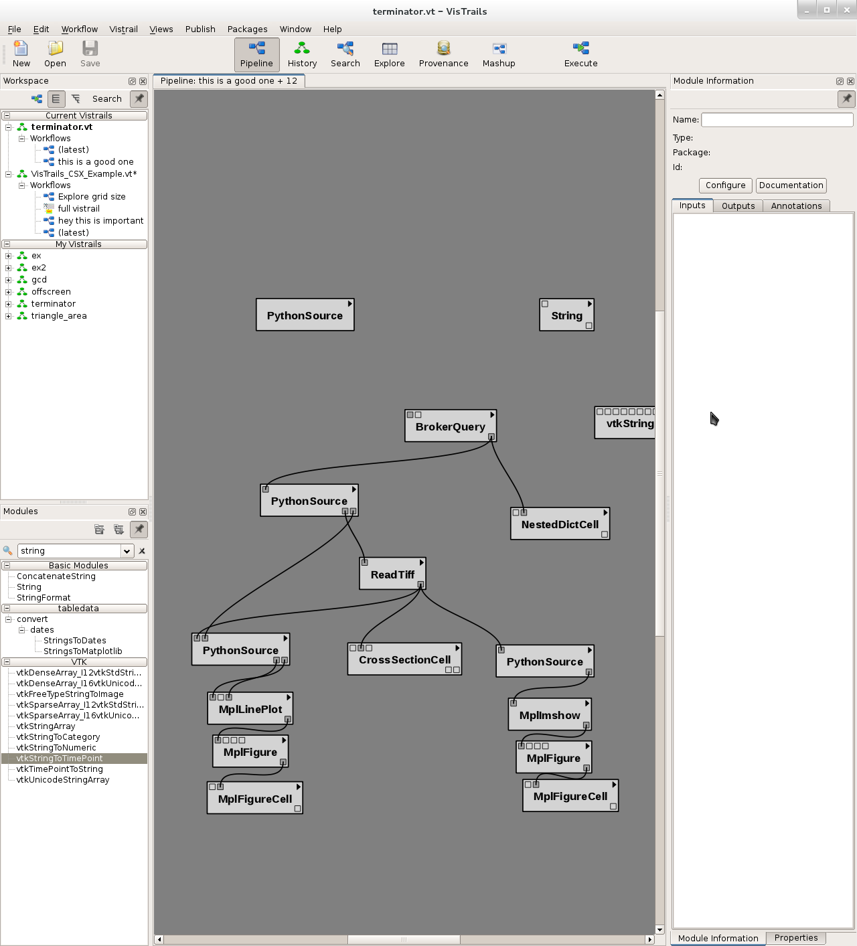
Design Status – Experiment Control (4 OF 4)

Slide 14
Data Storage
Data must be kept online for some time and may be stored to tape for some time
In 2016 we will need 2 PB to store one year of data, by 2020 35 PB will be needed.
There is a requirement to track data provenance and store intermediate analysis results.
Commercial solutions exist for this scale of data.
Tracking Provenance is being considered in workflow tools and the metaDataStore

Slide 15
Data Export
Scientists need to put together frame rate, time series, and configuration data in specific formats for existing analysis codes.
Scientists may want to export the data life cycle – from raw data through all analysis.
The DataBrokerAPI can be used in Python to access all data. Code must be developed to repackage data from different data stores into a desired export format.

Slide 16
Experimental Data Architecture
Experiment Control
File Formatter
Control System Studio with Correlation Plots
Web Clients
Channel Archiver View
DataBroker
DataBroker
PVManager
HTTP
NFS
CAC
PVAC
NFS
CAC
PVAC
CAC
PVAC
PVAC
Ethernet
PVAS
NFS
PVAS
REST
PVAS
PVAS
PVAS
Channel Finder Server
Archive Store/Retrieve
Experiment Information.
Experiment Information.
Archive Retrieval
Archive Retrieval
SQL
XML/RPC
SQL
SQL
XML/RPC
XML/RPC
RDB
Science
Data
Science
Data
PASS
OLOG
Machine Data
Beamline Data
CAS
PVAS
CAS
PVAS
N-lanes
Process Database.
Process Database.
Detector
Device Support
Device Support
Area Detector
Driver
Driver
Instrumentation

Slide 17
Remote data access problem
There is 1-10 Gbps link into BNL
Our users sit at universities, coffee shops, small offices (not on a high performance network port).
Analysis computers are being planned at BNL
A user interface to the analysis codes developed and maintained at BNL is being developed.

Slide 18
Conclusions
Two distinct areas of concern must be covered:
  Providing immediate feedback to allow scientists to effectively use their beam time.
  Provide an analysis and data management framework that supports deep analysis after the experiment is run.
No facility has demonstrated an architecture that supports the range of requirements posed by an entire facility.
A service based architecture is being developed to support the DAQ and data analysis needs of NSLS II.
Infrastructure is being used from an existing collaboration group that provides some strong basic capabilities.
There is a strong set of software architects, analysis, visualization, and fpga programmers working on these issues.

