Slide 1
Tools and Services at NSLSII
Kunal Shroff, Tasha Summers, Smith Reid, Gabriele Carcassi, Michael Davidsaver (NSLSII)
Ralph Lange (ITER)
Samuel Dallstream (UMich)
Michael Skinner (Marist College)

Slide 2
Publish/subscribe
v3
v4
IOC
IOC
…
IOC
IOC
…
CSS core
CSS
General purpose clients
CA client (JCA/CAJ)
pvA client
BOY
DataBrowser
Command/response
Core Java Client
…
v4
ca
pva
…
Data Sources
Masar
API
pvmanager core
Aggregation
vTypes
Data Definition
…
…
NEW!
Specialized clients
formula
Processing
Log Viewer
graphene
Visualization
AccelUtils
NEW!
Channel Viewer
pvm services
Registry
Web based REST services
masar
cf
…
Bindings
…
ChannelFinder
API
Olog
API
WebUI, scripts, other client
Logbook
...
…
cf-update
...

Slide 3
Publish/subscribe
v3
v4
IOC
IOC
…
IOC
IOC
…
CSS core
CSS
General purpose clients
CA client (JCA/CAJ)
pvA client
BOY
DataBrowser
Command/response
Core Java Client
…
v4
ca
pva
…
Data Sources
Masar
API
pvmanager core
Aggregation
vTypes
Data Definition
…
…
NEW!
Specialized clients
formula
Processing
Log Viewer
graphene
Visualization
AccelUtils
NEW!
Channel Viewer
pvm services
Registry
Web based REST services
masar
cf
…
Bindings
…
ChannelFinder
API
Olog
API
WebUI, scripts, other client
Logbook
...
…
cf-update
...

Slide 4
CS-Studio
An Integrated platform for controls and physics applications
Over 2 dozen releases
In production 3.1.6, 3.2.15a, and 3.3.10a

Slide 5
CS-Studio Applications
BOY
BEAST
LogViewer
DataBrowser
Pretune
ShiftViewer

Slide 6
BOY: Best OPI Yet
Approximately 5000 opi screens
All hosted in a mercurial repository
NFS mounted onto all machines in the controls network

Slide 7
BOY Screens
Engineering :
Developed by the controls engineers / the developers of the device IOC
Designed for device control
Physics:
Do the real useful stuff..
Created from a list of required interfaces and discussed in AP group meetings
Lots of rules, calls to external python scripts
Task oriented screens
Operator:
Combine/Summarize a lot of information

Slide 8
Issues Interesting Experiences

Slide 9
BOY Screen standards:
A perfect standards are hard to define
Following standards adds overhead
Source: http://xkcd.com/927/

Slide 10
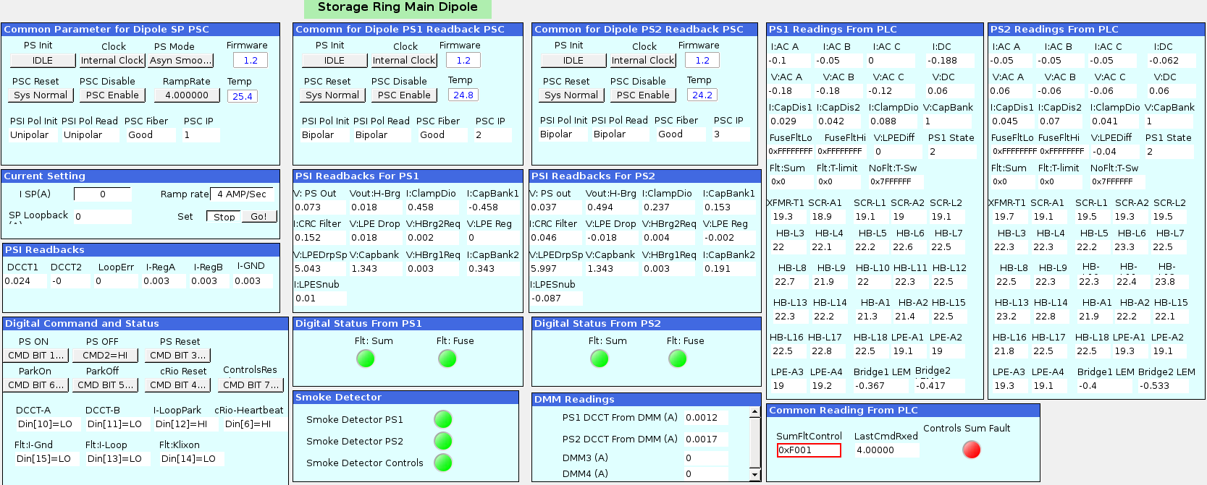
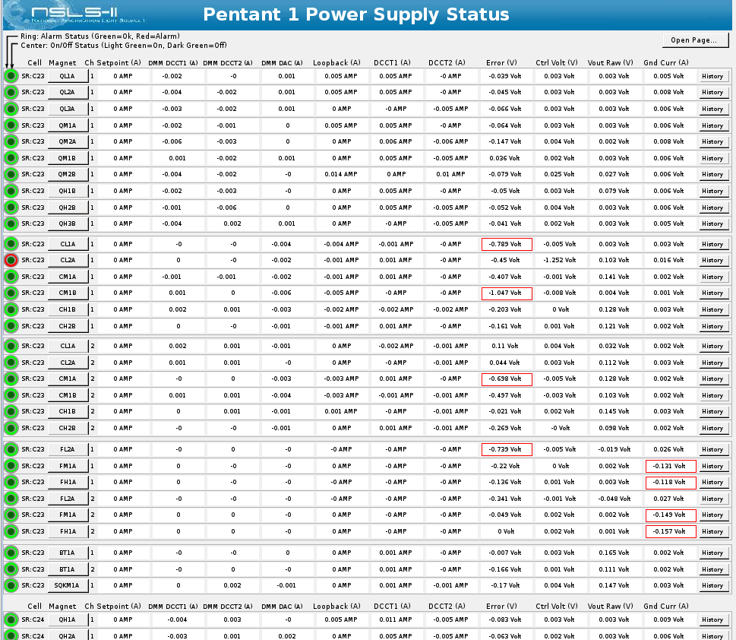
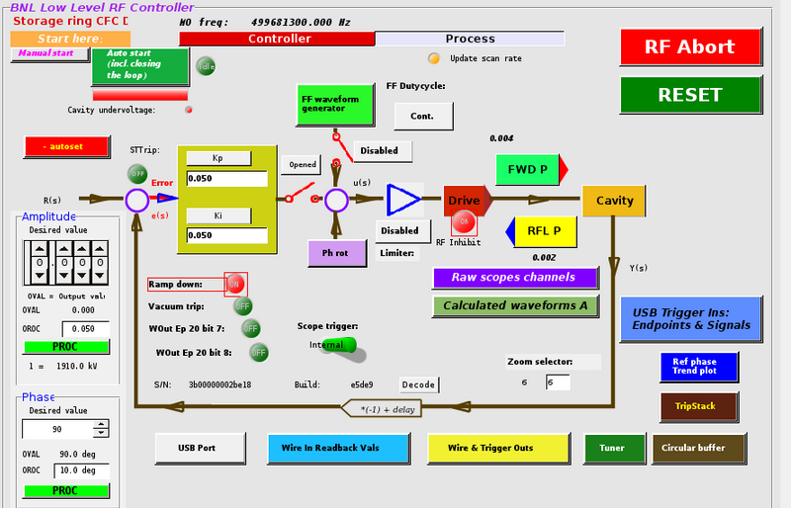
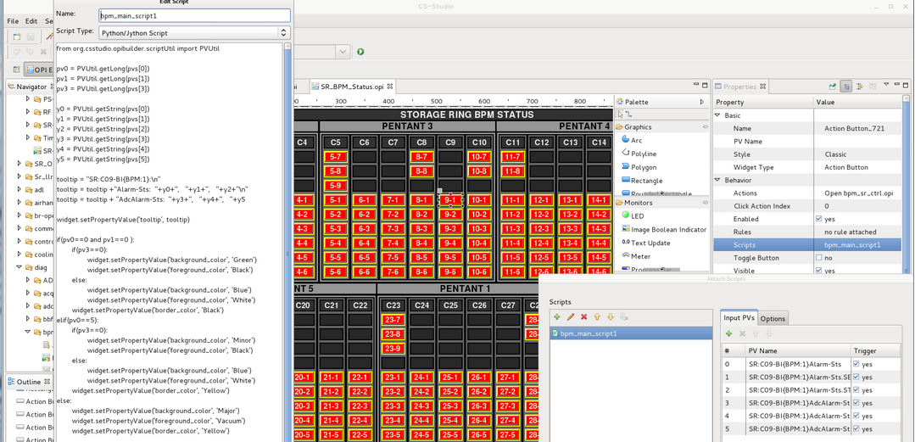
Absence of BOY Screen standards:

Slide 11
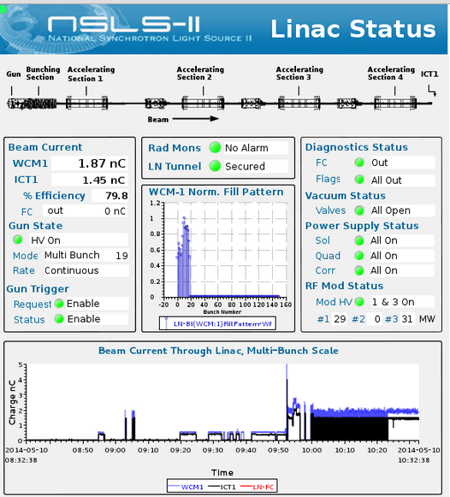
Solution*
Guidelines are easier than standards
Good examples more effective then good standards
* contingent on cooperation between physicist, engineers and operators

Slide 12
Good and Bad Practices:
PV naming convention + Macros + Linking containers
Reusable pieces
Easily modified

Slide 13
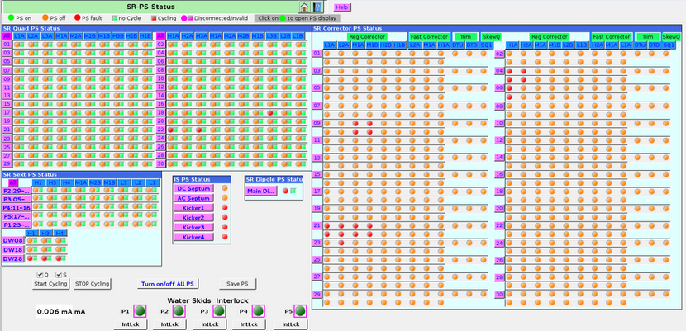
Good and Bad Practices:
PV naming convention + Macros + Linking containers + Rules
2000 + pvs with over 800 rules
Solution:
Multistate LED + formulas

Slide 14
Good and Bad Practices:
Avoid Scripts/Rules unless absolutely necessary
Should this be implemented in an IOC?
Is there a PvManager formula I can use?
Can I use rules? (Have I allocated a large enough PermGen space)
Use a script

Slide 15
Data Connection Layer:
3.1.x
Use PVManager to address threading issues, source rate throttling
3.2.x
PVManager with formula functions to provide and alternative to rules and scripts
Graphene prototype for displaying large waveforms
3.3.x
Passive scanning: switch from active polling of the queue to notification model
More graphene plots

Slide 16
SWT:
A limited widget set
Using native widget results in the lowest common denominator
Poor performance on Linux machines
JavaFX to the rescue
Part of jdk 8
Richer and easier to use widget set
TreeTable, Table with embedded controls
JavaFX and SWT share the UI thread
Can be easily embedded into SWT/Jface composites/views

Slide 17
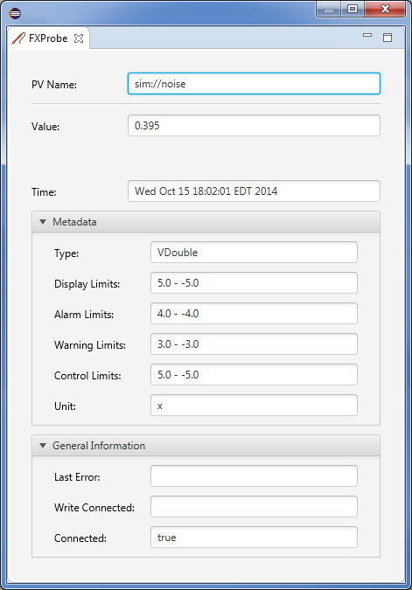
JavaFX in eclipse
Share the same UI thread
Relatively easy to embed
Require e(fx)clipse
Notes:
Unfortunately, JavaFX was not written with OSGi in mind so there are various sources of error when running inside OSGi. These problems include the location of the JavaFX binaries in your Java installation and class loading issues because of OSGi's visibility rules. e(fx)clipse provides helper libraries for dealing with all of those problems and makes writing JavaFX applications on top of Eclipse Equinox feel as easy as it is with SWT and Swing.

Slide 18
JavaFX preliminary comparisons
1000 label widgets updating at 1Hz
Notes:
The goal of this experiment was to measure the difference in performance between JavaFX and SWT when drawing many objects on a screen. In order to test performance, a program was written in both JavaFX and SWT that draws multiple text objects in an eclipse view and updates them using a PV. Windows Performance Monitor was used to monitor the CPU Load, and all tests were completed within the Windows 8 operating system.

Slide 19
Publish/subscribe
v3
v4
IOC
IOC
…
IOC
IOC
…
CSS core
CSS
General purpose clients
CA client (JCA/CAJ)
pvA client
BOY
DataBrowser
Command/response
Core Java Client
…
v4
ca
pva
…
Data Sources
Masar
API
pvmanager core
Aggregation
vTypes
Data Definition
…
…
NEW!
Specialized clients
formula
Processing
Log Viewer
graphene
Visualization
AccelUtils
NEW!
Channel Viewer
pvm services
Registry
Web based REST services
masar
cf
…
Bindings
…
ChannelFinder
API
Olog
API
WebUI, scripts, other client
Logbook
...
…
cf-update
...

Slide 20
Motivation and Objectives
A flat name space restricts seriously:
Clients need to know all channel names beforehand
Portable generic clients must be simple
Apps need full configuration or framework supplied service
Develop a Directory Service
Generic
No dependency on installation and local conventions
Simple and fast (enough)
Use standards wherever possible
Provides "query-by-functionality"

Slide 21
Directory Data
Set of Channels (unique names)
Each Channel has an arbitrary number of Properties (name/value pairs) and Tags (names)
Each Channel, Property, or Tag has an Owner (group) to allow basic access control
All names and values are strings

Slide 22
Directory Data example
<channel name="V:1-SR-BI:SUPER{BPM:4}SA:X" owner="cf-update">
<properties>
<property name="elemName" value="bpm:4" owner="cf-update"/>
<property name="elemIndex" value="400" owner="cf-update"/>
<property name="elemPosition" value="5.208" owner="cf-update"/>
<property name="pvStatus" value="Active" owner="cf-update"/>
</properties>
<tags>
<tag name="aphla.sys.SR" owner="operator"/>
</tags>

Slide 23
Query Example
SR:*C01*
All pvs from storage ring cell 1
SR:*C01*&elemName=bpm:4*
All pvs from storage ring cell 1 belonging to element bmp:4
SR:*C01*&elemName=bpm:4*&pvStatus=active
All pvs from storage ring cell 1 belonging to element bmp:4 and with pvStatus active
SR:*C01*&elemName=bpm:4&tag=aphla.sys.SR
All pvs from storage ring cell 1 belonging to element bmp:4 with tag aphla.sys.SR

Slide 24
Publish/subscribe
v3
v4
IOC
IOC
…
IOC
IOC
…
CSS core
CSS
General purpose clients
CA client (JCA/CAJ)
pvA client
BOY
DataBrowser
Command/response
Core Java Client
…
v4
ca
pva
…
Data Sources
Masar
API
pvmanager core
Aggregation
vTypes
Data Definition
…
…
NEW!
Specialized clients
formula
Processing
Log Viewer
graphene
Visualization
AccelUtils
NEW!
Channel Viewer
pvm services
Registry
Web based REST services
masar
cf
…
Bindings
…
ChannelFinder
API
WebUI, scripts, other client
Olog
API
cf-update
Logbook
...
…
Python hla scripts
...

Slide 25
Populating ChannelFinder
cf-update
Adds new channels
Manages existing channels
Orphaned channels
Moved channels
Python scripts
cf-properties (under development)

Slide 26
Example st.cmd
dbLoadRecords("gauss.db","P=ktest")
epicsEnvSet("EPICS_HOSTNAME", "dev32new")
epicsEnvSet("EPICS_IOCNAME", "gauss")
iocInit()
# pipe the output of the dbl command to a file
# the file name should follow the convention 'myHostName.myIOCName.dbl'
# write the file to a well know directory on which the cfmonitor deamon is running
dbl > $(CF_UPDATE_DIR)/$(EPICS_HOSTNAME).$(EPICS_IOCNAME).dbl

Slide 27
Under the Hood
The cf_monitor daemon monitors $(CF_UPDATE_DIR) directory and envokes an updare task when
A new *.dbl file is created in the dir
An existing *.dbl file is modified
The update task handles
Uses the filename to obtain the hostName, iocName property values
New channels – creates new channels with hostName, iocName, pvStatus and time properties
Orphaned channels – pvStatus property is updated
Moved channels – ensures that the hostName, iocName properties are update when channels are moved
Unchanged channels
In all cases existing properties(excluding hostName, iocName, pvStatus, time) and tags are left unaffecteds

Slide 28
device FM1G4C02A
Channel Name | SR:C02-MG:G04A{HFCor:FM1} Fld-I | SR:C02-MG:G04A{HFCor:FM1} Fld-SP | SR:C02-MG:G04A{HFCor:FM1} Fld-I | SR:C02-MG:G04A{HFCor:FM1} Fld-SP
handle | READBACK | SETPOINT | READBACK | SETPOINT
elemName | FXM1G4C02A |  | FYM1G4C02A
elemType | HFCOR |  | VFCOR
elemField | x |  | y
devName | FM1G4C02A
sEnd | 65.5222
cell | C02
girder | G4
symmetry | A
length | 0.044
ordinal | 263 |  | 264
tags | eget | eput | eget | eput
 | x |  | y
 | sys.SR
Notes:
From Linyun Yang (accelerator physics) talk:
From Channel Access to Channel Finder Service:
Channel Accesses in Python and Matlab are simple to use.
High level applications (HLA) deals with thousands of magnets, instruments and more channels.
Organized/structured channel information is necessary.
Channels linked to accelerator lattice and diagnostics are even better.
Searching instead of remembering is easier for HLA users.
A “dictionary” service can help HLA to manage the channels and build a lattice structure to which the AP is familiar. (they done simulation, analysis with it in the design).
Physics group can re-create the lattice from the information in channel finder
By tags, different lattices can be built, and elements can be shared between them.
Sharing is important for injection, where LTD1 and LTD2 shares a lot of elements with LTB

Slide 29
ChannelViewer

Slide 30
Auto-complete

Slide 31
PVManager Formula
=cf(“* elemType=HFCOR handle=SETPOINT tags=sys.SR”)
Queries ChannelFinder and returns a VTable consisting of all of channels for the setpoint pvs for all horizontal fast correctors in the storage ring

Slide 32
Even more Interesting Experiences

Slide 33
ChannelFinder data
Over 180k channels
Over 1.2 million instances of channel + tag/property
Service response (Query + Parsing) in the order of seconds

Slide 34
MongoDB
Embedded (denormalized) data model
Ideal for one-to-many relationships between entities.
provides better performance for read operations, as well as the ability to request and retrieve related data in a single database operation.
Embedded data models make it possible to update related data in a single atomic write operation.
// channels
{
name: “channel name”
owner: “channel owner”
properties: [{name: “property name”,
owner: “property owner”,
value: “property value”,
_id: properties._id},......]
tags: [tags._id,.....]
}
// tags
{
name: “Tag name”,
owner: “Tag owner”,
_id: ID
}
// properties
{
name: “Property name”,
owner: “Property owner”,
_id: ID
}

Slide 35
Performance Environment
Database
150k channels
15 million channel-properties/channel-tags
Queries
Search based on channel names and property values

Slide 36
Mysql Vs MongoDB
Mysql
MongoDB

Slide 37
Questions?

Slide 38
Links:
Control System Studio
http://controlsystemstudio.org/
ChannelFinder
http://channelfinder.sourceforge.net/
https://github.com/ChannelFinder/ChannelFinderService
Performance Tests
https://github.com/shroffk/cf-mongo-java-test
https://github.com/mskinner5278/cf-mongo-test
JavaFx
https://github.com/sjdallst/FXvsSWTProfiling
http://www.eclipse.org/efxclipse

