Slide 1
Integrating high speed detectors at Diamond
Nick Rees,, Mark Basham, Frederik Ferner, Ulrik Pedersen, Tom Cobb,
Tobias Richter, Jonathan Thompson…
(Diamond Light Source),
Elena Pourmal (The HDF Group)

Slide 2
Introduction
History
Detector developments
  Parallel detectors
  Spectroscopic detectors
HDF5 developments
  HDF5 1.8.11 (Available now):
    Dynamically loaded filter libraries
    Direct write of compressed chunks
  HDF5 1.10 (Being integrated):
    New dataset indexing: Extensible array indexing.
    SWMR
    VDS
    Journaling

Slide 3
History
Early 2007:
  Diamond first user.
  No detector faster than ~10 MB/sec.
Early 2009:
  first Lustre system (DDN S2A9900)
  first Pilatus 6M system @ 60 MB/s.
Early 2011:
  second Lustre system (DDN SFA10K)
  first 25Hz Pilatus 6M system @150 MB/s.
Early 2013:
  first GPFS system (DDN SFA12K)
  First 100 Hz Pilatus 6M system @ 600 MB/sec
  ~10 beamlines with 10 GbE detectors (mainly Pilatus and PCO Edge).
Late 2015:
  delivery of Percival detector (6000 MB/sec).
Doubling time = 7.5 months
Notes:
I02, I03, I04, I24, I22, B22, I12, I13

Slide 4
Detector developments

Slide 5
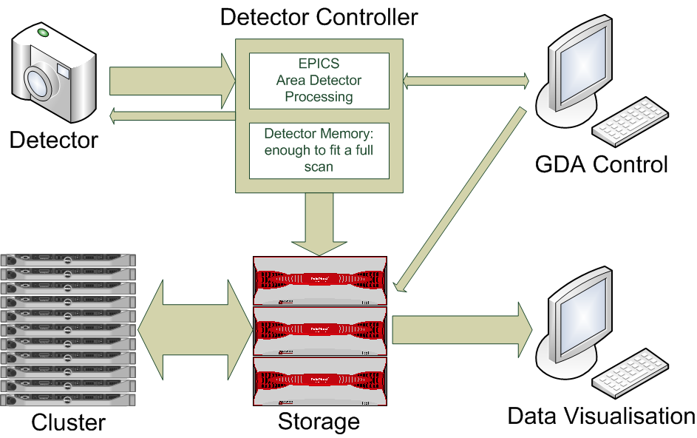
Diamond Detector Model

Slide 6
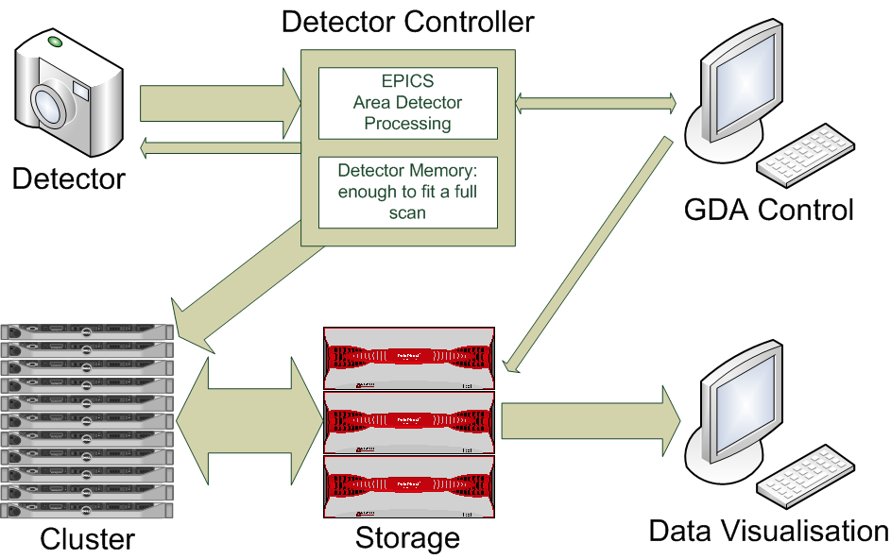
Potential EPICS Version 4 Model

Slide 7
Basic Parallel Detector Design
Control Process
FEM
Readout Node
FEM
Readout Node
Sensor/Medipix3 Hybrids
FEM
Readout Node
FEM
Readout Node
Network
FEM
Readout Node
FEM
Readout Node
Detector head
10GigE
Optical Links
Readout nodes all write in parallel
Need a mechanism to splice data into one file.

Slide 8
Detector Block Diagram
Actual/potential network or CPU socket boundaries
Detector Control
Detector Array
Detector Control Software
Detector Wire Protocols
Control Driver
Data Receiver
Detector Data Stream (n copies)
Data Processing:
2 bit gain handling
DCS subtraction
Pixel re-arrangement
Rate correction(?)
Flat field
Dark subtraction
Efficiency correction
Configuration
Cmd
Status
Documented
Controlled
Interfaces
HDF5 file
Control Server
Beamline Control Software
Detector API
Data Compression
Detector Engineer Software
EPICS/ Area Detector
Tango/ Lima
Calibration
Software
HDF5 File Writer
HDF5 file

Slide 9
Spectroscopic Detectors
areaDetector is poorly named…
  Base class is asynNDArrayDriver, but this name is not so catchy…
    NDArray* classes provide basic functionality
    Core plugins derive from NDPluginDriver and many will work with any NDArray.
    Most popular plugins are the file writing plugins that get data to disk.
  Basic areaDetector class is really NDDriver
    Provides methods for reading out a typical areaDetector
    The methods aren’t so good for other types of detectors, e.g.:
      Spectroscopic (MCA like) detectors.
      Analogue (A/D like) detectors.

Slide 10
Proposal for new ND Drivers
Need a set of basic driver classes for other types of NDArrays
  NDMCADriver (or NDSpectraDriver)
    Generates 2-D array of energy vs detector channel
    3rd dimension can be time.
  NDADCDriver (or ND DigitizerDriver)
    Generates 1D array of values from a set of ADC’s
    2nd dimension can be time.
Each driver can feed existing plugins, but also could benefit from specialist plugins.

Slide 11
Updated NDFileHDF5 plugin
Provides control of HDF5 chunking and compression features.
Now can define the HDF5 layout with an XML file.
  Data source can be detector data, NDAttributes or constant.
Can write any HDF file format – e.g. NeXus or Data Exchange.
Collaboration between Diamond and APS

Slide 12
HDF5 Developments

Slide 13
HDF5 key points
HDF5 is mature software that grew up in the HPC environment.
It is a widely used standard and has the richest set of high performance functionality of any file format.
It allows rich metadata and flexible data formats
It has some caveats we know about:
  HDF5 is single threaded.
  pHDF5 relies on MPI, which doesn’t happily co-exist with highly threaded architectures like EPICS.
  pHDF5 is not as efficient as HDF5
  pHDF5 doesn’t allow compression.
  Files cannot be read while they are written

Slide 14
Recent Developments: Release 1.8.11
H5DO_write_chunk
  Funded by Dectris and PSI
  Improves writing compressed data by:
    Avoiding double copy of filter pipeline
    Allowing optimised (e.g. multithreaded) compression implementations
Pluggable filters
  Funded by DESY
  Allows users to provide filters as a shared library that is loaded at runtime.
  Search path set by environment variable: HDF5_PLUGIN_PATH

Slide 15
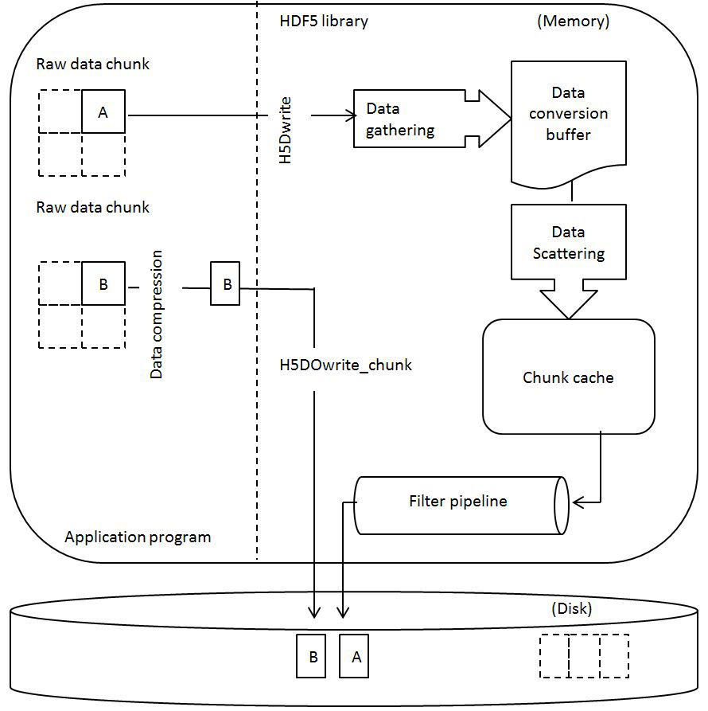
Chunk write mechanism

Slide 16
Current developments: Release 1.10
File format changes that need a major release:
  Improved dataset indexing:
    New B-Tree implementation
    Extensible array indexing
  Journaling
  Virtual Object Layer
  Single Writer Multiple Reader (SWMR)
    Funded by Diamond, Dectris and ESRF
  Virtual Data Set
    Funded by Diamond, DESY and Percival Detector
Beta release July 2015

Slide 17


Slide 18
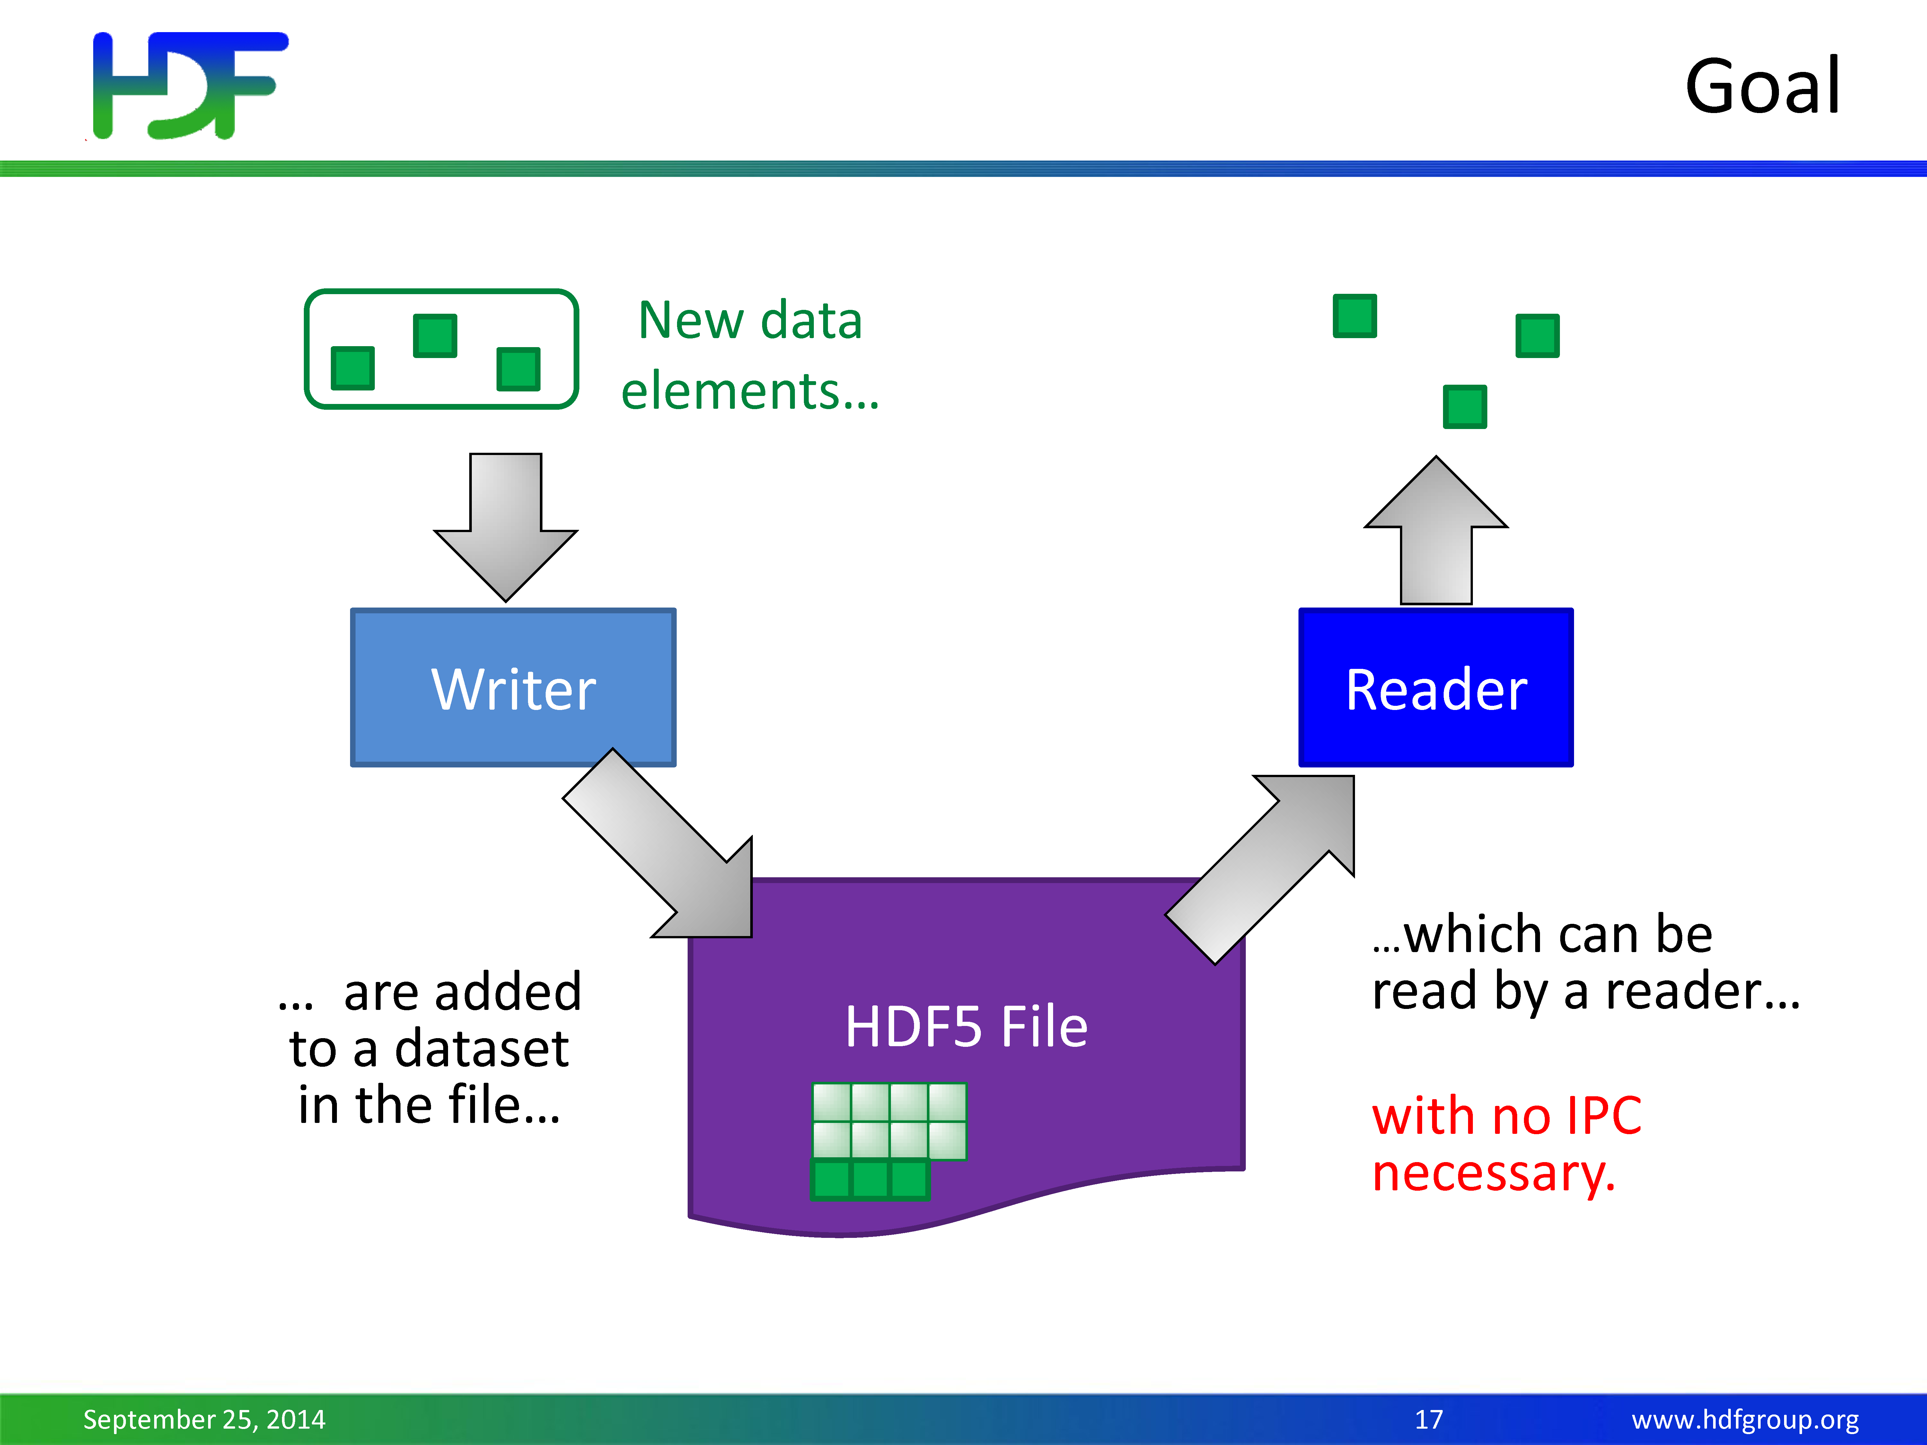

Slide 19
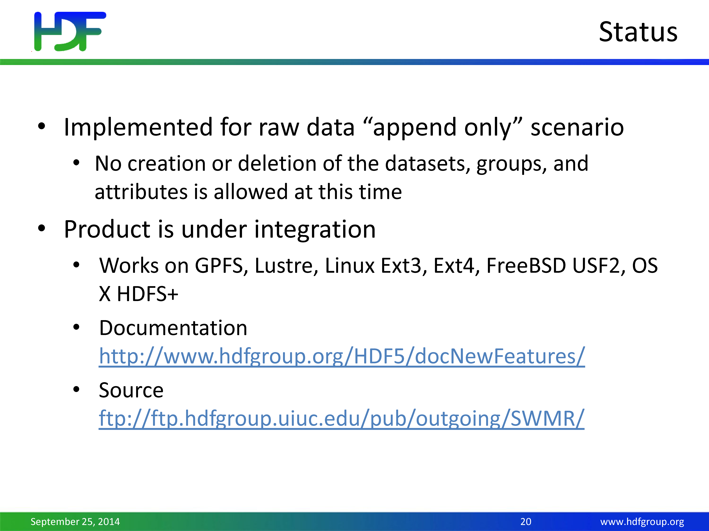

Slide 20
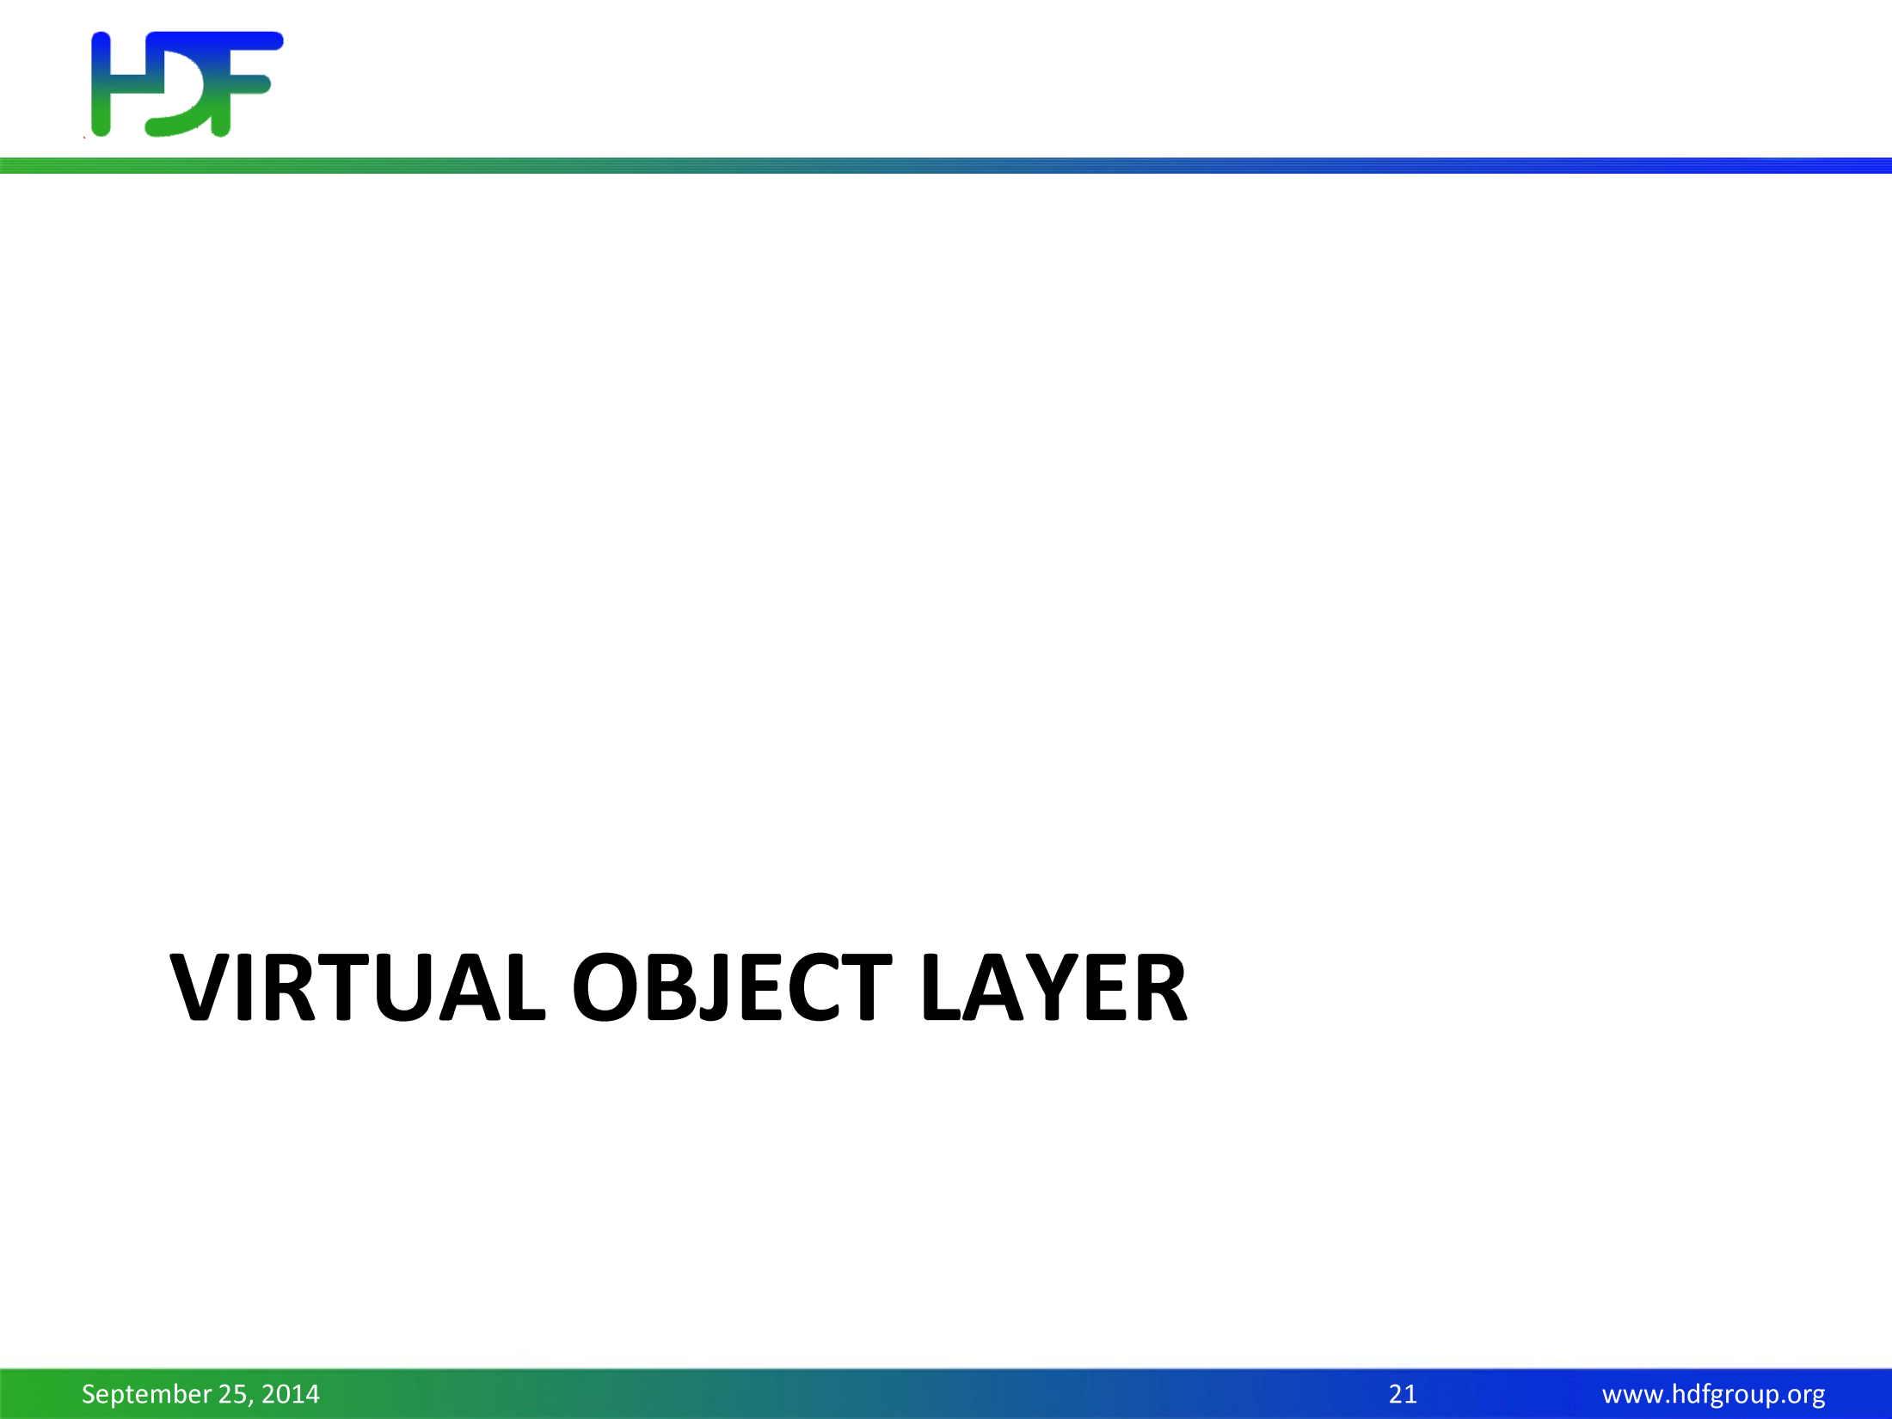

Slide 21
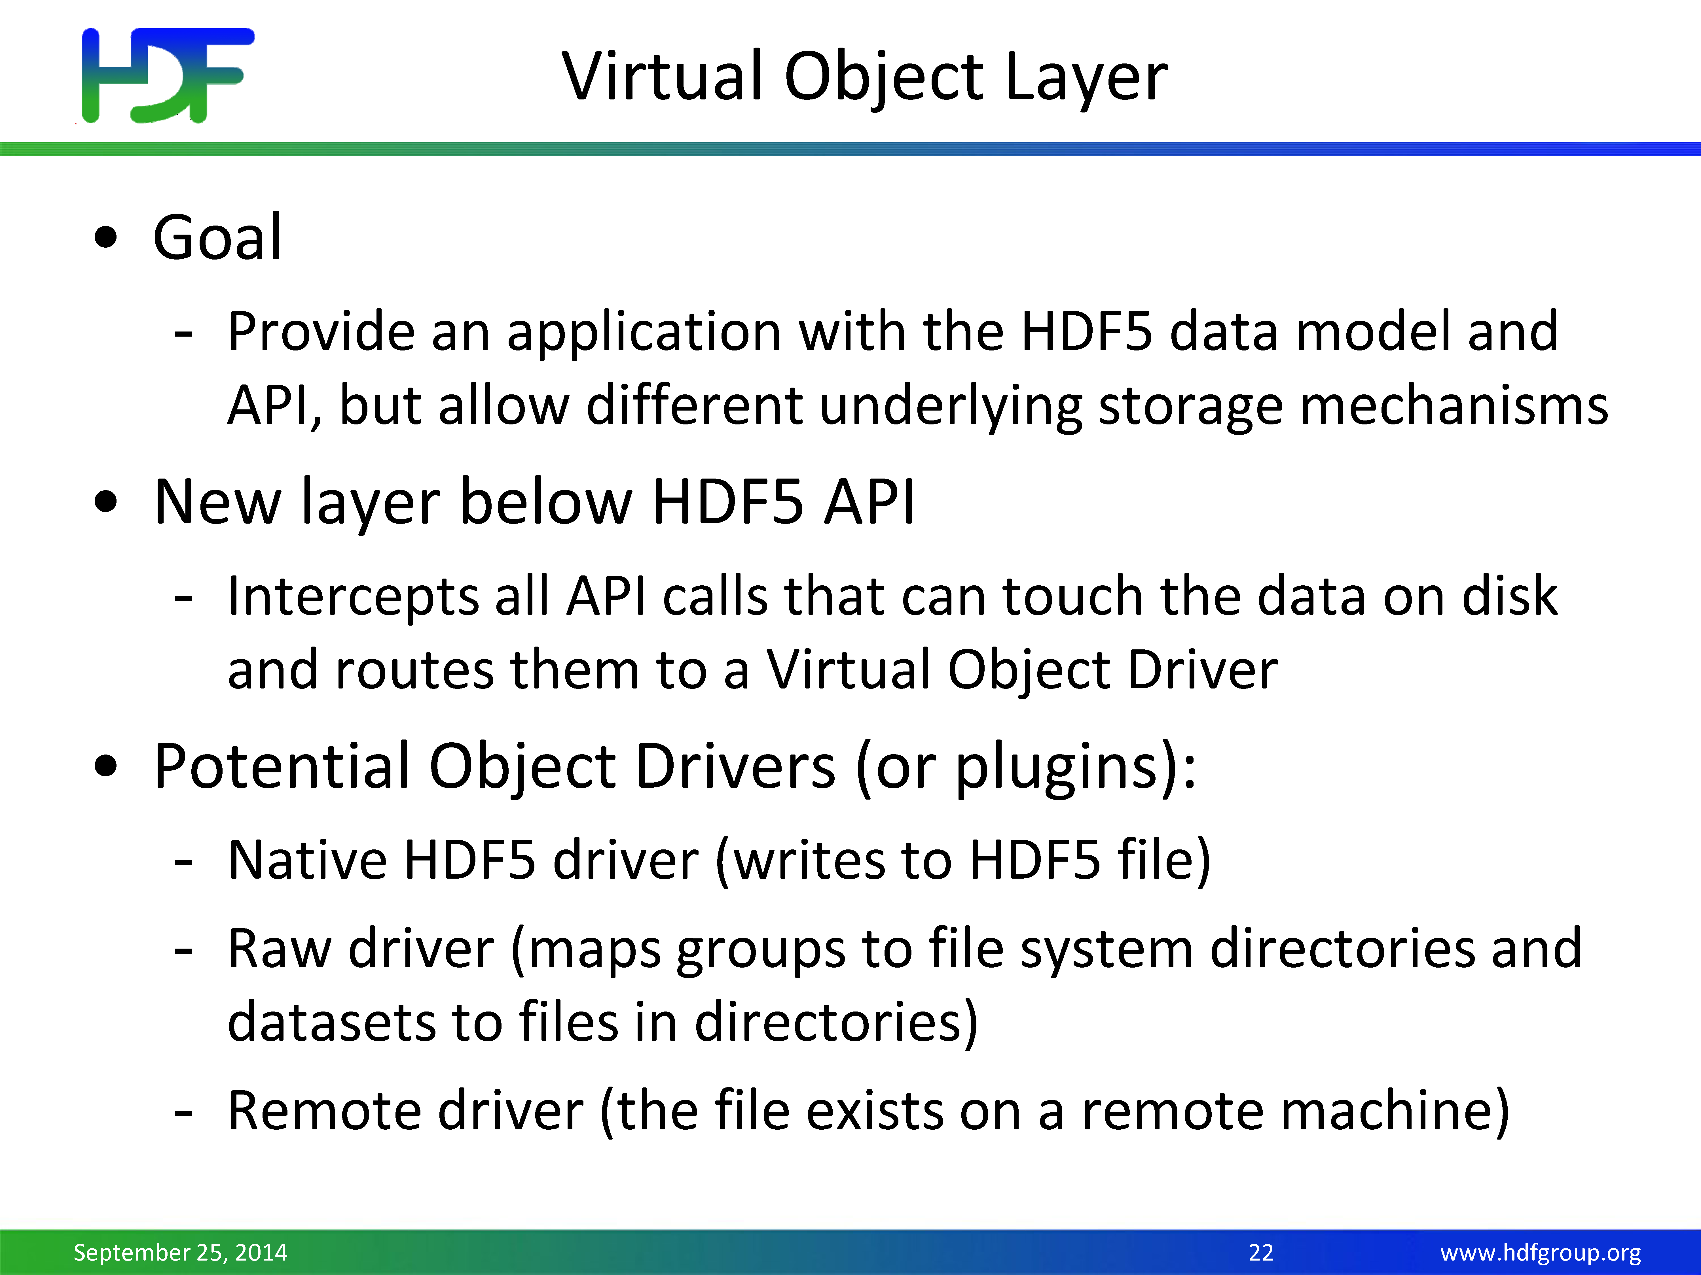

Slide 22
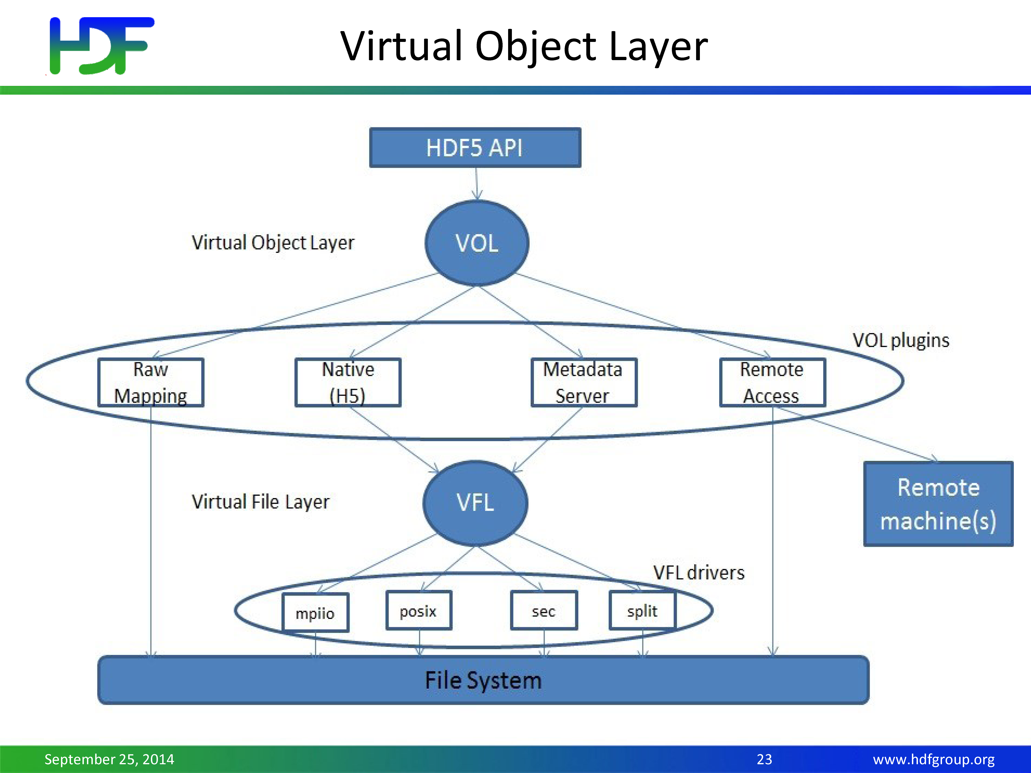

Slide 23
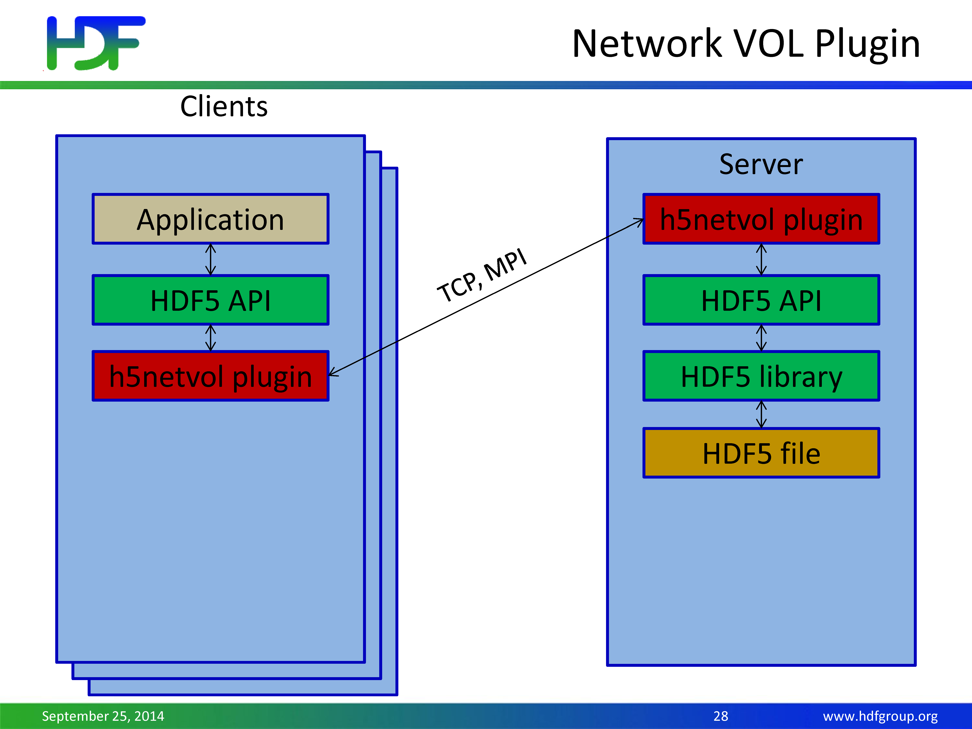

Slide 24
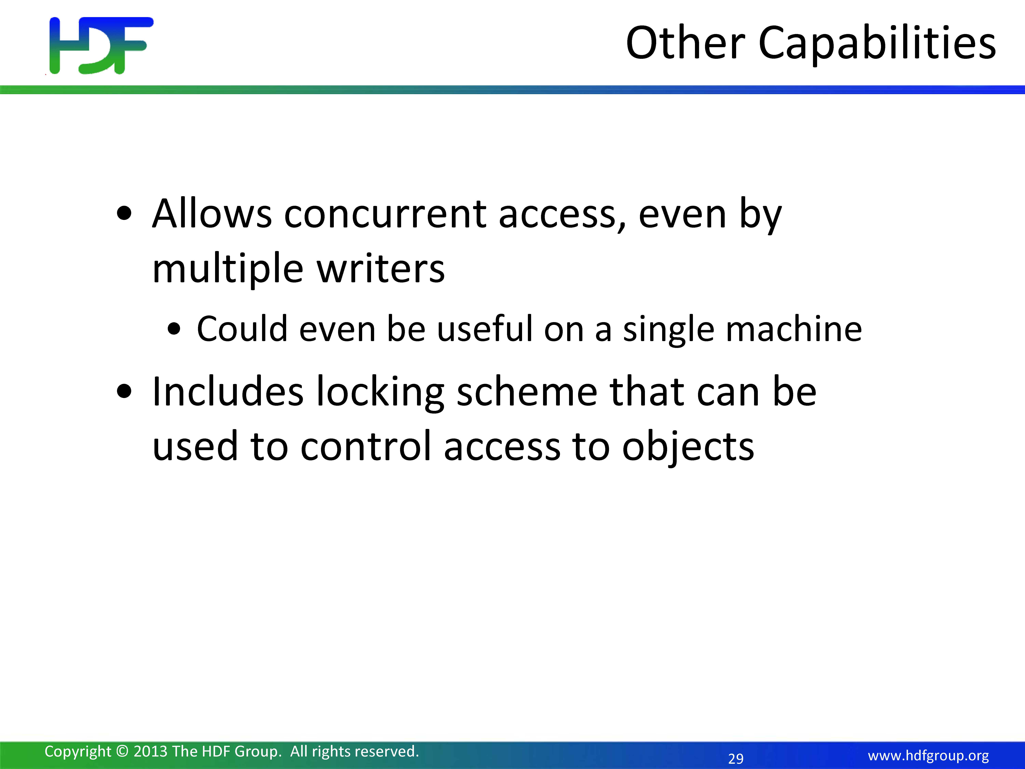

Slide 25
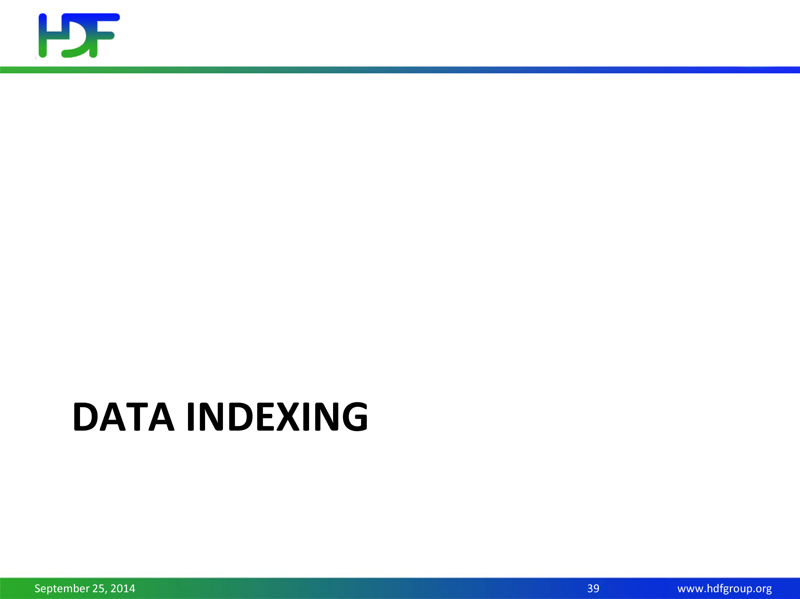

Slide 26
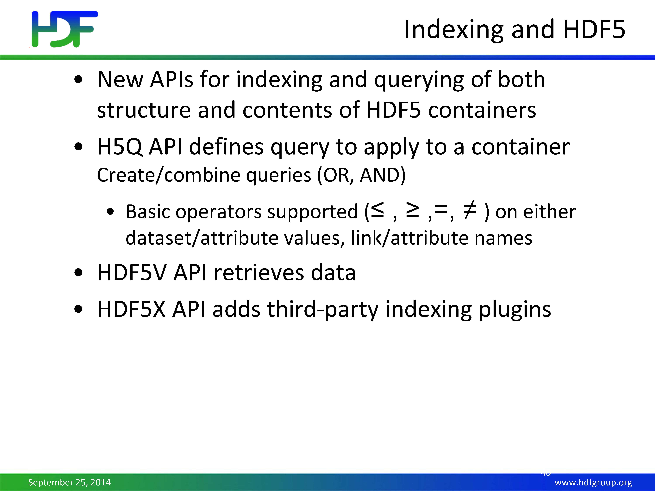

Slide 27
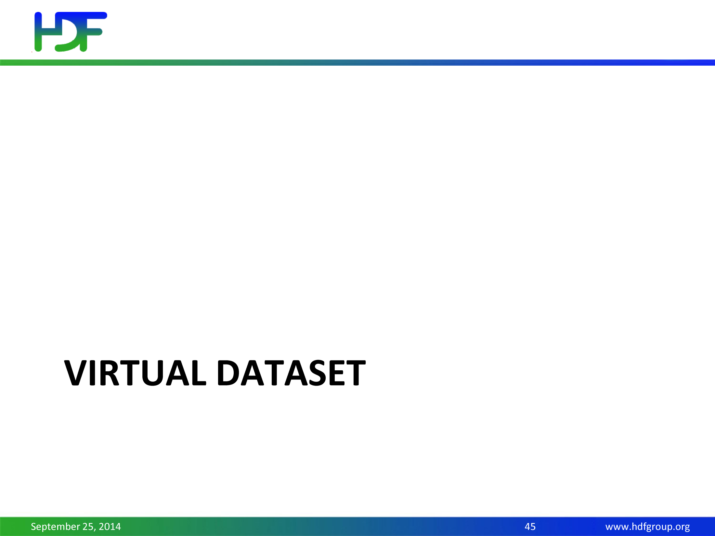

Slide 28
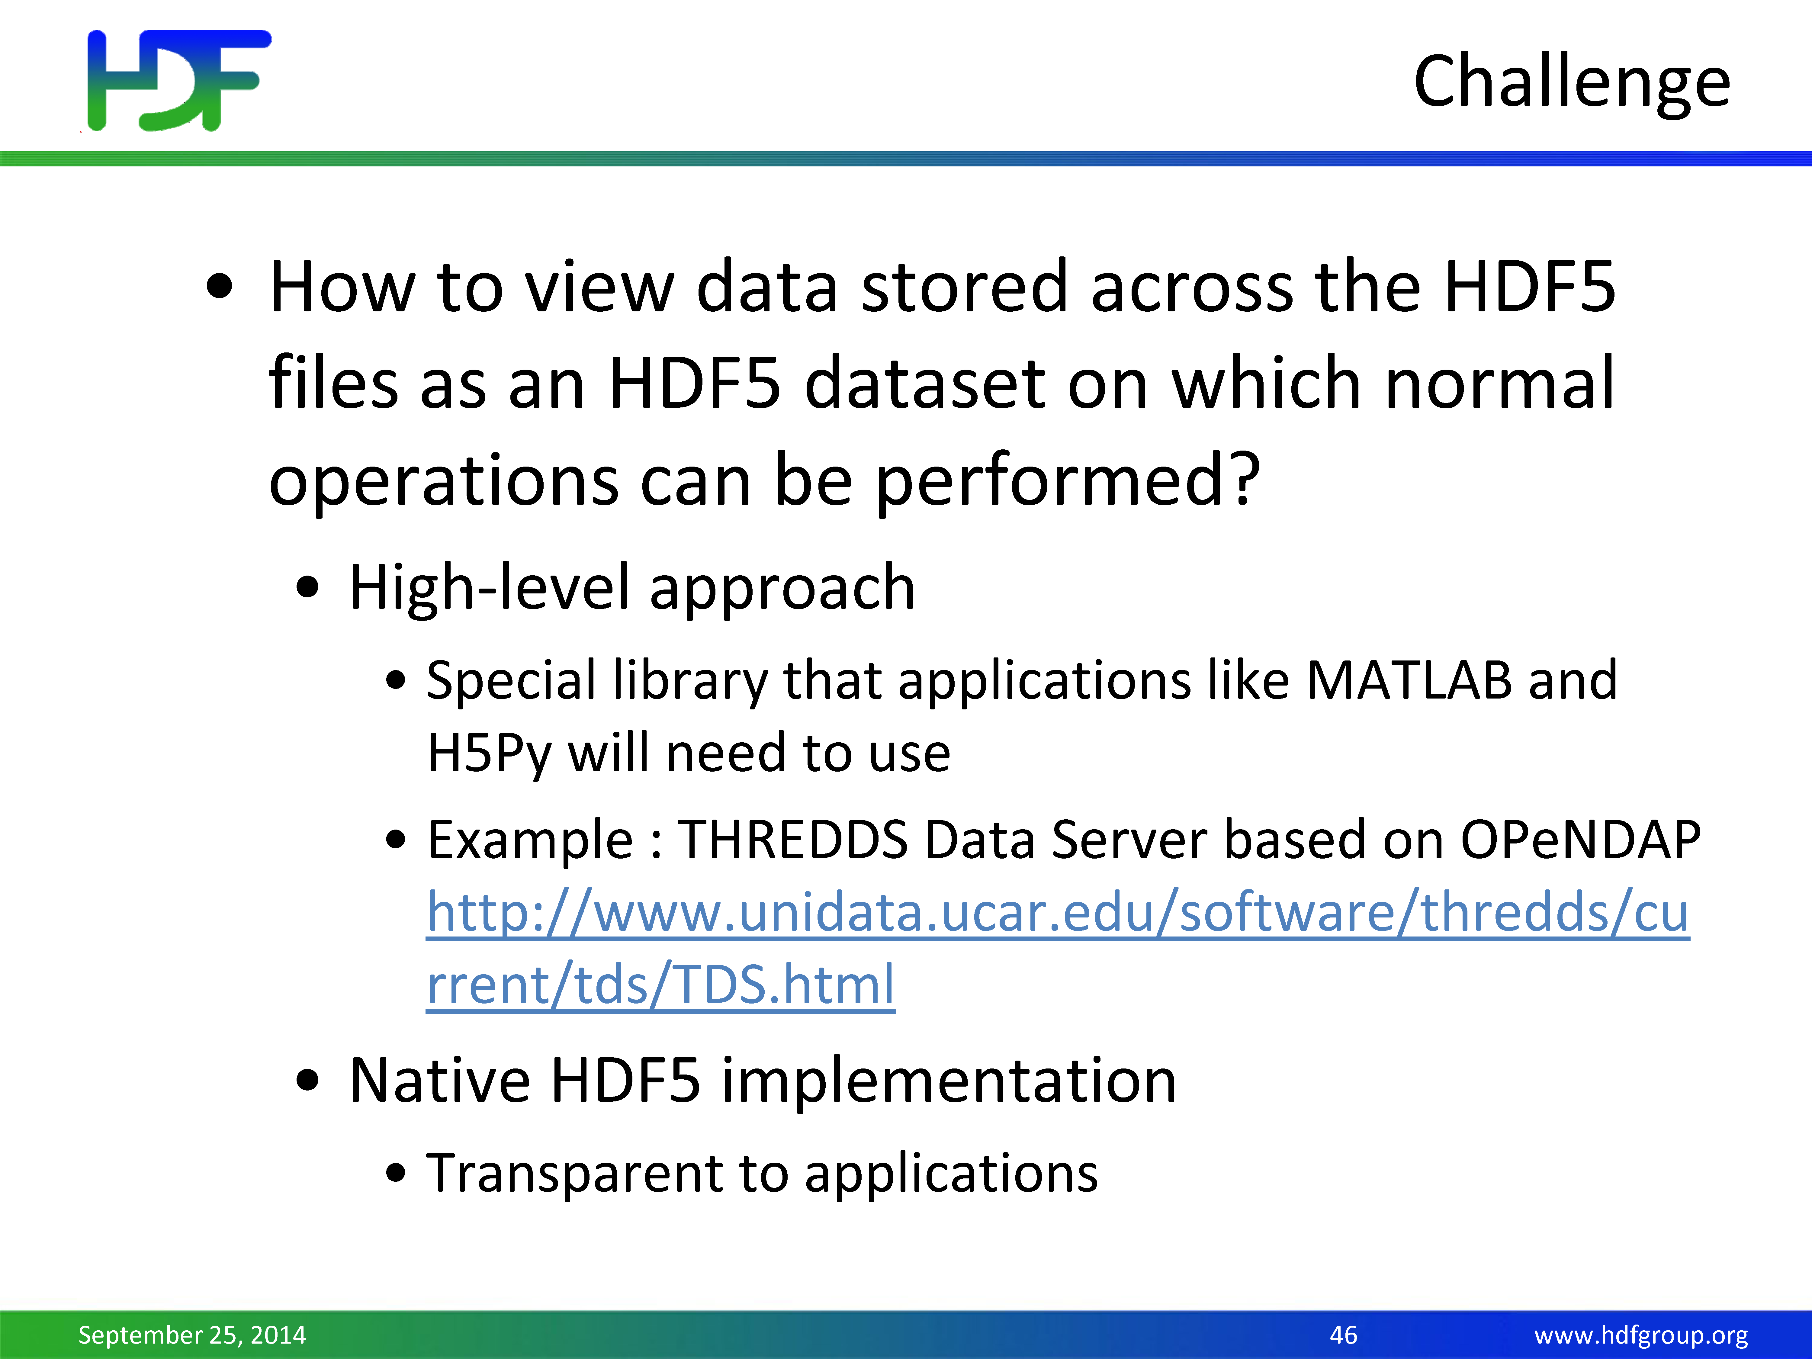

Slide 29
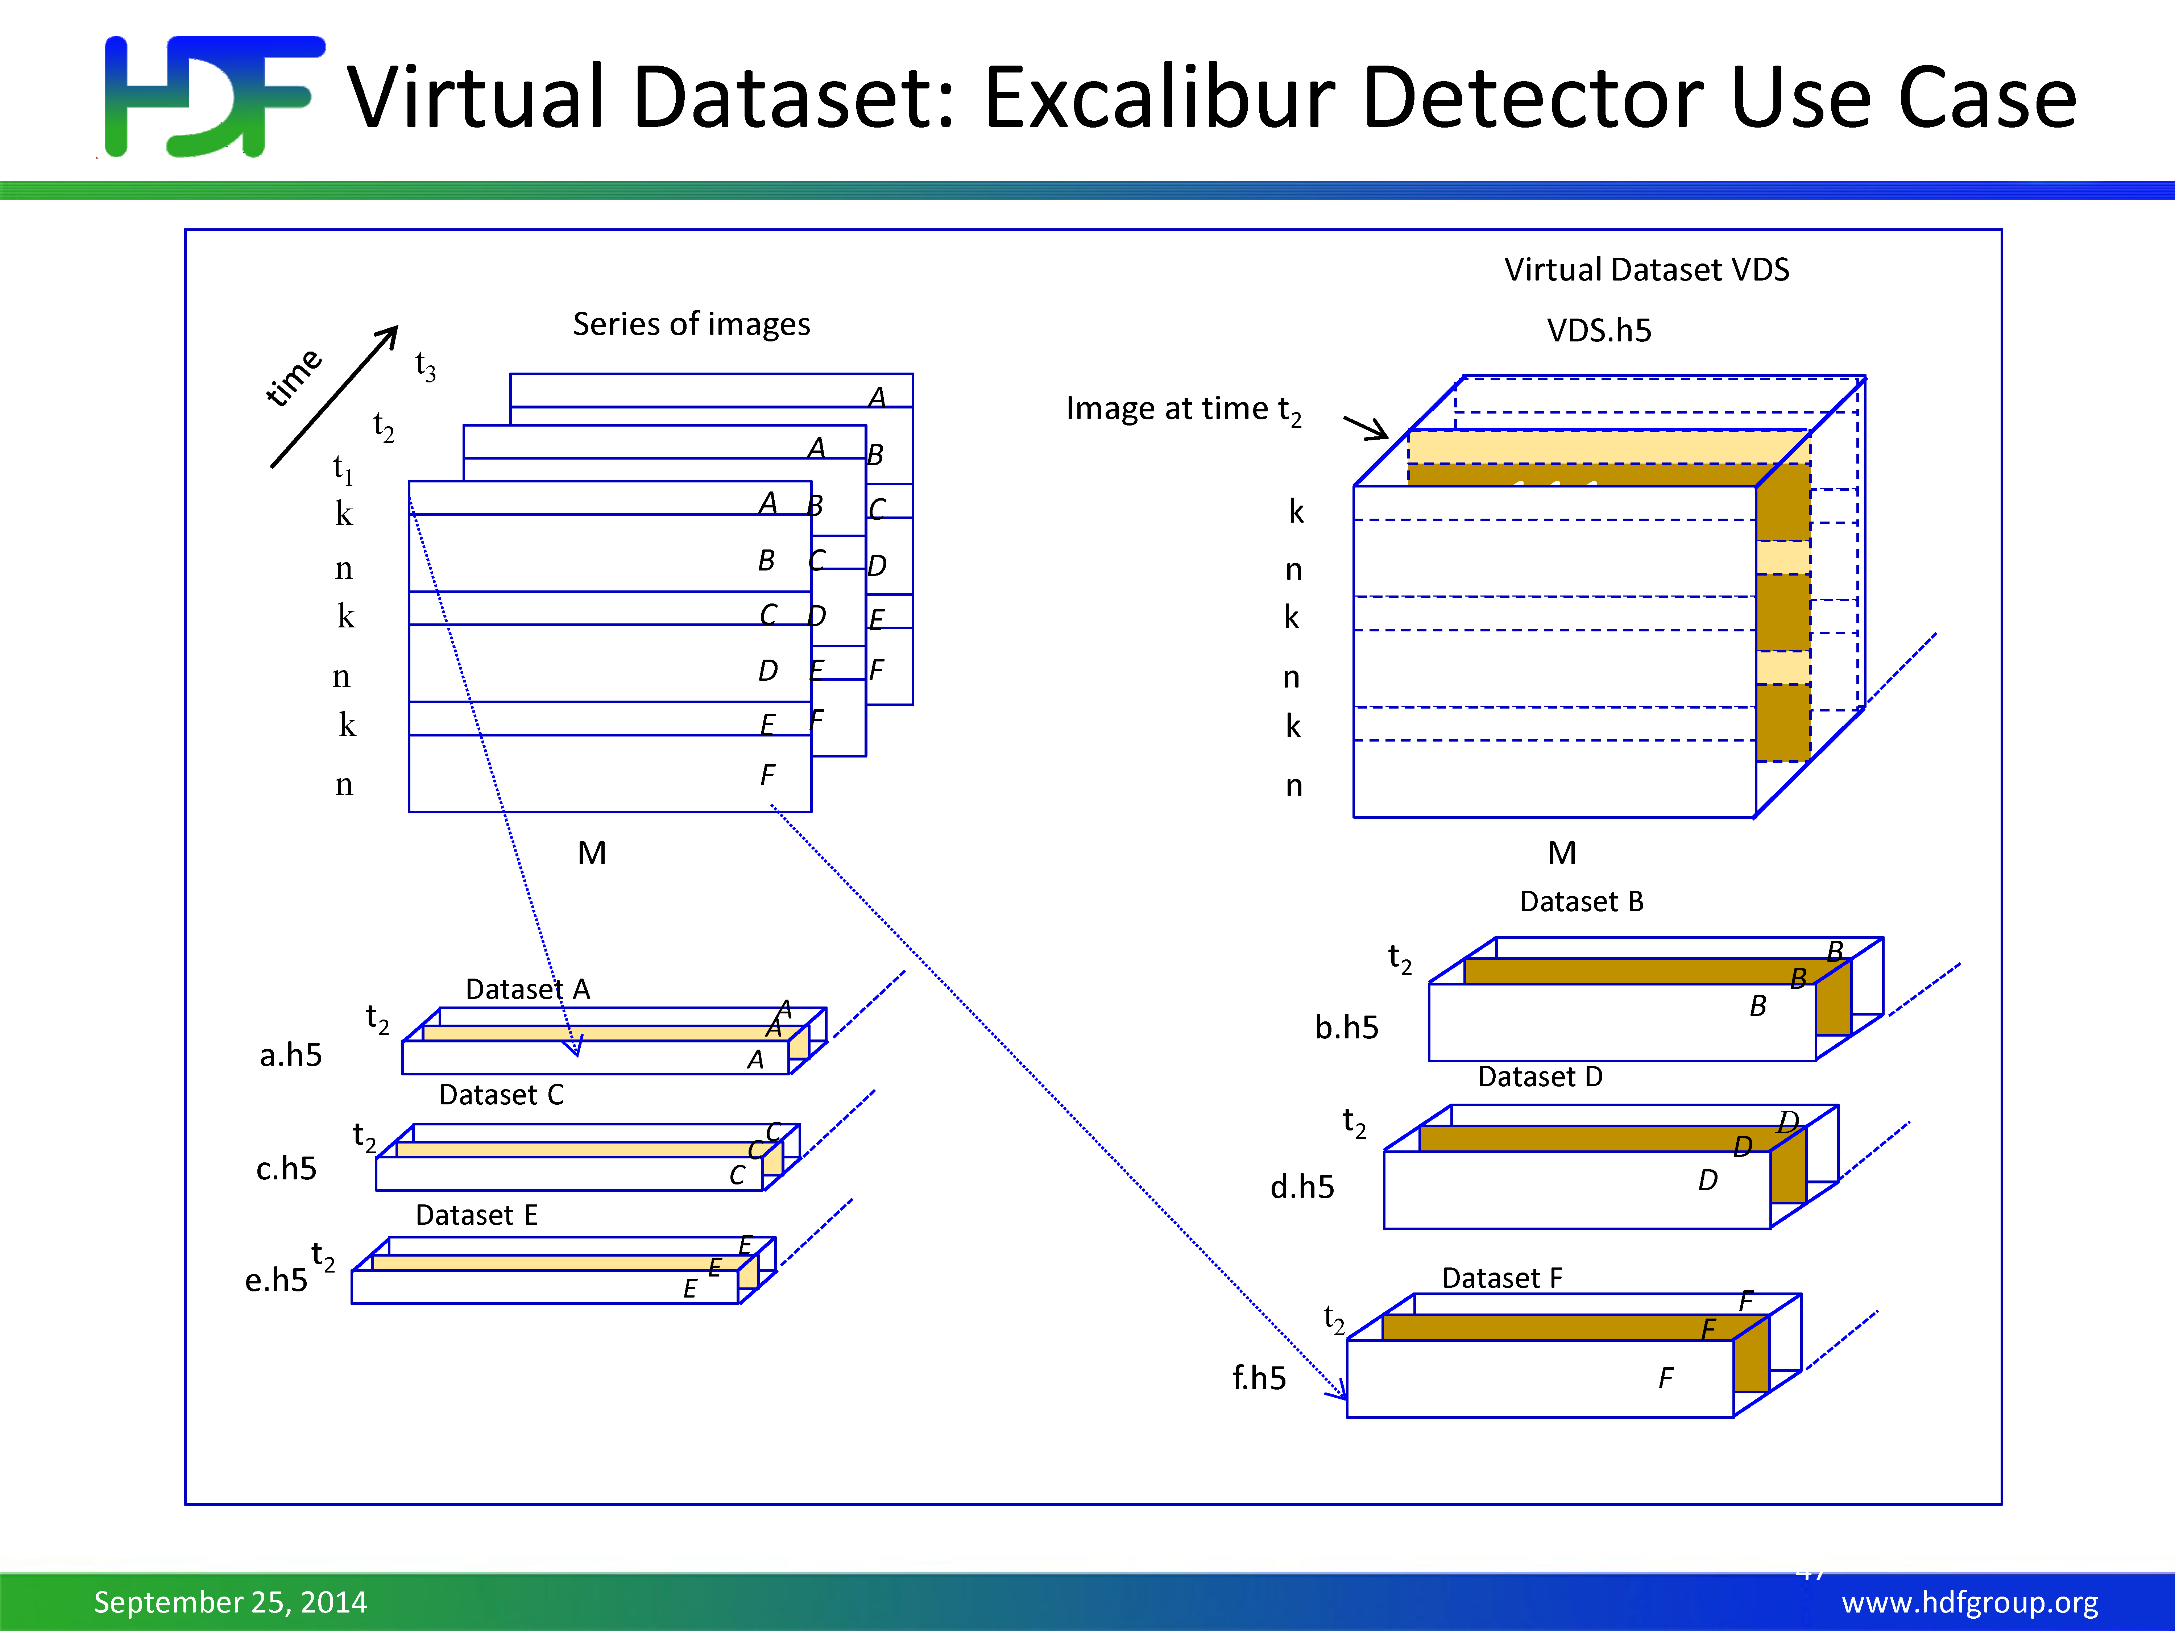

Slide 30
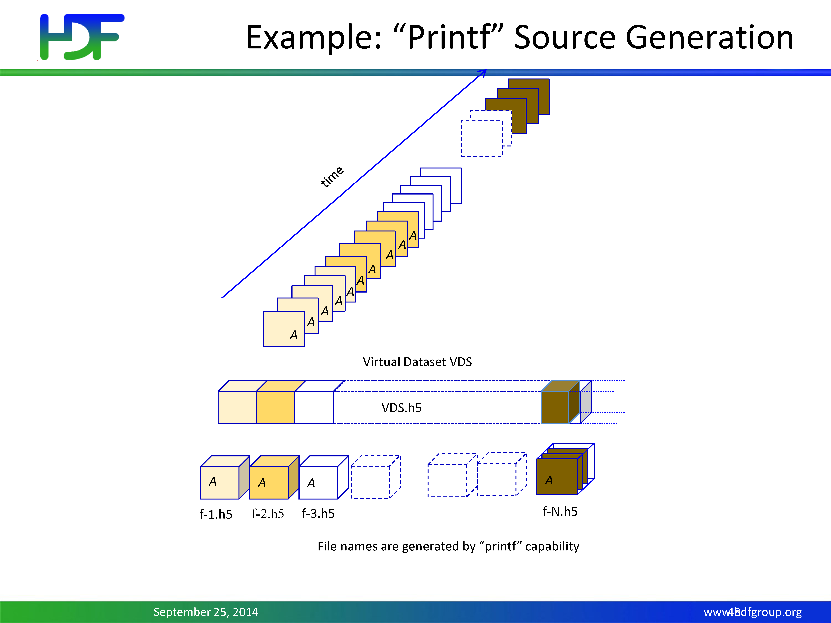

Slide 31
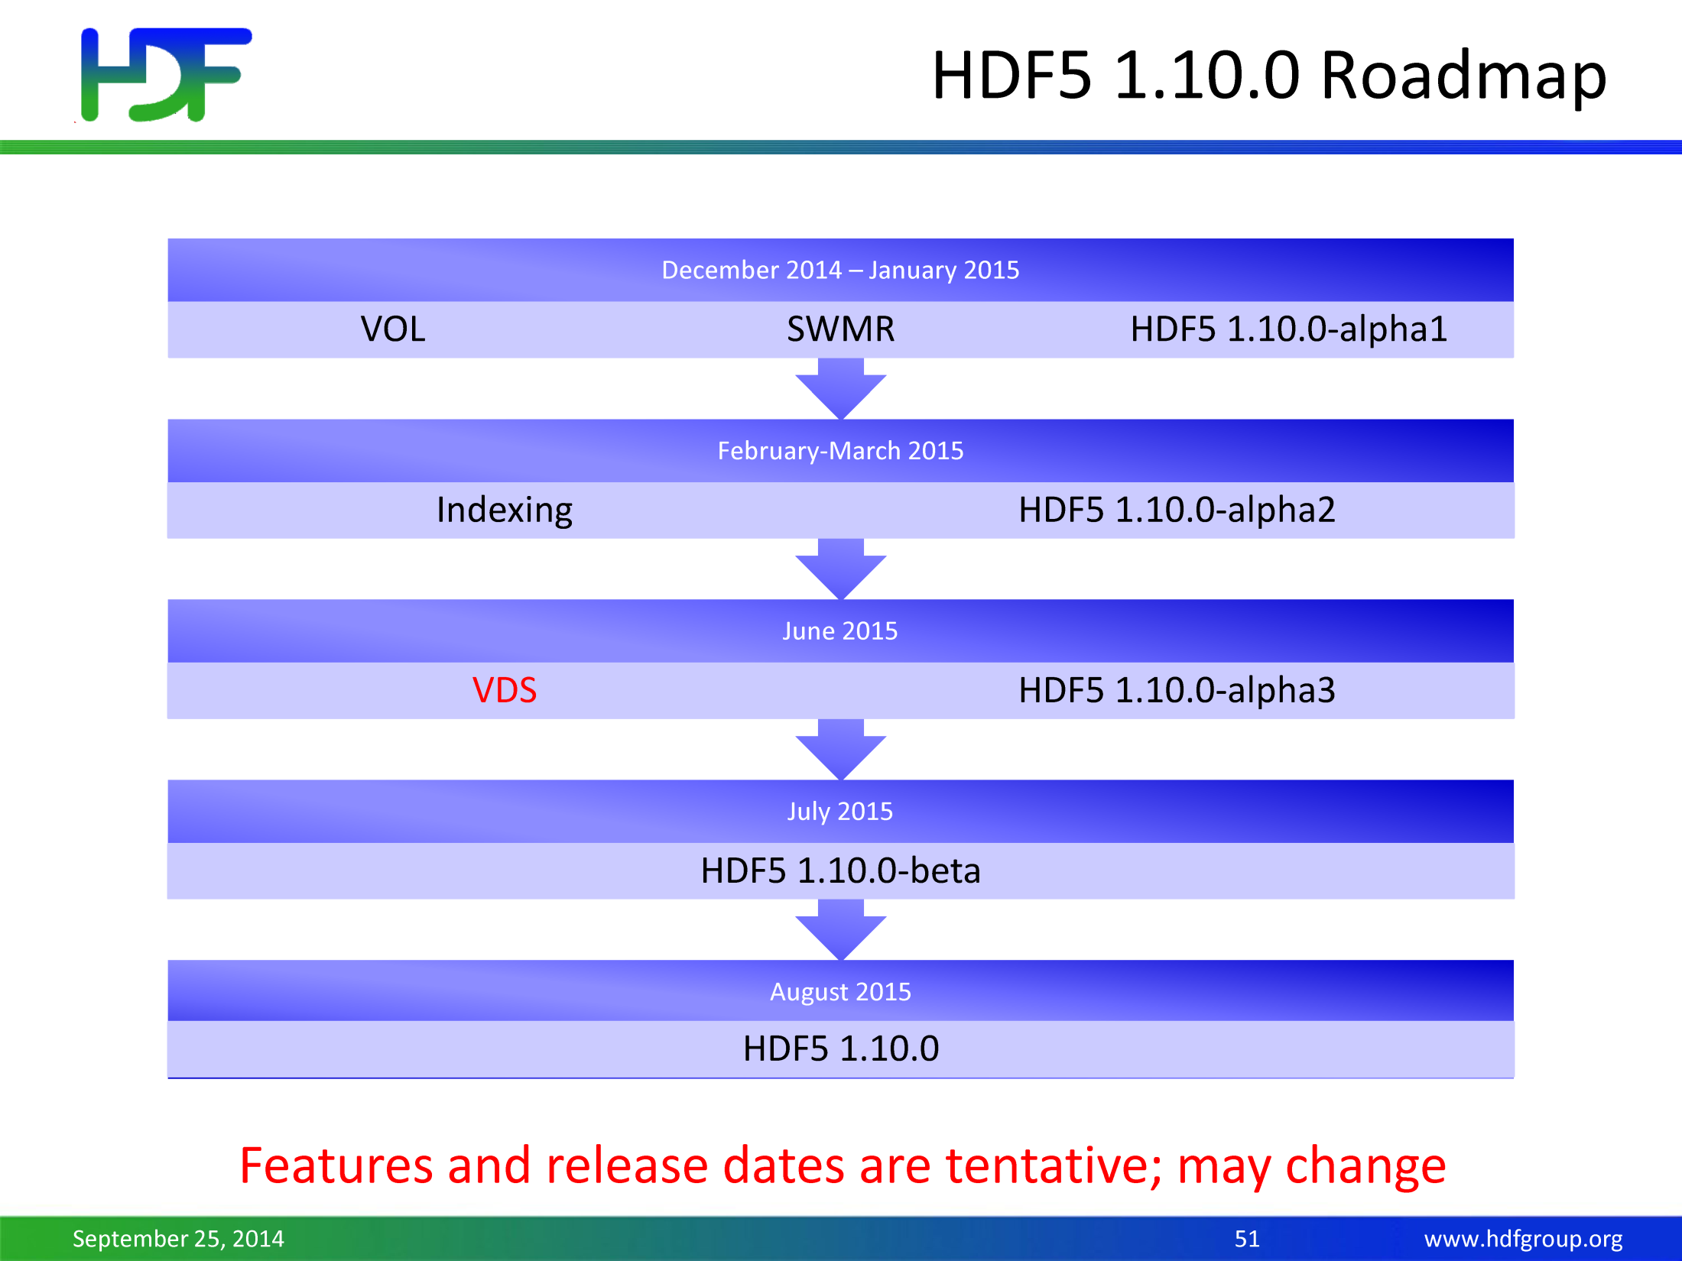

Slide 32
Thank you for your attention…

