Slide 1
The use of EtherCAT with EPICS at Diamond
Ronaldo Mercado
22/10/2014

Slide 2
^{Contents}
EtherCAT
Diamond setup
Hardware
EPICS driver
Recent work and work in-progress
Screenshots from actual setup

Slide 3
EtherCAT
Why EtherCAT?
How does it work?
EtherCAT master startup of LRW cycle

Slide 4
Why EtherCAT?
Open protocol, uses standard Ethernet hardware
Uses standard Ethernet cable and connectors. Can use standard switches and routers. DLS uses separate cabling - fieldbus.
Available Linux open source master.
Faster than most other fieldbuses.

Slide 5
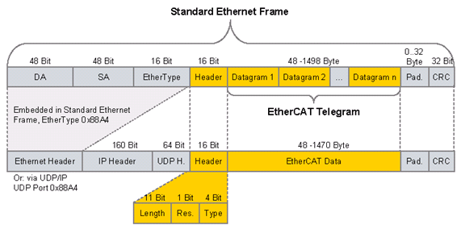
EtherCAT frame structure
IEC 61138 (Type 12)

Slide 6
EtherCAT: Principle of operation
Master – slave communications with a periodic scan cycle
All operations in hardware, using an FPGA or an ASIC
Global addressing
Messages processed on the fly. One pass on the way out and on return – used for distributed clocks timing..

Slide 7
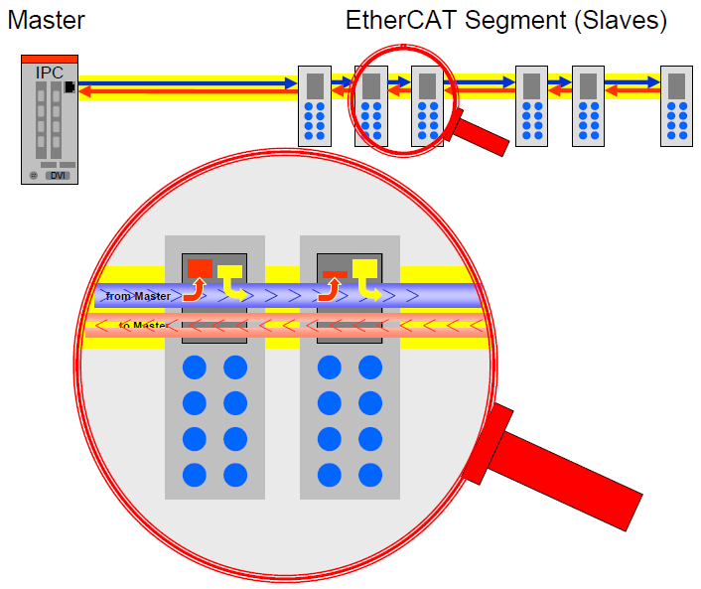
Picture by EtherCAT Technology Group

Slide 8
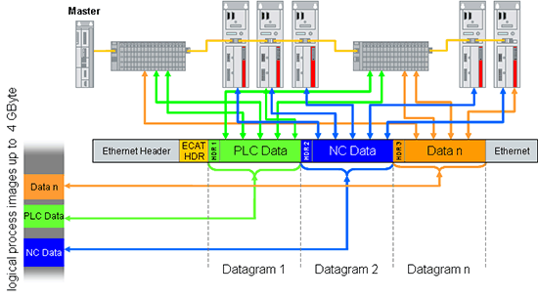
Master startup
Configure FMMU for LRW packets

Slide 9
^{Contents}
EtherCAT
Diamond setup
Hardware
EPICS driver
Recent work and work in-progress
Screenshots from actual setup

Slide 10
^{Experimental Remote I/O}
1U PC IOC
Timing interface panel
PCIe EVR
Timing system
TCP/IP
Various networks
IOC Remote I/O Network
Channel
Access
Clients
PLC Equipment
Remote IO
Modules
Video
Motion
Other

Slide 11
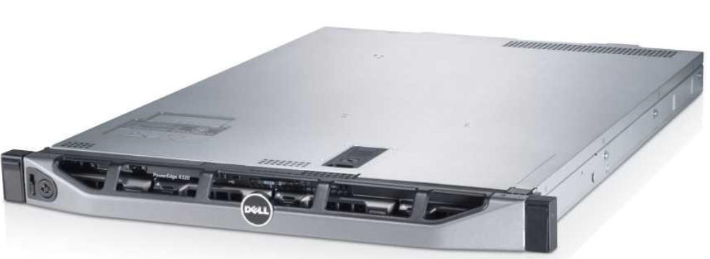
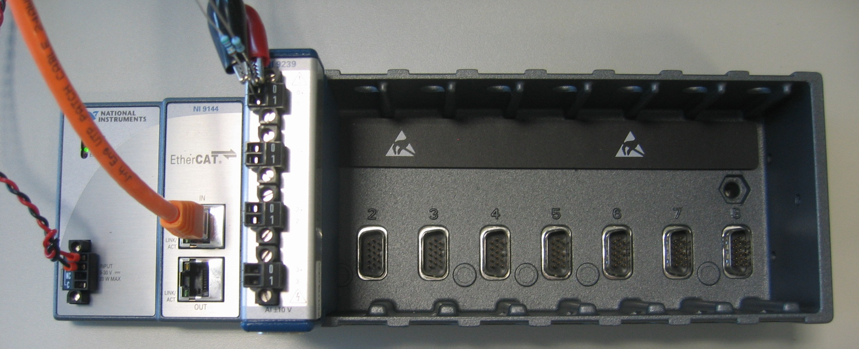
^{Hardware: Master and slaves}

Slide 12
^{View at the back of a server}
Beamline network
(TCP/IP)
IOC
Remote I/O
Fieldbus
(EtherCAT)
Remote IO
Modules

Slide 13
View at the back of a Front End server
Instrumentation Network
(TCP/IP)
Controls Network
(TCP/IP)
IOC
Remote I/O
Fieldbus
(EtherCAT)
Remote IO
Modules

Slide 14
^{Contents}
EtherCAT
Diamond setup
Hardware
EPICS driver
Recent work and work in-progress
Screenshots from actual setup

Slide 15
EtherCAT Scanner (Master)
EtherLab Master
www.etherlab.org
Open source, GPLv2
Realtime Linux (RTAI, Preempt_RT and others)
Part of Etherlab, marketed by IgH (Germany)

Slide 16
Etherlab Master
Kernel module
User space and kernel space API
Generic and hardware specific network driver
FMMU setup and slave state machine control
Scan timer not provided. Using 1 KHz. 10 KHz possible.
Configuration not provided

Slide 17
Diamond EtherCAT Driver
EPICS IOC
EPICS IOC
EPICS IOC
Userspace
EPICS Records
EPICS Records
EPICS Records
Diamond ethercat
Asyn Driver
Asyn Driver
Asyn Driver
Fieldbus Scanner
libethercat
Etherlab (Master)
Kernelspace Preempt RT Linux Kernel
EtherCAT Master Module
Generic Ethernet Driver Module
Network Stack
Hardware
Standard Ethernet Driver
Hardware (Network Interface Card)

Slide 18
Diamond EtherCAT Driver
EtherCAT integrated into EPICS. Uses
PREEMPT_RT Linux
Etherlab Ethercat Master for Linux
Asyn
Scanner broadcast bus data to several Soft IOCs for segregation of areas. Automatic Asyn port creation
One port per slave
One port for master status

Slide 19
Recent work and work in progress
PDO assignments
SDO read/write
Worst Case Response Time patch
Interfacing to Beckhoff Embedded PC CX9020

Slide 20
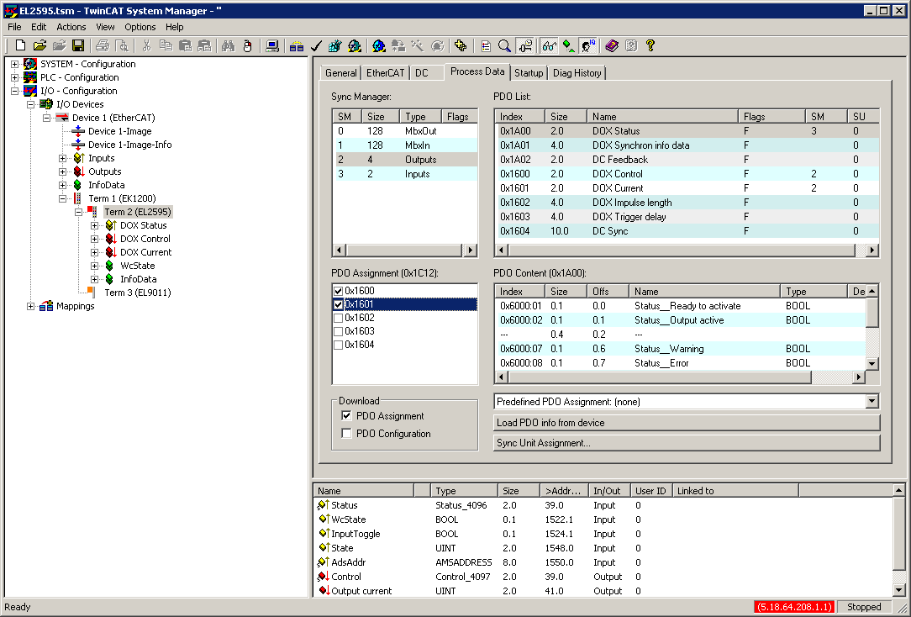
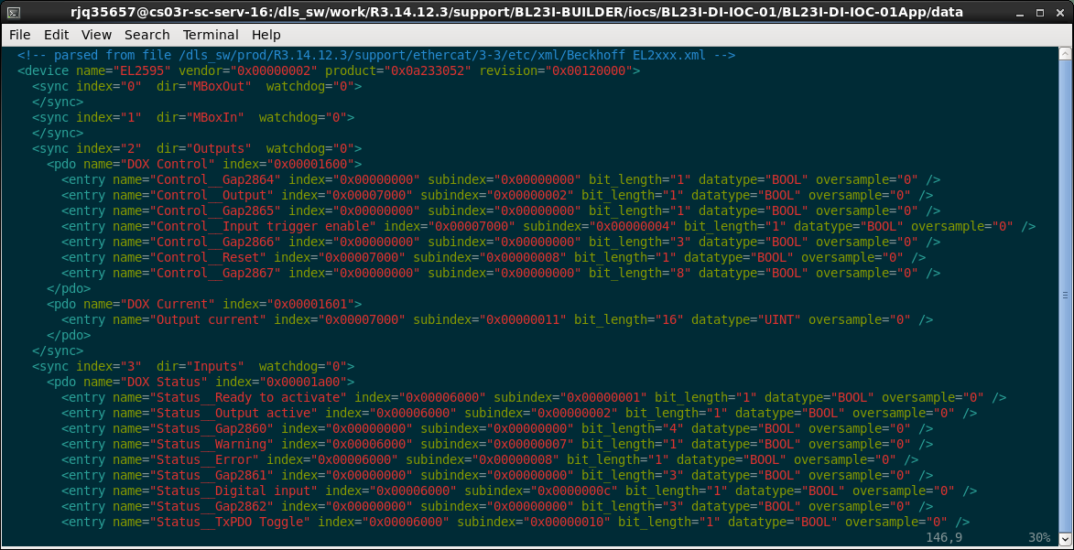
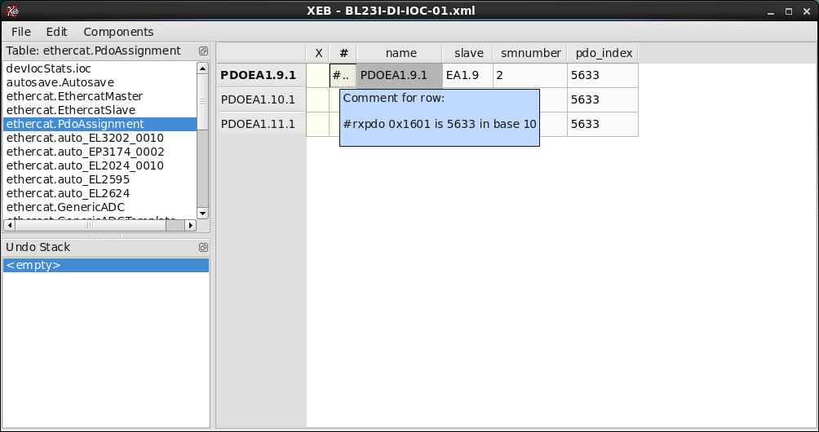
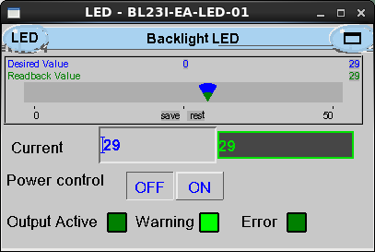
PDO assignment in screenshots

Slide 21
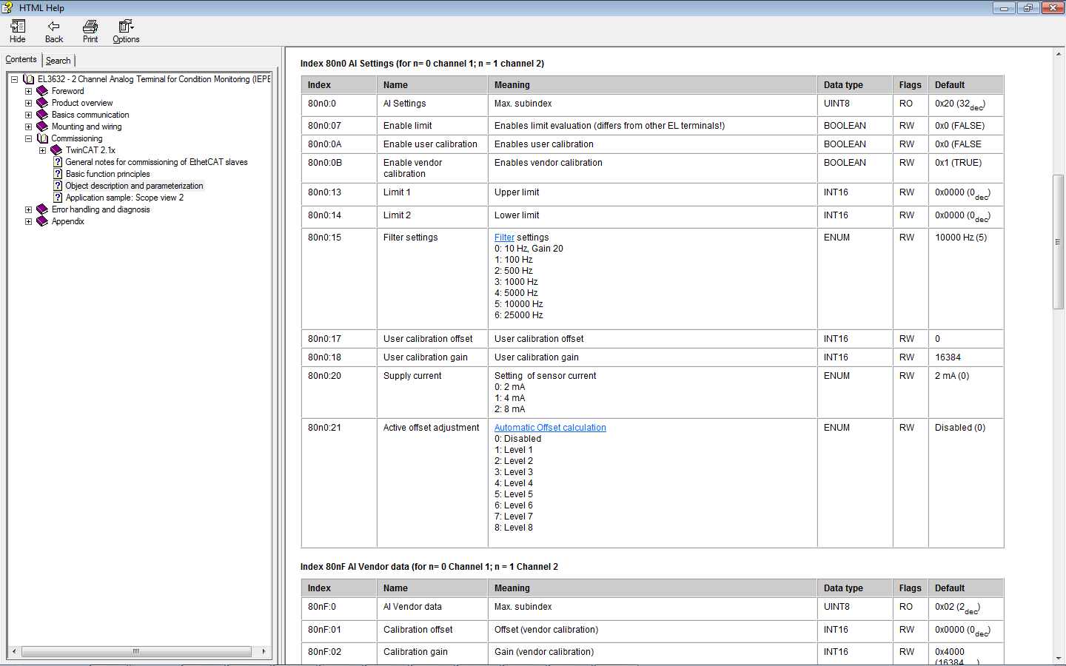
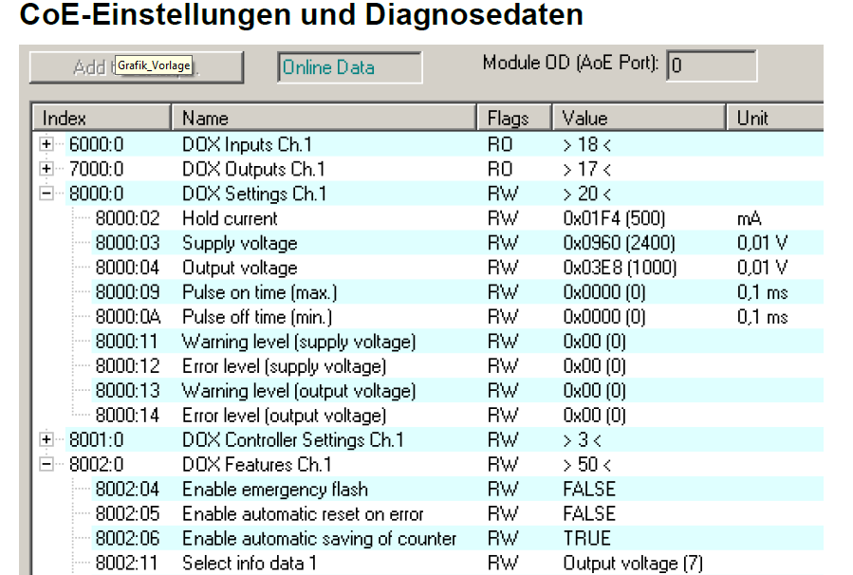
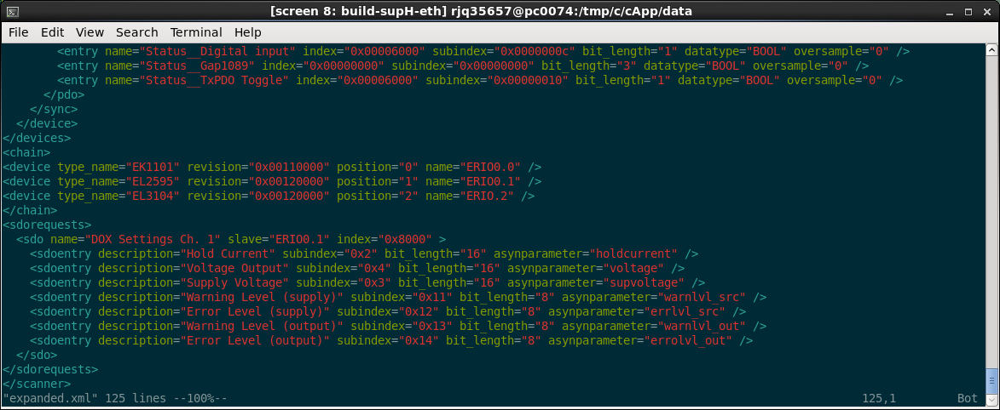
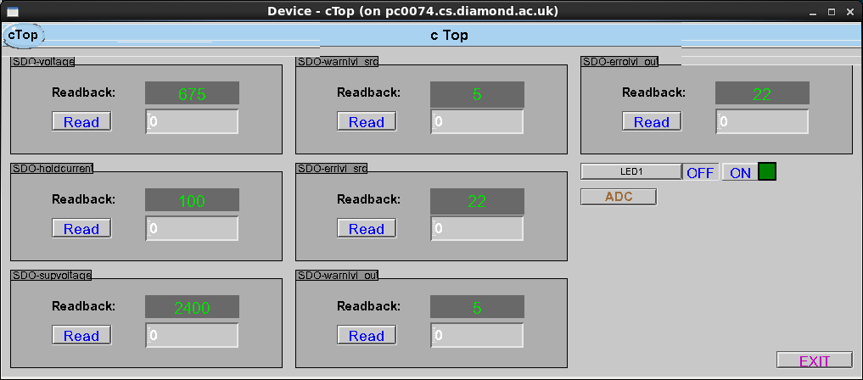
SDO configuration

Slide 22
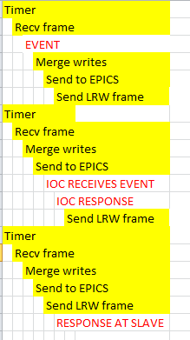
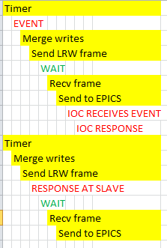
Worst Case Response Time
Reduce WCRT from 3 to 2 (Damien Lynch, ANSTO)

Slide 23
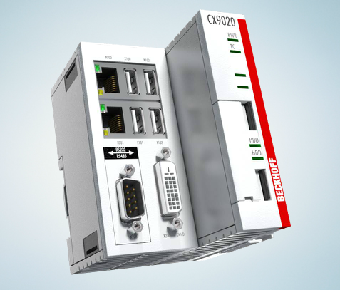
Interfacing to CX9020
Work by Damien Lynch at ANSTO
Adds Float64 data type

Slide 24
Thank you for listening!
http://controls.diamond.ac.uk/downloads/support/ethercat/
Thanks to:
James Rowland
Linda Pratt
Peter Leicester
Tom Cobb
Ian Gillingham
Andy Foster
Damien Lynch (Ansto)
Kevin Wilkinson
Armin Wagner

