Slide 1
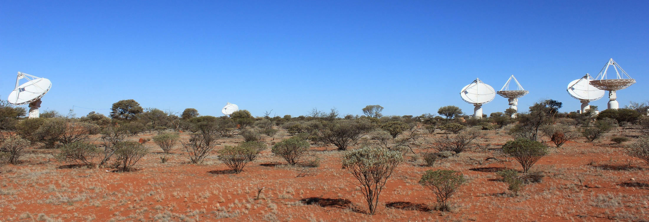
ASKAP Status Update
David Brodrick
EPICS [Spring] Collaboration Meeting
22nd October 2014
CSIRO Astronomy and Space Science

Slide 2
Australia Telescope Compact Array (Narrabri, NSW)

Slide 3
We measure the spatial coherence function
Spatial
Frequency
domain
Image
Fourier Transform

Slide 4
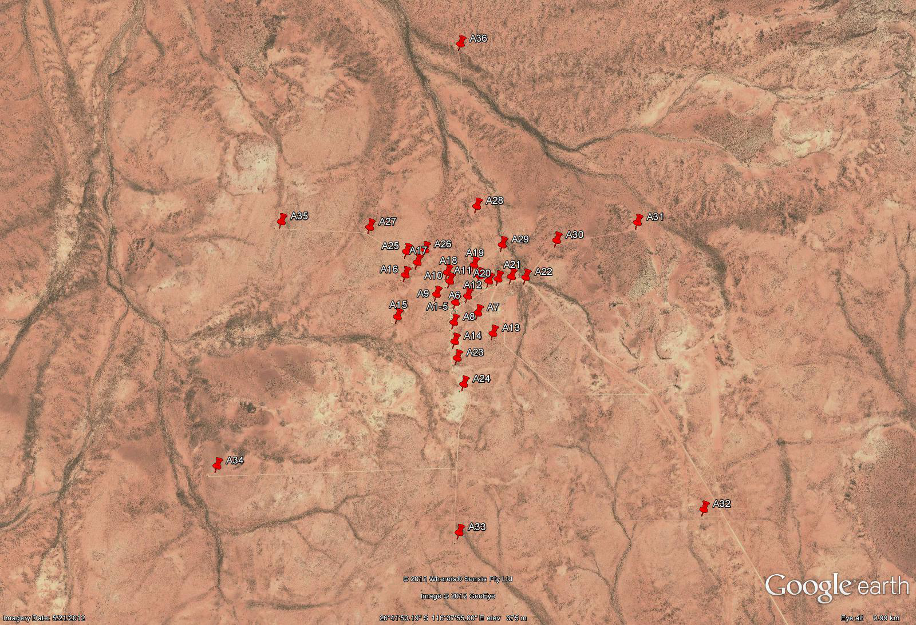
ASKAP Array Configuration
36 x 12m Antennas

Slide 5
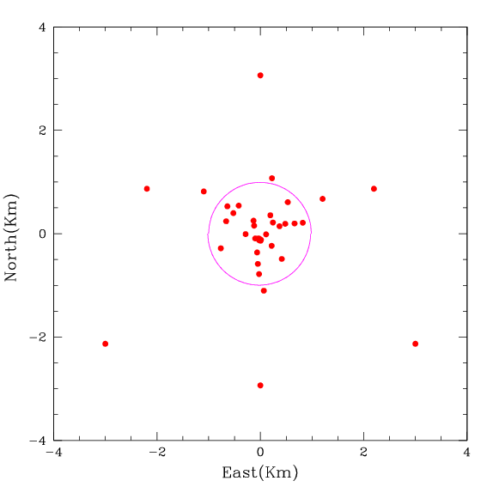
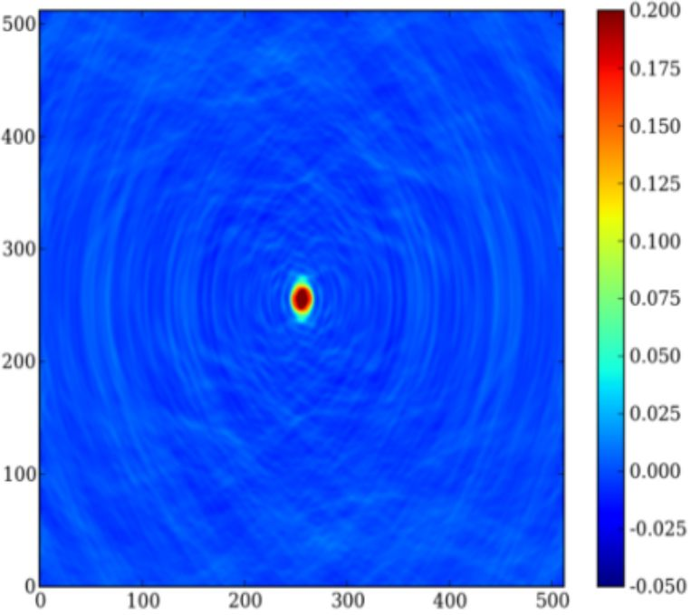
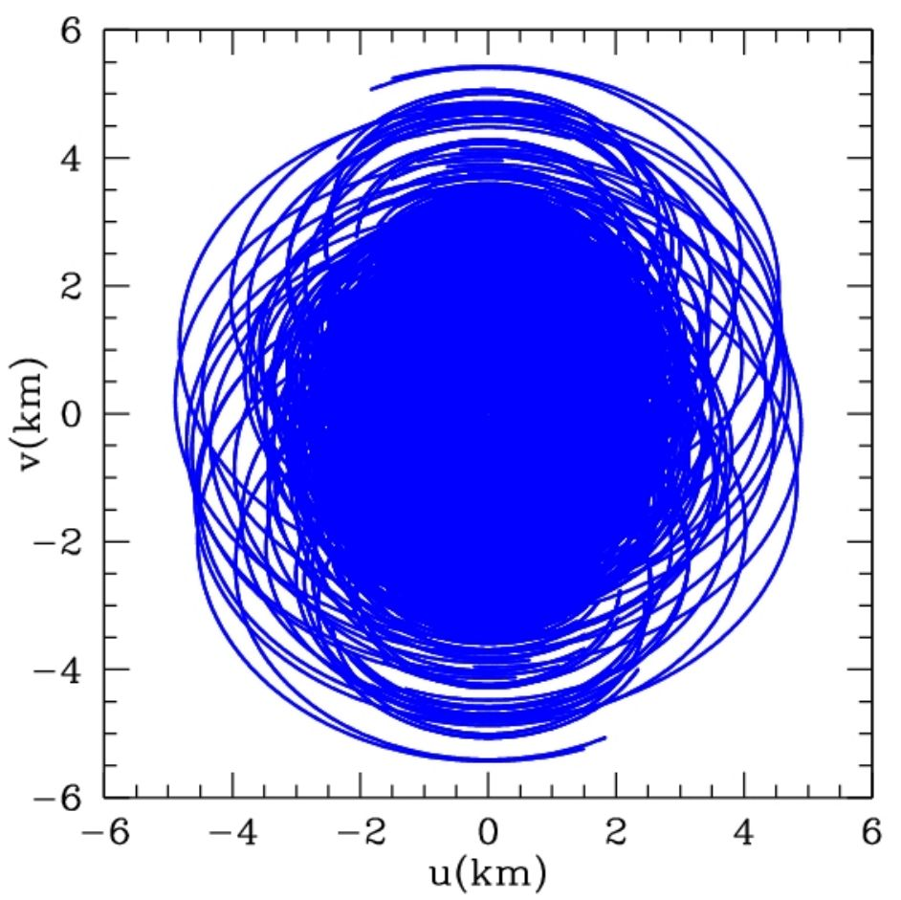
ASKAP u-v coverage

Slide 6
Introducing ASKAP
The Australian SKA Pathfinder is a radio telescope array that uses new receiver technology to improve field of view and provide unprecedented survey speed
Covers a section of the radio spectrum surrounding rest-frame neutral Hydrogen emission (700 MHz to 1.8 GHz)
Consists of 36 individual 12m antennas fitted with PAF receivers
Currently under construction at MRO, a radio quiet environment
Begins early science operations with a subset of antennas in 2015
Some science is already being done with a prototype 6-antenna array (BETA)

Slide 7
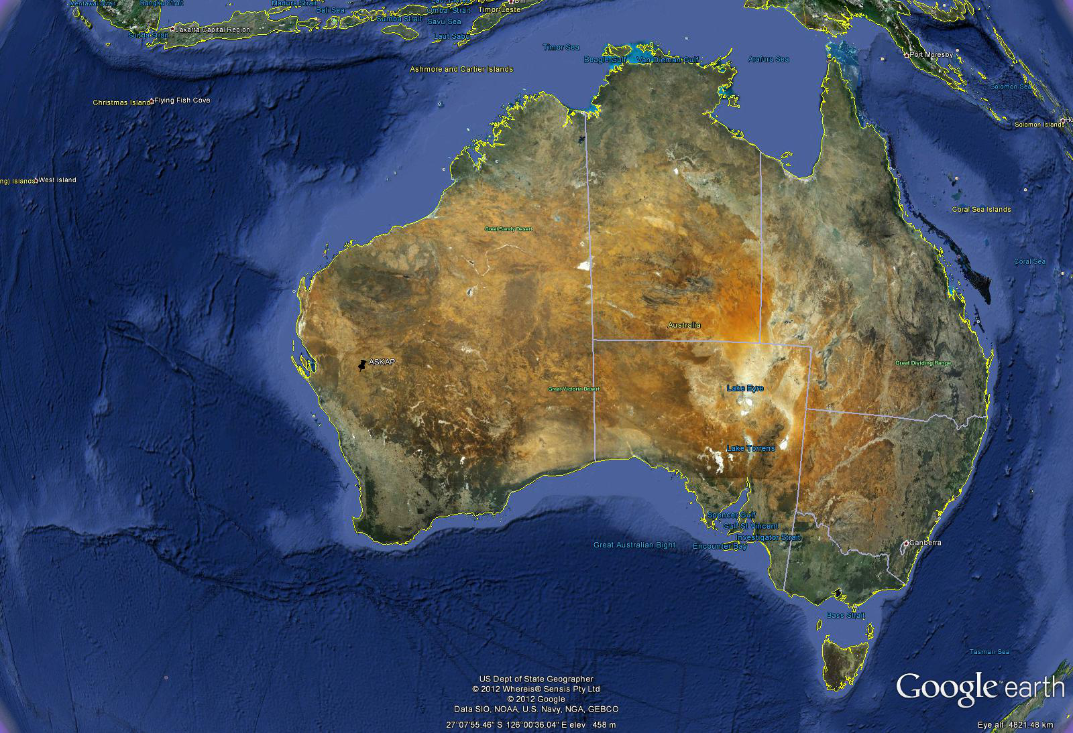
The Murchison Radio Observatory (MRO)

Slide 8
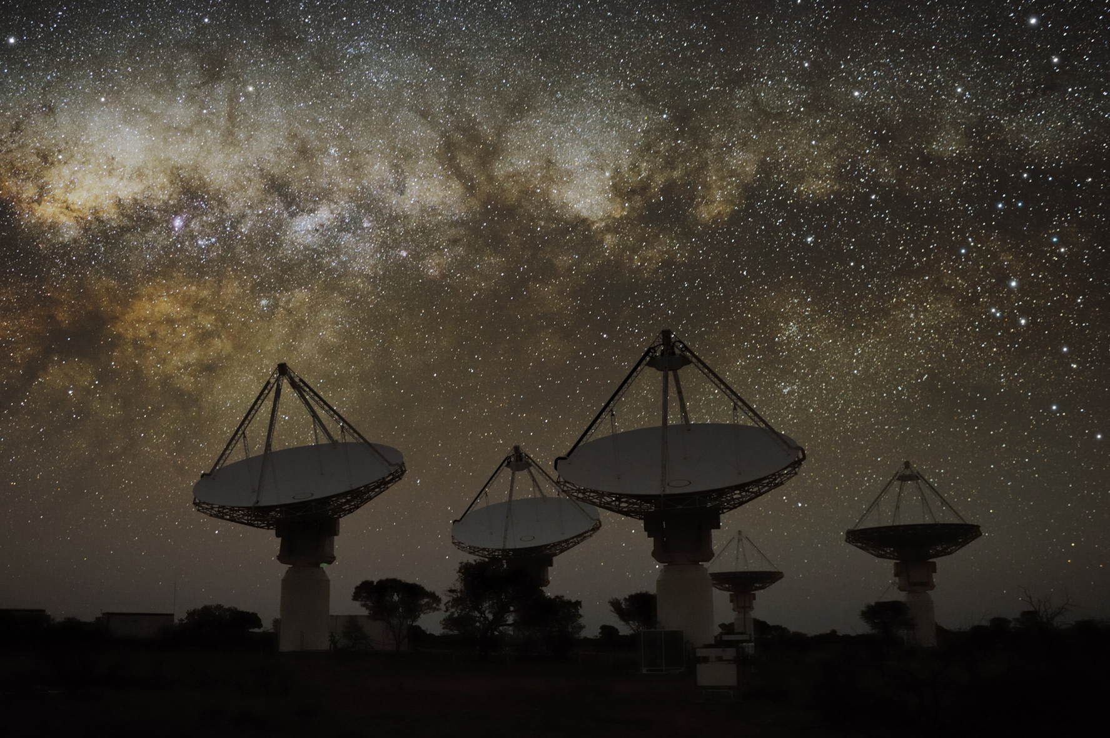

Slide 9
ASKAP Science Priorities
Most of the observing time will be spent on major survey projects.
ASKAP will cater for large international science teams.
Observations will be highly automated and done by facility operators.
10 major projects were selected to receive time during this first 5 yrs:
Evolutionary Map of the Universe (EMU)
Widefield ASKAP L-Band Legacy All-Sky Blind Survey (WALLABY)
The First Large Absorption Survey in HI (FLASH)
An ASKAP Survey for Variables and Slow Transients (VAST)
The Galactic ASKAP Spectral Line Survey (GASKAP)
Polarization Sky Survey of the Universe's Magnetism (POSSUM)
The Commensal Real-time ASKAP Fast Transients survey (CRAFT)
Deep Investigations of Neutral Gas Origins (DINGO)
The High Resolution Components of ASKAP (VLBI)
Compact Objects with ASKAP: Surveys and Timing (COAST)

Slide 10
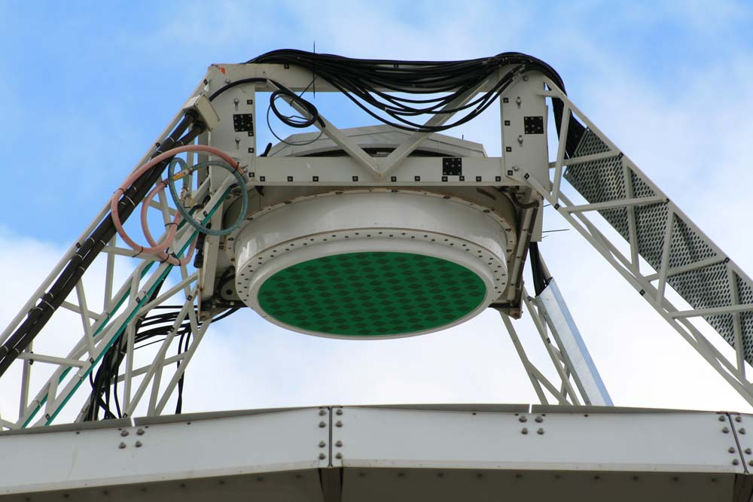
ATCA mm receiver vs. ASKAP Phased Array Feed

Slide 11
Data Flow at the Telescope
Information from 36 beams, 0.6 Tb/s
PAF on Antenna
Digitiser
Beamformer
Correlator
RF over Fibre
Information from all 188 PAF
elements, 2 Tb/s (once digitised)
Inside central
MRO building
FPGAs
x36 Antennas
PAF on Antenna
Digitiser
Beamformer
RF over Fibre

Slide 12
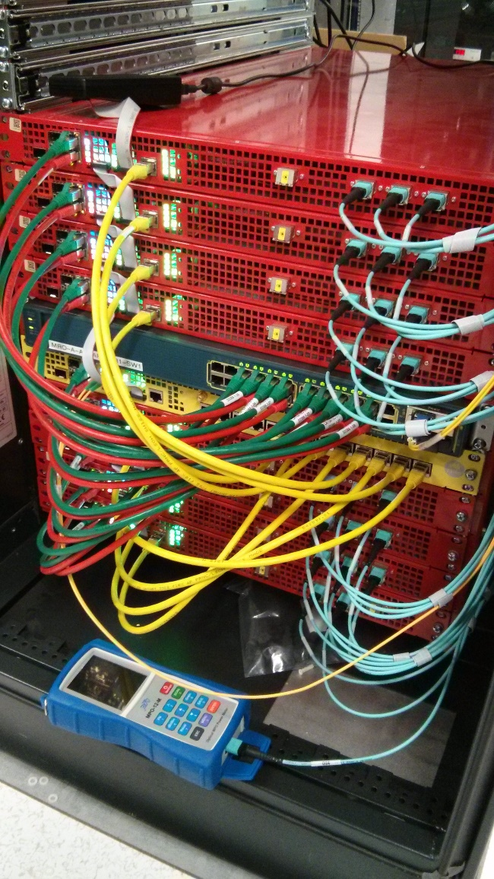
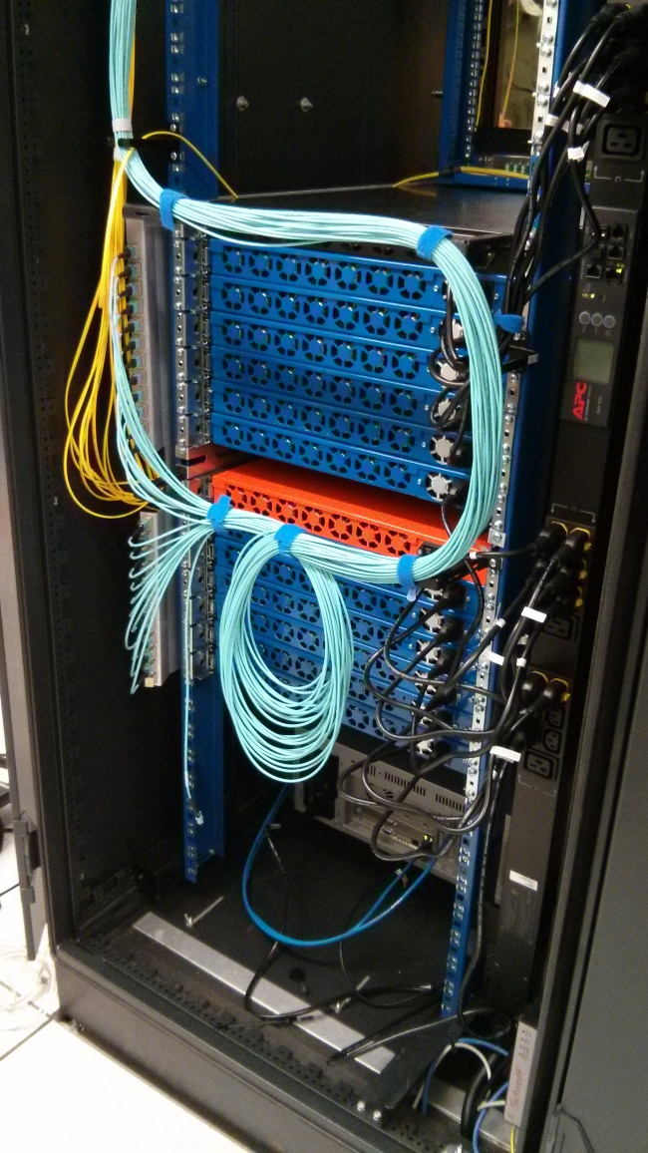
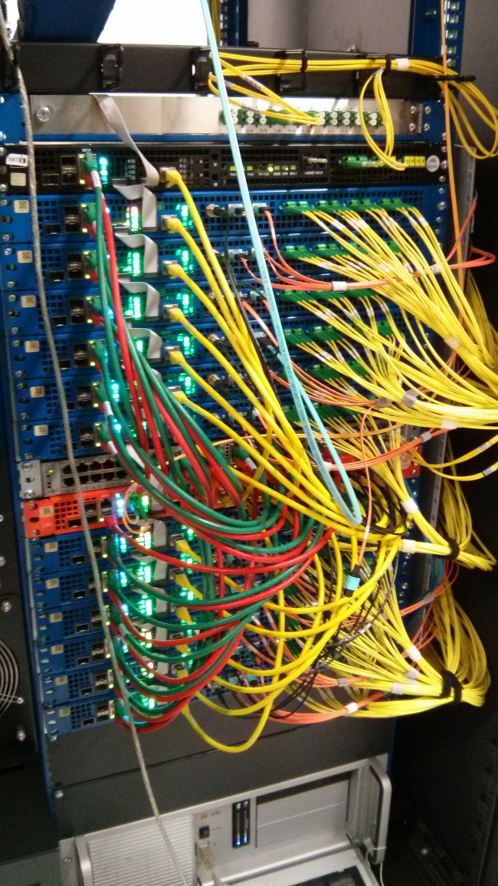
Digitisers and Beamformers

Slide 13
Data Flow out of the Correlator
Data rate out of the correlator is roughly 2.5 Gb/s, requiring a dedicated high-speed optical fibre link to a supercomputer.
Imaging occurs via an automated pipeline. Raw visibilities are too large to archive, so processing needs to be right first time!
Correlator has to be on-site. Data rates in are too high for economical long-distance transmission.
Off-site, at the Pawsey Centre in Perth
Astronomer
Astronomer
Correlator
Supercomputer
(Imaging & Calibration)
Archive (Storage & Interface)
Visibilities
Images
Astronomer
Astronomer

Slide 14
Pawsey Supercomputing Centre

Slide 15
Cray XC30 - 9440 Cores (Galaxy)

Slide 16
Architecture

Slide 17
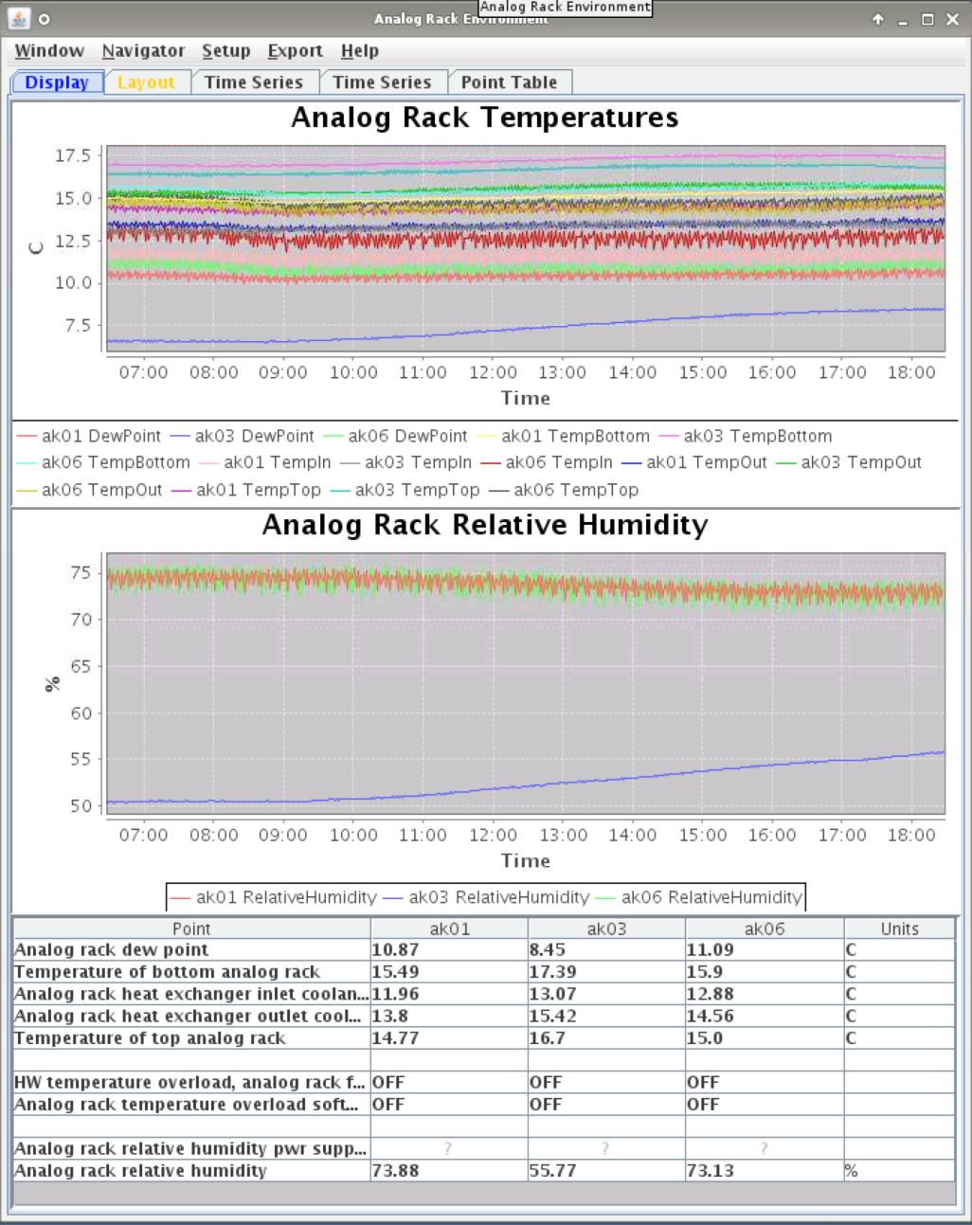
MoniCA
Monitoring and control system used at various radio observatories
Supports numerous protocols
CA aware (via Cosylab JCA/CAJ)
Archive PVs
Policy per PV configuration
CSS databrowser extension to query MoniCA
http://code.google.com/p/open-monica/

Slide 18
Antenna Drives IOC
Soft IOC
Interfaces with antenna Bosch-Rexroth PLC via TCP (asyn)
Presents stateful antenna drives
Stowed, Tracking, Slewing, Idle, etc.
Built using State Notation Language
Coordinate conversion (SLAlib)
Trajectory generation
Pointing parameters
Antenna monitoring

Slide 19
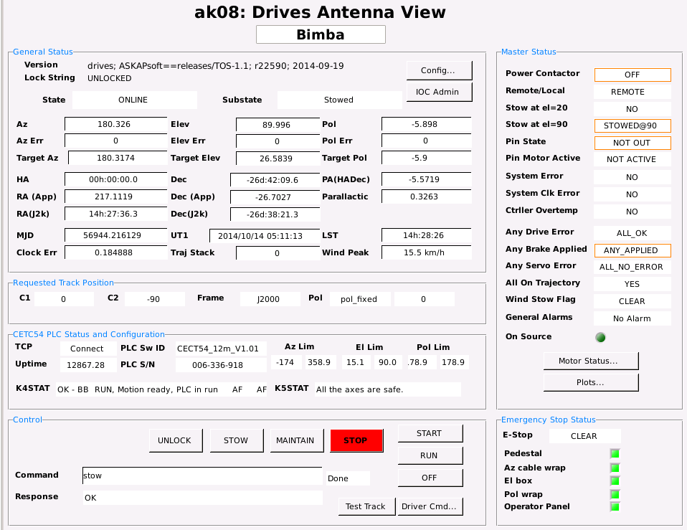
Drives OPI

Slide 20
Composite IOC (Craig Haskins)
Composite Antenna IOC to group heterogeneous subsystems
Composite Site IOC used to group homogenous antennas
EPICS database for both generated from single CSV file which specifies
PV and which subsystem IOCs contain that PV
optional sequence order to serialize the commands, default is parallel execution

Slide 21
Summary Alarm Records (Craig Haskins)
Automatically generated from DB parsing script
Using bigASub (128 I/O version of asub) to collect IOC alarms to single point
PV name of point(s) in alarm can be propagated up

Slide 22
Interface Developments (Xinyu Wu)
Experimenting with WebOPI / WebAlarm
Some useful additions to CSS alarm handling, will contribute back to project

Slide 23
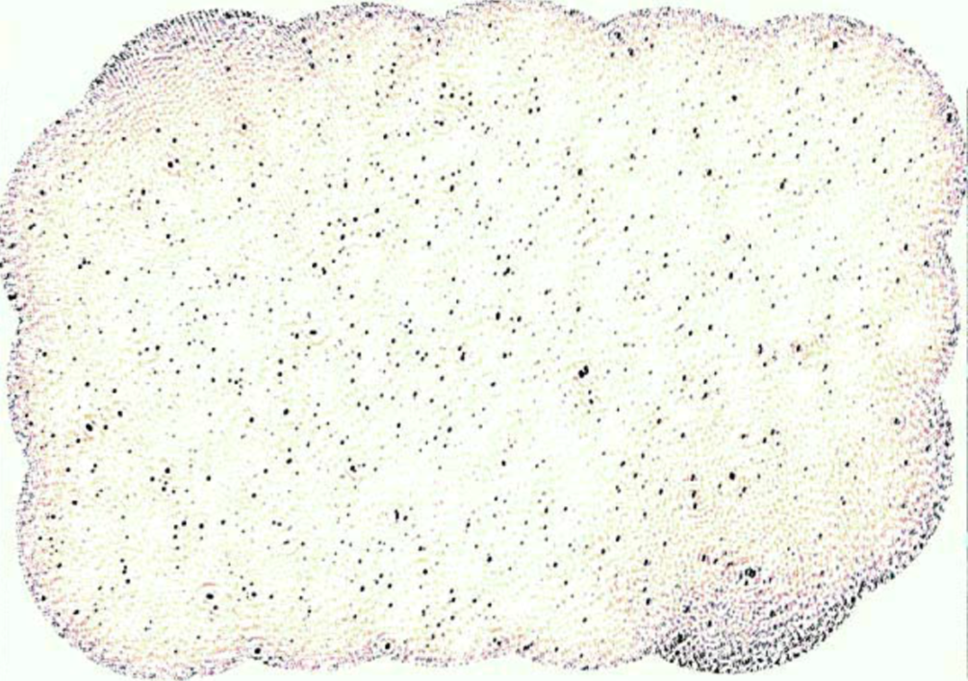
Observing Large Areas of the Sky (50 square degrees)
5.5 degrees
Image made by Ian Heywood
Notes:
Radio image (700 - 1000 MHz) of a region in the constellation Tucana centred near 22:50:00,-60:00:00.
The area shown is about 50 square degrees (9 x 5.5 degrees) – equivalent to 250 full Moons. There are a few more
than 1300 sources above a 5 sigma cutoff. Image by Ian Heywood.

