Slide 1
EPICS V4 for SNS Neutron Data
Kay Kasemir
Oct. 2014

Slide 2
Basic Idea: V4 for Raw Neutron Data
n
Data Collection
Nexus File
n
Neutron Detector
{ pixel, time-of-flight }
Neutron Stats
Neutron Count,
XY Histogram,
Time-of-Fight Histogram
Channel Access
Experiment Control
IOCs,
pcaspy,
ScanServer
User Display
CS-Studio

Slide 3
“V4”
pvData – Structured Data
  Java, C++
  Normative Types: Structs w/ time, alarm, ..
pvAccess – Network protocol
  Similar to CA
    Search via UDP 5076
    Connect by default on TCP 5075
  Server decides on byte order
  Partial transfers, whatever client requests
  Clever ‘size’: 1 byte if <255, …
Active development, protocol freeze in Oct. 2014

Slide 4
Orig. SNS neutron network protocol | V4 pvData, pvAccess
‘events’ via UDP broadcast to any number of listeners | ‘monitors’ via TCP to 2-3 listeners
Protocol documented in code | Protocol documented in specification
Custom MS Visual C++ code took years to get stable | Java, portable C++, python code with wider developer and user base
No ‘debug’ tools | pvinfo, pvget, CSS Probe, …
Clients receive neutron events | Clients can see last (=stale) value, then new events
Can put anything into network package | Need to fit into pvData

Slide 5
SNS Neutron Data
uint64 eventID
uint64 pulseID // timeStamp
double protonCharge
struct
{
uint32 time_of_flight
uint32 pixel
} events[]

Slide 6
SNS Neutron Data as pvData
Structure
// Time stamp for all;
// eventID in .userTag
time_t timeStamp
NTScalar protonCharge
double value
NTScalarArray time_of_flight
uint[] value
NTScalarArray pixel
uint[] value
NTScalarArray position_x
uint[] value
.. a few more optional elements

Slide 7
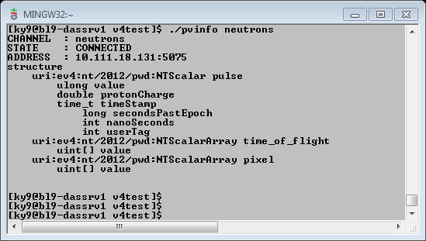
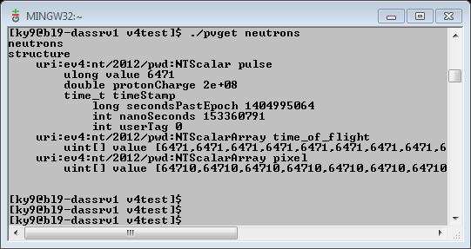
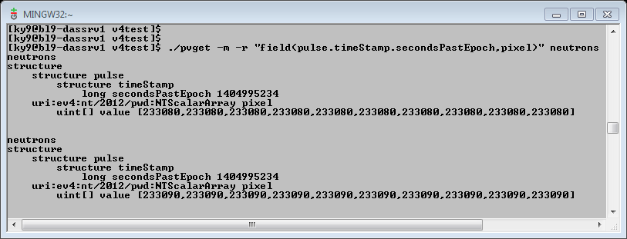
What you get for free

Slide 8
Tests
Server that generates fake neutron events
  Similar to pvDatabaseCPP example
  Can run standalone or in V3 IOC
“pvget –m” for initial tests
  Hit CPU limit because of string formatting
Custom client
  Tests for missing ‘event ID’
Results:
  Saturating 1GB network around 15M SNS events/sec
    100 updates/sec, each with 150000 events
    1 ‘event’ ⬄ T.o.F + pixel ⬄ 8 bytes, and indeed about 8 b/evt on network!!
  On 10GB network 100M SNS events/sec w/o problems
    Limit was CPU load, not network
  Required for SNS: 10M events/sec?

Slide 9
Plan
n
Data Collection
pvAccess client
n
Neutron Detector
EPICS IOC,
“nED” driver
w/ pvAccess srv
pvAccess
Area Detector
“ADnED”
pvAccess client,
XY Pixel Histogram,
Time-of-flight histogram,
std. ROI, Array, … plugins
Experiment Control
IOCs,
pcaspy,
ScanServer
User Display
CS-Studio

Slide 10
Looking Good!
  Can package data in flexible ways
  Already have network tools to inspect, monitor
  Performance is good
  Community of developers and users
    Thanks to Matej Sekoranja, Marty Kraimer, David Hickin for fast bug fixes and help

