Slide 1
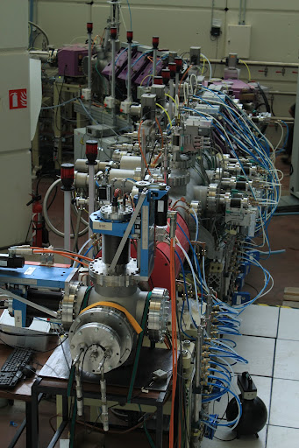
Irfu collaboration in Spiral2 & LIPAc control systems
Françoise Gougnaud
On behalf of D. Bogard,
J-F. Denis, A. Gomes,
J-F. Gournay (now retired),
Y. Lussignol and P. Mattei
EPICS Meeting October 21st 2014

Slide 2
OUTLINE
Brief legacy with some EPICS projects
Our collaboration in Spiral2
Our collaboration in LIPAc

Slide 3
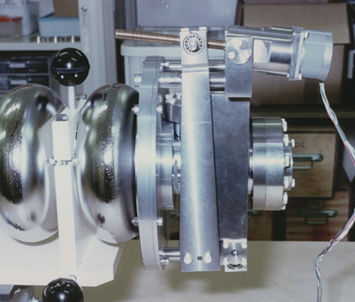
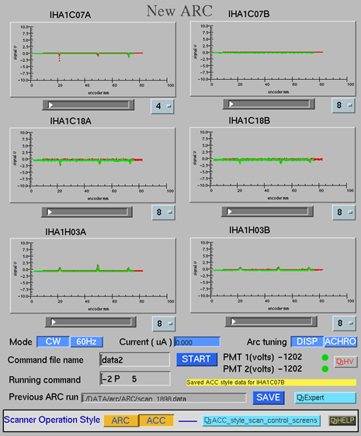
BRIEF legacy of epics in our INSTITUTE
Started with EPICS in 1993 on TTF at Desy TTF Injector, LLRF and some diagnostics
1996-1999 ARC energy measurement at Jlab, Hall A
Controls of wire scanners for the bend angle measurement
Field integral measurement of the ARC

Slide 4
EPICS between 2000-2005
4 EPICS VMEs on COMPASS at CERN
Micromegas and drift chambers
Quench data acquisition and slow control for the superconducting magnet
Ground Support equipment of MIRI imager (JWST)
ESO software for IR detector
EPICS for slow control

Slide 5
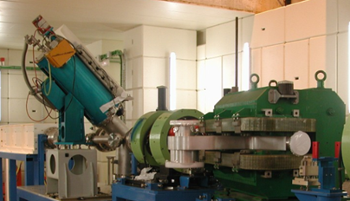
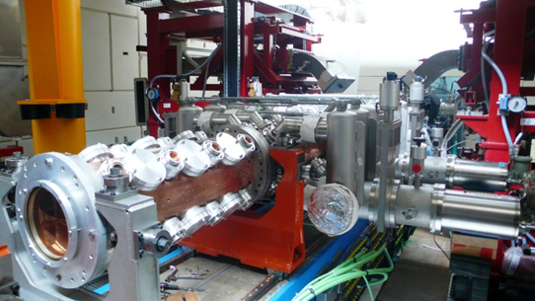
IPHI : an HPPA prototype installed at saclay
IPHI (High Intensity Proton Injector ) started in the 90’s
HPPA : High Power Proton Accelerator
CW Source SILHI
MEBT: with diags
5 MeV RFQ cavity
Notes:
Source suilhi qui a été utilisée comme modele for other projects SP2 and LIPAc
Several diagnostics like a FC,, an emittance meter Allison scanner type, Doppler proportionnalité
MEBT wire scanner,

Slide 6
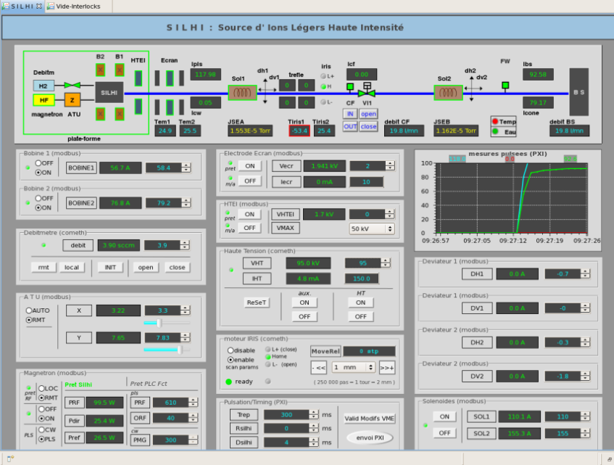
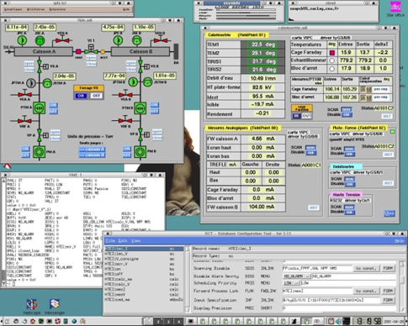
Renovation of the control
A first EPICS control system in 2001
Hardware and Software Renewal in 2012

Slide 7
Spiral2 CONTEXT
The Spiral2 facility will be a new Rare Ion Beam facility for nuclear physics and astrophysics at Ganil in Normandy
Spiral2 control system is under the responsibility of Ganil with E. Lécorché (following presentation)
3 French Labs, Ganil (Caen), IPHC (Strasbourg) and Irfu cooperate for the Spiral2 control system

Slide 8
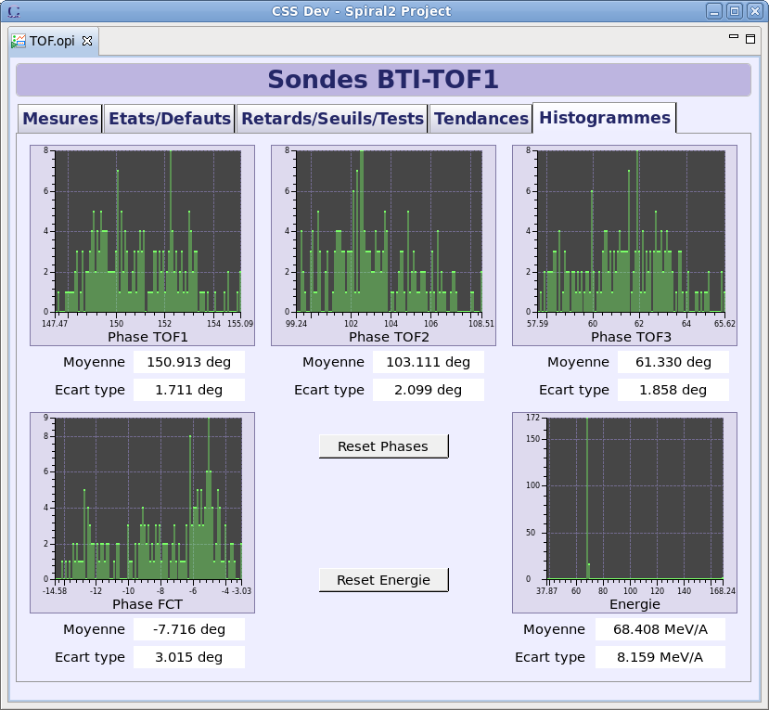
IRFU Control work-PACKAGES in Spiral2
the EPICS platform for the whole project
based on VME/VxWorks and Linux PCs
injector (2 sources, 2 LEBTs, RFQ) with CS
some diagnostics controls
FC, ACCT/DCCT
Fast Current Transformers
Time of Flight
Agilent oscilloscope EPICS interface
for the Fast Faraday Cup
Chopper
LLRF

Slide 9
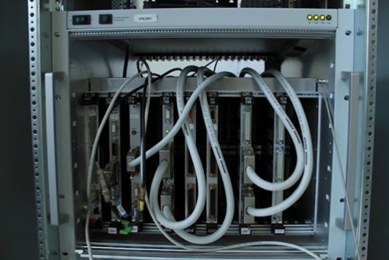
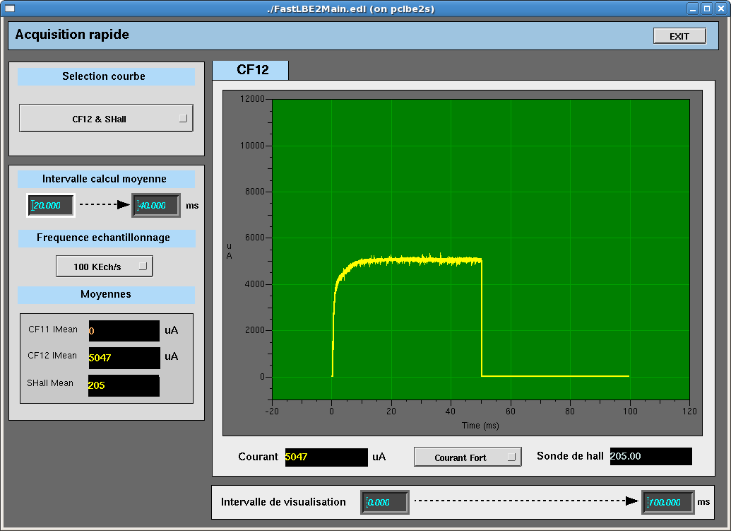
COMMON SPIRAL2 HARDWARE PLATFORM
Emerson MVME 5500
VME NEXEYA ADAS boards/EPICS drivers
ICV150: 32 ADCs, 16-bit resolution, 30 K samples/s
ICV714: 16 DACs, 12-bit resolution
ICV196: 96 binary I/O channels
ICV108: a controller board with RAM 4 Mbytes, external trigger
ICV178: 8 ADCs, 16-bit resolution, 50 K Samples/s up to 1.2 M Samples/s
EPICS driver developed for the synchronised intensity measurement (FC, ACCT, EMU) on Spiral2 and then used on other projects

Slide 10
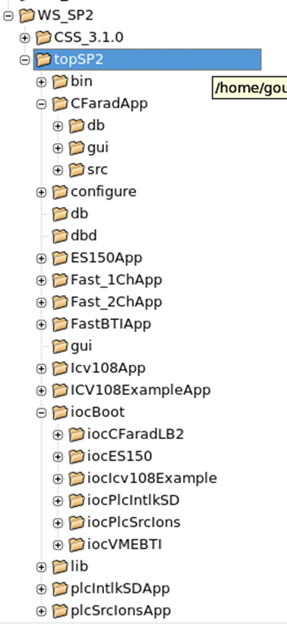
COMMON EPICS software platform (1)
Homogeneous development was needed
between the 3 labs to ease integration :
Rules :
for naming files and global functions
for naming PVs
Development model :
Top directory topSP2
makeBaseApp templates for Apps and IOCs

Slide 11
The COMMON epics platfoRm (2)
EPICS 3.14.12.4
VxWorks 6.9 for MVME5500
CentOs or Scientific Linux CERN on PCs
Available from SVN server at Ganil

Slide 12
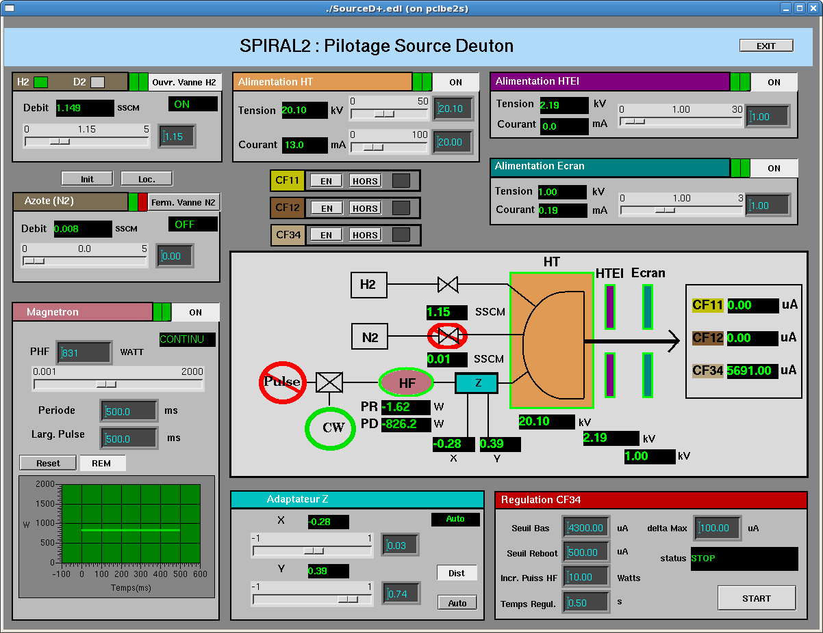
SPIRAL2 deuteron source equipment
50 KV PS polarizes pt
30 KV PS, intermediate electrode
-3 KV PS repelling electrode
2 Flow controllers: Deuterium/Hydrogen & Nitrogen
Agilent pulse generator
RF generator= magnetron
SNL program for regulation based on the beam current reading
Automatic Tuning Unit= impedance adapter

Slide 13
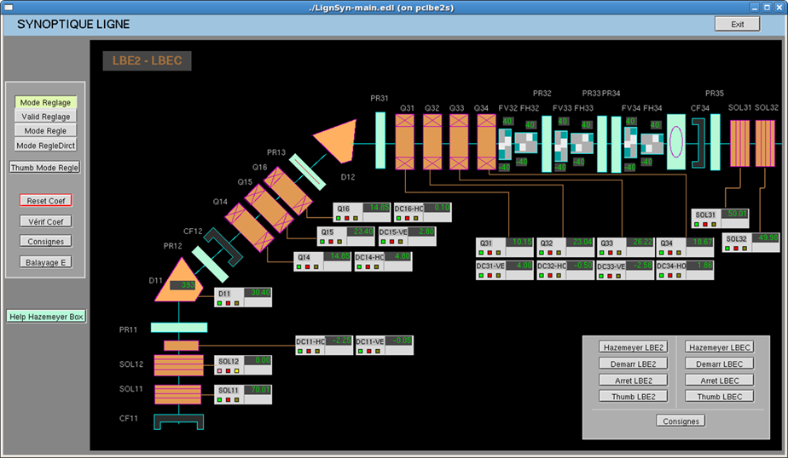
SPIRAL2 LEBT TESTED at Saclay
Controls of diagnostics & 20 Power Supplies
Diagnostics:
FC, ACCT & DCCT, SEM-grid harps (Ganil), Allison emittance-meters (IPHC), Slits => VME or Modbus/Tcp used
20 Hazemeyer Power Supplies :
2 dipoles
2 solenoids
7 quadrupoles
9 steerers
Connected to Ethernet fieldbus & accessed via Modbus/TCP
A common software interface (Ganil)

Slide 14
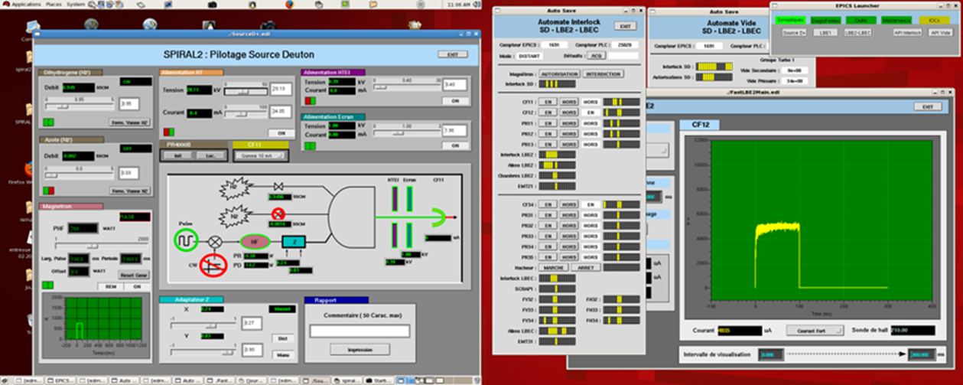
SPIRAL2 injector CONTROL STATUS
The 2 beamlines Saclay and Grenoble tested with only EDM displays
Migration to CSS BOY started late 2011
Tests at Saclay and Grenoble stopped in May 2012
We are waiting for the starting signal from Ganil for the CS installation

Slide 15
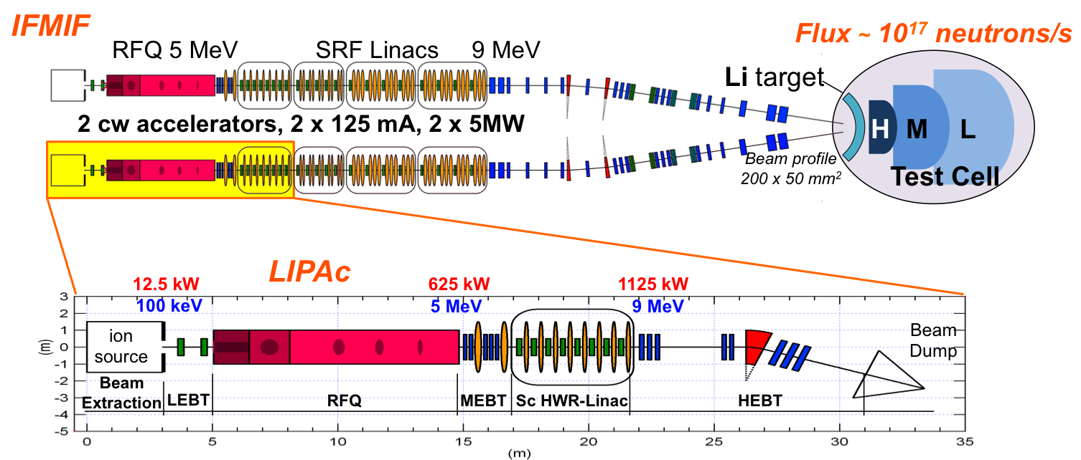
CEA COLLABORATION in LIPAc (ifmif)
IFMIF (International Fusion Materials Irradiation Facility) purpose: provide an accelerator based on a neutron source to produce high-energy neutrons (deuterons) at sufficient intensity and irradiation volume to qualify materials for fusion reactors
A prototype LIPAc (Linear Ifmif Particle Accelerator) identical to the low energy section of IFMIF is being built to check the validity of the design before launching the IFMIF construction

Slide 16
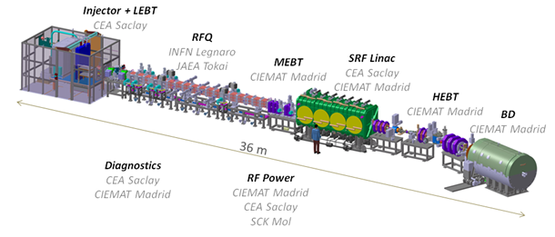
LCSS Shared between 3 institutes
LIPAc is developed under the Broader Approach for Fusion agreement between Europe and Japan. 3 European countries are involved: France, Italy and Spain and share the sub-systems
The control system is split into different LCSs between Ciemat Madrid, INFN Legnaro and CEA Saclay

Slide 17
IRFU LCSs
LCS | Institutes
Source & LEBT | CEA Irfu
RFQ | INFN Legnaro
MEBT | Ciemat Madrid
SRF Linac | Ciemat & CEA
Diagnostics | CEA & Ciemat
HEBT | Ciemat Madrid
Beam Dump | Ciemat Madrid
Coordination | CEA Irfu
in charge of a transverse coordination, standardisation of the development and acceptance tests through European LCSs

Slide 18
LIPAC transverse coordination
EPICS software platform
Identical to Spiral2 platforms (hardware & software)
With the same templates to use for development
Guidelines for installation
Guidelines for development
Guidelines for naming
Template LCS Acceptance Test
To be filled up and followed step by step during the acceptance

Slide 19
LCS ACCeptance tests
Checking of the manuals
User manual
Maintenance manuals (one per device)
Design of software development
Hardware configuration
Scenarios to test controls
Checking software installation
Start from scratch
The complete LCS software has to be reinstalled
automatically if possible
Checking of the topIFMIF tree
Checking of the database records naming
Scripts in collaboration with INFN/Legnaro

Slide 20
LCS ACCeptance tests (2)
Application module acceptance test
Checking scenarios adapted by the person/developers in charge of the LCS
Release acceptance test
This phase concerns the test of the full system from the LCS user interface to the I/Os.
Global acceptance test
All LCSs connected to the Rokkasho network and Central Control system
CEA diagnostics European LCS Acceptance tests took place May 2014

Slide 21
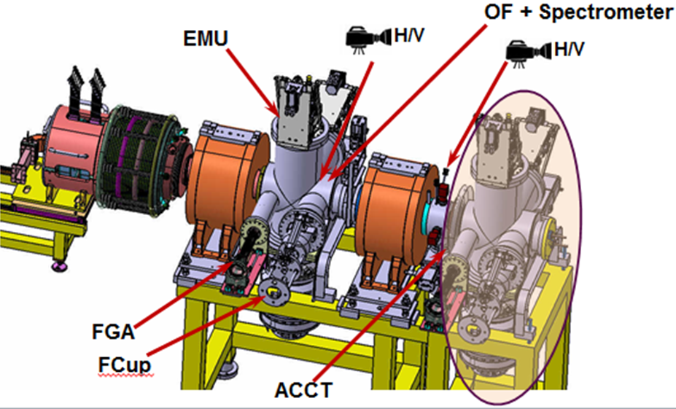
LIPAC Injector LCS: ECR source & LEBT
Injector disassembly at Saclay
November 2012

Slide 22
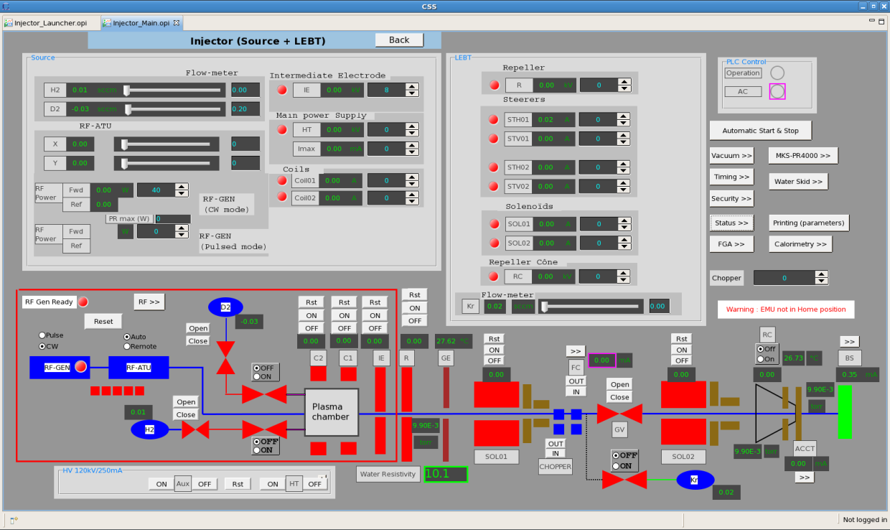
Injector at Rokkasho
Control system tested October 1-9th

Slide 23
3 other presentations on Lipac on WEDNESDAY
CEA Diagnostic controls of IFMIF-Eveda prototype accelerator:LIPAc
Jean-François Denis (CEA)
LIPAc LLRF control system development based on EPICS
Julio Calvo (Ciemat)
LIPAc status: EPICS integration and commissioning
Alvaro Marqueta (Project Team at Rokkasho)

Slide 24
CONCLUSION
Our collaboration in Spiral2 and then LIPAc :was, and still is, very rewarding
Fruitful exchanges
2 different projects enabled us to study different technologies
Improvement of our methods of work between the 2 projects
Many thanks to the EPICS community for all their help since 1993.

Slide 25
Irfu EPICS team
EPICS platform & tools : Y. Lussignol & P. Mattei
Spiral2 EPICS team
sources: J-F. Denis
LEBTs: J-F. Denis, F. Gougnaud, Y. Lussignol
LLRF: Y. Lussignol
LIPAc EPICS team:
Injector: D. Bogard, P. Mattei & A. Gomes
Diagnostics: J-F. Denis
Transverse Coordination: F. Gougnaud, J-F. Gournay (now retired)
2 EPICS beginners: T. Joannem & N. Senaud

