Slide 1
NSLSII Control System Developments and Lessons Learned
The Control Group – presented by Bob Dalesio
EPICS Meeting
April 24, 2010

Slide 2
Outline
Anatomy of an Integration shortcoming
Setting Standards
Fast Orbit Feedback Component Development
V4 Based Architecture for High Level Application
Relational Database Developments
EPICS Extensions
Control System Studio (CSS) Tools
Conclusions

Slide 3
NSLS II Integration Lessons Learned (1 of 5)
LINAC Beam Dump
Faraday Cup
Bending Magnet
Linac
Booster Tunnel
Restricted Area
Second Dump
Faraday Cup
Radiation
Monitor

Slide 4
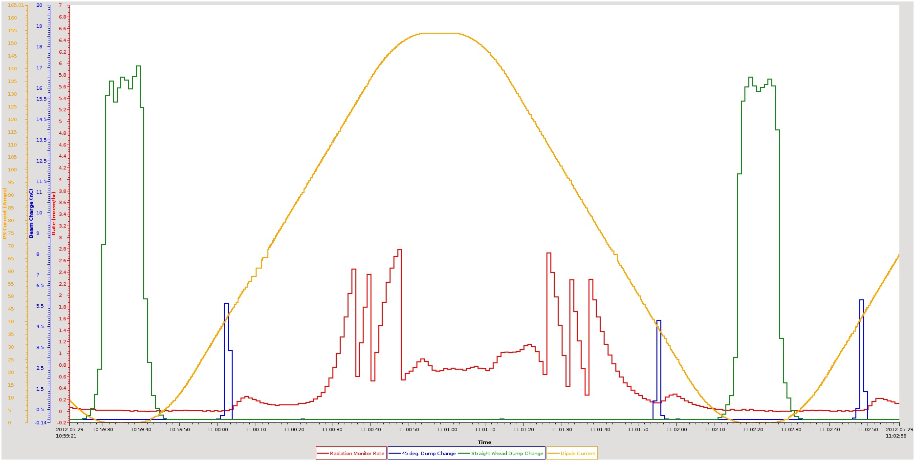
NSLS II Integration Lessons Learned (2 of 5)

Slide 5
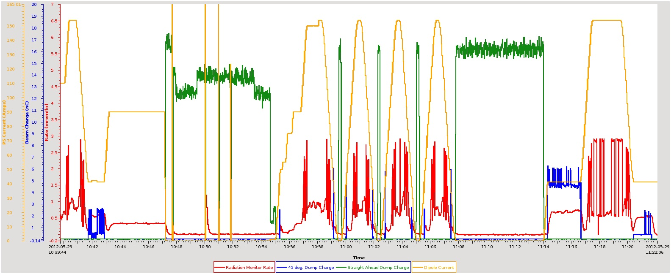
NSLS II Integration Lessons Learned (3 of 5)

Slide 6
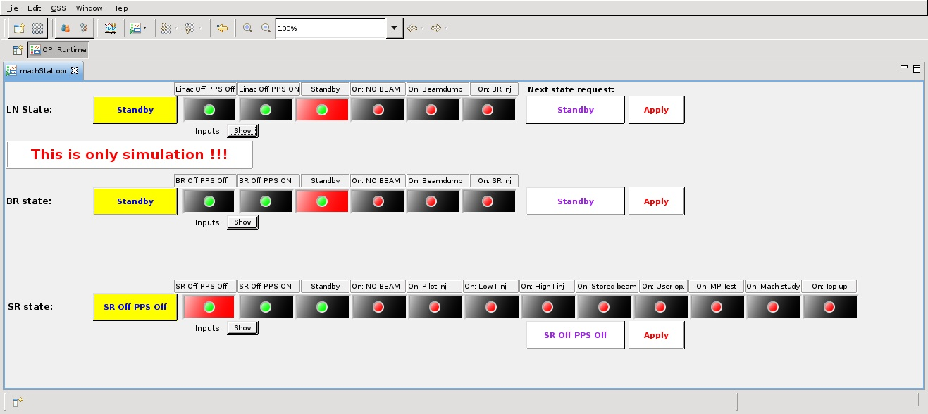
NSLS II Integration Lessons Learned - Machine States (4 of 5)

Slide 7
NSLS II Integration Lessons Learned (5 of 5)
Archiving important control and monitor channels during commissioning is very important.
Radiation Monitor Integration into the control system was tested for end to end communication, however it was not tested with a know radiation source for conversion and alarm accuracy.
Although we have had a subsystem engineer embedded with each of the equipment groups, we did not include an embedded engineer with the physics group to understand the modes of operations. Although we do have an engineer embedded in the Personnel Protection System engineering group, this did not give us the insight into how the system in this area was working.
We have since worked with the physics group to document the standard modes of operation for the accelerator. For each operational mode, the parameters that define the state and the main optics control ranges have been identified. The cognizant engineer is now working with each of the subsystem engineers to define the process variables (PVs) that are involved to stay in a given state and the control range for the subsystem PVs in that mode.
The overall state work will be used directly to inform the alarm states that will be set in the alarm limit fields and the creation of composite alarms such as storage ring vacuum OK.
The state machine will also drive the soft limits in the DRVH and DRVL fields for the PVs that have limited range in given modes.

Slide 8
Design Status - Standards (1 of 2)
All Hardware Integration is achieved through EPICS
Hardware standards are followed wherever possible through NSLS II
  https://wiki.bnl.gov/nsls2controls/index.php/Beamline_Controls_Equipment#Standards
Control System Studio is used for operator tools
Archive Appliance or Channel Archiver to archive time series data
BEAST – alarm server
Channel Finder Service – Provides properties/tag searches of the Process Variables
MASAR – save set manager and user interface
Olog – Electronic log book
MetaDataStore – store sweep information to search data sets

Slide 9
Design Status - Standards (2 of 2)
Naming convention
https://ps.bnl.gov/acc/controls/Shared%20Documents/NamingConvention/LT-ENG-RSI-STD-002_Rev4.docx
https://ps.bnl.gov/acc/controls/Shared%20Documents/NamingConvention/LT-PRJ-STD-CO-NAM-001.xlsx
Coordinate system
https://ps.bnl.gov/phot/ProjectBeamlines/Controls/References%20and%20Standards/Coordinate%20System/LT-C-XFD-STD-BL-COORD-001_Ver3.docx
Interfacing standards
https://ps.bnl.gov/phot/ProjectBeamlines/Controls/References%20and%20Standards/Wiring%20Standards/LT-C-XFD-SPC-CO-IIS-001_Ver5.docx
Controls RSI
https://ps.bnl.gov/phot/DocumentReferenceLibrary/RSIDocuments/1.04.02%20%20Standard%20Local%20Controls%20and%20Data%20Acquisition%20Systems/Stnd%20Local%20Controls%20and%20DAQ%20RSI%20Development/LT-C-XFD-RSI-CO-001_Ver3.docx
EPS standards (draft)
https://ps.bnl.gov/acc/controls/Shared%20Documents/BeamlineControls/Industrial%20Controls/LT-C-XFD-STD-BL-EPS-001_Ver1_draft.docx
PMAC programming standards (based on Diamond standards):
https://ps.bnl.gov/acc/controls/Shared%20Documents/MotionSystems/Standards/LT-R-XFD-STD-BL-MC-002_RevA.docx

Slide 10
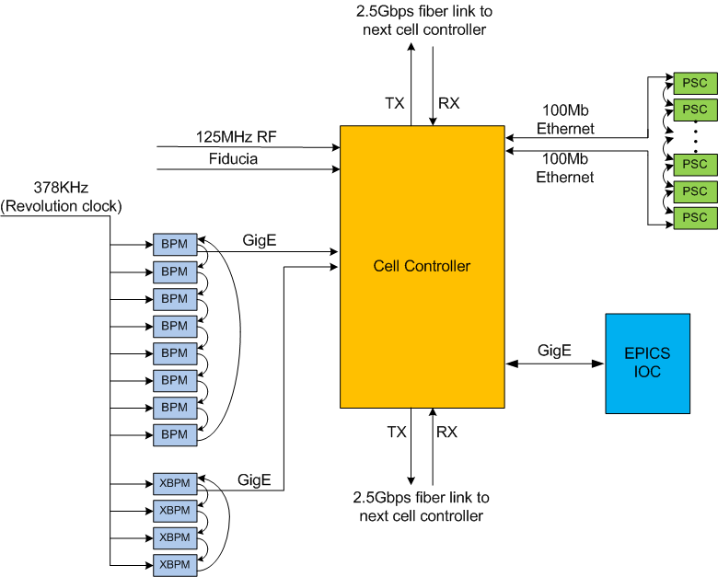
Orbit feedback system architecture
Fast orbit feedback system in one cell

Slide 11


Orbit feedback system is built, installed, tested
NSLS-II two tier device controller architecture
Cell 1
Cell 30
Cell 2
Cell 29
Cell 3
Storage Ring
SDI link
SDI link
Cell 17
Cell 15
Cell 16

Slide 12
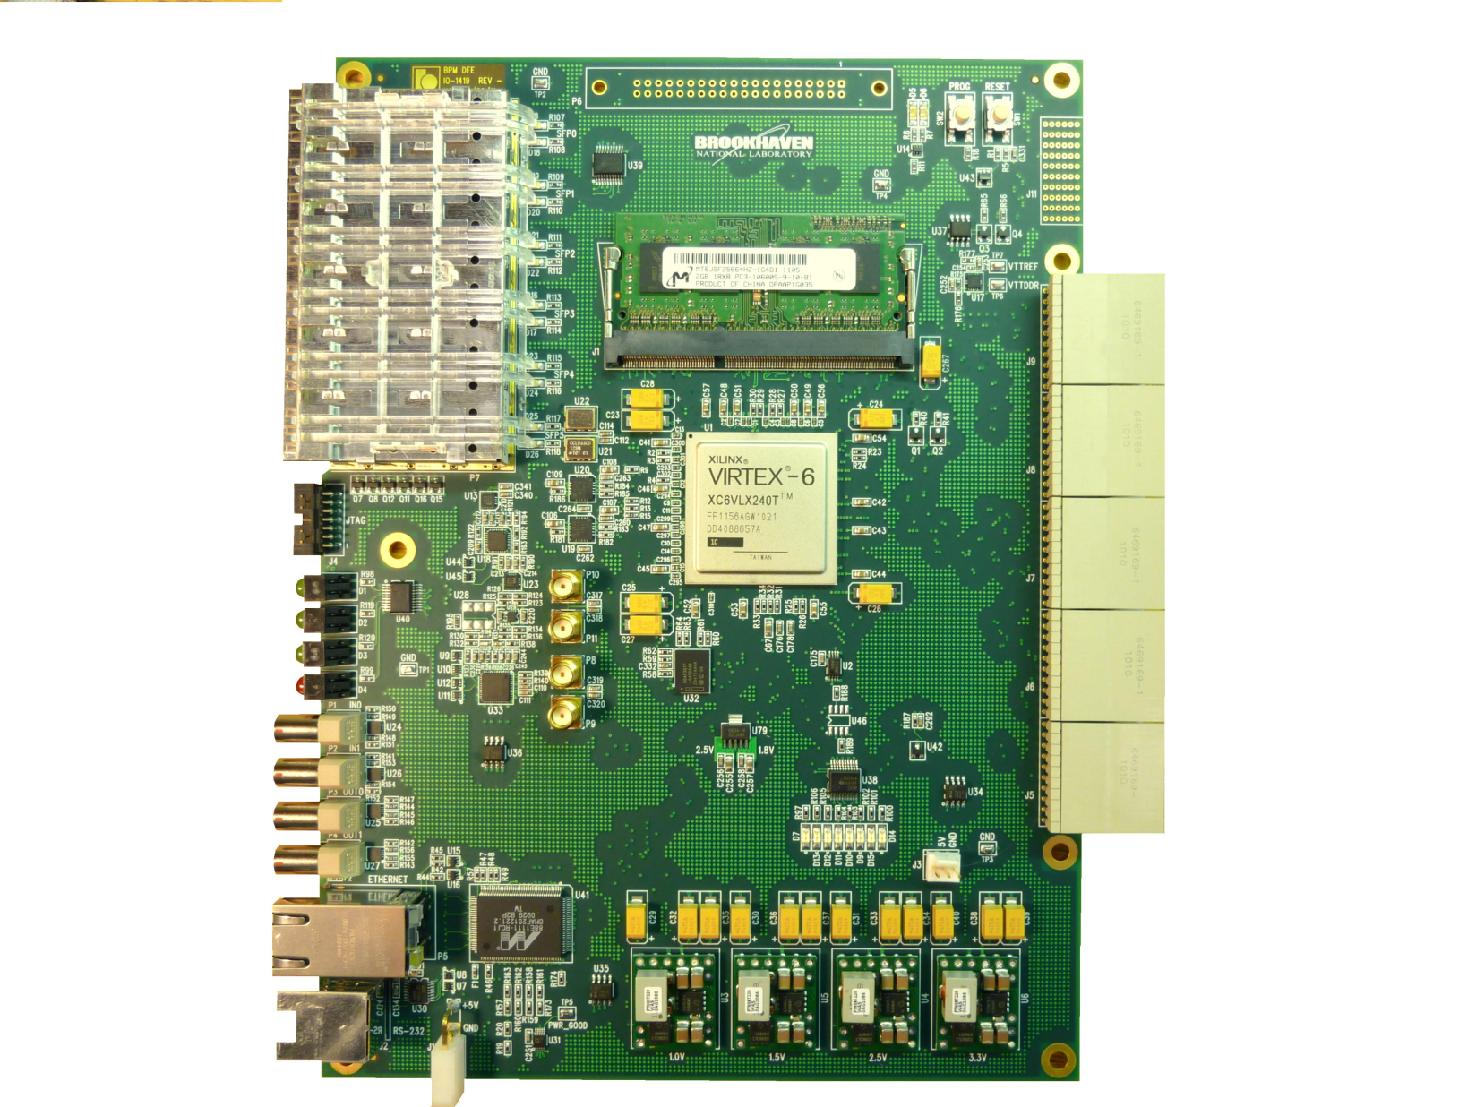
Production DFE

Slide 13
Fast Orbit Feedback – Time Budget
6.7 µs for BNL BPM Electronics delay to pipeline
  3.7 µs for analog value averaged from raw data
  3 µs estimated for BNL BPM Electronics (actual number 14 us?)
  (FYI 57 µs measured on Libera BPM Electronics with minimum filter)
7 µs measured BPM data distribution by Redundant Data Link
  14 µs measured when one of the redundant links not operational
4 µs measured for FOFB calculation with separate mode compensation
5 µs measured for set power supply by PS Shared Memory link
8 KHz measured for fast corrector PS bandwidth w 10 deg phase shift.
1 KHz measured for corrector magnet/chamber bandwidth.
  Measured on with Inconel beam pipe. This value is at 10 degree phase shift.
  New magnet/chamber set up will be tested when they are available.
Fast machine protection data is provided to a dedicated cell controller that uses ancillary IOC and BPM data to determine mitigation at the RF.

Slide 14
V4 High Level Applications (HLA)
High level application architecture is client/server based on the EPICS version 4 network protocol, PVAccess
  One server provides results to all clients
Tables are used to serve database results
These are being implemented in PVAccess
Servers are completed that provide:
  Channel Finder - List of process variables based on function and attributes
  MASAR – save set service
  Model/lattice services
Developer document for thin clients development
Standard clients in CSS can be used to display HLA data

Slide 15
V4 HLA Architecture
MMLT Client
Scripting HLA Client
Control System Studio
Completed
Early Development
Being Extended
PVAccess/CAC
PVAccess/CAC
PVAccess / CAC
Ethernet
PVAccess
PVAccess
PVAccess
PVAccess/CAC
PVAccess/CAC
PVAccess/CAC
Multi-Channel Arrays Svr
Save/Retrieve Server
Magnet, Resp Mtx, etc..
Middle Layer Servers
Model Server
Lattice Server
Channel Finder Svr
Save/Compare Restore Svr
Elegant/Tracy
SQL
SQL
Serves orbit, magnets, any array of channels
SQL
SQL
RDB
RDB
RDB
RDB
PVA
CAS
PVA
CAS
PVA
CAS
PVA
CAS
PVA
CAS
PVA
CAS
Utilities etc..,
Diag & PS
Distributed Front-Ends
Diagnostics
Power Supplies
RF
Vacuum
Physical Device
Physical Device
Physical Device
Physical Device
Physical Device
LS2 Simulation

Slide 16
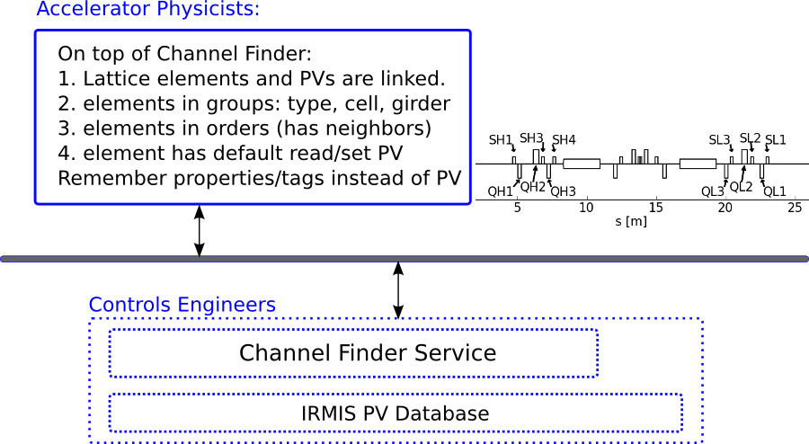
V4 HLA – Physics View
They talk about PV/IOC, we talk about element/cell/girder
PVs are associated with properties and tags, which are used to construct a lattice familiar to physicist.
“the BPM readings in cell 10 girder 2” is easier than PV name

Slide 17
V4 HLA – Use Case
HLA uses several thousand PVs. Each have properties like “elementname”, “elementtype”, “cell”, “girder”, “s_position”, …
Some PVs are tagged with “HLA.X”, “HLA.EGET”, “HLA.EPUT” which means that PV is a “horizontal reading/setting”, “default reading” and “default setting”
The lattice object is a list of elements, each owns several PVs. All of the data is initialized from channel finder service: pv, properties and tags.
No need to remember PV when writing a normal script.

Slide 18
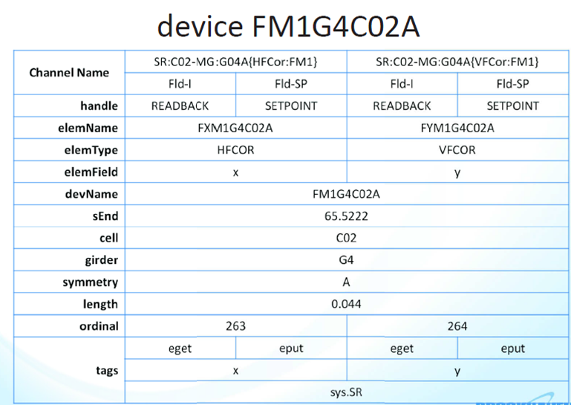
V4 HLA – Channel Finder Tags and Properties

Slide 19
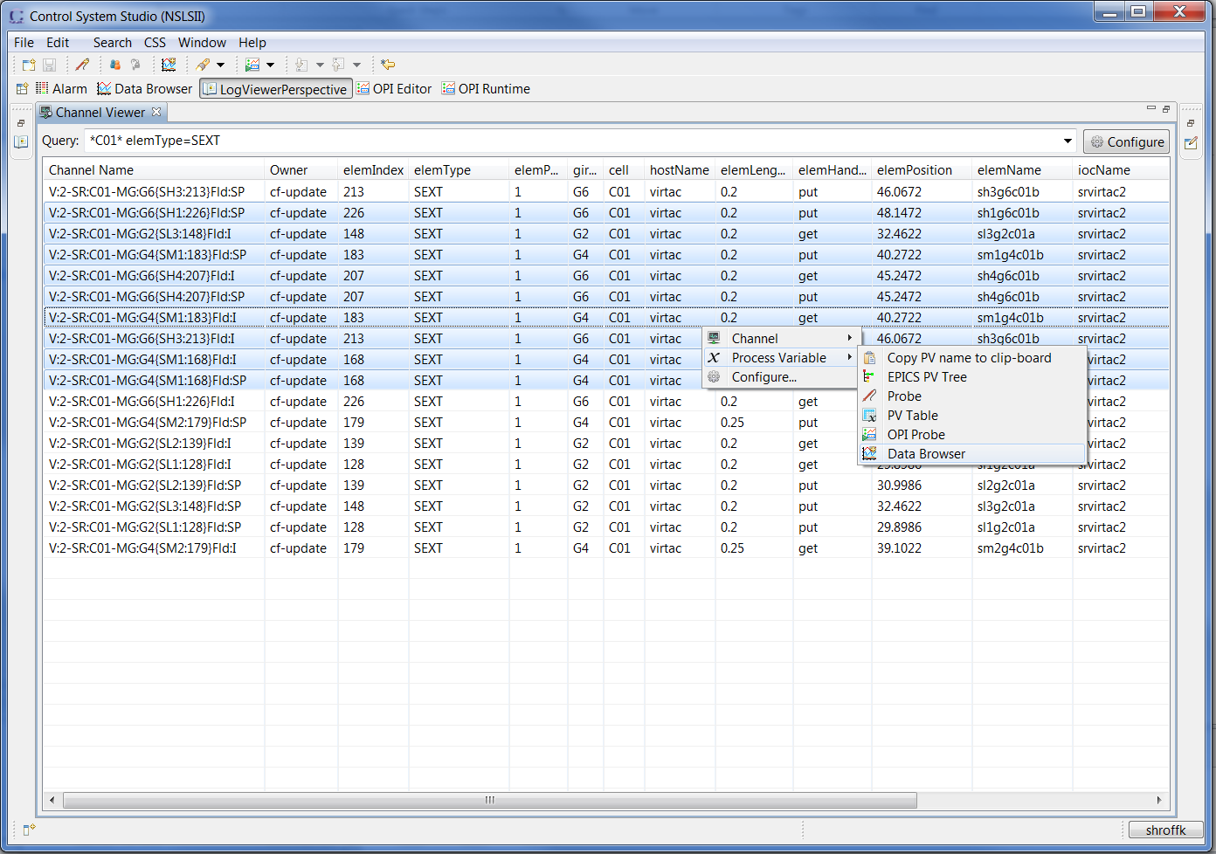
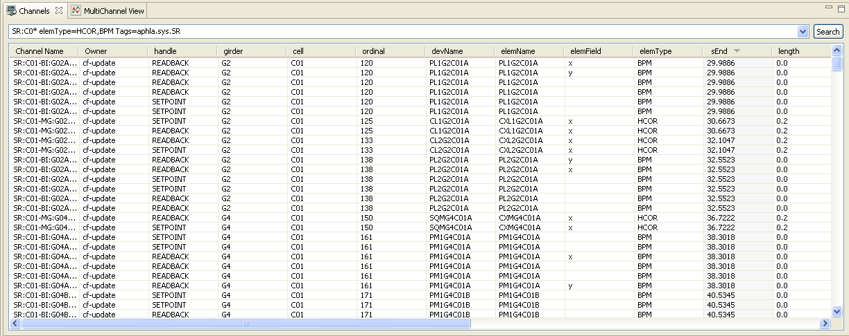
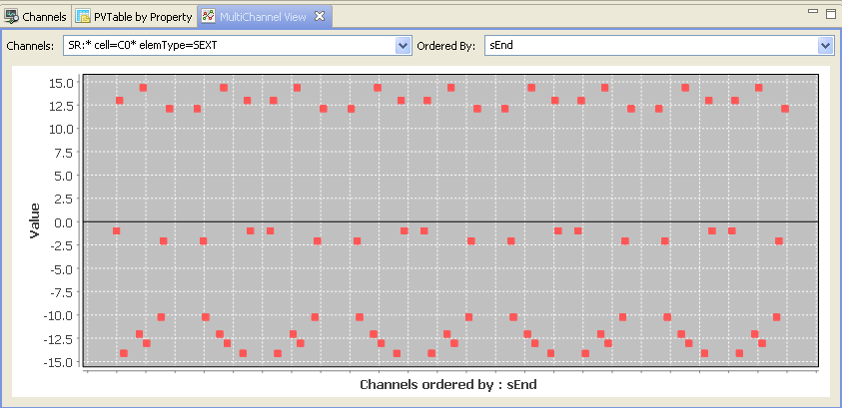
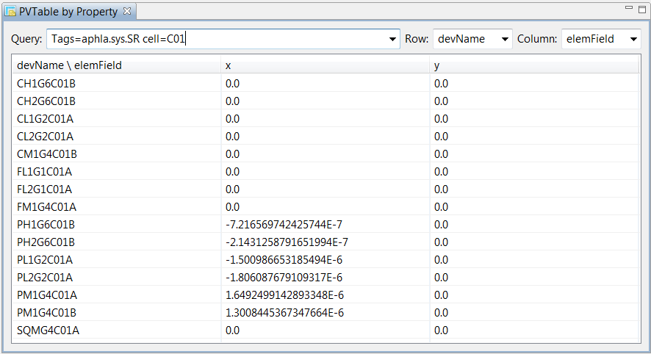
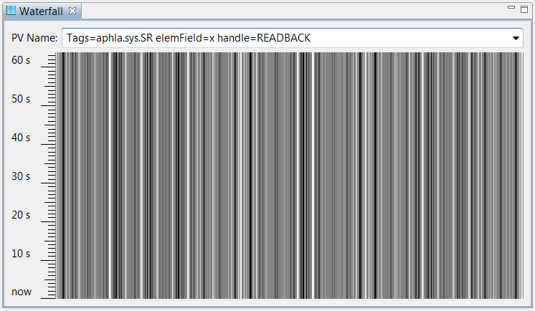
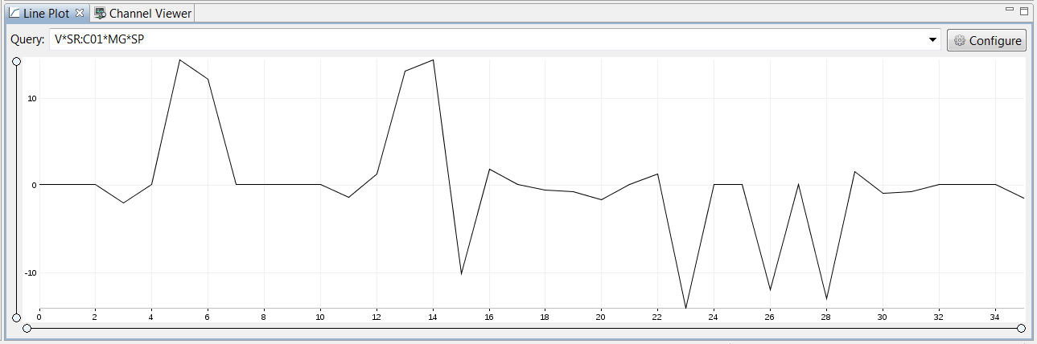
HLA – V4 CSStudio Integration

Slide 20
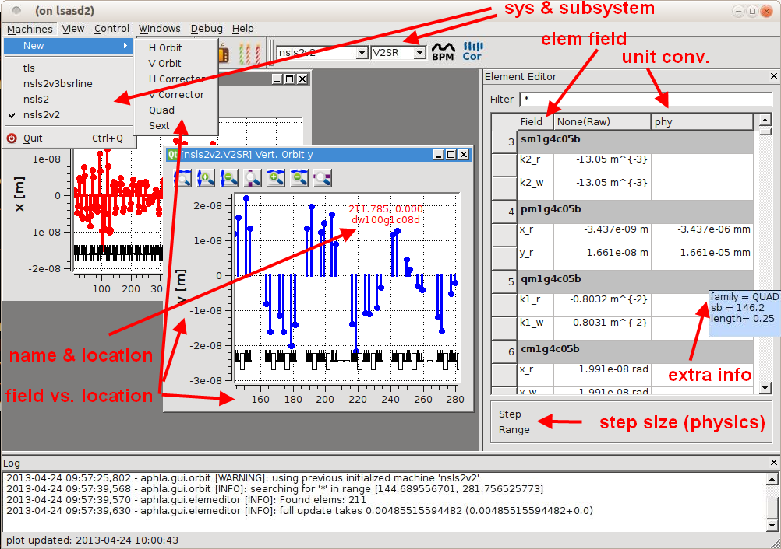
HLA - Thin Clients Can Be Developed

Slide 21
HLA – MASAR Use
Snapshots taken with time
  Events (by 2014-07-14 05:12:08)total taken: 1226, approved: 862
Date | Snapshots taken | Snapshots Approved
3-21-2012 9:28 AM | 0 | 0
3-29-2012 10:32 AM | 30 | 8
3-30-2012 6:01 PM | 31 | 9
4-24-2012 8:02 PM | 144 | 41
5-11-2012 10:27 AM | 210 | 63
5-24-2012 2:25 PM | 279 | 79
6-7-2012 6:28 PM | 331 | 96
6-14-2012 4:13 PM | 338 | 98
6-27-2012 5:02 PM | 347 | 100
4-17-2013 11:30 AM | 351 | 101
4-26-2013 11:13 AM | 355 | 102
4-26-2013 5:24 PM | 362 | 104
5-23-2013 4:03 PM | 364 | 104
9-4-2013 3:38:15 PM | 368 | 108
... | ... | ...
7-14-2014 5:12:08 AM | 1226 | 862
Notes:
362 snapshots taken, and 104 snapshots good
MASAR allows user to preview a saved data set to make sure the data set is exact what is desired. By default, MASAR flags a data set as not approved. User has to explicitly approve one data set as good.

Slide 22
Relational Database Experience
All relational data information integrated in IRMIS
IRMIS table evolution and application development conflicted
IRMIS table redesign broke all JDBC production code
……………..so domains were separated out except
New IRMIS tools were being developed for
  Component type editor
  Component editor
  Component Browser
  Wiring Editor
  BUT…… never completed in time to deploy
………… other domains developed into deployed applications

Slide 23
Relational Database Experience
Channel Finder application uses MySQL (moving to MongoDB) (V4 service in development)
Lattice development with MySQL (V4 service deployed)
Electronic log uses MySQL (moving to MongoDB) (No V4 service)
Save Retrieve uses MySQL (V4 service deployed)
Unit conversion uses mySQL for Magnet Measurements (deployed into an IOC application)
New metaDataStore uses MongoDB (V4 service in development)

Slide 24
Relational Database Experience
One large database with all of the facility data was not possible .
There are around thirty some identified database domains.
Collaboration led by MSU with ITER, ESS, NSLS II and others to develop applications
We have serious questions to answer on cross domain queries and technology evaluations that are ongoing.

Slide 25
Experimental Data Architecture
Control & Analysis Clients
File Formatter
Control System Studio with Correlation Plots
Web Clients
Channel Archiver View
DataBroker
DataBroker
PVManager
HTTP
NFS
CAC
PVAC
NFS
CAC
PVAC
CAC
PVAC
PVAC
Ethernet
PVAS
NFS
PVAS
REST
PVAS
PVAS
PVAS
PVAS
Channel Finder Server
Archive Store/Retrieve
Experiment Information.
Experiment Information.
Experiment Information.
Archive Retrieval
Archive Retrieval
SQL*
XML/RPC
SQL
MongoDB
SQL*
XML/RPC
XML/RPC
RDB
Science
Data
Science
Data
PASS
MetaData
Store
OLOG
Machine Data
Beamline Data
CAS
PVAS
CAS
PVAS
N-lanes
Process Database.
Process Database.
Detector
Device Support
Device Support
Area Detector
Driver
Driver
Instrumentation

Slide 26
Control System Studio
Adopted CSS for our user interface after evaluation
Developed ChannelFinderService to return process variables by function, location, device, etc…
Developed a channel access package to provide all client functions and time synchronous vectors from an arrays of process variables (PVManager)
Developed multichannel visualization tools
Developed an Integrated Log Book
Developed a multi-controller application (ChannelOrchestrator)
Developed a save/restore application (MASAR)
Developed standard extension points in CSS for services such as log book and directory service.
Developed standard extension points in CSS for plots.
This first deployment of CSStudio for a facility is exposing many new requirements and some shortcomings that need to be handled.

Slide 27
Conclusions
  NSLS II have leveraged off of years of development from the community: CSStudio, database applications, and middle layer service architecture and service development.
  We have invested in several areas of development (3.15 extensions, V4, CSS, middle layer services, fast orbit feedback hardware) and most of them greatly improved our productivity and functionality.
  We are starting to deploy these services for data acquisition and have been able to reuse several of the services.
  There are several key areas that need development in the future: PVAccess as the primary protocol for EPICS, CSStudio data layer maturation, an open-source hardware platform, to name a few.

