Slide 1
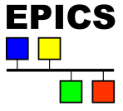
EPICS Qt
Andrew Rhyder - Australian Synchrotron
Fall Meeting October 2014 Saclay
Notes:
I’ll be talking about Qt within the EPICS community, and an update on the Qt framework from the Australian Synchrotron.

Slide 2
Notes:
But before I begin, I’d like to invite you all to Melbourne next year when the Australian Synchrotron will be hosting the 2015 International Conference on Accelerator and Large Experimental Physics Control Systems.
Which will be proceeded by a one day EPICS workshop, I’m told.

Slide 3
Presentation Summary
Qt Intro
Qt Within the EPICS community
Qt Update
Notes:
I’ll be talking about Qt itself,
how the EPICS community uses and can use Qt.
In particular I’ll cover recent developments with the EPICS Qt product from the Australian Synchrotron and where we are headed with it.

Slide 4
What is Qt
Qt is a cross-platform application and UI framework for developers using C++.
It can be used under an open source licence.
Qt has had a good track record of ongoing development and expanding use.
Strong community based governance.
Notes:
What is Qt?
The first couple of points here come direct from the Qt Project web site:
Qt is a cross-platform framework for developing applications and user interfaces
It builds on C++,
and it’s open source.
Qt has a great track record of ongoing development with an expanding user base.
Qt is also a well managed open source project with a governance structure that works well for its user base.

Slide 5
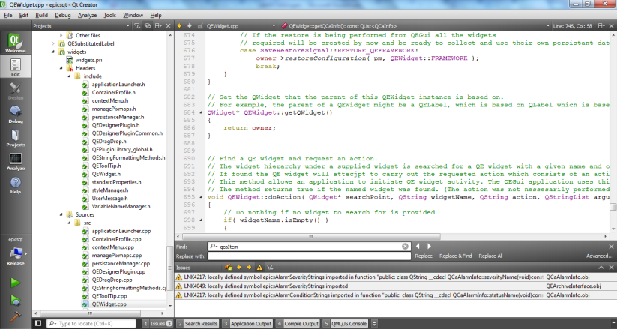
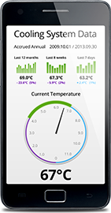
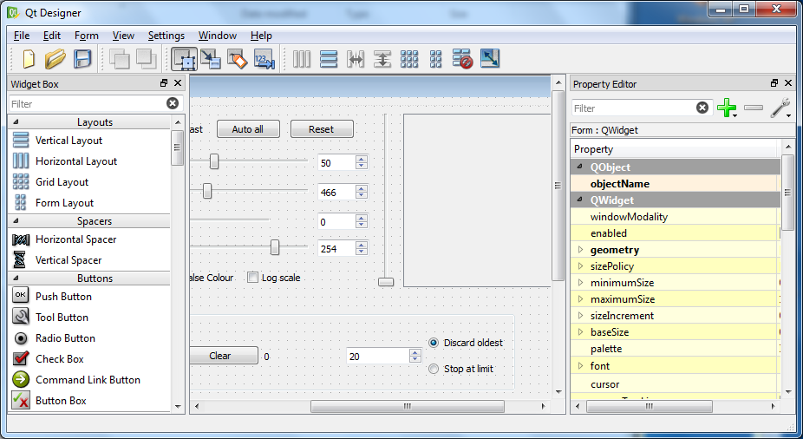
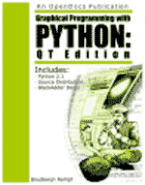
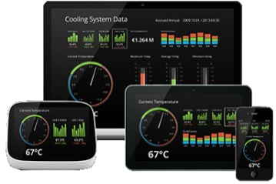
Qt is an ecosystem
An active open source community supporting documentation, forums, and tools
Any applications we produce come with a lot of support from that community.
Notes:
Qt is more than a coding framework. Its an ecosystem where an active community supports documentation, forums, and tools.
Any application we produce can draw on the support of a community of hundreds of thousands of other developers.

Slide 6
Qt roadmap
Traditional desktop
Embedded systems
RTOS (including VxWorks)
Touch screens
Mobile platforms
Notes:
One of the reasons I’m attached to Qt and have high expectations for it is the greater Qt community. Anyone developing in Qt, discovers the support the community provides fairly quickly. And it is that community moving Qt forward now.
The Qt project roadmap shows that as well as running Qt on Linux, Windows and Mac OS X desktops, Qt is moving towards:
- Embedded Android, Linux, Windows
- RTOS. VxWorks and others
- Touch screens
- Mobile platforms: Android, IOS, WinRT (under development)
All of this is available now. And it’s in these areas Qt will be developing.
What will we do in these areas? I don’t know. We can imagine a few things. But the point is Qt offers some interesting horizons.

Slide 7
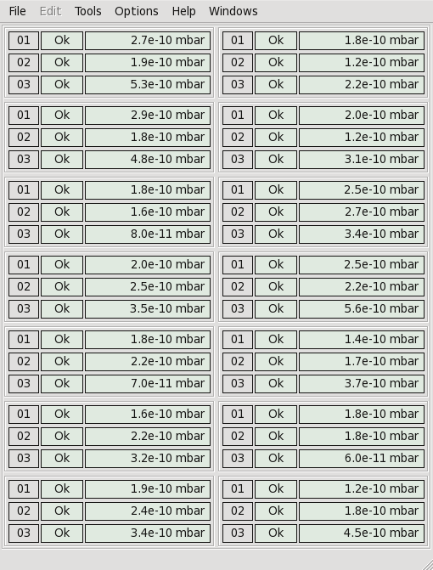
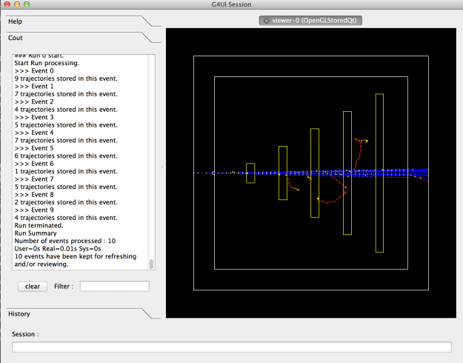
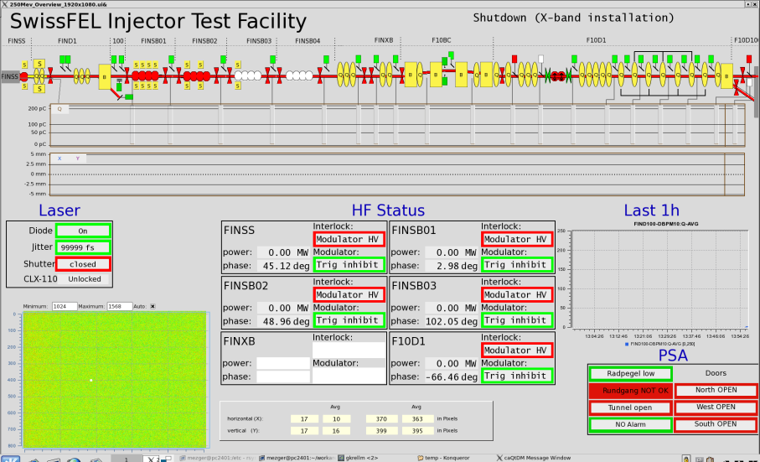
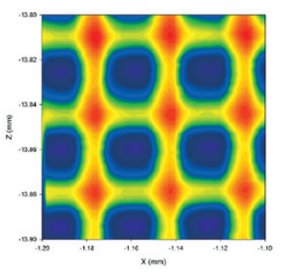
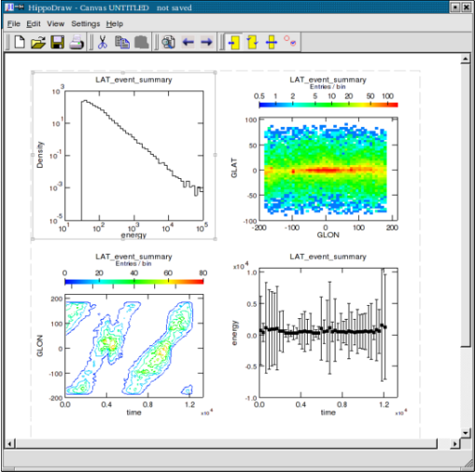
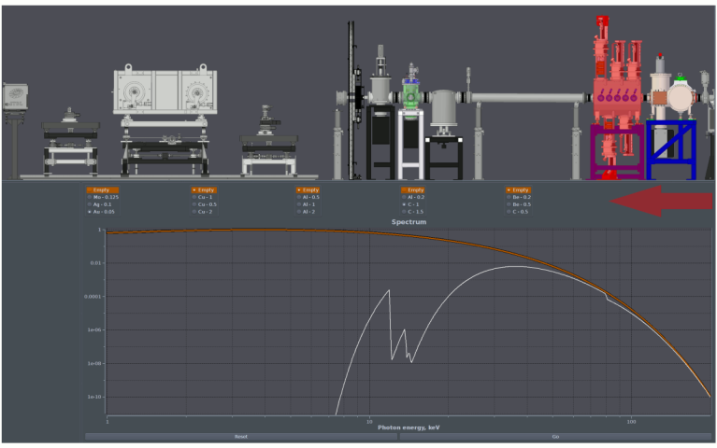
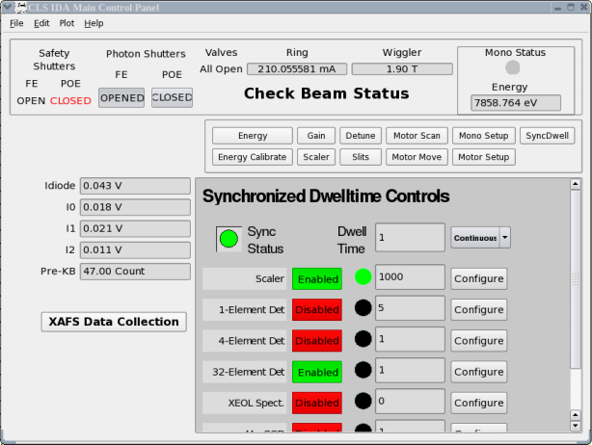
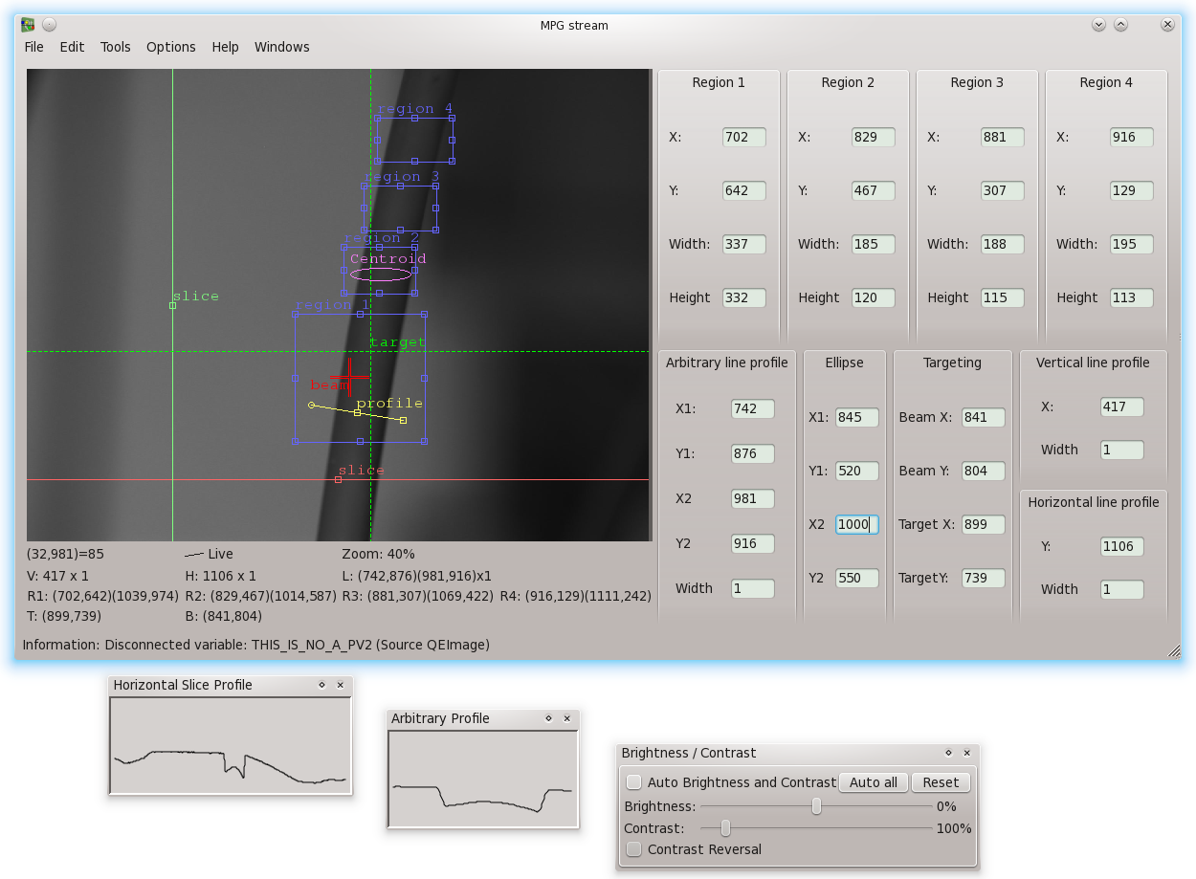
Can we benefit from Qt?
Notes:
Already developers within our facilities are using Qt, and have been for a long time.
Some are larger projects that have been presented here, others are more under the radar.
Developers find Qt a valuable tool for producing applications. That’s good. A few of those projects have been designed to be shared, and that’s better, but we need to work on ensuring applications with similar scope are complimentary, are easy to get hold of and easy to use outside the facilities where they were designed.

Slide 8
Can we benefit from Qt?
The Paul Scherrer Institute:
MEDM conversion tools
The Australian Synchrotron:
Unifying GUI system
Lyncean Technologies:
Python physics and science applications.
Notes:
An example of this is what we have been doing with PSI…
The Paul Scherrer Institute needed an medm conversion tool – the produced caQtDM and have added many features to this beyond a conversion tool.
The Australian Synchrotron needed a unifying GUI system for all new developments – We developed EPICSQt.
These two applications are effective tools, they are not competitors; they are complimentary in scope.
Lyncean Technogies is producing python based physics and scientific applications for their accelerator. They want to use tools like these in those applications and they want that to be as easy as possible – easier than it currently is.
Lyncean has begun an investigation supported by the nuclear physics office of the Department of Energy into how collaboration tools, systems, forums, whatever can be embedded within the EPICS community for the development of Qt based applications.
Emanual Mayset is managing this program and an early output has been facilitating plans for the merger of the Paul Scherrer Institute’s Qt based GUI system and the Australian Synchrotron’s Qt based GUI system.

Slide 9
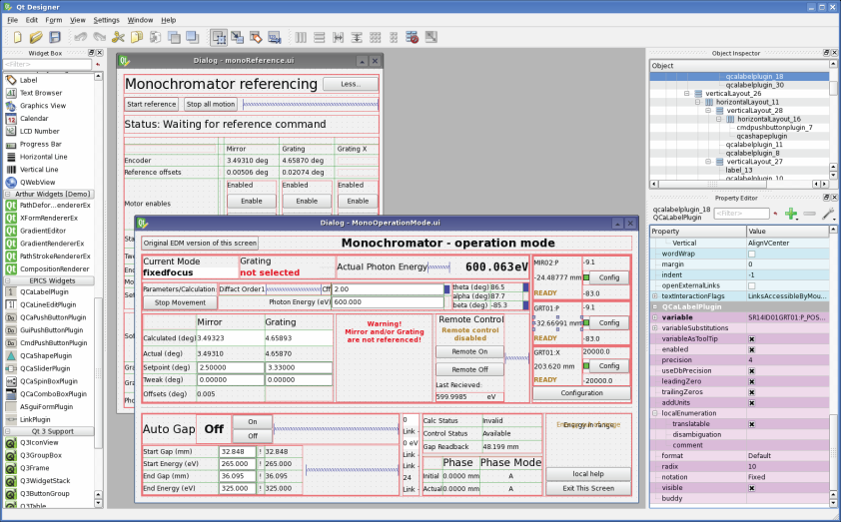
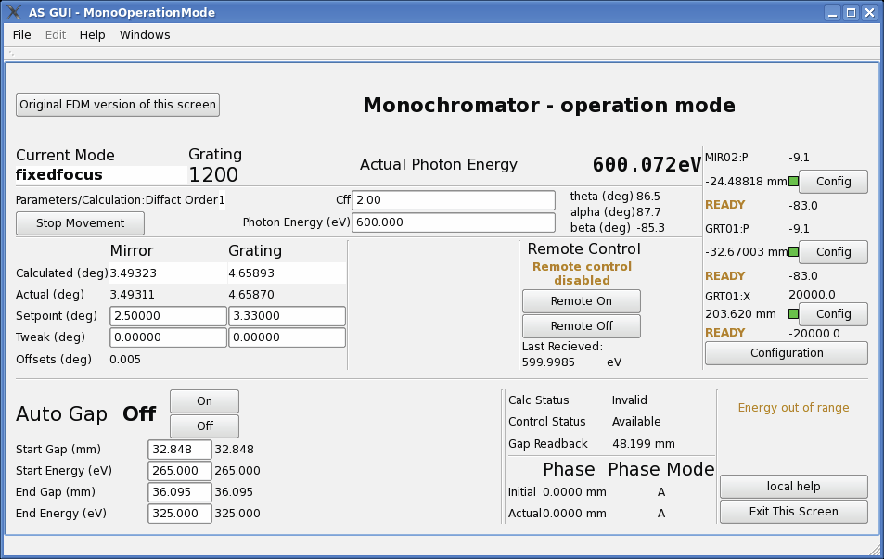
Collaboration results – EPICSQT + caQtDM
Just like before – only combined!
Common documentation
Common packaging
Includes all functionality from the Australian Synchrotron application
Includes PSI’s MEDM conversion tools and extended functionality
Notes:
That merger is underway:
We are making one product form two that both facilities can then use.
We are still using Qt’s simple Form Designer for producing screens.
Still use a simple GUI presentation tool.
All the functionality from the Australian Synchrotron application is there.
Plus PSI’s MEDM conversion tools and other features.
Merging the two products was not a big ask, technically.
One of the strengths of Qt is how easily Qt components can be mixed and matched.
EPICSQt could already be used within the caQtDM framework, and now caQtDM can now be used within the EPICSQt.
Non technical changes are also not difficult but are probably more important to making this combined application accessible.
Common documentation.
Common and convenient packaging and installation.
Hopefully we can keep this moving in the following months to the point where we have a single suite of two complimentary products.

Slide 10
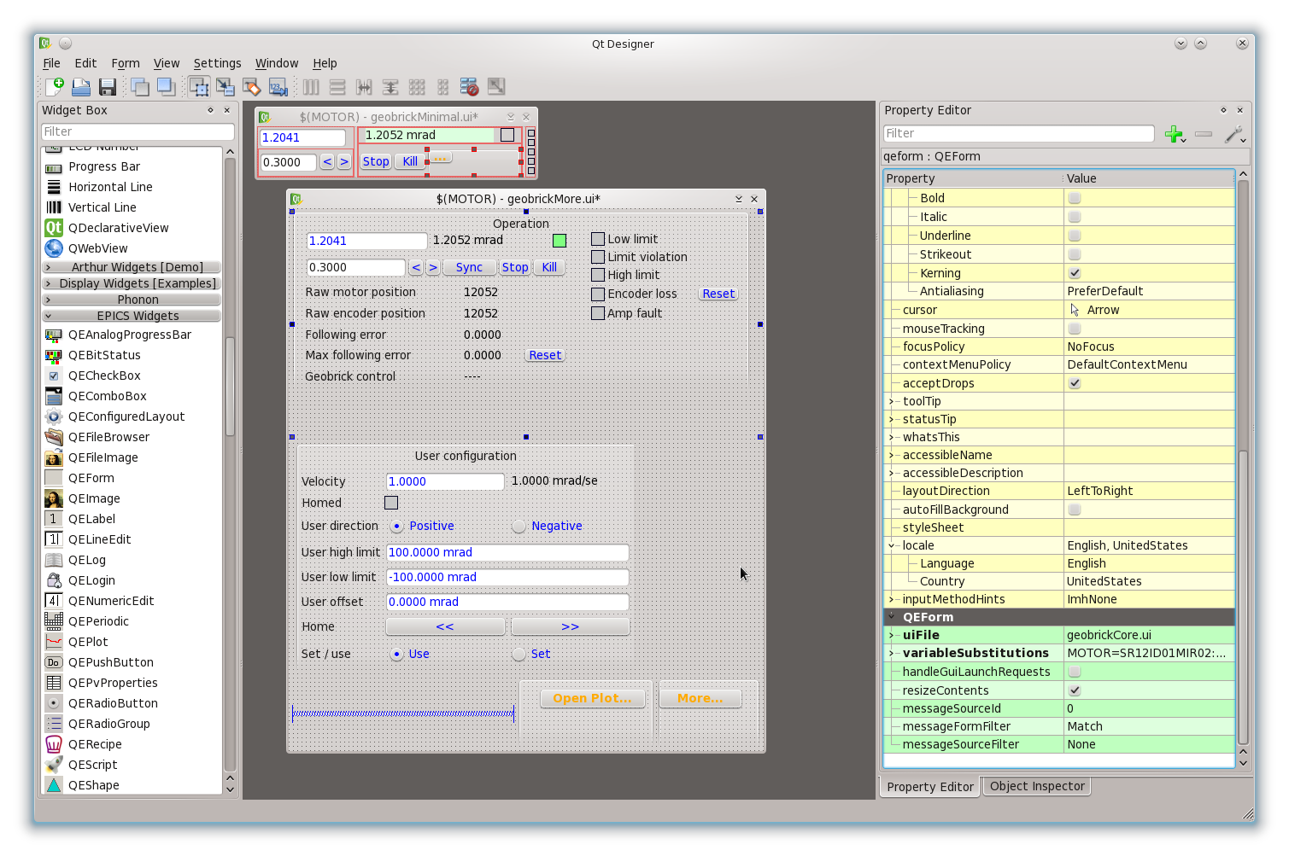
EPICSQt
Notes:
At the Australian Synchrotron we have placed particular emphasis on enabling the easy production of GUIs that focus on beamline users and their processes, rather a pure presentation of EPICS data.
We did, by the way, produce a list of requirements covering all the accelerator GUIs within the Australian Synchrotron and ensured we have added functionality to cover all those requirements, but the focus of recent development has been beamline use.

Slide 11
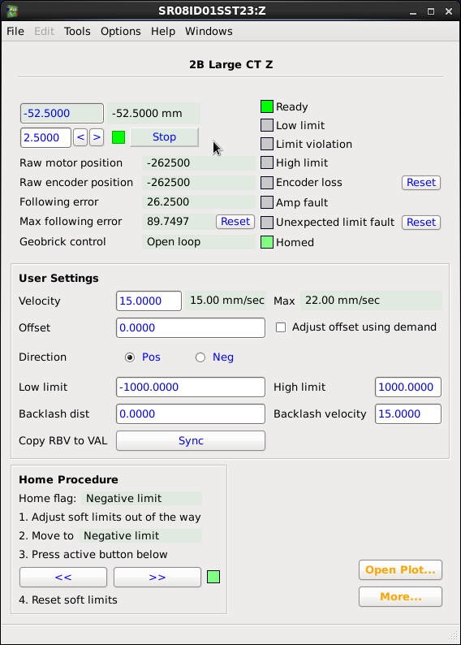
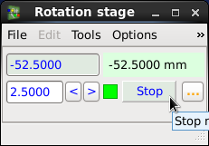
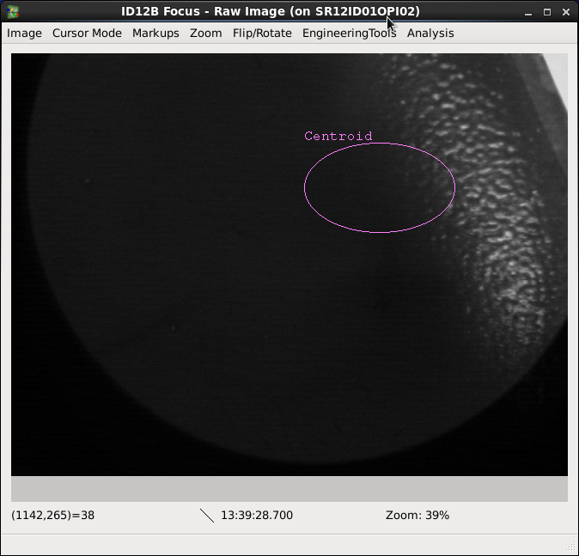
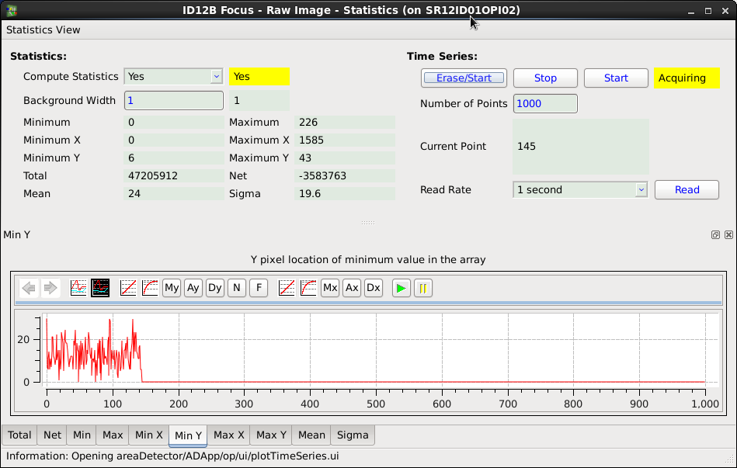
EPICSQt
Notes:
At the Australian Synchrotron we have placed particular emphasis on enabling the easy production of GUIs that focus on beamline users and their processes, rather a pure presentation of EPICS data.
We did, by the way, produce a list of requirements covering all the accelerator GUIs within the Australian Synchrotron and ensured we have added functionality to cover all those requirements, but the focus of recent development has been beamline use.

Slide 12
EPICSQt - differentiation
UI presentation application that is not restricted to medm behaviour
Docks
Tabs
Application specific menu bars and toolbars
Widget set that is not restricted to medm behaviour
Notes:
At the Australian Synchrotron we have placed particular emphasis on enabling the easy production of GUIs that focus on beamline users and their processes, rather a pure presentation of EPICS data.
We did, by the way, produce a list of requirements covering all the accelerator GUIs within the Australian Synchrotron and ensured we have added functionality to cover all those requirements, but the focus of recent development has been beamline use.

Slide 13
EPICSQt update
Notes:
At the Australian Synchrotron we have placed particular emphasis on enabling the easy production of GUIs that focus on beamline users and their processes, rather a pure presentation of EPICS data.
We did, by the way, produce a list of requirements covering all the accelerator GUIs within the Australian Synchrotron and ensured we have added functionality to cover all those requirements, but the focus of recent development has been beamline use.

Slide 14
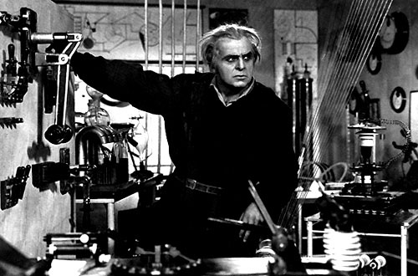
EPICSQt update - GUIs for Beamline Users
Notes:
At the Australian Synchrotron we have placed particular emphasis on enabling the easy production of GUIs that focus on beamline users and their processes, rather a pure presentation of EPICS data.
We did, by the way, produce a list of requirements covering all the accelerator GUIs within the Australian Synchrotron and ensured we have added functionality to cover all those requirements, but the focus of recent development has been beamline use.

Slide 15
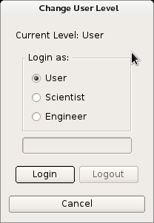
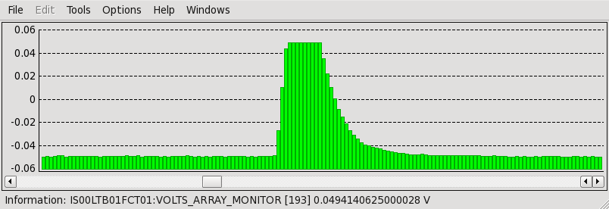
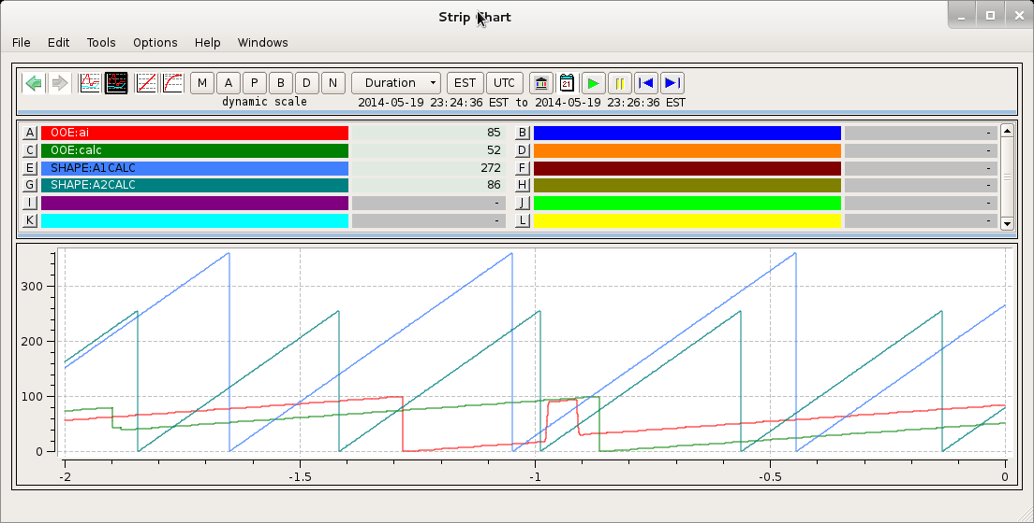
EPICSQt update
User levels
Plotting
Stripcharts
Notes:
EPICSQt now includes:
User level management
Stripchart and plotting tools

Slide 16
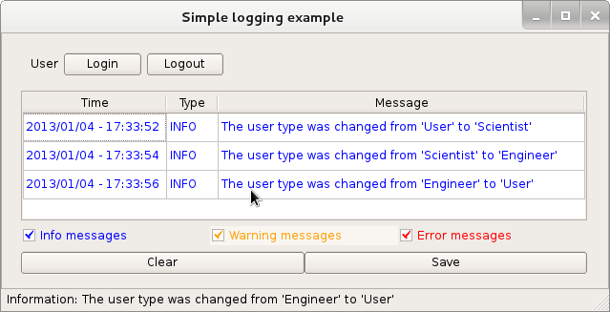
EPICSQt update
PV Scratch pad tool
Logging
Notes:
- PV Scratch pad tool
- User levels
- Logging

Slide 17
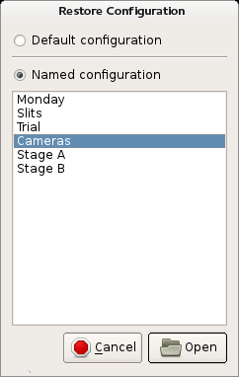
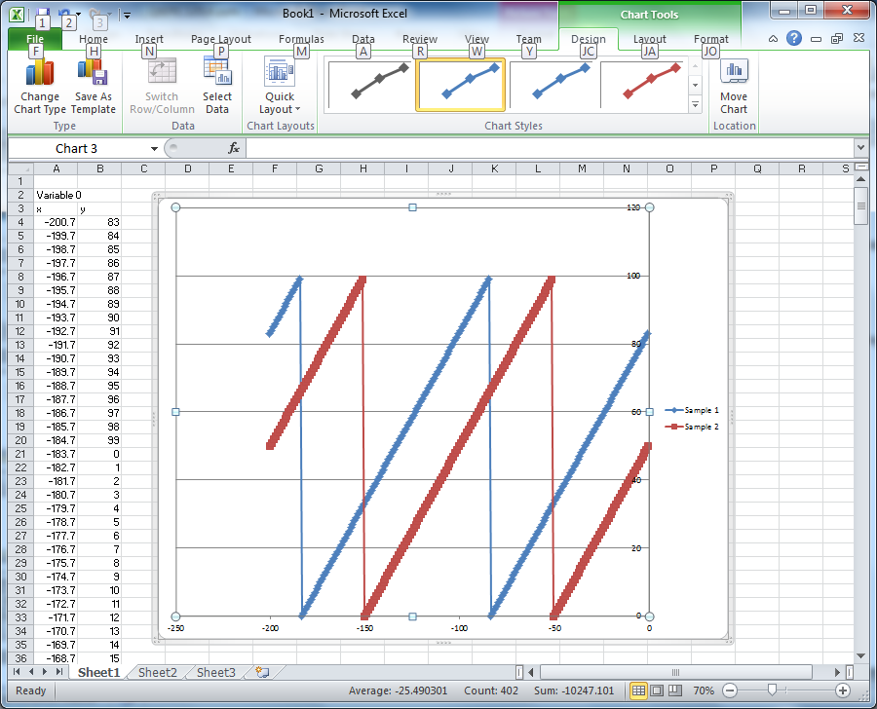
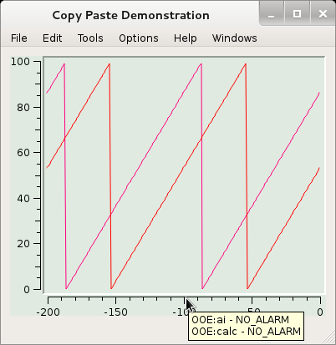
EPICSQt update
Configuration Save/Restore
Improved cut and paste
Notes:
- Configuration Save/Restore
- More documentation
- Drag/drop, and Cut and paste is improved

Slide 18
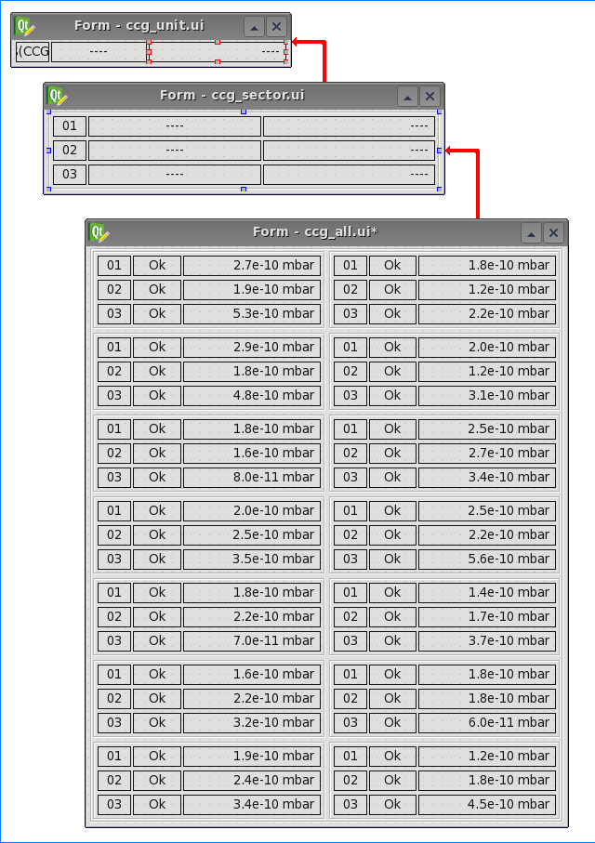
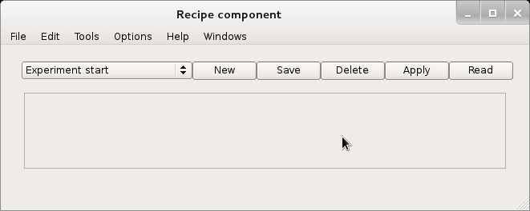
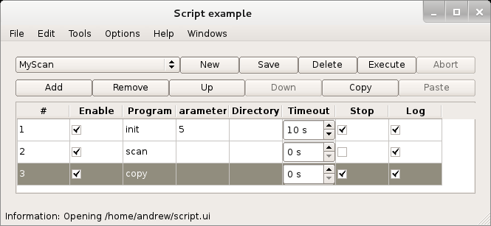
EPICSQt update
Dynamic tables
PV Recipes
User script management
Notes:
- Dynamic tables. UI designers can easily develop nested tables of sub-forms where macros are automatically set up according to the sub form’s position in the table
- PV Recipes
User script manager
Note all the previous tools are widgets that can be used individually as shown here, or embedded within a larger GUI.

Slide 19
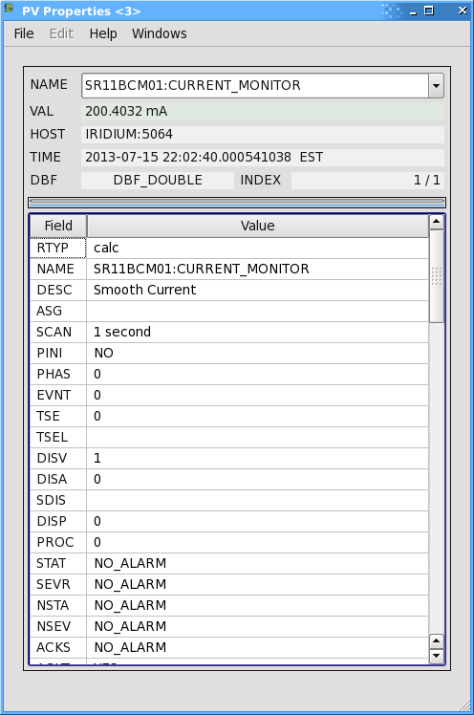
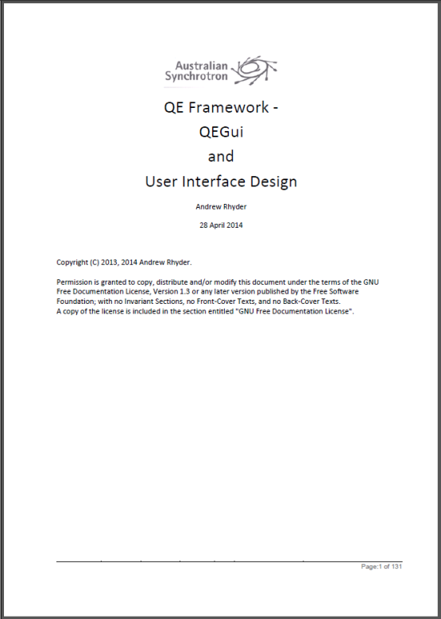
EPICSQt update
Documentation
PV properties tool
Notes:
PV properties tool
More documentation

Slide 20
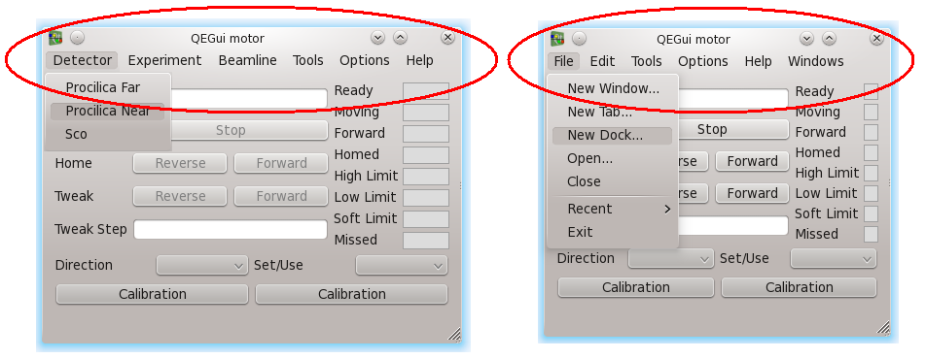
EPICSQt update
Menu and tool bar customisation
Notes:
Enables the tool presenting the displays – QEGui – to be perform more like a custom user application and less like a display manager.
On the right is QEGui with its standard menu bar, and on the left with a set of custom menus.
The menu items can launch new windows, create docks, run commands, launch associated applications, and interact with widgets in the display. For example, a menu item could be added to provide zoom options for an embedded Image widget.
Every other application you use has a set of menus supporting the purpose of the application. So if a beamline user is looking at their sample positioning application they should see meus related to sample positioning, not menus related to a GUI presentation tool you didn’t even know you were using.

Slide 21
EPICSQt update
Imaging
Interactive AreaDetector integration
Interactive user tasks
Analysis tools
Local presentation options
Notes:
A lot of development has gone into the Image widget recently.
The goals have been:
Provide an interactive interface to areaDetector. For example, selecting regions of interest, or selecting image profile ordinates.
Provide an interactive interface for common user functions such as sample positioning.
Provide the most commonly used functions available in common imaging tools such as ImageJ. For example, thick line arbitrary profiling, recording and playback, snapshots.
Provide local user presentation functions. For example brightness and contrast, rotation, flipping, clipping. While a lot of these functions can be performed through area detector plugins, they are intended to allow individual image manipulation that does not affect any other consumer of the image.
The Image widget can take an image stream from CA, from an mpeg stream (typically from the mpeg plugin). The widget works exactly the same regardless of the image source providing the same interaction and tools.
This ability to take an input from multiple sources shows the sharp internal distinction the EPICSQt framework has between the presentation widgets and the data classes feeding them. This separation will make it easier to introduce other data sources. For example, a data model where the data flow is controlled by the application or, in the case of the image widget, a V4 based source to make use of Diamond’s PVAccess areaDetector plugin.

Slide 22
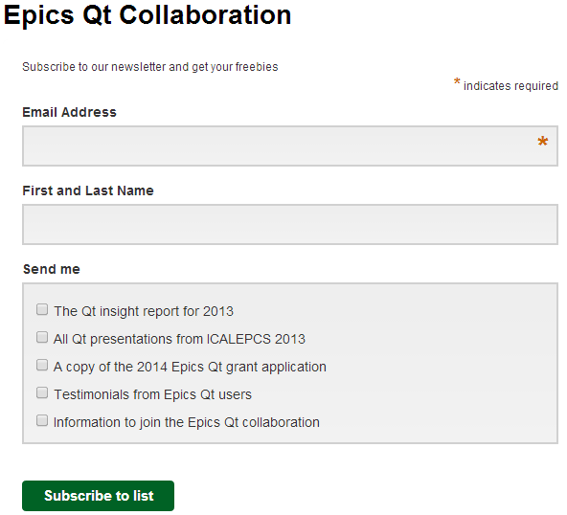
Get involved
Are you interested in Python python@epicsqt.org
Are you interested in the EPICSQt project specifically? andrew.rhyder@epicsqt.org
join@epicsqt.org
www.epicsqt.org
Notes:
Do you want to know more? Do you want to let us know what is on your ‘must have’ list? Do you want to get involved?
Here are some email addresses if you are interested in Python with Qt, The EPICSQt application (merged) or EPICS and Qt generally.
There’s the web site.
Join over 100 other people subscribing to the EPICS Qt newsletter.
And of course, there is me. Please feel free to talk any time.
AreaDetector demo if time
Videos if time
Now’s a good time if you have any questions.

