Slide 1
Modularity and Integration of Instrument Control Hardware at the ESS
Thomas Gahl
Group Leader Motion Control & Automation
www.europeanspallationsource.se
October 23, 2014

Slide 2
Outline
Neutron Production & Instruments at ESS
Modular Instrument Control Concept
Timing System for Synchronisation and Time Stamping
Requirements Motion Control
Organisational Challenges
Internal and external (in-kind) Interfaces
Status Motion Control
Achnowledgements

Slide 3
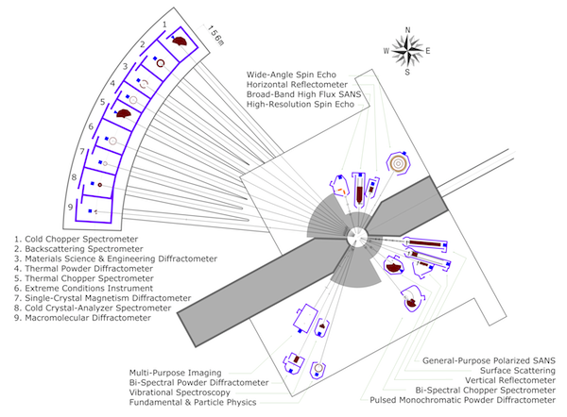
Neutron Instrumentation
Target produces fast neutrons (several GeV, like IFMIF facility)
2 Moderators, slowing down the neutrons into meV and eV range
Neutron Instruments = Neutron Beam Lines
4 Groups of Instruments (different lengths)
p
Notes:
Generic suite of instruments,
Groups with different lengths (30 to 160m)

Slide 4
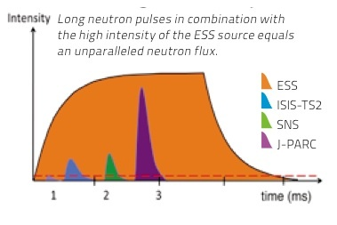
Time Structure of the Neutron Beam
14 Hz rep rate
71.4 ms cycle time
2.86 ms pulse time
4% duty cycle
200 – 2000 m/s
t
3 ms
68 ms
30.5 ms
30.5 ms
d
71 ms

Slide 5
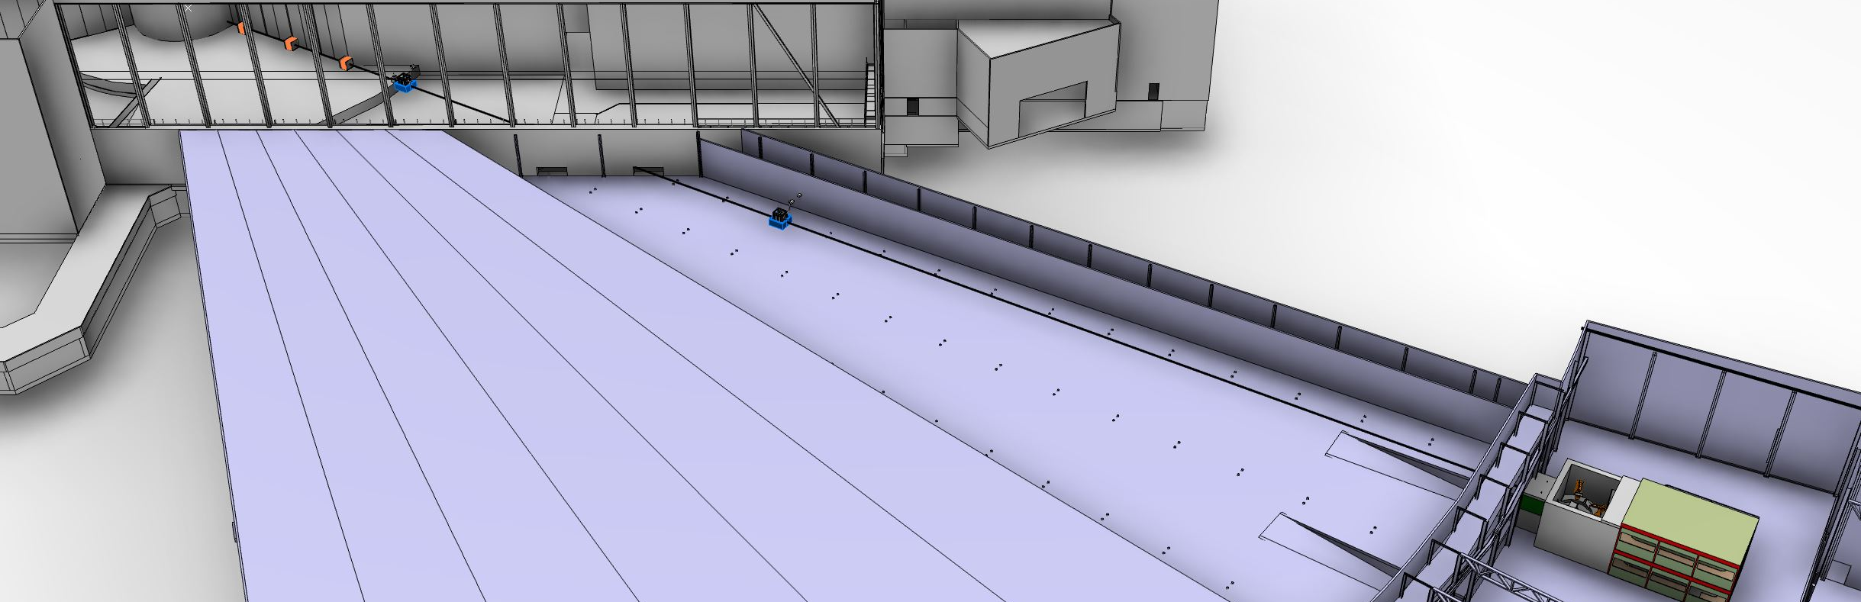
Long Neutron Instrument
160m
n
Beam Extraction + Bunker Area
Beam Transport & Conditioning Area
Sample Area
Notes:
Clear a tendency for higher integration rates within an instrument, across instruments and across the facility
And this hits the reality in ESS instrumentation:
160m over 3 Halls
20 Chopper, remote diagnostics, preemptive maintenance (high availability)
In-kind, external suppliers, decentralised production

Slide 6
Modular Instrument Control Concept
160m
n
EPICS
Timing
CB
CB
CB
CB
CB+
CB
CB
CB
CB
CB+
PSS
Beam Extraction + Bunker Area
Beam Transport & Conditioning Area
Sample Area
Notes:
Backbone are the two networks for EPICS and timing,
Physically one subnet for each instruments, but connectivity to the whole facility
Timing based on Micro Research Finland: one Master generator + timing receiver in each box
Network + Boxes supplied by the Controls Division, Integration shared between Controls and Instrument Teams

Slide 7
Modular Instrument Control Concept
160m
n
EPICS
Timing
CB
CB
CB
CB
CB+
CB
CB
CB
CB
CB+
Shutter
Collimation
PSS
Detector Movement
Chopper
Chopper
Vacuum
Sample
Environment
Beam Extraction + Bunker Area
Beam Transport & Conditioning Area
Sample Area

Slide 8
Modular Instrument Control Concept
160m
n
EPICS
Timing
CB
CB
CB
CB
CB+
CB
CB
CB
CB
CB+
Shutter
Collimation
Monitors
PSS
Detector Movement
Detector
Chopper
Chopper
Vacuum
Sample
Environment
Beam Extraction + Bunker Area
Beam Transport & Conditioning Area
Sample Area

Slide 9
Modular Instrument Control Concept
160m
n
Instrument Control, Data Acquisition, GUI
EPICS
Timing
CB
CB
CB
CB
CB+
CB
CB
CB
CB
CB+
Shutter
Collimation
Monitors
PSS
Detector Movement
Detector
Chopper
Chopper
Vacuum
Sample
Environment
Beam Extraction + Bunker Area
Beam Transport & Conditioning Area
Sample Area
Notes:
3 Layers:
Bottom: local control SW for fast control loops and MPS
Middle: EPICS as transport layer
Top: Instrument Control, Data Aggregator and GUI
Only the top layer brings all functionality together and relates them in the right way:
Example: detector movement
The readout of the detector (as channel number) is relative to its outlines and the transformation into the physical space of the instruments is possible with the help of the position readout from the motion control system and best done by this top layer

Slide 10
Modular Instrument Control Concept
What can (or has to) be done locally will be done locally
Clear functionalities and interfaces for a single box, avoid direct interconnects
Linked together by an already existing facility wide network infrastructure
160m
n
Instrument Control, Data Acquisition, GUI
EPICS
Timing
CB
CB
CB
CB
CB+
CB
CB
CB
CB
CB+
Shutter
Collimation
Monitors
PSS
Detector Movement
Detector
Chopper
Chopper
Vacuum
Sample
Environment
Beam Extraction + Bunker Area
Beam Transport & Conditioning Area
Sample Area
Notes:
Summ-Up:
Everything that can be done (or has to be done) locally will be done locally (in one of the colored boxes), everything that has to be related to signals or data from other boxes has to be time stamped and sent to the Instrument Control/ Data Acquisition layer
That gives clear functionalities and clear interfaces for single boxes, easy to specify and to bring in as in-kind contributions or from suppliers
All modules are linked together by the Instrument Control/ Data Acquisition Software, it’s a crucial part of the instrument and will be tailored to the needs of each instrument
That’s gives the flexibility necessary to adapt the same hardware to each of the ESS instruments: the hardware is done once and prepared for all future (hi-level) functionalities

Slide 11
Diagnostics
160m
1
n
Instrument Control, Data Acquisition, GUI
2
EPICS
Timing
CB
CB
CB
CB
CB+
CB
CB
CB
CB
CB+
3
Shutter
Collimation
Monitors
PSS
Detector Movement
Detector
Chopper
Chopper
Vacuum
Sample
Environment
Beam Extraction + Bunker Area
Beam Transport & Conditioning Area
Sample Area

Slide 12
Requirements on Timing System
Coupling of all timing to one single source
Everywhere in the facility available, (time-) compensated cable lengths
Jitter 10 ns, precision of time stamp 100 ns
Master CLOCK 88 Mhz
Custom CLOCK i.e. 10 khz
Master Pulse, 14 Hz
Custom Pulse,
n x 14 Hz
Master Pulse with delay Δt n
Δt n
t

Slide 13
Motion Control: Time Stamping
EPICS
Transfer absolute timing information from Control Box to the local HW control unit:
Synchronise a timer on the control unit
Timestamp in the control unit direct readings of the sensor with minimal latencies
Transfer the sensor readings through the Control Box into EPICS
Synchronously vs. asynchronously
Timing
Control Box
Pulse (14 Hz)
Clock
Command Interface
Motion Control Unit
Timer
Stamping
Motor
Encoder
Notes:
Introduce to functionalities in the control unit:
Timer + timestamping
Synchron: With a fixed sample rate, might be synchronised with 14 Hz or not, i.e. repetitive analog signal like oscillation or movement with constant speed
Asynchron: With a fixed delta of a value: Each time when the value changes a certain amount a sample is taken (more often with rapid changes)

Slide 14
Motion Control: Time Stamping
EPICS
Transfer absolute timing information from Control Box to the local HW control unit:
Synchronise a timer on the control unit
Timestamp in the control unit direct readings of the sensor with minimal latencies
Transfer the sensor readings through the Control Box into EPICS
Synchronously vs. asynchronously
Local distribution of control unit functionalities with real time field busses
Timing
Control Box
Pulse (14 Hz)
Clock
Command Interface
Motion Control Unit
Timer
Stamping
RT Field Bus
(i.e. ETHERCAT)
Driver
I/O
Motor
Encoder

Slide 15
Motion Control: Top Requirements
Time stamping + 14 Hz synchronisation
Multi-axes synchronisation
Free configurable trajectories
Decentralisation through field bus with real-time capabilities
Modular and scalable (in terms of performance and price)
Diagnostics (preemptive maintenance)
EPICS integration
Components for high radiation environment
Stepper motors, DC, DC brushless, piezo
Encoder inc. quad., abs. SSI, resolver, (analog), (BiSS-C)

Slide 16
Organisational Challenges: Time Line
Prepare & standardise technologies before instruments are built
2012 | 2013 | 2014 | 2015 | 2016 | 2017 | 2018 | 2019 | 2020 | 2021 | 2022 | 2023 | 2024 | 2025 | 2026 | 2027
Operation
Instrument Development
Construction
3
4
2
3
2
3
3
2

Slide 17
Organisational Challenges: Internal Interfaces
Strong interaction between machine and beam line tech groups
Building overlapping interfaces

Slide 18
Organisational Challenges: Internal Interfaces
Strong interaction between machine and beam line tech groups
Building overlapping interfaces
DMSC
Instrument Control, Data Acquisition, GUI
ICS
CB
CB
Technology Groups
Motion
Control
Sample
Environment

Slide 19
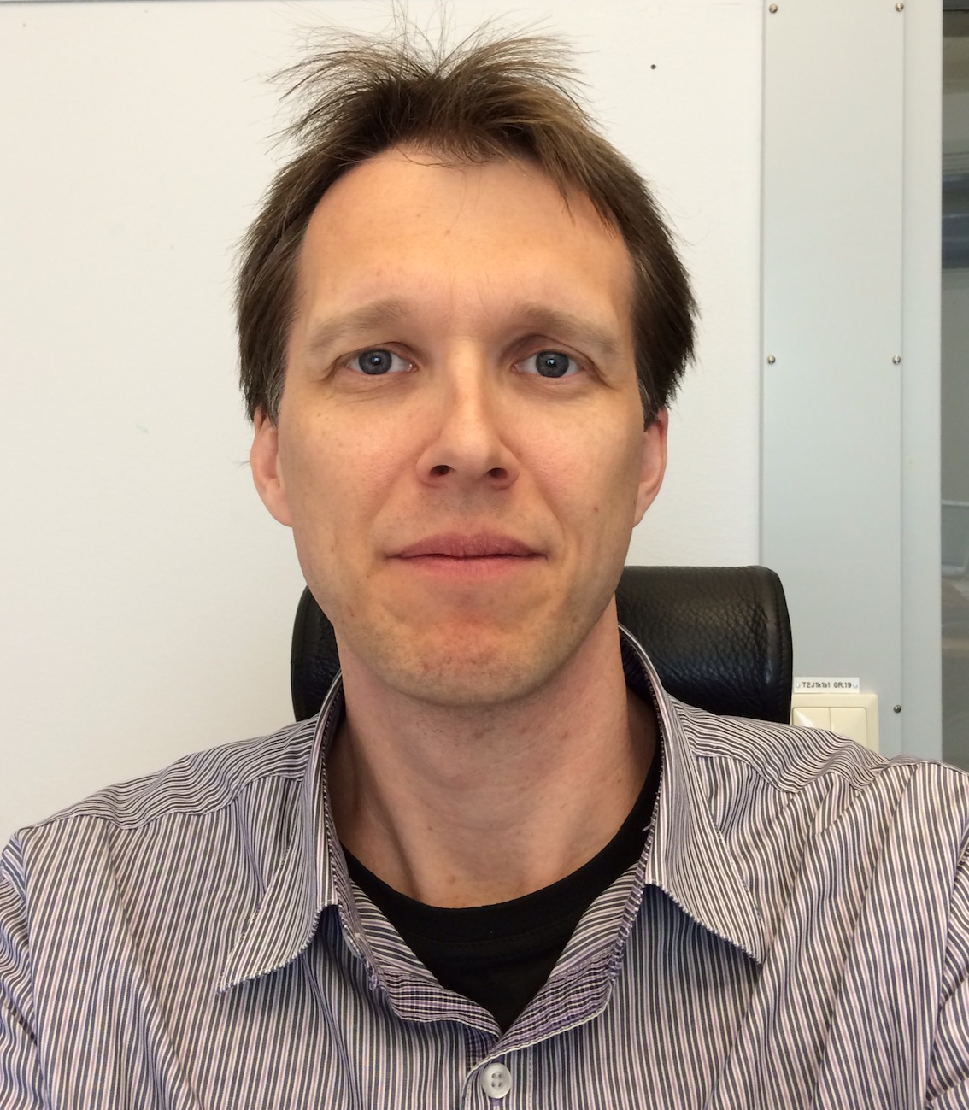
Organisational Challenges: Internal Interfaces
Strong interaction between machine and beam line tech groups
Building overlapping interfaces
DMSC
Mark Hagen
Instrument Control, Data Acquisition, GUI
Timo Korhonen
ICS
CB
CB
Technology Groups
Torsten
Bögershausen
Anders
Petersson
Motion
Control
Sample
Environment

Slide 20
Organisational Challenges: External
17 European partner countries
70 % of Neutron Instrumentation is in-kind
Ranges from whole instruments to single modules
Strong standardisation necessary (hardware list)
+ good definition of functionality and interfaces
Support of partners in testing their modules

Slide 21
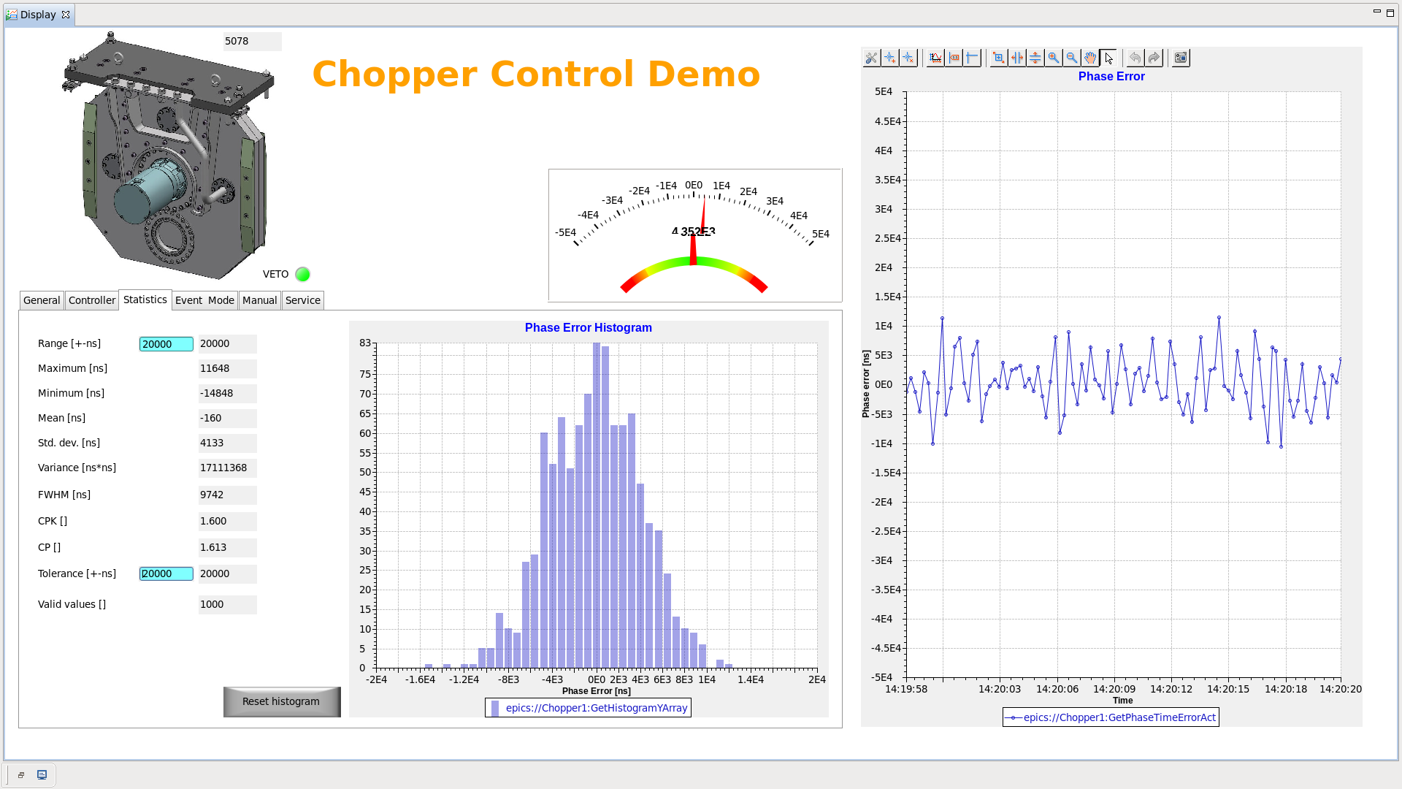
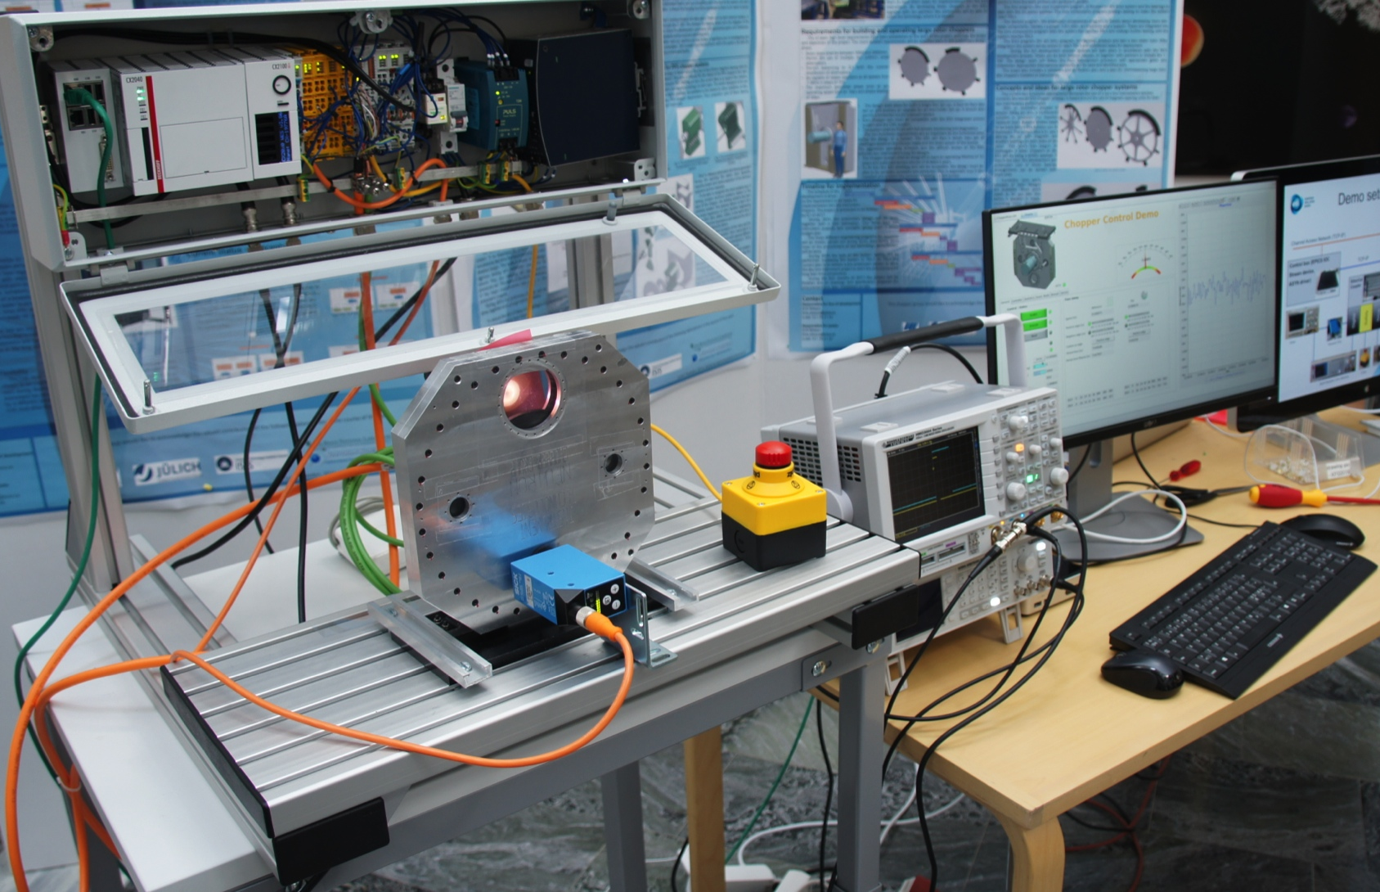
Motion Control: Status
Started with Delta Tau Geobrick for Test Stands and Demonstrators
Market survey / Requirements catalog
First steps in practical evaluation (Delta Tau Powerbrick, Beckhoff)
Integration of a Beckhoff ETHERCAT system into EPICS (TwinCat)
First application as chopper control demonstrator

Slide 22
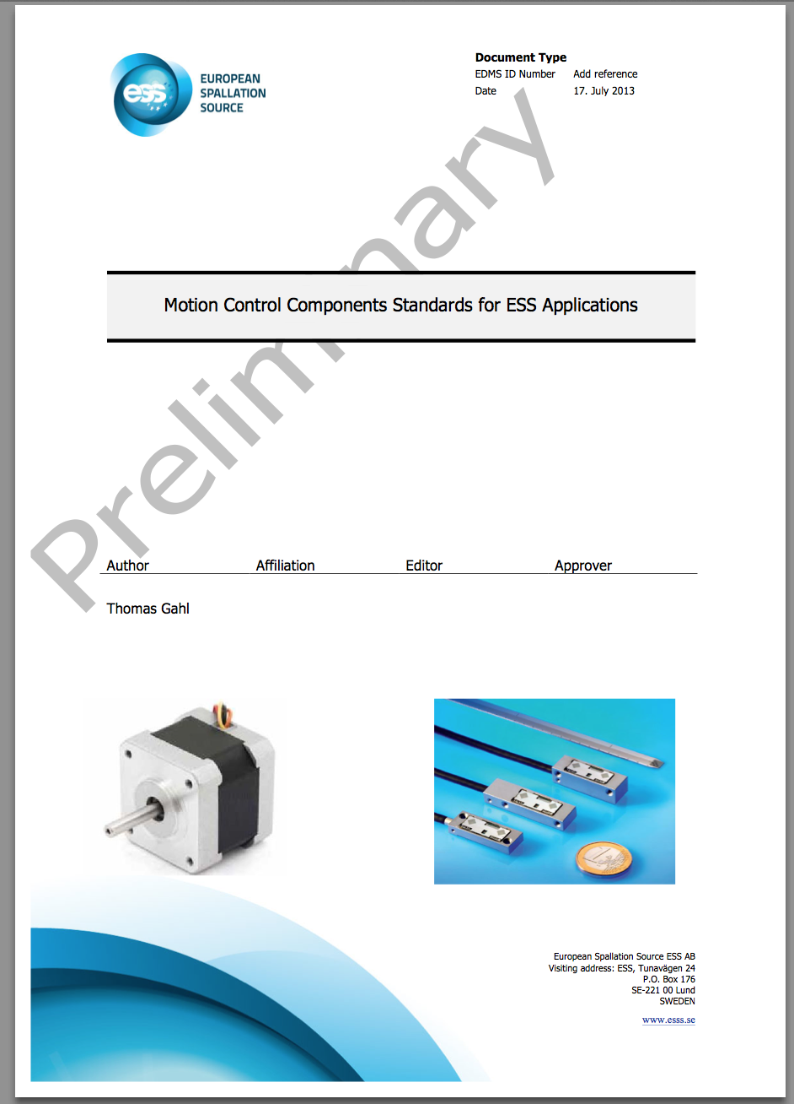
Motion Control: A path to an ESS Standard
Hardware Harmonisation Work Group @ESS
Collecting use cases from stake holders
Refine requirements catalog
Select candidates for practical evaluation
Coordinate evaluation/selection with stake holders and collaborators
Workshop in 2015 (2nd half) >> common decision on MCU standard
Issue Standard Document Motor/Encoder
Issue Standard Document Motion Control Unit
Framework agreement with supplier (incl. possible deliveries to in-kind partners)

Slide 23
Thanks to
Motion Control & Automation Group
(Anders Sandström, Paul Barron, Torsten Bögershausen, Markus Larsson)
Sample Environments Group
(Anders Petersson)
Integrated Control Systems Division, Detector Group, Chopper Group, DMSC
Other colleagues on various institutes and facilities
(among others: Mark Könnecke-PSI, Steve Cox-ISIS, Brian Nutter-Diamond)

Slide 24
Thanks to
… and you!
Notes:
Thank you very much and I’m open for questions…

Slide 25
ESS Instrument Control - Details for Motion Control-
Thomas Gahl
Group Leader Motion Control & Automation
www.europeanspallationsource.se
September 16, 2014

Slide 26
Synchronising Motion Control (multiple axes)
14 Hz pulse (to synchronise movements with neutron pulse)
10 kHz as masterclock (to synchronise multi-axes systems)
≈1 Hz or slower pulse + reading of the appropriated absolute time over EPICS (to synchronise internal timer)
Master CLOCK 88 Mhz
Custom CLOCK i.e. 10 khz
Master Pulse, 14 Hz
Master Pulse, 1 Hz
t

Slide 27
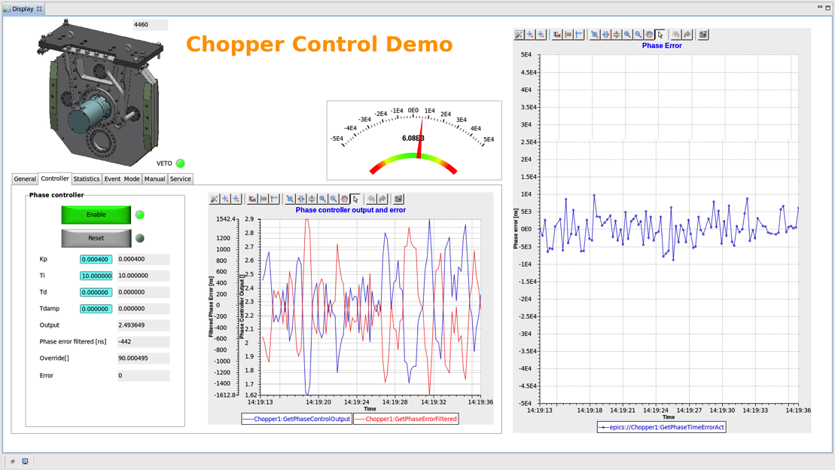
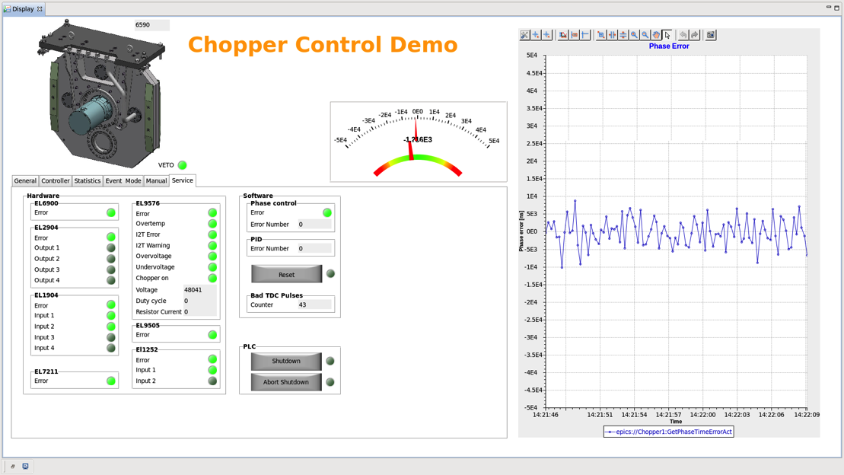
Chopper Control Demo
Development of a motion control for a ¼ scale chopper model and integration in an EPICS environment; interfaces and functionality according to ESS standards
Demonstration model at IKON7 and DENIM conference in Munich, Germany
Screenshots of User Interfaces

Slide 30
ESS Instrument Control - Use cases-
Thomas Gahl
Group Leader Motion Control & Automation
www.europeanspallationsource.se
September 16, 2014

Slide 31
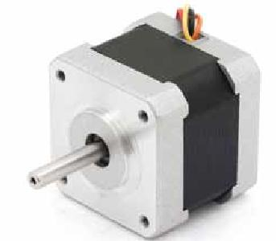
Taking data on the fly
Custom CLOCK i.e. 10 khz
Motion Control (positions)
+151
+651
+151
+651
+151
+651
+651
+079
+xxx
+xxx
+098
+xxx
+xxx
+xxx
+036
+xxx
+xxx
+xxx
+085
+xxx
+xxx
+xxx
Detectors, Monitors (neutron events)
+xxx
+xxx
+xxx
+xxx
+xxx
+xxx
+xxx
+xxx
+xxx
+xxx
+xxx
+xxx
+xxx
+xxx
+xxx
+xxx
+xxx
+xxx
+xxx
+xxx
+xxx
AAZ1+000
AAZ2+000
AAZ3+000
AAZ4+000
ESS Timing System, 14 Hz
(Proton Pulse)
Notes:
Use cases: Most obvious from Automation point of view: Why not move and take data at the same time? Each machine in the industry is doing…
Move one or even more axes at the same time, synchronised
And take Neutron data and motor positions at the same time
Automatic scans are possible where the speed is determined by the the count rate and the statistics and the sampling rate of the position by the wanted precision in space (for a given speed)
Non-linear relation between axes possible, something like constant energy scans

Slide 32
Stroboscopic Mode (Sample Environment)
+xxx
+xxx
+xxx
+xxx
Tensile load frame
(force, torque)
+xxx
+xxx
+xxx
+068
+xxx
+079
+xxx
+xxx
+098
+xxx
+xxx
+xxx
+036
+xxx
+xxx
+xxx
+085
+xxx
+xxx
+xxx
Detectors, Monitors (neutron events)
+xxx
+xxx
+xxx
+xxx
+xxx
+xxx
+xxx
+xxx
+xxx
+xxx
+xxx
+xxx
+xxx
+xxx
+xxx
+xxx
+xxx
+xxx
+xxx
+xxx
+xxx
AAZ1+000
AAZ2+000
AAZ3+000
AAZ4+000
ESS Timing System, 14 Hz
(Proton Pulse)

Slide 33
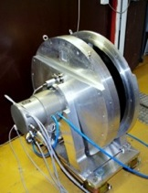
Flexible Chopper Veto
+498
+495
+510
+510
Chopper (TDC signal)
Nominal Value
+500
+500
+500
+500
+079
+xxx
+xxx
+098
+xxx
+xxx
+xxx
+036
+xxx
+xxx
+xxx
+085
+xxx
+xxx
+xxx
Detectors, Monitors (neutron events)
+xxx
+xxx
+xxx
+xxx
+xxx
+xxx
+xxx
+xxx
+xxx
+xxx
+xxx
+xxx
+xxx
+xxx
+xxx
+xxx
+xxx
+xxx
+xxx
+xxx
+xxx
AAZ1+000
AAZ2+000
AAZ3+000
AAZ4+000
ESS Timing System, 14 Hz
(Proton Pulse)
Notes:
TDC signal could be an extra sensor outside the control electronics of the chopper motor:
Group results afterwards:
First class data -- 498
Second class data -- 495
Third class data -- 510
rubbish

Slide 34
Diagnostics (Chopper Systems and Beam Transport)
Chopper n (TDC signal)
+402
+xxx
+450
+xxx
+395
+xxx
+455
+xxx
+xxx
+xxx
+xxx
+xxx
Monitor 2 (neutron events)
+xxx
+xxx
+xxx
+xxx
+498
+497
+498
+495
Chopper 2 (TDC signal)
+275
+xxx
+098
+xxx
+036
+xxx
+085
+xxx
+xxx
+xxx
+xxx
+xxx
Monitor 1 (neutron events)
+xxx
+xxx
+xxx
+xxx
+331
+333
+330
+332
Chopper 1 (TDC signal)
AAZ1+000
AAZ2+000
AAZ3+000
AAZ4+000
ESS Timing System, 14 Hz
(Proton Pulse)
Notes:
One neutron monitor behind each chopper: neutron flux through window
Even think on a gamma monitor on the chopper, showing the effect of neutrons hitting the disc
Give time structure to monitor data and relate them to the corresponding
Use only monitor data within the time window (reduce background)
If considerable data is outside time window: Problem!
If number of counts is outside the ratio of

Slide 35
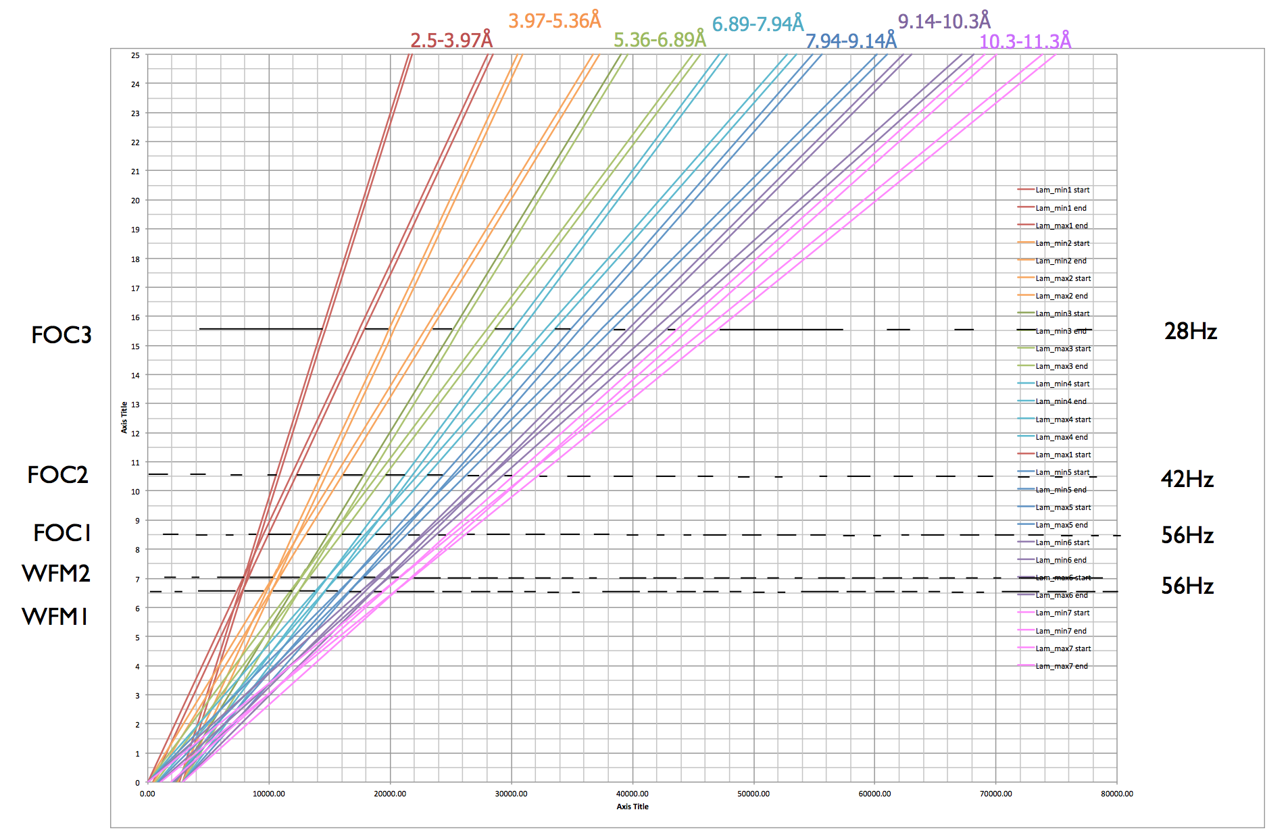
Diagnostics (Wavelength Frame Multiplication Chopper)
Notes:
In this case the count rate in all 5 monitors should be the same (minus the loss in the beam transport)
Or the sensitivity of the monitor has changed!

Slide 36
Opportunities
Well defined modularity
Flexibility (Operation & Add-ons)
Higher availability
Better use of available beam time
Recover data
Advanced diagnostics

Slide 37
Challenges & Risks
Handling large data streams
Failing of central services (like timing system)
New kind of data mining / data sorting SW necessary, has to be adapted to each functionality individually
Latency must be very well understood
Notes:
I understand that we load a lot of responsibility to the SW people, in our case the DMSC
I know that in times of troubles there is always an arguing: is the problem on my side or on your side of the interface
But if we stand together from the beginning, develop and implement ideas together than I’m convinced we will succeed in presenting ESS users new capabilities in instrument control
If we have –straight from the beginning- the right HW in place, we can gradually implement the functionality of the instruments by implementing basic SW first and complement them with advanced features at a later stage.
And I would be very happy if we get input from you as experienced users for other new exiting use cases

Slide 38
Time Stamping (Event Mode)
AAZ1+000
AAZ2+000
AAZ3+000
AAZ4+000
ESS Timing System, 14 Hz
(Proton Pulse)
+079
+xxx
+xxx
+098
+xxx
+xxx
+xxx
+036
+xxx
+xxx
+xxx
+085
+xxx
+xxx
+xxx
Detectors, Monitors (neutron events)
+xxx
+xxx
+xxx
+xxx
+xxx
+xxx
+xxx
+xxx
+xxx
+xxx
+xxx
+xxx
+xxx
+xxx
+xxx
+xxx
+xxx
+xxx
+xxx
+xxx
+xxx

Slide 39
Time Stamping (Event Mode)
AAZ1+000
AAZ2+000
AAZ3+000
AAZ4+000
ESS Timing System, 14 Hz
(Proton Pulse)
+079
+xxx
+xxx
+098
+xxx
+xxx
+xxx
+036
+xxx
+xxx
+xxx
+085
+xxx
+xxx
+xxx
Detectors, Monitors (neutron events)
+xxx
+xxx
+xxx
+xxx
+xxx
+xxx
+xxx
+xxx
+xxx
+xxx
+xxx
+xxx
+xxx
+xxx
+xxx
+xxx
+xxx
+xxx
+xxx
+xxx
+xxx
+498
+497
+498
+495
Chopper (TDC signal)

Slide 40
Time Stamping (Event Mode)
AAZ1+000
AAZ2+000
AAZ3+000
AAZ4+000
ESS Timing System, 14 Hz
(Proton Pulse)
+079
+xxx
+xxx
+098
+xxx
+xxx
+xxx
+036
+xxx
+xxx
+xxx
+085
+xxx
+xxx
+xxx
Detectors, Monitors (neutron events)
+xxx
+xxx
+xxx
+xxx
+xxx
+xxx
+xxx
+xxx
+xxx
+xxx
+xxx
+xxx
+xxx
+xxx
+xxx
+xxx
+xxx
+xxx
+xxx
+xxx
+xxx
+498
+497
+498
+495
Chopper (TDC signal)
+xxx
+xxx
+xxx
+xxx
Strain Scanner (force, torque)
+xxx
+xxx
+xxx
+068
+xxx

Slide 41
Time Stamping (Event Mode)
AAZ1+000
AAZ2+000
AAZ3+000
AAZ4+000
ESS Timing System, 14 Hz
(Proton Pulse)
+079
+xxx
+xxx
+098
+xxx
+xxx
+xxx
+036
+xxx
+xxx
+xxx
+085
+xxx
+xxx
+xxx
Detectors, Monitors (neutron events)
+xxx
+xxx
+xxx
+xxx
+xxx
+xxx
+xxx
+xxx
+xxx
+xxx
+xxx
+xxx
+xxx
+xxx
+xxx
+xxx
+xxx
+xxx
+xxx
+xxx
+xxx
+498
+497
+498
+495
Chopper (TDC signal)
+xxx
+xxx
+xxx
+xxx
Strain Scanner (force, torque)
+xxx
+xxx
+xxx
+068
+xxx
Motion Control (positions)
+151
+651
+151
+651
+151
+651
+151
+651

