Slide 1
CS-Studio PVTable and Autosave
Kay Kasemir
Oct. 2014

Slide 2
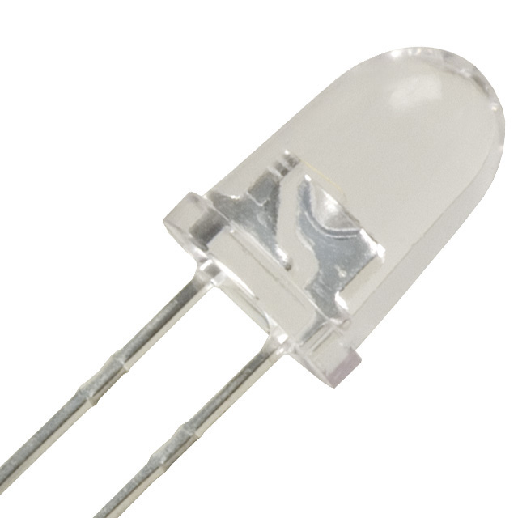
EPICS Autosave
By Tim Mooney, APS/AOD/BCDA
“Bumpless Reboot”
Since 5.1, May 2013: “configMenu”
Manually save/restore sets of PVs
CS-Studio PV Table
Manually save/restore sets of PVs
With comparison
.. Partial restore

Slide 3
CS-Studio PVTable Update
Load & Save *.sav files
In addition to original *.pvs format
Supports array channels
BYTE array that contains only ASCII displayed as text
Allows entering current value
Enums offered as list

