Slide 1
Control System Studio Status
Eric Berryman Controls Engineer

Slide 2
History and Future
In the past we had problems
No traceability
Without a framework for unit testing on Jenkins
Anyone could commit on master, with whatever changes
Communication problems
Went too long without a release
We started looking into the ISO 9001 Quality Standard one year ago

Slide 3
Where are we now?

Slide 4
Where are we now?

Slide 5
Where are we now?

Slide 6
Where are we now?

Slide 7
Where are we now?

Slide 8
ISO 9001 Quality Standard
Following as a guideline to improve quality
Management Review
Quality Policy and Objectives
Process Performance and Product Conformity
Status of Corrective and Preventative Actions
Customer Feedback Analysis
Decisions and Actions for improvements
Resource needs
Continual Improvement of the Quality System
Customers
Management Responsibility
Customers
Resource Management
Measurement, Analysis and Improvement
Satisfaction
Requirements
Product Realization
Product
information
activities
taken from ISO 9001

Slide 9
Management Review Meeting

Slide 10
CS-Studio Quality Policy and Objectives
Through a strategy of continuous improvement and teamwork, the Control System Studio Collaboration is dedicated to supplying tools for control systems, data integration and data visualization to enable our users to achieve their scientific objectives.
The foundation for achieving our commitment is based on:
understanding and meeting the requirements of our users,
continuously improving all processes related to the Control System Studio product,
effectively utilizing the creative talents in the collaboration
and meeting statutory, regulatory, and other requirements.
Objectives
Fraction of releases per site deployed vs releases considered for deployment minimum 75% within registered site representatives
100% sites with registered site representatives moved to Tycho

Slide 11
Customer Feedback

Slide 12
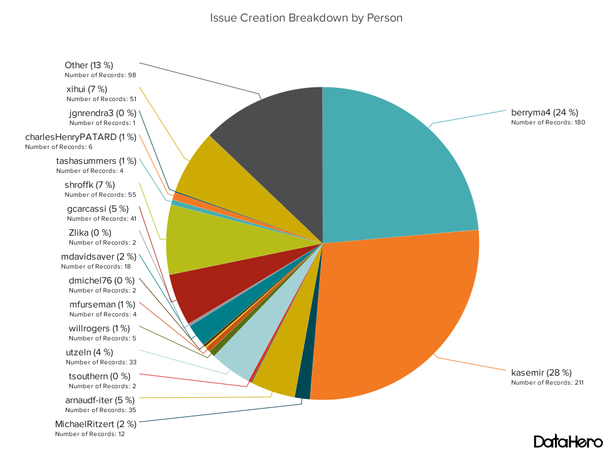
Status of Preventative and Corrective Actions

Slide 13
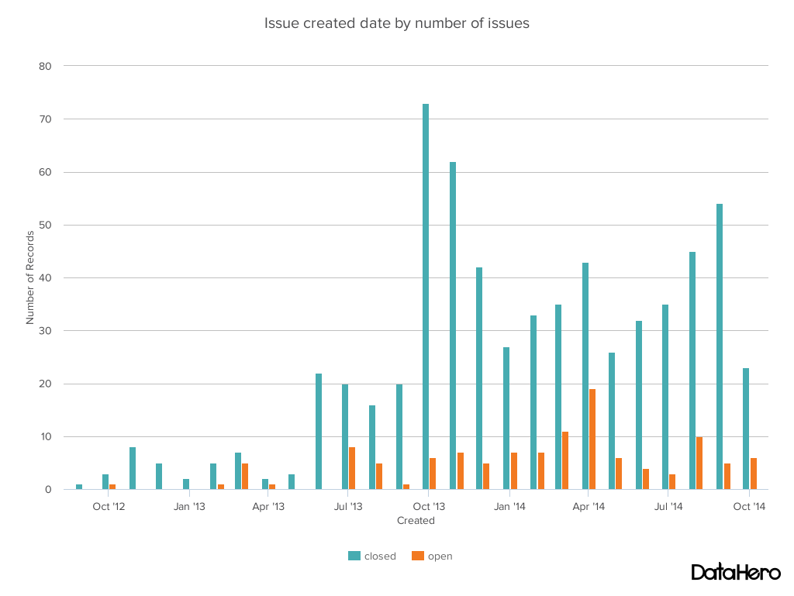
Status of Preventative and Corrective Actions
Total closed | 644 (85%)
Total open | 118 (15%)

Slide 14
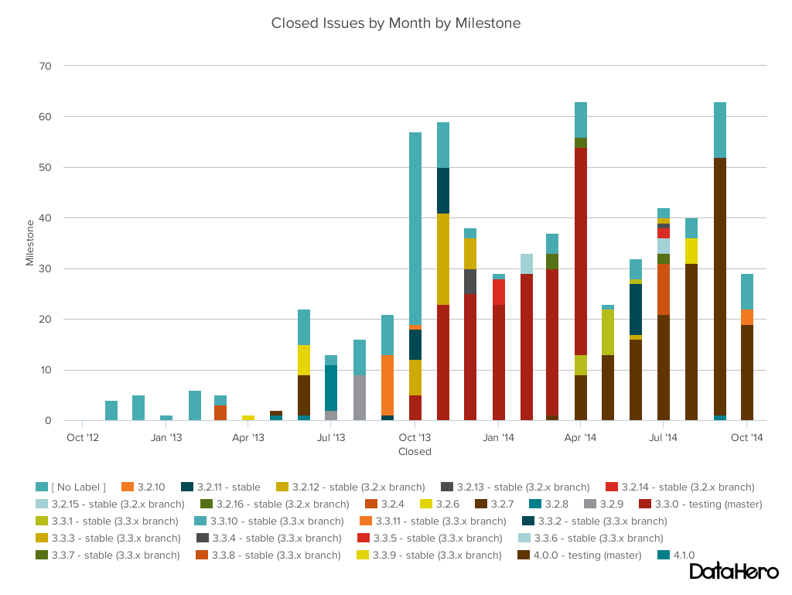
Status of Preventative and Corrective Actions

Slide 15
Results of Audits
First audit was started last week
Site Representatives were emailed a form to fill out from the FRIB Quality Manager
The processes are being audited, not the people
Suggestions for improvements on our processes
Results will be shared with the Site Representatives, and any issues or suggestions for improvements will be made into Github issues

Slide 16
Actions for Improvement
Issue of people working in a box for projects then, integrating too late.
lead should form a team, for weekly meeting, progress at monthly meeting
Document process
Change to google spreadsheet with links (format change)
Make more clear
Bug reports to Github issues
User question to tech talk (close cs-studio-users)
cs-studio-core build issues and development
Maintenance Process
Move open issues from milestone to backlog, not the next milestone (Unless owner confirms)
Tag all repositories on releases
Development Process
On demand (preferred Monday before Wednesday meeting) meeting for demonstrating project work

Slide 17
Resource Needs
BOY person still needed (interim still: BNL (RCP), ITER (RAP))
If work can be packaged, contract work

Slide 18
3.3.x (stable)
3.3.x marked feature complete as of April 30th, only accepting pull request that fix issues/performance
PVManager functions for arrays– FRIB / NSLSII
Tycho build – DESY / CosyLab / FRIB
Autocomplete – ITER
PVManager time cache (design plan) – ITER / NSLSII
Shift service integration – NSLSII
Archive Appliance Databrowser plugin – FRIB / CosyLab
Validation and Verification Plan – ESS / CosyLab
OPI regression tests – NSLSII
Requests from last meeting (ICALEPCS 2013)
Multi state led in BOY – FRIB
BOY template iterator application – FRIB

Slide 19
3.3.x (stable)
Validation and Verification Plan – ESS / CosyLab
Using Maven Tycho build
Jenkins for continuous integration
Surefire for code coverage
SonarQube for static code analysis

Slide 20
4.0.x (testing)
4.0.x marked feature complete October*
Move to eclipse 4.4 (Lead: SNS(RCP), ITER(RAP))
Feature clean up (owner of the feature/application) (Lead: BNL)
Implement Validation and Verification plan (Lead: ESS / CosyLab)
CS-Studio development environment (Lead: FRIB - Reviewers: SNS, BNL)
Common product (Lead: FRIB - Reviewers: SNS, BNL)
We will delay up to another 2 months
feature cleanup and reorganization (Lead: BNL – Reviewer: FRIB)
rap build (Lead: ITER – Reviewer: SNS)
Validate Unit tests (Lead: FRIB – Reviewer: ESS)

Slide 21
4.1.x (unstable)
4.1.x due date 6 months after 4.0.x freezes
Move sites to Tycho/Maven (Lead: FRIB)
Validate unit tests (Lead: FRIB – Reviewers: ESS)
Java 8 branch use of Instant and Period (Lead: BNL – Reviewer: SNS)
Review javafx table; tables throughout cs-studio (Lead: BNL – Reviewers: SNS)
Perspectives for Operational use (Lead: SNS – Reviewers: BNL and FRIB)
OSGI diirt bundles (Lead: BNL/FRIB – Reviewer: SNS)
Review VTypes for Java 8 (Lead: BNL – Reviewer: SNS)
Diirt Time cache (Lead: ? – Reviewer: BNL)
Databrowser rework of plot, model load/save (Lead: SNS – Reviewer: ISIS)
OPI Examples with good practices (Lead: ? – Reviewers: SNS, BNL)
Save/Set/Restore UI (Lead: FRIB – Reviewer: BNL)
Uniform properties; java properties, eclipse properties, third-party (Lead: BNL – Reviewer: ?)

Slide 22
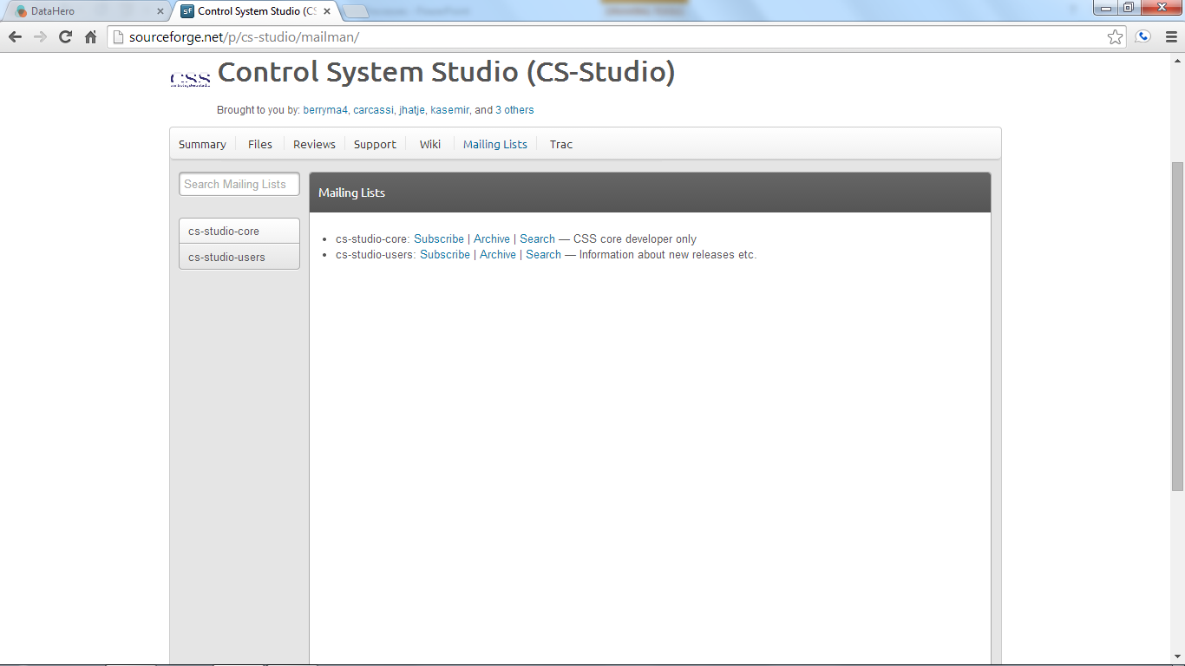
Mailing List
Subscribe at Sourceforge for question about build and development
http://sourceforge.net/p/cs-studio/mailman/
cs-studio-core@lists.sourceforge.net
Subscribe to tech-talk for user questions

Slide 23
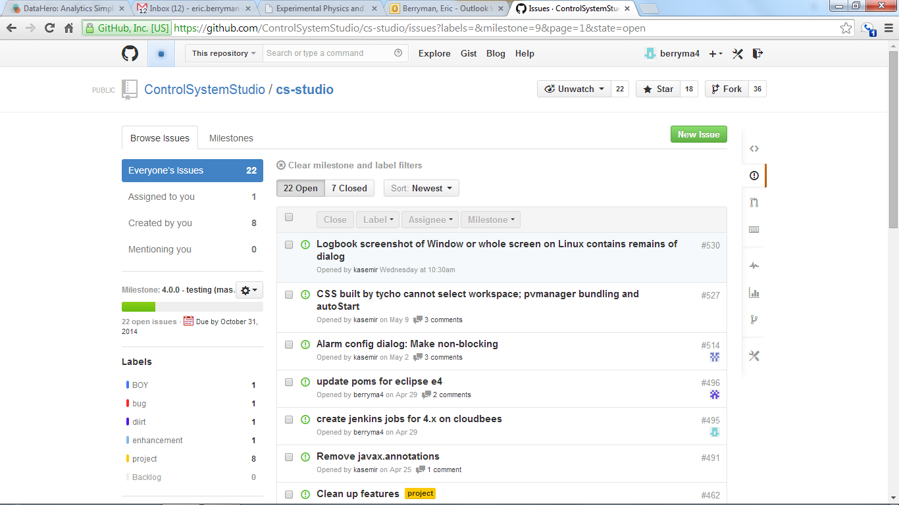
Github Issues
Report bugs to Github (or pick one to work on)
https://github.com/ControlSystemStudio/cs-studio/issues

Slide 24
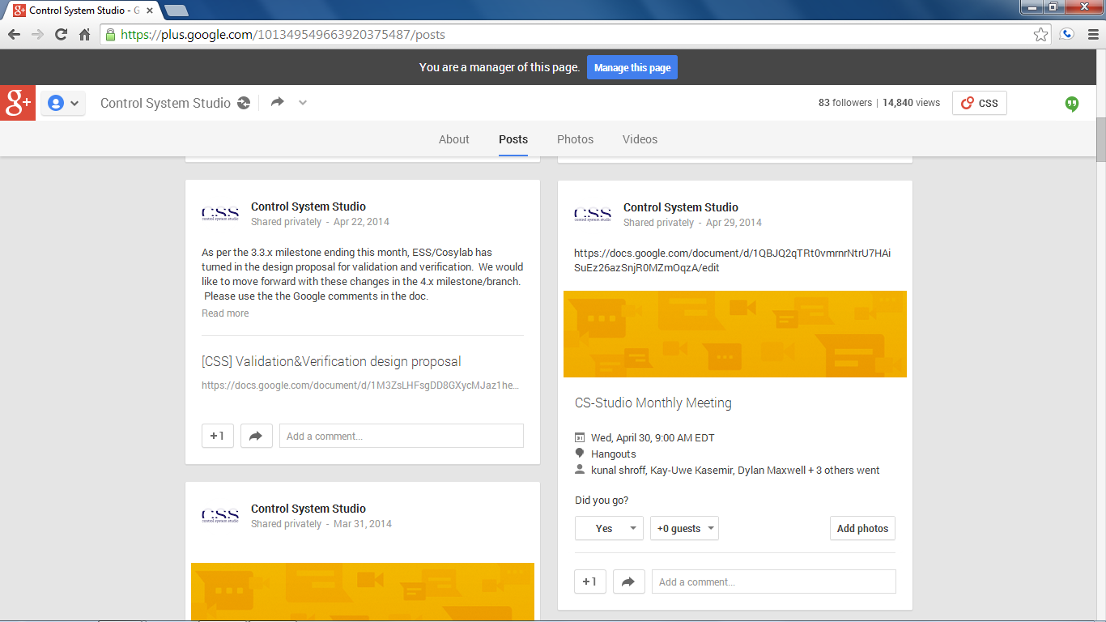
Attend Meetings
We use Google Hangouts to share our progress and discuss issues
Follow us on Google Plus
https://plus.google.com/101349549663920375487/posts
Meetings are posted (viewable after being added to group)

Slide 25
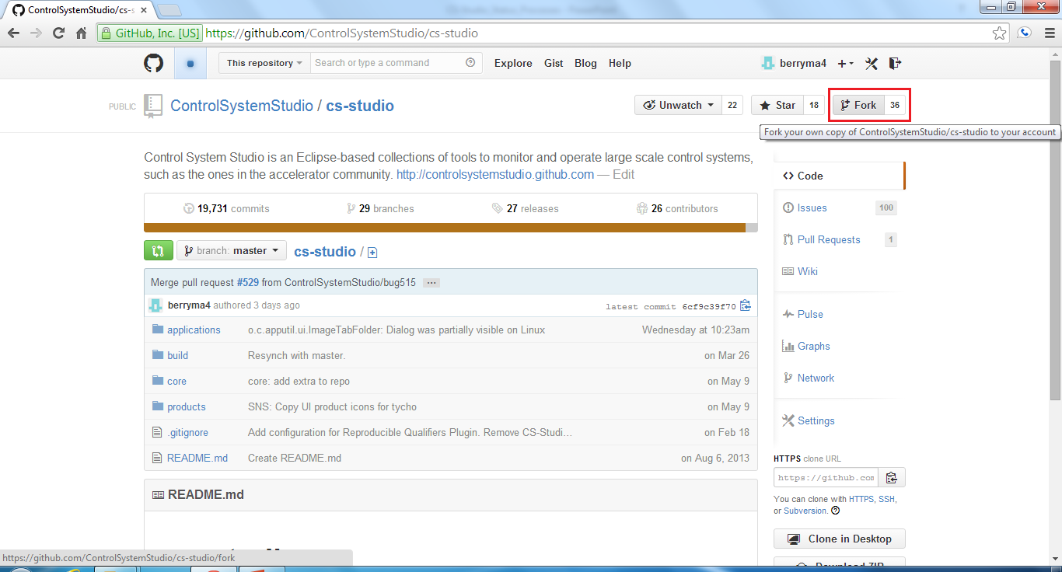
Fork Us on Github
Just go to the git repository you would like to work with
https://github.com/ControlSystemStudio/cs-studio
Basic workflow
“Fork” button -> issue -> associated commit -> pull requests -> merge

Slide 26
Our Website

Slide 27
Our Website

Slide 28
Our Website

