Slide 1
pvmanager status with tool strategy and architecture
Gabriele Carcassi - BNL

Slide 2
Architecture objectives
Architecture that can last for the next decade
  A place for everything and everything in the right place
Modularity
  Allow small contributions
  Lower the risk, compartmentalize failure
  Cooperate on parts common to other labs without forcing the whole
Allows use of coming technologies
  Multi-core
  High-resolution displays
  Tablets
  GPU

Slide 3
pvmanager timeline
2013/2
v2.0
Major refactoring
PVA support
Non-channel data
Channel debug info
Dynamic PV map
v0.1 2010/10
Queuing/caching
Rate handling
Aggregation
CA support
2011/9
v1.0
Write support
Timeout
v0.3 2010/11
Error handling
Performance
v2.2 2013/6
Services
JDBC Services
CSV
v0.5 2011/5
2010
2011
2012
2013
2014
2010/2
First skeleton
v1.1 2012/8
epics-util
graphene
Formulas
Pause/resume
Datasource ease-of-impl
v2.1 2013/3
v0.4 2011/1
Waterfall
v2.3 2013/10
Exec services
v0.2 2010/11
Sim support

Slide 4
Publish/subscribe
v3
v4
IOC
IOC
…
IOC
IOC
…
CS-Studio core
CS-Studio
General purpose clients
CA client (JCA/CAJ)
pvA client
BOY
DataBrowser
Command/response
Core Java Client
…
v4
ca
pva
…
Data Sources
Masar
API
pvmanager core
Aggregation
vTypes
Data Definition
…
…
Specialized clients
formula
Processing
Log Viewer
graphene
Visualization
AccelUtils
Channel Viewer
pvm services
Registry
Web based REST services
masar
cf
…
Bindings
…
ChannelFinder
API
NEW!
NEW!
Olog
API
Databases
Command-line
...
…

Slide 5

New in pvmanager ca datasource
No resources to officially support JCA (CAJ only)
  It kind of works, but no time to make sure it does
    Couldn’t even get it to work on Win64
  JCA has 2 or 3 actual implementation inside. CAJ has one. All these implementations do not follow the same multi-threading semantic
    You can’t be sure on what thread you are notified and with what lock
  It makes it impossible to have one implementation for everything that is both correct and efficient
  Better to invest the time in just one version and fix all the outstanding issues there
Maintainer for JCA (JNI) and pvmanager integration

Slide 6
New in pvmanager ca datasource
Improvements in CAJ (Murali + Matej + Gabriele)
  More efficient handling of large arrays (not so new)
  More uniform to C client library (not so new)
    DBE_PROPERTY support
    Variable sized array
    MAX_ARRAY_BYTES
  Fixing hard to reproduce bugs
    Infinte loop in reconnect
    Large number (750000) of channels connecting to the gateway
Improvements in CA pvmanager datasource
  Encapsulate “quirks” from CA (not so new)
    Value only for RTYP
    Long string support (reads VString from byte array)
    Can choose between put and put-with-callback
    Autodetects if var array is supported
  Metadata monitor (not so new)
  Various bug fixes and performance improvements from usage (not so new)
    Lower connection priority for large arrays
Murali and Matej are awesome!

Slide 7
New in pvmanager pva datasource
Support for EPICS v4 pvAccess (in CS-Studio)
  Publish/subscribe support (see later for services)
Types supported:
  Scalar (VNumber, VEnum and VString)
  Array (VNumberArray and VStringArray)
  Table
  Matrices (VNumberArray 2D)
  Images
Work done Matej

Slide 8
New file datasource
File datasource, allows to read files
  file://path/to/file
  Parses CSV tables
  Handles images (png, bmp)
It’s mainly a stub
  Add notification if file is update
  Improve CSV parsing
  Support for other files (matlab, excel, HDF5, …)
Looking for volunteer to expand it

Slide 9
Goals for pvmanager core
Provide logic required by well-behaved application
  Queuing or caching
  Rate decoupling between subsystems (typically CA and UI, but also CA and anything else)
  Rate limiting (notification rate capped)
  Rate throttling (notification rate adapts, skips instead of building up lag)
  Shared connections (similar requests on a single monitor)
  Ability to offload work on a shared pool
You still need to understand what all of this is
You just don’t have to implement it

Slide 10
New in pvmanager core
Becoming the main way to access data in CS-Studio
Significant refactoring in 2.0 (02/2013)
  Cleaner interface
  Dynamic map
    add/remove pvs, always get a single event with all values
  Channels can report properties for extra debugging information

Slide 11
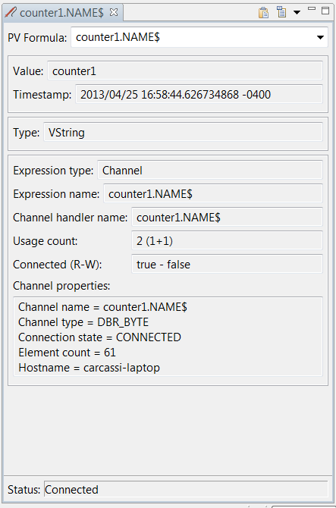
New in pvmanager core
Probe can display the extra properties
Note the long string support:
  The value is vString
  The channel type is DBR_TYPE

Slide 12
epics-util
Placeholder for utility classes that hopefully will appear in standard Java at some point
org.epics.util.array – numeric collection
  Read only view, lazy computation/functional programming, single binding for all numeric types instead of 6 (double, float, long, int, short, byte), circular buffers, sorted views
org.epics.util.time – time definitions and formats
  Timestamp, TimeDuration, … while we wait for Java 8
EPICS macro substitution,
unsigned primitive math,
common configuration mechanism

Slide 13
New in vTypes
Control system data interfaces for Java client
Taken out of pvmanager so they can be used for services
VNumber and VNumberArray superclass
Value to text formatting
More consistent toString implementation
VTable columns can contain timestamps
First steps for exporting to CSV
Improve import/export (CSV, matlab, HDF5),
common value formatting

Slide 14
Export vType to Excel

Slide 15
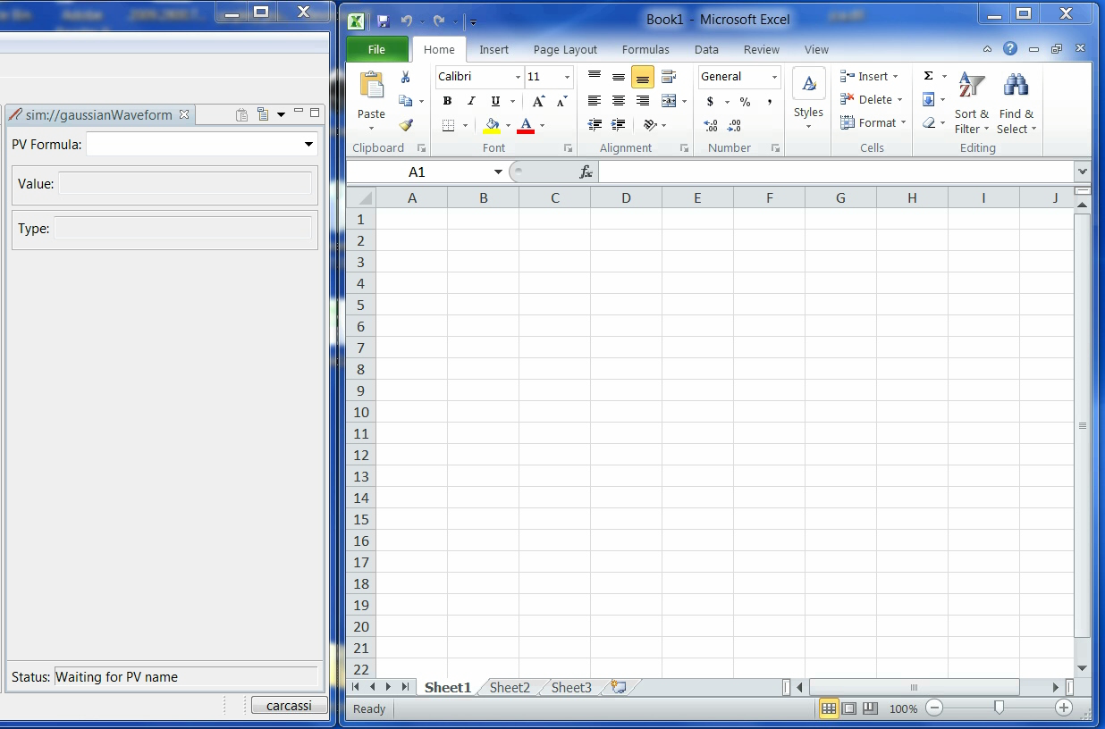

Slide 16
Goals for pvmanager formulas
Current problems:
  New type (i.e. table) or new service (i.e. channelfinder) means having to write new widgets and applications
    Difficult to extend the tools
  Each widget and application has to implement behavior that may be common, for example:
    Display the alarm/time instead of the value
    Display the value of the enum instead of the label
    Display the FFT instead of the waveform
    Display value in different unit
    Options will be slightly different, more work and code to maintain
This functionality should neither be in the datasources nor the widget
  Need a better place!

Slide 17
pvmanager formulas
Allow to specify formulas everywhere you had pvs
Currently implemented
  ‘mypv’ pvs in single quotes
  “Some text” text literals in double quotes
  3.14 numeric literals with standard C/C++/Java notation
  ‘pv1’ – ‘pv2’ standard math operators
  log(‘mypv’) functions, pluggable in CSS
  java.lang.Math methods already implemented
  arrayOf(‘pv1’, ‘pv2’, ‘pv3’) coverts scalars into arrays
  columnOf(‘tablepv’, “column1”) column from table as an array
Unit conversion, function fit, linear algebra, full join

Slide 18
Functions
Numeric operators
  + - * / % ^ **
  > < >= <= == !=
  ?:
  || &&
  | &
Math functions
  abs
  acos
  asin
  atan
  cbrt
  ceil
  cos
  cosh
  exp
  floor
  integrate
  log
  log10
  signum
  sin
  sinh
  sqrt
  tan
  tanh
  toRadians
  toDegrees
Array functions
  + - / *
  arrayOf
  elementAt
  rescale
  subArray
Table functions
  columnOf
  join
  tableOf
String function
  concat
  toString
Pointer-like function
  pv
  pvs
Other functions
  highestSeverity

Slide 19
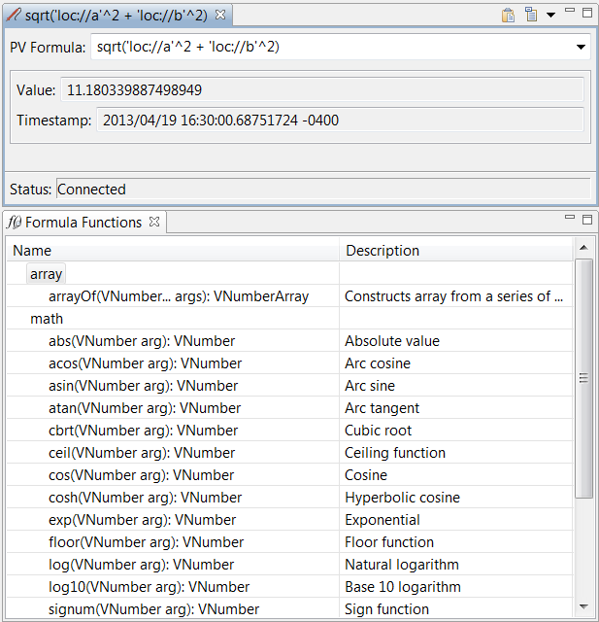
pvmanager formulas
Formula in Probe
Function viewer
lists all the
contributions
and serves as
documentation

Slide 20
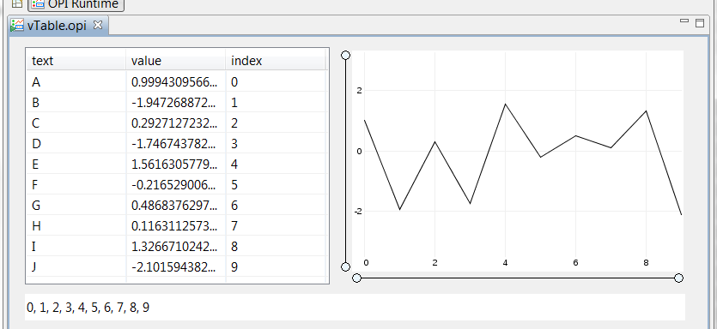
pvmanager formulas
columnOf(‘sim://table’, “value”)
value column
index column

Slide 21
pvmanager formulas
Can register functions through extension point
We expect to:
  Significantly increase the functionality
  Reduce the complexity
    Fewer widgets
    Fewer parameters per widget
  Increase consistency within CS-Studio
If formulas become important for the whole of CS-Studio, makes it possible to have:
  Formula editors
  Syntax coloring
  Autocomplete (Already being contributed by ITER!)

Slide 22
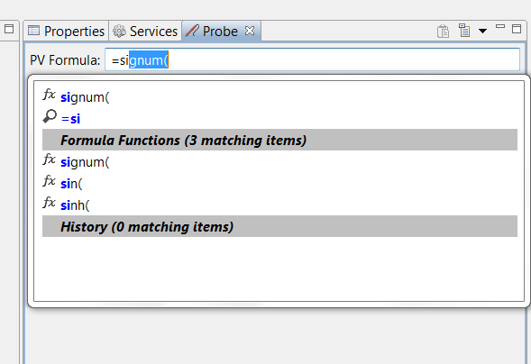
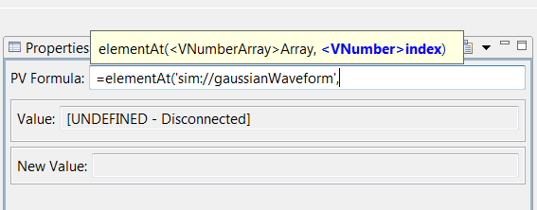
Formula auto-complete
Formula auto-documentation

Slide 23
Goals for graphene
One year ago we started working on a graph package with the following goals:
  Interfaces for datasets
  Rendering without UI
  Changes are thread-safe and atomic
  Publishable quality
  Performance suitable for “large data” in real time

Slide 24
New in graphene
Current status
  Further ahead but not as far as I’d like
  Four graphs are in decent shape:
    Scatter graph
    Line graph
    Area graph
    Bubble graph
  Common patterns are starting to drive the architecture
    Common elements to create the axis
    Common elements to handle the dynamic range

Slide 26
Graphene in CS-Studio
Line graph and scatter graph available as:
  SWT widgets
  BOY widgets
  Independent views
Table is king
  Re-implemented to work off of tables
  Does not work for histogram and intensity graphs, though
    Have already ideas on how to extend VNumberArray with range information

Slide 27
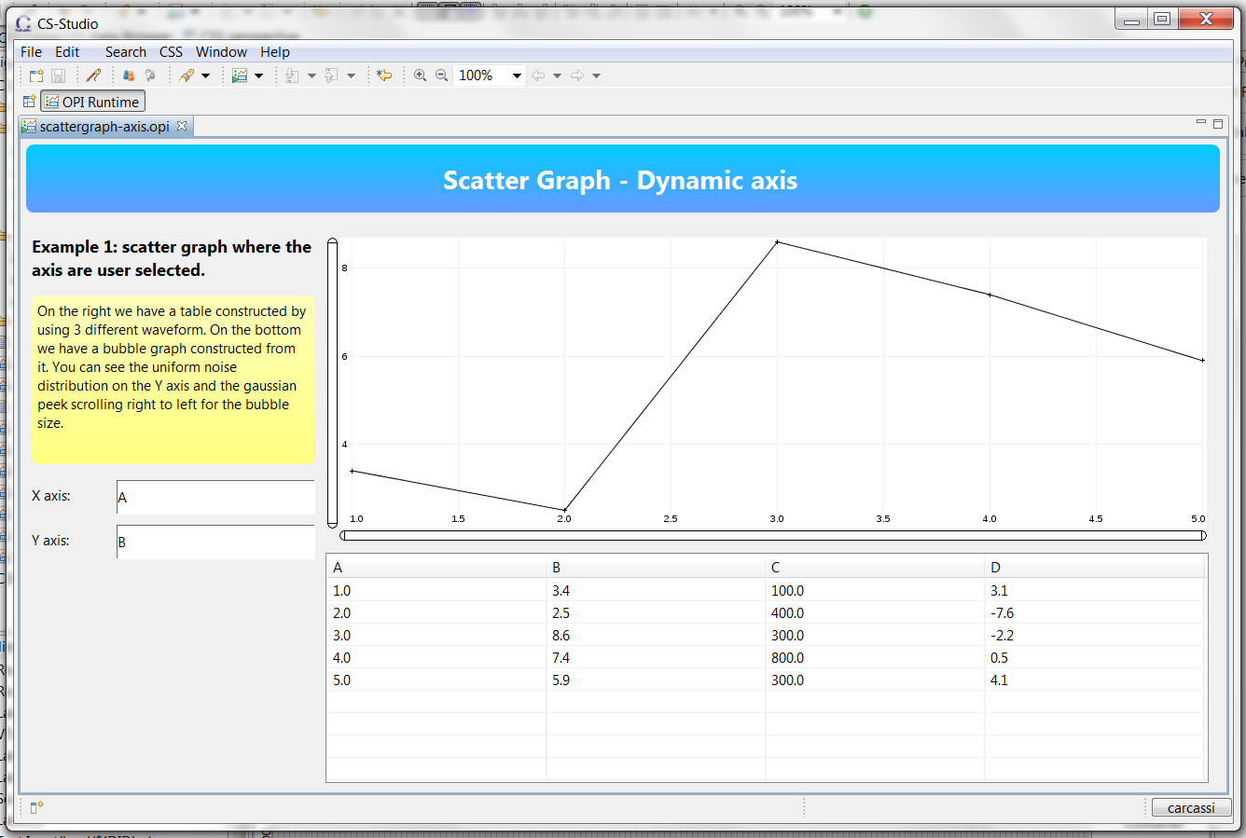

Slide 28
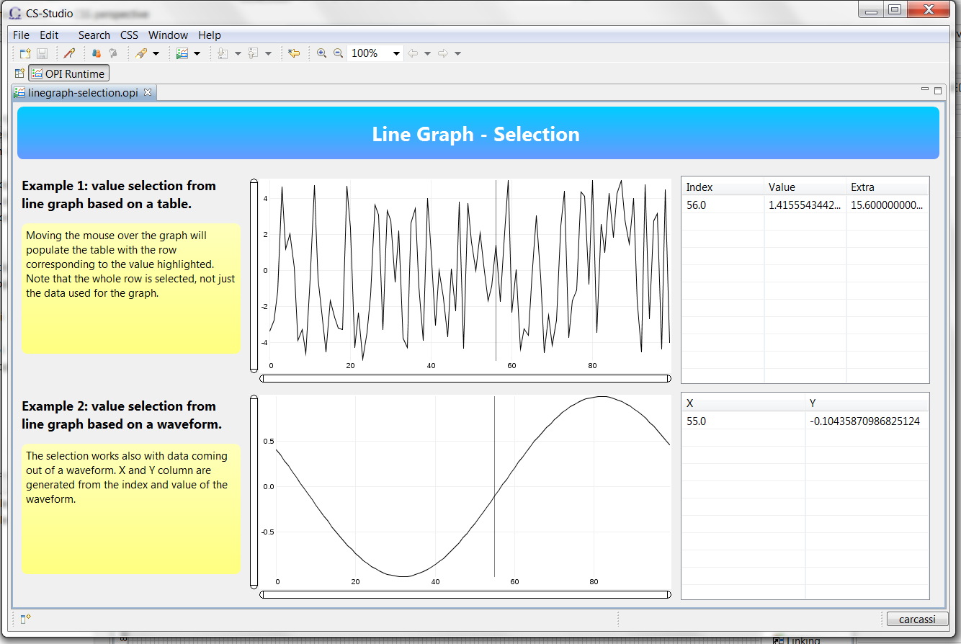

Slide 29
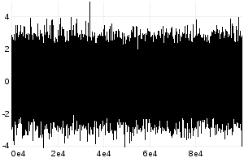

graphene performance
LineGraph performance improved through data reduction
  For each pixel draw 4 values: first, max, min, last
Displaying 100,000 points, 300x200
  How many differences can you find?
Without data reduction - 255.4 ms
With data reduction - 6.077 ms

Slide 30
graphene
Line graph, 600x400, JDK 7, i7 2.70GHz
N points | Time ms (no redux) | Time ms (redux)
10 | 0.986232349 | 0.980788919
100 | 1.924796332 | 1.872743481
1,000 | 5.553831552 | 5.345118646
10,000 | 38.57528235 | 15.73147583
100,000 | 431.8435542 | 18.28121567
500,000 | 4280.394044 | 26.20789778
1,000,000 | 15556.68846 | 36.36819781
10,000,000 |  | 257.451379
50,000,000 |  | 1178.120411
ms
N points

Slide 31
Graphene line graph demo

Slide 32
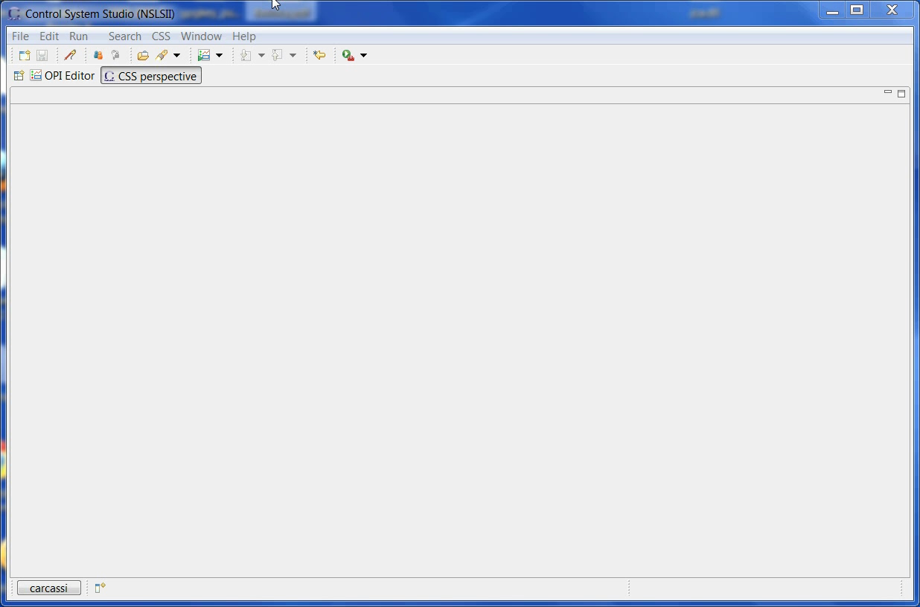

Slide 33
Goals for pvmanager services
Services cannot be integrated with standard pvmanager: a service is not a pv
  Needs parameters
  Needs someone to click send (services are not idempotent in general)
  Each client needs its own return value
  The result can be complex and may need several widgets to display
In general, you’ll need service specific APIs and applications, with specific workflow
  There is no way around it

Slide 34
Goals for pvmanager services
BUT! Some services in some cases
  Have parameters that can be expressed by vTypes (e.g. VString and VNumbers)
  Can return data that can be expressed in a vTable, vNumericArray, …
  These can be digested by general purpose clients
For example, channel finder
  Will need a specific UI to manage tags and properties
  Can export into a table the result of a query
For the general purpose only we introduce pvmanager services

Slide 35
pvmanager services
public abstract class ServiceMethod {
public String getName();
public String getDescription();
public Map<String, Class<?>> getArgumentTypes();
public Map<String, String> getArgumentDescriptions();
public final Map<String, Class<?>> getResultTypes();
public Map<String, String> getResultDescriptions();
public abstract void executeMethod(
Map<String, Object> arguments,
WriteFunction<Map<String, Object>> callback,
WriteFunction<Exception> errorCallback);
}

Slide 36
Pvmanager services demo

Slide 37
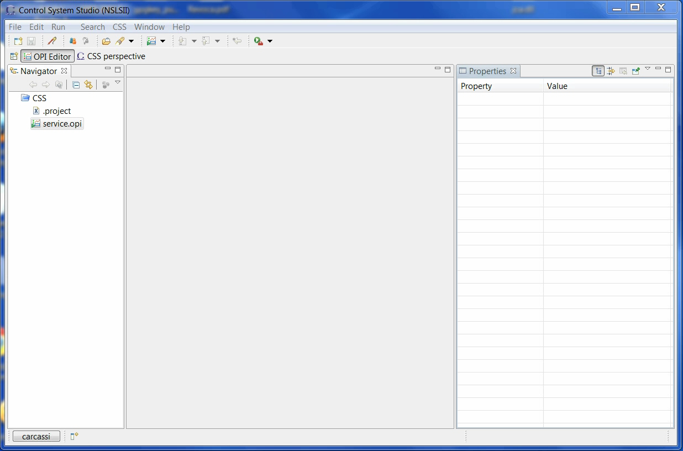

Slide 38
jdbc services
Services that execute database queries
  Xml files can be places in
  $cs-studio/configuration/services/jdbc
  Each service is a database with a set of parameterized queries
  Parameters can be VString/VNumber/…
  Results are VTable
Maintainer to extend implementation

Slide 39
jdbc service example
<?xml version="1.0" encoding="UTF-8"?>
<jdbcService ver="1" name="jdbcSample" description="A test service">
<jdbcUrl>jdbc:mysql://localhost/test?user=root&amp;password=root</jdbcUrl>
<methods>
<method name="query" description="A test query">
<query>SELECT * FROM Data</query>
<result name="result" description="The query result"/>
</method>
<method name="insert" description="A test insert query">
<query>INSERT INTO `test`.`Data` (`Name`, `Index`, `Value`) VALUES (?, ?, ?)</query>
<argument name="name" description="The name" type="VString"/>
<argument name="index" description="The index" type="VNumber"/>
<argument name="value" description="The value" type="VNumber"/>
</method>
</methods>
</jdbcService>

Slide 40
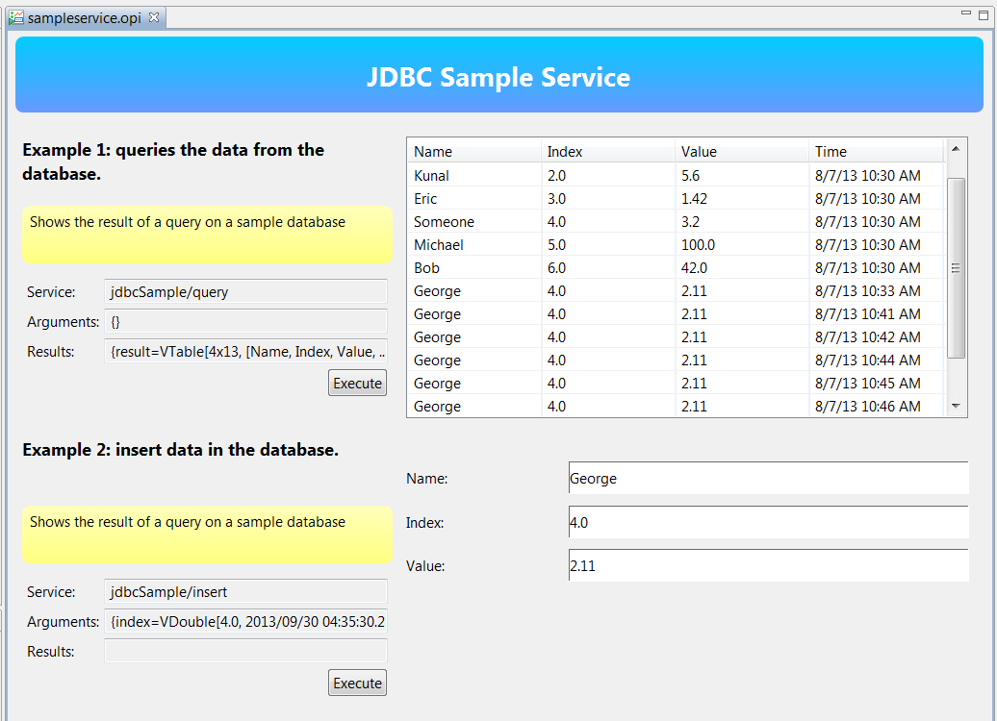

Slide 41
exec service
Exec services, services based on command-line execution
  Xml files can be places in
  $cs-studio/configuration/services/exec
  Each service is a set of parameterized commands
  Parameters can be VString/VNumber
  Result is a VString or VTable (if output is a CSV)
  Generic exec/run service to execute an arbitrary command (a VString)

Slide 42
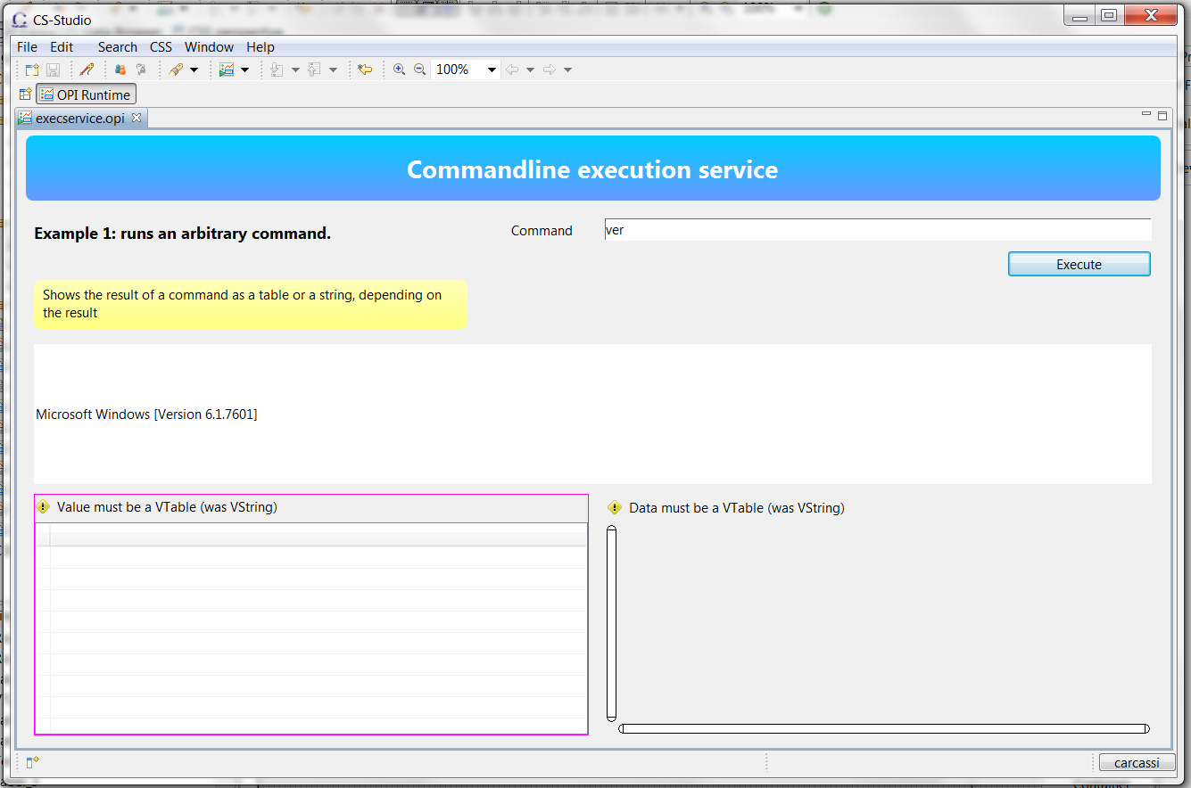

Slide 43
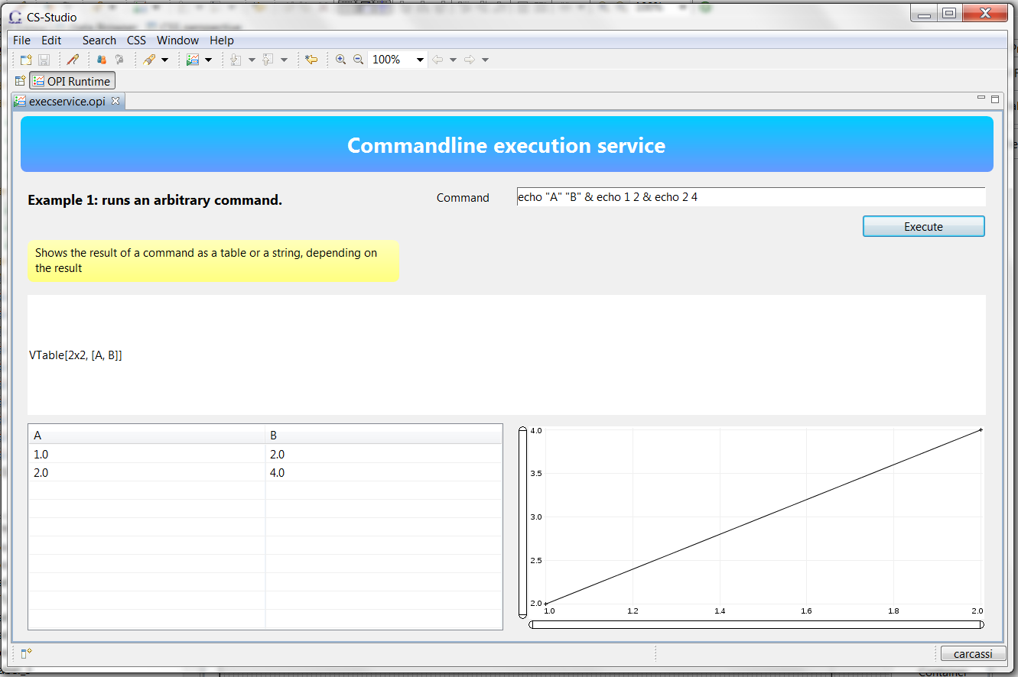

Slide 44
exec service example
<?xml version="1.0" encoding="UTF-8"?>
<execService ver="1" name="execSample" description="A test service">
<methods>
<method name="echo" description="A test script">
<command>echo You selected #string#</command>
<argument name="string" description="The string" type="VString"/>
<result name="result" description="The result"/>
</method>
<method name="script" description="My script">
<command>myscript.py #value#"</command>
<argument name="value" description="The value" type="VNumber"/>
<result name="result" description="The script result"/>
</method>
</methods>
</execService>
Maintainer to extend implementation

Slide 45
pva service
Working with Cosylab to create a pva to pvmanager service binding that looks similar
  Write xml file
  Put it in the configuration directory
  CS-Studio is aware of the service

Slide 46
Framework for real time data manipulation
pvmanager datasources: pluggable sources of live data
pvmanager services: pluggable sources of static data
pvmanager formula functions: pluggable ways to combine the data
Graphene graphs: hopefully efficient way to display the data
VType export: ways to export the data
Users can now quickly and safely combine these!

Slide 47
Infrastructure
Projects are on SourceForge
  http://epics-util.sourceforge.net/
  http://pvmanager.sourceforge.net/
  http://graphene.sourceforge.net/
Built on cloudbees (Jenkins in the cloud)
  https://openepics.ci.cloudbees.com/
Libraries deployed in maven central
  http://search.maven.org/#search|ga|1|g%3A%22org.epics%22

Slide 48
Still a lot more work to do …

Slide 49
… if you want to help make progress

Slide 50
Take something over
Having an architecture does not mean that everything is done
  Just means everything has a place
Many things could be developed a lot better and farther
  CSV import/export, exec services, jdbc services, file datasource, formula functions for physics, …
Always looking for people to take over pieces

Slide 51
Gathering requirement
Used to talk to multiple people before implementing anything. This has become impossible at this point.
This is the current process for a new spec:
  Whenever I need to make a substantial choice, I open a github issue with a proposal
  Wait for feedback on that proposal
  Follow up whenever I am implementing something
  Close even if not enough review
For changing spec:
  Open issue on github
  All sites need to sign off change if breaks compatibility

