Slide 1
CLS Control System
Recent Upgrades
Elder Matias

Slide 2
Major Changes
Synchrotron Upgrade
New Isotope Production Linac
EPICS Software
  Python EDM
  Aquaman
  ScienceStudio (ANISE)

Slide 3
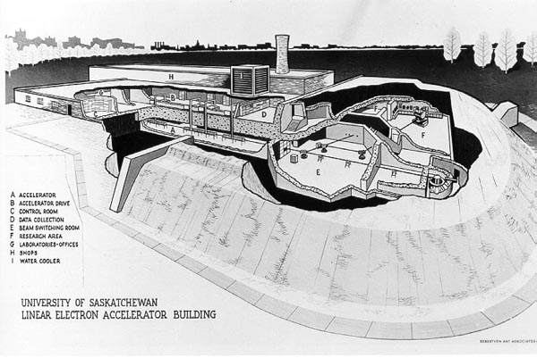
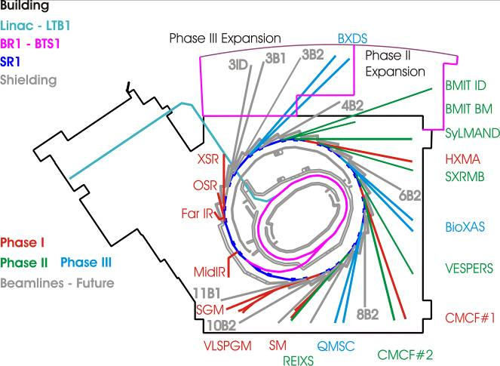
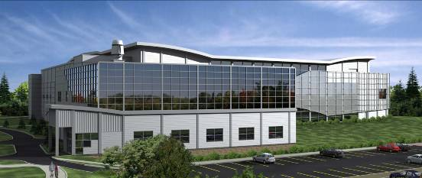
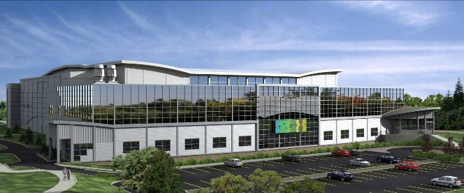
Beamline Expansions
1964
2007
Future

Slide 4
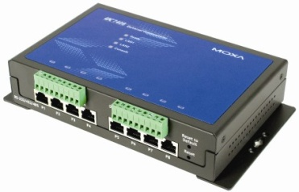

EPICS
Channel Access (CA) Protocol
Profibus
TCP/IP
CA
CA
Operator Workstation
User Applications
IOC
Siemens S7/300 PLC
Touch
Panels
CA
Modbus
TCP/IP
CA
IOC
Telemecanique Momentum PLC
CA
State Machine
Engine
CA
CA
GPIB
IOC
Data Archive
CA
IOC
CA
RS-232
CA
IOC
VME
Single Board
Computer

Slide 5
Synchrotron Accelerator Upgrade
Major Linac upgrades
  New ScadiNova Modulators
  (using SLS EPCIS driver)
  New Magnet Power Supplies
  Moxa Upgrade for Serial Devices
Working on a strategy to upgrade the Storage Ring Low Level RF
CSS Alarm Handler

Slide 6
Isotope Linac for
Molybdenum 99
World wide shortage of Molybdenum 99 for use as Technetium 99 generators
Primarily used for Cardiac and Bone Imagining
Normally produced in a nuclear reactor
CLS is working on a Linac Gamma-n process

Slide 7
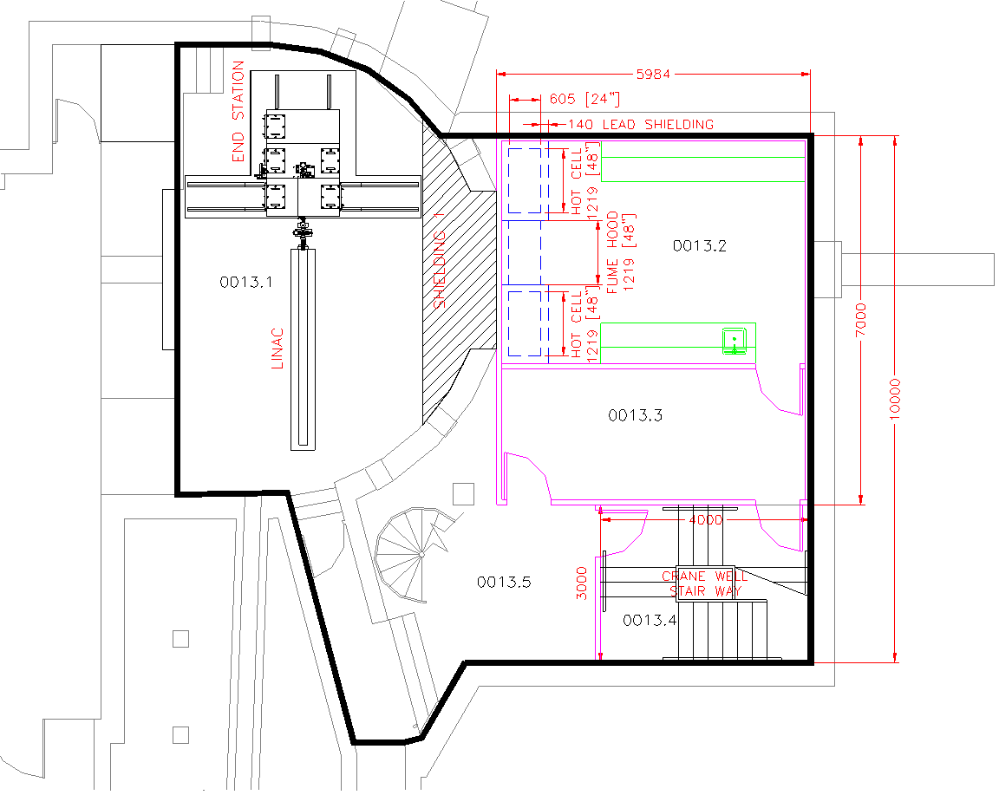
Isotope Linac and
Processing Facility

Slide 8
Isotope Linac
Controls Design
Isotope Linac (35MeV 40 kW)
  Commercial off-the-shelf Linac
  Existing Siemens S7 PLC Design
Converter and Target will use an EPICS Control System (VME & Moxa control)

Slide 9
Python EDM
Original (Motif) EDM from Oak Ridge
CLS control screens built on EDM
The future of Motif?
The next step .....
  Re-implement the EDM display tool using Python
  Continue to use the current EDM as the editor
Developed by: Glen Wright

Slide 10
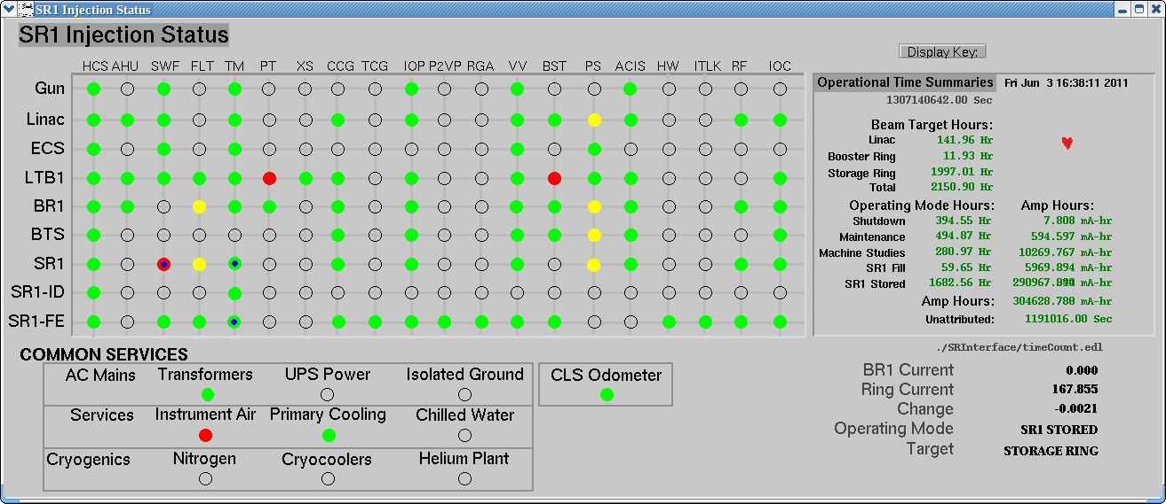
Injection Status Screen
Motif EDM Display

Slide 11
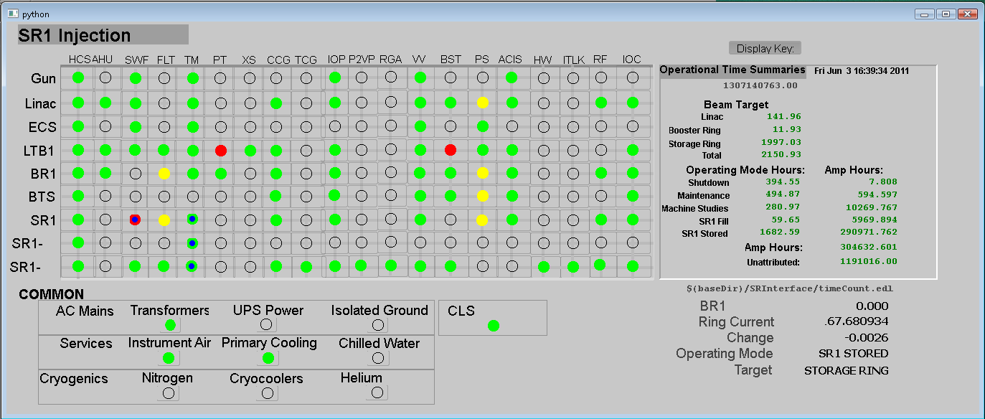
Injection Status Screen
Motif EDM Display

Slide 12
Python EDM
A Work in Progress.....
Qt (4.5 on Linux, 4.6 on Windows)
Python (2.5 on Linux, 2.6 on Windows)
Uses pyepics 3.1.1 by Matt Newville.
Still to Do:
  x/y graph widget (should use qwt);
  mouse press is taken by just one widget rather than sent to all widgets
  Fonts aren’t identical
  There is no “edit mode” in python.
For more information: glen.wright@lightsource.ca
More info at EPICS Fall Meeting

Slide 13
Aquaman
The Story
Superhero Mission: Transforming beamline software away from "Controlling Machines" to "Supporting Experiments“
Spawned By: A creative design session of synchrotron users, beamline staff, and software developers in Summer 2010
Seeks to Protect: The whole experimental process: From planning and organizing old data, to running experiments on beamlines, to visualization, analysis, and making connections
Sidekick: "Dataman", a take-home version that lets scientists compare, process, visualize, and export their data, using the same interface they see on the beamline
Super Powers: Adapts to new beamlines and techniques in the blink of an eye. Can run on almost any platform (Linux, Mac, Windows).
Secret Abilities: Agile development; fast and frequent user feedback; modular design; integrated documentation.
Arch-Nemeses: 8AM mornings. TestBoy (his test suite). Being confused with Aquaman, the lamest comic book character ever.
Developed by:
  Mark Boots, David Chevrier, Darren Hunter

Slide 14
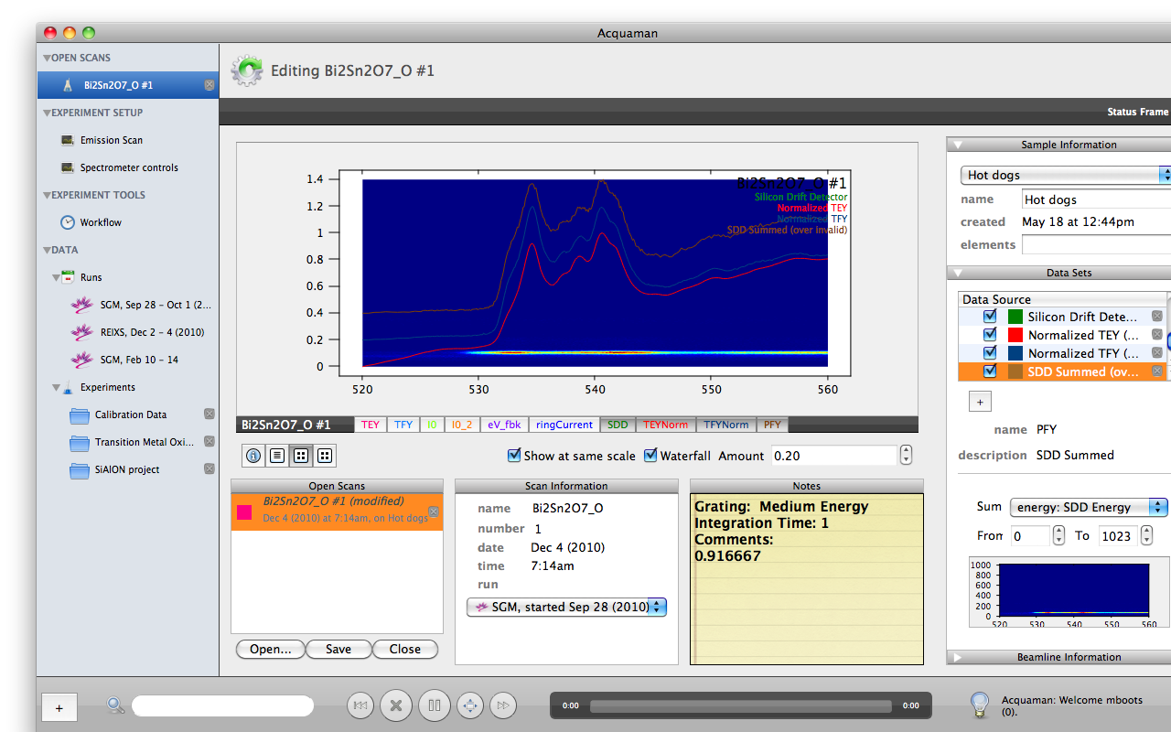
Aquaman
Screen Shots

Slide 15
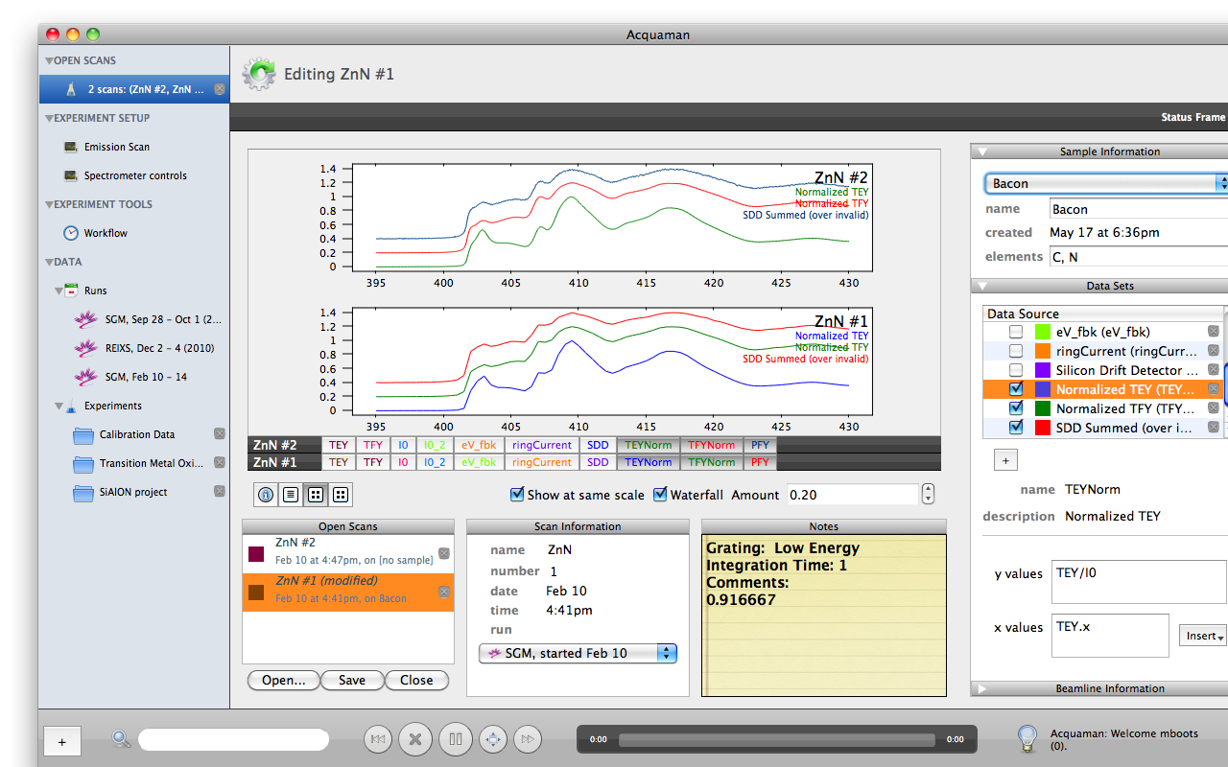
Aquaman
Screen Shots

Slide 16
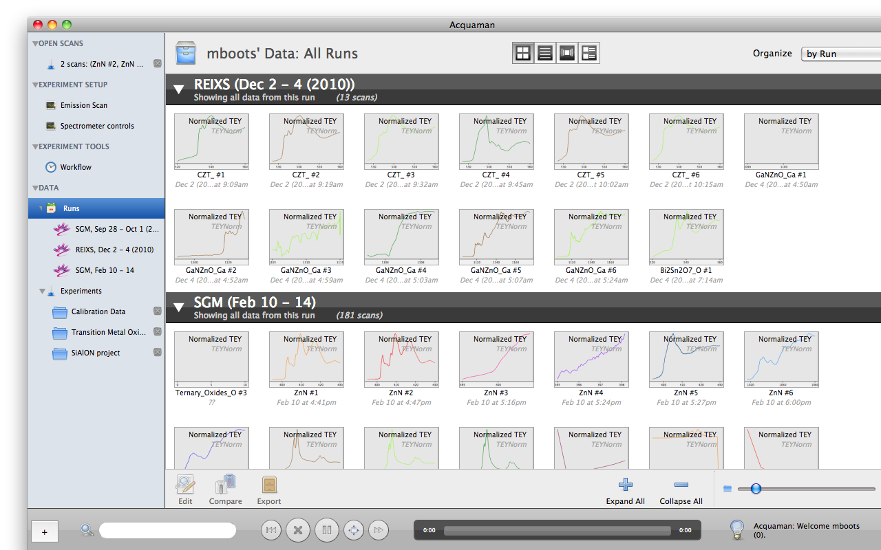
Aquaman
Screen Shots

Slide 17
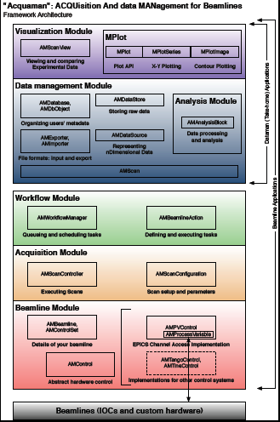
Aquaman
Open platform
C/C++ Qt based
Lead developers: David Chevrier, Mark Boots
Contributors: Darren Hunter
Support from: Tom Regier, Elder Matias, & Alexander Moewes
For more information contact:
mark.boots@lightsource.ca
Download/Contribute at:
https://github.com/acquaman/acquaman

Slide 18
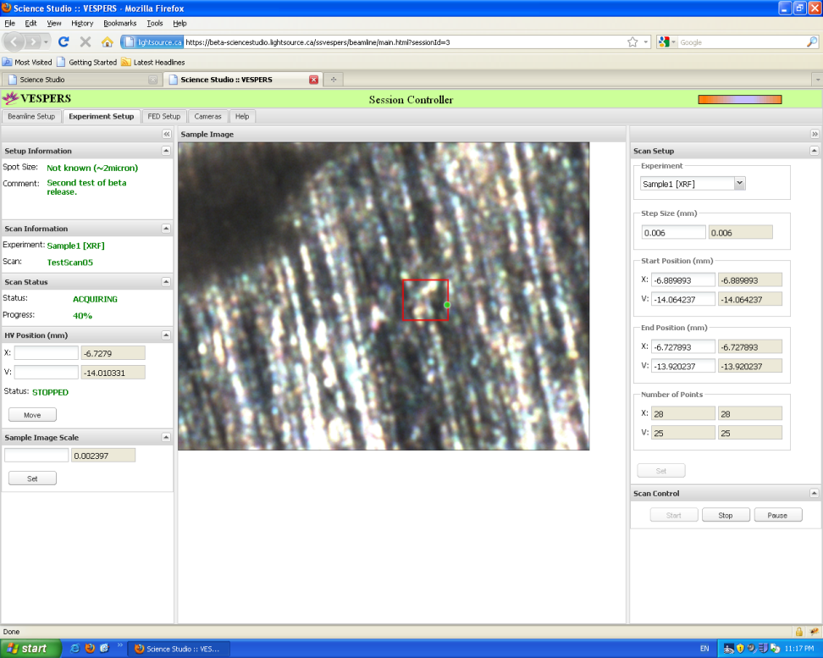
Science Studio
Web based Remote Beamline Control
Recent development
  added integration for grid analysis
  ability to have projects shared across
  multiple sites
  Integration with grid computing
For more information contact:
dylan.maxwell@lightsource.ca
Download/Contribute at:
http://sourceforge.net/projects/sciencestudio/

Slide 19
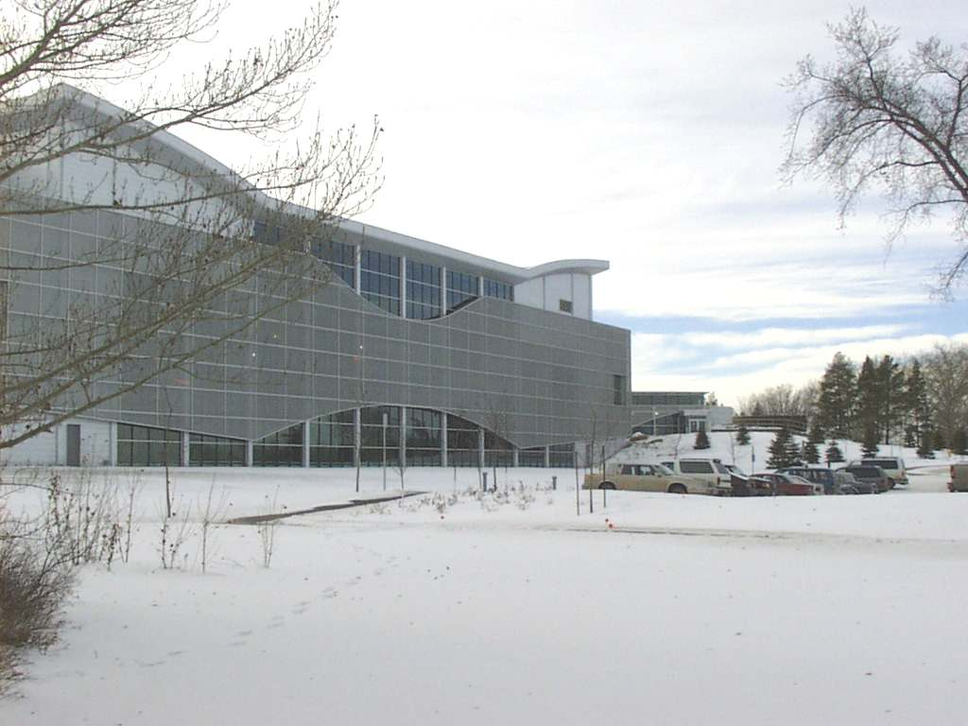
Thank you.... Questions?

